Slide 1

Renal Transplant
Health Analysis
The creation of software to analyze data about renal transplant patients
Notes:
Welcome,
Here’s Jens, Louis, Paul, Chris and myself Boudewijn
We will use the next 30 minutes to present our product.

Slide 2
Overview
The ADMIRE project
Our task
Final product
Future improvements
Demonstration
Notes:
Walk through:
Background
The precise task we were given
What we actually produced
What we’d want to improve
Demo
Part 2 for software engineering

Slide 3

The ADMIRE project
Assessment of a Disease management system with Medical devices In REnal disease
Home-based medical measuring
System to assess monitoring systems
Mijnnierinzicht.nl
Notes:
Short, everyone knows this already.
Tell the entire ADMIRE story

Slide 4
Our task
Data from
Mijnnierinzicht.nl
Measurement device
Hospital records
Tool to analyze and interpret this data
Notes:
Slide spreekt voor zich

Slide 5
Our task – Why?
Other analysis tools
Specialized for quick analysis
Notes:
Tell stuff about other analysis tools too generic, ours is specialized and thus easier to use.

Slide 6
Final product
Modules
Import
View
Analyze
Visualize
Export
Notes:
Final product is composed of these 5 modules
Import -> importing data
View -> view the imported data
Analyse -> write and perform analysis
Visualize -> turn data into graphs
Export -> export data to be used in other tools

Slide 7
Import & view
Import text or excel
Define file structure with XML
View imported data
Notes:
Spreekt voor zichzelf

Slide 8
Analyze
Comparisons
Constraints
Conversions
Computations
The C’s
Chunks
Comments
Codes
Connections
Additional functions
Notes:
Spreekt voor zichzelf
Additional functions like set operations such as union and difference to ease analysis writing.

Slide 9
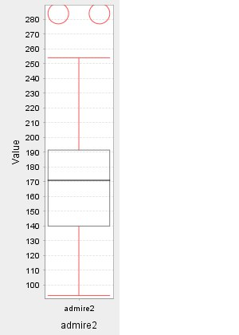
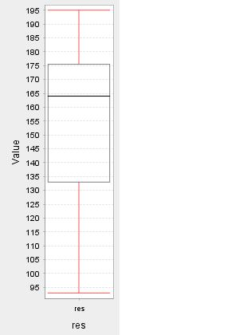
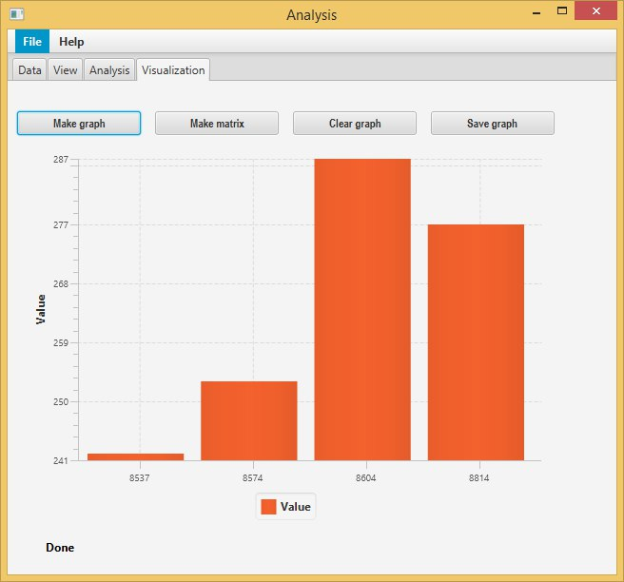
Visualize
Boxplot
Bar chart
Notes:
Spreekt voor zichzelf

Slide 10
Export
Define delimiters
Export to text
Usable in e.g. SPSS
Notes:
Spreekt voor zichzelf

Slide 11
Future improvements
Export to excel
More visualizations
GUI improvements
Notes:
Excel comma -> semicolon
More visualizations
Improvements to GUI to enhance usability.

Slide 12
Demo

Slide 13
Demo (backup)
Insert video here

Slide 14
End
Noon presentation ends here

Slide 15
Part two
In this part
Data structure
Generics problem
Maintaining simplicity
Extended demonstration
Notes:
In part 2 will go into some more depth regarding the software engineering side of our product.

Slide 16
Data structure
Structured in rows and columns
DataValues
String
Boolean
Int
Dates and times required subclasses
Float
Date
Time
Notes:
Slide uitleggen

Slide 17
Generics problem
Runtime problem
No type checking
Not easily fixable
Notes:
Slide uitleggen

Slide 18
Maintaining simplicity
More features increases language complexity
More functionalities increases GUI complexity
Notes:
Slide uitleggen

Slide 19
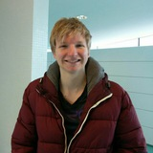
Extended demonstration
Chriiiiiiiis…………

