Slide 1

Renal Transplant
Health Analysis
The creation of software to analyze data about renal transplant patients

Slide 2
Overview
Created system
Import
Analyze
Visualize
Export

Slide 3
Import
Import text or excel
Define file structure
Etc.

Slide 4
Analyze
The C’s
Additional function
Standard Deviation
Etc.

Slide 5
Visualize
Boxplot
Bar chart
Stem leaf

Slide 6
Export
Define delimiters
Export to text
Usable in SPSS

Slide 7
Walkthrough

Slide 8
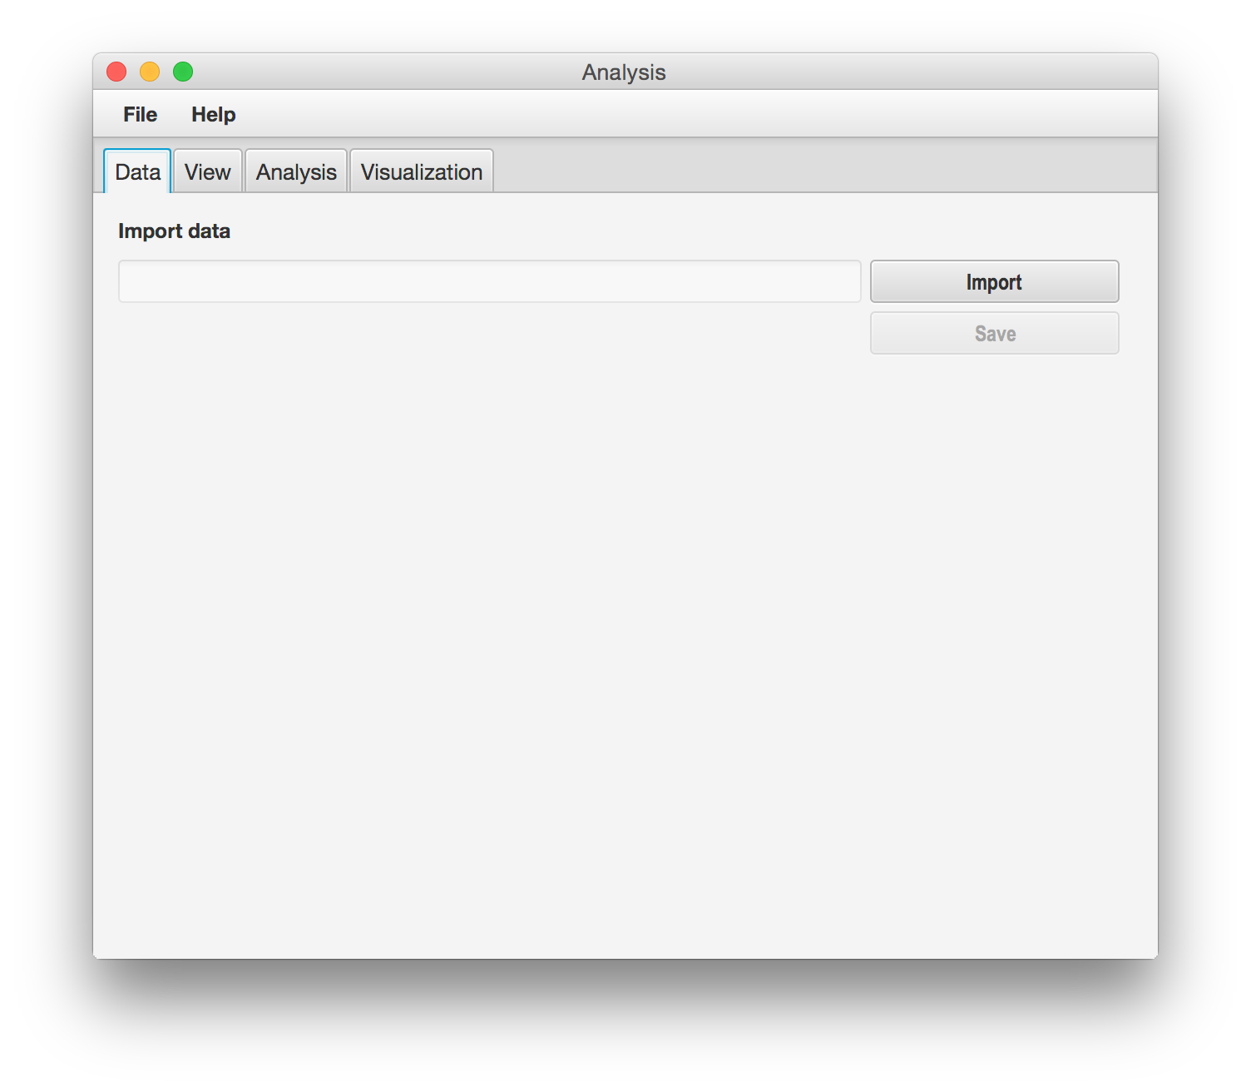
Walkthrough

Slide 9
Walkthrough
Etc……

Slide 10
Walkthrough
Finito

