Slide 1

Renal Transplant
Health Analysis
The creation of software to analyze data about renal transplant patients

Slide 2
Overview
The ADMIRE project
Our task
Final product
Future improvements
Demonstration

Slide 3

The ADMIRE project
Assessment of a Disease management system with Medical devices In REnal disease
Home-based medical measuring
System to assess monitoring systems
Mijnnierinzicht.nl

Slide 4
Our task
Data from
Mijnnierinzicht.nl
Measurement device
Hospital records
Tool to analyze and interpret this data

Slide 5
Our task – Why?
Other analysis tools
Specialized for quick analysis

Slide 6
Final product
Modules
Import
View
Analyze
Visualize
Export

Slide 7
Import & view
Import text or excel
Define file structure with XML
View imported data

Slide 8
Analyze
Comparisons
Constraints
Conversions
Computations
The C’s
Chunks
Comments
Codes
Connections
Additional functions

Slide 9
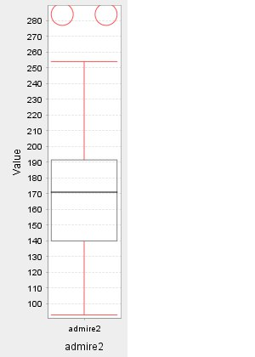
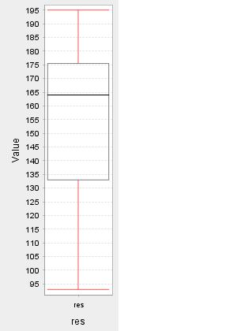
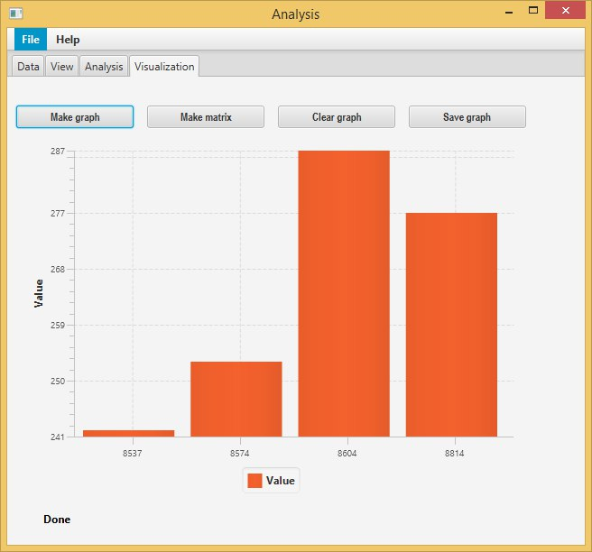
Visualize
Boxplot
Bar chart

Slide 10
Export
Define delimiters
Export to text
Usable in e.g. SPSS

Slide 11
Future improvements
Export to excel
More visualizations
GUI improvements

Slide 12
Demo

Slide 13
Demo (backup)
Insert video here

Slide 14
End
Noon presentation ends here

Slide 15
Part two
In this part
Data structure
Generics problem
Maintaining simplicity
Extended demonstration

Slide 16
Data structure
Structured in rows and columns
DataValues
String
Boolean
Int
Dates and times required subclasses
Float
Date
Time

Slide 17
Generics problem
Runtime problem
No type checking
Not easily fixable

Slide 18
Maintaining simplicity
More features increases language complexity
More functionalities increases GUI complexity

Slide 19

Extended demonstration
Chriiiiiiiis…………

