Slide 1
Data Warehousing Overview
CS245 Notes 11
Hector Garcia-Molina
Stanford University
CS 245
Notes11

Slide 2
Outline
What is a data warehouse?
Why a warehouse?
Models & operations
Implementing a warehouse
CS 245
Notes11

Slide 3
What is a Warehouse?
Collection of diverse data
  subject oriented
  aimed at executive, decision maker
  often a copy of operational data
  with value-added data (e.g., summaries, history)
  integrated
  time-varying
  non-volatile
more
CS 245
Notes11

Slide 4
What is a Warehouse?
Collection of tools
  gathering data
  cleansing, integrating, ...
  querying, reporting, analysis
  data mining
  monitoring, administering warehouse
CS 245
Notes11

Slide 5
Warehouse Architecture
Client
Client
Query & Analysis
Metadata
Warehouse
Integration
Source
Source
Source
CS 245
Notes11

Slide 6
Motivating Examples
Forecasting
Comparing performance of units
Monitoring, detecting fraud
Visualization
CS 245
Notes11

Slide 7

Alternative to Warehousing
Two Approaches:
  Query-Driven (Lazy)
  Warehouse (Eager)
?
Source
Source
CS 245
Notes11

Slide 8
Query-Driven Approach
Client
Client
Mediator
Wrapper
Wrapper
Wrapper
Source
Source
Source
CS 245
Notes11
Notes:
7

Slide 9
Advantages of Warehousing
High query performance
Queries not visible outside warehouse
Local processing at sources unaffected
Can operate when sources unavailable
Can query data not stored in a DBMS
Extra information at warehouse
  Modify, summarize (store aggregates)
  Add historical information
CS 245
Notes11

Slide 10
Advantages of Query-Driven
No need to copy data
  less storage
  no need to purchase data
More up-to-date data
Query needs can be unknown
Only query interface needed at sources
May be less draining on sources
CS 245
Notes11

Slide 11
Warehouse Models & Operators
Data Models
  relational
  cubes
Operators
CS 245
Notes11

Slide 12
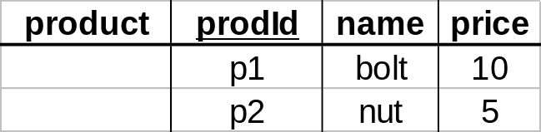
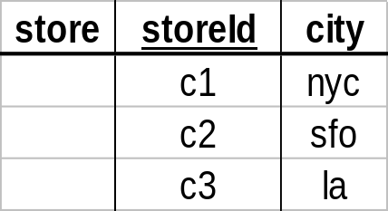
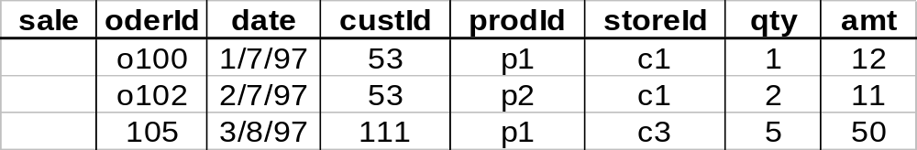
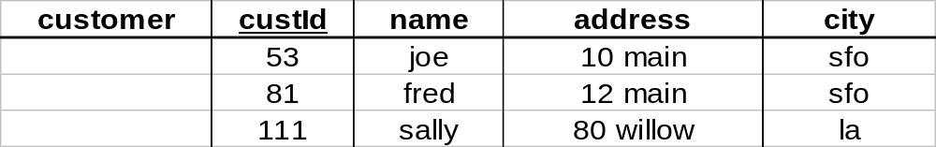
Star
CS 245
Notes11

Slide 13
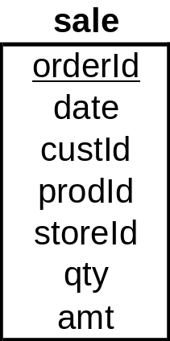
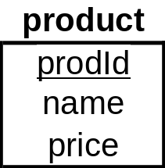
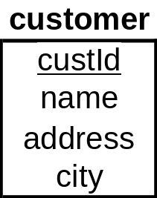
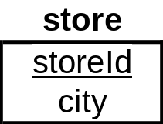
Star Schema
CS 245
Notes11

Slide 14
Terms
Fact table
Dimension tables
Measures
CS 245
Notes11

Slide 15
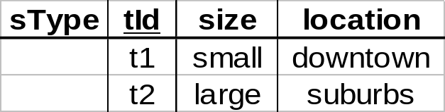
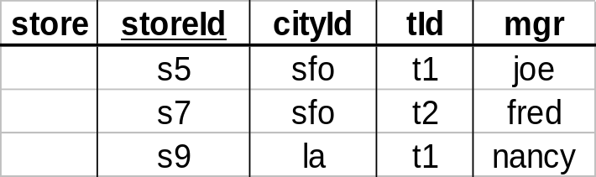
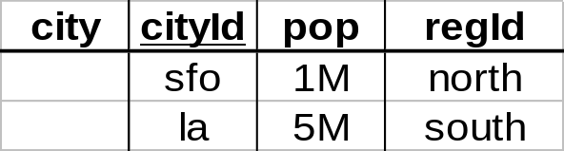
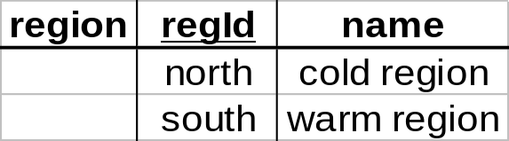
Dimension Hierarchies
sType
store
city
region
➔ snowflake schema
➔ constellations
CS 245
Notes11

Slide 16
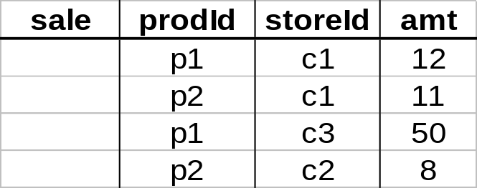
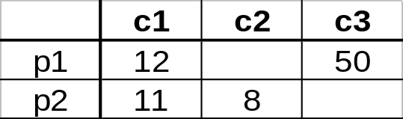
Cube
Fact table view:
Multi-dimensional cube:
dimensions = 2
CS 245
Notes11

Slide 17
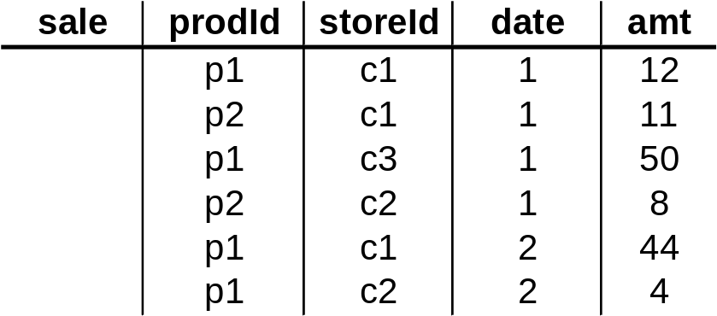
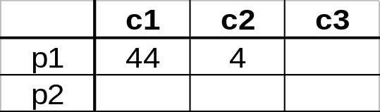
3-D Cube
Fact table view:
Multi-dimensional cube:
day 2
day 1
dimensions = 3
CS 245
Notes11

Slide 18
Operators
Traditional
  selection
  aggregation
  ...
Analysis
  clean data
  find trends
  ...
Relational
Cube
CS 245
Notes11

Slide 19
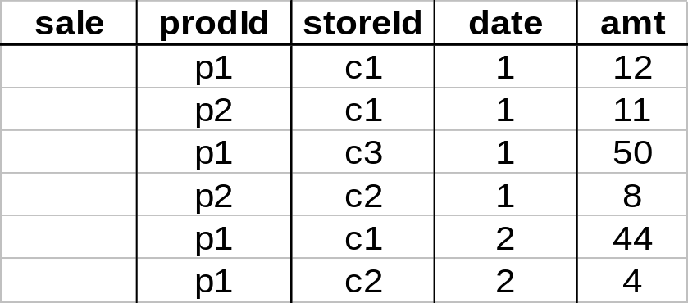
Aggregates
Add up amounts for day 1
In SQL: SELECT sum(amt) FROM SALE
WHERE date = 1
81
CS 245
Notes11

Slide 20
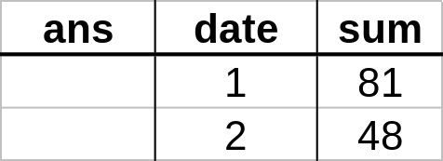
Aggregates
Add up amounts by day
In SQL: SELECT date, sum(amt) FROM SALE
GROUP BY date
CS 245
Notes11

Slide 21
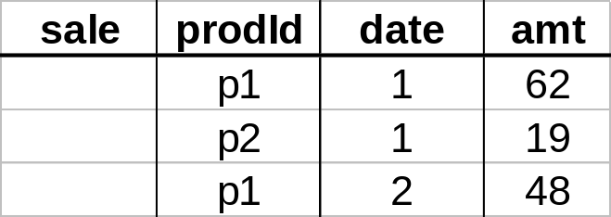
Another Example
Add up amounts by day, product
In SQL: SELECT date, sum(amt) FROM SALE
GROUP BY date, prodId
rollup
drill-down
CS 245
Notes11

Slide 22
Aggregates
Operators: sum, count, max, min, median, ave
“Having” clause
Using dimension hierarchy
  average by region (within store)
  maximum by month (within date)
CS 245
Notes11

Slide 23
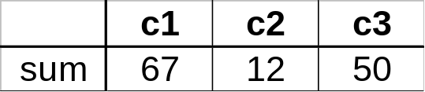
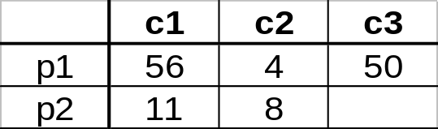
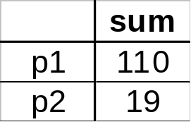
Cube Aggregation
Example: computing sums
day 2
. . .
day 1
129
rollup
drill-down
CS 245
Notes11

Slide 24
Cube Operators
day 2
. . .
day 1
sale(c1,*,*)
129
sale(c2,p2,*)
sale(*,*,*)
CS 245
Notes11

Slide 25
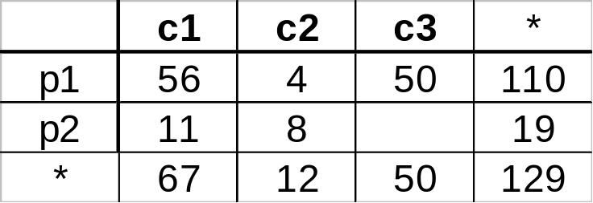
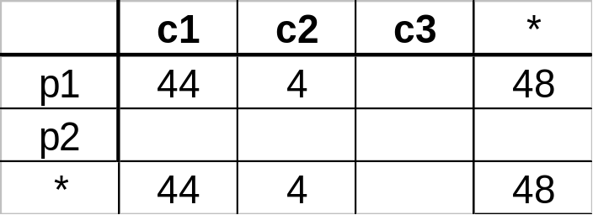
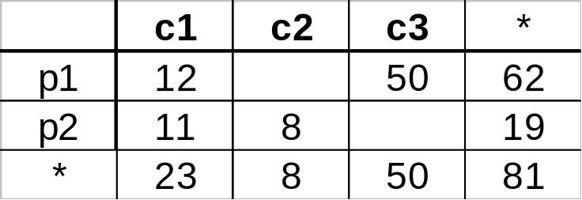
Extended Cube
*
day 2
sale(*,p2,*)
day 1
CS 245
Notes11

Slide 26
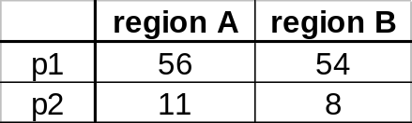
Aggregation Using Hierarchies
day 2
customer
day 1
region
country
(customer c1 in Region A;
customers c2, c3 in Region B)
CS 245
Notes11

Slide 27
Data Analysis
Decision Trees
Clustering
Association Rules
CS 245
Notes11

Slide 28
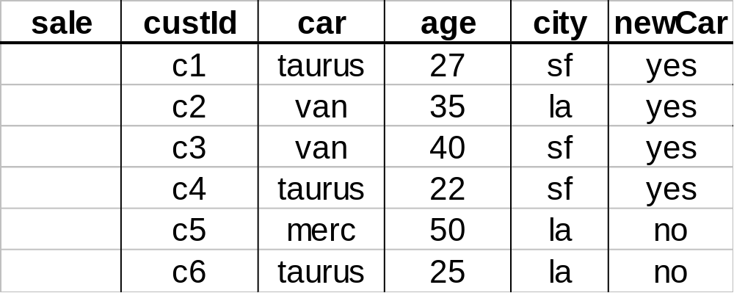
Decision Trees
Example:
Conducted survey to see what customers were
interested in new model car
Want to select customers for advertising campaign
training
set
CS 245
Notes11

Slide 29
One Possibility
age<30
Y
N
city=sf
car=van
Y
N
Y
N
likely
unlikely
likely
unlikely
CS 245
Notes11

Slide 30
Another Possibility
car=taurus
Y
N
city=sf
age<45
Y
N
Y
N
likely
unlikely
likely
unlikely
CS 245
Notes11

Slide 31
Issues
Decision tree cannot be “too deep”
    would not have statistically significant amounts of data for lower decisions
Need to select tree that most reliably predicts outcomes
CS 245
Notes11

Slide 32
Clustering
income
education
age
CS 245
Notes11

Slide 33
Clustering
income
education
age
CS 245
Notes11

Slide 34
Another Example: Text
Each document is a vector
  e.g., <100110...> contains words 1,4,5,...
Clusters contain “similar” documents
Useful for understanding, searching documents
sports
international
news
business
CS 245
Notes11

Slide 35
Issues
Given desired number of clusters?
Finding “best” clusters
Are clusters semantically meaningful?
  e.g., “yuppies’’ cluster?
Using clusters for disk storage
CS 245
Notes11

Slide 36
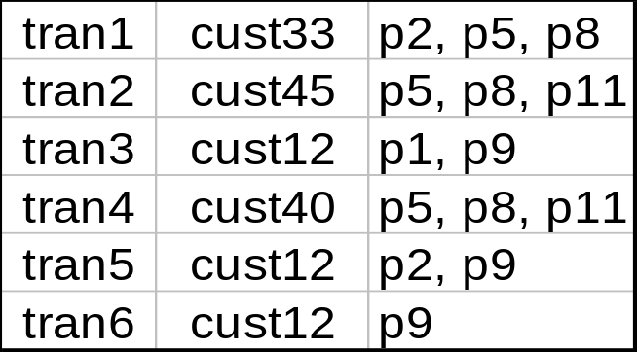
Association Rule Mining
transaction
id
customer
id
products
bought
sales
records:
market-basket
data
Trend: Products p5, p8 often bough together
Trend: Customer 12 likes product p9
CS 245
Notes11

Slide 37
Association Rule
Rule: {p₁, p₃, p₈}
Support: number of baskets where these products appear
High-support set: support ≥ threshold s
Problem: find all high support sets
CS 245
Notes11

Slide 38
Implementation Issues
ETL (Extraction, transformation, loading)
  Getting data to the warehouse
  Entity Resolution
What to materialize?
Efficient Analysis
  Association rule mining
  ...
CS 245
Notes11

Slide 39
ETL: Monitoring Techniques
Periodic snapshots
Database triggers
Log shipping
Data shipping (replication service)
Transaction shipping
Polling (queries to source)
Screen scraping
Application level monitoring
➔ Advantages & Disadvantages!!
CS 245
Notes11

Slide 40
ETL: Data Cleaning
Migration (e.g., yen ⇨ dollars)
Scrubbing: use domain-specific knowledge (e.g., social security numbers)
Fusion (e.g., mail list, customer merging)
Auditing: discover rules & relationships
(like data mining)
billing DB
customer1(Joe)
merged_customer(Joe)
service DB
customer2(Joe)
CS 245
Notes11

Slide 41
More details: Entity Resolution
e1
e2
N: a A: b CC#: c Ph: e
N: a Exp: d Ph: e
Notes:
applies to persons, but also other kinds of entities
two-fold:
1 - identify records that represent the same entity
2 - combine these entities

Slide 42
Applications
comparison shopping
mailing lists
classified ads
customer files
counter-terrorism
e1
N: a A: b CC#: c Ph: e
e2
N: a Exp: d Ph: e

Slide 43
Why is ER Challenging?
Huge data sets
No unique identifiers
Lots of uncertainty
Many ways to skin the cat

Slide 44
Taxonomy: Pairwise vs Global
Decide if r, s match only by looking at r, s?
Or need to consider more (all) records?
Nm: Patrick Smith
Ad: 132 Main St
Ph: (650) 555-1212
Nm: Pat Smith
Ad: 123 Main St
Ph: (650) 555-1212
or
Nm: Patricia Smith
Ad: 123 Main St
Ph: (650) 777-1111

Slide 45
Taxonomy: Pairwise vs Global
Global matching complicates things a lot!
  e.g., change decision as new records arrive
Nm: Patrick Smith
Ad: 132 Main St
Ph: (650) 555-1212
Nm: Pat Smith
Ad: 123 Main St
Ph: (650) 555-1212
or
Nm: Patricia Smith
Ad: 123 Main St
Ph: (650) 777-1111

Slide 46
Taxonomy: Outcome
Partition of records
  e.g., comparison shopping
Merged records
Nm: Pat Smith
Ad: 123 Main St
Ph: (650) 555-1212
Nm: Patricia Smith
Ad: 123 Main St
Ph: (650) 555-1212
(650) 777-1111
Hair: Black
Nm: Patricia Smith
Ad: 132 Main St
Ph: (650) 777-1111
Hair: Black

Slide 47
Taxonomy: Outcome
Iterate after merging
Nm: Tom
Ad: 123 Main
BD: Jan 1, 85
Wk: IBM
Nm: Tom
Wk: IBM
Oc: laywer
Sal: 500K
Nm: Thomas
Ad: 123 Maim
Oc: lawyer
Nm: Tom
Ad: 123 Main
BD: Jan 1, 85
Wk: IBM
Oc: lawyer
Nm: Tom
Ad: 123 Main
BD: Jan 1, 85
Wk: IBM
Oc: lawyer
Sal: 500K

Slide 48
Taxonomy: Record Reuse
One record related to multiple entities?
Nm: Pat Smith Sr.
Ph: (650) 555-1212
Nm: Pat Smith Sr.
Ph: (650) 555-1212
Ad: 123 Main St
Ph: (650) 555-1212
Ad: 123 Main St
Nm: Pat Smith Jr.
Ph: (650) 555-1212
Ad: 123 Main St
Nm: Pat Smith Jr.
Ph: (650) 555-1212

Slide 49
Taxonomy: Record Reuse
Partitions
Merges
r s t
r
rs
s
st
t

Slide 50
Taxonomy: Record Reuse
Partitions
Merges
r s t
r
rs
s
st
t
Record reuse complex and expensive!

Slide 51



Taxonomy: Multiple Entity Types
person 1
person 2
brother
Organization A
member
member
business
Organization B

Slide 52
Taxonomy: Multiple Entity Types
authors
papers
a1
p1
a2
p2
same??
a3
p5
a4
p7
a5

Slide 53
Taxonomy: Exact vs Approximate
cameras
ER
resolved
cameras
products
CDs
ER
resolved
CDs
books
resolved
books
ER
...
...

Slide 54
Taxonomy: Exact vs Approximate
terrorists
terrorists
sort
by age
match against
ages 25-35
B Cooper 30

Slide 55
Implementation Issues
ETL (Extraction, transformation, loading)
  Getting data to the warehouse
  Entity Resolution
What to materialize?
Efficient Analysis
  Association rule mining
  ...
CS 245
Notes11

Slide 56

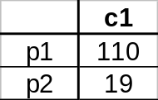
What to Materialize?
Store in warehouse results useful for common queries
Example:
total sales
day 2
. . .
day 1
129
materialize
CS 245
Notes11

Slide 57
Materialization Factors
Type/frequency of queries
Query response time
Storage cost
Update cost
CS 245
Notes11

Slide 58
Cube Aggregates Lattice
129
all
city
product
date
city, product
city, date
product, date
use greedy
algorithm to
decide what
to materialize
city, product, date
day 2
day 1
CS 245
Notes11

Slide 59
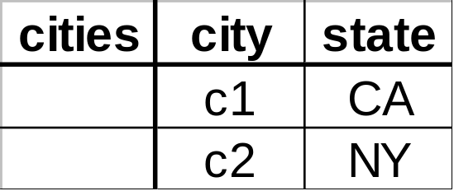
Dimension Hierarchies
all
state
city
CS 245
Notes11

Slide 60
Dimension Hierarchies
all
city
product
date
city, product
city, date
product, date
state
city, product, date
state, date
state, product
state, product, date
not all arcs shown...
CS 245
Notes11

Slide 61
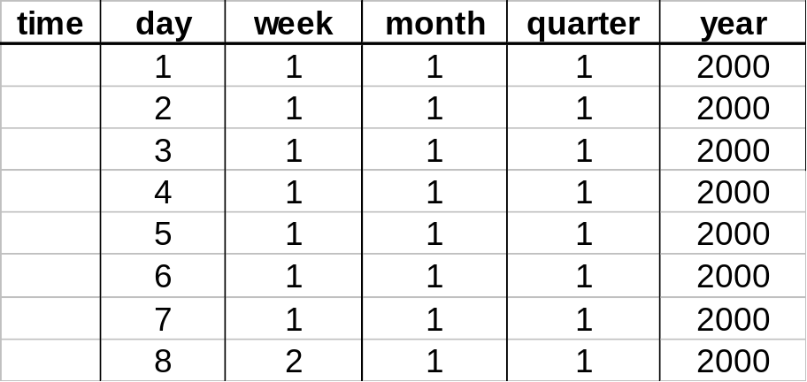
Interesting Hierarchy
all
years
weeks
quarters
months
conceptual
dimension table
days
CS 245
Notes11

Slide 62
Implementation Issues
ETL (Extraction, transformation, loading)
  Getting data to the warehouse
  Entity Resolution
What to materialize?
Efficient Analysis
  Association rule mining
  ...
CS 245
Notes11

Slide 63
Finding High-Support Pairs
Baskets(basket, item)
SELECT I.item, J.item, COUNT(I.basket)
FROM Baskets I, Baskets J
WHERE I.basket = J.basket AND
I.item < J.item
GROUP BY I.item, J.item
HAVING COUNT(I.basket) >= s;
CS 245
Notes11

Slide 64
Finding High-Support Pairs
Baskets(basket, item)
SELECT I.item, J.item, COUNT(I.basket)
FROM Baskets I, Baskets J
WHERE I.basket = J.basket AND
I.item < J.item
GROUP BY I.item, J.item
HAVING COUNT(I.basket) >= s;
WHY?
CS 245
Notes11

Slide 65
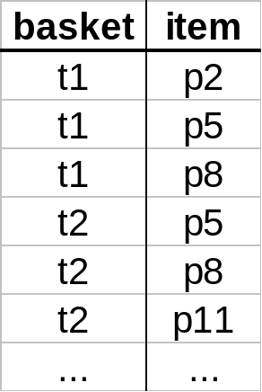
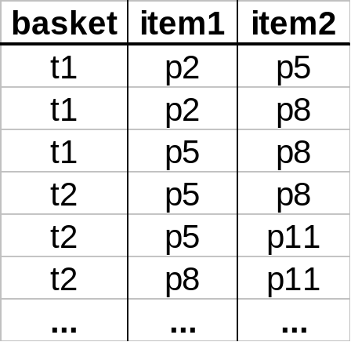
Example
CS 245
Notes11

Slide 66
Example
check if
count ≥ s
CS 245
Notes11

Slide 67
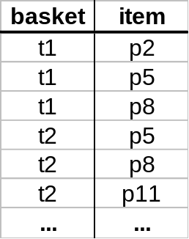
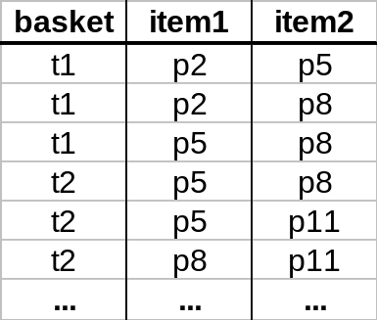
Issues
Performance for size 2 rules
even
bigger!
big
Performance for size k rules
CS 245
Notes11

Slide 68
Association Rules
How do we perform rule mining efficiently?
CS 245
Notes11

Slide 69
Association Rules
How do we perform rule mining efficiently?
Observation: If set X has support t, then each X subset must have at least support t
CS 245
Notes11

Slide 70
Association Rules
How do we perform rule mining efficiently?
Observation: If set X has support t, then each X subset must have at least support t
For 2-sets:
  if we need support s for {i, j}
  then each i, j must appear in at least s baskets
CS 245
Notes11

Slide 71
Algorithm for 2-Sets
(1) Find OK products
  those appearing in s or more baskets
(2) Find high-support pairs
using only OK products
CS 245
Notes11

Slide 72
Algorithm for 2-Sets
INSERT INTO okBaskets(basket, item)
SELECT basket, item
FROM Baskets
GROUP BY item
HAVING COUNT(basket) >= s;
CS 245
Notes11

Slide 73
Algorithm for 2-Sets
INSERT INTO okBaskets(basket, item)
SELECT basket, item
FROM Baskets
GROUP BY item
HAVING COUNT(basket) >= s;
Perform mining on okBaskets
SELECT I.item, J.item, COUNT(I.basket)
FROM okBaskets I, okBaskets J
WHERE I.basket = J.basket AND
I.item < J.item
GROUP BY I.item, J.item
HAVING COUNT(I.basket) >= s;
CS 245
Notes11

Slide 74
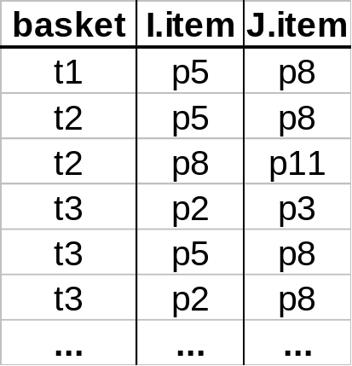
Counting Efficiently
One way:
threshold = 3
CS 245
Notes11

Slide 75
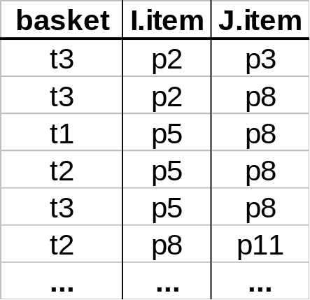
Counting Efficiently
One way:
threshold = 3
sort
CS 245
Notes11

Slide 76
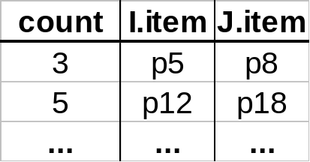
Counting Efficiently
One way:
threshold = 3
count &
remove
sort
CS 245
Notes11

Slide 77
Counting Efficiently
Another way:
threshold = 3
CS 245
Notes11

Slide 78
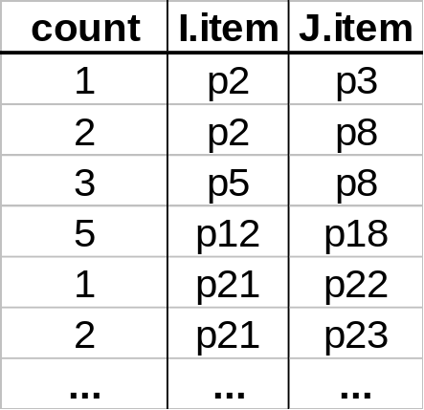
Counting Efficiently
Another way:
threshold = 3
scan &
count
keep counter
array in memory
CS 245
Notes11

Slide 79
Counting Efficiently
Another way:
threshold = 3
scan &
count
remove
keep counter
array in memory
CS 245
Notes11

Slide 80
Counting Efficiently
Another way:
threshold = 3
scan &
count
remove
keep counter
array in memory
CS 245
Notes11

Slide 81
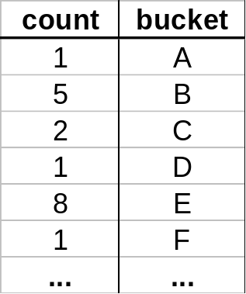
Yet Another Way
(1)
scan &
hash &
count
in-memory
hash table
threshold = 3
CS 245
Notes11

Slide 82
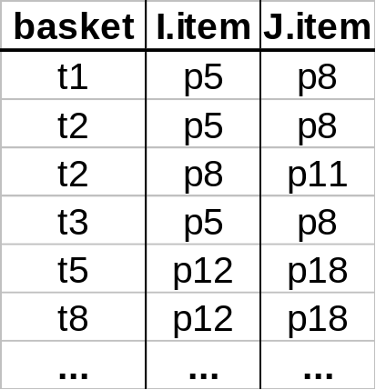
Yet Another Way
(1)
scan &
hash &
count
in-memory
hash table
threshold = 3
(2) scan &
remove
CS 245
Notes11

Slide 83
Yet Another Way
(1)
scan &
hash &
count
in-memory
hash table
threshold = 3
(2) scan &
remove
false positive
CS 245
Notes11

Slide 84
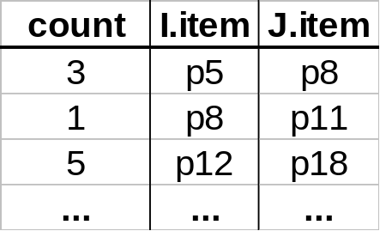
Yet Another Way
(1)
scan &
hash &
count
in-memory
hash table
threshold = 3
in-memory
counters
(2) scan &
remove
false positive
(3) scan& count
CS 245
Notes11

Slide 85
Yet Another Way
(1)
scan &
hash &
count
in-memory
hash table
threshold = 3
in-memory
counters
(4) remove
(2) scan &
remove
false positive
(3) scan& count
CS 245
Notes11

Slide 86
Discussion
Hashing scheme: 2 (or 3) scans of data
Sorting scheme: requires a sort!
Hashing works well if few high-support pairs and many low-support ones
CS 245
Notes11

Slide 87
Discussion
Hashing scheme: 2 (or 3) scans of data
Sorting scheme: requires a sort!
Hashing works well if few high-support pairs and many low-support ones
iceberg queries
frequency
threshold
item-pairs ranked by frequency
CS 245
Notes11

Slide 88
Implementation Issues
ETL (Extraction, transformation, loading)
  Getting data to the warehouse
  Entity Resolution
What to materialize?
Efficient Analysis
  Association rule mining
  ...
CS 245
Notes11

Slide 89
Extra: Data Mining in the InfoLab
Recommendations in CourseRank
quarters
user | q1 | q2 | q3 | q4
u1 | a: 5 | b: 5 | d: 5
u2 | a: 1 | e: 2 | d: 4 | f: 3
u3 | g: 4 | h: 2 | e: 3 | f: 3
u4 | b: 2 | g: 4 | h: 4 | e: 4
u | a: 5 | g: 4 | e: 4
CS 245
Notes11

Slide 90
Extra: Data Mining in the InfoLab
Recommendations in CourseRank
quarters
user | q1 | q2 | q3 | q4
u1 | a: 5 | b: 5 | d: 5
u2 | a: 1 | e: 2 | d: 4 | f: 3
u3 | g: 4 | h: 2 | e: 3 | f: 3
u4 | b: 2 | g: 4 | h: 4 | e: 4
u | a: 5 | g: 4 | e: 4
u3 and u4 are similar to u
Recommend h
CS 245
Notes11

Slide 91
Extra: Data Mining in the InfoLab
Recommendations in CourseRank
quarters
user | q1 | q2 | q3 | q4
u1 | a: 5 | b: 5 | d: 5
u2 | a: 1 | e: 2 | d: 4 | f: 3
u3 | g: 4 | h: 2 | e: 3 | f: 3
u4 | b: 2 | g: 4 | h: 4 | e: 4
u | a: 5 | g: 4 | e: 4
Recommend d (and f, h)
CS 245
Notes11

Slide 92
Sequence Mining
Given a set of transcripts, use Pr[x|a]
to predict if x is a good recommendation
given user has taken a.
Two issues...
CS 245
Notes11

Slide 93
Pr[x|a] Not Quite Right
transcript | containing
1 | -
2 | a
3 | x
4 | a -> x
5 | x -> a
target user’s transcript:
[ ... a .... || unknown ]
recommend x?
Pr[x|a] = 2/3
Pr[x|a^{~x}] = 1/2
CS 245
Notes11

Slide 94
User Has Taken >= 1 Course
User has taken T= {a, b, c}
Need Pr[x|T^{~x}]
Approximate as Pr[x|a^{~x} b^{~x} c^{~x} ]
Expensive to compute, so...
CS 245
Notes11

Slide 95
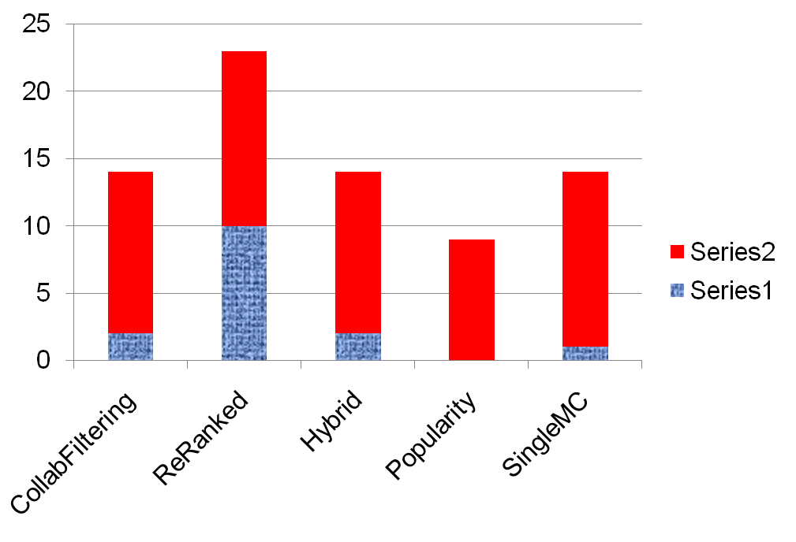
CourseRank User Study
percentage of ratings
good, expected
good, unexpected
CS 245
Notes11

