Slide 1
CS 245: Database System Principles
Notes 13:
BigTable, HBASE, Cassandra
Hector Garcia-Molina
CS 245
Notes 13

Slide 2
Sources
HBASE: The Definitive Guide, Lars George, O’Reilly Publishers, 2011.
Cassandra: The Definitive Guide, Eben Hewitt, O’Reilly Publishers, 2011.
BigTable: A Distributed Storage System for Structured Data, F. Chang et al, ACM Transactions on Computer Systems, Vol. 26, No. 2, June 2008.
CS 245
Notes 13

Slide 3
Lots of Buzz Words!
“Apache Cassandra is an open-source, distributed, decentralized, elastically scalable, highly available, fault-tolerant, tunably consistent, column-oriented database that bases its distribution design on Amazon’s dynamo and its data model on Google’s Big Table.”
Clearly, it is buzz-word compliant!!
CS 245
Notes 13

Slide 4
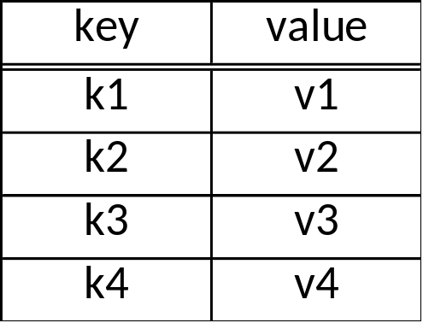
Basic Idea: Key-Value Store
Table T:
CS 245
Notes 13

Slide 5
Basic Idea: Key-Value Store
API:
  lookup(key) → value
  lookup(key range) → values
  getNext → value
  insert(key, value)
  delete(key)
Each row has timestemp
Single row actions atomic
(but not persistent in some systems?)
No multi-key transactions
No query language!
Table T:
keys are sorted
CS 245
Notes 13

Slide 6

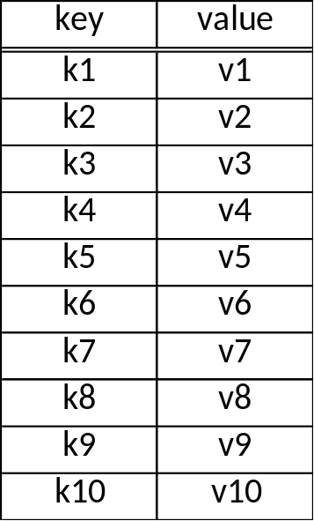
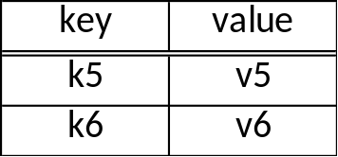
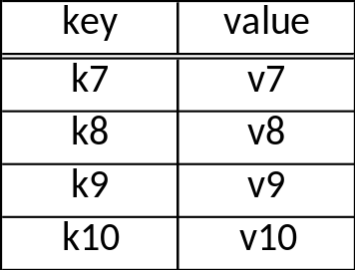
Fragmentation (Sharding)
server 1
server 2
server 3
tablet
use a partition vector
“auto-sharding”: vector selected automatically
CS 245
Notes 13

Slide 7
Tablet Replication
server 3
server 4
server 5
primary
backup
backup
Cassandra:
Replication Factor (# copies)
R/W Rule: One, Quorum, All
Policy (e.g., Rack Unaware, Rack Aware, ...)
Read all copies (return fastest reply, do repairs if necessary)
HBase: Does not manage replication, relies on HDFS
CS 245
Notes 13

Slide 8
Need a “directory”
Table Name: Key → Server that stores key
→ Backup servers
Can be implemented as a special table.
CS 245
Notes 13

Slide 9
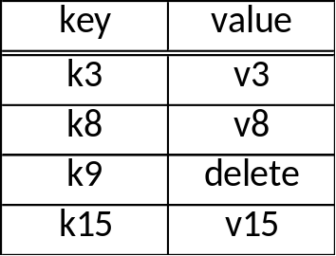
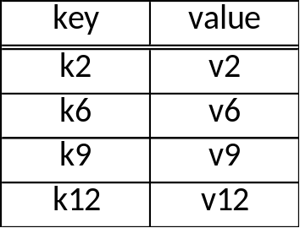
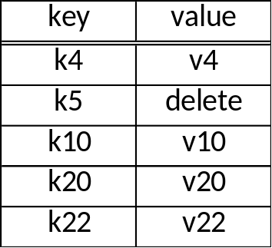
Tablet Internals
memory
disk
Design Philosophy (?): Primary scenario is where all data is in memory.
Disk storage added as an afterthought
CS 245
Notes 13

Slide 10
Tablet Internals
tombstone
memory
flush periodically
disk
tablet is merge of all segments (files)
disk segments imutable
writes efficient; reads only efficient when all data in memory
periodically reorganize into single segment
CS 245
Notes 13

Slide 11
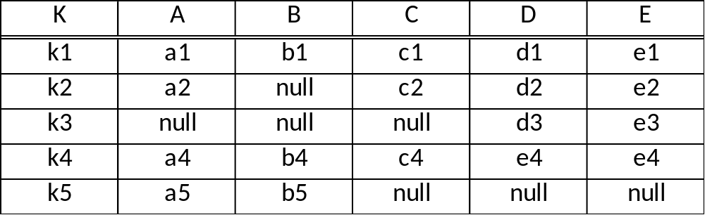
Column Family
CS 245
Notes 13

Slide 12
Column Family
for storage, treat each row as a single “super value”
API provides access to sub-values
(use family:qualifier to refer to sub-values
e.g., price:euros, price:dollars )
Cassandra allows “super-column”:
two level nesting of columns
(e.g., Column A can have sub-columns X & Y )
CS 245
Notes 13

Slide 13
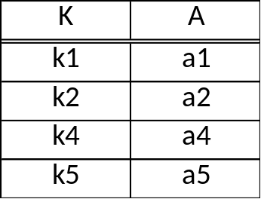
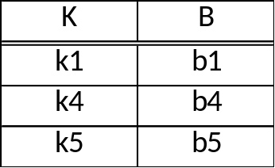
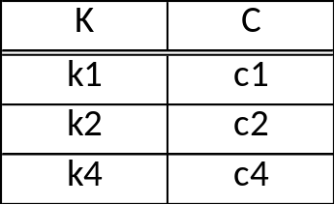
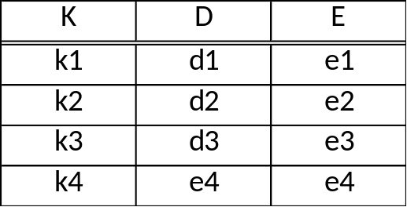
Vertical Partitions
can be manually implemented as
CS 245
Notes 13

Slide 14
Vertical Partitions
column family
good for sparse data;
good for column scans
not so good for tuple reads
are atomic updates to row still supported?
API supports actions on full table; mapped to actions on column tables
API supports column “project”
To decide on vertical partition, need to know access patterns
CS 245
Notes 13

Slide 15
Failure Recovery (BigTable, HBase)
ping
memory
tablet server
master node
spare
tablet server
write ahead logging
log
GFS or HFS
CS 245
Notes 13

Slide 16
Failure recovery (Cassandra)
No master node, all nodes in “cluster” equal
server 1
server 2
server 3
CS 245
Notes 13

Slide 17
Failure recovery (Cassandra)
No master node, all nodes in “cluster” equal
access any table in cluster
at any server
server 1
server 2
server 3
that server sends requests
to other servers
CS 245
Notes 13

Slide 18
Bonus Slides*:
Are Traditional Databases Dead?
Heard on Twitter:
  noSQL rules
  new DB systems scale better than old ones
  DBMS too slow ...
Therefore, need new, revolutionary technology!!
* WARNING: Author may be biased :-)

Slide 19
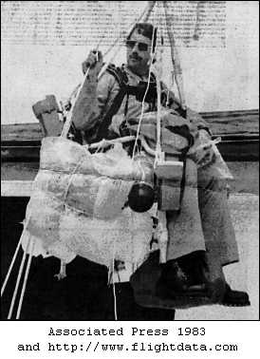
Cautionary Tale
Lawrence Richard Walters, nicknamed "Lawnchair Larry" or the "Lawn Chair Pilot", (April 19, 1949 – October 6, 1993) was an American truck driver who took flight on July 2, 1982 in a homemade aircraft. Dubbed Inspiration I, the "flying machine" consisted of an ordinary patio chair with 45 helium-filled weather balloons attached to it. Walters rose to an altitude of over 15,000 feet (4,600 m) and floated from his point of origin in San Pedro, California into controlled airspace near Los Angeles International Airport.

Slide 20
Parallels
Lawnchair Larry
  Wanna fly
  Can’t afford airplane
T-Gen
  Wanna DB services
  Can’t afford real DBMS

Slide 21
Parallels
Lawnchair Larry
  Wanna fly
  Can’t afford airplane
  I can do myself!
  I am off!!
T-Gen
  Wanna DB services
  Can’t afford real DBMS
  I can do myself!
  I am off!!

Slide 22
Parallels
Lawnchair Larry
  Wanna fly
  Can’t afford airplane
  I can do myself!
  I am off!!
  How do I land???
T-Gen
  Wanna DB services
  Can’t afford real DBMS
  I can do myself!
  I am off!!
  I need joins???

Slide 23
Parallels
Lawnchair Larry
  Wanna fly
  Can’t afford airplane
  I can do myself!
  I am off!!
  How do I land???
  How talk ATC?
  How to navigate?
  Need oxygen!!??
T-Gen
  Wanna DB services
  Can’t afford real DBMS
  I can do myself!
  I am off!!
  I need joins???
  How to index?
  Just had crash! Now what?
  Data inconsistent!
  Oh? Need to maintain???

Slide 24
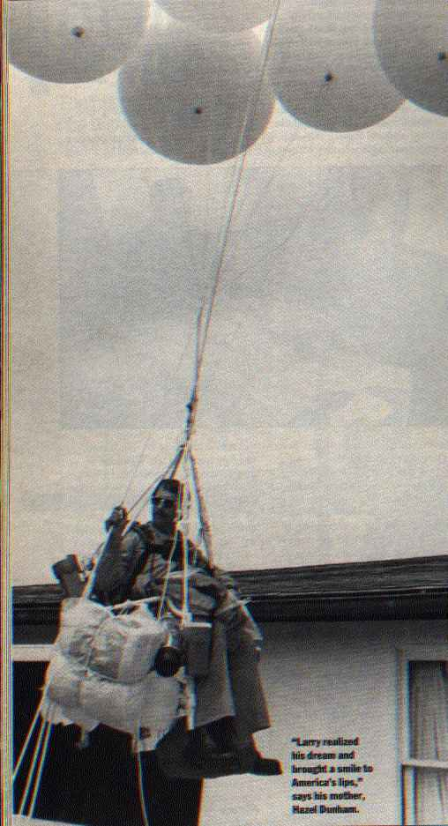
Keep Lawnchair Larry in Mind
Does DBMS technology
not cut it and we need to
start from scratch??
  Or are you just being cheap? ☺
If you think you need a subset of DBMS, will needs change over time?

