Slide 1
CS 245: Database System Principles
Notes 01: Introduction
Peter Bailis
CS 245
Notes 1

Slide 2

This course pioneered by
Hector Garcia-Molina
All credit due to Hector
All mistakes due to Peter
CS 245
Notes 1

Slide 3
Hector Peter
Assistant professor, CS
New this year!
Study data-intensive computing
  Usable large-scale ML
  Distributed systems
CS 245
Notes 1

Slide 4


Come to OHs!
CS 245
Notes 1

Slide 5
2017: Data is Insanely Important
The New Oil
  Powers every modern application
  Collected in increasingly huge volumes
Database systems are fundamental tech
  What’s the point of collecting if you can’t query, analyze, extract insight from it?
  Principles are widely applicable
CS 245
Notes 1

Slide 6
Isn’t Implementing a Database System Simple?
Relations
Statements
Results
CS 245
Notes 1

Slide 7
Introducing the
MEGATRON 3000
Database Management System
The latest from Megatron Labs
Incorporates latest relational technology
UNIX compatible
CS 245
Notes 1

Slide 8
Megatron 3000 Implementation Details
!
!
First sign non-disclosure agreement
CS 245
Notes 1

Slide 9
Megatron 3000 Implementation Details
Relations stored in files (ASCII)
e.g., relation R is in /usr/db/R
Smith # 123 # CS
Jones # 522 # EE
.
.
.
CS 245
Notes 1

Slide 10
Megatron 3000 Implementation Details
Directory file (ASCII) in /usr/db/directory
R1 # A # INT # B # STR …
R2 # C # STR # A # INT …
.
.
.
CS 245
Notes 1

Slide 11
Megatron 3000
Sample Sessions
% MEGATRON3000
Welcome to MEGATRON 3000!
&
& quit
%
.
.
.
CS 245
Notes 1

Slide 12
Megatron 3000
Sample Sessions
& select *
from R #
Relation R
A B C
SMITH 123 CS
&
CS 245
Notes 1

Slide 13
Megatron 3000
Sample Sessions
& select A,B
from R,S
where R.A = S.A and S.C > 100 #
A B
123 CAR
522 CAT
&
CS 245
Notes 1

Slide 14
Megatron 3000
Sample Sessions
& select *
from R | LPR #
&
Result sent to LPR (printer).
CS 245
Notes 1

Slide 15
Megatron 3000
Sample Sessions
& select *
from R
where R.A < 100 | T #
&
New relation T created.
CS 245
Notes 1

Slide 16
Megatron 3000
To execute “select * from R where condition”:
(1) Read dictionary to get R attributes
(2) Read R file, for each line:
(a) Check condition
(b) If OK, display
CS 245
Notes 1

Slide 17
Megatron 3000
To execute “select * from R
where condition | T”:
(1) Process select as before
(2) Write results to new file T
(3) Append new line to dictionary
CS 245
Notes 1

Slide 18
Megatron 3000
To execute “select A,B from R,S where condition”:
(1) Read dictionary to get R,S attributes
(2) Read R file, for each line:
(a) Read S file, for each line:
(i) Create join tuple
(ii) Check condition
(iii) Display if OK
CS 245
Notes 1

Slide 19
What’s wrong with the Megatron 3000 DBMS?
CS 245
Notes 1

Slide 20
What’s wrong with the Megatron 3000 DBMS?
Tuple layout on disk
e.g., - Change string from ‘Cat’ to ‘Cats’ and we have to rewrite file
- ASCII storage is expensive
- Deletions are expensive
CS 245
Notes 1

Slide 21
What’s wrong with the Megatron 3000 DBMS?
Search expensive; no indexes
e.g., - Cannot find tuple with given key quickly
- Always have to read full relation
CS 245
Notes 1

Slide 22
What’s wrong with the Megatron 3000 DBMS?
Brute force query processing
e.g., select *
from R,S
where R.A = S.A and S.B > 1000
- Do select first?
- More efficient join?
CS 245
Notes 1

Slide 23
What’s wrong with the Megatron 3000 DBMS?
No buffer manager
e.g., Need caching
CS 245
Notes 1

Slide 24
What’s wrong with the Megatron 3000 DBMS?
No concurrency control
CS 245
Notes 1

Slide 25
What’s wrong with the Megatron 3000 DBMS?
No reliability
e.g., - Can lose data
- Can leave operations half done
CS 245
Notes 1

Slide 26
What’s wrong with the Megatron 3000 DBMS?
No security
e.g., - File system insecure
- File system security is coarse
CS 245
Notes 1

Slide 27
What’s wrong with the Megatron 3000 DBMS?
No application program interface (API)
e.g., How can a payroll program get at the data?
CS 245
Notes 1

Slide 28
What’s wrong with the Megatron 3000 DBMS?
Cannot interact with other DBMSs.
CS 245
Notes 1

Slide 29
What’s wrong with the Megatron 3000 DBMS?
Poor dictionary facilities
CS 245
Notes 1

Slide 30
What’s wrong with the Megatron 3000 DBMS?
No GUI
CS 245
Notes 1

Slide 31
What’s wrong with the Megatron 3000 DBMS?
Lousy salesman!!
CS 245
Notes 1

Slide 32
Course Overview
File & System Structure
Records in blocks, dictionary, buffer management,…
Indexing & Hashing
B-Trees, hashing,…
Query Processing
Query costs, join strategies,…
Crash Recovery
Failures, stable storage,…
CS 245
Notes 1

Slide 33
Course Overview
Concurrency Control
Correctness, locks,…
Transaction Processing
Logs, deadlocks,…
Security & Integrity
Authorization, encryption,…
Distributed Databases
Interoperation, distributed recovery,…
CS 245
Notes 1

Slide 34
System Structure
Strategy Selector
Query Parser
User
User Transaction
Transaction Manager
Concurrency Control
Buffer Manager
Recovery Manager
Lock Table
File Manager
M.M. Buffer
Log
Statistical Data
Indexes
User Data
System Data
CS 245
Notes 1

Slide 35
Stanford Data Management Courses
CS 145
Fall
CS 246
CS 245
CS 345
here
Advanced Topics
Mining Massive Datasets
Winter
Winter (not in 2016)
Winter
CS 341
CS 224W
CS 346
CS 347
CS 395
CS 545
Social Info and Network Analysis
Database
System
Implement.
Parallel & Distributed
Data Mgmt
Independent
DB Project
DB Seminar
Projects in MMDS
Winter
(not 2016)
All
Spring
Fall
Spring
Spring
CS 245
Notes 1

Slide 36
If you did not take CS145:
You can still take this class
Read in textbook:
  Chapter 2 (Relational Model) through Section 2.4
  Chapter 6 (SQL) through Section 6.2
CS 245
Notes 1

Slide 37
Some Terms
Database system
Transaction processing system
File access system
Information retrieval system
CS 245
Notes 1

Slide 38
Mechanics
http://www.stanford.edu/class/cs245/
CS 245
Notes 1

Slide 39
Staff
INSTRUCTOR: Peter Bailis Office: Gates 410
Office Hours: Wednesdays 3-4PM
TEACHING ASSISTANTS
  Timothy Lee
  Aaron Loh
  Danyang Wang
  Connie Zeng
cs245-win1617-staff@lists.stanford.edu OR Piazza
CS 245
Notes 1

Slide 40
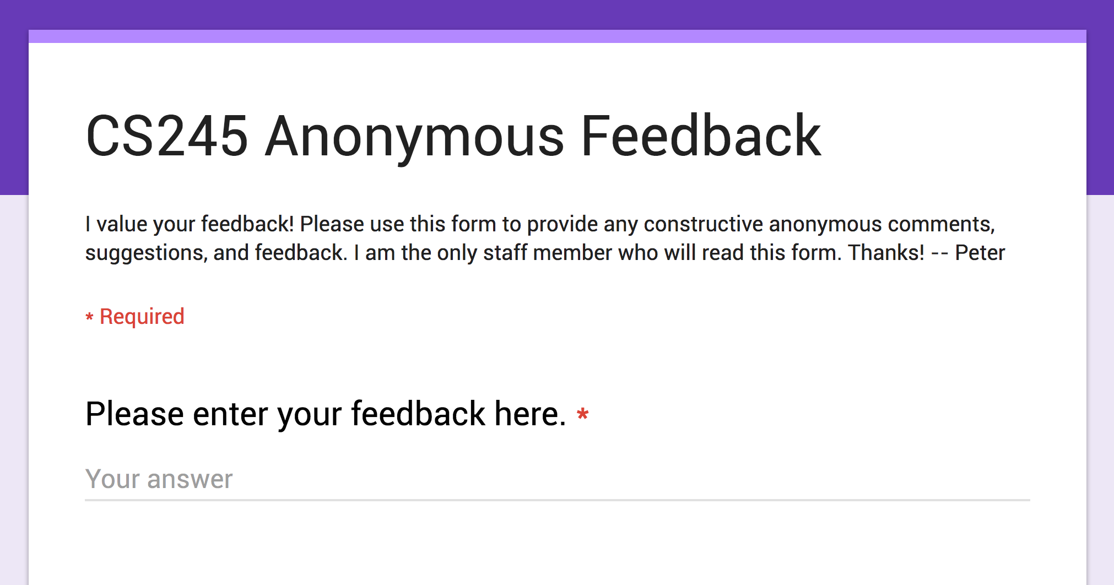
CS 245
Notes 1

Slide 41
Details
LECTURES: Monday, Wednesday 1:30 to 2:50pm, NVidia Auditorium
TEXTBOOK: Garcia-Molina, Ullman, Widom
“DATABASE SYSTEMS, THE COMPLETE BOOK”
[Second edition]
ASSIGNMENTS: Six written homework assignments.
Two (or three) MySQL "code analysis" homeworks.
Also readings in Textbook.
GRADING: Homeworks: 20%, Midterm: 30%, Final: 50%.
WEB SITE: All handouts & assignments will be posted on our Web site at
http://www.stanford.edu/class/cs245
Please check it periodically for last minute announcements.
CS 245
Notes 1

Slide 42
Tentative Syllabus 2016
DATE CHAPTER [2nd Ed] TOPIC
Tuesday January 5 Introduction
Thursday January 7 Ch. 11 [13] Hardware
Tuesday January 12 Ch. 12 [13] File and System Structure
Thursday January 14 Ch. 12 [13] File and System Structure
Tuesday January 19 Ch. 13 [14] Indexing and Hashing
Thursday January 21 Ch. 13 [14] Indexing and Hashing
Tuesday January 26 Ch. 14 [14] Indexing and Hashing
Thursday January 28 Ch. 15 [15] Query Processing
Tuesday February 2 Ch. 15 [16] Query Processing
Thursday February 4 Ch. 16 [16] Query Processing
Tuesday February 9 MIDTERM (in class)
Thursday February 11 Ch. 17 [17] Crash Recovery
Tuesday February 16 Ch. 17 [17] Crash Recovery
Thursday February 18 Ch. 18 [18] Concurrency Control
Tuesday February 23 Ch. 18 [18] Concurrency Control
Thursday February 25 Ch. 18 [18] Concurrency Control
Tuesday March 1 Ch. 19 [19] Transaction Processing
Thursday March 3 Ch. 19 [19] Transaction Processing
Tuesday March 8 Ch. 20 [21,22] Information Integration
Thursday March 10 Review
Wednesday March 16, 12:15-3:00pm FINAL EXAM
CS 245
Notes 1

Slide 43
Read: Chapters 11-20 [13-22 in Second Edition]
Except following optional material
[brackets for Second Edition Complete Book]:
  Sections 11.7.4, 11.7.5 [13.4.8, 13.4.9]
  Sections 14.3.6, 14.3.7, 14.3.8 [14.6.6, 14.6.7, 14.6.8]
  Sections 14.4.2, 14.4.3, 14.4.4 [14.7.2, 14.7.3, 14.7.4]
  Sections 15.7, 15.8, 15.9 [15.7, 15.8]
  Sections 16.6, 16.7 [16.6, 16.7]
  In Chapters 15, 16 [15, 16]: material on duplicate elimination operator, grouping, aggregation operators
  Section 18.8 [18.8]
  Sections 19.2 19.4, 19.5, 19.6 [none, i.e., read all Ch 19]
  [In the Second Edition, skip all of Chapter 20, and Sections 21.5, 21.6, 21.7, 22.2 through 22.7]
CS 245
Notes 1

Slide 44
Next time:
Hardware
Read chapter 11 [13.1 through 13.4]
CS 245
Notes 1

