Slide 1
CS 245: Database System Principles
Notes 11: Modern and Distributed Transactions
Peter Bailis
CS 245
Notes 11

Slide 2
Outline
Replication Strategies
Partitioning Strategies
AC & 2PC
CAP
Why is coordination hard?
NoSQL
Warning:
Coarse
crash
course!
CS 245
Notes 10

Slide 3
Replication
General problem:
  How do recover from server failures?
  How to handle network failures?
CS 245
Notes 10

Slide 4
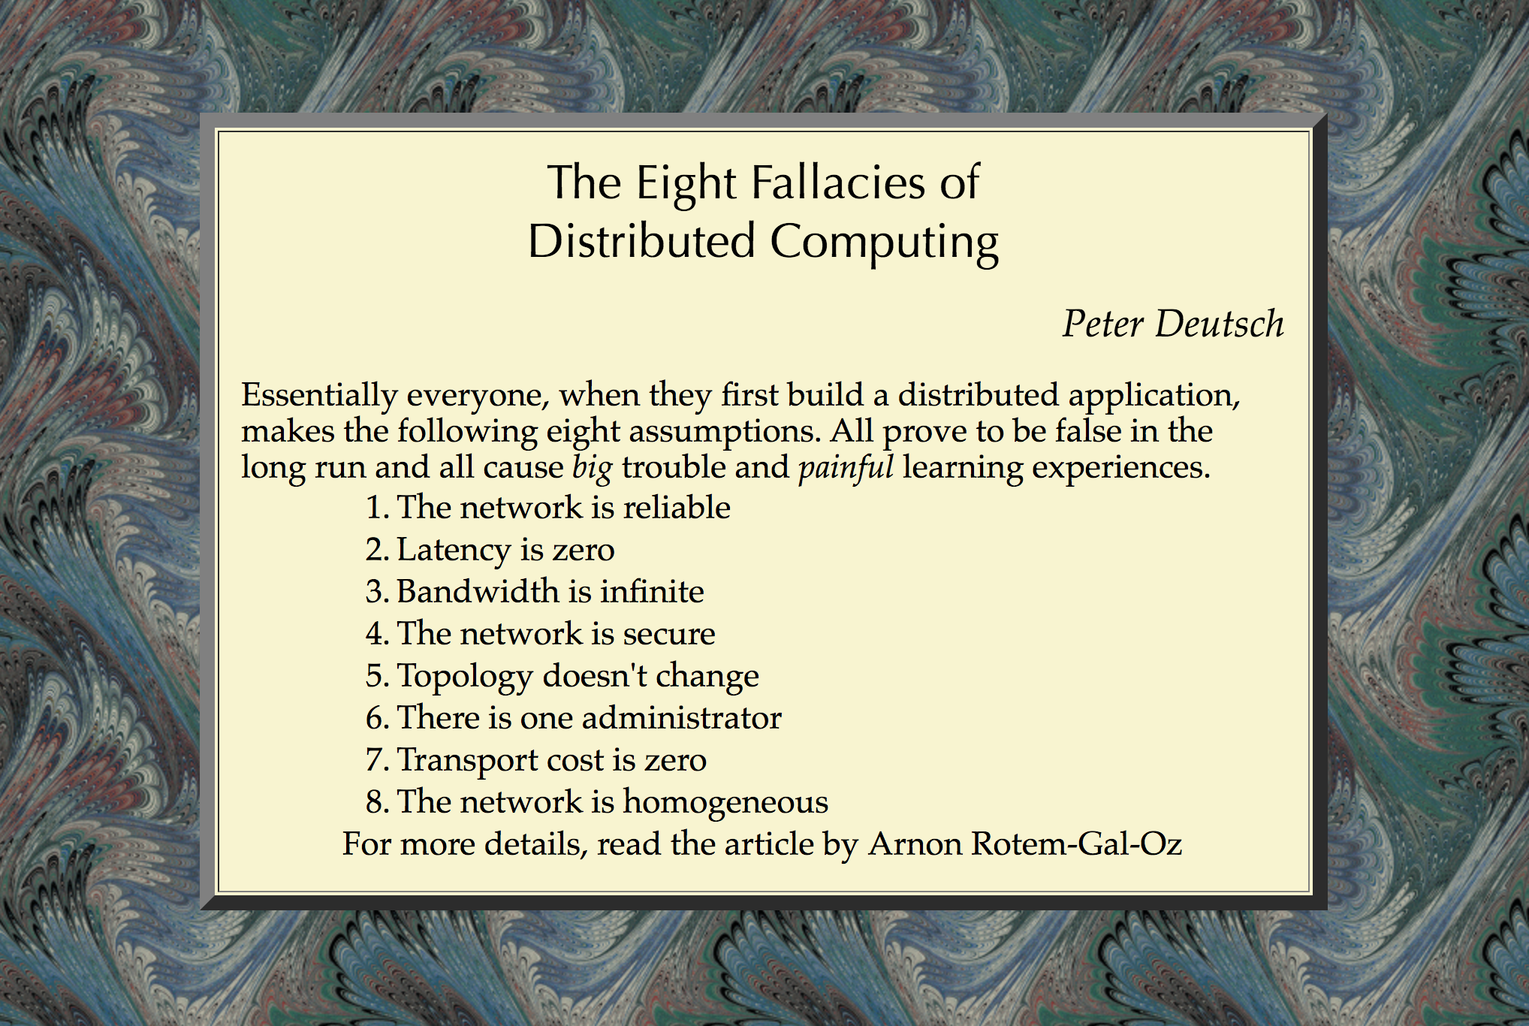

CS 245
Notes 10

Slide 5
Replication
Store each data item on multiple nodes!
Question: how to read/write to them?
CS 245
Notes 10

Slide 6
Primary-Backup
Elect one node “primary”
Store other copies on “backup”
Send operations to primary
Backup synchronization is either:
  Synchronous (write to backups before returning)
  Asynchronous (backups slightly stale)
CS 245
Notes 10

Slide 7
Quorum Replication
Read and write to intersecting sets of servers; no one “primary”
Common: majority quorum
Exotic: “grid” quorum (rarely used)
Surprise: primary-backup is a quorum too!
CS 245
Notes 10

Slide 8
What if we don’t have intersection?
CS 245
Notes 10

Slide 9
What if we don’t have intersection?
Alternative: “eventual consistency”
  If writes stop, eventually all replicas contain the same data
  Basic idea: asynchronously broadcast all writes to all replicas
When is this acceptable?
CS 245
Notes 10

Slide 10
How many replicas?
In general, to survive F fail-stop failures, need F+1 replicas
Question: what if replicas fail arbitrarily? Adversarially?
CS 245
Notes 10

Slide 11
What to do during failures?
Cannot contact primary?
CS 245
Notes 10

Slide 12
What to do during failures?
Cannot contact primary?
  Is the primary failed?
  Or can we simply not contact it?
CS 245
Notes 10

Slide 13
What to do during failures?
Cannot contact majority?
  Is the majority failed?
  Or can we simply not contact it?
CS 245
Notes 10

Slide 14
Solution to failures:
Traditional DB: page the DBA
Distributed computing: use consensus
  Several algorithms: Paxos, Raft
  Today: many implementations
    Zookeeper, etcd, Doozer, Consul
  Idea: keep a reliable, distributed shared record of who is “primary”
CS 245
Notes 10

Slide 15
Consensus in a Nutshell
Goal: distributed agreement
  e.g., on who is primary
Participants broadcast votes
  If majority of notes ever accept a vote v, then they will eventually choose v
  In the event of failures, retry
  Randomization greatly helps!
Take CS244B
CS 245
Notes 10

Slide 16
What to do during failures?
Cannot contact majority?
  Is the majority failed?
  Or can we simply not contact it?
Consensus can provide an answer!
  Although we may need to stall…
  (more on that later)
CS 245
Notes 10

Slide 17
Replication
Store each data item on multiple nodes!
Question: how to read/write to them?
  Answers: primary-backup, quorums
  Use consensus to decide on configuration
CS 245
Notes 10

Slide 18
Outline
Replication Strategies
Partitioning Strategies
AC & 2PC
CAP
Why is coordination hard?
NoSQL
CS 245
Notes 10

Slide 19
Partitioning
General problem:
  Databases are big!
  What if we don’t want to store the whole database on each server?
CS 245
Notes 10

Slide 20
Partitioning Basics
Split database into chunks called “partitions”
  Typically partition by row
  Can also partition by column (rare)
Put one or more partitions per server
CS 245
Notes 10

Slide 21
Partitioning Strategies
Hash keys to servers
  Random “spray”
Partition keys by range
  Keys stored contiguously
What if servers fail (or we add servers)?
  Rebalance partitions (use consensus!)
Pros/cons of hash vs range partitioning?
CS 245
Notes 10

Slide 22
What about distributed txns?
Replication:
  Must make sure replicas stay up to date
  Need to reliably replicate commit log!
Partitioning:
  Must make sure all partitions commit/abort
  Need cross-partition concurrency control!
CS 245
Notes 10

Slide 23
Outline
Replication Strategies
Partitioning Strategies
AC & 2PC
CAP
Why is coordination hard?
NoSQL
CS 245
Notes 10

Slide 24
Atomic Commitment
Informally: either all participants commit a transaction, or none do
“participants” = partitions involved in a given transaction
CS 245
Notes 10

Slide 25
So, what’s hard?
CS 245
Notes 10

Slide 26
So, what’s hard?
All the problems as consensus…
…plus, if any node votes to abort, all must decide to abort
  In consensus, simply need agreement on “some” value…
CS 245
Notes 10

Slide 27
Two-Phase Commit
Canonical protocol for atomic commitment (developed 1976-1978)
Basis for most fancier protocols
Widely used in practice
Use a transaction coordinator
  Usually client – not always!
CS 245
Notes 10

Slide 28
Two Phase Commit (2PC)
Transaction coordinator sends prepare to each participating node
Each participating node responds to coordinator with prepared or no
If coordinator receives all prepared:
  Broadcast commit
If coordinator receives any no:
  Broadcast abort
CS 245
Notes 10

Slide 29
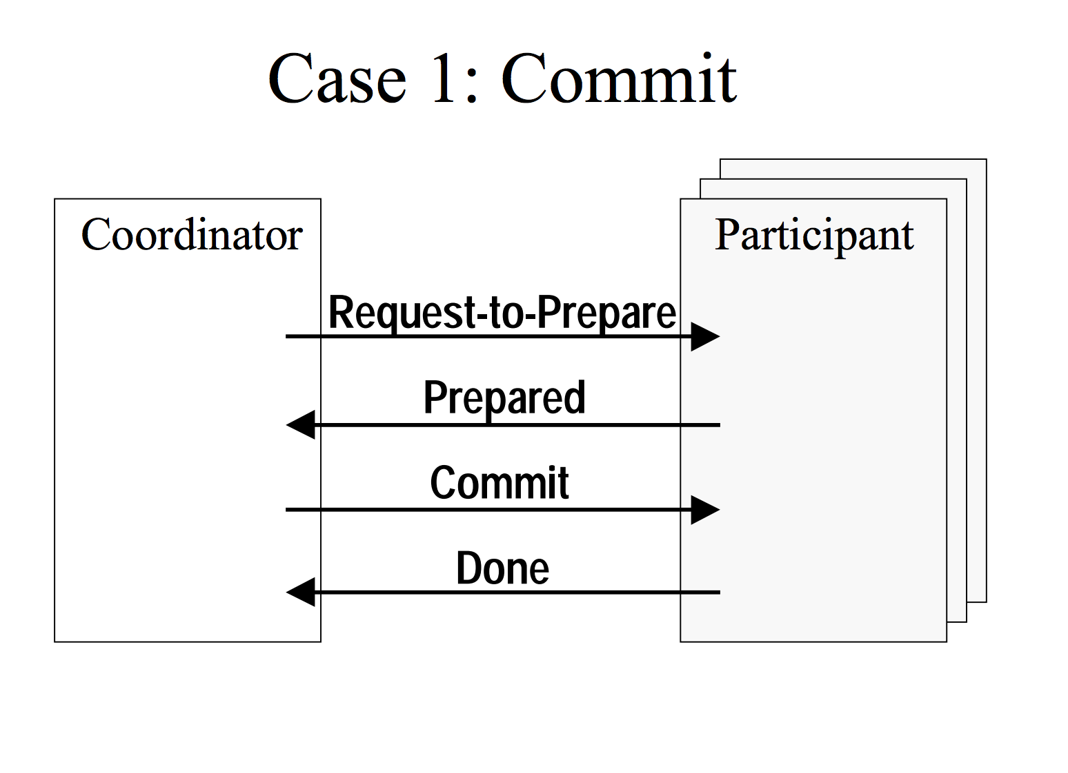
CS 245
Notes 10
UW CSE545

Slide 30
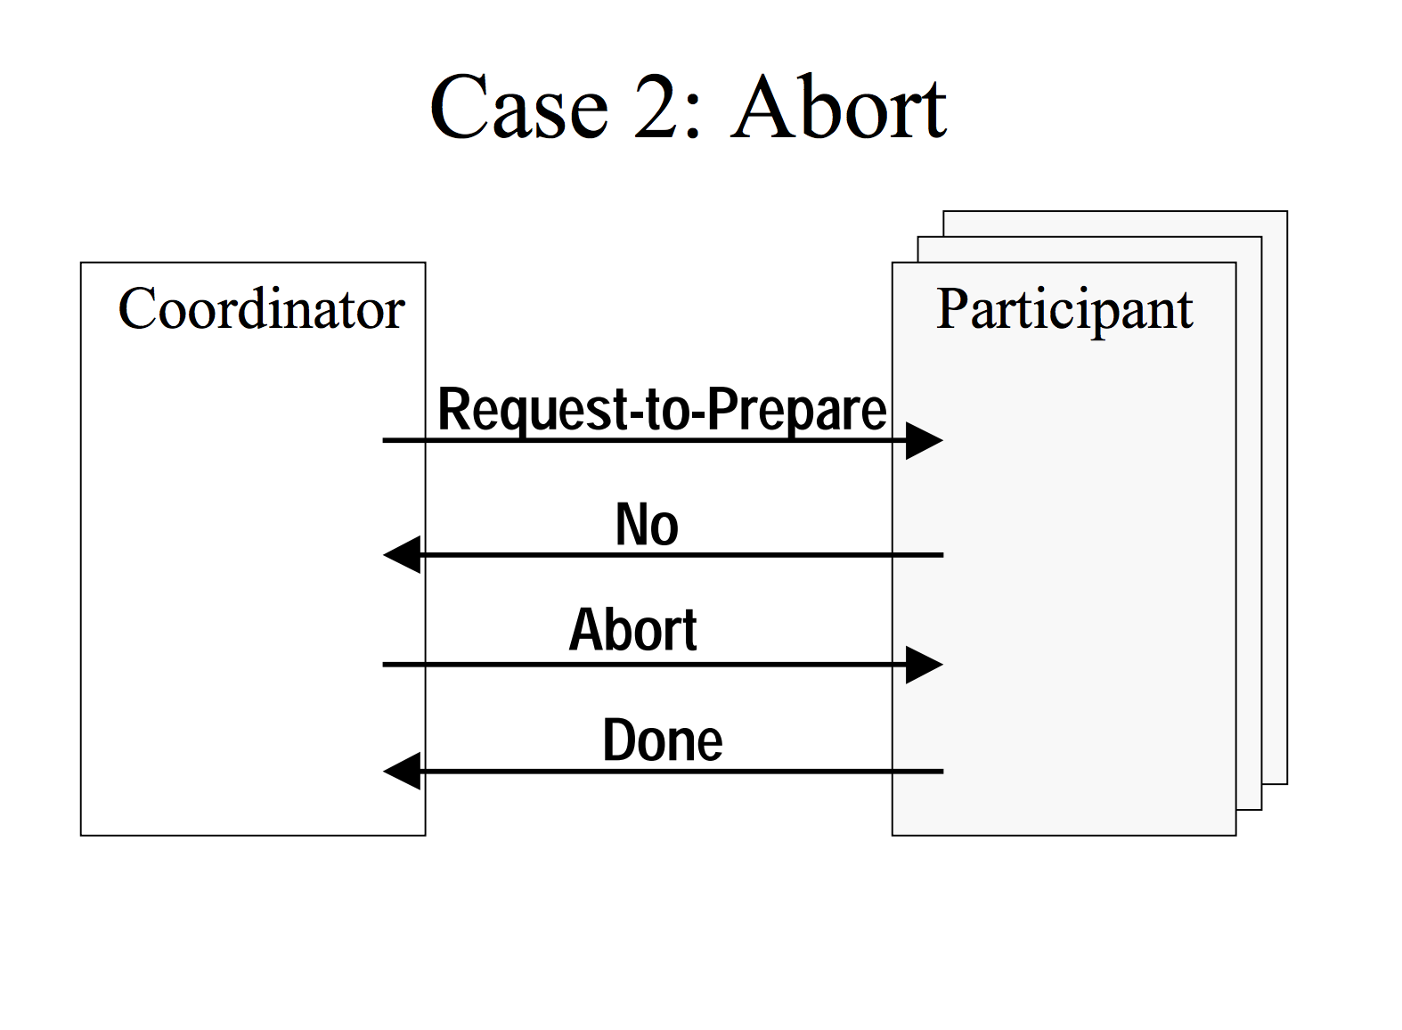
CS 245
Notes 10
UW CSE545

Slide 31
2PC + Validation
Participants perform validation upon receipt of prepare message
Validation essentially blocks between prepare and commit message
CS 245
Notes 10

Slide 32
2PC + 2PL
Traditionally: run 2PC at commit time
  i.e., perform locking as usual, then run 2PC when transaction would normally commit
Under strict 2PL, run 2PC before unlocking write locks
CS 245
Notes 10

Slide 33
2PC + logging
Log records must be flushed to disk before participants reply to prepare
  (And/or updates must be replicated to F other replicas)
CS 245
Notes 10

Slide 34
Optimizations Galore
CS 245
Notes 10

Slide 35
Optimizations Galore
Participants can send prepared messages to each other:
  Can commit without the client
  Requires O(p^2) messages
  2PL: piggyback lock ”unlock” commands on commit/abort message
  Piggyback transaction’s last command on prepare message
CS 245
Notes 10

Slide 36
What could go wrong?
  Coordinator
PREPARE
  Participant
  Participant
  Participant
CS 245
Notes 10

Slide 37
What could go wrong?
  Coordinator
PREPARED
What if we don’t
hear back?
PREPARED
  Participant
  Participant
  Participant
CS 245
Notes 10

Slide 38
Case I: Participant Unavailable
We don’t hear back from a participant
Coordinator can still decide to abort
  Coordinator makes the final call!
Participant comes back online?
  Will receive the abort message
CS 245
Notes 10

Slide 39
What could go wrong?
  Coordinator
PREPARE
  Participant
  Participant
  Participant
CS 245
Notes 10

Slide 40
What could go wrong?
Coordinator does not reply!
PREPARED
PREPARED
PREPARED
  Participant
  Participant
  Participant
CS 245
Notes 10

Slide 41
Case II: Coordinator Unavailable
Participants cannot make progress
But: can agree to elect a new coordinator, never listen to the old coordinator
  Old coordinator comes back online? Overruled by participants, who reject its messages
CS 245
Notes 10

Slide 42
What could go wrong?
  Coordinator
PREPARE
  Participant
  Participant
  Participant
CS 245
Notes 10

Slide 43
What could go wrong?
Coordinator does not reply!
No contact with
third
participant!
PREPARED
PREPARED
  Participant
  Participant
  Participant
CS 245
Notes 10

Slide 44
Case III: Coordinator and Participant Unavailable
Worst-case scenario:
  Unavailable/unreachable participant voted to prepare
  Coordinator hears back all prepare, broadcasts commit
  Unavailable/unreachable participant commits
Rest of participants must wait!!!
CS 245
Notes 10

Slide 45
Coordination is Bad News
Every atomic commitment protocol is blocking (i.e., may stall) in the presence of:
  asynchronous network behavior (e.g., unbounded delays)
    cannot distinguish between delay and failure
  failing nodes
    if nodes never failed, could just wait
Cool: actual theorem!
CS 245
Notes 10

Slide 46
Outline
Replication Strategies
Partitioning Strategies
AC & 2PC
CAP
Why is coordination hard?
NoSQL
CS 245
Notes 10

Slide 47
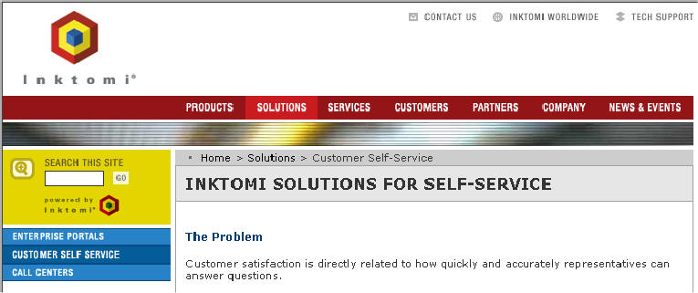


CS 245
Notes 10

Slide 48
Asynchronous Network Model
Messages can be arbitrarily delayed
Effectively cannot distinguish between delayed messages and failed nodes in a finite amount of time
CS 245
Notes 10

Slide 49
CAP Theorem
In an asynchronous network, a distributed database can either:
  guarantee a response from any replica in a finite amount of time (“availability”) OR
  guarantee arbitrary “consistency” criteria/constraints about data
but not both
CS 245
Notes 10

Slide 50
CAP Theorem
Choose either:
  Consistency and “Partition Tolerance”
  Availability and “Partition Tolerance”
Example consistency criteria:
  Exactly one key can have value “Peter”
“CAP” is a reminder:
  No free lunch for distributed systems
CS 245
Notes 10

Slide 51
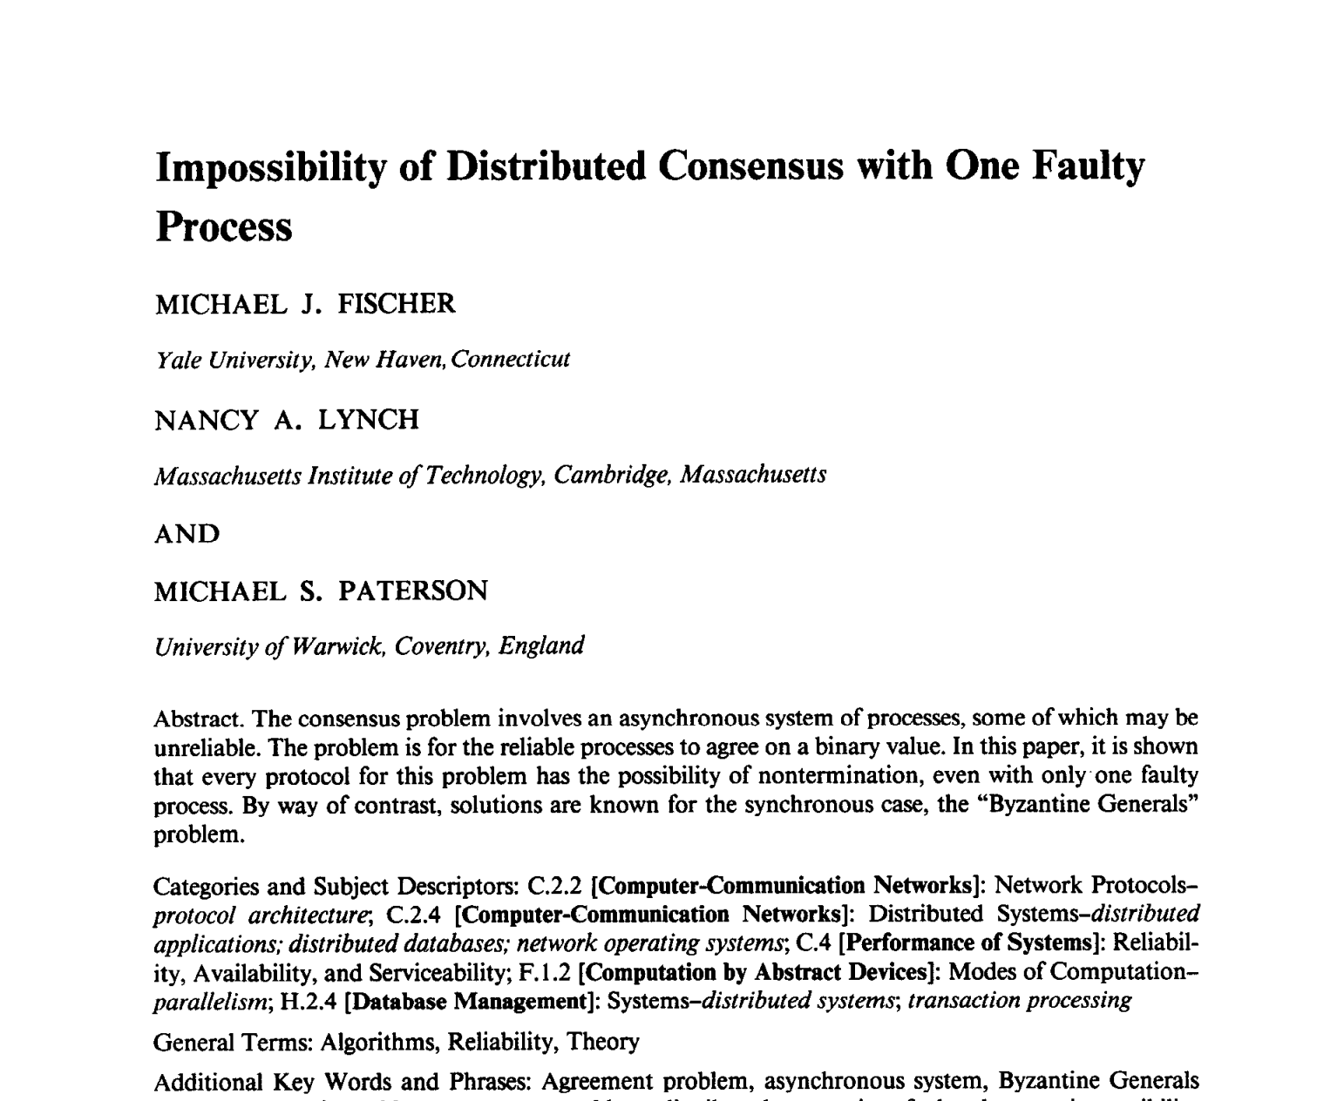
CS 245
Notes 10

Slide 52
Why CAP is Important
Pithy reminder: “consistency” (serializability, various integrity constraints) is expensive!
  Costs us the ability to provide “always on” operation (availability)
  Requires expensive coordination (synchronous communication) even when we don’t have failures
CS 245
Notes 10

Slide 53
Outline
Replication Strategies
Partitioning Strategies
AC & 2PC
CAP
Why is coordination hard?
NoSQL
CS 245
Notes 10

Slide 54
Let’s talk about coordination
If we’re “AP”, then we don’t have to talk even when we can!
If we’re “CP”, then we have to talk all of the time.
How fast can we send messages?
CS 245
Notes 10

Slide 55
Let’s talk about coordination
If we’re “AP”, then we don’t have to talk even when we can!
If we’re “CP”, then we have to talk all of the time.
How fast can we send messages?
  Planet Earth: 144ms RTT
    (77ms if we drill thru center of earth)
  Einstein!
CS 245
Notes 10

Slide 56
Multi-Datacenter Transactions
Message delays often much worse than speed of light (due to routing)
44ms apart? maximum 22 conflicting transactions per second
  Of course, no conflicts, no problem!
  Can scale out
Major pain point for today’s systems
CS 245
Notes 10

Slide 57
Do we have to coordinate?
Is it possible achieve some forms of “correctness” without coordination?
CS 245
Notes 10

Slide 58
Do we have to coordinate?
Example: no key in the database has value “peter”
  If no replica assigns “peter” on their own, then “peter” will never appear in the DB!
Whole topic of research!
  Key finding: most applications have a few points where they need coordination, but many operations do not
CS 245
Notes 10

Slide 59
So why bother with serializability?
For arbitrary integrity constraints, non-serializable execution will compromise constraints. (Exercise: how to prove?)
Serializability: just look at reads, writes
To get “coordination-free execution”:
  Must look at application semantics
  Can be hard to get right!
  Strategy: start coordinated, then relax
CS 245
Notes 10

Slide 60
Punchlines:
Serializability has a provable cost to latency, availability, scalability (in the presence of conflicts)
We can avoid this penalty if we are willing to look at our application and our application does not require coordination
  Major topic of ongoing research
CS 245
Notes 10

Slide 61
Bonus:
Does machine learning always need serializability?
  e.g., say I want to train a deep network on 1000s of GPUs
CS 245
Notes 10

Slide 62
Bonus:
Does machine learning always need serializability?
  No! Turns out asynchronous execution is provably safe (for sufficiently small delays)
  Convex optimization routines (e.g., SGD) run faster on modern HW without locks
  Best paper name ever: HogWild!
CS 245
Notes 10

Slide 63
Outline
Replication Strategies
Partitioning Strategies
AC & 2PC
CAP
Why is coordination hard?
NoSQL
CS 245
Notes 10

Slide 64
“NoSQL”
Popular set of databases, largely built by web companies in the 2000s
  Focus on scale-out and flexible schemas
  Lots of hype, somewhat dying down
MongoDB, Cassandra, Redis
“NewSQL”: Spanner, CockroachDB
CS 245
Notes 10

Slide 65
What couldn’t RDBMSs do well?
Schema changes were (are?) a pain
  Hard to add new columns, critical when building new applications quickly
Auto-partition and re-partition (”shard”)
Gracefully fail-over during failures
Multi-partition operations
CS 245
Notes 10

Slide 66
How much of “NoSQL” et al. is new?
Basic algorithms for scale-out execution were known in 1980s
Google’s Spanner: core algorithms published in 1993
Reality: takes a lot of engineering to get right! (web & cloud drove demand)
  Hint: adding distribution is much harder than building from the ground up!
CS 245
Notes 10

Slide 67
How much of “NoSQL” et al. is new?
Semi-structured data management is hugely useful for developers
  Web and open source: shift from “DBA-first” to “developer-first” mentality
  Not always a good thing for a mature products or services needing stability!
Have less info for query optimization, but… people cost more than compute!
CS 245
Notes 10

Slide 68
Lessons from “NoSQL”
Scale drove 2000s technology demands
Open source enabled adoption of less mature technology, experimentation
Developers, not DBAs (“DevOps”)
Exciting time for data infrastructure
  More on this next lecture!
CS 245
Notes 10

Slide 69
How does NASA organize their company parties?
CS 245
Notes 10

Slide 70
How does NASA organize their company parties?
They planet
CS 245
Notes 10

