Slide 1
CS 245: Database System Principles
Notes 02: Storage Hardware
Peter Bailis
CS 245
Notes 2

Slide 2
Outline
Hardware: Disks
Access Times
Solid State Drives
Optimizations
Other Topics:
  Storage costs
  Using secondary storage
  Disk failures
CS 245
Notes 2

Slide 3
Hardware
DBMS
Data Storage
CS 245
Notes 2

Slide 4
P
Typical
Computer
...
...
M
C
Secondary
Storage
CS 245
Notes 2

Slide 5
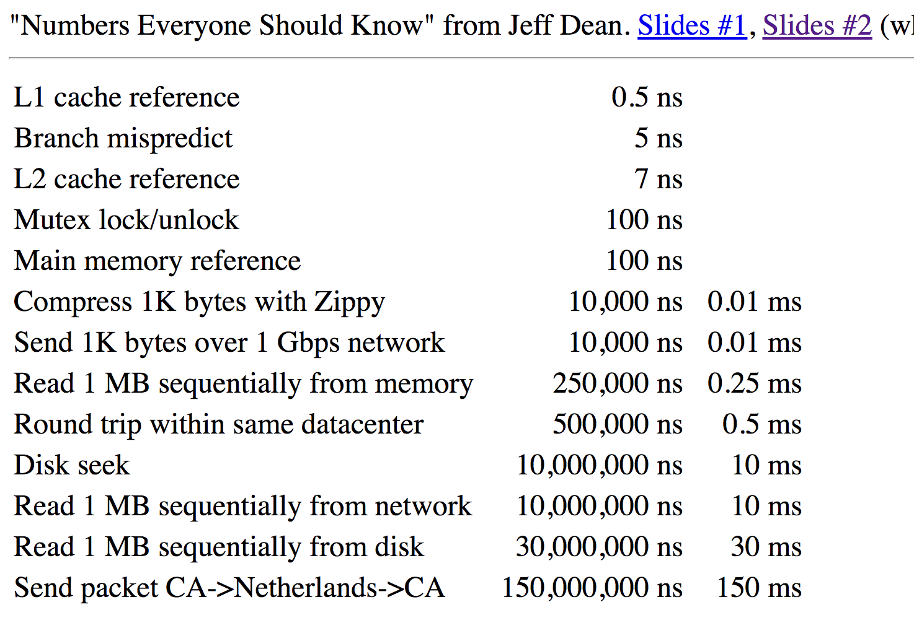

CS 245
Notes 2

Slide 6


Storage Latency:
How Far Away is the Data?
Andromeda
10
9
Tape /Optical
2,000 Years
Robot
10
6
Disk
Pluto
2 Years
Sacramento
1.5 hr
100
Memory
10
On Board Cache
This Campus
10 min
2
On Chip Cache
This Room
1
Registers
My Head
1 min

Slide 7
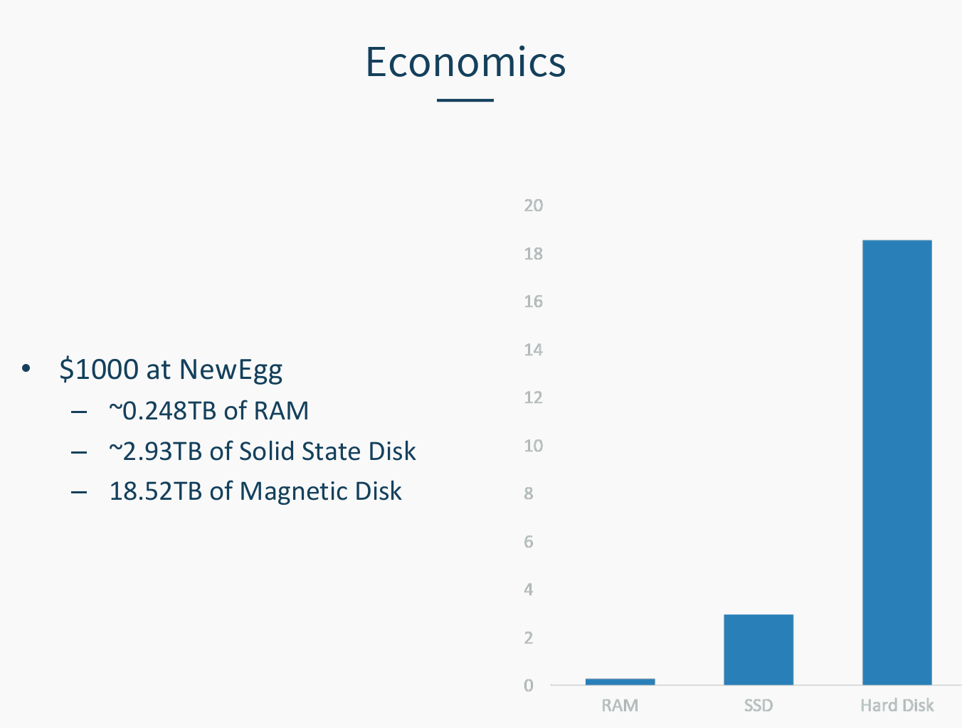
Shukla + Ramaswamy, UCB
CS 245
Notes 2

Slide 8
Secondary storage
Many flavors:
- Disk: Floppy (hard, soft)
Removable Packs
Winchester
SSD disks
Optical, CD-ROM…
Arrays
- Tape Reel, cartridge
Robots
CS 245
Notes 2

Slide 9
Focus on: “Typical Disk”
…
Terms: Platter, Head, Actuator
Cylinder, Track
Sector (physical),
Block (logical), Gap
CS 245
Notes 2

Slide 10
Top View
CS 245
Notes 2

Slide 11
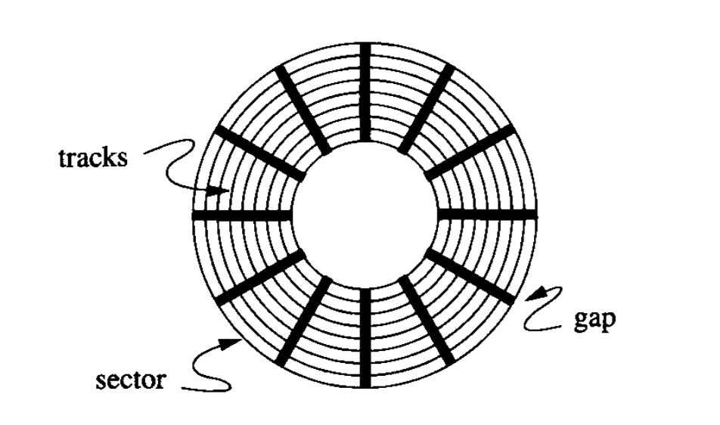
CS 245
Notes 2

Slide 12
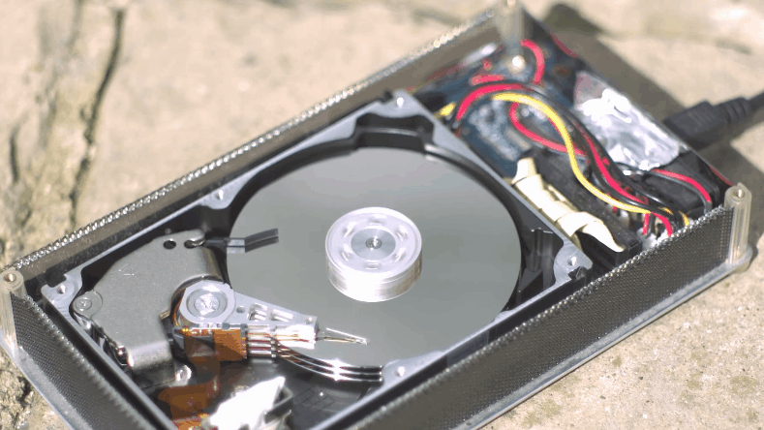
CS 245
Notes 2

Slide 13
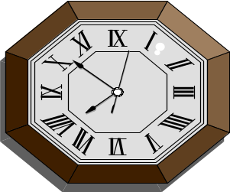
Disk Access Time
I want
block X
block x
in memory
?
CS 245
Notes 2

Slide 14
Time = Seek Time +
Rotational Delay +
Transfer Time +
Other
CS 245
Notes 2

Slide 15
Seek Time
3 or 5x
Time
x
1
N
Cylinders Traveled
CS 245
Notes 2

Slide 16
Average Random Seek Time
N
N
∑ ∑ SEEKTIME (i → j)
S =
N(N-1)
i=1
j=1
j≠i
CS 245
Notes 2

Slide 17
Typical Seek Time
Ranges from
  4ms for high end drives
  15ms for mobile devices
Typical SSD: ranges from
  0.08ms
  0.16ms
Source: Wikipedia, "Hard disk drive performance characteristics"
CS 245
Notes 2

Slide 18
Rotational Delay
Head Here
Block I Want
CS 245
Notes 2

Slide 19
Average Rotational Delay
R = 1/2 revolution
R=0 for SSDs
Typical HDD figures
HDD Spindle [rpm] | Average rotational latency [ms]
4,200 | 7.14
5,400 | 5.56
7,200 | 4.17
10,000 | 3.00
15,000 | 2.00
Source: Wikipedia, "Hard disk drive performance characteristics"
CS 245
Notes 2

Slide 20
Transfer Rate: t
value of t ranges from
  up to 1000 Mbit/sec
  432 Mbit/sec 12x Blu-Ray disk
  1.23 Mbits/sec 1x CD
  for SSDs, limited by interface
  e.g., SATA 3000 Mbit/s
transfer time: block size
t
CS 245
Notes 2

Slide 21
Other Delays
CPU time to issue I/O
Contention for controller
Contention for bus, memory
CS 245
Notes 2

Slide 22
Other Delays
CPU time to issue I/O
Contention for controller
Contention for bus, memory
“Typical” Value: 0
CS 245
Notes 2

Slide 23
So far: Random Block Access
What about: Reading “Next” block?
CS 245
Notes 2

Slide 24
If we do things right (e.g., Double Buffer, Stagger Blocks…)
Time to get = Block Size + Negligible
block t
- skip gap
- switch track
- once in a while,
next cylinder
CS 245
Notes 2

Slide 25
Rule of Random I/O: Expensive
Thumb Sequential I/O: Much less
CS 245
Notes 2

Slide 26
Cost for Writing similar to Reading
…. unless we want to verify!
need to add (full) rotation + Block size
t
CS 245
Notes 2

Slide 27
To Modify a Block?
CS 245
Notes 2

Slide 28
To Modify a Block?
To Modify Block:
(a) Read Block
(b) Modify in Memory
(c) Write Block
[(d) Verify?]
CS 245
Notes 2

Slide 29
SSDs
Source: Reza Sadri,
STEC ("the SSD Company")
storage is block oriented
(not random access)
lots of errors
  e.g., write of one block may cause an error of nearby block
  e.g., a block can only be written a limited number of times
logic masks most issues
  e.g., using log structure
sequential writes improve throughput (less bookkeeping)
  latency for seq. writes = random writes
  performance seq. reads = random reads
interface
HDD or
other
on-device
logic
SSD
CS 245
Notes 2

Slide 30
SSD vs Hard Disk Comparison
(from Wikipedia)
Factors: start up time, random access time, read latency time, data transfer rate, read performance, fragmentation, noise, temperature control, environmental factors, installation and mounting, magnetic fields, weight and size, reliability, secure writing, cost, capacity, R/W symmetry, power consumption.
CS 245
Notes 2

Slide 31
Random Access Time
SSD: Typically under 0.1 ms. As data can be retrieved directly from various locations of the flash memory, access time is usually not a big performance bottleneck.
Hand Drive: Ranges from 2.9 (high end server drive) to 12 ms (laptop HDD) due to the need to move the heads and wait for the data to rotate under the read/write head
CS 245
Notes 2

Slide 32
Data Transfer Rate
SSD: In consumer products the maximum transfer rate typically ranges from about 100 MB/s to 600 MB/s, depending on the disk. Enterprise market offers devices with multi-gigabyte per second throughput.
Hard Disk: Once the head is positioned, an enterprise HDD can transfer data at about 140 MB/s. In practice transfer speeds are lower due to seeking. Data transfer rate depends also upon rotational speed, which can range from 4,200 to 15,000 rpm and also upon the track (reading from the outer tracks is faster due higher).
CS 245
Notes 2

Slide 33
Reliability
SSD: Reliability varies across manufacturers and models with return rates reaching 40% for specific drives. As of 2011 leading SSDs have lower return rates than mechanical drives. Many SSDs critically fail on power outages; a December 2013 survey found that only some of them are able to survive multiple power outages.
Hard Disk: According to a study performed by CMU for both consumer and enterprise-grade HDDs, their average failure rate is 6 years, and life expectancy is 9–11 years. Leading SSDs have overtaken hard disks for reliability, however the risk of a sudden, catastrophic data loss can be lower for mechanical disks.
CS 245
Notes 2

Slide 34
Cost and Capacity
SSD: NAND flash SSDs have reached US$0.35 per GB. In 2016, SSDs were available in sizes up to 60 TB, but less costly 512GB to 1TB drives were more common.
Hard Drive: HDDs cost about US$0.035 per GB for 3.5-inch and $0.06 per GB for 2.5-inch drives. In 2017, HDDs of up to 10 TB are available.
CS 245
Notes 2

Slide 35
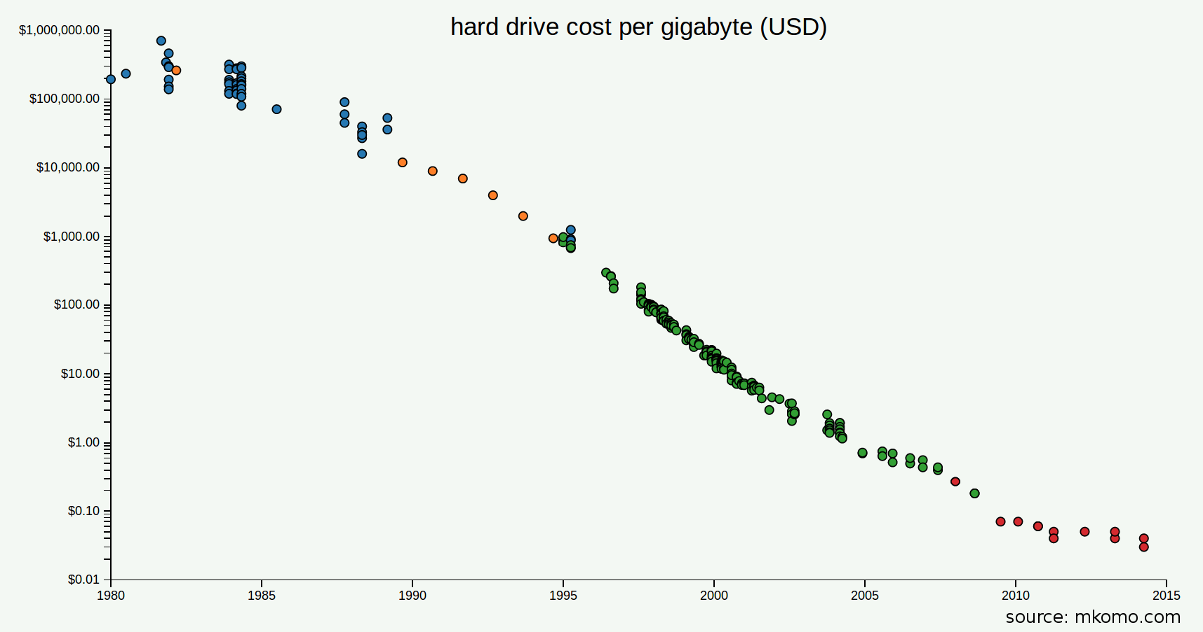
CS 245
Notes 2

Slide 36
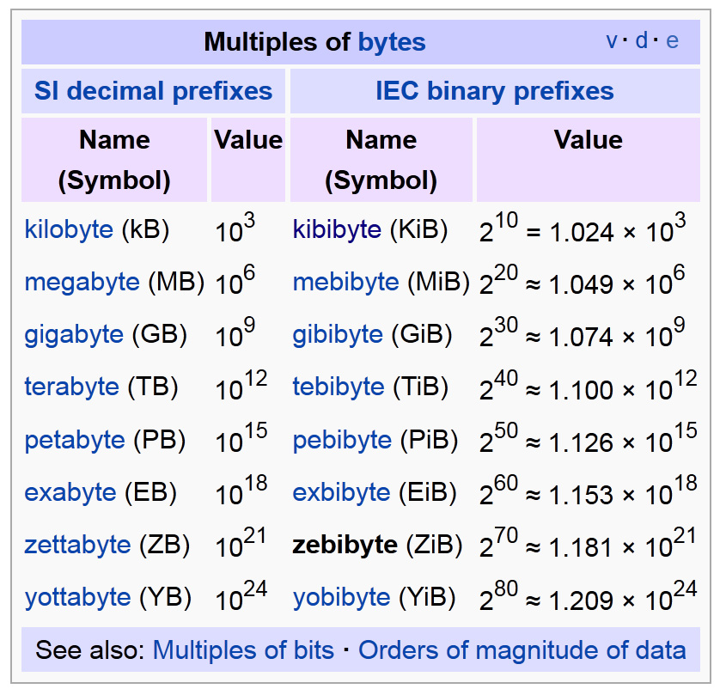
Kibibytes
1 kibibyte = 2¹⁰ bytes = 1024 bytes.
from
Wikipedia
CS 245
Notes 2

Slide 37
Outline
Hardware: Disks
Access Times
Solid State Drives
Optimizations
Other Topics
  Storage Costs
  Using Secondary Storage
  Disk Failures
here
CS 245
Notes 2

Slide 38
Optimizations (in controller or O.S.)
Disk Scheduling Algorithms
  e.g., elevator algorithm
Track (or larger) Buffer
Pre-fetch
Arrays
Mirrored Disks
On Disk Cache
CS 245
Notes 2

Slide 39
Double Buffering
Problem: Have a File
        Sequence of Blocks B1, B2
      Have a Program
        Process B1
        Process B2
        Process B3
...
CS 245
Notes 2

Slide 40
Single Buffer Solution
(1) Read B1 → Buffer
(2) Process Data in Buffer
(3) Read B2 → Buffer
(4) Process Data in Buffer ...
CS 245
Notes 2

Slide 41
Say P = time to process/block
R = time to read in 1 block
n = # blocks
Single buffer time = n(P+R)
CS 245
Notes 2

Slide 42
Double Buffering
process
Memory:
Disk:
A
B
C
D
E
F
G
CS 245
Notes 2

Slide 43
Double Buffering
process
Memory:
Disk:
A
B
A
B
C
D
E
F
G
done
CS 245
Notes 2

Slide 44
Double Buffering
process
Memory:
Disk:
C
B
A
A
B
C
D
E
F
G
done
CS 245
Notes 2

Slide 45
Double Buffering
process
process
Memory:
Disk:
C
B
A
B
A
A
B
C
D
E
F
G
done
done
CS 245
Notes 2

Slide 46
Say P ≥ R
P = Processing time/block
R = IO time/block
n = # blocks
What is processing time?
CS 245
Notes 2

Slide 47
Say P ≥ R
P = Processing time/block
R = IO time/block
n = # blocks
What is processing time?
Double buffering time = R + nP
Single buffering time = n(R+P)
CS 245
Notes 2

Slide 48
Disk Arrays
RAIDs (various flavors)
Block Striping
Mirrored
logically one disk
CS 245
Notes 2

Slide 49
On Disk Cache
P
...
...
M
C
cache
cache
CS 245
Notes 2

Slide 50
Five Minute Rule
THE 5 MINUTE RULE FOR TRADING MEMORY FOR DISC ACCESSES
Jim Gray & Franco Putzolu
May 1985
The Five Minute Rule, Ten Years Later
Goetz Graefe & Jim Gray
December 1997
CS 245
Notes 2

Slide 51
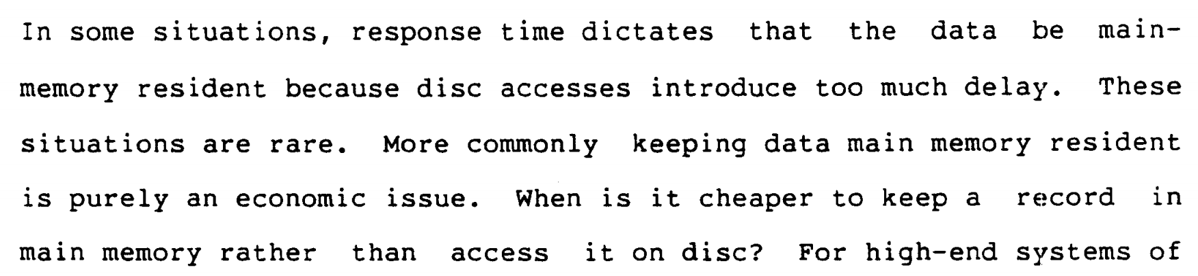
Five Minute Rule
CS 245
Notes 2

Slide 52
Five Minute Rule
Say a page is accessed every X seconds
CD = cost if we keep that page on disk
  $D = cost of disk unit
  I = numbers IOs that unit can perform
  In X seconds, unit can do XI IOs
  So CD = $D / XI
CS 245
Notes 2

Slide 53
Five Minute Rule
Say a page is accessed every X seconds
CM = cost if we keep that page on RAM
  $M = cost of 1 MB of RAM
  P = numbers of pages in 1 MB RAM
  So CM = $M / P
CS 245
Notes 2

Slide 54
Five Minute Rule
Say a page is accessed every X seconds
If CD is smaller than CM,
  keep page on disk
  else keep in memory
Break even point when CD = CM, or
$D P
I $M
X =
CS 245
Notes 2

Slide 55
Using ‘97 Numbers
P = 128 pages/MB (8KB pages)
I = 64 accesses/sec/disk
$D = 2000 dollars/disk (9GB + controller)
$M = 15 dollars/MB of DRAM
X = 266 seconds (about 5 minutes)
(did not change much from 85 to 97)
CS 245
Notes 2

Slide 56
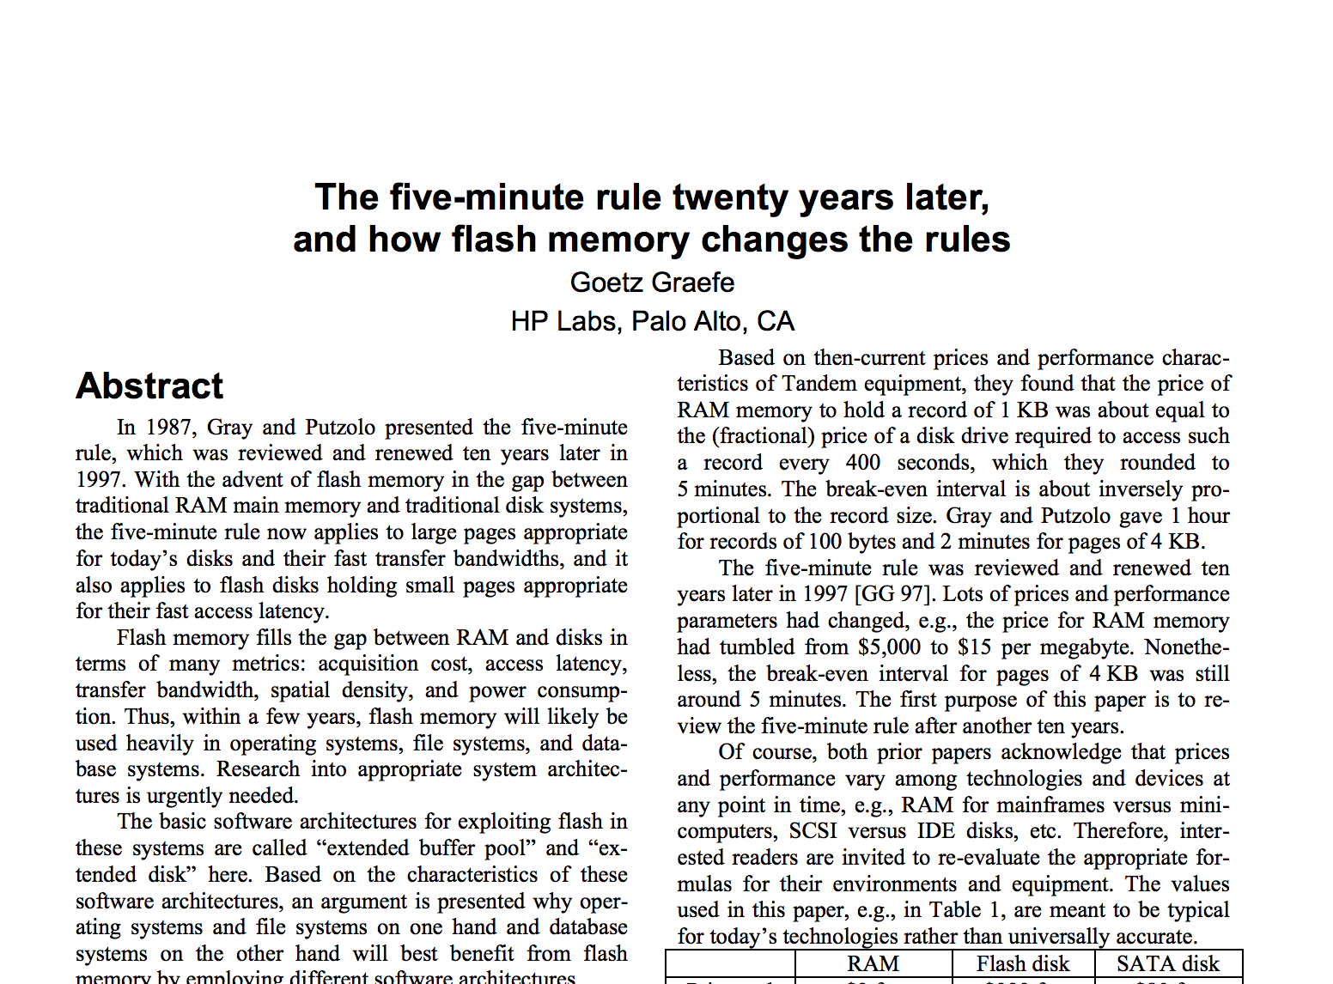
1KB pages, 2007: ~6 hours HDD-DRAM
CS 245
Notes 2

Slide 57
Disk Failures (Sec 2.5)
Partial → Total
Intermittent → Permanent
CS 245
Notes 2

Slide 58
Coping with Disk Failures
Detection
  e.g. Checksum
Correction
  ⇒ Redundancy
CS 245
Notes 2

Slide 59
At what level do we cope?
Single Disk
  e.g., Error Correcting Codes
Disk Array
Logical
Physical
CS 245
Notes 2

Slide 60
Operating System e.g., Stable Storage
Logical Block Copy A Copy B
CS 245
Notes 2

Slide 61
Database System
e.g.,
Log
Current DB Last week’s DB
CS 245
Notes 2

Slide 62
Summary
Summary
Secondary storage, mainly disks
I/O times
I/Os should be avoided,
especially random ones…..
CS 245
Notes 2

Slide 63
Outline
Hardware: Disks
Access Times
Example: Megatron 747
Optimizations
Other Topics
  Storage Costs
  Using Secondary Storage
  Disk Failures
here
CS 245
Notes 2

