Slide 1
CS 245: Database System Principles
Notes 7: Query Optimization
Peter Bailis
CS 245
Notes 7

Slide 2
Query Optimization
--> Generating and comparing plans
Query
Generate Plans
Pruning x x
Estimate Cost
Cost
Select
Pick Min
CS 245
Notes 7

Slide 3
To generate plans consider:
Transforming relational algebra expression
        (e.g. order of joins)
Use of existing indexes
Building indexes or sorting on the fly
CS 245
Notes 7

Slide 4
Implementation details:
e.g. - Join algorithm
- Memory management
- Parallel processing
CS 245
Notes 7

Slide 5
Estimating IOs:
Count # of disk blocks that must be read (or written) to execute query plan
CS 245
Notes 7

Slide 6
To estimate costs, we may have additional parameters:
B(R) = # of blocks containing R tuples
f(R) = max # of tuples of R per block
M = # memory blocks available
CS 245
Notes 7

Slide 7
To estimate costs, we may have additional parameters:
B(R) = # of blocks containing R tuples
f(R) = max # of tuples of R per block
M = # memory blocks available
HT(i) = # levels in index i
LB(i) = # of leaf blocks in index i
CS 245
Notes 7

Slide 8
Clustering index
Index that allows tuples to be read in an order that corresponds to physical order
A
10
15
A
index
17
19
35
37
CS 245
Notes 7

Slide 9
Notions of clustering
Clustered file organization
…..
Clustered relation
…..
Clustering index
R1 R2 S1 S2
R3 R4 S3 S4
R1 R2 R3 R4
R5 R5 R7 R8
CS 245
Notes 7

Slide 10
Example R1 R2 over common attribute C
T(R1) = 10,000
T(R2) = 5,000
S(R1) = S(R2) = 1/10 block
Memory available = 101 blocks
CS 245
Notes 7

Slide 11
Example R1 R2 over common attribute C
T(R1) = 10,000
T(R2) = 5,000
S(R1) = S(R2) = 1/10 block
Memory available = 101 blocks
→ Metric: # of IOs
(ignoring writing of result)
CS 245
Notes 7

Slide 12
Caution!
This may not be the best way to compare
ignoring CPU costs
ignoring timing
ignoring double buffering requirements
CS 245
Notes 7

Slide 13
Options
Transformations: R1 R2, R2 R1
Joint algorithms:
  Iteration (nested loops)
  Merge join
  Join with index
  Hash join
CS 245
Notes 7

Slide 14
Iteration join (conceptually)
for each r ∈ R1 do
for each s ∈ R2 do
if r.C = s.C then output r,s pair
CS 245
Notes 7

Slide 15
Merge join (conceptually)
  (1) if R1 and R2 not sorted, sort them
  (2) i ← 1; j ← 1;
  While (i ≤ T(R1)) ∧ (j ≤ T(R2)) do
  if R1{ i }.C = R2{ j }.C then outputTuples
  else if R1{ i }.C > R2{ j }.C then j ← j+1
  else if R1{ i }.C < R2{ j }.C then i ← i+1
CS 245
Notes 7

Slide 16
Procedure Output-Tuples
While (R1{ i }.C = R2{ j }.C) ∧ (i ≤ T(R1)) do
[jj ← j;
while (R1{ i }.C = R2{ jj }.C) ∧ (jj ≤ T(R2)) do
[output pair R1{ i }, R2{ jj };
jj ← jj+1 ]
i ← i+1 ]
CS 245
Notes 7

Slide 17
Example
i R1{i}.C R2{j}.C j
1 10 5 1
2 20 20 2
3 20 20 3
4 30 30 4
5 40 30 5
50 6
52 7
CS 245
Notes 7

Slide 18
Join with index (Conceptually)
For each r ∈ R1 do
[ X ← index (R2, C, r.C)
for each s ∈ X do
output r,s pair]
Assume R2.C index
Note: X ← index(rel, attr, value)
then X = set of rel tuples with attr = value
CS 245
Notes 7

Slide 19
Hash join (conceptual)
  Hash function h, range 0 → k
  Buckets for R1: G0, G1, ... Gk
  Buckets for R2: H0, H1, ... Hk
CS 245
Notes 7

Slide 20
Hash join (conceptual)
  Hash function h, range 0 → k
  Buckets for R1: G0, G1, ... Gk
  Buckets for R2: H0, H1, ... Hk
Algorithm
(1) Hash R1 tuples into G buckets
(2) Hash R2 tuples into H buckets
(3) For i = 0 to k do
match tuples in Gi, Hi buckets
CS 245
Notes 7

Slide 21
Simple example hash: even/odd
R1 R2 Buckets
2 5 Even
4 4 R1 R2
3 12 Odd:
5 3
8 13
9 8
11
14
2 4 8
4 12 8 14
3 5 9
5 3 13 11
CS 245
Notes 7

Slide 22
Factors that affect performance
(1) Tuples of relation stored
physically together?
(2) Relations sorted by join attribute?
(3) Indexes exist?
CS 245
Notes 7

Slide 23
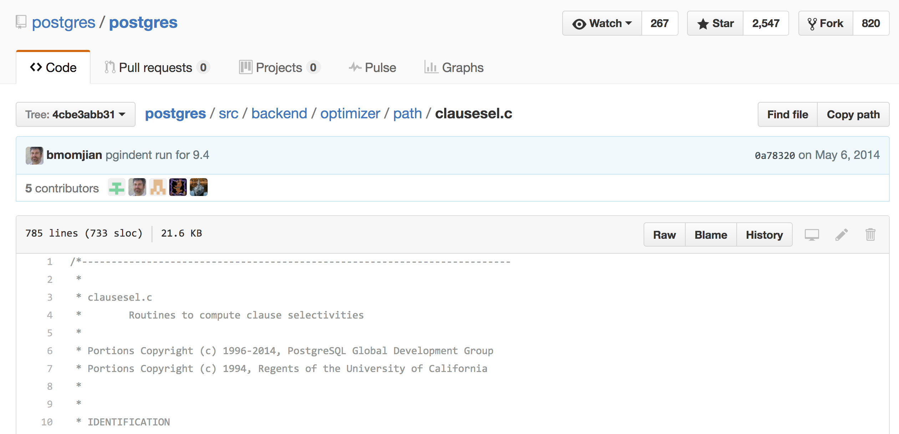
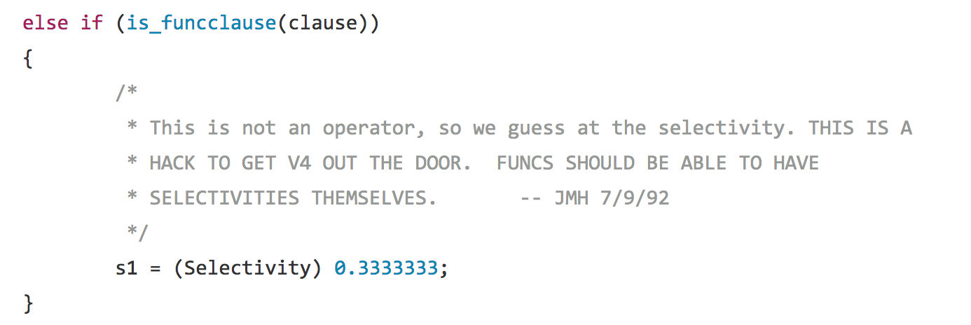
CS 245
Notes 7

Slide 24
pbailis@suna:/tmp/postgres/src/backend/optimizer/path$ git log --pretty=format:"%C(yellow)%h %Cblue%>(12)%ad %Cgreen%<(7)%aN%Cred%d %Creset%s" --abbrev-commit --date=relative .
181bdb9 2 days ago Heikki Linnakangas Fix typos in comments.
da08a65 11 days ago Robert Haas Refactor bitmap heap scan estimation of heap pages fetched.
d479e37 3 weeks ago Tom Lane Fix Assert failure induced by commit 215b43cdc.
69f4b9c 3 weeks ago Andres Freund Move targetlist SRF handling from expression evaluation to new executor node.
716c7d4 3 weeks ago Robert Haas Factor out logic for computing number of parallel workers.
215b43c 3 weeks ago Tom Lane Improve RLS planning by marking individual quals with security levels.
0777f7a 3 weeks ago Tom Lane Fix matching of boolean index columns to sort ordering.
0c2070c 4 weeks ago Robert Haas Fix cardinality estimates for parallel joins.
1d25779 5 weeks ago Bruce Momjian Update copyright via script for 2017
59649c3 7 weeks ago Robert Haas Refactor merge path generation code.
7fa93ee 7 weeks ago Tom Lane Fix FK-based join selectivity estimation for semi/antijoins.
41e2b84 2 months ago Tom Lane Fix bogus handling of JOIN_UNIQUE_OUTER/INNER cases for parallel joins.
d6c8b34 2 months ago Tom Lane Fix incorrect variable type in set_rel_consider_parallel().
6fa391b 3 months ago Tom Lane Avoid masking a function parameter name with a local variable name.
34ca090 3 months ago Tom Lane Adjust cost_merge_append() to reflect use of binaryheap_replace_first().
72daabc 4 months ago Tom Lane Disallow pushing volatile quals past set-returning functions.
a4c35ea 5 months ago Tom Lane Improve parser's and planner's handling of set-returning functions.
65a603e 6 months ago Tom Lane Guard against parallel-restricted functions in VALUES expressions.
da1c916 6 months ago Tom Lane Speed up planner's scanning for parallel-query hazards.
69995c3 7 months ago Tom Lane Fix cost_rescan() to account for multi-batch hashing correctly.
45639a0 7 months ago Tom Lane Avoid invalidating all foreign-join cached plans when user mappings change.
29a2195 7 months ago Tom Lane Typo fix.
110a6db 7 months ago Tom Lane Allow RTE_SUBQUERY rels to be considered parallel-safe.
4ea9948 7 months ago Tom Lane Fix up parallel-safety marking for appendrels.
2c6e647 7 months ago Tom Lane Allow treating TABLESAMPLE scans as parallel-safe.
c89d507 7 months ago Tom Lane Round rowcount estimate for a partial path to an integer.
3154e16 7 months ago Tom Lane Dodge compiler bug in Visual Studio 2013.
100340e 8 months ago Tom Lane Restore foreign-key-aware estimation of join relation sizes.
75be664 8 months ago Tom Lane Invent min_parallel_relation_size GUC to replace a hard-wired constant.
3303ea1 8 months ago Tom Lane Remove reltarget_has_non_vars flag.
4bc424b 8 months ago Robert Haas pgindent run for 9.6
b12fd41 8 months ago Robert Haas Don't generate parallel paths for rels with parallel-restricted outputs.
e415831 8 months ago Tom Lane Mop-up for parallel degree-ectomy.
c9ce4a1 8 months ago Robert Haas Eliminate "parallel degree" terminology.
77ba610 8 months ago Tom Lane Revert "Use Foreign Key relationships to infer multi-column join selectivity".
68d704e 9 months ago Robert Haas Minimal fix for crash bug in quals_match_foreign_key.
2a2435e 9 months ago Tom Lane Small improvements to OPTIMIZER_DEBUG code.
c45bf57 9 months ago Tom Lane Fix planner crash from pfree'ing a partial path that a GatherPath uses.
207d5a6 9 months ago Tom Lane Fix mishandling of equivalence-class tests in parameterized plans.
77cd477 10 months ago Robert Haas Enable parallel query by default.
9c75e1a 10 months ago Robert Haas Forbid parallel Hash Right Join or Hash Full Join.
8b99ede 10 months ago Teodor Sigaev Revert CREATE INDEX ... INCLUDING ...
386e3d7 10 months ago Teodor Sigaev CREATE INDEX ... INCLUDING (column[, ...])
25fe8b5 10 months ago Robert Haas Add a 'parallel_degree' reloption.
0711803 10 months ago Robert Haas Use quicksort, not replacement selection, for external sorting.
137805f 10 months ago Simon Riggs Use Foreign Key relationships to infer multi-column join selectivity

Slide 25
SLOC Directory SLOC-by-Language (Sorted)
142283 utils ansic=139092,perl=1984,lex=1155,sh=37,sed=15
80735 parser ansic=67069,yacc=11966,lex=1537,perl=163
60499 access ansic=60499
44886 commands ansic=44886
36147 optimizer ansic=36147
26147 executor ansic=26147
25750 snowball ansic=25750
23758 storage ansic=23714,perl=44
21665 catalog ansic=21142,perl=523
17386 nodes ansic=17386
13396 replication ansic=12681,lex=400,yacc=315
10924 postmaster ansic=10924
8776 regex ansic=8776
7728 libpq ansic=7728
7260 tsearch ansic=7260
6362 tcop ansic=6362
3990 rewrite ansic=3990
2932 port ansic=2831,asm=65,sh=36
2686 bootstrap ansic=2151,yacc=386,lex=149
1234 lib ansic=1234
CS 245
Notes 7

Slide 26
Example 1(a) Iteration Join R1 R2
Relations not contiguous
Recall T(R1) = 10,000 T(R2) = 5,000
S(R1) = S(R2) =1/10 block
MEM=101 blocks
CS 245
Notes 7

Slide 27
Example 1(a) Iteration Join R1 R2
Relations not contiguous
Recall T(R1) = 10,000 T(R2) = 5,000
S(R1) = S(R2) =1/10 block
MEM=101 blocks
Cost: for each R1 tuple:
[Read tuple + Read R2]
Total =10,000 [1+5000]=50,010,000 IOs
CS 245
Notes 7

Slide 28
Can we do better?
CS 245
Notes 7

Slide 29
Can we do better?
Use our memory
(1) Read 100 blocks of R1
(2) Read all of R2 (using 1 block) + join
(3) Repeat until done
CS 245
Notes 7

Slide 30
Cost: for each R1 chunk:
Read chunk: 1000 IOs
Read R2: 5000 IOs
6000
CS 245
Notes 7

Slide 31
Cost: for each R1 chunk:
Read chunk: 1000 IOs
Read R2: 5000 IOs
6000
Total = 10,000 x 6000 = 60,000 IOs
1,000
CS 245
Notes 7

Slide 32
Can we do better?
CS 245
Notes 7

Slide 33
Can we do better?
 Reverse join order: R2 R1
Total = 5000 x (1000 + 10,000) =
1000
5 x 11,000 = 55,000 IOs
CS 245
Notes 7

Slide 34
Example 1(b) Iteration Join R2 R1
Relations contiguous
CS 245
Notes 7

Slide 35
Example 1(b) Iteration Join R2 R1
Relations contiguous
Cost
For each R2 chunk:
Read chunk: 100 IOs
Read R1: 1000 IOs
1,100
Total= 5 chunks x 1,100 = 5,500 IOs
CS 245
Notes 7

Slide 36
Example 1(c) Merge Join
Both R1, R2 ordered by C; relations contiguous
Memory
…..
R1
R1
R2
…..
R2
CS 245
Notes 7

Slide 37
Example 1(c) Merge Join
Both R1, R2 ordered by C; relations contiguous
Memory
…..
R1
R1
R2
…..
R2
Total cost: Read R1 cost + read R2 cost
= 1000 + 500 = 1,500 IOs
CS 245
Notes 7

Slide 38
Example 1(d) Merge Join
R1, R2 not ordered, but contiguous
--> Need to sort R1, R2 first…. HOW?
CS 245
Notes 7

Slide 39
One way to sort: Merge Sort
(i) For each 100 blk chunk of R:
- Read chunk
- Sort in memory
- Write to disk
sorted
chunks
Memory
R1
...
R2
CS 245
Notes 7

Slide 40
(ii) Read all chunks + merge + write out
Sorted file Memory Sorted
Chunks
...
...
CS 245
Notes 7

Slide 41
Cost: Sort
Each tuple is read,written,
read, written
so...
Sort cost R1: 4 x 1,000 = 4,000
Sort cost R2: 4 x 500 = 2,000
CS 245
Notes 7

Slide 42
Example 1(d) Merge Join (continued)
R1,R2 contiguous, but unordered
Total cost = sort cost + join cost
= 6,000 + 1,500 = 7,500 IOs
CS 245
Notes 7

Slide 43
Example 1(d) Merge Join (continued)
R1,R2 contiguous, but unordered
Total cost = sort cost + join cost
= 6,000 + 1,500 = 7,500 IOs
But: Iteration cost = 5,500
so merge join does not pay off!
CS 245
Notes 7

Slide 44
But say R1 = 10,000 blocks contiguous
R2 = 5,000 blocks not ordered
Iterate: 5000 x (100+10,000) = 50 x 10,100
100
= 505,000 IOs
Merge join: 5(10,000+5,000) = 75,000 IOs
Merge Join (with sort) WINS!
CS 245
Notes 7

Slide 45
How much memory do we need for merge sort?
E.g: Say I have 10 memory blocks
10
100 chunks ⇒ to merge, need
100 blocks!
R1
...
CS 245
Notes 7

Slide 46
In general:
Say k blocks in memory
x blocks for relation sort
# chunks = (x/k) size of chunk = k
CS 245
Notes 7

Slide 47
In general:
Say k blocks in memory
x blocks for relation sort
# chunks = (x/k) size of chunk = k
# chunks < buffers available for merge
CS 245
Notes 7

Slide 48
In general:
Say k blocks in memory
x blocks for relation sort
# chunks = (x/k) size of chunk = k
# chunks < buffers available for merge
so... (x/k) ≤ k
or k² ≥ x or k ≥ √x
CS 245
Notes 7

Slide 49
In our example
R1 is 1000 blocks, k ≥ 31.62
R2 is 500 blocks, k ≥ 22.36
Need at least 32 buffers
CS 245
Notes 7

Slide 50
Can we improve on merge join?
Hint: do we really need the fully sorted files?
R1
Join?
R2
sorted runs
CS 245
Notes 7

Slide 51
Cost of improved merge join:
C = Read R1 + write R1 into runs
+ read R2 + write R2 into runs
+ join
= 2000 + 1000 + 1500 = 4500
--> Memory requirement?
CS 245
Notes 7

Slide 52
Example 1(e) Index Join
Assume R1.C index exists; 2 levels
Assume R2 contiguous, unordered
Assume R1.C index fits in memory
CS 245
Notes 7

Slide 53
Cost: Reads: 500 IOs
for each R2 tuple:
- probe index - free
- if match, read R1 tuple: 1 IO
CS 245
Notes 7

Slide 54
What is expected # of matching tuples?
(a) say R1.C is key, R2.C is foreign key
then expect = 1
(b) say V(R1,C) = 5000, T(R1) = 10,000
with uniform assumption
expect = 10,000/5,000 = 2
CS 245
Notes 7

Slide 55
What is expected # of matching tuples?
(c) Say DOM(R1, C)=1,000,000
T(R1) = 10,000
with alternate assumption
Expect = 10,000 = 1
1,000,000 100
CS 245
Notes 7

Slide 56
Total cost with index join
(a) Total cost = 500+5000(1)1 = 5,500
(b) Total cost = 500+5000(2)1 = 10,500
(c) Total cost = 500+5000(1/100)1=550
CS 245
Notes 7

Slide 57
What if index does not fit in memory?
Example: say R1.C index is 201 blocks
Keep root + 99 leaf nodes in memory
Expected cost of each probe is
E = (0)99 + (1)101 ≈ 0.5
200 200
CS 245
Notes 7

Slide 58
Total cost (including probes)
= 500+5000 [Probe + get records]
= 500+5000 [0.5+2] uniform assumption
= 500+12,500 = 13,000 (case b)
CS 245
Notes 7

Slide 59
Total cost (including probes)
= 500+5000 [Probe + get records]
= 500+5000 [0.5+2] uniform assumption
= 500+12,500 = 13,000 (case b)
For case (c):
= 500+5000[0.5 × 1 + (1/100) × 1]
= 500+2500+50 = 3050 IOs
CS 245
Notes 7

Slide 60
So far
Iterate R2 R1 55,000 (best)
Merge Join _______
Sort+ Merge Join _______
R1.C Index _______
R2.C Index _______
Iterate R2 R1 5500
Merge join 1500
Sort+Merge Join 7500 → 4500
R1.C Index 5500 → 3050 → 550
R2.C Index ________
not
contiguous
contiguous
CS 245
Notes 7

Slide 61
Example 1(f) Hash Join
R1, R2 contiguous (un-ordered)
→ Use 100 buckets
→ Read R1, hash, + write buckets
R1 →
100
...
...
10 blocks
CS 245
Notes 7

Slide 62
-> Same for R2
-> Read one R1 bucket; build memory hash table
-> Read corresponding R2 bucket + hash probe
R1
R2
R1
...
...
memory
 Then repeat for all buckets
CS 245
Notes 7

Slide 63
Cost:
“Bucketize:” Read R1 + write
Read R2 + write
Join: Read R1, R2
Total cost = 3 x [1000+500] = 4500
CS 245
Notes 7

Slide 64
Cost:
“Bucketize:” Read R1 + write
Read R2 + write
Join: Read R1, R2
Total cost = 3 x [1000+500] = 4500
Note: this is an approximation since
buckets will vary in size and
we have to round up to blocks
CS 245
Notes 7

Slide 65
Minimum memory requirements:
Size of R1 bucket = (x/k)
m = number of memory buffers
x = number of R1 blocks
So... (x/m) < k
m > √x need: k+1 total memory
buffers
CS 245
Notes 7

Slide 66
Trick: keep some buckets in memory
E.g., k’=33 R1 buckets = 31 blocks
keep 2 in memory
memory
in
G0
R1
31
G1
33-2=31
...
called hybrid hash-join
CS 245
Notes 7

Slide 67
Trick: keep some buckets in memory
E.g., k’=33 R1 buckets = 31 blocks
keep 2 in memory
memory
Memory use:
G0 31 buffers
G1 31 buffers
Output 33-2 buffers
R1 input 1
Total 94 buffers
6 buffers to spare!!
in
G0
R1
31
G1
33-2=31
...
called hybrid hash-join
CS 245
Notes 7

Slide 68
Next: Bucketize R2
  R2 buckets =500/33= 16 blocks
  Two of the R2 buckets joined immediately with G0,G1
memory
R2 buckets
R1 buckets
in
G0
R2
16
31
G1
33-2=31
33-2=31
...
...
CS 245
Notes 7

Slide 69
Finally: Join remaining buckets
  for each bucket pair:
    read one of the buckets into memory
    join with second bucket
memory
one full R2
bucket
R2 buckets
R1 buckets
out
ans
Gi
16
31
one R1
buffer
33-2=31
33-2=31
...
...
CS 245
Notes 7

Slide 70
Cost
Bucketize R1 = 1000+31×31=1961
To bucketize R2, only write 31 buckets: so, cost = 500+31×16=996
To compare join (2 buckets already done) read 31×31+31×16=1457
Total cost = 1961+996+1457 = 4414
CS 245
Notes 7

Slide 71
How many buckets in memory?
memory
memory
in
G0
in
G0
R1
R1
G1
?
OR...
 See textbook for answer...
CS 245
Notes 7

Slide 72
Another hash join trick:
Only write into buckets <val,ptr> pairs
When we get a match in join phase, must fetch tuples
CS 245
Notes 7

Slide 73
To illustrate cost computation, assume:
  100 <val,ptr> pairs/block
  expected number of result tuples is 100
CS 245
Notes 7

Slide 74
To illustrate cost computation, assume:
  100 <val,ptr> pairs/block
  expected number of result tuples is 100
Build hash table for R2 in memory 5000 tuples → 5000/100 = 50 blocks
Read R1 and match
Read ~ 100 R2 tuples
CS 245
Notes 7

Slide 75
To illustrate cost computation, assume:
  100 <val,ptr> pairs/block
  expected number of result tuples is 100
Build hash table for R2 in memory 5000 tuples → 5000/100 = 50 blocks
Read R1 and match
Read ~ 100 R2 tuples
Total cost = Read R2: 500
Read R1: 1000
Get tuples: 100
1600
CS 245
Notes 7

Slide 76
So far:
Iterate 5500
Merge join 1500
Sort+merge joint 7500
R1.C index 5500 → 550
R2.C index _____
Build R.C index _____
Build S.C index _____
Hash join 4500+
with trick,R1 first 4414
with trick,R2 first _____
Hash join, pointers 1600
contiguous
CS 245
Notes 7

Slide 77
Summary
Iteration ok for “small” relations (relative to memory size)
For equi-join, where relations not sorted and no indexes exist, hash join usually best
CS 245
Notes 7

Slide 78
Sort + merge join good for non-equi-join (e.g., R1.C > R2.C)
If relations already sorted, use merge join
If index exists, it could be useful
(depends on expected result size)
CS 245
Notes 7

Slide 79
Join strategies for parallel processors
Later on….
CS 245
Notes 7

Slide 80
Chapter 16 [16] summary
Relational algebra level
Detailed query plan level
  Estimate costs
  Generate plans
    Join algorithms
  Compare costs
CS 245
Notes 7

Slide 81
What are the data items we want to store?
a salary
a name
a date
a picture
CS 245
Notes 3

Slide 82
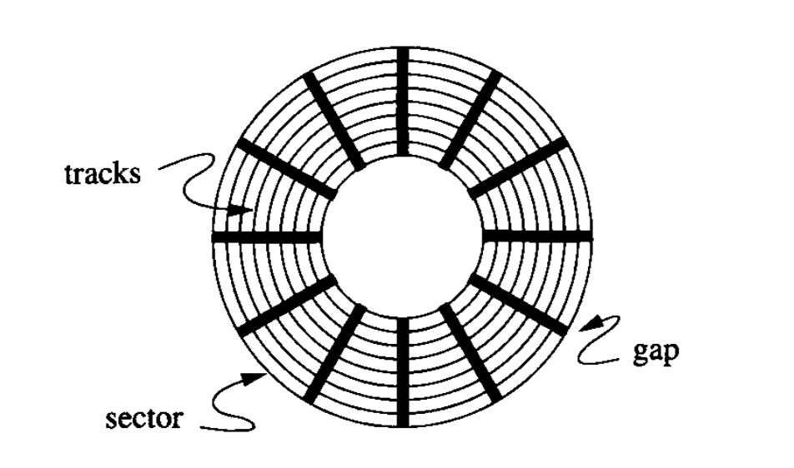
CS 245
Notes 2

Slide 83
Rule of Random I/O: Expensive
Thumb Sequential I/O: Much less
CS 245
Notes 2

Slide 84
Overview
Data Items
Records
Blocks
Files
Memory
CS 245
Notes 3

Slide 85
What are the data items we want to store?
a salary
a name
a date
a picture
CS 245
Notes 3

Slide 86
Types of records:
Main choices:
  FIXED vs VARIABLE FORMAT
  FIXED vs VARIABLE LENGTH
CS 245
Notes 3

Slide 87
Buffer Management
DB features needed
Why LRU may be bad Read
Pinned blocks Textbook!
Forced output
Double buffering
Swizzling
in Notes02
CS 245
Notes 3

Slide 88
Row vs Column Store
Advantages of Column Store
  more compact storage (fields need not start at byte boundaries)
  efficient reads on data mining operations
Advantages of Row Store
  writes (multiple fields of one record)more efficient
  efficient reads for record access (OLTP)
CS 245
Notes 3

Slide 89
Dense Index
Sequential File
10
10
20
20
30
30
40
40
50
60
50
70
60
80
70
90
80
100
90
110
100
120
CS 245
Notes 4

Slide 90
Sparse 2nd level
Sequential File
10
10
10
90
30
20
170
50
30
250
70
40
90
330
50
110
410
60
130
490
150
570
70
170
80
190
90
210
100
230
CS 245
Notes 4

Slide 91
B+Tree Example n=3
Root
100
30
120
150
180
3
5
11
30
35
100
101
110
120
130
150
156
179
180
200
CS 245
Notes 4

Slide 92
SQL query
parse
parse tree
convert
answer
logical query plan
execute
apply rules
statistics
Pi
“improved” l.q.p
pick best
estimate result sizes
l.q.p. +sizes
{(P1,C1),(P2,C2)...}
consider physical plans
estimate costs
{P1,P2,…..}
CS 245
Notes 6

