Slide 1
CS 245: Database System Principles
Review Notes
Peter Bailis
CS 245
Notes 4

Slide 2
Isn’t Implementing a Database System Simple?
Relations
Statements
Results
CS 245
Notes 1

Slide 3
Course Overview
File & System Structure
Records in blocks, dictionary, buffer management,…
Indexing & Hashing
B-Trees, hashing,…
Query Processing
Query costs, join strategies,…
Crash Recovery
Failures, stable storage,…
CS 245
Notes 1

Slide 4
Course Overview
Concurrency Control
Correctness, locks,…
Transaction Processing
Logs, deadlocks,…
Distributed Databases
Interoperation, distributed recovery,…
CS 245
Notes 1

Slide 5
PART II
Crash recovery (2 lectures) Ch.17[17]
Transaction processing (3 lects) Ch.18-19[18-19]
Advanced topics (1-2 lects):
  Distributed and parallel databases
  Systems for ML + data science
CS 245
Notes 08

Slide 6
Integrity or correctness of data
Would like data to be “accurate” or “correct” at all times
EMP
Name
Age
White
Green
Gray
52
3421
1
CS 245
Notes 08

Slide 7
Integrity or consistency constraints
Predicates data must satisfy
Examples:
  - x is key of relation R
  - x → y holds in R
  - Domain(x) = {Red, Blue, Green}
  − α is valid index for attribute x of R
  - no employee should make more than twice the average salary
CS 245
Notes 08

Slide 8
Definition:
Consistent state: satisfies all constraints
Consistent DB: DB in consistent state
CS 245
Notes 08

Slide 9
Constraints (as we use here) may not capture “full correctness”
Example 1 Transaction constraints
When salary is updated,
new salary > old salary
When account record is deleted,
balance = 0
CS 245
Notes 08

Slide 10
One solution: undo logging (immediate
modification)
CS 245
Notes 08

Slide 11
Undo logging (Immediate modification)
T1: Read (A,t); t ← t×2 A=B
Write (A,t);
Read (B,t); t ← t×2
Write (B,t);
Output (A);
Output (B);
A:8
B:8
A:8
B:8
memory
disk
log
CS 245
Notes 08

Slide 12
Undo logging (Immediate modification)
T1: Read (A,t); t ← t×2 A=B
Write (A,t);
Read (B,t); t ← t×2
Write (B,t);
Output (A);
Output (B);
<T1, start>
<T1, A, 8>
A:8
B:8
A:8
B:8
16
16
memory
disk
log
CS 245
Notes 08

Slide 13
Undo logging (Immediate modification)
T1: Read (A,t); t ← t×2 A=B
Write (A,t);
Read (B,t); t ← t×2
Write (B,t);
Output (A);
Output (B);
<T1, start>
<T1, A, 8>
A:8
B:8
A:8
B:8
16
16
16
<T1, B, 8>
memory
disk
log
CS 245
Notes 08

Slide 14
Undo logging (Immediate modification)
T1: Read (A,t); t ← t×2 A=B
Write (A,t);
Read (B,t); t ← t×2
Write (B,t);
Output (A);
Output (B);
<T1, start>
<T1, A, 8>
A:8
B:8
A:8
B:8
16
16
16
<T1, B, 8>
16
memory
disk
log
CS 245
Notes 08

Slide 15
Undo logging (Immediate modification)
T1: Read (A,t); t ← t×2 A=B
Write (A,t);
Read (B,t); t ← t×2
Write (B,t);
Output (A);
Output (B);
<T1, start>
<T1, A, 8>
A:8
B:8
A:8
B:8
16
16
16
<T1, B, 8>
16
<T1, commit>
memory
disk
log
CS 245
Notes 08

Slide 16
One “complication”
Log is first written in memory
Not written to disk on every action
memory
DB
Log
A: 8
B: 8
A: 8 16
B: 8 16
Log:
<T1,start>
<T1, A, 8>
<T1, B, 8>
CS 245
Notes 08

Slide 17
Undo logging rules
(1) For every action generate undo log record (containing old value)
(2) Before x is modified on disk, log records pertaining to x must be
on disk (write ahead logging: WAL)
(3) Before commit is flushed to log, all writes of transaction must be
reflected on disk
CS 245
Notes 08

Slide 18
Recovery rules: Undo logging
(1) Let S = set of transactions with <Ti, start> in log, but no
<Ti, commit> (or <Ti, abort>) record in log
(2) For each <Ti, X, v> in log,
in reverse order (latest → earliest) do:
- if Ti ∈ S then - write (X, v)
- output (X)
(3) For each Ti ∈ S do
- write <Ti, abort> to log
CS 245
Notes 08

Slide 19
Need to write abort records in order!
Can writes of <Ti, abort> records
be done in any order (in Step 3)?
  Example: T1 and T2 both write A
  T1 executed before T2
  T1 and T2 both rolled-back
  <T1, abort> written but NOT <T2, abort>?
  <T2, abort> written but NOT <T1, abort>?
T1 write A
time/log
T2 write A
CS 245
Notes 08

Slide 20
What if failure during recovery?
No problem! Undo idempotent
CS 245
Notes 08

Slide 21
Redo logging (deferred modification)
T1: Read(A,t); t t×2; write (A,t);
Read(B,t); t t×2; write (B,t);
Output(A); Output(B)
A: 8
B: 8
A: 8
B: 8
memory
DB
LOG
CS 245
Notes 08

Slide 22
Redo logging (deferred modification)
T1: Read(A,t); t t×2; write (A,t);
Read(B,t); t t×2; write (B,t);
Output(A); Output(B)
<T1, start>
<T1, A, 16>
<T1, B, 16>
<T1, commit>
A: 8
B: 8
A: 8
B: 8
16
16
memory
DB
LOG
CS 245
Notes 08

Slide 23
Redo logging (deferred modification)
T1: Read(A,t); t t×2; write (A,t);
Read(B,t); t t×2; write (B,t);
Output(A); Output(B)
<T1, start>
<T1, A, 16>
<T1, B, 16>
<T1, commit>
A: 8
B: 8
output
A: 8
B: 8
16
16
16
16
memory
DB
LOG
CS 245
Notes 08

Slide 24
Redo logging (deferred modification)
T1: Read(A,t); t t×2; write (A,t);
Read(B,t); t t×2; write (B,t);
Output(A); Output(B)
<T1, start>
<T1, A, 16>
<T1, B, 16>
<T1, commit>
A: 8
B: 8
output
A: 8
B: 8
16
16
16
16
<T1, end>
memory
DB
LOG
CS 245
Notes 08

Slide 25
Redo logging rules
(1) For every action, generate redo log
record (containing new value)
(2) Before X is modified on disk (DB), all log records for transaction that modified X (including commit) must
be on disk
(3) Flush log at commit
(4) Write END record after DB updates
flushed to disk
CS 245
Notes 08

Slide 26
Key drawbacks:
Undo logging: cannot bring backup DB copies up to date
Redo logging: need to keep all modified blocks in memory until commit
CS 245
Notes 08

Slide 27
Solution: undo/redo logging!
Update ⇒ <Ti, Xid, New X val, Old X val>
page X
CS 245
Notes 08

Slide 28
Rules
Page X can be flushed before or after Ti commit
Log record flushed before corresponding updated page
  called “write ahead logging”
Flush log at commit
CS 245
Notes 08

Slide 29
Recovery process:
Analysis pass (backwards from end of log)
  construct set S of committed transactions
Forward pass (redo)
  redo actions of committed transactions in S
Backward pass (undo)
  undo actions of uncommitted transactions
CS 245
Notes 08

Slide 30
Example: Undo/Redo logging what to do at recovery?
log (disk):
<checkpoint>
<T1, A, 10, 15>
<T1, B, 20, 23>
<T1, commit>
<T2, C, 30, 38>
<T2, D, 40, 41>
Crash
...
...
...
...
...
...
CS 245
Notes 08
Notes:
T1 committed, so write A=15, B=23 to main memory / disk; T2 did not commit, so roll back and set C=38, D=41

Slide 31
Non-quiesce checkpoint
L
O
G
for
undo dirty buffer
pool pages
flushed
Start-ckpt
active TR:
Ti,T2,...
end
ckpt
...
...
...
...
CS 245
Notes 08
Notes:
If we’re running transactions, we may not want to halt everything; can instead have some “dirty records” in the log

Slide 32
Non-quiesce checkpoint
memory
checkpoint process:
for i := 1 to M do
output(buffer i)
[transactions run concurrently]
CS 245
Notes 08

Slide 33
Examples what to do at recovery time?
no T1 commit
L
O
G
...
T1,-
a
...
Ckpt
T1
...
Ckpt
end
...
T1-
b
CS 245
Notes 08
Notes:
No commit for T1? has to be undone

Slide 34
Examples what to do at recovery time?
no T1 commit
L
O
G
...
T1,-
a
...
Ckpt
T1
...
Ckpt
end
...
T1-
b
☒ Undo T1 (undo a,b)
CS 245
Notes 08

Slide 35
Example
L
O
G
...
T1
a
...
ckpt-s
T1
...
T1
b
...
ckpt-
end
...
T1
c
...
T1
cmt
...
CS 245
Notes 08
Notes:
no matter what, write to a was reflected in memory, so we can ignore writing it out
can’t guarantee whether b or c are done, so need to redo them

Slide 36
Recover From Valid Checkpoint:
L
O
G
...
ckpt
start
...
ckpt
end
...
T1
b
...
ckpt-
start
...
T1
c
...
start
of latest
valid
checkpoint
CS 245
Notes 08
Notes:
later checkpoint didn’t complete, so only use the most recent complete checkpoint.

Slide 37
Concepts
Transaction: sequence of ri(x), wi(x) actions
Conflicting actions: r1(A) w2(A) w1(A)
w2(A) r1(A) w2(A)
Schedule: represents chronological order in which actions are executed
Serial schedule: no interleaving of actions or transactions
CS 245
Notes 09

Slide 38
Definition
S1, S2 are conflict equivalent schedules
if S1 can be transformed into S2 by a series of “swaps” on non-conflicting actions.
(can reorder non-conflicting operations in S1 to obtain S1)
CS 245
Notes 09

Slide 39
Definition
A schedule is conflict serializable if it is conflict equivalent to some serial schedule.
key idea:
conflicts “change” result of reads and writes
conflict serializable: there exists some equivalent serial execution that does not change the effects
CS 245
Notes 09

Slide 40
Precedence graph P(S) (S is schedule)
Nodes: transactions in S
Arcs: Ti → Tj whenever
- pi(A), qj(A) are actions in S
- pi(A) <_{S} qj(A)
- at least one of pi, qj is a write
CS 245
Notes 09

Slide 41
Exercise:
What is P(S) for
S = w3(A) w2(C) r1(A) w1(B) r1(C) w2(A) r4(A) w4(D)
Is S serializable?
CS 245
Notes 09
Notes:
look at variables first
3 writes A, 1 reads A, so T3 -> T1 // 1 reads A, 2 writes A, so T1 -> T2 // and also, T3-> T1, but arcs are transitive // and also 4 reads A, so T2 -> T4
B has no conflicts, so we’re done, and C has T2 -> T1
so we have a cycle! we will prove shortly that it is the case

Slide 42
How to enforce serializable schedules?
Option 1: run system, recording P(S); at end of day, check for P(S) cycles and declare if execution was good
CS 245
Notes 09
Notes:
we call this an optimistic method

Slide 43
How to enforce serializable schedules?
Option 2: prevent P(S) cycles from occurring
T1 T2 ….. Tn
Scheduler
DB
CS 245
Notes 09
Notes:
we call this a pessimistic schedule

Slide 44
Rule #3: Two phase locking (2PL) for transactions
Ti = ……. li(A) ………... ui(A) ……...
no unlocks no locks
CS 245
Notes 09

Slide 45
# locks
held by
Ti
Time
Growing Shrinking
Phase Phase
CS 245
Notes 09
Notes:
rule: once we unlock (begin to “shrink”, cannot lock anymore)

Slide 46
2PL subset of Serializable
Serializable
2PL
CS 245
Notes 09

Slide 47
S1: w1(x) w3(x) w2(y) w1(y)
Serializable
2PL
S1
CS 245
Notes 09

Slide 48
Beyond this simple 2PL protocol, it is all a matter of improving performance and allowing more concurrency….
  Shared locks
  Multiple granularity
  Inserts, deletes and phantoms
  Other types of C.C. mechanisms
CS 245
Notes 09

Slide 49
Shared locks
So far:
S = ...l1(A) r1(A) u1(A) … l2(A) r2(A) u2(A) …
Do not conflict
CS 245
Notes 09

Slide 50
A way to summarize Rule #2
Compatibility matrix
Comp S X
S true false
X false false
CS 245
Notes 09

Slide 51
Rule # 3 2PL transactions
No change except for upgrades:
(I) If upgrade gets more locks
(e.g., S → {S, X}) then no change!
(II) If upgrade releases read (shared) lock (e.g., S → X)
- can be allowed in growing phase
CS 245
Notes 09

Slide 52
Sample Locking System:
(1) Don’t trust transactions to request/release locks
(2) Hold all locks until transaction commits
#
locks
time
CS 245
Notes 09

Slide 53
Lock table Conceptually
If null, object is unlocked
A
Λ
B
Lock info for B
C
Lock info for C
Λ
Every possible object
...
CS 245
Notes 09

Slide 54
Multiple granularity
Comp Requestor
IS IX S SIX X
IS
Holder IX
S
SIX
X
CS 245
Notes 09

Slide 55
Multiple granularity
Comp Requestor
IS IX S SIX X
IS
Holder IX
S
SIX
X
T
T
T
T
F
T
T
F
F
F
T
F
T
F
F
T
F
F
F
F
F
F
F
F
F
CS 245
Notes 09

Slide 56
Parent Child can be locked
locked in by same transaction in
IS
IX
S
SIX
X
IS, S
IS, S, IX, X, SIX
none
X, IX, [SIX]
none
P
C
not necessary
CS 245
Notes 09

Slide 57
Exercise:
Can T2 access object f3.1 in X mode? What locks will T2 get?
T1(IS)
R1
t1
T1(S)
t2
t4
t3
f2.1
f2.2
f3.1
f3.2
CS 245
Notes 09
Notes:
T2 gets ix on r1
T2 wants ix on t3
T2 gets X on f3.1

Slide 58
Still have a problem: Phantoms
Example: relation R (E#,name,…)
constraint: E# is key
use tuple locking
R E# Name ….
o1 55 Smith
o2 75 Jones
CS 245
Notes 09

Slide 59
Tree-like protocols are used typically for B-tree concurrency control
E.g., during insert, do not release parent lock, until you are certain child does not have to split
Root
CS 245
Notes 09

Slide 60
Example
all objects accessed
through root,
following pointers
T1 lock
A
B
C
T1 lock
T1 lock
D
E
F
 can we release A lock
if we no longer need A??
CS 245
Notes 09

Slide 61
Idea: traverse like “Monkey Bars”
T1 lock
A
B
C
T1 lock
D
E
F
CS 245
Notes 09

Slide 62
Validation
Transactions have 3 phases:
(1) Read
  all DB values read
  writes to temporary storage
  no locking
(2) Validate
  check if schedule so far is serializable
(3) Write
  if validate ok, write to DB
CS 245
Notes 09

Slide 63
Validation (also called optimistic concurrency control) is useful in some cases:
- Conflicts rare
- System resources plentiful
- Have real time constraints
CS 245
Notes 09

Slide 64
Replication
Store each data item on multiple nodes!
Question: how to read/write to them?
  Answers: primary-backup, quorums
  Use consensus to decide on configuration
CS 245
Notes 10

Slide 65
Primary-Backup
Elect one node “primary”
Store other copies on “backup”
Send operations to primary
Backup synchronization is either:
  Synchronous (write to backups before returning)
  Asynchronous (backups slightly stale)
CS 245
Notes 10

Slide 66
Quorum Replication
Read and write to intersecting sets of servers; no one “primary”
Common: majority quorum
Exotic: “grid” quorum (rarely used)
Surprise: primary-backup is a quorum too!
CS 245
Notes 10

Slide 67
Solution to failures:
Traditional DB: page the DBA
Distributed computing: use consensus
  Several algorithms: Paxos, Raft
  Today: many implementations
    Zookeeper, etcd, Doozer, Consul
  Idea: keep a reliable, distributed shared record of who is “primary”
CS 245
Notes 10

Slide 68
How many replicas?
In general, to survive F fail-stop failures, need F+1 replicas
Question: what if replicas fail arbitrarily? Adversarially?
CS 245
Notes 10

Slide 69
Partitioning
General problem:
  Databases are big!
  What if we don’t want to store the whole database on each server?
CS 245
Notes 10

Slide 70
Partitioning Strategies
Hash keys to servers
  Random “spray”
Partition keys by range
  Keys stored contiguously
What if servers fail (or we add servers)?
  Rebalance partitions (use consensus!)
Pros/cons of hash vs range partitioning?
CS 245
Notes 10

Slide 71
What about distributed txns?
Replication:
  Must make sure replicas stay up to date
  Need to reliably replicate commit log!
Partitioning:
  Must make sure all partitions commit/abort
  Need cross-partition concurrency control!
CS 245
Notes 10

Slide 72
Atomic Commitment
Informally: either all participants commit a transaction, or none do
“participants” = partitions involved in a given transaction
CS 245
Notes 10

Slide 73
Two Phase Commit (2PC)
Transaction coordinator sends prepare to each participating node
Each participating node responds to coordinator with prepared or no
If coordinator receives all prepared:
  Broadcast commit
If coordinator receives any no:
  Broadcast abort
CS 245
Notes 10

Slide 74
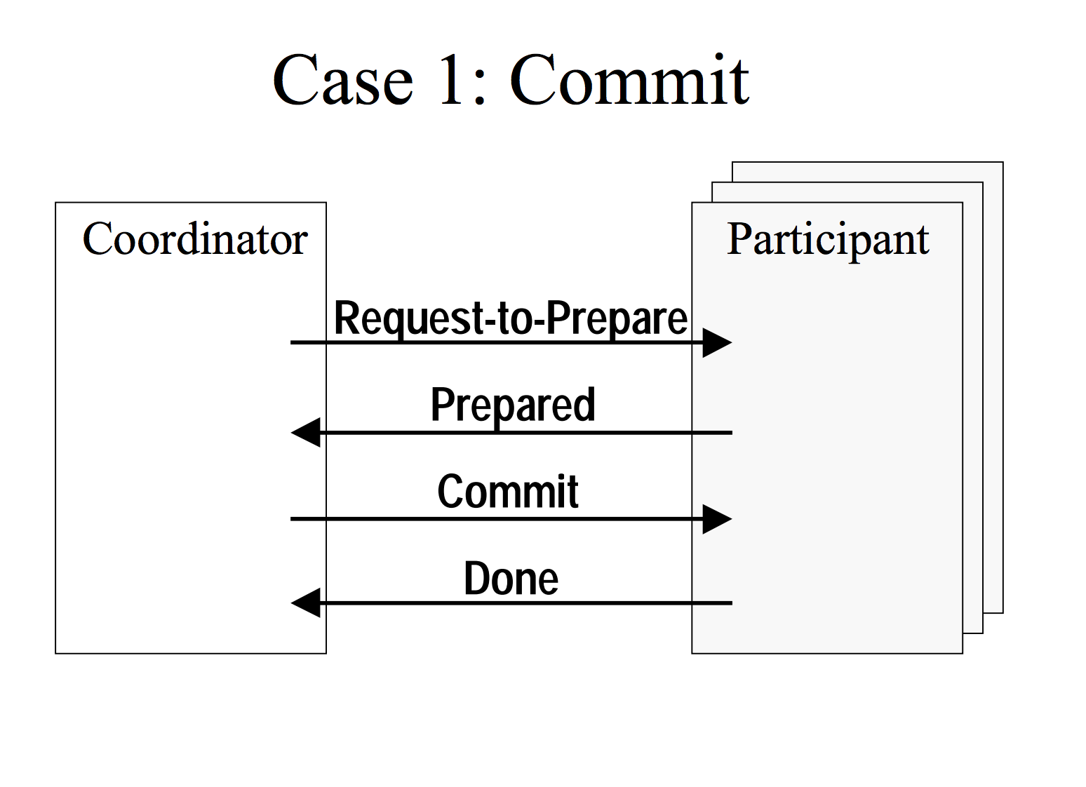

CS 245
Notes 10
UW CSE545

Slide 75
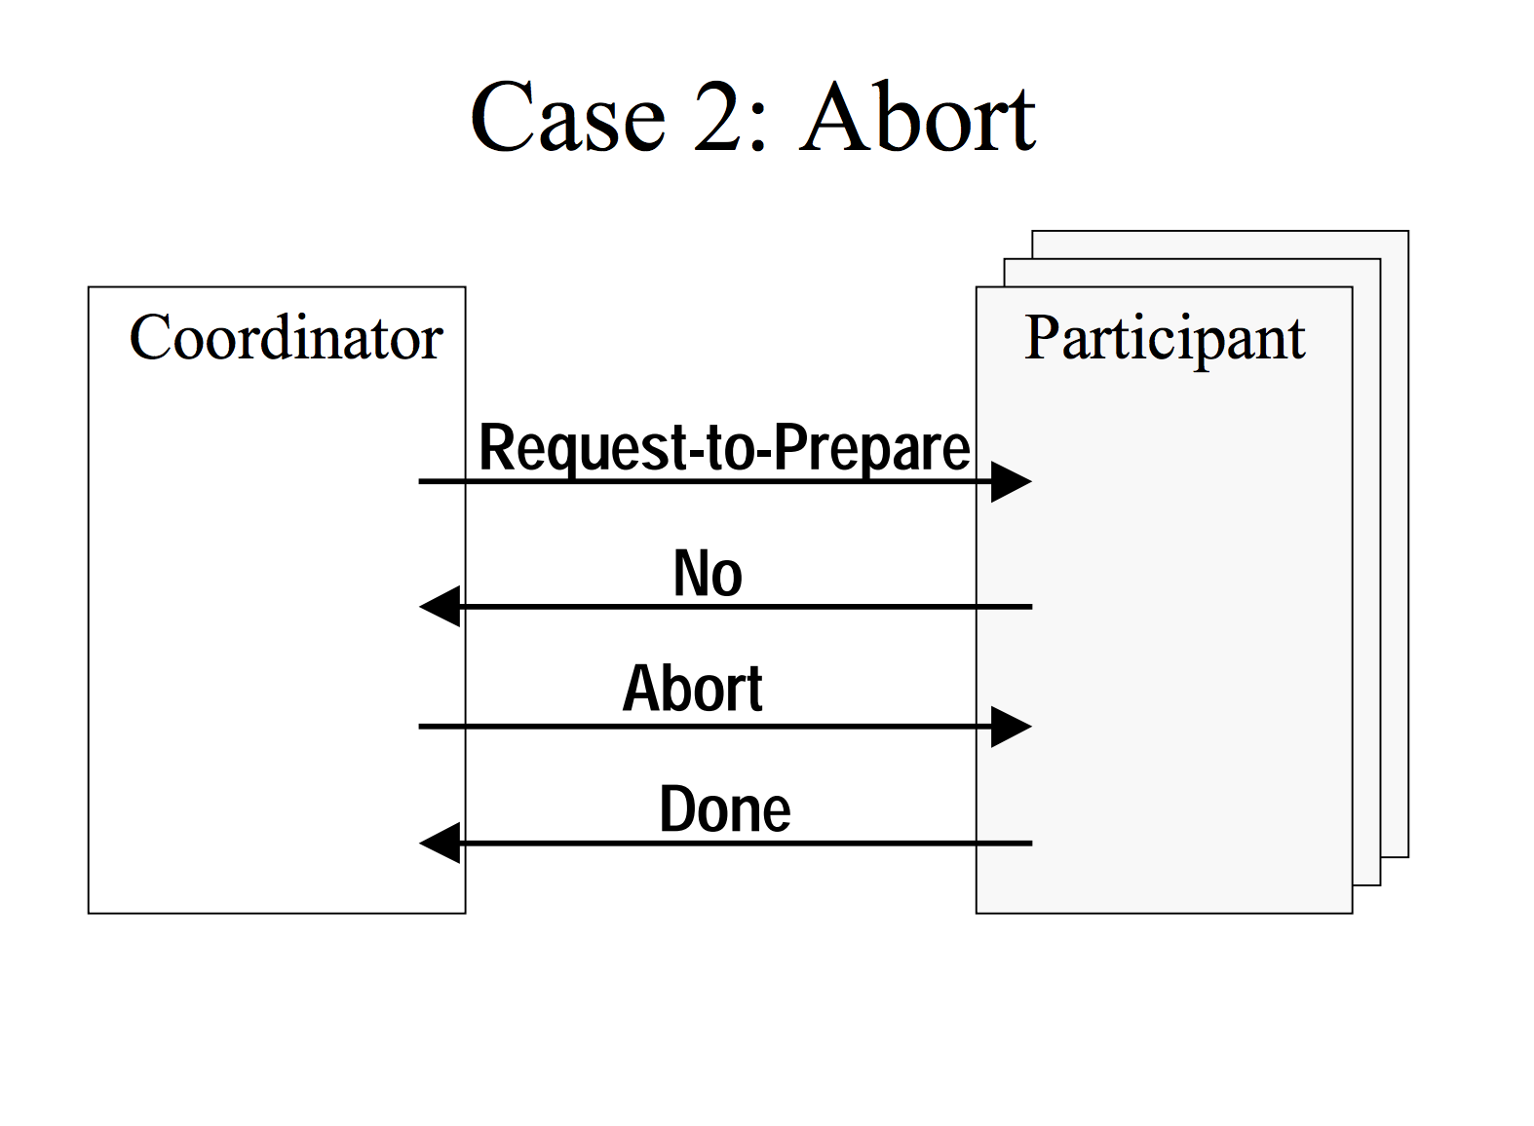
CS 245
Notes 10
UW CSE545

Slide 76
Two Phase Commit (2PC)
Transaction coordinator sends prepare to each participating node
Each participating node responds to coordinator with prepared or no
If coordinator receives all prepared:
  Broadcast commit
If coordinator receives any no:
  Broadcast abort
CS 245
Notes 10

Slide 77
CS 245
Notes 10
UW CSE545

Slide 78
CS 245
Notes 10
UW CSE545

Slide 79
What could go wrong?
  Coordinator
PREPARE
  Participant
  Participant
  Participant
CS 245
Notes 10

Slide 80
What could go wrong?
  Coordinator
PREPARED
What if we don’t
hear back?
PREPARED
  Participant
  Participant
  Participant
CS 245
Notes 10

Slide 81
What could go wrong?
  Coordinator
PREPARE
  Participant
  Participant
  Participant
CS 245
Notes 10

Slide 82
What could go wrong?
Coordinator does not reply!
PREPARED
PREPARED
PREPARED
  Participant
  Participant
  Participant
CS 245
Notes 10

Slide 83
What could go wrong?
  Coordinator
PREPARE
  Participant
  Participant
  Participant
CS 245
Notes 10

Slide 84
What could go wrong?
Coordinator does not reply!
No contact with
third
participant!
PREPARED
PREPARED
  Participant
  Participant
  Participant
CS 245
Notes 10

Slide 85
CAP Theorem
Choose either:
  Consistency and “Partition Tolerance”
  Availability and “Partition Tolerance”
Example consistency criteria:
  Exactly one key can have value “Peter”
“CAP” is a reminder:
  No free lunch for distributed systems
CS 245
Notes 10

Slide 86
Do we have to coordinate?
Example: no key in the database has value “peter”
  If no replica assigns “peter” on their own, then “peter” will never appear in the DB!
Whole topic of research!
  Key finding: most applications have a few points where they need coordination, but many operations do not
CS 245
Notes 10

Slide 87
So why bother with serializability?
For arbitrary integrity constraints, non-serializable execution will compromise constraints. (Exercise: how to prove?)
Serializability: just look at reads, writes
To get “coordination-free execution”:
  Must look at application semantics
  Can be hard to get right!
  Strategy: start coordinated, then relax
CS 245
Notes 10

Slide 88
Punchlines:
Serializability has a provable cost to latency, availability, scalability (in the presence of conflicts)
We can avoid this penalty if we are willing to look at our application and our application does not require coordination
  Major topic of ongoing research
CS 245
Notes 10

Slide 89
System Structure
Strategy Selector
Query Parser
User
User Transaction
Transaction Manager
Concurrency Control
Buffer Manager
Recovery Manager
Lock Table
File Manager
M.M. Buffer
Log
Statistical Data
Indexes
User Data
System Data
CS 245
Notes 1

Slide 90
Stanford Data Management Courses
CS 145
Fall
CS 246
CS 245
CS 345
here
Advanced Topics
Mining Massive Datasets
Winter
Winter (not in 2016)
Winter
CS 341
CS 224W
CS 346
CS 347
CS 395
CS 545
Social Info and Network Analysis
Database
System
Implement.
Parallel & Distributed
Data Mgmt
Independent
DB Project
DB Seminar
Projects in MMDS
Winter
(not 2016)
All
Spring
Fall
Spring
Spring
CS 245
Notes 1

