Slide 1
Blotter: Low Latency Transactions for Geo-Replicated Storage Henrique Moniz João Leitão Ricardo J. Dias3 Johannes Gehrke WWW 2017
Bing Xiao

Slide 2
Overview
Snapshot Isolation Review
Non-monotonic Snapshot Isolation
Design of Blotter
Summary and Conclusion
Snapshot Isolation Spectrum

Slide 3
What is isolation?
One of ACID
In database systems, isolation determines how transaction integrity is visible to other users or systems.
A lower isolation level increases the ability of many users to access data at the same time, but also increases the number of concurrency effects users might encounter(eg. Dirty Read).
A higher isolation level opposites.
Notes:
实现： lock || MVCC
不同隔离级别上的并发事务关系到应用设计者处理生产的正确性
当事务串行化将获得最高隔离级别，但是会增加锁的开销以及死锁的出现，顾一般会避免串行化级别
降低隔离级别获取更大的吞吐量

Slide 4
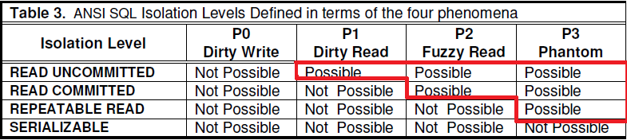
Anomaly define Isolation Levels
1995 : A Critique of ANSI SQL Isolation Levels
w1(x)…w2(x)...(a1 OR c1) (Dirty Write)
w1(x)…r2(x)...(a1 OR c1) (Dirty Read)
r1(x)…w2(x)...(a1 OR c1) (Fuzzy Read)
r1(P)…w2(y in P)...(a1 OR c1) (Phantom)
r1(x)...w2(x)...w1(x)... c1 (Lost Update)
r1(x)...w2(x)...w2(y)...c2...r1(y)...(c1 OR a1) (Read Skew)
r1(x)...r2(y)...w2(x)...w1(y)...(c1 AND c2) (Write Skew)

Slide 5
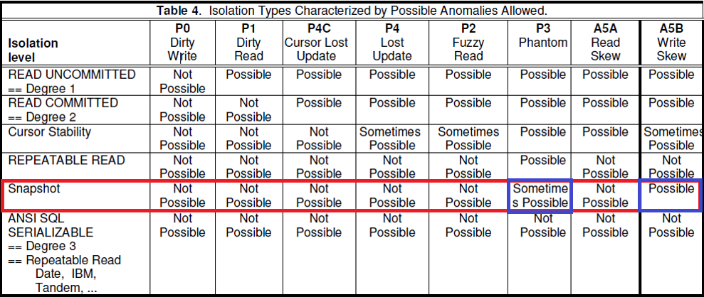
Snapshot Isolation

Slide 6
Snapshot Isolation
Each transaction reads data from a snapshot of the (committed) data as of the time the transaction started, called its Start-Timestamp.
A transaction running in Snapshot Isolation is never blocked attempting a read as long as the snapshot data from its Start-Timestamp can be maintained.
The transaction's writes (updates, inserts, and deletes) will also be reflected in this snapshot, to be read again if the transaction accesses (i.e., reads or updates) the data a second time.
Updates by other transactions active after the transaction Start-Timestamp are invisible to the transaction.

Slide 7
Snapshot Isolation
When the transaction T1 is ready to commit, it gets a Commit-Timestamp, which is larger than any existing Start-Timestamp or Commit-Timestamp.
First-committer wins (a feature)
The transaction successfully commits only if no other transaction T2 with a Commit-Timestamp in T1’s execution interval [Start-Timestamp, Commit-Timestamp] wrote data that T1 also wrote. Otherwise, T1 will abort.
Snapshot Isolation is a multi-version (MV) method.

Slide 8
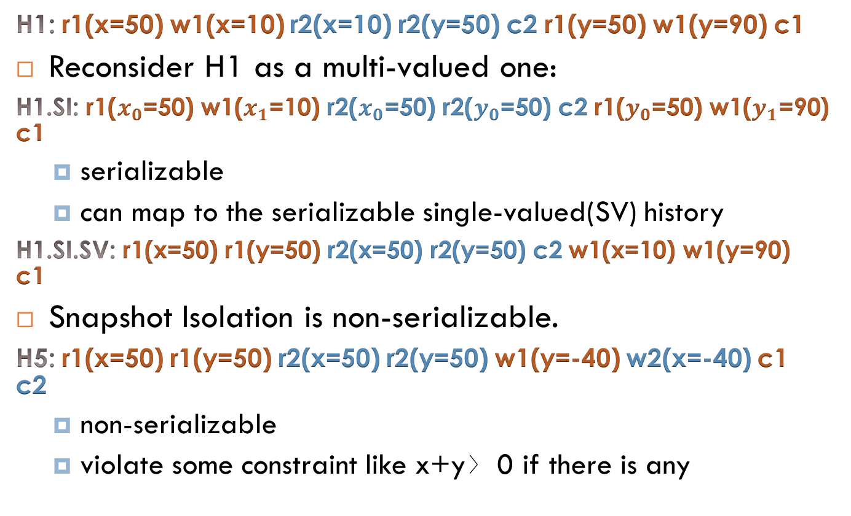
Snapshot Isolation
H1: r1(x=50) w1(x=10) r2(x=10) r2(y=50) c2 r1(y=50) w1(y=90) c1
Reconsider H1 as a multi-valued one:
H1.SI: r1($x_{0}$=50) w1($x_{1}$=10) r2($x_{0}$=50) r2($y_{0}$=50) c2 r1($y_{0}$=50) w1($y_{1}$=90) c1
serializable
can map to the serializable single-valued(SV) history
H1.SI.SV: r1(x=50) r1(y=50) r2(x=50) r2(y=50) c2 w1(x=10) w1(y=90) c1
Snapshot Isolation is non-serializable.
H5: r1(x=50) r1(y=50) r2(x=50) r2(y=50) w1(y=-40) w2(x=-40) c1 c2
non-serializable
violate some constraint like x+y〉0 if there is any

Slide 9
Snapshot Isolation in partial order
An implementation of a transactional system obeys SI if, for any trace of an execution of that system, there exists a partial order ≺ among transactions that obeys the following rules, for any pair of transactions ti and tj in that trace:
if tj reads a value for object x written by ti then
ti ≺ tj^∄tk writing to x : ti ≺ tk ≺ tj
if ti and tj write to the same object x then either ti ≺ tj or tj ≺ ti.
ti ≺ tj if and only if ti commits before tj begins
Notes:
（重）定义需要明确：
所有事务可见的值，读能够返回最新事务写下的值
写同一个对象的事务是全序的
保证事务获取的快照能够反应在该事务开始前所有提交的操作

Slide 10


Snapshot Isolation in partial order
An example of non-SI execution where T2 will abort because of FCW:
An example of write-skew anomaly allowed under SI:

Slide 11
Non-Monotonic Snapshot Isolation
NMSI vs SI
Concepts & Definition

Slide 12
What is NMSI ?
Aims at strong consistency for scalability
only replicas updated by a transaction T make steps to execute T;
a read-only transaction never waits for concurrent transactions and always commits;
a transaction may read object versions committed after it started; and
two transactions synchronize with each other only if their writes conflict
For object x, transaction t must read the value written by the “latest” transaction that updated x;
Any pair of transactions that write the same object x must have a relative(partial) order.
NMSI « SI

Slide 13


Weakened Snapshot Isolation
An example of long fork anomaly allowed under NMSI but not under SI:
An example of forward freshness giving the flexibility to reflect a more convenient set of transactions in the snapshot under NMSI:

Slide 14
NMSI in partial order
An implementation of a transactional system obeys NMSI if, for any trace of the system execution, there exists a partial order ≺ among transactions that obeys the following rules, for any pair of transactions ti and tj in the trace:
if tj reads a value for object x written by ti then
ti ≺ tj^∄tk writing to x : ti ≺ tk ≺ tj
if ti and tj write to the same object x then either ti ≺ tj or tj ≺ ti.
ti ≺ tj if and only if ti commits before tj begins

Slide 15
Pros
Enables:
a single(local) replica to make a decision concerning what data the snapshot should read (long fork)
for highly available design
a transaction in most cases can read the most recent version of a given replica (forward freshness)
avoids a kind of conflict

Slide 16
Cons
Programmer needs to make decision:
Long fork
updates made by users may not become instantly visible across all replicas
Is this admissible ?
Forward freshness
a transaction x can observe the effects of another transaction y that committed after x began in real time
Is this a violation of the application semantics ?

Slide 17
Design of Blotter
Overview
Architecture
Single data center protocol
Extension in Geo-replication

Slide 18
Overview
For geo-replicated storage
Using NMSI to achieve ACID with low latency
Based on Cassandra
Read from local data center
Update to a subset of replicas
Run parallel instances of Paxos for different objects

Slide 19
System Model
Each data object is replicated at all data centers
Inside data objects are replicated and partitioned across several nodes with no restrictions
Nodes can recover from crashing failure
Asynchronous without assuming bounds on computation and communication delays
Allows for plugging in different replication protocols that run within each data center
Notes:
Assumptions
Modular design

Slide 20
Architecture
API: begin, read, write, commit
Blotter intra-data center replication
It has a protocol that provides the vision of a single logical copy per data center of each data object. Not prescribed.
Blotter Concurrency Control
It ensures transaction atomicity and NMSI isolation in a single data center, and are extensible to multiple data centers by serializing a single protocol step.
Paxos
It replicates a subset of the steps of the concurrency control protocol across data centers, at the same time needs to avoid unnecessary coordination across data centers.

Slide 21
Single Data Center Protocol
Partial Order
if ti writes xm and tj writes xn,
then ti ≺ tj ⇔ m < n
if ti writes xm and tj reads xn,
then ti ≺ tj ⇔ m ≤ n

Slide 22
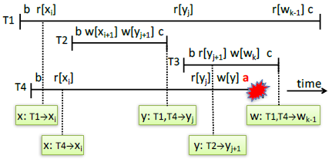
Single Data Center Protocol--overview
Reading the “latest” preceding version
Preventing illegal overwrites
Applying the rules transitively

Slide 23
Single Data Center Protocol--design
Client library
Provide system interface: begin, read, write, commit
Transaction Manager(TM)
Relay reads and reply to or from DM
Coordinate writes as receiving commit request to DM
Data Manager(DM, the replicated component)
The core of concurrency control logic
Manage information associated with data objects

Slide 24
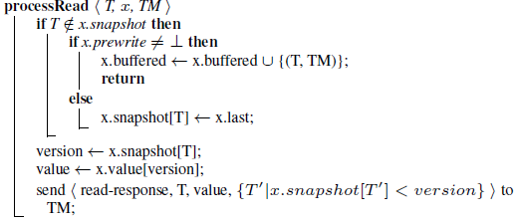
Single Data Center Protocol -- DM

Slide 25
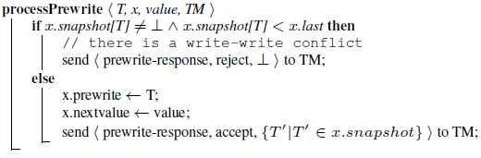
Single Data Center Protocol -- DM

Slide 26
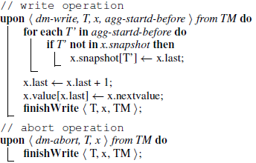
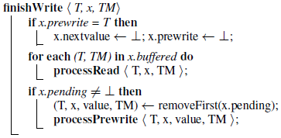
Single Data Center Protocol -- DM
Garbage Collection
an entry for T in the snapshot data structure only needs to be maintained while T is executing
Each transaction T has a TTL(Time To Live)
After the TTL of T expires, any entries for T are automatically garbage collected.

Slide 27
Single Data Center Protocol – extend
Drawbacks when extended to geo-replication:
read operations are state machine commands that mutate the state, thus requiring an expensive consensus round
the total order of the state machine precludes the concurrent execution of two commits, even for transactions that do not conflict ???
each Paxos-based state machine command requires several cross-data center message delays

Slide 28
Blotter Geo-replication
Local Read Operations
Observation:
read operations modify the snapshot variable state and need to be executed in the state machine.
Solution:
snapshot variable is independently maintained by each replica, only the replica in the data center where T is initiated records the information for snapshot[T]
the snapshot information is forwarded with commit command for all data centers to check write-write conflicts
Connection to NMSI:
NMSI allows for independence between the state reflected by transactions

Slide 29
Blotter Geo-replication
Concurrent execution of database operations
Observation:
serializing dm-prewrite operation on per-object basis can build partial order in NMSI
Solution:
one state machine per object supporting only dm-prewrite operation
Connection to NMSI:
possible of having long fork
Deadlock Resolution
deadlocks are replicated across different data centers
eg. edge-chasing can be employed

Slide 30
Blotter Geo-replication
Paxos with a single cross-data center round-trip
Goal:
reduce the cross data center steps to a single round-trip
Solution:
Multi-Paxos: client(TM) · Paxos leader · replicas
configure Paxos to only tolerate one unplanned outage of a data center
parameterize Paxos to use read quorums of N-1 and write quorums of 2 processes
Connection to NMSI:
NMSI allows using asymmetric quorums and optimize the location of the Paxos leader per-object

Slide 31
Evaluation
Benchmark & Workloads:
Microbenchmark for latency and throughput
RUBiS benchmark to key-value store
Social networking workload
Setup
DCs：Ireland(EU), Virginia(US-E), California(US-E)
Virtual machines: 4 of server cluster + 4 clients
Reference
Blotter · Cassandra · Spanner’s 2PL
Notes:
Virtual machines: 64-bit processor, 4 virtual cores, 15GB RAM
Blotter: inside DC - N=2 replicas

Slide 32
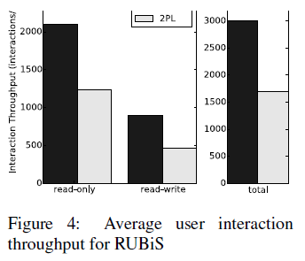
Evaluation
RUBiS
additionaly store index and foreign key data
85% read-only + 15% read-write
initially load with 10,000 users, 1,000 old items and 32,667 active items

Slide 33
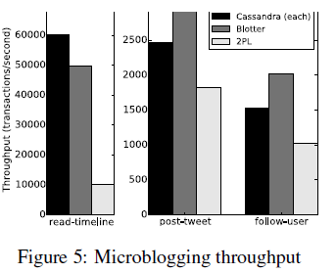
Evaluation
Microblogging
85% read-timeline + 10% post-tweet + 5% follow-user
initially load with 100,000 users, each has an average of 6 followers
Notes:
Adding small overhead in a single data center Suitable when several replicas are separated by high latency
Suitable when performance is critical and the semantic differences between NMSI and SI are tolerated by the application

Slide 34
Summary and Conclusion

Slide 35
Summary and Conclusion
Blotter uses NMSI to improve the performance of geo-replicated transactional systems with proposed new concurrency control protocols mainly in two ways :
reduce coordinate demands
limit replica communication times
Limitation still exists
configuration of Paxos

Slide 36
Snapshot Isolation Spectrum

Slide 37
Snapshot Isolation Spectrum
05-GSI(Generalized Snapshot Isolation)
allows transaction to read from older snapshots.
11-PSI(Parallel Snapshot Isolation)
a non-monotonic variant of SI allowing long fork
13-NMSI(Non-Monotonic Snapshot Isolation)
first used in Jessy which focus on partial replication settings
13-Serializable
replica commit, etc.

Slide 38
THANKS FOR LISTENING !
Blotter: Low Latency Transactions for Geo-Replicated Storage

