Slide 1
Validation-based Concurrency Control
Guohao Ding
2018.6.13
Notes:
Need an agenda

Slide 2
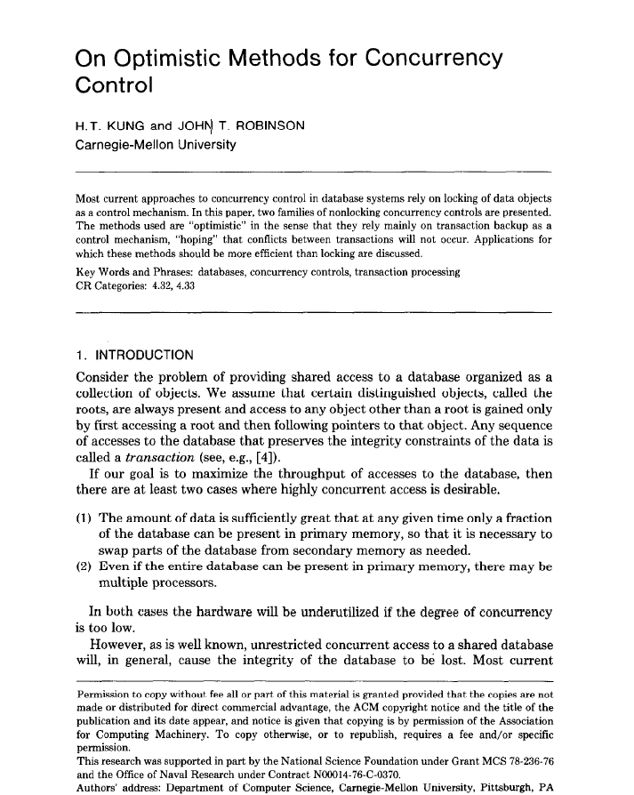
Optimistic Concurrency Control
Assume that multiple txns can frequently complete without interfering with each other.
While running, transactions use data resources without acquiring locks on those resources.
When a txn commits, the DBMS verifies that there are no conflicts.
First proposed in 1981 at CMU by H.T. Kung.

Slide 3
Optimistic Concurrency Control
Transactions have 3 phases:
Read
Track the read/write sets of txns
store their writes in a private workspace.
Validate
check whether it conflicts with other txns.
Write
if validate succeeds, apply private changes to database. Otherwise abort and restart the txn.

Slide 4
Performance Issues
Suffers from timestamp allocation bottleneck
Aborts are more wasteful because they only occur after a txn has already excuted
Validation/write phase bottlenecks
Read Phase
Validation Phase
Abort
Write Phase

Slide 5
Silo: Speedy Transactions in Multicore In-Memory Databases
Stephen Tu, Wenting Zheng, Eddie Kohler†, Barbara Liskov, Samuel Madden
MIT CSAIL, †Harvard University

Slide 6
Goal
Extremely high throughput in-memory relational database.
Fully serializable transactions.
Can recover from crashes.

Slide 7

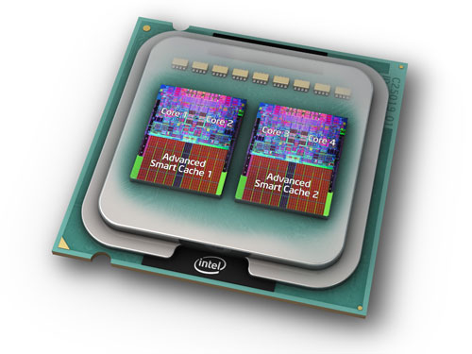


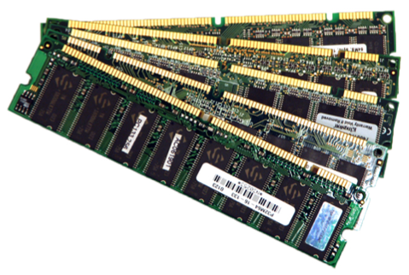
Multicores to the rescue?
txn_commit()
{
// prepare commit
// […]
commit_tid = atomic_fetch_and_add(&global_tid);
// quickly serialize transactions a la Hekaton
}

Slide 8
Why have global TIDs?
Notes:
能摆脱这个吗？也许我们可以生成唯一但不是全局有序的TID。为什么我们需要这个有序属性？

Slide 9


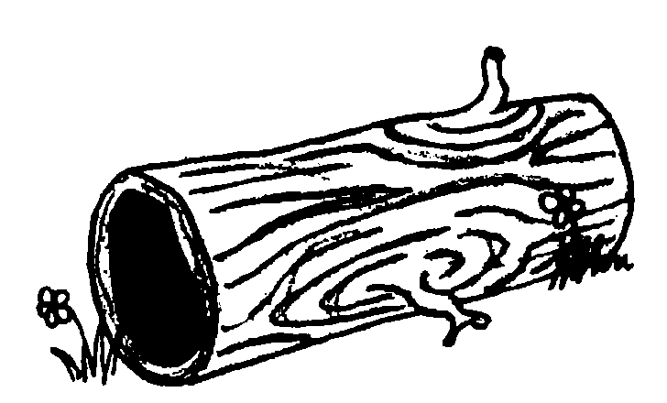

Recovery with global TIDs
State:
T1:
tmp = Read(A); // tmp = 1
Write(B, tmp);
Commit();
{ A:1, B:0 }
Global TID
T2:
Write(A, 2);
Commit();
{ A:2, B:1 }
Time
How do we properly recover the DB?
Record: [A:2]
Record: [B:1]
TID: 2, Rec: [A:2]
TID: 1, Rec: [B:1]
…
…
…
…
…
…
…
…

Slide 10


Slide 11
Silo: transactions for multicores
Near linear scalability on popular database benchmarks.
Raw numbers several factors higher than those reported by existing state-of-the-art transactional systems.
Notes:
Think about how to emphasis this more
(put some graph there?)
Can we just say awesome raw throughput numbers w/o making a reference to existing literature?

Slide 12
Secret sauce
A scalable and serializable transaction commit protocol.
Shared memory contention only occurs when transactions conflict.
Surprisingly hard: preserving scalability while ensuring recoverability.
Notes:
共享内存冲突访问只发生在事务修改数据时。如果两个事务read/write两个不相交的集合是不会造成共享内存发生冲突的，之前除了修改数据还有分配TID冲突

Slide 13
Solution from high above
Use time-based epochs to avoid doing a serialization memory write per transaction.
Assign each txn a sequence number and an epoch.
Seq #s provide serializability during execution.
Insufficient for recovery.
Need both seq #s and epochs for recovery.
Recover entire epochs (all or nothing).

Slide 14
Epoch design
Notes:
What is “this”?

Slide 15
Epochs
Divide time into epochs.
A single thread advances the current epoch.
Use epoch numbers as recovery boundaries.
Reduces non data driven shared writes to happening very infrequently.
Serialization point is now a memory read of the epoch number!
Notes:
每个epoch有一个epoch number，一个指定线程定期增加epoch number的值，所有其它线程在提交事务的时候获取epoch number
以epoch为一个恢复单位
这里的关键是减少了非数据驱动造成的对共享内存的写入，TID，之前是每个事务都要进行一次写入
换一种方式理解：将提交协议中的串行化点从对共享内存的写入，也就是之前的原子递增操作转变为对共享内存的读，也就当前epoch number的一次读取操作

Slide 16
Transaction Identifiers (TIDs)
Each record contains TID of its last writer.
TID is broken into three pieces:
Assign TID at commit time (after reads).
Take the smallest number in the current epoch larger than all record TIDs observed in the transaction.
Status bits | Sequence number | Epoch number
0
63
Notes:
Seq用于区分同一个epoch中的事务
状态位逻辑上与TID是分离的，有一个锁位，标志该条记录是否被其它事务锁住
分散的方式分配TID，只有当确认事务可以提交时，工作线程才会计算出当前epoch中最小的值，大于当前事务看到的所有记录的TID,具体一点就是要查看当前事务读写集合中所有记录的TID,还有当前线程最新提交事务的TID
Be more clear that TID is assigned at *end* of TID

Slide 17
Transaction Identifiers (TIDs)
Select TID
Larger than the TID of record read or written
Larger than the worker’s most recently chosen TID
In the current global epoch
The TID order often reflects the serial order, but not always.
T2 reads T1’s write → T2’s TID > T1’s TID(a above)
T2 overwrites a key T1 read →?

Slide 18
Example
TID=Epoch:Seq
worker0
Epoch=1
Epoch=2
T1:R(b)
T2:R(a)
worker1
1:1
1:3
2:5
2:7
worker2
1:2
1:4
2:6
2:8
T3:W(a)
T4:W(b)
T1->T2->T3->T4

Slide 19
Executing/committing transactions
Notes:
Make the flow of transactions more clear?

Slide 20
Pre-commit execution
Idea: proceed as if records will not be modified – check otherwise at commit time.
To read record A, save the record’s TID in a local read-set, then use the value.
To write record A, store the write in a local write-set.
(Standard optimistic concurrency control)

Slide 21
Commit Protocol
Phase 1: Lock (in global order) all records in the write set.
Read the current epoch.
Phase 2: Validate records in read set.
Abort if record’s TID changed or lock is held (by another transaction).
Phase 3: Pick TID and perform writes.
Use the epoch recorded in Phase 1 for the TID.
Notes:
Intuition of what phase 1 and phase 2 achieve– in phase 3 we ensure no conflict in RW sets

Slide 22
// Phase 1
for w, v in WriteSet {
Lock(w); // use a lock bit in TID
}
Fence(); // compiler-only on x86
e = Global_Epoch; // serialization point
Fence(); // compiler-only on x86
// Phase 2
for r, t in ReadSet {
Validate(r, t); // abort if fails
}
tid = Generate_TID(ReadSet, WriteSet, e);
// Phase 3
for w, v in WriteSet {
Write(w, v, tid);
Unlock(w);
}
Notes:
需要特别指出两个内存Fench
Don’t resay the previous slide

Slide 23
Returning results
Say T1 commits with a TID in epoch E.
Cannot return T1 to client until all transactions in epochs ≤ E are on disk.
Notes:
当我们将一个事务的执行结果返回给客户端，我们需要确保这个事务是可以恢复的

Slide 24
Correctness

Slide 25
Epoch read = serialization point
One property we require is that epoch differences agree with dependencies.
T2 reads T1’s write → T2’s epoch ≥ T1’s.
T2 overwrites a key T1 read → T2’s epoch ≥ T1’s.
The commit protocol achieves this.
Full proof in paper.
Notes:
Want to show epochs agree w/ serial order.
Mention in english write-write conflicts?

Slide 26
Write-after-read example
Say T2 overwrites a key T1 reads.
T1:
tmp = Read(A);
WriteLocal(B, tmp);
Lock(B);
e = Global_Epoch;
Validate(A); // passes
t = GenerateTID(e);
WriteAndUnlock(B, t);
T1() {
tmp = Read(A);
Write(B, tmp);
}
T2() {
Write(A, 2);
}
T2’s epoch ≥ T1’s epoch
Time
T2:
WriteLocal(A, 2);
Lock(A);
e = Global_Epoch;
t = GenerateTID(e);
WriteAndUnlock(A, t);
B
A
A happens-before B
Notes:
Mention you can do a similar argument for RAW

Slide 27
Read-after-write example
Say T2 reads a value T1 writes.
T1:
WriteLocal(A, 2);
Lock(A);
e = Global_Epoch;
t = GenerateTID(e);
WriteAndUnlock(A, t);
T1() {
Write(A, 2);
}
T2() {
tmp = Read(A);
Write(A, tmp+1);
}
T2’s epoch ≥ T1’s epoch
T2’s TID > T1’s TID
Time
T2:
tmp = Read(A);
WriteLocal(A, tmp+1);
Lock(A);
e = Global_Epoch;
Validate(A); // passes
t = GenerateTID(e);
WriteAndUnlock(A, t);
B
A
A happens-before B
Notes:
This lets us correctly replay writes in the same epoch

Slide 28
Storing the data

Slide 29
Storing the data
A commit protocol requires a data structure to provide access to records.
We use Masstree, a fast non-transactional B-tree for multicores.
But our protocol is agnostic to data structure.
E.g. could use hash table instead.
Notes:
Masstree 是针对多核性能而优化的快速并发Btree结构，但是masstree只支持不可串行化的单主键的事务，而实际中大部分数据库都需要支持多主键并且以某种串行化顺序执行的事务，silo是能够提供这种属性最小争用可串行化的提交协议
协议是数据结构无关，也可以使用其它数据结构

Slide 30
Masstree in Silo
Silo uses a Masstree for each primary/secondary index.
We adopt many parallel programming techniques used in Masstree and elsewhere.
E.g. read-copy-update (RCU), version number validation, software prefetching of cachelines.

Slide 31
From Masstree to Silo
Inserts/removals/overwrites.
Range scans (phantom problem).
Garbage collection.
Read-only snapshots in the past.
Decentralized logger.
NUMA awareness and CPU affinity.
And dependencies among them!
See paper for more details.

Slide 32
Evaluation

Slide 33
Setup
32 core machine:
2.1 GHz, L1 32KB, L2 256KB, L3 shared 24MB
256GB RAM
Three Fusion IO ioDrive2 drives, six 7200RPM disks in RAID-5
Linux 3.2.0
No networked clients.

Slide 34
Workloads
TPC-C: online retail store benchmark.
Large transactions (e.g. delivery is ~100 reads + ~100 writes).
Average log record length is ~1KB.
All loggers combined writing ~1GB/sec .
YCSB-like: key/value workload.
Small transactions.
80/20 read/read-modify-write.
100 byte records.
Uniform key distribution.

Slide 35
Scalability of Silo on TPC-C
I/O
(scalability
bottleneck)
I/O slightly limits scalability, protocol does not.
Note: Numbers several times faster than a leading commercial system + numbers better than those in paper.
Notes:
Talk about IO bottleneck as a hypothesis, and how we validated it
Tmpfs（基于内存的文件系统）是使用内存作为日志的存储介质
Silo是使用磁盘作为日志的存储介质

Slide 36
Cost of transactions on YCSB
Protocol (~4%)
Global TID (~45%)
Key-Value: Masstree (no multi-key transactions).
Transactional commits are inexpensive.
MemSilo+GlobalTID: A single compare-and-swap added to commit protocol.
Notes:
Say Key-Value has no durability.

Slide 37
Related work

Slide 38
Solution landscape
Shared database approach.
E.g. Hekaton, Shore-MT, MySQL+
Global critical sections limit multicore scalability.
Partitioned database approach.
E.g. H-Store/VoltDB, DORA, PLP
Load balancing is tricky; experiments in paper.
Notes:
Shore-MT:2PL的长时间锁定和读取锁定要求引入了多核架构的固有可扩展性问题

Slide 39

Conclusion
Silo is a new in memory database designed for transactions on modern multicores.
Key contribution: a scalable and serializable commit protocol.
Great performance on popular benchmarks.
Fork us on github: https://github.com/stephentu/silo

Slide 40

Transaction Healing: Scaling Optimistic Concurrency Control on Multicores
Yingjun Wu, Chee-Yong Chan, and Kian-Lee Tan
National University of Singapore

Slide 41
Motivation
Optimistic Concurrency control (OCC) cannot scale well under highly contended workload due to high abort rate!
High-contention
Low-contention
Conventional OCC and Silo’s OCC on a 48 core machine using the TPC-C benchmark.
Notes:
在TPC-C中，负载争用程度随着仓库数的减少而增大
当仓库数在递减的过程中，两个系统的性能都急剧下降，特别地，当仓库数为2时，tps大概为60k和150k，可以看出系统对负载争用情况还是比较敏感的

Slide 42
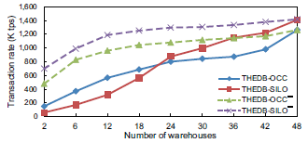
Motivation
Optimistic Concurrency control (OCC) cannot scale well under highly contended workload due to high abort rate!
High-contention
Low-contention
Conventional OCC and Silo’s OCC on a 48 core machine using the TPC-C benchmark.
Notes:
为了进一步研究事务中止对系统性能的影响，关闭两个系统中的OCC中的验证阶段，这样的修改可能会导致非可串行化的结果产生因为缺少对读一致性的检查，理论上应该是在没有事务中止的情况下可以获得的最好性能，大概3-12倍
关键的原因是THEDB-SILO的提交协议设计消除了跟踪反依赖关系的必要性，因此导致锁定开销降低。

Slide 43
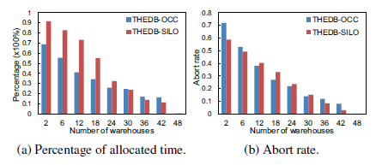
Motivation
The overheads incurred by OCC protocols due to their abort-and-restart mechanism
Overhead of the abort-and-restart mechanism with different degree of contentions
Notes:
OCC协议由于其中止和重启机制而引起的开销大小
花在事务中止和重新启动上时间占事务执行总执行时间的百分比，可以看出中止重试机制是OCC不高效的主要原因。
冲突率随着数据争用的增加而增加
总结：在上面的实验中，我们证实了现有的OCC协议由于昂贵的中止和重启机制而不能在多核架构上扩展

Slide 44
Solution Overview
Most of the processing time is wasted in re-executing aborted transactions!
Read
Validation
Healing
Write
Abort
OCC
Transaction
healing
wasted efforts!
Transaction healing avoids successive aborts-and-restarts by restoring only non-serializable operations.
Notes:
通过仅恢复非可串行操作避免连续中止和重新启动。
非可串行化操作：给定一个事务T，如果T中一个读/写操作再次执行时产生结果不一样
愈合阶段旨在重新利用尽可能多的无效事务的执行结果，以根据提取的依赖关系来修复其不一致的事务状态及其查询结果。

Slide 45
Solution Overview
Transaction healing
Static time: dependency extraction
Dependency graph
Read phase: runtime context maintenance
Access cache and read/write set
Validation & healing phases: operation restoration

Slide 46
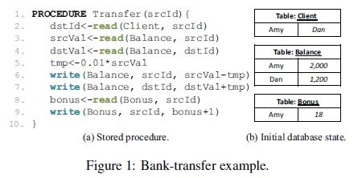
Example

Slide 47
Static Time
INPUT: transaction program
OUTPUT: dependency graph
1. PROCEDURE Transfer(srcId){
2. dstId<-read(Family, srcId)
3. srcVal<-read(Balance, srcId)
4. dstVal<-read(Balance, dstId)
5. tmp<-0.01*srcVal
6. write(Balance, srcId, srcVal-tmp)
7. write(Balance, dstId, dstVal+tmp)
8. bonus<-read(Bonus, srcId)
9. write(Bonus, srcId, bonus+1)
10. }
3
2
srcVal<-read(Balance, srcId)
dstId<-read(Family, srcId)
5
4
tmp<-0.01*srcVal
dstVal<-read(Balance, dstId)
6
7
write(Balance, srcId, srcVal-tmp)
write(Balance, dstId, dstVal+tmp)
8
bonus<-read(Bonus, srcId)
9
write(Bonus, srcId, bonus+1)
Key dependency: the preceding operation determines the accessing key of the subsequent operation.
Value dependency: the preceding operation determines the non-key value used in the subsequent operations.
Notes:
在事务处理之前从每个预定义存储过程中提取操作依赖项，提取的操作依赖关系分为两类
键依赖：前面的操作确定后续操作的访问键，也就是主键key
值依赖：前面的操作决定了后续操作中使用的非键值

Slide 48
Read Phase
During the read phase, transaction healing maintains a lightweight transaction-local access cache to keep track of the runtime behavior of each operation in the transaction.
1. PROCEDURE Transfer(srcId){
2. dstId<-read(Client, srcId)
3. srcVal<-read(Balance, srcId)
4. dstVal<-read(Balance, dstId)
5. tmp<-0.01*srcVal
6. write(Balance, srcId, srcVal-tmp)
7. write(Balance, dstId, dstVal+tmp)
8. bonus<-read(Bonus, srcId)
9. write(Bonus, srcId, bonus+1)
10. }
ACCESS CACHE
Bookmark | Inputs | Updates | Outputs | Access set
Line 2
Line 3
Line 4 | Dan |  | 1200 | 0xCCCC
Line 6 | Amy, 1980 | 1980 |  | 0xBBBB
Line 7 | Dan, 1220 | 1220 |  | 0xCCCC
Line 8 | Amy |  | 18 | 0xDDDD
Line 9 | Amy, 19 | 19 |  | 0xDDDD
Bookmark | Inputs | Updates | Outputs | Access set
Line 2
Line 3
Line 4
Line 6
Line 7
Line 8
Line 9
READ/WRITE SET
Amy
Dan
0xAAAA
{ }
Address | Mode | Timestamp | Bookmark
 | RW
0xCCCC | RW | 10 | Line 4
0xDDDD | RW | 14 | Line 8
Address | Mode | Timestamp | Bookmark
Amy
2000
0xBBBB
{ }
0xAAAA
R
25
Line 2
{ }
0xBBBB
R
27
Line 3
{ }
{ }
{ }
{ }
Notes:
读/写集是一个线程本地数据结构(即由单个线程私有更新的结构)，其中集合中的每个元素由事务访问的某些数据记录的主内存地址表示。
此外，对事务的读/写集中的每个被访问记录维护以下元数据：
（1）指示访问的类型（2）记录数据记录被读取时的时间戳的值（3）一个书签字段，惟一地标识第一次读取记录的事务操作
每个操作都会调用索引查找来检索一定数量的数据库记录。
通过使用前面操作的输出或其存储过程的输入参数，读操作op返回某些值，这些值将被依赖于op的操作使用，或者用作查询结果；而写入操作产生更新效果将被缓冲到其访问记录的本地副本。
在事务修复中，访问缓存监控输入，输出以及更新效果来捕获每个操作的行为。
每个操作会进一步在访问维护高速缓存中维护一个访问集合，以记录它读取或写入的所有记录的内存地址。
访问高速缓存便于恢复操作：一方面，记录每个操作的运行时行为有助于重新利用由这些可序列化操作产生的执行结果;另一方面，只要操作的访问key保持不变，高速缓存访​​问记录的内存地址就不需要调用索引查找来访问记录

Slide 49
Validation & Healing Phases
During the validation and healing phases, transaction healing detects inconsistencies and restores all the non-serializable operations according to extracted operation dependencies.
1. PROCEDURE Transfer(srcId){
2. dstId<-read(Family, srcId)
3. srcVal<-read(Balance, srcId)
4. dstVal<-read(Balance, dstId)
5. tmp<-0.01*srcVal
6. write(Balance, srcId, srcVal-tmp)
7. write(Balance, dstId, dstVal+tmp)
8. bonus<-read(Bonus, srcId)
9. write(Bonus, srcId, bonus+1)
10. }
ACCESS CACHE
Bookmark | Inputs | Updates | Outputs | Access set
Line 2 | Amy | - | Dan | 0xAAAA
Line 3 | Amy | - | 2000 | 0xBBBB
Line 4 | Dan | - | 1200 | 0xCCCC
Line 6 | Amy, 1980 | 1980 | - | 0xBBBB
Line 7 | Dan, 1220 | 1220 | - | 0xCCCC
Line 8 | Amy | - | 18 | 0xDDDD
Line 9 | Amy, 19 | 19 | - | 0xDDDD
READ/WRITE SET
Validate!
{ }
Address | Mode | Timestamp | Bookmark
0xAAAA | R | 25 | Line 2
0xBBBB | RW | 27 | Line 3
0xCCCC | RW | 10 | Line 4
0xDDDD | RW | 14 | Line 8
{ }
✗
{ }
Delete
{ }
{ }
✗
{ }
Insert
{ }
Bypass index lookup!
Notes:
检测事务中操作op读取了不一致的元素r
(1)首先修改op操作的output，这是因为r不一致导致的最初的不可串行化操作的影响，r指向的记录上的修改可能会影响op的输出，从而影响依赖于op的操作的行为
不是直接将这条语句重新执行一次，而是直接访问访问缓存中维护的记录的内存地址，减少了不必要的内存索引扫描，这个操作的key没有变化，因此访问集合也就没有变化
(2)根据静态提取的程序依赖图修复所有依赖于op的操作，根据依赖类型选择不同的修复策略
值依赖：根据访问缓存中维护的内存地址，直接访问内存，尽管op的操作的输出可能作为依赖于op操作的输入，但访问的key值是不变的，也避免了索引检索带来的开销
键依赖：稍微复杂一些，重新执行一次，更新访问缓存中的访问集合，也会更新事务的读写集合

Slide 50
Performance Comparison
4 12-core AMD Opteron Processor 6172(48 cores in total)
We compare with the following protocols:
OCC: classic optimistic concurrency control
SILO: Silo’s OCC implementation
2PL: classic two-phase locking
HYBRID: Hybrid concurrency control protocol(OCC+2PL)
DETERMINISTIC: partitioned deterministic protocol

Slide 51
Performance Comparison
TPC-C: Transaction rate achieved under different workload contentions.
High-contention
Low-contention
Notes:
分区确定性数据库：将跨分区事务的百分比设置为0
Core 48
（1）相比之下，所有的系统都实现了接近线性的可伸缩性当仓库的数量设置为48，确定性数据库有最好的交易速率
（2）随着工作负载争用的增加，所有数据库的性能都急剧下降，尤其当仓库数为2，相比之下，Transaction healing维持较高的性能

Slide 52
Performance Comparison
TPC-C: Transaction rate achieved when processing high-contention workload (4 warehouses).
2x
Notes:
进一步说明了在使用相同benchmark，高度争用的工作负载下，系统可扩展性性，设置4warehouse
（1）silo性能最差，容易受到频繁事务中止的影响，浪费更多资源
（2）2PL>OCC 25% 它的长时间锁降低了并发程度，使得它在多核架构上的效率降低
（3）healing 在提出的优化机制的帮助下，完全消除了中止和重新启动所带来的昂贵开销

Slide 53
Conclusion
We introduced a new mechanism, called transaction healing, which scales the conventional OCC towards dozens of cores even under high-contention workloads.
Extract program dependency graph at static time;
Restore non-serializable operations once inconsistency is detected during validation;
Maintain thread-local access cache to reduce re-execution overhead.
https://github.com/Cavalia/Cavalia

Slide 54
Thanks!

