Slide 1
Speedy Transactions and Parallel Logging
Stephen Tu, Wenting Zheng
MIT CSAIL and Harvard University
——Silo and SiloR Introduction
王嘉豪
DaSE
20180404
Notes:
Please give a slow speech

Slide 2
Main Purpose
Parallelism in all parts of the system both runtime and recovery
Introduce both the mechanism and the theory
Notes:
多核
内存环境下

Slide 3
Hard to scale up with Global TID
txn_commit()
{
// prepare commit
// […]
commit_tid = atomic_fetch_and_add(&global_tid);
// quickly serialize transactions a la Hekaton
}

Slide 4
Why we need TID
Answer ：
Logging and Recovery

Slide 5


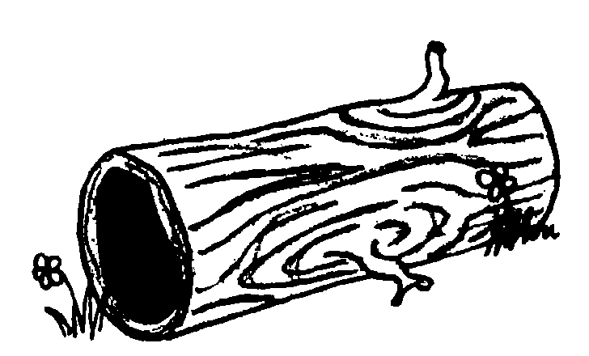

Recovery with global TIDs
State:
T1:
tmp = Read(A); // tmp = 1
Write(B, tmp);
Commit();
{ A:1, B:0 }
Global TID
T2:
Write(A, 2);
Commit();
{ A:2, B:1 }
Time
How do we properly recover the DB?
Record: [A:2]
Record: [B:1]
TID: 2, Rec: [A:2]
TID: 1, Rec: [B:1]
…
…
…
…
…
…
…
…

Slide 6
Key bottleneck
Global TID generation in a multi-core hardware
Solution :
epoch-based group commit

Slide 7
Epoch design
Divide time into epochs. (every 40ms)
A single thread advances the current epoch.
Use epoch numbers as recovery boundaries.
Reduces non data driven shared writes to happening very infrequently.
Serialization point is now a memory read of the epoch number!
Notes:
不要集中式的，找一个线程来产生时间戳

Slide 8
Data-Driven TID generation
Each record contains TID of its last writer.
TID is broken into three pieces:
Assign TID at commit time (after reads).
Epoch number :
Read from the global counter
Sequence number :
Take the smallest number in the current epoch larger than all record TIDs observed in the transaction.
Limitation : Commit the whole log of one epoch or not.
Status bits | Sequence number | Epoch number
0
63
Notes:
Epoch是全序的，不同Epoch的日志是有完全先后顺序的

Slide 9
Logging and recovery Issues
Sequential flush
One logging file
One commit thread
One Log buffer
Sequential replay
Read logs sequentially
Replay them one by one according to TID
Solved by SiloR

Slide 10
SiloR Goal
Small performance impact on runtime throughput and latency
Recovery of a big database in a few minutes

Slide 11
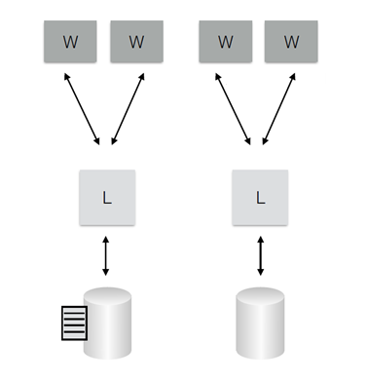
Idea
Must use multiple disks
One logger per disk
Multiple workers for one logger

Slide 12
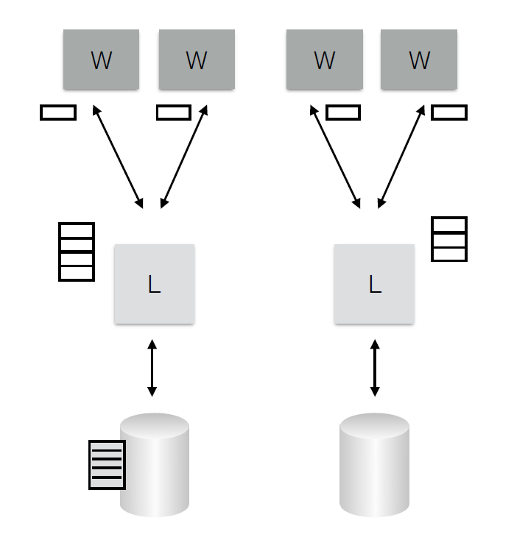
Buffer management
Worker
One individual log buffer (512KB)
When push to Logger :
Full
At an Epoch boundary
Logger
Many Log buffers （# of workers）
When flush to Disk
Regularly
Log file on Disk
Logs are not ordered
Create New file every 100 epochs
e
Notes:
Buffer两个问题
when往里填东西
When往外扔

Slide 13
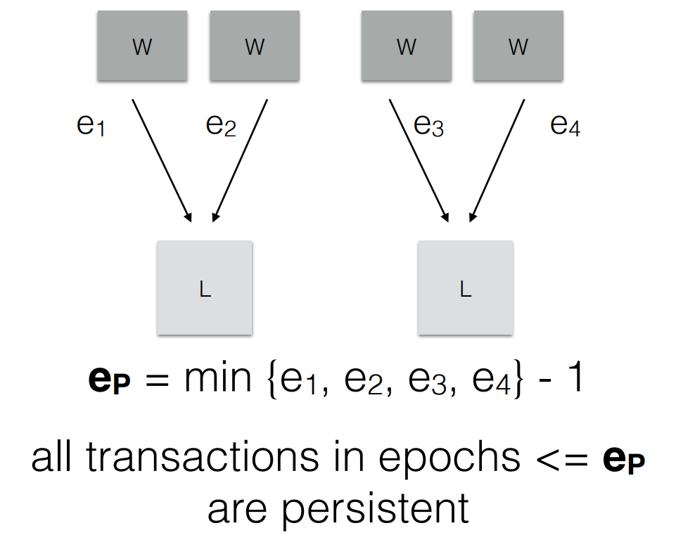
Persistence epoch
Notes:
e1 e2 最近一次提交的epoch

Slide 14
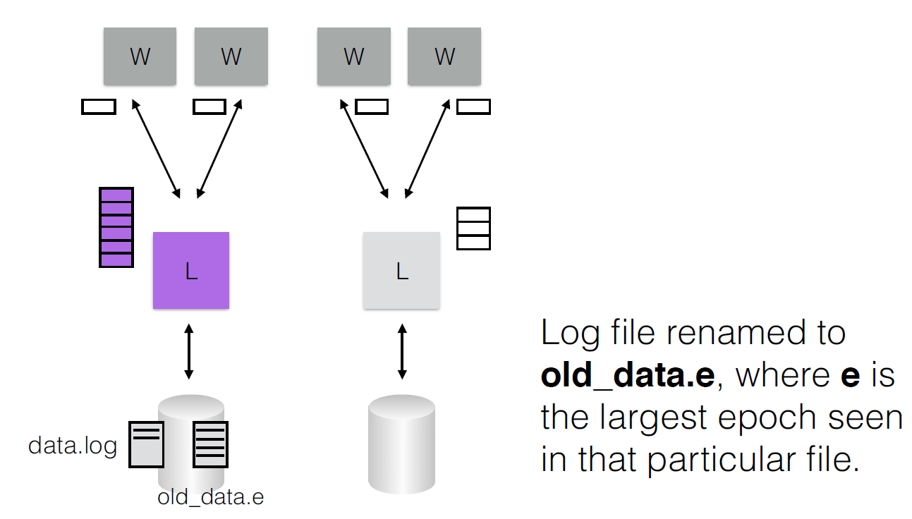
Log rotation

Slide 15
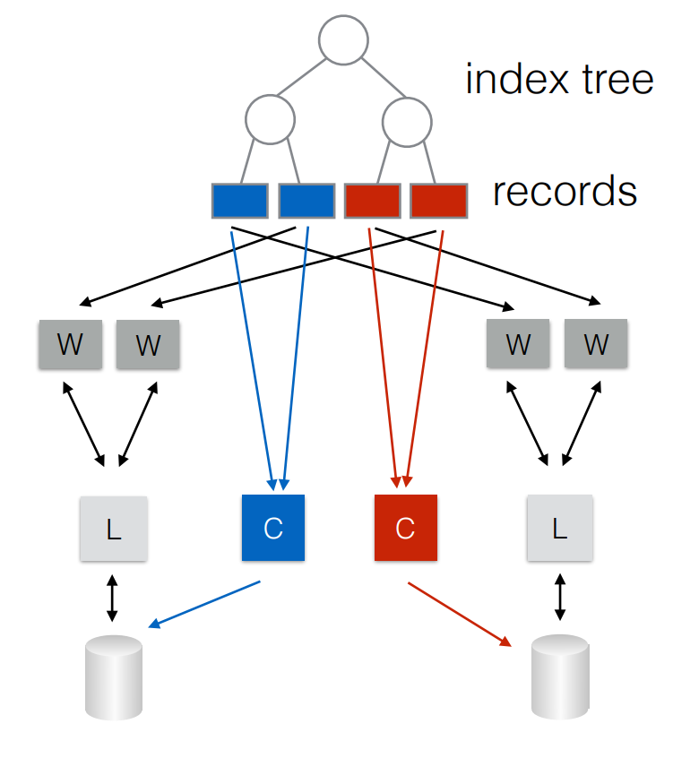
Parallel checkpointing
Notes:
每个checkpointer负责一个partition的数据. Btree 扫描

Slide 16
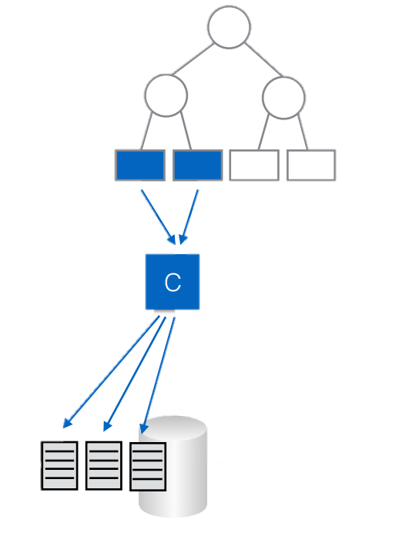
Parallel checkpointing
Tree walk over a range of each table - inconsistent checkpoint
Only committed records in checkpoint
Writes out to multiple files, enabling easy recovery parallelism

Slide 17
Checkpoint Design Detail
Checkpoint starts in epoch e_{L}
skips over records with TID.e such that e>= eL!
Checkpoint ends in epoch e_{H}
usable once e_{H} <= e_{P}
removes old_data.e log file where e < e_{L}
Checkpointing CP
e_{L}
e_{H}
e_{now}
LOG:
e_{H}
e_{H}
e_{H}
e_{H+1}
e_{H} = e_{P}
Enable CP
Notes:
检查点：啥时候算开始，啥时候算结束，我在CP期间我能够cover那些日志，结束之后那些日志可以删掉，如何恢复到一个一致性的点
Ep persistent

Slide 18
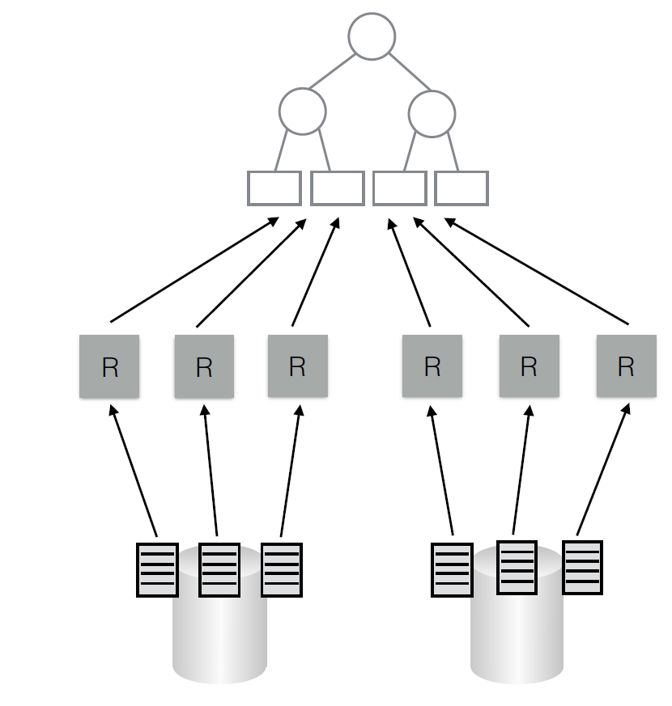
Recovery
Easy parallelism: one checkpoint recovery thread per file

Slide 19
Log Replay
Value logging enables log files to be played in any order — highest TID per key wins
logs in later epochs replayed first
No log record from epoch > e_{p} is replayed

Slide 20
Experiment & Workload
Experiment setup
single machine with four 8 core Intel
Xeon E7-4830 processors (32 physical cores)
machine has 256 GB of DRAM, 64GB of DRAM attached to each socket
4 disks: 3 Fusion IO drives, 1 RAID-5 disk array
YCSB-A Key-value benchmark
400 million keys, 100 byte records
70% read, 30% write
28 workers, 4 loggers, 4 checkpoint threads
Database does not grow

Slide 21
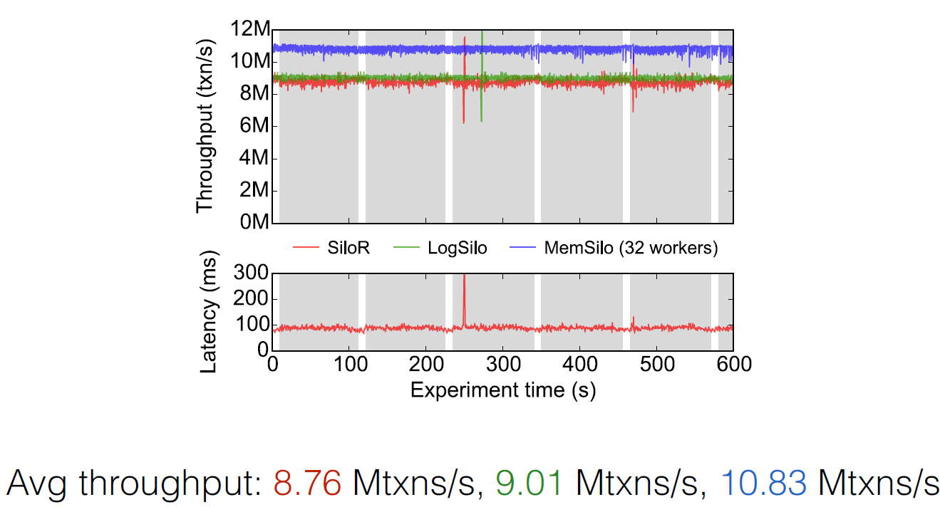
Evaluation - YCSB-A
Notes:
灰色是在做checkpoint

Slide 22
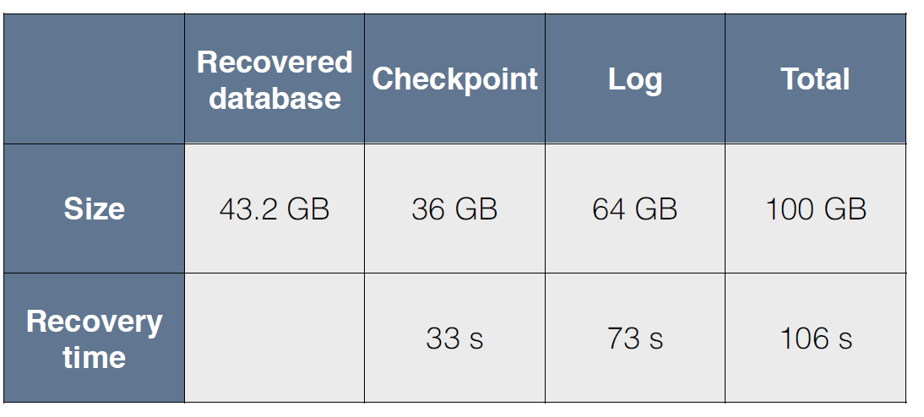
Recovery for YCSB-A
Simulates crash right before the second checkpoint completes

Slide 23
Scalable Logging through Emerging Non-Volatile Memory
Tianzheng Wang
University of Toronto

Slide 24
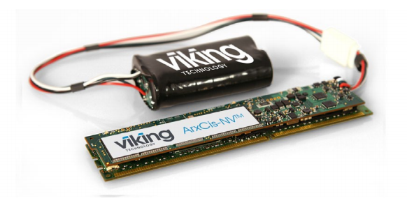
NV-DIMMs
DIMMs + batteries or flash

Slide 25
Phase-change memory (PCM)
PRAMs exploit the unique behaviour of chalcogenide glass.
Stores data by changing the state of underlying material.
Heat produced by the passage of an electric current through a heating element switching it to a crystalline state
PCM also has the ability to achieve a number of distinct intermediary states, thereby having the ability to hold multiple bits in a single cell
Longer lantency
80ns – 1μs (DRAM 20ns – 50ns)
Notes:
General write times for common Flash devices are on the order of 0.1ms (for a block of data), about 10,000 times the typical 10 ns read time
PRAM's switching time and inherent scalability^{[13]} make it most appealing

Slide 26
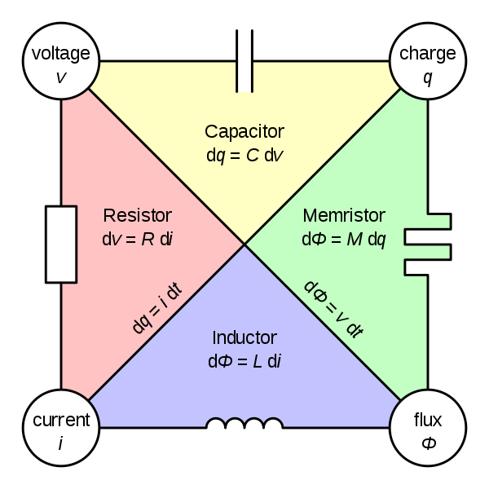
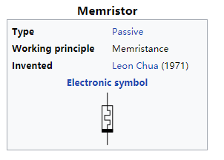
Memristor
The memristor present resistance depends on how much electric charge has flowed in what direction through it in the past
Latency Low
hundreds of pico-seconds to tens of nanoseconds
100TB memristor drives may be available at 2018
Notes:
第四基本电路元件——忆阻器

Slide 27
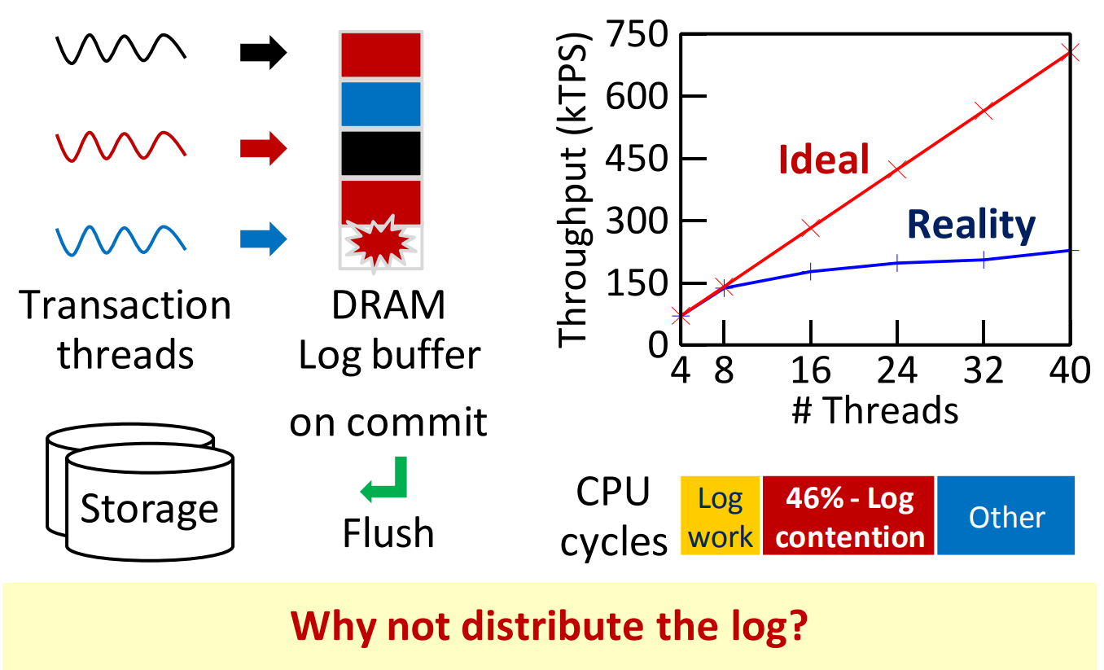
Centralized log: a serious bottleneck

Slide 28
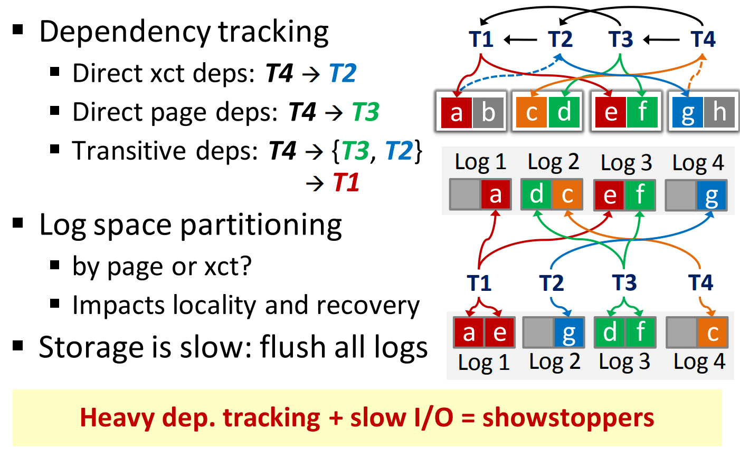
The (impractical) distributed log

Slide 29
Problem #1: LSN gives partial order
LSNs only good in any one log
Recovery needs total order in any log/transaction/page
Solution: global sequence number (GSN)

Slide 30
Global sequence number (GSN)
Based on logical clock
GSN is maintained in each page, transaction and log
Pinning a page in buffer pool sets page GSNs to max(tx GSN, page GSN) + 1
If update that page, set transaction GSNs to max(tx GSN, page GSN) + 1, otherwise max(tx GSN, page GSN)
Insert a log record will set both transaction and page GSNs to max(tx GSN, page GSN) + 1

Slide 31
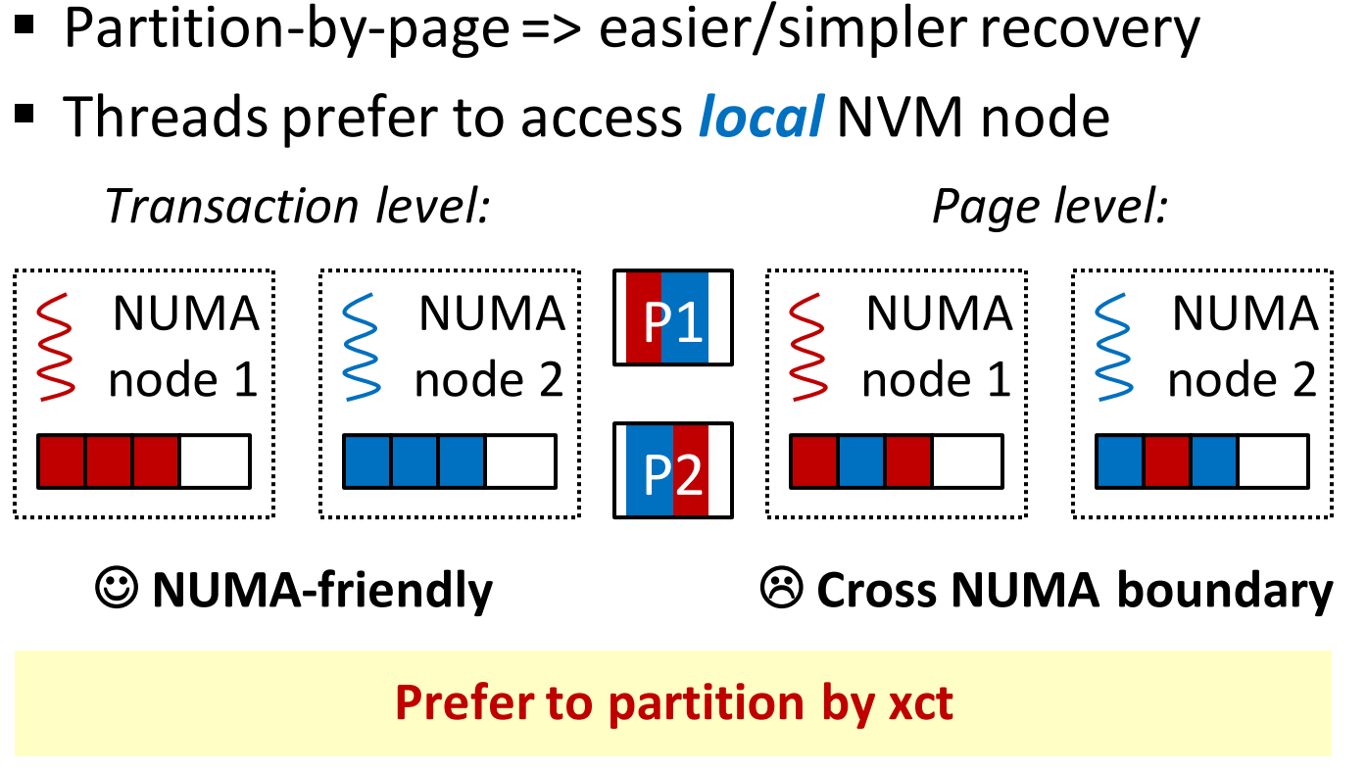
Problem #2: NUMA effects

Slide 32
Recovery
Page-level
Easy parallel redo
Expensive parallel undo (need to hop among multiple logs)
Transaction-level
Log synchronization needed for parallel redo
Cheap parallel undo by transactions
Notes:
Transaction level
Redo: 需要解决dependency，全局事务排序
Undo: 需要undo的全在一个transaction内部
Redo解决办法：map reduce，第一阶段将log按照page分区到M个桶里

Slide 33
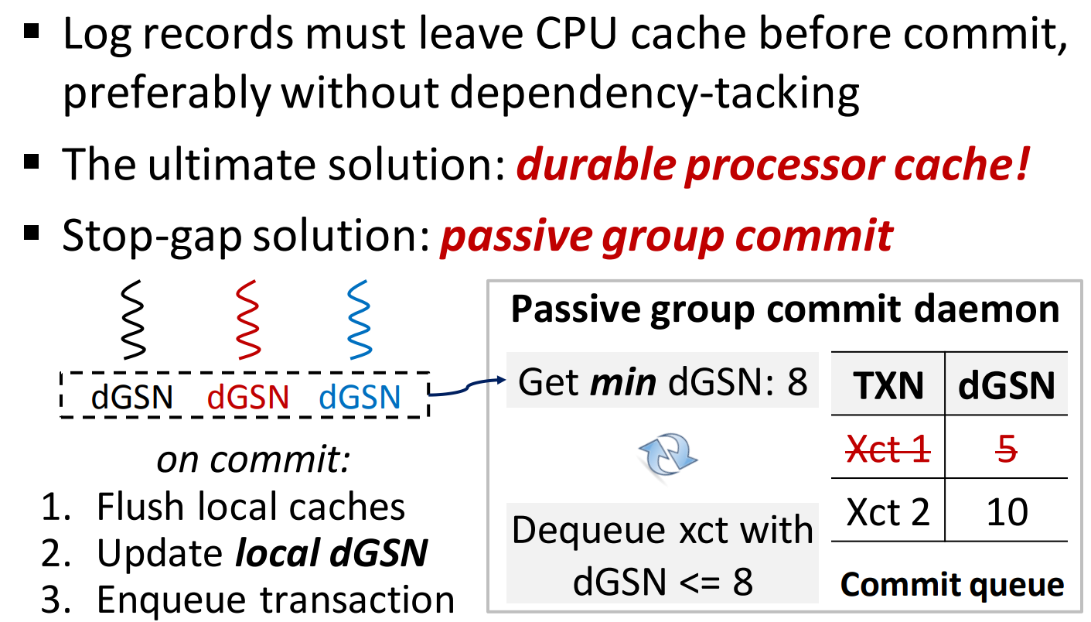
Problem #3: Volatile CPU caches

Slide 34
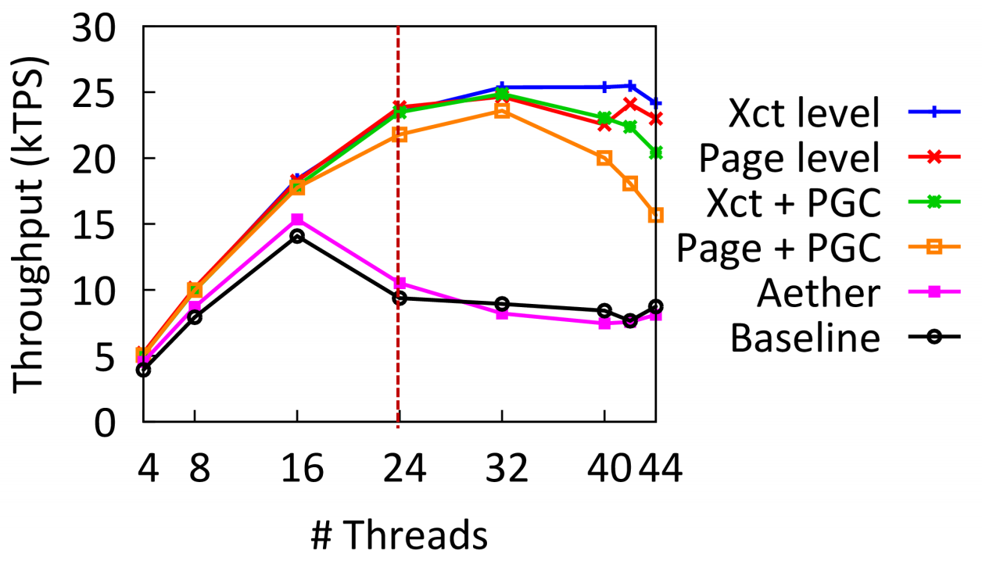
Evaluation with TPC-C
Shore-MT + 4-socket x 6-core Xeon, everything in DRAM
Notes:
PGC passive group commit 非durable cache

Slide 35
Detail Correctness Discussion

Slide 36
Correctness
Silo has a generated TID for each commit transaction
Why Silo need to replay the whole log unit of epoch ?

Slide 37
Behind the veil
Logging need sequenced logs
Dependency of transaction => log sequence
Key of bottlenecks :
It is anti-dependency (write-after-read conflict) !
What is this？

Slide 38
WR dependency

Slide 39
WW dependency

Slide 40
RW dependency（anti-dependency）
Notes:
解释一下为啥叫反依赖

Slide 41
Review
Silo Commit Protocol
Take the smallest number in the current epoch larger than all record TIDs observed (Read/Write) in the transaction.
Wang’s Protocol
Update GSNs when transaction
latches pages
inserts log records
The log sets its GSN to max(tx GSN, page GSN, log GSN)
Notes:
其实省事儿了，日志虽然写到不同的地方，但是他们在全局还是有序的，下周肖冰给大家带来完全意义上的无序日志的写

Slide 42
Thank you！
Notes:
清明假期玩的开心

