Slide 1
Taurus: A Parallel Transaction Recovery Method Based on Fine-Granularity Dependency Tracking XIANGYAO YU SIYE ZHU Justin kaashoek Andrew pavlo SRINIVAS DEVADAS Semantic Scholar
Bing Xiao
Notes:
为数据日志和命令日志都提供了恢复的并行
DBx1000

Slide 2
Overview
Motivation
Background
TAURUS Dependency Tracking
Evaluation

Slide 3
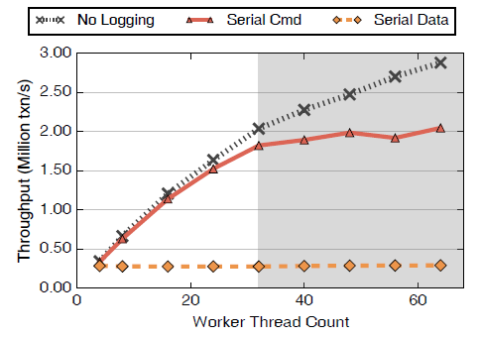
Logging in Database
Data Logging
Command Logging
Multi-core trend
Multiple persistent storage
Limitation of global LSN
Data-oriented Logging
Notes:
打破LSN的抽象概念和在多核条件下的限制；允许日志记录和恢复的并行，通过追踪事务间依赖实现。
解耦了事务的日志顺序和提交顺序，允许”事务”独立、并行地刷盘. – 提交前刷盘的事务会在恢复时根据日志记录的依赖信息被发现并且忽略掉
可利用多个存储设备记日志
可利用多个设备和多个工作线程并行恢复
For both data an command logging

Slide 4
Background
ACID
Main-memory DBMS
Uncommitted data stays in DRAM
Only needs REDO but not UNDO data in the form of log
Assumptions
A single log record of each transaction
Log records are flushed in batches to multiple storage devices
Transaction execution phase
Read and write logic
Pre-commit
Notes:
ACID最后的D： 保证提交的事务在系统崩溃后可恢复
预提交：意味着事务不会被中止，除非系统崩溃
Commit only after committable

Slide 5
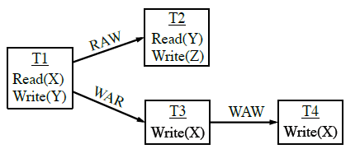
Committability & Durability
Serializability Theory
RAW
Committability
Predecessors in RAW is committable too
REDO log is persistent
Notes:
可串行化(恢复)理论：如果每一个事务都在其所读对应的事务提交之后提交，那么这段历史是可恢复的
All and only committable transactions should be recovered
Recovery: committable transaction identification + proper order
Taurus将依赖信息写入日志记录，使得
提交和恢复的顺序只在真的有依赖的事务之间才会需要
记日志和提交的过程是解耦的， 因为依赖关系可以在不需要日志顺序的情况下确定事务合适的提交和恢复顺序
LSN – global serial order – all data dependencies
Taurus只跟踪RAW和WAW， 而不需要跟踪WAR

Slide 6
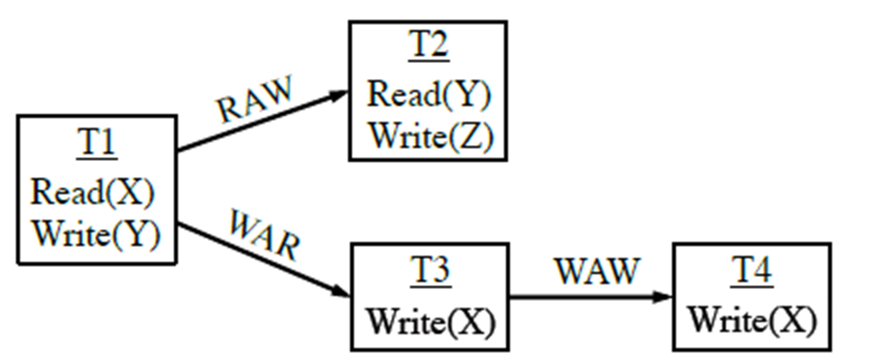
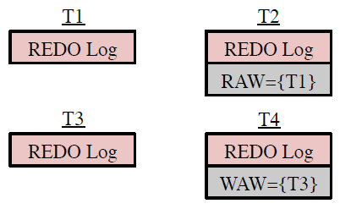
Parallel Dependency Tracking
in log records
construct and recover
Notes:
在恢复阶段：？
For data logging: WAW的前驱恢复好以后恢复自己 ？
For command logging: RAW和WAW的前驱恢复好以后恢复自己 ？
T1 T3 T4刷入任意的logger即可提交，因为没有RAW依赖于其他的事务; crash后也是可以无条件恢复的
T2 T1的RAW关系限制了提交顺序但是不影响记日志的顺序，他们可以刷入任意的logger

Slide 7
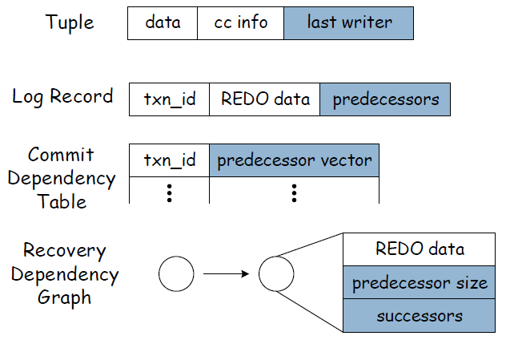
Data Logging
RAW/WAW
txn addresses in loggers
RAW/WAW
Notes:
事务执行阶段：
访问tuple， 除了data ccinfo还要访问last writer,并记载predecessor中
当事务要预提交时：
更新tuple的last_writer
Create a log record
Write log record to a logger
(maybe) T更新自己在提交依赖表中的predecessor vector
Logger thread flush log record to persistent storage in background

Slide 8

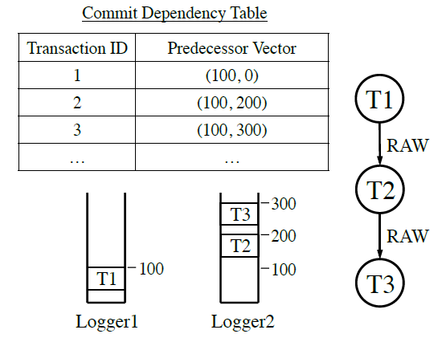
Data Logging
Committability from RAW
Tradeoff: dependency graph maintaining overhead
Cooperate with a persistent vector
Notes:
不需要追踪整张依赖图，而只需要针对每个要提交的事务，追踪每个日志文件中必须要为此持久化的位置.
Persistent vector is maintained here, 大于或等于preprocessor vector时，事务可提交并从提交依赖表中删除

Slide 9

Data Logging
Recoverability from RAW
Recovery order from WAW
3 phases:
Construct recovery dependency graph (logging threads)
Determine recoverability (worker threads)
Recover transactions (worker threads)
Notes:
Optimized parallel recovery phases:
Phase 2+phase 3 during phase 1
Logging threads handle garbage collection as transaction get recovered
Recover_queue （no WAW conflict transactions）for worker threads

Slide 10
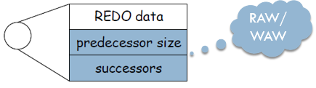
Data Logging
Transaction status：
Unrecoverable
Recoverable
ReadyForRecovery
Recovered
Notes:
Garbage collecting transactions from the same log file in the txn_id order
System remembers min_gc_id for each log file

Slide 11
Command Logging
Same parallel logging algorithm as data logging
Store procedure needs to read tuples while recovering
Recover from RAW besides WAW
WAR brings side effect

Slide 12
Command Logging
Multi-version Parallel Recovery
plus commit timestamp in each log record
ReadyForRecovery state: RAW+WAW
Notes:
For WAR
No tuples are overwritten in multi-version
假设所有的事务日志均落盘了
GC

Slide 13
Experimental Setup
DBx1000 uses the scalable timestamp ordering-based CC
8 cores * 4 CPU *2 hyperthreading on
3 Fusion IO ioDrive2 flash drives +1 RAID5 (2GB/s)
16 MB buffer for each logger in group commit
YCSB TPC-C

Slide 14
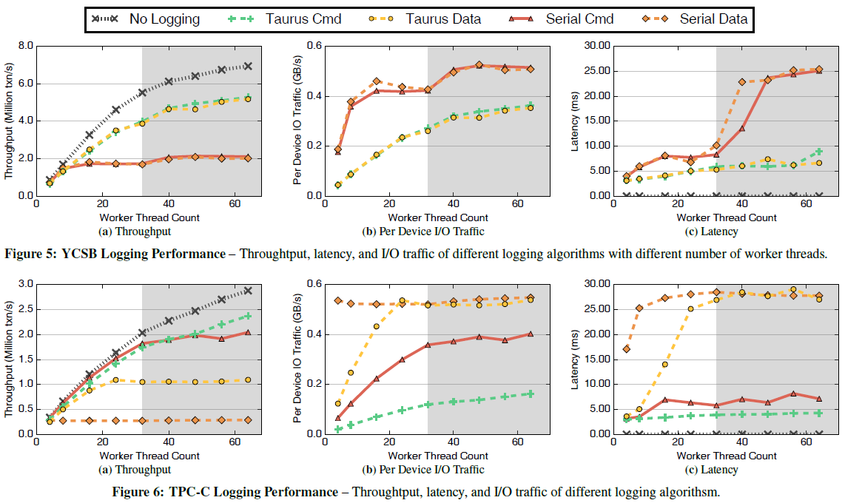
Logging Performance

Slide 15
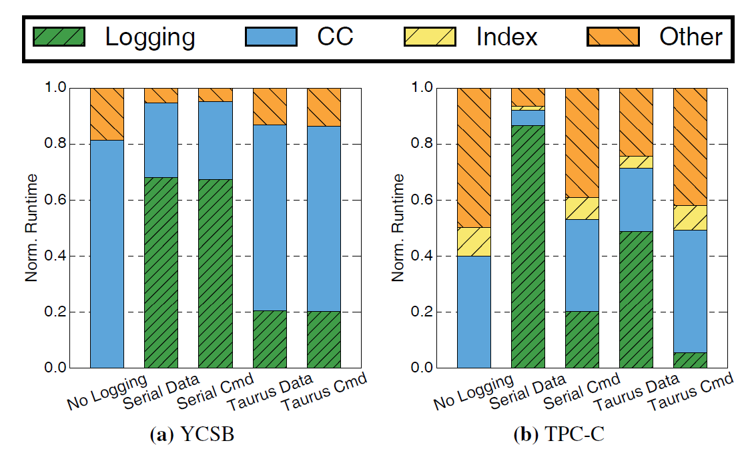
Logging Time Breakdown

Slide 16
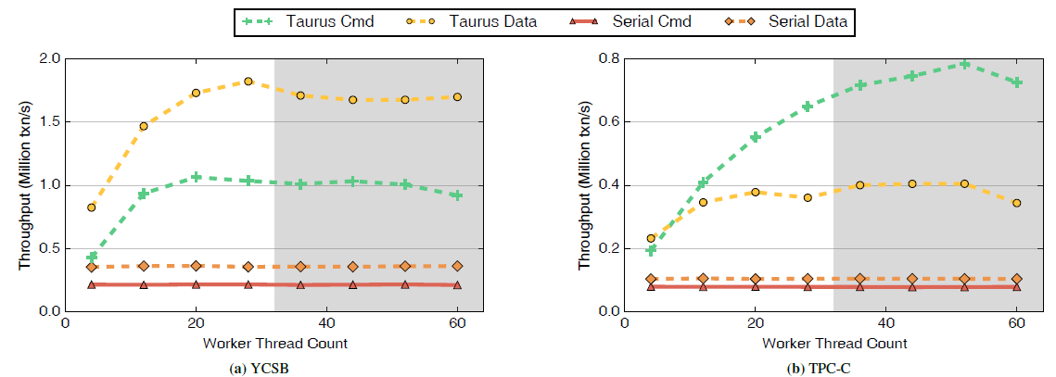
Recovery Performance

Slide 17
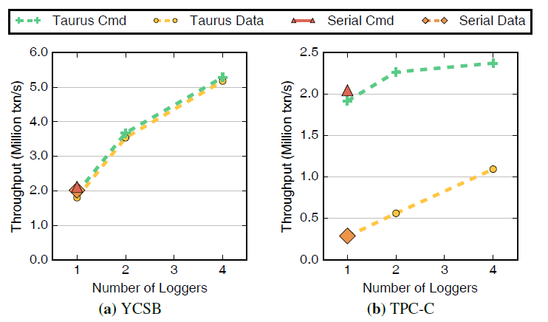
Scalability

Slide 18
THANKS FOR LISTENING !
Taurus

