Slide 1
Verilog HDL로
디지털 회로설계
Feb 11,2026
by SIKWON

Slide 2
산술연산 조합회로(arithmetric logic)
1. Half adder
2. 1bit full adder
3. 4bit full adder

Slide 3
산술연산 조합회로(combinational logic)
조합회로출력이 현재의 입력에 의해 결정되는 기억소자가 없는 회로
순차회로
  Clock이 발생할 때 Data를 출력하고, 다음 clock이 발생할 때 까지 그 값을 유지하는 회로
  출력이 현재의 입력과 과거의 입력 정보를 포함하여 결정되는 기억소자를 포함하는 회로
  종류: D f/f, register, counter

Slide 4
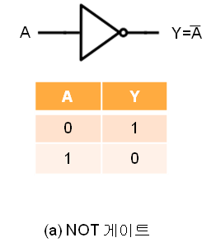
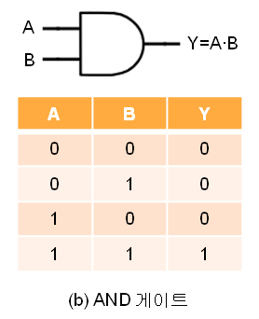
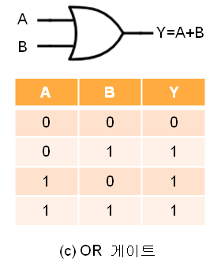
산술연산 / 논리 게이트(logic gate)
module inv(a, y);
input a;
output y;
assign y = ~a ;
endmodule
module and(a, b, y);
input a, b;
output y;
assign y = a&b ;
endmodule
module or(a, b, y);
input a, b;
output y;
assign y = a|b ;
endmodule

Slide 5
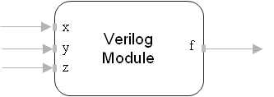
산술연산 / 조합회로 기술 하기
모듈: 입력과 출력을 가지고 있는 단위 블록
Behavioral 모델
  모듈의 기능을 기술 하듯이 표현
module ex_behavioral(x, y, z, f);
input x, y, z;
output f;
assign f = ~x & y & z | ~x & y & ~z | x & z;
Endmodule

Slide 6
산술연산
module inv(a, y); // NOT
input a;
output y;
assign y = ~a ;
endmodule
module and2( a, b, y); // 2-input AND
input a, b;
output y;
assign y = a & b;
endmodule
module and3( a, b, c, y); // 3-input AND
input a, b, c;
output y;
assign y = a & b & c;
endmodule
module or3(a, b, c, y); // 3-input OR
input a, b, c;
output y;
assign y = a | b | c;
endmodule
module ex_structure(x, y, z, f);
input x, y, z;
output f;
wire w_inv_x, w_inv_z;
wire w_and3_0, w_and3_1, w_and2_0;
Inv inv_x (x, w_inv_x);
inv inv_z (z, w_inv_z);
and3 and3_0 (w_inv_x, y, z, w_and3_0);
and3 and3_1 (w_inv_x, y, w_inv_z, w_and3_1);
and2 and2_0 (x, z, w_and2_0);
or3 or3_0 (w_and3_0, w_and3_1, w_and2_0, f);
endmodule

Slide 7
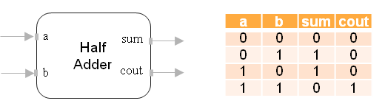
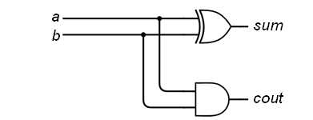
산술연산 / half adder
testbench_half_adder.v
`timescale 1ns / 1ps
module testbench_half_adder();
reg a, b;
wire sum, carry_out;
half_adder dut(
.a(a),
.b(b),
.sum(sum),
.carry_out(carry_out)
);
initial begin
#00 a = 1'b0; b = 1'b0;
#10 a = 1'b0; b = 1'b1;
#10 a = 1'b1; b = 1'b0;
#10 a = 1'b1; b = 1'b1;
#10 $finish;
end
endmodule
half_adder.v
`timescale 1ns / 1ps
module half_adder(a, b, sum, carry_out);
input a, b;
output sum, carry_out;
assign sum = a ^ b;
assign carry_out = a & b;
endmodule

Slide 8
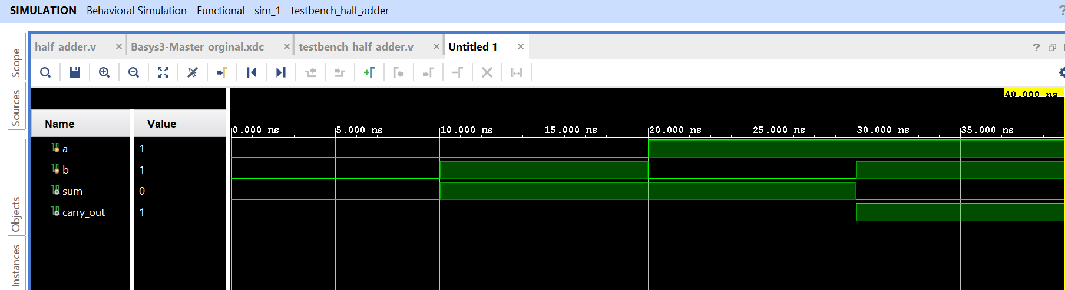
산술연산 / half adder
Constraint file
## Switches
set_property -dict { PACKAGE_PIN V17 IOSTANDARD LVCMOS33 } [get_ports { a }]
set_property -dict { PACKAGE_PIN V16 IOSTANDARD LVCMOS33 } [get_ports { b }]
## LEDs
set_property -dict { PACKAGE_PIN U16 IOSTANDARD LVCMOS33 } [get_ports { sum }]
set_property -dict { PACKAGE_PIN E19 IOSTANDARD LVCMOS33 } [get_ports { carry_out }]
## Configuration options, can be used for all designs
set_property CONFIG_VOLTAGE 3.3 [current_design]
set_property CFGBVS VCCO [current_design]
## SPI configuration mode options for QSPI boot, can be used for all designs
set_property BITSTREAM.GENERAL.COMPRESS TRUE [current_design]
set_property BITSTREAM.CONFIG.CONFIGRATE 33 [current_design]
set_property CONFIG_MODE SPIx4 [current_design]

Slide 9
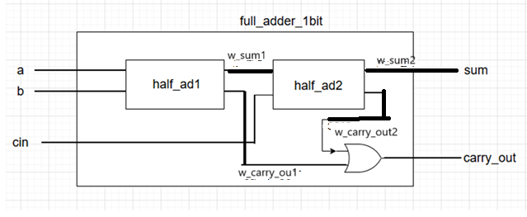
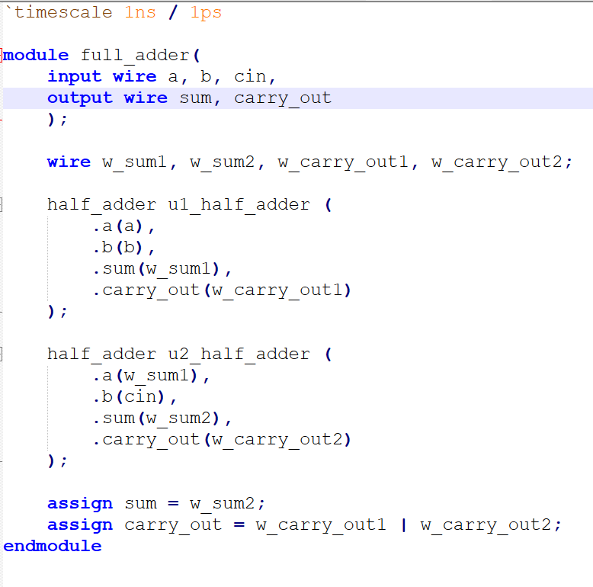
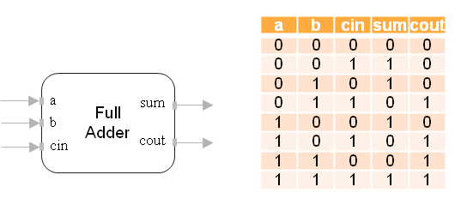
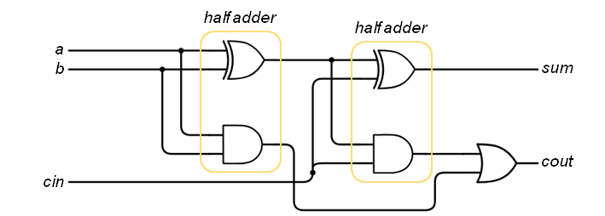
산술연산 / 1 bit full adder
<그림 1> 1bit full adder 회로 instance를 보고 Velilog code로coding
Structrual 모델: 모듈의 기능을 간단한 모듈의 조합으로 구조적으로 표현
<그림 1> 1bit full adder 회로 instance
< full_adder.v>

Slide 10
산술연산 / 1 bit full adder
## Clock signal
###set_property -dict { PACKAGE_PIN W5 IOSTANDARD LVCMOS33 } [get_ports clk]
###create_clock -add -name sys_clk_pin -period 10.00 -waveform {0 5} [get_ports clk]
## Switches
set_property -dict { PACKAGE_PIN V17 IOSTANDARD LVCMOS33 } [get_ports { a }]
set_property -dict { PACKAGE_PIN V16 IOSTANDARD LVCMOS33 } [get_ports { b }]
set_property -dict { PACKAGE_PIN W16 IOSTANDARD LVCMOS33 } [get_ports { cin }]
## LEDs
set_property -dict { PACKAGE_PIN U16 IOSTANDARD LVCMOS33 } [get_ports { sum } ]
set_property -dict { PACKAGE_PIN E19 IOSTANDARD LVCMOS33 } [get_ports { carry_out }]
#set_property -dict { PACKAGE_PIN U19 IOSTANDARD LVCMOS33 } [get_ports {led[2]}]
#set_property -dict { PACKAGE_PIN V19 IOSTANDARD LVCMOS33 } [get_ports {led[3]}]
##Buttons
#set_property -dict { PACKAGE_PIN U18 IOSTANDARD LVCMOS33 } [get_ports btnC]
#set_property -dict { PACKAGE_PIN T18 IOSTANDARD LVCMOS33 } [get_ports btnU]
#set_property -dict { PACKAGE_PIN T18 IOSTANDARD LVCMOS33 } [get_ports increase_duty_btn]
#set_property -dict { PACKAGE_PIN W19 IOSTANDARD LVCMOS33 } [get_ports btnL]
#set_property -dict { PACKAGE_PIN T17 IOSTANDARD LVCMOS33 } [get_ports btnR]
#set_property -dict { PACKAGE_PIN U17 IOSTANDARD LVCMOS33 } [get_ports btnD]
#set_property -dict { PACKAGE_PIN U17 IOSTANDARD LVCMOS33 } [get_ports decrease_duty_btn]
##USB-RS232 Interface
#set_property -dict { PACKAGE_PIN B18 IOSTANDARD LVCMOS33 } [get_ports RsRx]
#set_property -dict { PACKAGE_PIN A18 IOSTANDARD LVCMOS33 } [get_ports RsTx]
## Configuration options, can be used for all designs
set_property CONFIG_VOLTAGE 3.3 [current_design]
set_property CFGBVS VCCO [current_design]
## SPI configuration mode options for QSPI boot, can be used for all designs
set_property BITSTREAM.GENERAL.COMPRESS TRUE [current_design]
set_property BITSTREAM.CONFIG.CONFIGRATE 33 [current_design]
set_property CONFIG_MODE SPIx4 [current_design]

Slide 11
// 1-bit Full Adder Module
module full_adder(
input a, // 첫 번째 입력 비트
input b, // 두 번째 입력 비트
input cin, // 이전 자리에서 올라온 자리올림 입력
output sum, // 합 출력
output carry_out ); // 자리올림 출력
// 합: a, b, cin을 XOR
assign sum = a ^ b ^ cin;
// 자리올림: (a & b) | (b & cin) | (a & cin)
assign carry_out = (a & b) | (b & cin) | (a & cin);
endmodule
// 설명: Full Adder는 세 개의 입력 비트(a, b, cin)를 받아 합(sum)과 자리올림(cout)
// sum은 세 입력의 홀수 개 1을 검출하는 XOR 연산으로, cout은 두 입력 이상이 1일 때 자리올림이 발생하는 OR-AND 조합으로

Slide 12
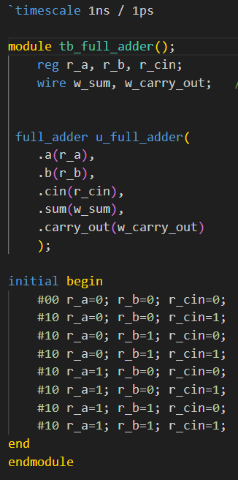
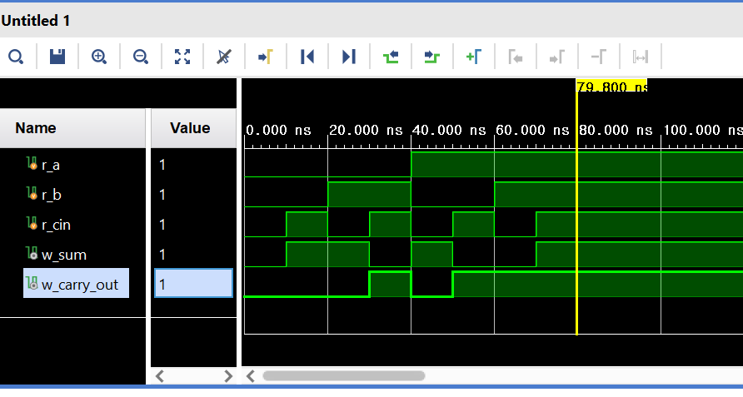
산술연산 / 1 bit full adder
<tb_full_adder.v>

Slide 13
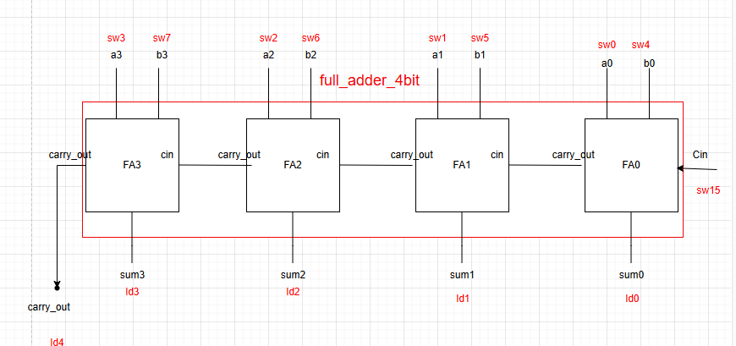
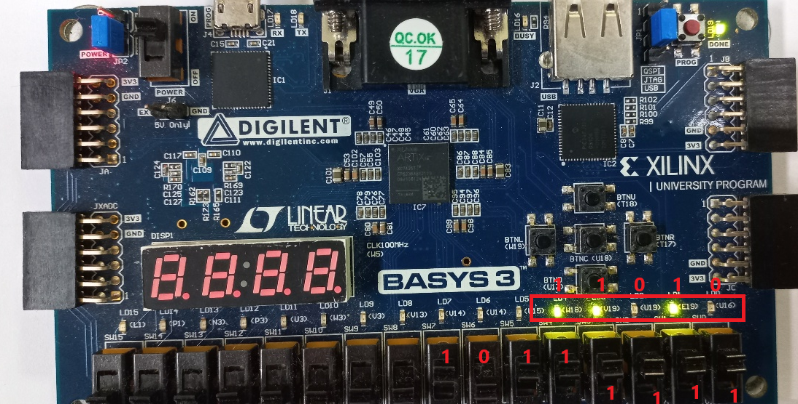
산술연산 / 4bit full adder
FA3 FA2 FA1 FA0
1 1 1 1 a
+ 1 0 1 1 b
----------------------
1 1 0 1 0
Carry out
적색 글자는 basys3에 있는 물리적인 port를 가리킨다.
예를 들어서 a0는 sw0에 mapping 된다.
< 실행 결과>

Slide 14
산술연산 / 4bit full adder
< full_adder_4bit.v>
< tb_fulladder_4bit.v>
`timescale 1ns / 1ps
module full_adder_4bit(
input [3:0] a,
input [3:0] b,
input cin, // 1bit
output [3:0] sum,
output carry_out
);
wire w_carry0, w_carry1, w_carry2;
full_adder_1bit FA0 (
.a(a[0]), // a[0] 1bit
.b(b[0]),
.cin(1’b0),
.sum(sum[0]),
.carry_out(w_carry0)
); // named instantiation
full_adder_1bit FA1 (
.a(a[1]), // a[0] 1bit
.b(b[1]),
.cin(w_carry0),
.sum(sum[1]),
.carry_out(w_carry1)
);
full_adder_1bit FA2 (
.a(a[2]), // a[0] 1bit
.b(b[2]),
.cin(w_carry1),
.sum(sum[2]),
.carry_out(w_carry2)
);
full_adder_1bit FA3 (
.a(a[3]), // a[0] 1bit
.b(b[3]),
.cin(w_carry2),
.sum(sum[3]),
.carry_out(carry_out)
);
endmodule
`timescale 1ns / 1ps
module tb_fulladder_4bit(); // 시물레이션에서 입출력은 없다.
reg [3:0] a; // 시물레이션에서 입력은 reg
reg [3:0] b;
reg cin; // 1bit
wire [3:0] sum; // 시물레이션에서 출력은 wire로 선언
wire carry_out;
full_adder_4bit dut (
.a(a),
.b(b),
.cin(cin), // 1bit
.sum(sum),
.carry_out(carry_out)
);
initial begin
#00 a=0; b=0; cin=0;
#10 a=0; b=2;
#10 a=7; b=9;
#10 a=9; b=9;
#10 a=7; b=7;
for (integer i=0; i < 20; i= i+1) begin
#10 a=i;
end
#10 $finish;
end
endmodule
//cin초기값 0
full_adder_1bit FA0
instantiation.인스턴시에이션
(상위모듈에서 하위모듈을 호출(연결)하는것
물리적 공간에 영역을 할당하여, 실제로 이름을
가진 독립된 객체를 다룰 수 있게 된다

Slide 15
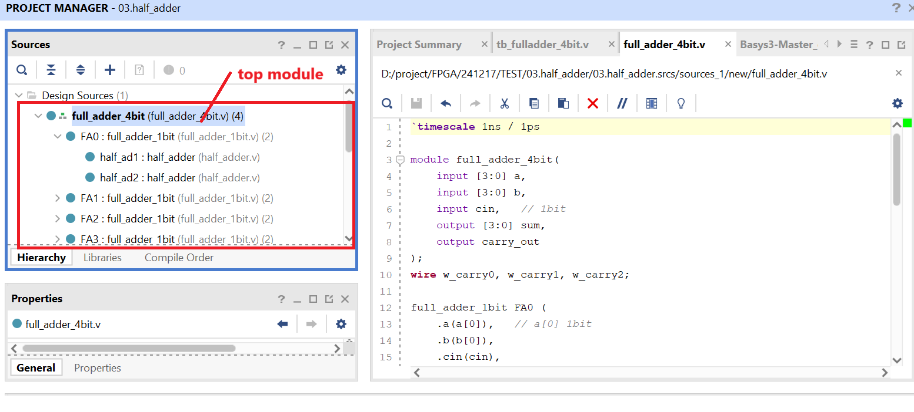
산술연산 / 4bit full adder

Slide 16
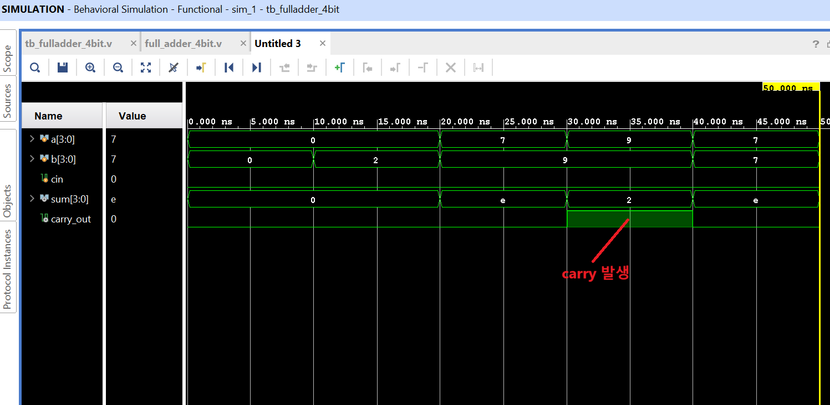
산술연산 / 4bit full adder
simulation 결과

Slide 17
산술연산 / 4bit full adder
< Constraints 파일> XDC화일
## This file is a general .xdc for the Basys3 rev B board
## To use it in a project:
## - uncomment the lines corresponding to used pins
## - rename the used ports (in each line, after get_ports) according to the top level signal names in the project
## Clock signal
#set_property -dict { PACKAGE_PIN W5 IOSTANDARD LVCMOS33 } [get_ports clk]
#create_clock -add -name sys_clk_pin -period 10.00 -waveform {0 5} [get_ports clk]
## Switches
set_property -dict { PACKAGE_PIN V17 IOSTANDARD LVCMOS33 } [get_ports {a[0]}]
set_property -dict { PACKAGE_PIN V16 IOSTANDARD LVCMOS33 } [get_ports {a[1]}]
set_property -dict { PACKAGE_PIN W16 IOSTANDARD LVCMOS33 } [get_ports {a[2]}]
set_property -dict { PACKAGE_PIN W17 IOSTANDARD LVCMOS33 } [get_ports {a[3]}]
set_property -dict { PACKAGE_PIN W15 IOSTANDARD LVCMOS33 } [get_ports {b[0]}]
set_property -dict { PACKAGE_PIN V15 IOSTANDARD LVCMOS33 } [get_ports {b[1]}]
set_property -dict { PACKAGE_PIN W14 IOSTANDARD LVCMOS33 } [get_ports {b[2]}]
set_property -dict { PACKAGE_PIN W13 IOSTANDARD LVCMOS33 } [get_ports {b[3]}]
#set_property -dict { PACKAGE_PIN V2 IOSTANDARD LVCMOS33 } [get_ports {sw[8]}]
#set_property -dict { PACKAGE_PIN T3 IOSTANDARD LVCMOS33 } [get_ports {sw[9]}]
#set_property -dict { PACKAGE_PIN T2 IOSTANDARD LVCMOS33 } [get_ports {sw[10]}]
#set_property -dict { PACKAGE_PIN R3 IOSTANDARD LVCMOS33 } [get_ports {sw[11]}]
#set_property -dict { PACKAGE_PIN W2 IOSTANDARD LVCMOS33 } [get_ports {sw[12]}]
#set_property -dict { PACKAGE_PIN U1 IOSTANDARD LVCMOS33 } [get_ports {sw[13]}]
#set_property -dict { PACKAGE_PIN T1 IOSTANDARD LVCMOS33 } [get_ports {sw[14]}]
set_property -dict { PACKAGE_PIN R2 IOSTANDARD LVCMOS33 } [get_ports {cin}]
## LEDs
set_property -dict { PACKAGE_PIN U16 IOSTANDARD LVCMOS33 } [get_ports { sum[0] }]
set_property -dict { PACKAGE_PIN E19 IOSTANDARD LVCMOS33 } [get_ports { sum[1] }]
set_property -dict { PACKAGE_PIN U19 IOSTANDARD LVCMOS33 } [get_ports { sum[2] }]
set_property -dict { PACKAGE_PIN V19 IOSTANDARD LVCMOS33 } [get_ports { sum[3] }]
set_property -dict { PACKAGE_PIN W18 IOSTANDARD LVCMOS33 } [get_ports { carry_out }]
#set_property -dict { PACKAGE_PIN U15 IOSTANDARD LVCMOS33 } [get_ports {led[5]}]
#set_property -dict { PACKAGE_PIN U14 IOSTANDARD LVCMOS33 } [get_ports {led[6]}]
#set_property -dict { PACKAGE_PIN V14 IOSTANDARD LVCMOS33 } [get_ports {led[7]}]
#set_property -dict { PACKAGE_PIN V13 IOSTANDARD LVCMOS33 } [get_ports {led[8]}]
#set_property -dict { PACKAGE_PIN V3 IOSTANDARD LVCMOS33 } [get_ports {led[9]}]
#set_property -dict { PACKAGE_PIN W3 IOSTANDARD LVCMOS33 } [get_ports {led[10]}]
#set_property -dict { PACKAGE_PIN U3 IOSTANDARD LVCMOS33 } [get_ports {led[11]}]
#set_property -dict { PACKAGE_PIN P3 IOSTANDARD LVCMOS33 } [get_ports {led[12]}]
#set_property -dict { PACKAGE_PIN N3 IOSTANDARD LVCMOS33 } [get_ports {led[13]}]
#set_property -dict { PACKAGE_PIN P1 IOSTANDARD LVCMOS33 } [get_ports {led[14]}]
#set_property -dict { PACKAGE_PIN L1 IOSTANDARD LVCMOS33 } [get_ports {led[15]}]

