Slide 1
TXODDS WORLD CUP HACKATHON
Onside
Football markets settled by proof,
not opinion.
01
Notes:
Onside is a trustless football prediction market built on Solana. Fans can bet on match outcomes, goals, cards, corners, and same-match combinations—but no administrator gets to decide the winner. Every result is verified using cryptographic data from TxODDS.

Slide 2
THE PROBLEM
The last step still asks:
who decides the result?
A common optimistic-oracle flow
Propose
→
Challenge
→
Vote
Settlement becomes a human interpretation layer—
even when trading itself is on-chain.
Source: Polymarket resolution documentation · docs.polymarket.com/concepts/resolution
02
Notes:
Prediction markets promise transparency, but settlement often introduces interpretation again. A proposer declares an outcome, others may challenge it, and disputed cases can end in a vote. Users can inspect the final transaction, but they still depend on people agreeing about the result.

Slide 3
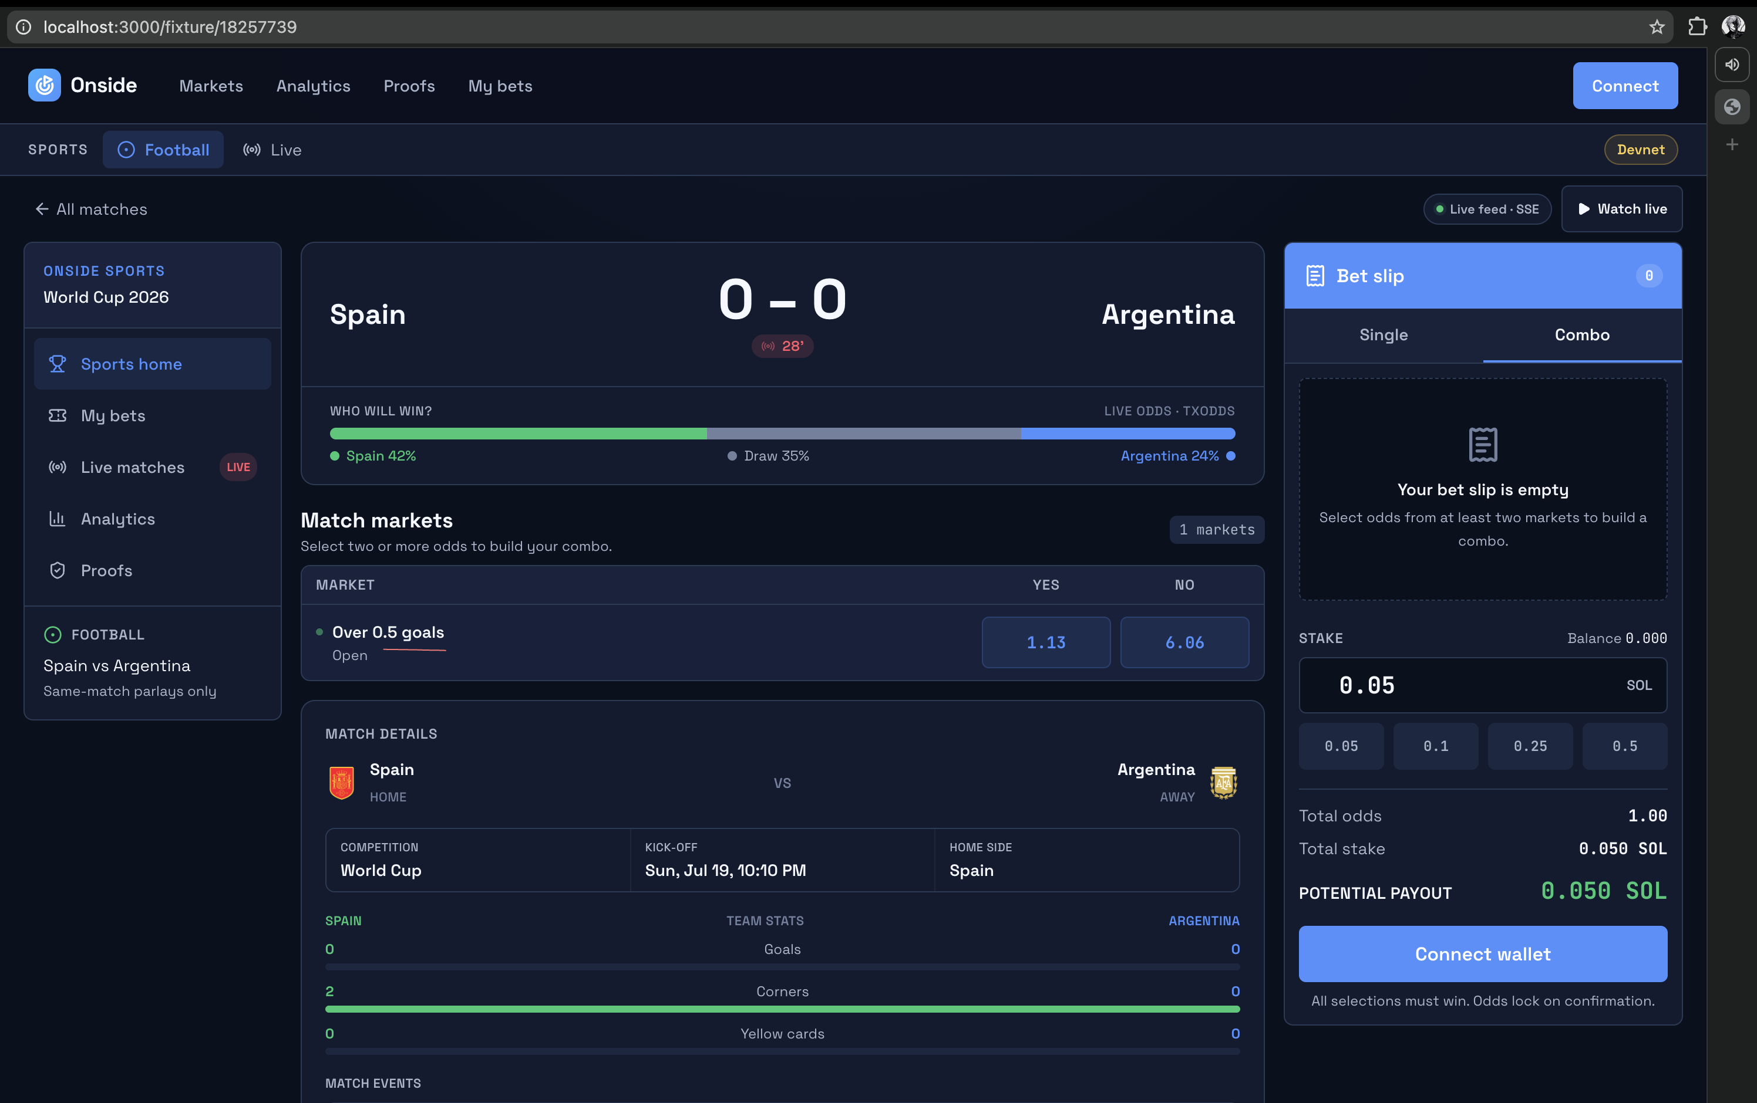
THE PRODUCT
A sportsbook experience—without sportsbook authority
YES / NO
Simple fan-facing markets
PARIMUTUEL
Shared pools, no counterparty
COMBOS
Multiple picks, one ticket
Recorded devnet World Cup replay
03
Notes:
Onside gives fans a familiar sportsbook experience. They connect a wallet, choose YES or NO across markets, and can combine outcomes into one same-match ticket. Individual markets use shared parimutuel pools, so users do not need to find a direct counterparty. Their stake joins the pool, and winners share the payout.

Slide 4
TRUSTLESS SETTLEMENT
The contract proves the result itself
TxODDS
Merkle proof
Onside
Outcome
→
→
→
Final score
and stats
Timestamped
on Solana
CPI verifies
the proof
Winner derived
on-chain
The keeper submits proof. It never chooses the winner.
Source: TxODDS TxLINE · txodds.net/our-products/tx-line
04
Notes:
When the match finishes, TxODDS supplies the final score and Merkle proof. The keeper submits that proof to Onside. The Onside program calls the TxODDS oracle program, verifies the value against the on-chain root, and derives the winner from the market predicate. The keeper can submit proof, but it cannot invent a score or select an outcome.

Slide 5
BUILT END-TO-END ON DEVNET
The result is proven,
not trusted.
Deployed
Permissionless
Public
Anchor program
proof submission
settlement receipts
Serhii Khara · Ruslan Yakumenko
web-seven-black-v94mn9a4vm.vercel.app
Program 6F6f…Epvb
05
Notes:
Onside is already deployed end-to-end on Solana devnet: a working consumer interface, shared parimutuel pools, permissionless proof submission, and public settlement receipts. It turns TxODDS verified sports data into a prediction market that fans can understand and anyone can audit. Onside: the result is proven, not trusted.

