Slide 1
Deep Natural Language Processing for User Representation
Traitement du langage naturel profond pour la modélisation d’utilisateurs
Clara Gainon de Forsan de Gabriac – 13 décembre2021
JURY DE THESE
Rapporteurs
Anne Boyer
Julien Velcin
Examinateurs
Mohamed Chetouani
Alejandro Bellogin
Encadrants
Patrick Gallinari
Vincent Guigue
Notes:
Hello
Thank you for being here
I’ll be presenting my PHD

Slide 2
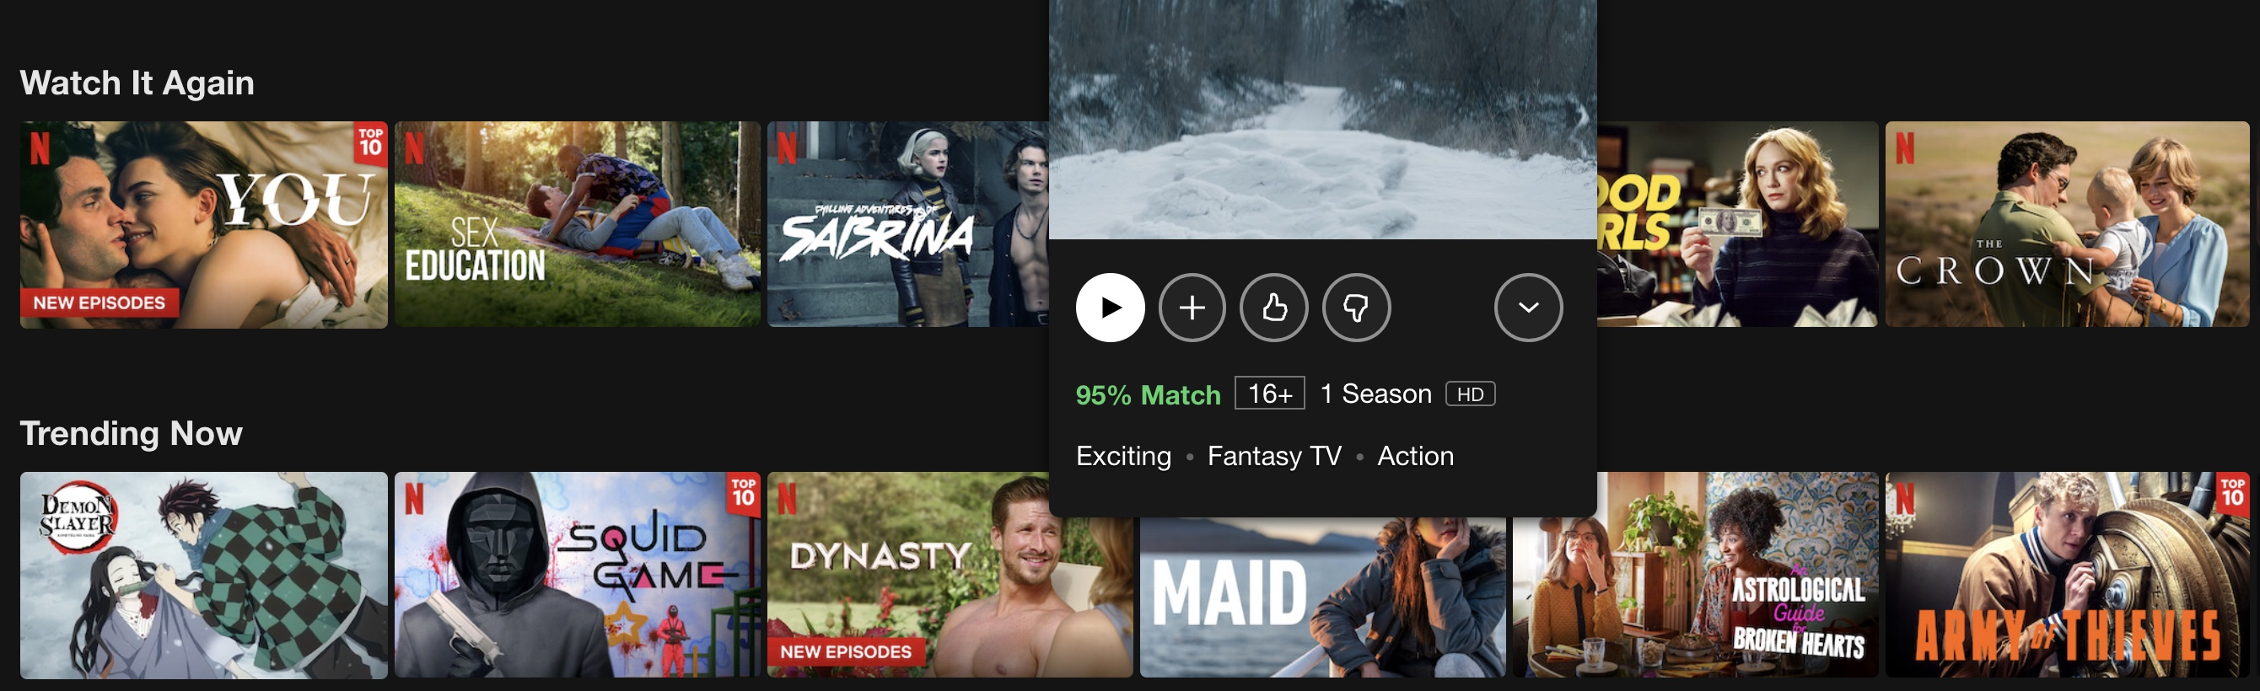
The Information Era
Illustration of Netflix recommendations
Ever-growing quantity of data to choose from
Multiplication of user (textual) traces
Notes:
In the past decades, the rise of internet led to an explosion of data and basically of choice and online services: movies on Netflix, stuff on amazon and so on.
Additionally, the number of interactions between users and those systems keeps increasing, namely in the form of textual traces such as reviews.

Slide 3
The Information Era
Illustration of Netflix recommendations
Ever-growing quantity of data to choose from
Multiplication of user (textual) traces
Challenge: present users with relevant items
Notes:
This situation brings a challenge: to present users with a subset of relevant items rather than the whole catalog to ease their search.
The notion of relevance is a complex one to define and it is highly discussed in the community.
In this work, we will consider an item to be relevant if it is personalized and if we can explain why it is consistent with the user’s profile.

Slide 4
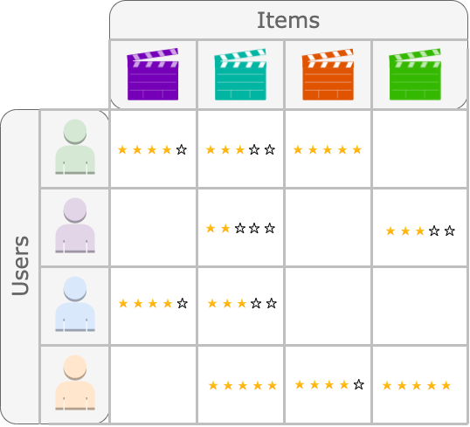
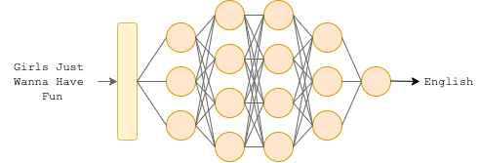
Artificial Intelligence and Deep Learning
Schema of a language classifier
A user-item Matrix (Collaborative Filtering)
Computer Vision
Recommendation
Natural Language Processing
…
Rise of AI for numerous applications:
Notes:
This challenge is a classic Recommendation Problem, that often addressed by Machine Learning algorithms.
Machine Learning, and in particular Deep Learning models have grown very popular in the past few yeas because they can be applied to various domains, ranging from Recommendation to Computer Vision to Natural Language Processing.

Slide 5
Problematics
Rich User
Representation
What
Understand the users’ tastes
Model diversity and complexity of their profiles
How
Recommendation [1], [2]
Representation Learning
[1] J. McAuley et al., 2012, [2] J. McAuley et al., 2013
Notes:
In order to achieve relevant recommendation, one must first understand the user.
In other words, we want to build rich user representations in the sense that they can model complex and diverse aspects of their profiles,
This goal has been at the heart of the Recommendation domain since the focus shifted from item-centric models to user-centric ones.
Namely, McAuley et al. have explored the multi aspect quality and hidden factors of textual reviews, by explicitly modeling them.
Our approach rather lies in the wake of the representation learning paradigm, where we implicitly model various aspects of the users by learning a representation on an initial high-level task.
This type of representations is often called versatile because they can be re-used or fine-tuned on other tasks than the ones they were trained on.

Slide 6
Problematics
Rich User
Representation
Leverage
User-generated
Text
What
How
Notes:
We choose to address this problem by the leveraging of user-generated text.
Indeed, aside from this type of data being widely available, we think it Is also highly descriptive of the users themselves. It is especially clear when we think of written reviews: the users clearly state what they like and dislike about a product, giving us a lot more information than the rating alone.
From a broader point of view, one can think of text as highly descriptive of a user because the words and the syntax they use to talk about their experiences are almost always unique to them.

Slide 7
Problematics
Rich User
Representation
Leverage
User-generated
Text
What
Understand the users’ tastes
Model diversity and complexity of their profiles
Make Predictions Explainable
How
Recommendation [1], [2]
Representation Learning
Notes:
This choice to focus on user-generated text (as well as the advances of generative models) also allows us to explore the explainability of our models’ predictions, which we consider to be one of the biggest challenge faced by Deep Learning and Artificial Intelligence in general.
Indeed, if AI is to take a bigger place in our society, then we must be able to understand or at least explain the predictions it gives.

Slide 8
Problematics
Rich User
Representation
Leverage
User-generated
Text
Make Predictions Explainable
This Work
Notes:
The work presented in this thesis is motivated by those three aspects.
We want to use user-generated texts to build rich meaningful and explainable representations.

Slide 9
Motivations and contributions
Motivations
Axes
Rich, versatile user representation
Recommendation
Leverage user-generated text
Natural Language Processing
Make predictions explainable
Text Generation
Notes:
We tackle the motivations of this thesis along several axes: recommendation, RL, NLP and Text Generation.
Expliquer plus ?

Slide 10
Motivations and contributions
Motivations
Axes
Contribution
Rich, versatile user representation
Recommendation
1
HRAN
Leverage user-generated text
Natural Language Processing
2
Resume
Make predictions explainable
Text Generation
Notes:
In our first contribution, HRAN, we will combine a Recommendation, RL and NLP methods in order to refine our understanding of user tastes in a classic Recommendation problematic.
In our second contribution, Resume, we propose a framework to learn and evaluate user professional profiles, a new task, by combining RL to NLP and Text generation.

Slide 11
Motivations and contributions
Motivations
Axes
Contribution
Rich, versatile user representation
Recommendation
1
HRAN
Leverage user-generated text
Natural Language Processing
2
Resume
Make predictions explainable
Text Generation
Representation Learning

Slide 12
Outline
Refining User Understanding In Recommendation Via NLP (HRAN)
An NLP Approach To Professional Profile Learning And Evaluation (Resume)
User Dynamic Modeling
Conclusion & Perspective
Notes:
The presentation is thus organized as follows:
We will go over our first contribution, HRAN,

Slide 13
REFINING USER UNDERSTANDING IN RECOMMENDATION VIA NLP
RNN & modèle d’attention pour l’apprentissage de profils textuels personnalisés
Charles-Emmanuel Dias, Clara Gainon de Forsan de Gabriac, Vincent Guigue, and Patrick Gallinari CORIA 2018
Notes:
Let’s begin with our HRAN model, which was published

Slide 14
Motivation and intuition
Motivation
Refining user understading
Good prediction accuracy
Prediction Explainability
Intuition
Reviews can help improve performances
& make predictions understandable.
Notes:
This work is motivated by …
The intuition behind this contribution is that reviews can help improve performances & make predictions understandable.

Slide 15
Motivation and intuition
Motivation
Good prediction accuracy
Prediction Explainability
Intuition
Reviews can help improve performances
& make predictions understandable.
Approach
Rating regression
+
Sentiment analysis
Hierarchical Recurrent Attentive Network
Sentiment Analysis
Polarity
Prediction
Reviews
User profile +
Item profile
Rating regression
Rating
Prediction
Notes:
We implement this intuition by combining a traditional rating regression module to an attentive sentiment analysis module.
The resulting model is called HRAN, for Hierarchical Recurrent Attentive Network.
The sentiment analysis part takes the reviews as input…
The rating regression module takes both the user and the item profiles as input…
Both modules share inner intermediate representation to refine the models’ enderstadning of the user’s tastes.

Slide 16
Motivation and intuition
Collaborative Filtering via Matrix Factorization [1]
Leveraging Textual reviews for recommendation [2]
Hierarchical Attentive Network for document classification [3]
Approach
Rating regression
+
Sentiment analysis
Hierarchical Recurrent Attentive Network
Sentiment Analysis
Polarity
Prediction
Reviews
User profile +
Item profile
Rating regression
Rating
Prediction
[1] Koren et al., 2009, [2] J. McAuley and Leskovec, 2013, [3] Z. Yang et al., 2016

Slide 17
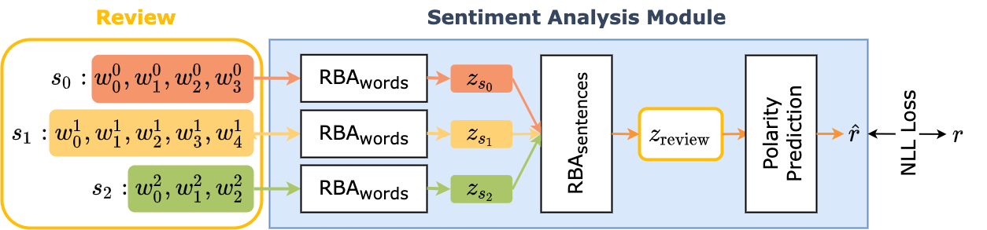
The model : HRAN, Sentiment Analysis Module
Illustration of the sentiment analysis module.
Notes:
More precisely, the sentiment analysis uses the representation of the rating prediciton module in two places: once at the word level RBA, and then at the sentence level RBA, which gives it its hierarchical component.
RBA stands for Hierarchical Bidirectionnal Attentive module and is described in detail in the following slides.

Slide 18
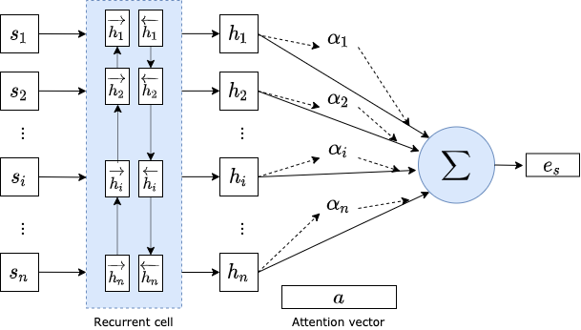
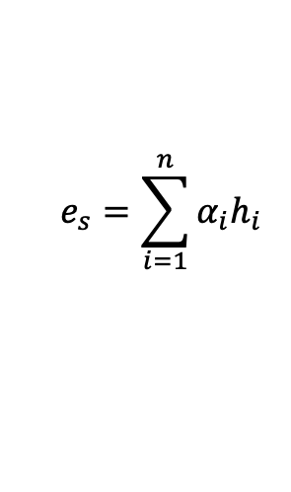
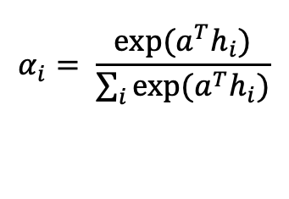
The model : HRAN, RBA
Hierarchical attention networks for document classification
Yang, Zichao and Yang, Diyi and Dyer, Chris and He, Xiaodong and Smola, Alex and Hovy, Eduard, in: ACL 2016.
$$e_{s}=\sum_{i=1}^{n}{α_{i}h_{i}}$$
$$α_{i}= \frac{exp⁡(a^{T}h_{i})}{\sum_{i}{exp⁡(a^{T}h_{i})}}$$

Slide 19
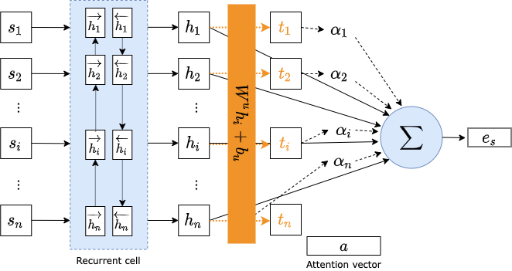

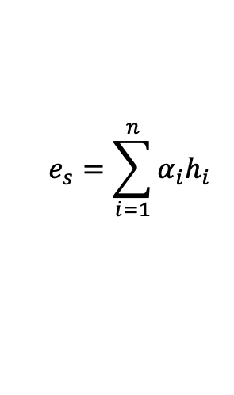
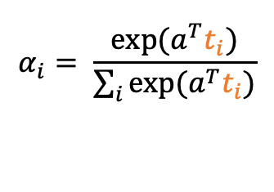
The model : HRAN, RBA – our version
Modification: we project the $h_{i}$ before computing the affinities.
$$e_{s}=\sum_{i=1}^{n}{α_{i}h_{i}}$$
$$t_{i}= \tanh{(W^{u}h_{i}+b_{u} )}$$
$$α_{i}= \frac{exp⁡(a^{T}t_{i})}{\sum_{i}{exp⁡(a^{T}t_{i})}}$$

Slide 20
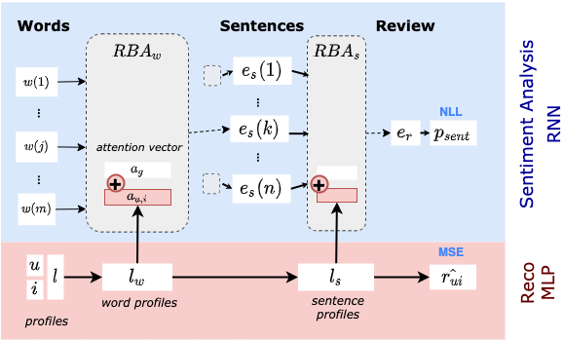
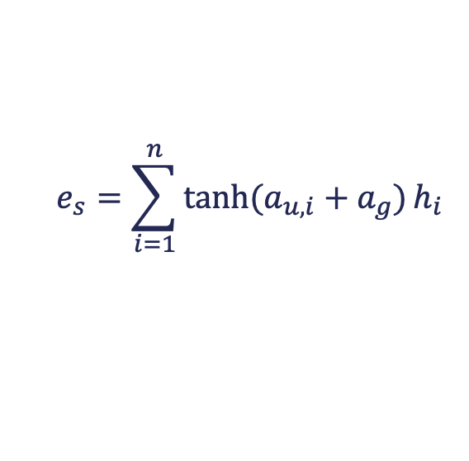
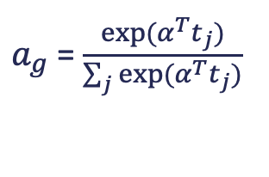


The model : HRAN, overview
$a_{u,i}$ =$W^{l}l$
$$e_{s}=\sum_{i=1}^{n}{\tanh{(a_{u,i}+a_{g})}h_{i}}$$
$$a= \tanh{(a_{u,i}+a_{g})}$$
$a_{g}$ = $\frac{exp⁡(α^{T}t_{j})}{\sum_{j}{exp⁡(α^{T}t_{j})}}$

Slide 21
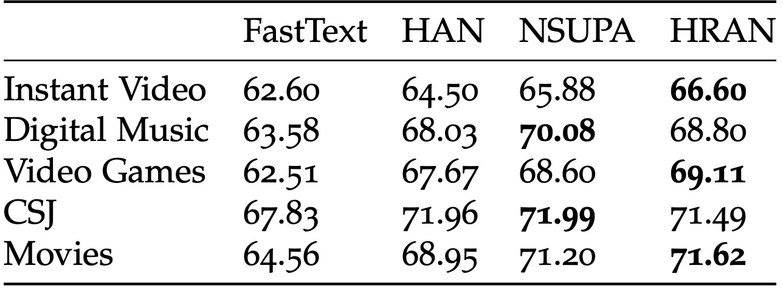
Results – sentiment analysis
Accuracy metric on the sentiment analysis task.
Hierarchical models show better performances
Modeling the user/product bias improves performances
Our approach is competitive with the then SOTA models

Slide 22
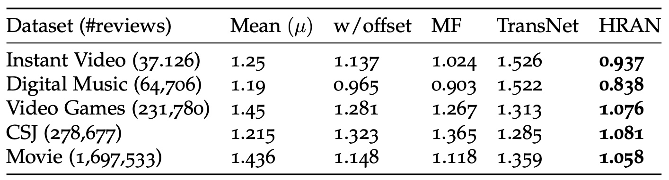
Results
RMSE in rating prediction.
Combining the user/product bias to the reviews as well as the rating prediction yields the best performances.

Slide 23
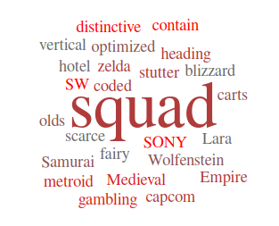
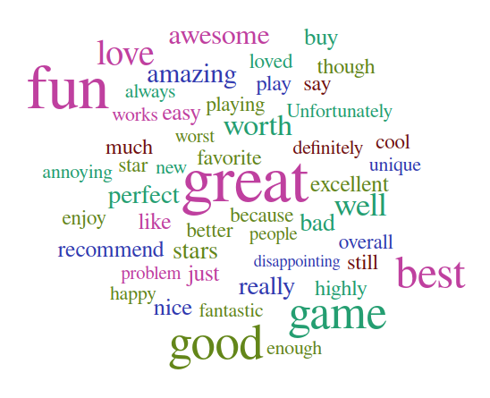
Attention Visualization
Generalist component of attention
Personalized component of attention

Slide 24
Conclusion
Integrate text reviews in the recommendation process
Improve performances
Proposes explanations to the system’s suggestions
Alleviate the Cold Start Problem
Personalized review reading model

Slide 25
An NLP APPROACH TO PROFESSIONAL PROFILE LEARNING AND EVALUATION
Resume: A Robust Framework for Professional Profile Learning & Evaluation
Clara Gainon de Forsan de Gabriac, Vincent Guigue, and Patrick Gallinari ESANN 2020

Slide 26


Motivation & Problematic
People tend to change jobs more and more often
More and more online job boards
Problematic
How can we accurately represent a person’s professional profile?

Slide 27
Motivation and intuition
Schematic representation of a LinkedIn Profile

Slide 28
Motivation and intuition
Schematic representation of a LinkedIn Profile
Intuition
We can use their LinkedIn page to build their professional profiles
Their past jobs (natural language) should be enough to represent them

Slide 29
Motivation and intuition
Intuition
We can use their LinkedIn page to build their professional profiles
Their past jobs (natural language) should be enough to represent them
Approach
User-generated text → build their representation
Remainder of the profile → evaluation

Slide 30
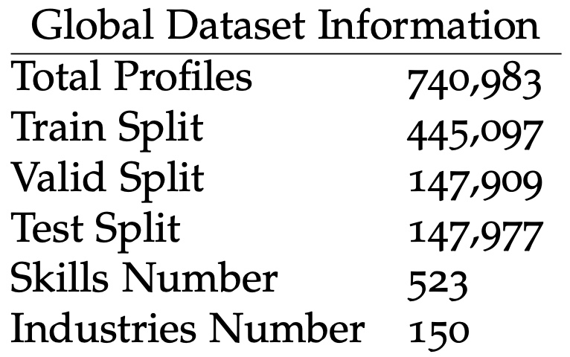
Data
Noisy, unstructured, redundant

Slide 31
Data - Examples
+ exemples de tuples

Slide 32
The model : Resume

Slide 33
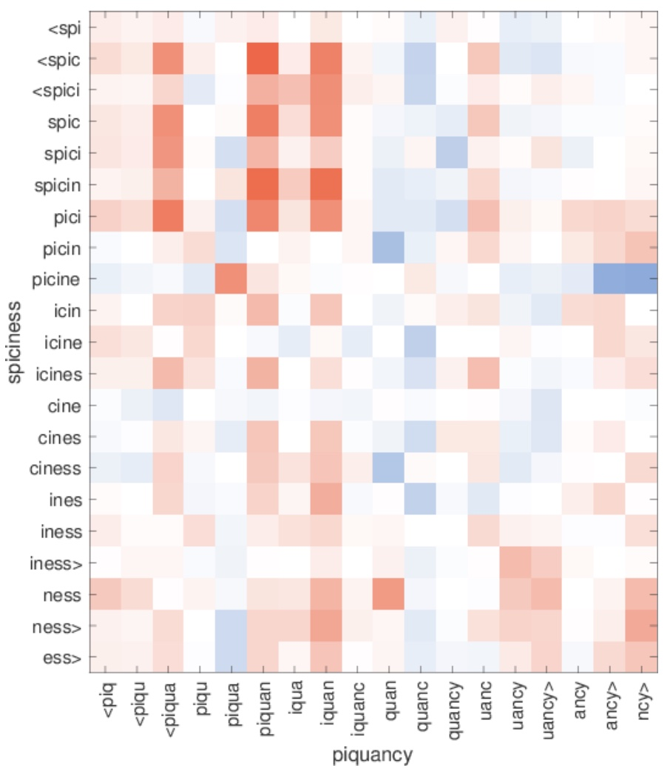
Related work - FastText
Enriching Word Vectors with Subword Information
Bojanowski, Piotr and Grave, Edouard and Joulin, Armand and Mikolov, Tomas
ACL 2016
Sub-word embeddings
Great for out-of-vocabulary words
Very fast to train
Similarity between character n-grams in out-of- vocabulary words.

Slide 34

Related work - ELMo
Deep contextualized word representations
Peters, Matthew E. and Neumann, Mark and Iyyer, Mohit and Gardner, Matt and Clark, Christopher and Lee, Kenton and Zettlemoyer, Luke.
In: Proc. of NAACL 2018.
TODO : schema global d’elmo montrant la ponderation des représentations

Slide 35
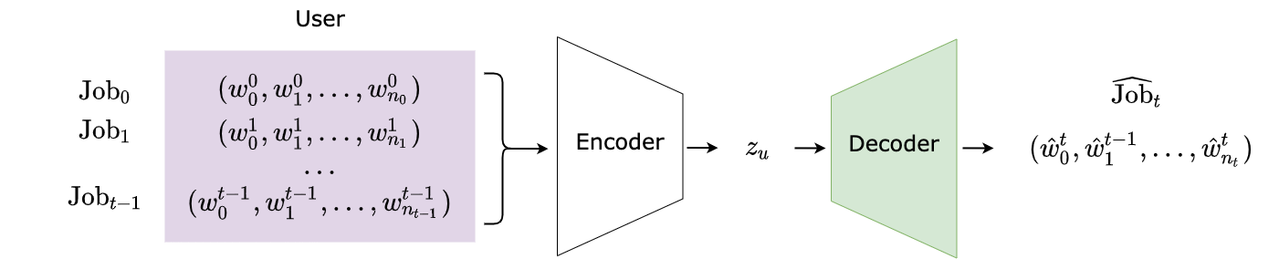
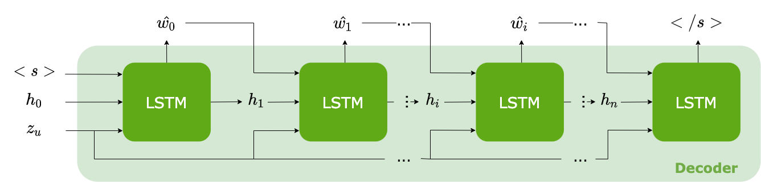
The model : Resume
Illustration of the Text generator
Illustration of the Decoder
Add training loss
Notes:
The user profile is built by encoding their t first professional experiences (or jobs).
Then, a decoder is trained to generate the user's last job, Job_t .
This formulation is a practical proxy for learning to predict a user's next job.

Slide 36
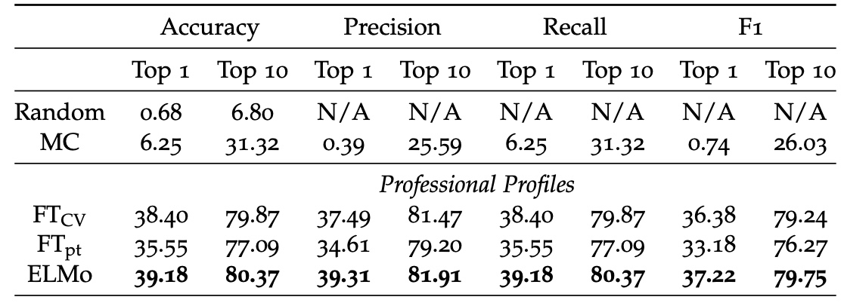
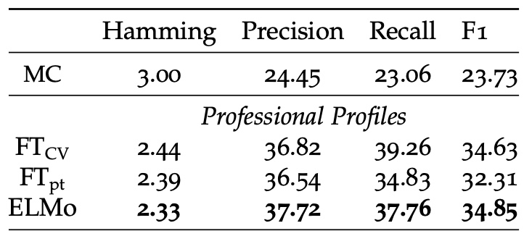
Results - Classification
Industry classification results on 150 classes.
Disambiguation in ELMo improves performances
But FT_CV is still competitive
Skills Prediction Results on 523 classes

Slide 37
Results - Classification
Examples of misclassified profiles
TODO
# | Profile |  | Predicted Industry | Actual Industry
 | Title | Description
(1)
(0)
(1)
(0)

Slide 38
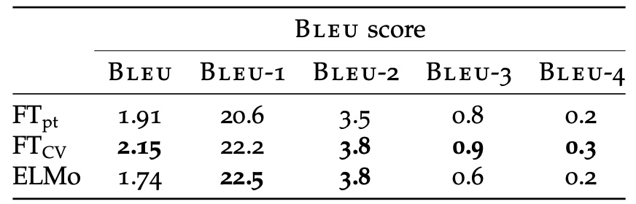
Results
Experimental results on job generation (title & description)
The BLEU score expresses a syntactic resemblance between a prediction and a reference – not a semantic one.
FT_{CV} outperforms ELMo and FT_{pt}:
a CV is not traditional natural language.

Slide 39
Results
Illustration of text generated by our decoder
Ground Truth
E-commerce Consultant. My mission consists in reaching the goals set up by the clients regarding their profitability and/or notoriety issues […]
FastText pre-trained
Marketing Manager. Management of the client relationship, Social networks management, Social networks management […]
FastText CV-oriented
Marketing Manager. Managing the communication strategy and the communication strategy for clients […]
ELMo
Sector Manager. Management of the client relationship, UNK, stock management, stock management[…]

Slide 40
Conclusion
Textual traces yield rich representations
New task: Professional Profile Learning
New application Domain: Human Resources
New framework for User Representation: Resume

Slide 41
USER DYNAMIC MODELING
Exploratory work

Slide 42
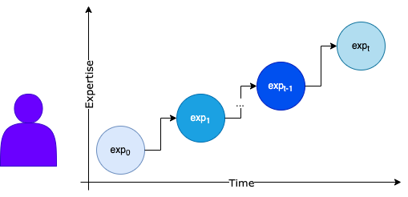
User Dynamic Modeling
With time
People evolve uniformly
With respect to one another
Uniform Hypothesis
Not very realistic
Forbids precise predictions
+
Ideal, easy scenario
-

Slide 43
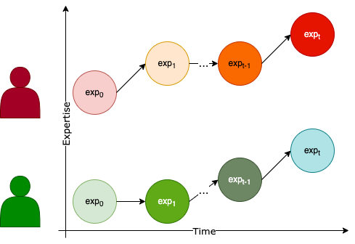
User Dynamic Modeling
Dynamic Hypothesis
Their tastes may change
People change with time
Their expertise too [1]
Depending on their environment
People change differently
Depending on their personality
[1] J.J. McAuley and J. Leskovec (2013)

Slide 44
User Dynamic Modeling
Dynamic Hypothesis
Goal
We want to understand how users change
in order to best predict their future behavior

Slide 45
User Dynamic Modeling - Challenges
Highly unstructured, no two jobs are the same
Noisy Data
No supervision on the experience level
Typos, wrongly filled out…
44

Slide 46
User Dynamic Modeling - Challenges
Highly unstructured, no two jobs are the same
Noisy Data
No supervision on the experience level
Typos, wrongly filled out…
Latent representation is very noisy
Classification approach impossible
Navigating the latent space is hard
45

Slide 47
User Dynamic Modeling - Challenges
Highly unstructured, no two jobs are the same
Noisy Data
No supervision on the experience level
Typos, wrongly filled out…
Latent representation is very noisy
Intuition
People in different industries have different career evolutions
The professional evolution is not constant w.r.t time and expertise.
Classification approach impossible
Navigating the latent space is hard
46

Slide 48
Job Expertise Rewriting
Intuition
People in different industries have different career evolutions
The professional evolution is not constant w.r.t. time and expertise.
Disentangling
the industry from
the expertise level of a job
will help us understand
the user’s trajectory.
Simplified model of job exp rew

Slide 49
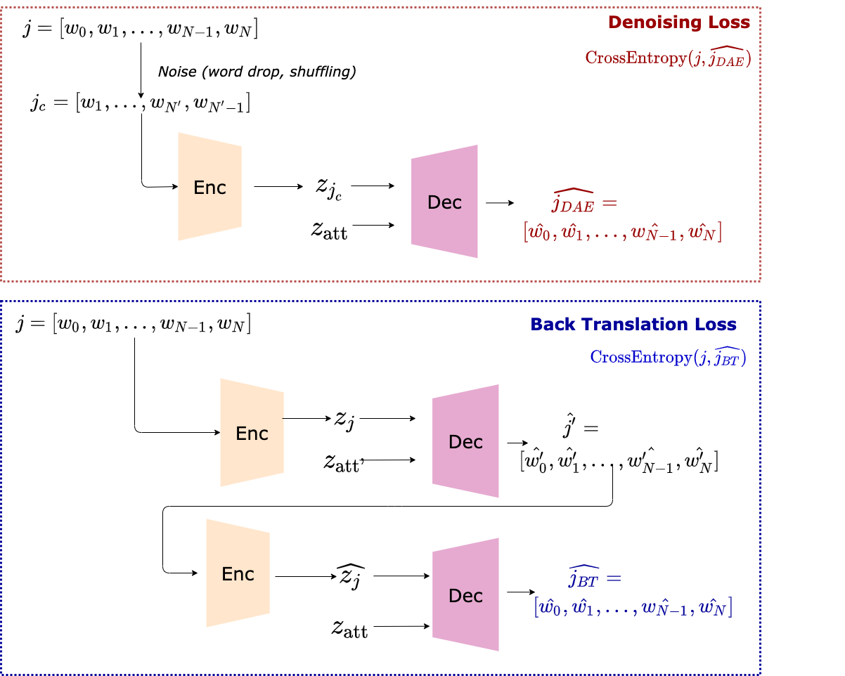
Job Expertise Rewriting

Slide 50
Industry Latent Space Structuring via VAE
Highly unstructured, no two jobs are the same
Noisy Data
No supervision on the experience level
Typos, wrongly filled out…

Slide 51
Industry Latent Space Structuring via VAE
Highly unstructured, no two jobs are the same
Noisy Data
No supervision on the experience level
Typos, wrongly filled out…
Latent representation is very noisy
Classification approach impossible
Navigating the latent space is hard

Slide 52
Industry Latent Space Structuring via VAE
Highly unstructured, no two jobs are the same
Noisy Data
No supervision on the experience level
Typos, wrongly filled out…
Latent representation is very noisy
Intuition
We need to better organize our data
Enforcing structure in the latent space will help us navigate it
Classification approach impossible
Navigating the latent space is hard

Slide 53
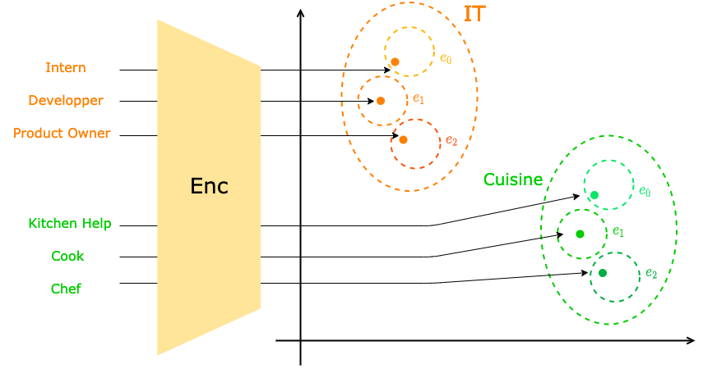
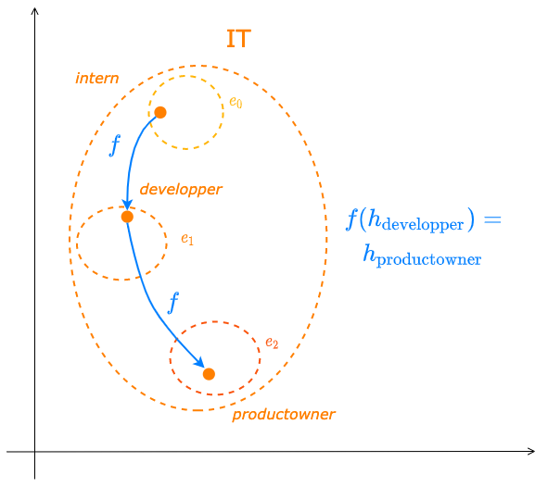
Industry Latent Space Structuring via VAE
Intuition
Career progression varies from one industry to another
Enforcing this separation will improve the latent space quality
It will ease the learning of users’ trajectories

Slide 54
User Dynamic Modeling - Obstacles
Noisy and unstructured data
Lack of direct supervision on experience
Insufficient data
Comparing incomparable objects?

Slide 55
Conclusion

Slide 56
Contributions
Grosse prise de recul nécéssaire
A refined, explainable user representation
An NLP-based user representation framework
A new application domain: Human Resources

Slide 57
Perspectives
Update existing models with newer architectures
Diversify training objectives
User Dynamic Modeling
New applications

Slide 58
Perspectives
TODO : illustration des phrases générées avec un transformer

Slide 59
Thank You!
Publications:
RNN & modèle d’attention pour l’apprentissage de profils textuels personnalisés. C.-E. Dias, C. Gainon de Forsan de Gabriac, V. Guigue, P. Gallinari. CORIA 2018
Resume: A Robust Framework for Professional Profile Learning & Evaluation C. Gainon de Forsan de Gabriac, V. Guigue, P. Gallinari. ESANN 2020.

Slide 60
References ⠐ Appendix

Slide 61
References

Slide 62
Appendix for HRAN

Slide 63
Appendix for Resumé

Slide 64
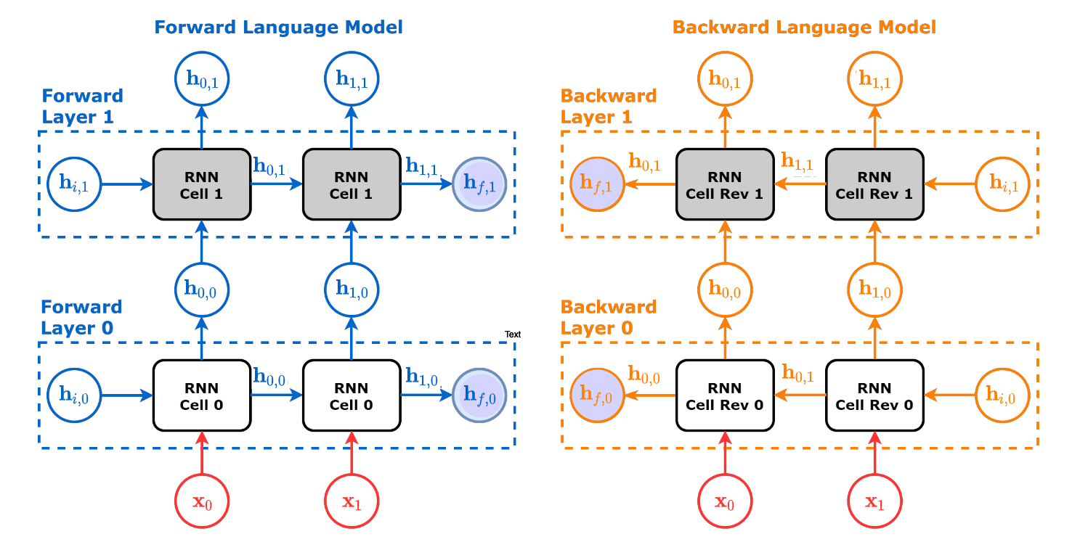
ELMo Architecture - detail

Slide 65
Appendix for User Modeling

Slide 66
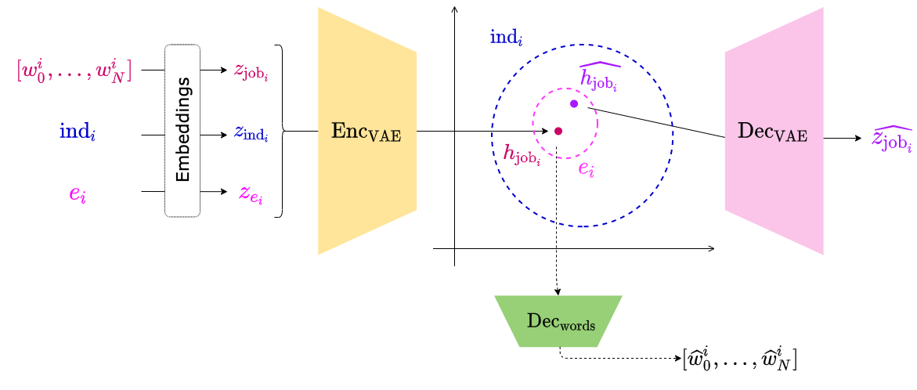
VAE Training
Illustration of the global architecture

