Slide 1
Deep Natural Language Processing for User Representation
Traitement du langage naturel profond pour la modélisation d’utilisateurs
Clara Gainon de Forsan de Gabriac – 13 décembre2021
JURY DE THESE
Rapporteurs
Anne Boyer
Julien Velcin
Examinateurs
Mohamed Chetouani
Alejandro Bellogin
Encadrants
Patrick Gallinari
Vincent Guigue

Slide 2
The Information Era
Nice picture of netflix rec + amazon review
Generalities about the amount of available data, online user profiles and the textual traces users leave
Make link with the fact that we are interested in user representation
Notes:
A lot of info and accessible data

Slide 3
Problematics
Rich User
Representation

Slide 4
Problematics
Rich User
Representation
Leverage
User-generated
Text

Slide 5
Problematics
Rich User
Representation
Leverage
User-generated
Text
Make Predictions Explainable

Slide 6
Problematics
Rich User
Representation
Leverage
User-generated
Text
Make Predictions Explainable
This
Work

Slide 7
Motivations and contributions
Motivations
Rich, versatile user representation
Leverage user-generated text
Make predictions explainable

Slide 8
Motivations and contributions
Motivations
Axes
Recommendation
Rich, versatile user representation
Representation Learning
Leverage user-generated text
Natural Language Processing
Make predictions explainable
Generative models

Slide 9
Motivations and contributions
Motivations
Axes
Contribution
Recommendation
Rich, versatile user representation
1
HRAN
Representation Learning
Leverage user-generated text
Natural Language Processing
Make predictions explainable
2
Résumé
Generative models

Slide 10
Outline
Refining User Understanding In Recommendation Via NLP
A Nlp Approach To Professional Profile Learning And Evaluation
User Dynamic Modeling
Conclusion & Perspective

Slide 11
REFINING USER UNDERSTANDING IN RECOMMENDATION VIA NLP
RNN & modèle d’attention pour l’apprentissage de profils textuels personnalisés
Charles-Emmanuel Dias, Clara Gainon de Forsan de Gabriac, Vincent Guigue, and Patrick Gallinari CORIA 2018

Slide 12
Motivation and intuition
Motivation
Good prediction accuracy
Prediction Explainability
Intuition
Reviews can help improve performances
& make predictions understandable.
Approach
Traditional rating regression
+
attentive sentiment analysis
Dessin simplifié de l’archi

Slide 13
Related work
Collaborative Filtering & Matrix Factorization
Ref
Leveraging Textual reviews for recommendation
Ref
Hierarchical Attentive Network for document classification
Ref (HAN)

Slide 14
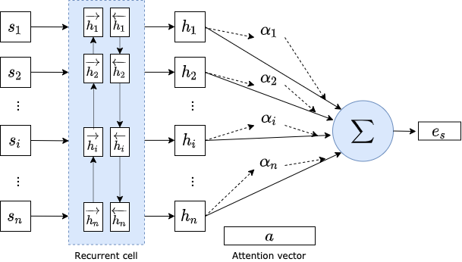
The model : HRAN, RBA
Ref HAN
Equation of global attention vector

Slide 15
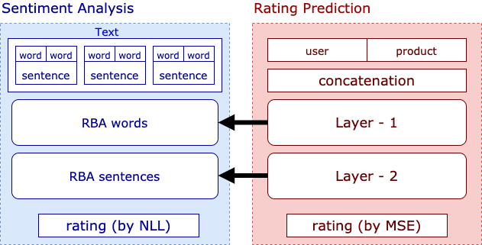
The model : HRAN

Slide 16
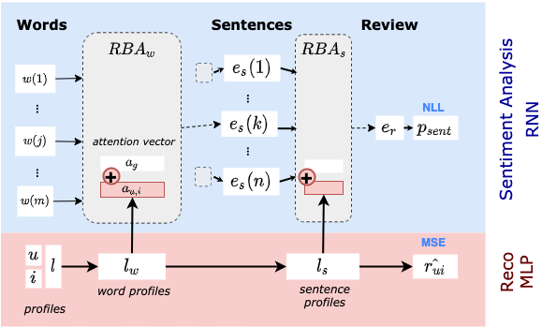
The model : HRAN, overview

Slide 17
The model : HRAN, overview
Equation qui lie les 2 attentions

Slide 18
Results
Tableaux de résultat

Slide 19
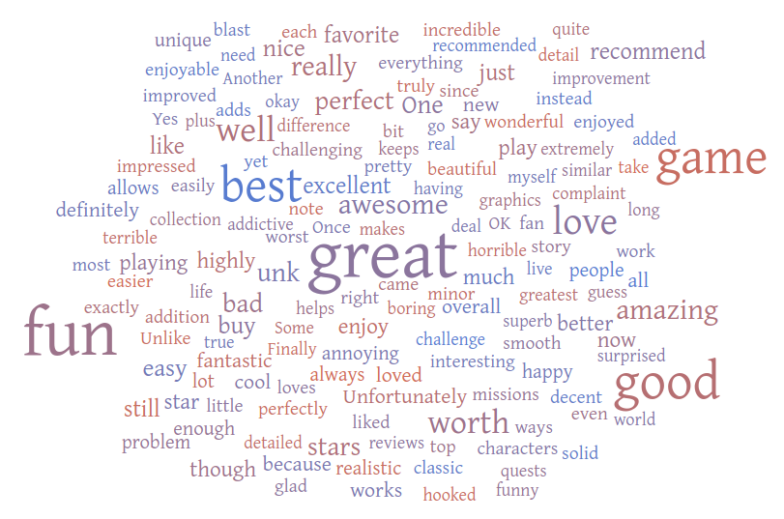
Attention Visualization

Slide 20
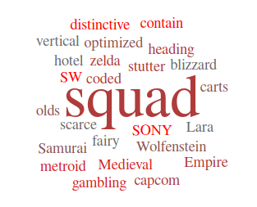
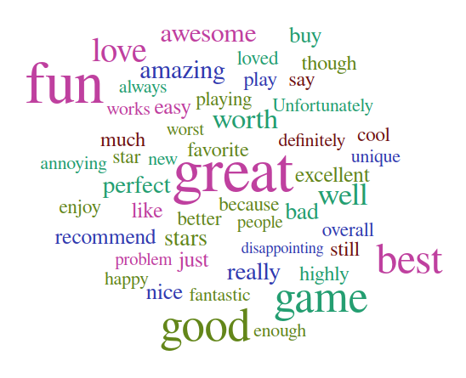
Attention Visualization

Slide 21
A NLP APPROACH TO PROFESSIONAL PROFILE LEARNING AND EVALUATION
Resume: A Robust Framework for Professional Profile Learning & Evaluation
Clara Gainon de Forsan de Gabriac, Vincent Guigue, and Patrick Gallinari ESANN 2020

Slide 22


Motivation & Problematic
People tend to change jobs more and more often
More and more online job boards
Problematic

Slide 23
Motivation and intuition
Intuition
We can use their LinkedIn page to build their professional profiles
Their past jobs (natural language) should be enough to represent them
Approach
User-generated text → build their representation
Remainder of the profile → evaluation

Slide 24
Data

Slide 25
Data

Slide 26
Related work

Slide 27
The model : Resumé

Slide 28
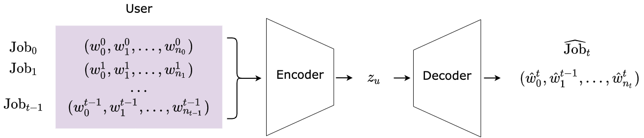
The model : Resumé

Slide 29
USER DYNAMIC MODELING

Slide 30
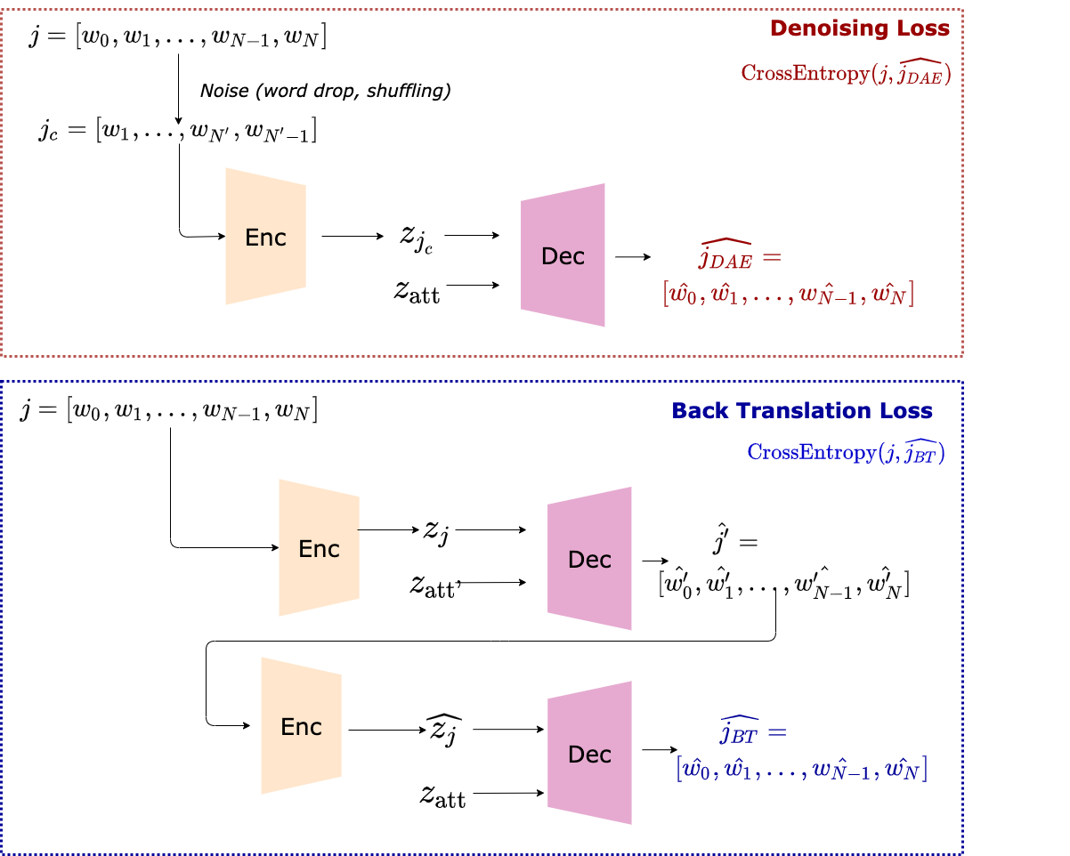
Job Expertise Rewriting

Slide 31
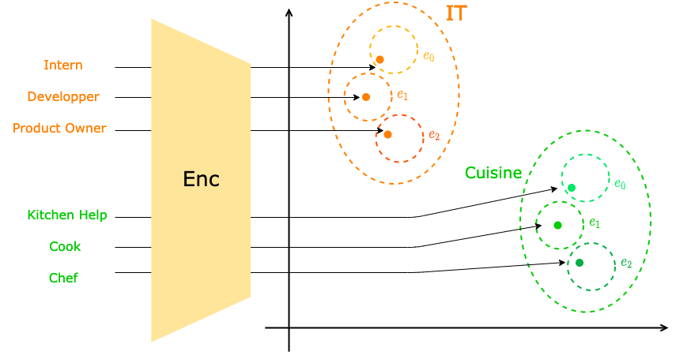
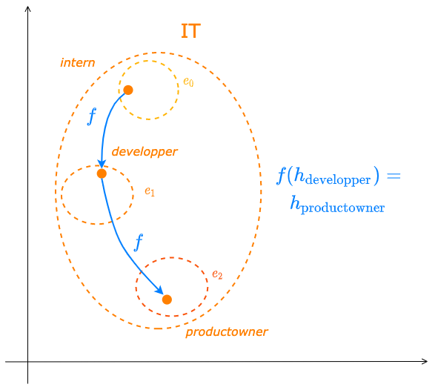
Industry Latent Space Structuring via VAE

Slide 32
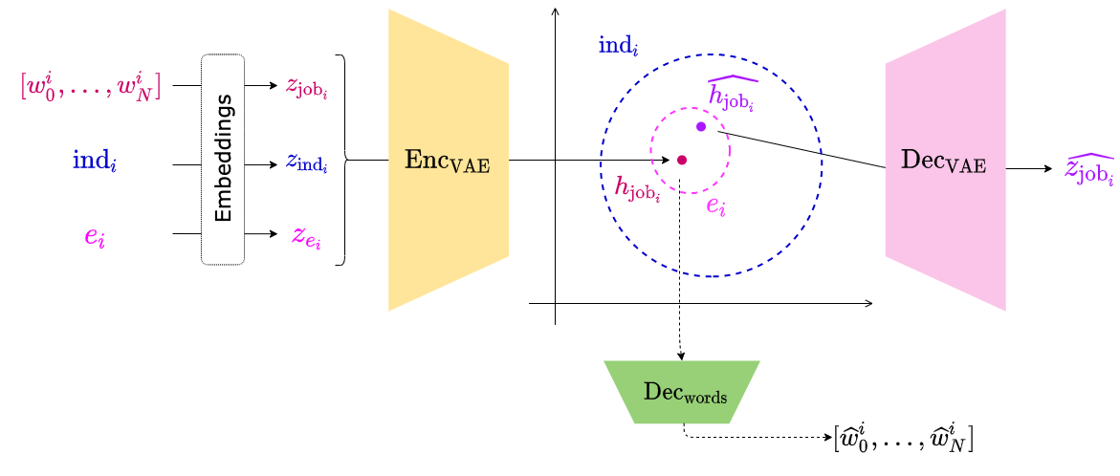
Industry Latent Space Structuring via VAE

Slide 33
Industry Latent Space Structuring via VAE

Slide 34
Conclusion

Slide 35
Contributions

Slide 36
Perspectives

Slide 37
Perspectives

Slide 38
Thank You!
Publications:
RNN & modèle d’attention pour l’apprentissage de profils textuels personnalisés. C.-E. Dias, C. Gainon de Forsan de Gabriac, V. Guigue, P. Gallinari. CORIA 2018
Resume: A Robust Framework for Professional Profile Learning & Evaluation C. Gainon de Forsan de Gabriac, V. Guigue, P. Gallinari. ESANN 2020.

Slide 39
References ⠐ Appendix

Slide 40
References

Slide 41
Appendix for HRAN

Slide 42
Appendix for Resumé

Slide 43
Appendix for User Modeling

