Slide 1
Deep Natural Language Processing for User Representation
Traitement du langage naturel profond pour la modélisation d’utilisateurs
Clara Gainon de Forsan de Gabriac – 13 décembre2021
JURY DE THESE
Rapporteurs
Anne Boyer
Julien Velcin
Examinateurs
Mohamed Chetouani
Alejandro Bellogin
Encadrants
Patrick Gallinari
Vincent Guigue

Slide 2
The Information Era
Notes:
A lot of info and accessible data

Slide 3
Problematics

Slide 4
Motivations and contributions
Motivations
Axes
Contribution
Collaborative Filtering
Need for personnalized decisions
HRAN
Natural Language Processing
Need for versatile user representation
Résumé
Need for explainable models and profiles
Text Generation

Slide 6
Related Work

Slide 8
REFINING USER UNDERSTANDING IN RECOMMENDATION VIA NLP
RNN & modèle d’attention pour l’apprentissage de profils textuels personnalisés
Charles-Emmanuel Dias, Clara Gainon de Forsan de Gabriac, Vincent Guigue, and Patrick Gallinari CORIA 2018

Slide 9
Recommendation

Slide 10
Motivation and intuition

Slide 11
Related work
Original HAN paper

Slide 12
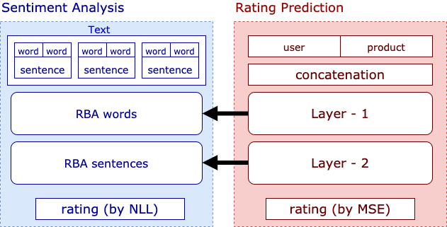
The model : HRAN

Slide 13
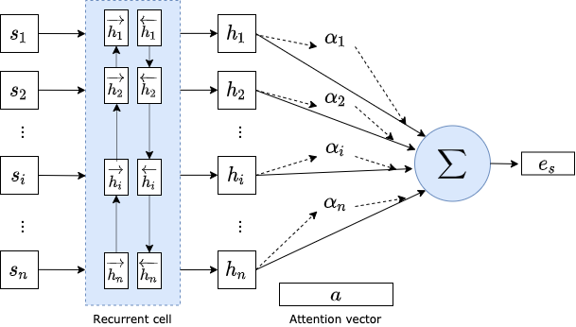
The model : HRAN, RBA

Slide 14
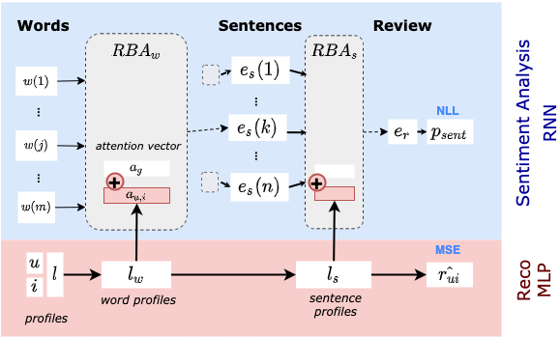
The model : HRAN, overview

Slide 15
Results

Slide 16
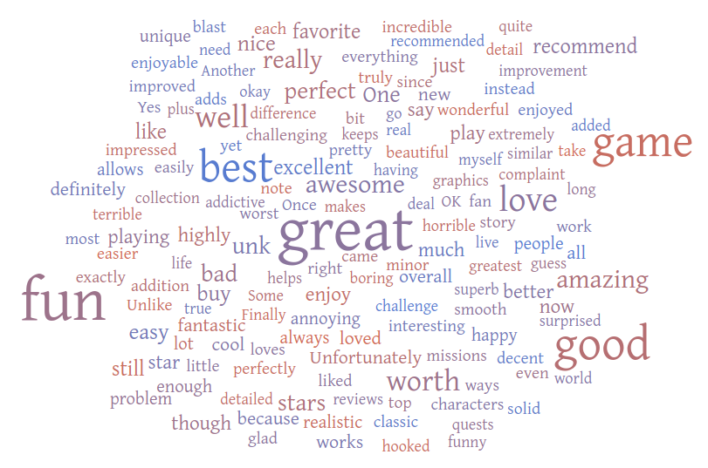
Attention Visualization

Slide 17
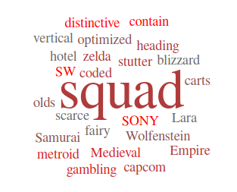
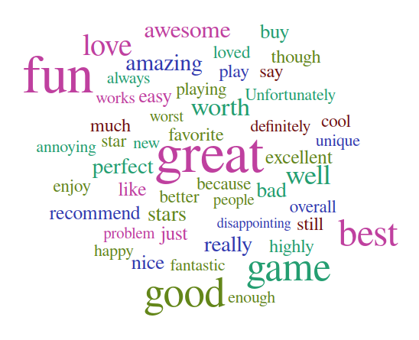
Attention Visualization

Slide 18
A NLP APPROACH TO PROFESSIONAL PROFILE LEARNING AND EVALUATION
Resume: A Robust Framework for Professional Profile Learning & Evaluation
Clara Gainon de Forsan de Gabriac, Vincent Guigue, and Patrick Gallinari ESANN 2020

Slide 19
Problematic

Slide 20
Motivation and intuition

Slide 21
Data

Slide 22
Data

Slide 23
Related work

Slide 24
The model : Resumé

Slide 25
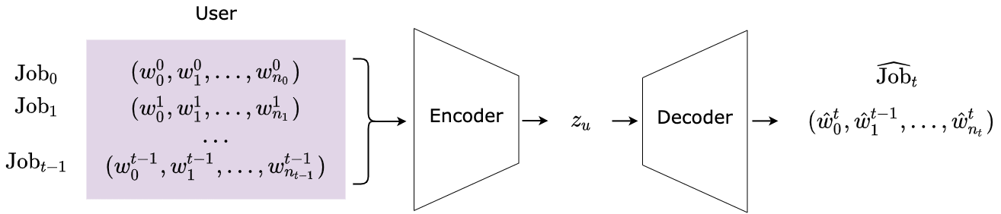
The model : Resumé

Slide 26
USER DYNAMIC MODELING

Slide 27
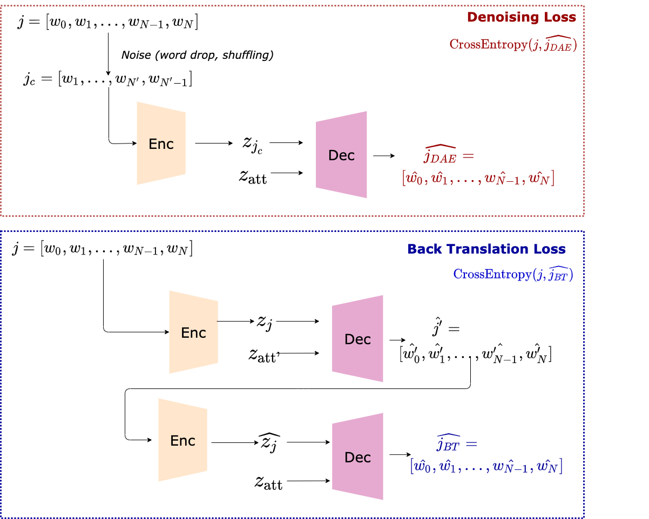
Job Expertise Rewriting

Slide 28
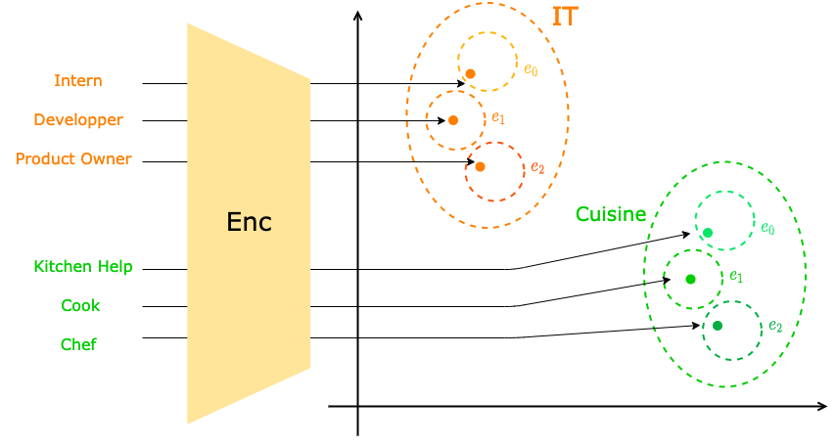
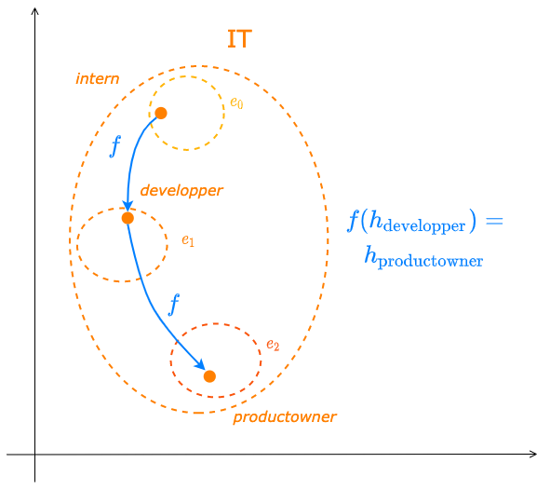
Industry Latent Space Structuring via VAE

Slide 29
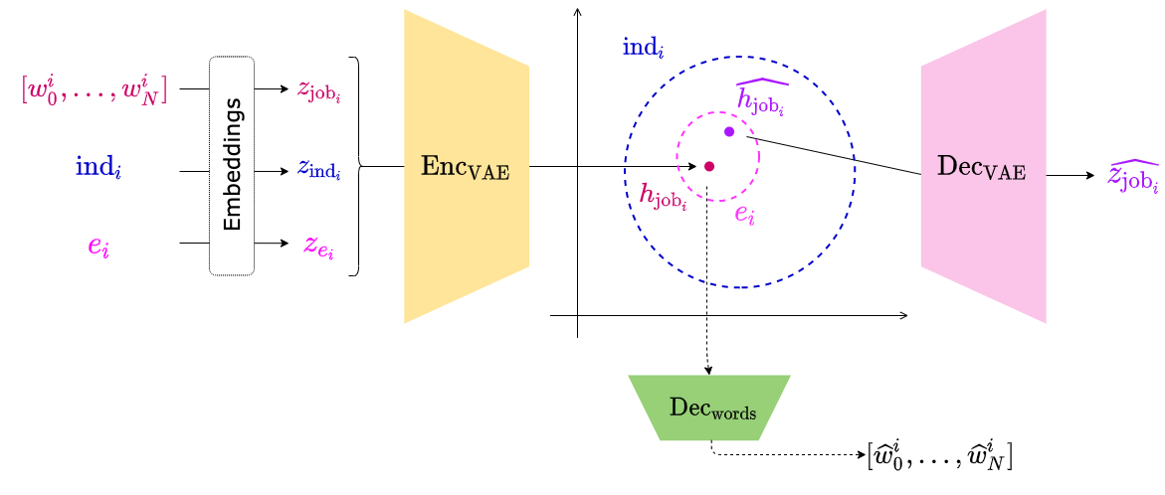
Industry Latent Space Structuring via VAE

Slide 30
Industry Latent Space Structuring via VAE

Slide 31
Conclusion

Slide 32
Contributions

Slide 33
Perspectives

Slide 34
Perspectives

Slide 35
Thank You!
Publications:
RNN & modèle d’attention pour l’apprentissage de profils textuels personnalisés. C.-E. Dias, C. Gainon de Forsan de Gabriac, V. Guigue, P. Gallinari. CORIA 2018
Resume: A Robust Framework for Professional Profile Learning & Evaluation C. Gainon de Forsan de Gabriac, V. Guigue, P. Gallinari. ESANN 2020.

Slide 36
References ⠐ Appendix

Slide 37
References

Slide 38
Appendix for HRAN

Slide 39
Appendix for Resumé

Slide 40
Appendix for User Modeling

