Slide 1
Deep Natural Language Processing for User Representation
Traitement du langage naturel profond pour la modélisation d’utilisateurs
Clara Gainon de Forsan de Gabriac – 13 décembre2021
JURY DE THESE
Rapporteurs
Anne Boyer
Julien Velcin
Examinateurs
Mohamed Chetouani
Alejandro Bellogin
Encadrants
Patrick Gallinari
Vincent Guigue
Notes:
Hello
Thank you for being here
I’ll be presenting my PHD

Slide 2
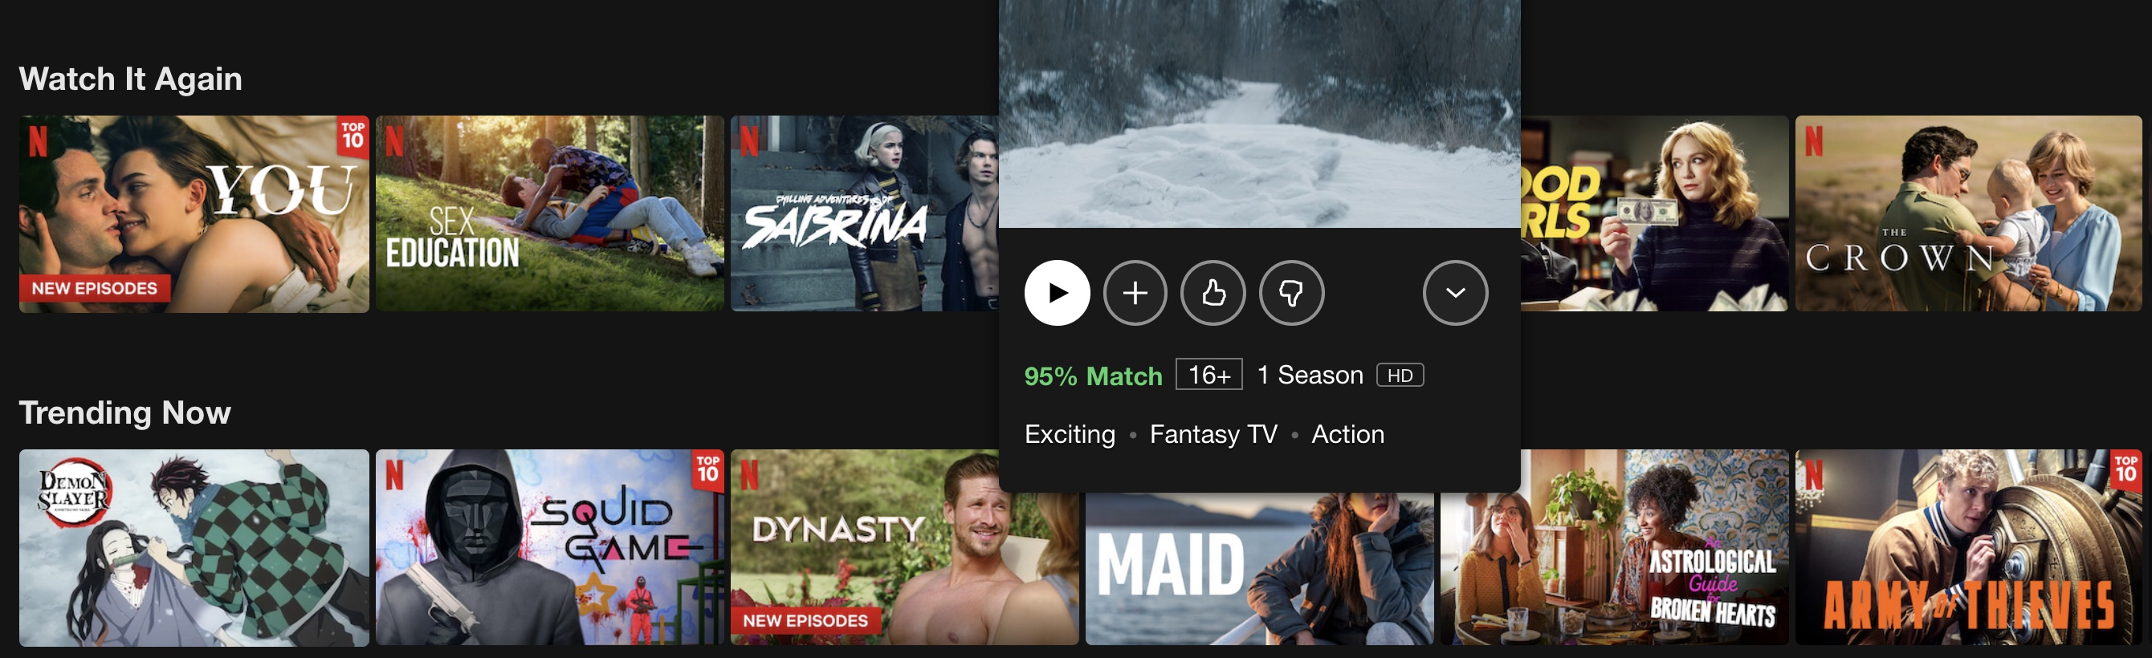
The Information Era
Illustration of Netflix recommendations
Ever-growing quantity of data to choose from
Multiplication of user (textual) traces
Notes:
In the past decades, the rise of internet led to an explosion of data and basically of choice and online services: movies on Netflix, stuff on amazon and so on.
Additionally, the number of interactions between users and those systems keeps increasing, namely in the form of textual traces such as reviews.

Slide 3
The Information Era
Illustration of Netflix recommendations
Ever-growing quantity of data to choose from
Multiplication of user (textual) traces
Challenge: present users with relevant items
Notes:
This situation brings a challenge: to present users with a subset of relevant items rather than the whole catalog to ease their search.
The notion of relevance is a complex one to define and it is highly discussed in the community.
In this work, we will consider an item to be relevant if it is personalized and if we can explain why it is consistent with the user’s profile.

Slide 4
Artificial Intelligence and Deep Learning
We have to mention Recommendation, ML and DL in a generalist slide
Notes:
This challenge is a classic Recommendation Problem, that often addressed by Machine Learning algorithms.
Machine Learning, and in particular Deep Learning models have grown very popular in the past few yeas because they can be applied to various domains, ranging from Recommendation to Computer Vision to Natural Language Processing.

Slide 5
Problematics
Rich User
Representation
Notes:
In order to achieve relevant recommendation, one must first understand the user.
In other words, we want to build rich user representations in the sense that they can model complex and diverse aspects of their profiles, in the wake of the representation learning paradigm.
Such representations are often called versatile because they can be re-used or fine-tuned on other tasks than the ones they were trained on.

Slide 6
Problematics
Rich User
Representation
Leverage
User-generated
Text
Notes:
We choose to address this problem by the leveraging of user-generated text.
Indeed, aside from this type of data being widely available, we think it Is also highly descriptive of the users themselves. It is especially clear when we think of written reviews: the users clearly state what they like and dislike about a product, giving us a lot more information than the rating alone.
From a broader point of view, one can think of text as highly descriptive of a user because the words and the syntax they use to talk about their experiences are almost always unique to them.

Slide 7
Problematics
Rich User
Representation
Leverage
User-generated
Text
Make Predictions Explainable
Notes:
This choice to focus on user-generated text (as well as the advances of generative models) also allows us to explore the explainability of our models’ predictions, which we consider to be one of the biggest challenge faced by Deep Learning and Artificial Intelligence in general.
Indeed, if AI is to take a bigger place in our society, then we must be able to understand or at least explain the predictions it gives.

Slide 8
Problematics
Rich User
Representation
Leverage
User-generated
Text
Make Predictions Explainable
This
Work
Notes:
The work presented in this thesis is motivated by those three aspects.
We want to use user-generated texts to build rich meaningful and explainable representations.

Slide 9
Motivations and contributions
Motivations
Rich, versatile user representation
Leverage user-generated text
Make predictions explainable

Slide 10
Motivations and contributions
Motivations
Axes
Recommendation
Rich, versatile user representation
Representation Learning
Leverage user-generated text
Natural Language Processing
Make predictions explainable
Text Generation
Notes:
We tackle the motivations of this thesis along several axes: recommendation, RL, NLP and Text Generation.
Expliquer plus ?

Slide 11
Motivations and contributions
Motivations
Axes
Contribution
Recommendation
Rich, versatile user representation
1
HRAN
Representation Learning
Leverage user-generated text
Natural Language Processing
2
Make predictions explainable
Resume
Text Generation
Notes:
In our first contribution, HRAN, we will combine a Recommendation, RL and NLP methods in order to refine our understanding of user tastes in a classic Recommendation problematic.
In our second contribution, Resume, we propose a framework to learn and evaluate user professional profiles, a new task, by combining RL to NLP and Text generation.

Slide 12
Outline
Refining User Understanding In Recommendation Via NLP (HRAN)
An NLP Approach To Professional Profile Learning And Evaluation (Resume)
User Dynamic Modeling
Conclusion & Perspective
Notes:
The presentation is thus organized as follows:
We will go over our first contribution, HRAN,

Slide 13
REFINING USER UNDERSTANDING IN RECOMMENDATION VIA NLP
RNN & modèle d’attention pour l’apprentissage de profils textuels personnalisés
Charles-Emmanuel Dias, Clara Gainon de Forsan de Gabriac, Vincent Guigue, and Patrick Gallinari CORIA 2018
Notes:
Let’s begin with our HRAN model, which was published

Slide 14
Motivation and intuition
Motivation
Refining user understading
Good prediction accuracy
Prediction Explainability
Intuition
Reviews can help improve performances
& make predictions understandable.
Notes:
This work is motivated by …
The intuition behind this contribution is that reviews can help improve performances & make predictions understandable.

Slide 15
Motivation and intuition
Motivation
Good prediction accuracy
Prediction Explainability
Intuition
Reviews can help improve performances
& make predictions understandable.
Approach
Rating regression
+
Sentiment analysis
Hierarchical Recurrent Attentive Network
Sentiment Analysis
Polarity
Prediction
Reviews
User profile +
Item profile
Rating regression
Rating
Prediction
Notes:
We implement this intuition by combining a traditional rating regression module to an attentive sentiment analysis module.
The resulting model is called HRAN, for Hierarchical Recurrent Attentive Network.
The sentiment analysis part takes the reviews as input…
The rating regression module takes both the user and the item profiles as input…
Both modules share inner intermediate representation to refine the models’ enderstadning of the user’s tastes.

Slide 16
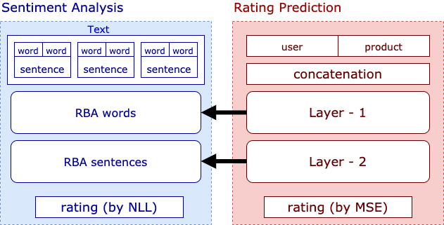
The model : HRAN
Notes:
More precisely, the sentiment analysis uses the representation of the rating prediciton module in two places: once at the word level RBA, and then at the sentence level RBA, which gives it its hierarchical component.
RBA stands for Hierarchical Bidirectionnal Attentive module and is described in detail in the following slides.

Slide 17
Related work
Cette slide est un peu bizarre, je sais pas si je dois en faire l’économie ou la diviser
Collaborative Filtering & Matrix Factorization
Koren et al., 2009
Leveraging Textual reviews for recommendation
J. McAuley and Leskovec, 2013
Hierarchical Attentive Network for document classification
Z. Yang et al., 2016
Notes:
This work takes its foundation in 3 principal sources: Collaborative Filtering by Matrix Factorization, Leveraging Textual reviews for recommendation and Hierarchical Attentive Network for document classification, which is the article

Slide 18
Related work
Cette slide est un peu bizarre, je sais pas si je dois en faire l’économie ou la diviser
Collaborative Filtering & Matrix Factorization
Leveraging Textual reviews for recommendation
Hierarchical Attentive Network for document classification
Z. Yang et al., 2016
Notes:
This work takes its foundation in 3 principal sources: Collaborative Filtering by Matrix Factorization, Leveraging Textual reviews for recommendation and Hierarchical Attentive Network for document classification, which is the article

Slide 19
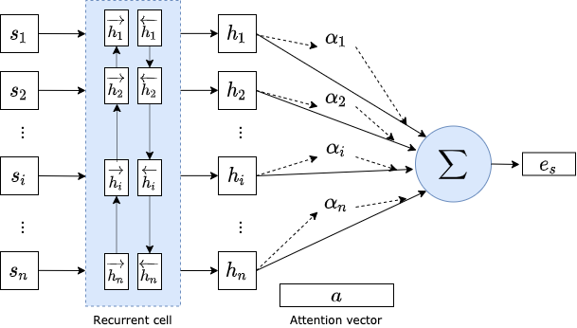
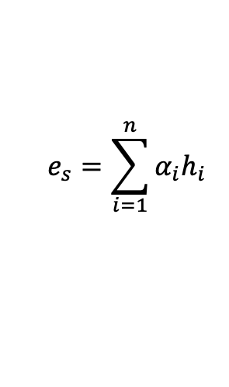
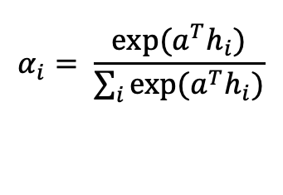
The model : HRAN, RBA
Hierarchical attention networks for document classification
Yang, Zichao and Yang, Diyi and Dyer, Chris and He, Xiaodong and Smola, Alex and Hovy, Eduard, in: ACL 2016.
$$e_{s}=\sum_{i=1}^{n}{α_{i}h_{i}}$$
$$α_{i}= \frac{exp⁡(a^{T}h_{i})}{\sum_{i}{exp⁡(a^{T}h_{i})}}$$

Slide 20
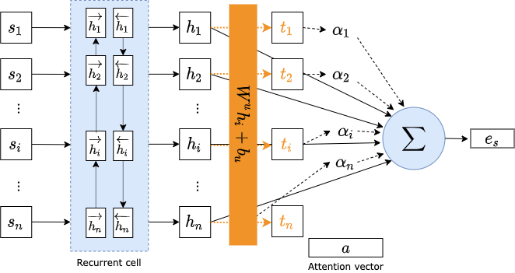

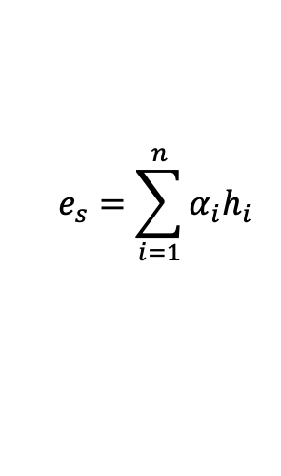
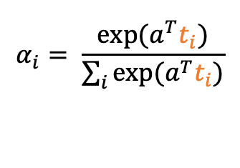
The model : HRAN, RBA – our version
Cette slide relève-t-elle du détail ou est elle pertinente ?
Modification: we project the $h_{i}$ before computing the affinities.
$$e_{s}=\sum_{i=1}^{n}{α_{i}h_{i}}$$
$$t_{i}= \tanh{(W^{u}h_{i}+b_{u} )}$$
$$α_{i}= \frac{exp⁡(a^{T}t_{i})}{\sum_{i}{exp⁡(a^{T}t_{i})}}$$

Slide 21
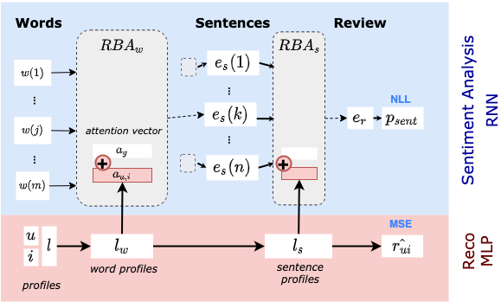
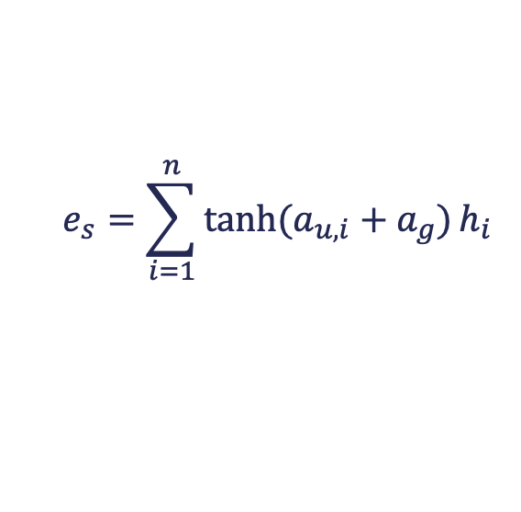
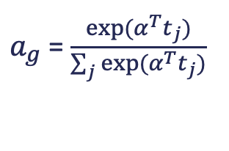


The model : HRAN, overview
$a_{u,i}$ =$W^{l}l$
$$e_{s}=\sum_{i=1}^{n}{\tanh{(a_{u,i}+a_{g})}h_{i}}$$
$$a= \tanh{(a_{u,i}+a_{g})}$$
$a_{g}$ = $\frac{exp⁡(α^{T}t_{j})}{\sum_{j}{exp⁡(α^{T}t_{j})}}$

Slide 22
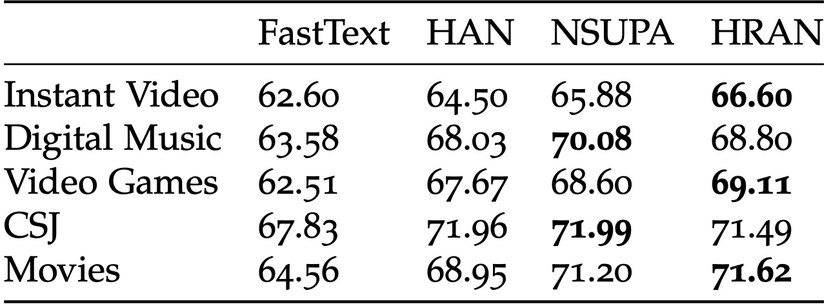
Results – sentiment analysis
Accuracy metric on the sentiment analysis task.
Hierarchical models show better performances
Modeling the user/product bias improves performances
Our approach is competitive with the then SOTA models

Slide 23
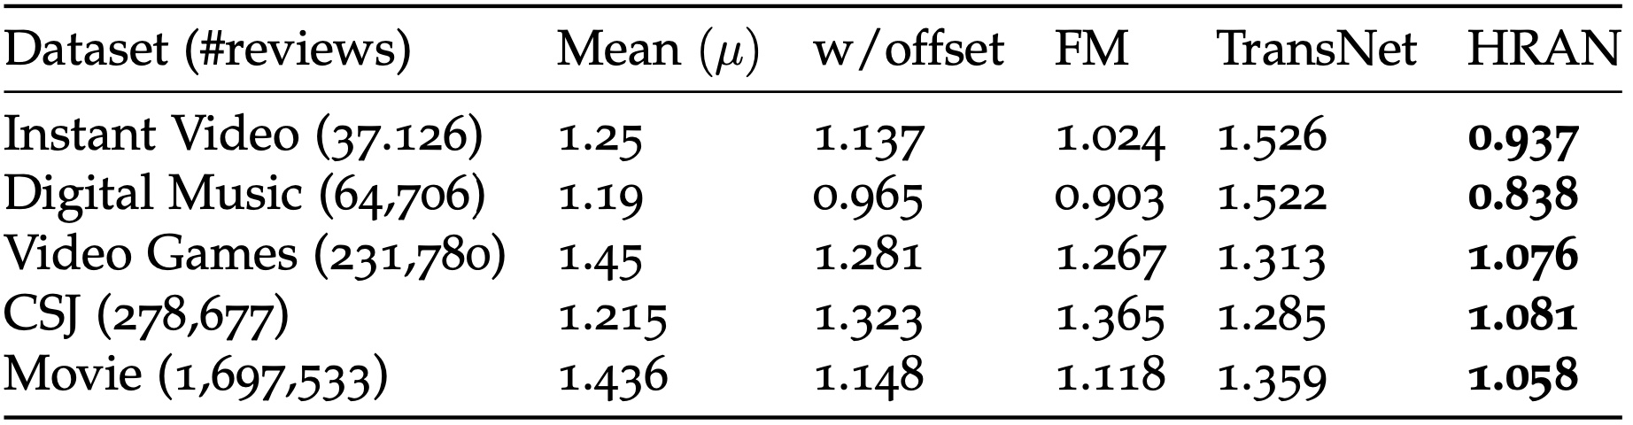
Results
RMSE in rating prediction.
Combining the user/product bias to the reviews as well as the rating prediction yields the best performances.

Slide 24
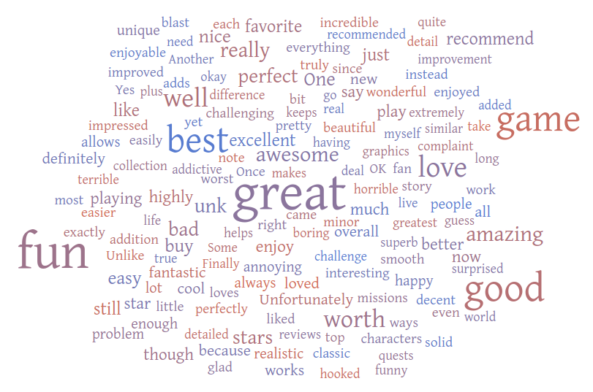
Attention Visualization
Cloud of the most discriminating words in the dataset Video Games according to the global attention vector
23
23

Slide 25
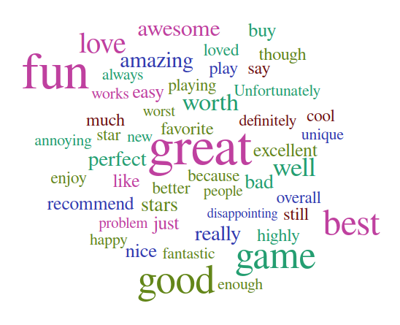
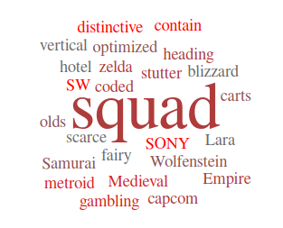
Attention Visualization
Generalist component of attention
Personalized component of attention

Slide 26
Conclusion
Integrate text reviews in the recommendation process
Improve peformances
Proposes explanations to the system’s suggestions
Alleviate the Cold Start Problem

Slide 27
An NLP APPROACH TO PROFESSIONAL PROFILE LEARNING AND EVALUATION
Resume: A Robust Framework for Professional Profile Learning & Evaluation
Clara Gainon de Forsan de Gabriac, Vincent Guigue, and Patrick Gallinari ESANN 2020

Slide 28


Motivation & Problematic
People tend to change jobs more and more often
More and more online job boards
Problematic
How can we accurately represent a person’s career?

Slide 29
Motivation and intuition
Schematic representation of a LinkedIn Profile

Slide 30
Motivation and intuition
Schematic representation of a LinkedIn Profile
Intuition
We can use their LinkedIn page to build their professional profiles
Their past jobs (natural language) should be enough to represent them

Slide 31
Motivation and intuition
Intuition
We can use their LinkedIn page to build their professional profiles
Their past jobs (natural language) should be enough to represent them
Approach
User-generated text → build their representation
Remainder of the profile → evaluation

Slide 32
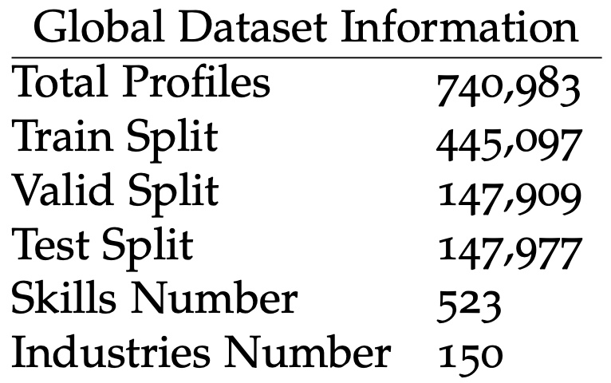
Data
Add that they are unstructured and noisy ?

Slide 33
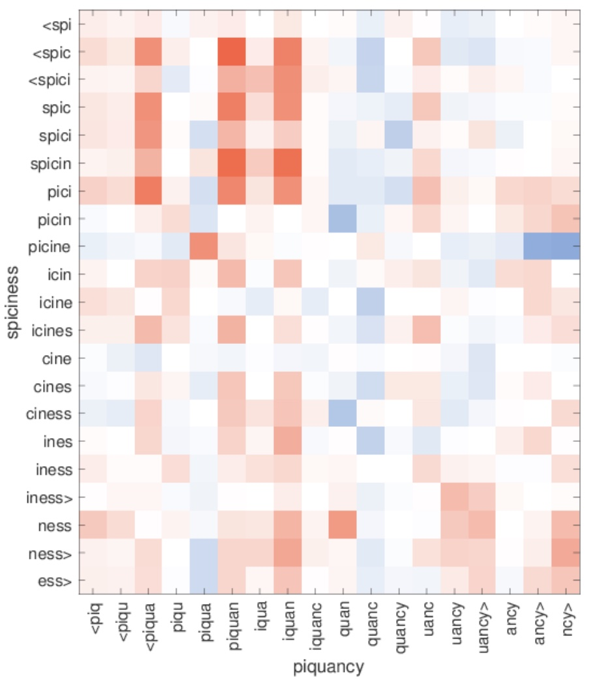
Related work - FastText
Enriching Word Vectors with Subword Information
Bojanowski, Piotr and Grave, Edouard and Joulin, Armand and Mikolov, Tomas
ACL 2016
Sub-word embeddings
Great for OOV words
Very Fast to train
Similarity between character n-grams in out-of- vocabulary words.

Slide 34

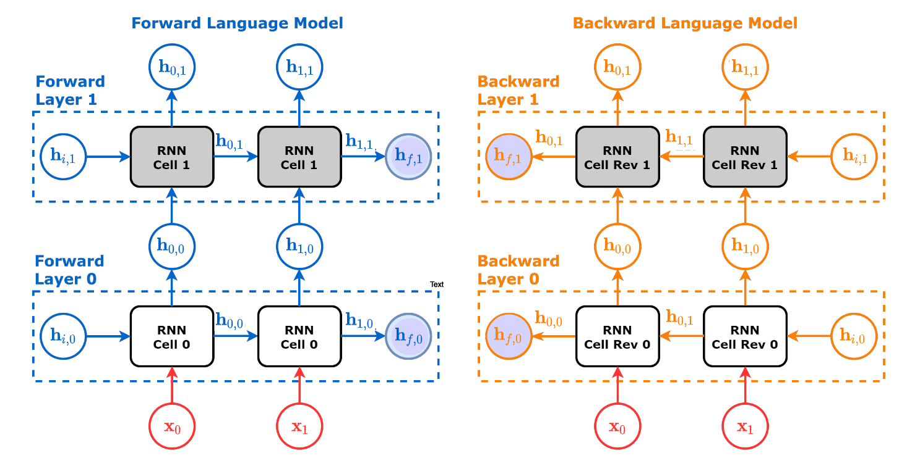
Related work - ELMo
Deep contextualized word representations
Peters, Matthew E. and Neumann, Mark and Iyyer, Mohit and Gardner, Matt and Clark, Christopher and Lee, Kenton and Zettlemoyer, Luke.
In: Proc. of NAACL 2018.

Slide 35
The model : Resume

Slide 36
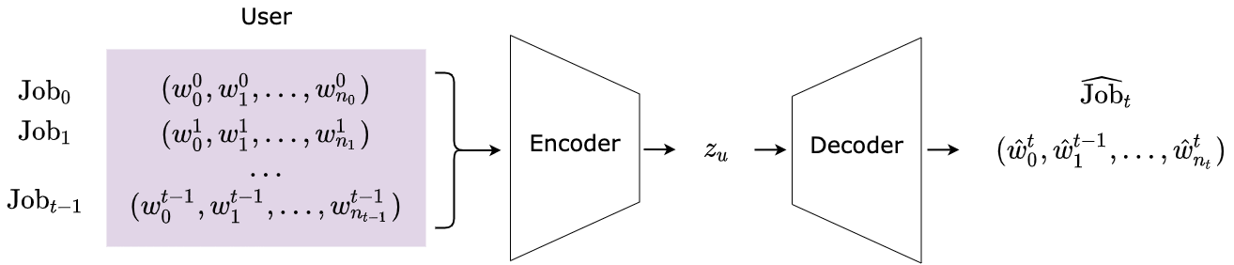
The model : Resume
Illustration of the Text generator
Add training loss and detail the architecture of decoder
Notes:
The user profile is built by encoding their t first professional experiences (or jobs).
Then, a decoder is trained to generate the user's last job, Job_t .
This formulation is a practical proxy for learning to predict a user's next job.

Slide 37
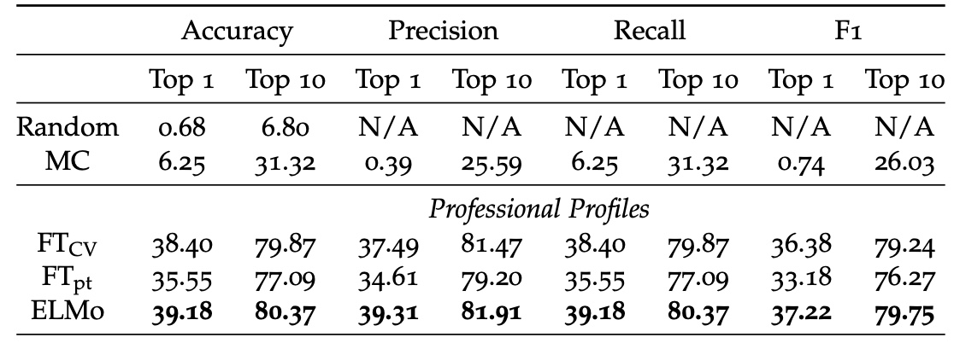
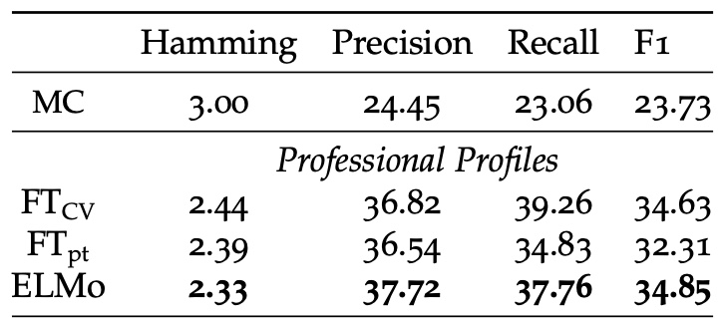
Results - Classification
Industry classification results on 150 classes.
Disambiguation in ELMo improves performances
But FT_CV is still competitive
Skills Prediction Results on 523 classes

Slide 38
Results - Classification
TODO
Examples of misclassified profiles
# | Profile |  | Predicted Industry | Actual Industry
 | Title | Description
(1)
(0)
(1)
(0)

Slide 39
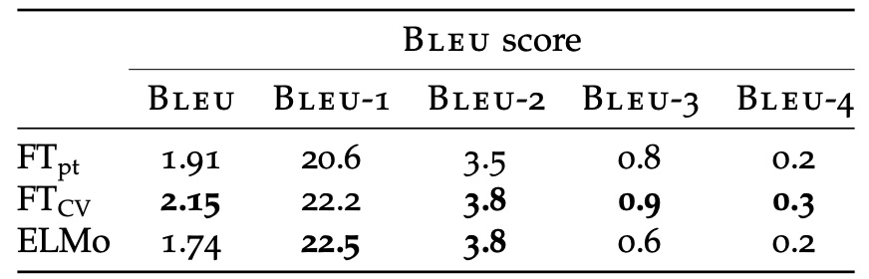
Results
Experimental results on job generation (title & description)
The BLEU score expresses a syntactic resemblance between a prediction and a reference – not a semantic one.
FT_{CV} outperforms ELMo and FT_{pt}:
a CV is not traditional natural language.

Slide 40
Results
Illustration of text generated by our decoder
Ground Truth
E-commerce Consultant. My mission consists in reaching the goals set up by the clients regarding their profitability and/or notoriety issues […]
FastText pre-trained
Marketing Manager. Management of the client relationship, Social networks management, Social networks management […]
FastText CV-oriented
Marketing Manager. Managing the communication strategy and the communication strategy for clients […]
ELMo
Sector Manager. Management of the client relationship, UNK, stock management, stock management[…]

Slide 41
Conclusion
New task: Professional Profile Learning
New application Domain: Human Resources
New framework for User Representation: Resumé
Textual traces yield rich representations

Slide 42
USER DYNAMIC MODELING

Slide 43
User Dynamic Modeling
TODO schéma explicatif global, illustrant la tâche finale

Slide 44
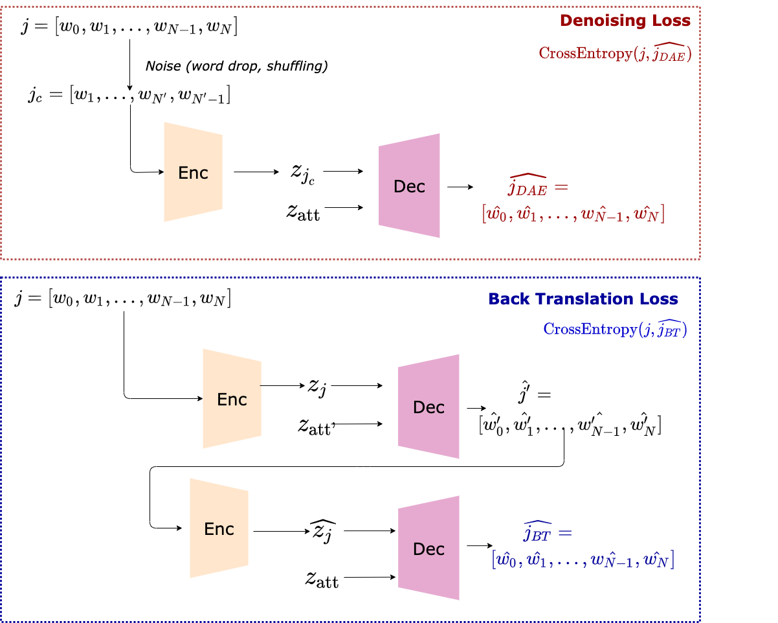
Job Expertise Rewriting

Slide 45
Industry Latent Space Structuring via VAE
Highly unstructured, no two jobs are the same
Noisy Data
No supervision on the experience level
Typos, wrongly filled out…

Slide 46
Industry Latent Space Structuring via VAE
Highly unstructured, no two jobs are the same
Noisy Data
No supervision on the experience level
Typos, wrongly filled out…
Latent representation is very noisy
Classification approach impossible
Navigating the latent space is hard

Slide 47
Industry Latent Space Structuring via VAE
Noisy Data
Highly unstructured, no two jobs are the same
Typos, wrongly filled out…
Intuition
We need to better organize our data
Enforcing structure in the latent space will help us navigate it
Latent representation is very noisy
Classification approach impossible
Navigating the latent space is hard

Slide 48
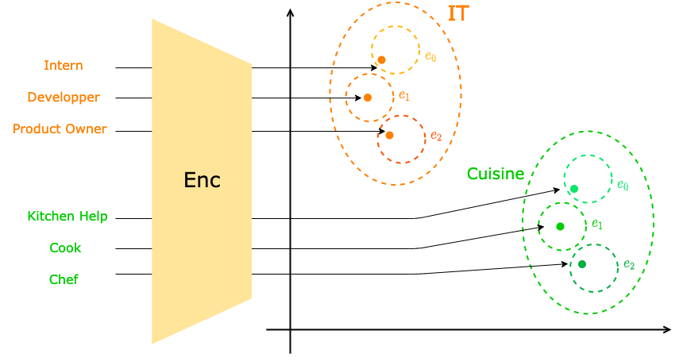
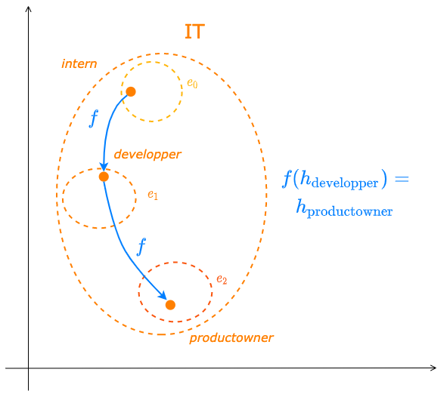
Industry Latent Space Structuring via VAE
Intuition
Career progression varies from one industry to another
Enforcing this separation will improve the latent space quality
It will ease the learning of users’ trajectories

Slide 49
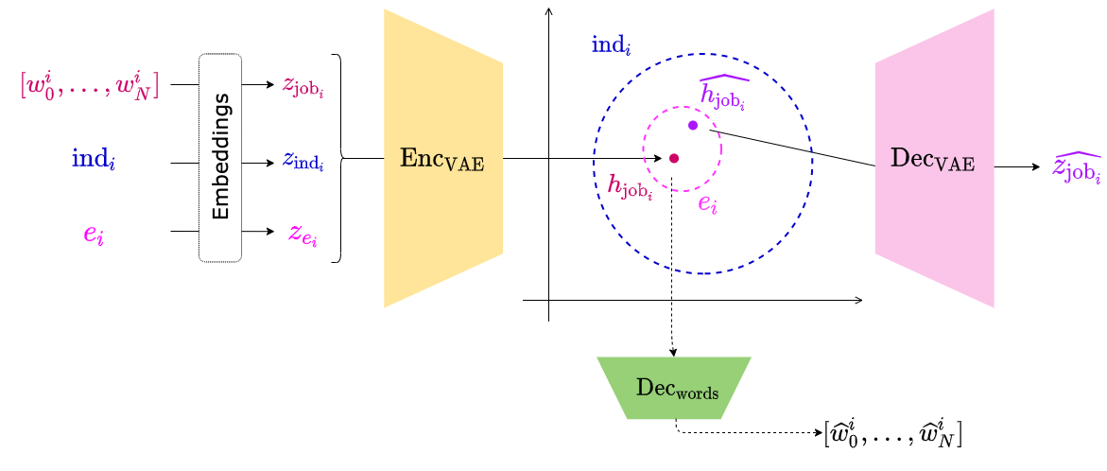
Industry Latent Space Structuring via VAE

Slide 50
Industry Latent Space Structuring via VAE

Slide 51
Conclusion

Slide 52
Contributions
A refined, explainable user representation
An NLP-based user representation framework
A new application domain: Human Resources

Slide 53
Perspectives
Update existing models with newer architectures
Diversify training objectives
User Dynamic Modeling
New applications

Slide 54
Perspectives
TODO : illustration des phrases générées avec un transformer

Slide 55
Thank You!
Publications:
RNN & modèle d’attention pour l’apprentissage de profils textuels personnalisés. C.-E. Dias, C. Gainon de Forsan de Gabriac, V. Guigue, P. Gallinari. CORIA 2018
Resume: A Robust Framework for Professional Profile Learning & Evaluation C. Gainon de Forsan de Gabriac, V. Guigue, P. Gallinari. ESANN 2020.

Slide 56
References ⠐ Appendix

Slide 57
References

Slide 58
Appendix for HRAN

Slide 59
Appendix for Resumé

Slide 60
Appendix for User Modeling

