Slide 1
Deep Natural Language Processing for User Representation
Traitement du langage naturel profond pour la modélisation d’utilisateurs
Clara Gainon de Forsan de Gabriac – 13 décembre2021
JURY DE THESE
Rapporteurs
Anne Boyer
Julien Velcin
Examinateurs
Mohamed Chetouani
Alejandro Bellogin
Encadrants
Patrick Gallinari
Vincent Guigue

Slide 2
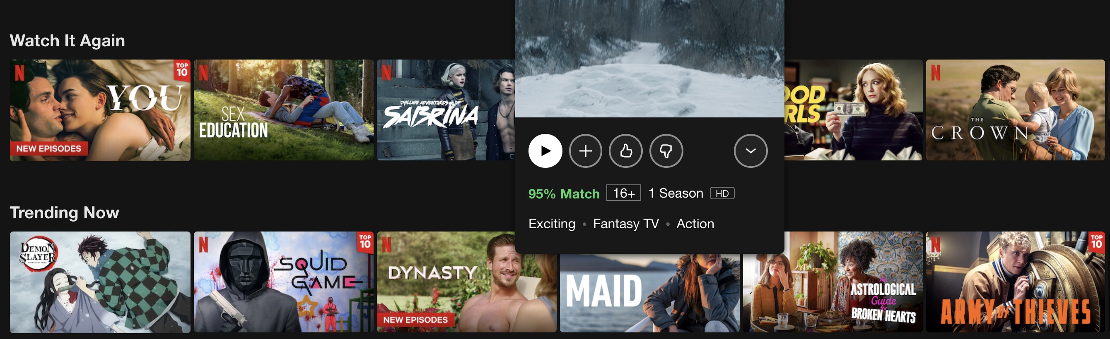
The Information Era
Generalities about the amount of available data, online user profiles and the textual traces users leave
Make link with the fact that we are interested in user representation
Notes:
A lot of info and accessible data

Slide 3
Problematics
Rich User
Representation

Slide 4
Problematics
Rich User
Representation
Leverage
User-generated
Text

Slide 5
Problematics
Rich User
Representation
Leverage
User-generated
Text
Make Predictions Explainable

Slide 6
Problematics
Rich User
Representation
Leverage
User-generated
Text
Make Predictions Explainable
This
Work

Slide 7
Motivations and contributions
Motivations
Rich, versatile user representation
Leverage user-generated text
Make predictions explainable

Slide 8
Motivations and contributions
Motivations
Axes
Recommendation
Rich, versatile user representation
Representation Learning
Leverage user-generated text
Natural Language Processing
Make predictions explainable
Generative models

Slide 9
Motivations and contributions
Motivations
Axes
Contribution
Recommendation
Rich, versatile user representation
1
HRAN
Representation Learning
Leverage user-generated text
Natural Language Processing
2
Make predictions explainable
Résumé
Generative models

Slide 10
Outline
Refining User Understanding In Recommendation Via NLP
A NLP Approach To Professional Profile Learning And Evaluation
User Dynamic Modeling
Conclusion & Perspective

Slide 11
REFINING USER UNDERSTANDING IN RECOMMENDATION VIA NLP
RNN & modèle d’attention pour l’apprentissage de profils textuels personnalisés
Charles-Emmanuel Dias, Clara Gainon de Forsan de Gabriac, Vincent Guigue, and Patrick Gallinari CORIA 2018

Slide 12
Motivation and intuition
Motivation
Good prediction accuracy
Prediction Explainability
Intuition
Reviews can help improve performances
& make predictions understandable.
Approach
Traditional rating regression
+
attentive sentiment analysis
Dessin simplifié de l’archi

Slide 13
Related work
Collaborative Filtering & Matrix Factorization
Ref
Leveraging Textual reviews for recommendation
Ref
Hierarchical Attentive Network for document classification
Ref (HAN)

Slide 14
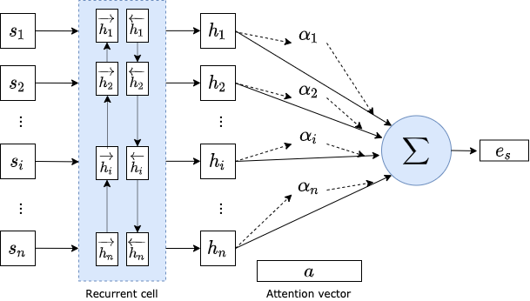
The model : HRAN, RBA
Ref HAN
Equation of global attention vector

Slide 15
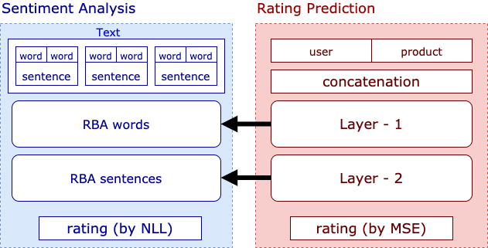
The model : HRAN

Slide 16
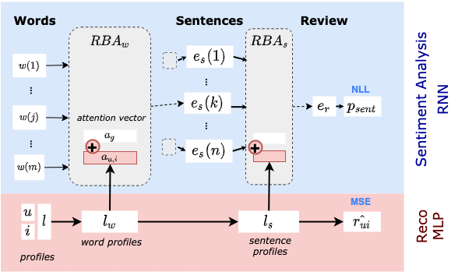
The model : HRAN, overview

Slide 17
The model : HRAN, overview
Equation qui lie les 2 attentions

Slide 18
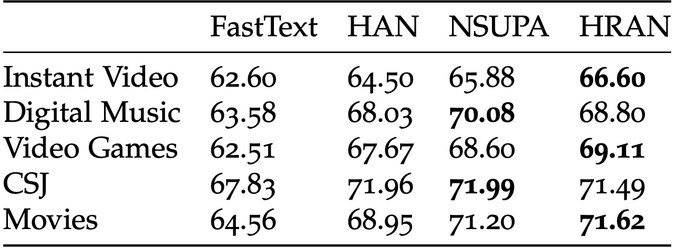
Results
Accuracy metric on the sentiment analysis task.

Slide 19
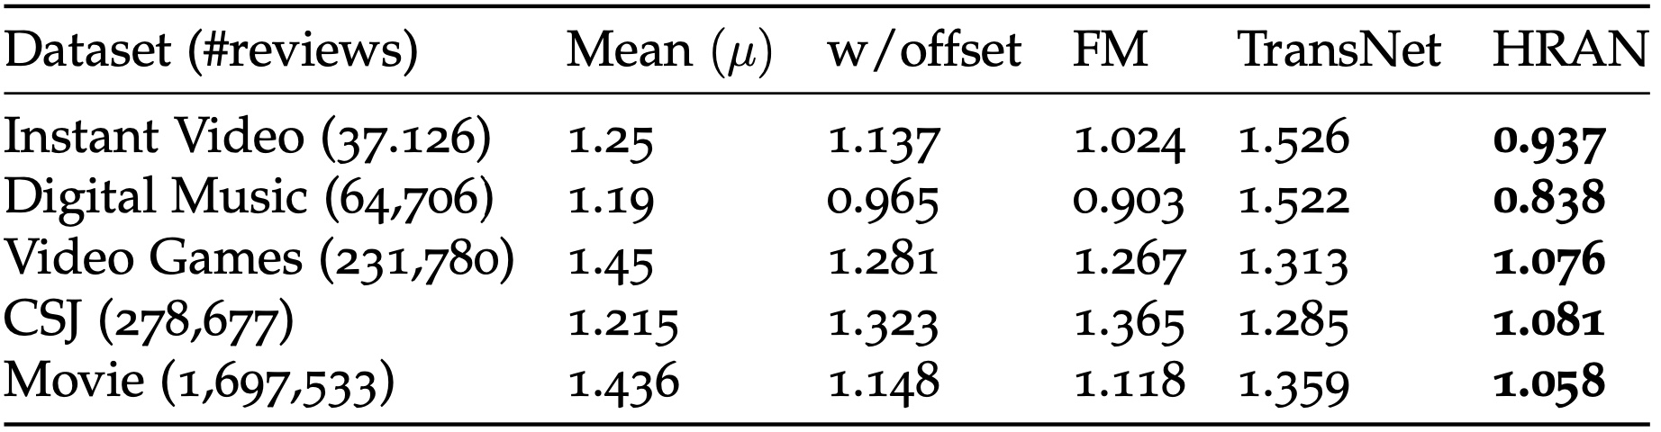
Results
RMSE in rating prediction.

Slide 20
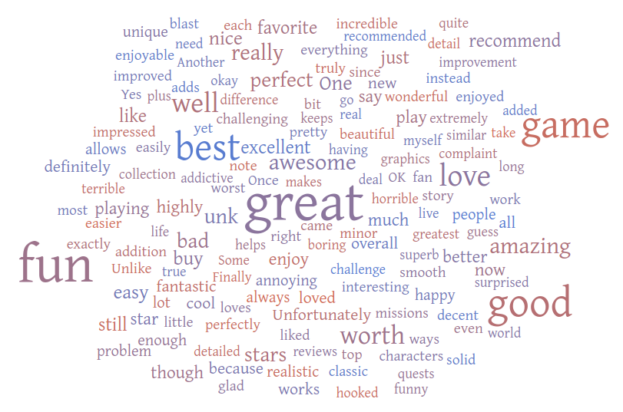
Attention Visualization

Slide 21
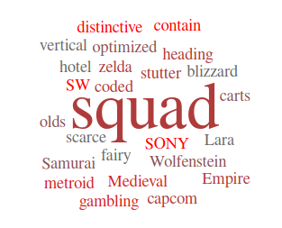
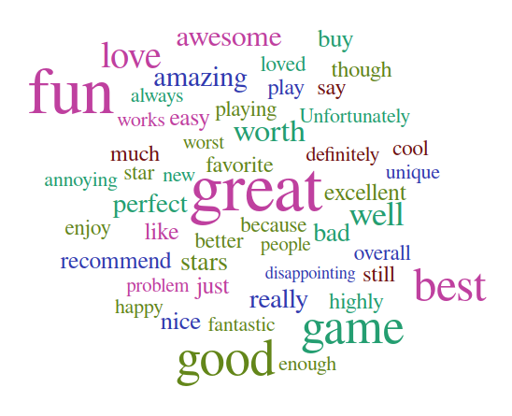
Attention Visualization

Slide 22
Conclusion

Slide 23
A NLP APPROACH TO PROFESSIONAL PROFILE LEARNING AND EVALUATION
Resume: A Robust Framework for Professional Profile Learning & Evaluation
Clara Gainon de Forsan de Gabriac, Vincent Guigue, and Patrick Gallinari ESANN 2020

Slide 24


Motivation & Problematic
People tend to change jobs more and more often
More and more online job boards
Problematic
How can we accurately represent a person’s career?

Slide 25
Motivation and intuition
Intuition
We can use their LinkedIn page to build their professional profiles
Their past jobs (natural language) should be enough to represent them

Slide 26
Motivation and intuition
Intuition
We can use their LinkedIn page to build their professional profiles
Their past jobs (natural language) should be enough to represent them

Slide 27
Motivation and intuition
Intuition
We can use their LinkedIn page to build their professional profiles
Their past jobs (natural language) should be enough to represent them
Approach
User-generated text → build their representation
Remainder of the profile → evaluation

Slide 28
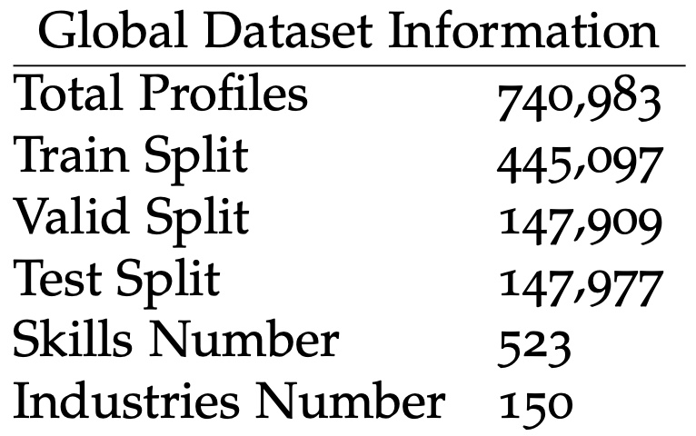
Data

Slide 29
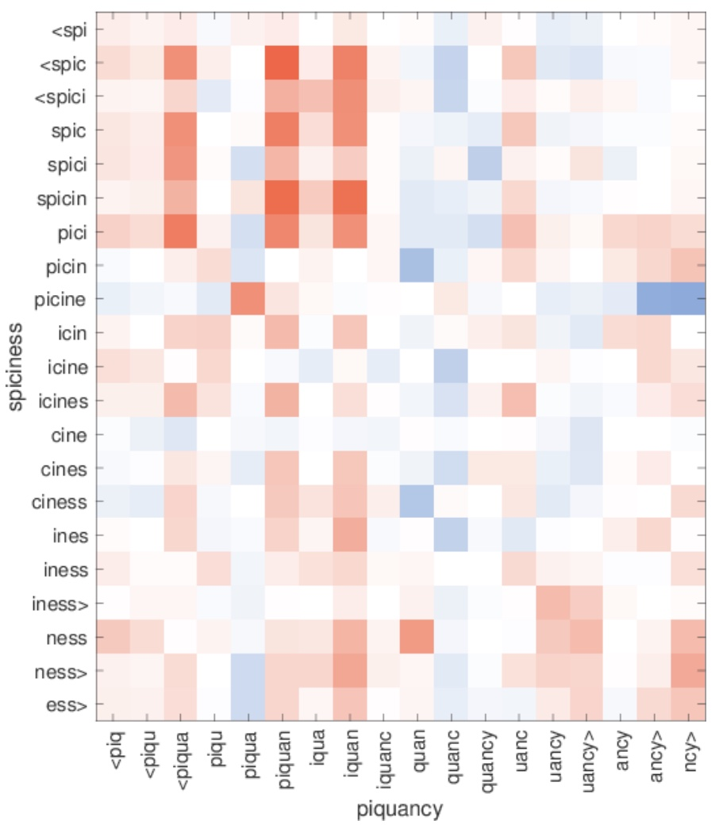
Related work - FastText
REF
Sub-word embeddings
Great for OOV words
Very Fast to train
Similarity between character n-grams in out-of- vocabulary words.

Slide 30
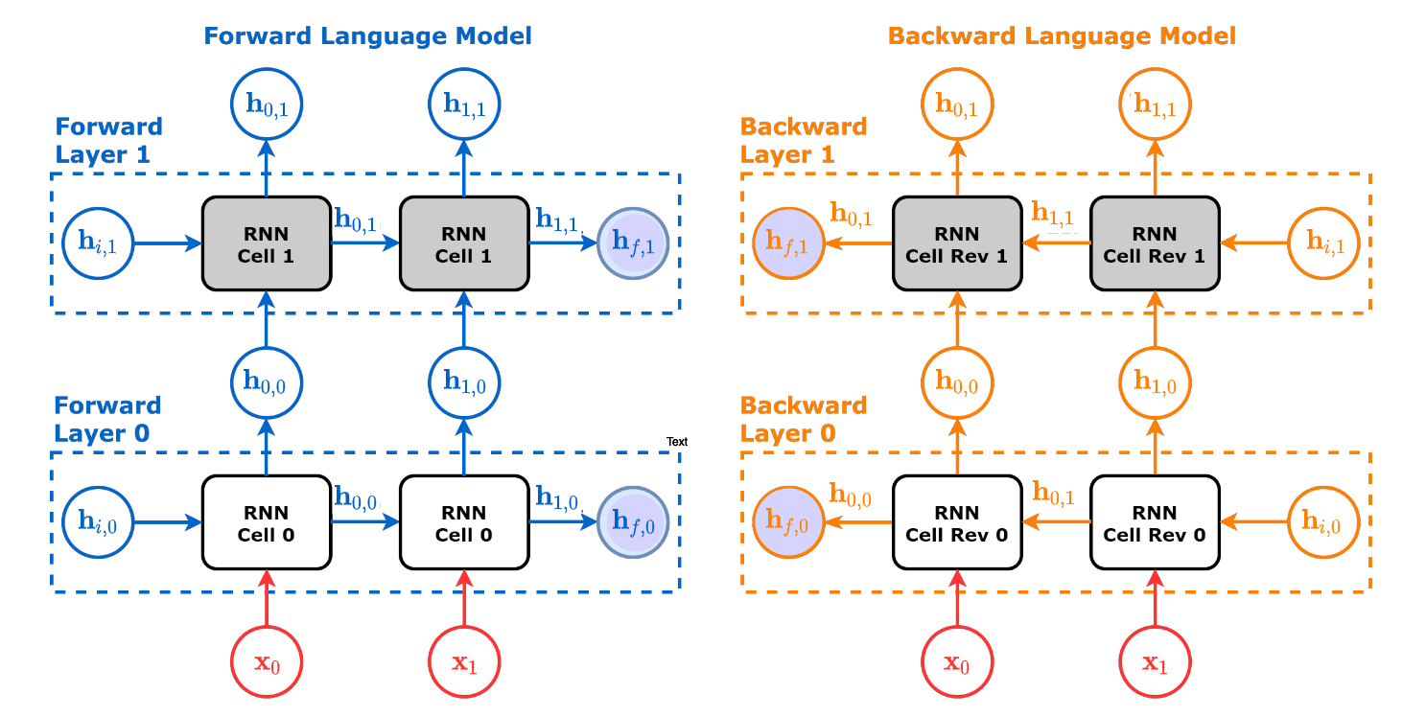

Related work - ELMo
REF

Slide 31
The model : Resumé

Slide 32
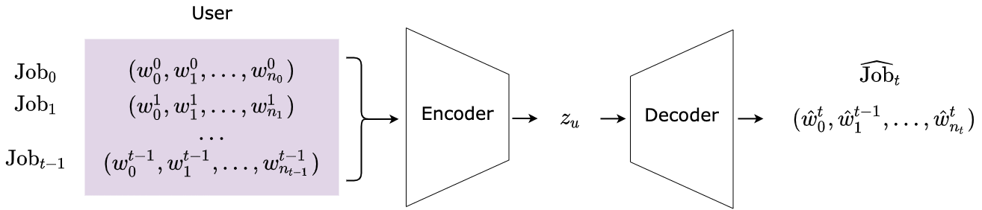
The model : Resumé

Slide 33
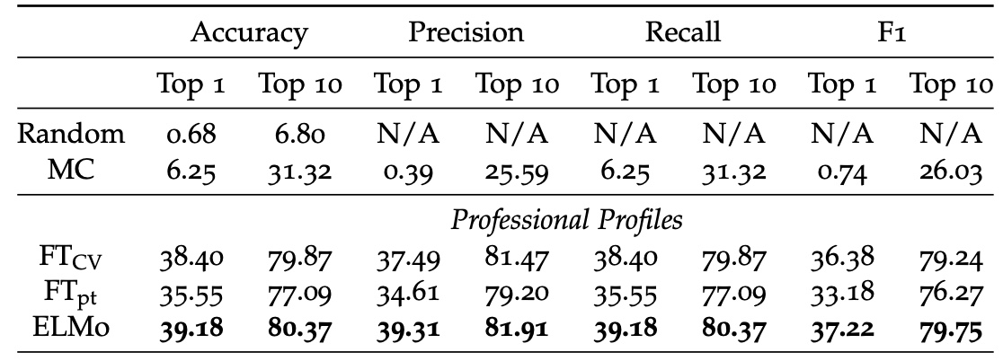
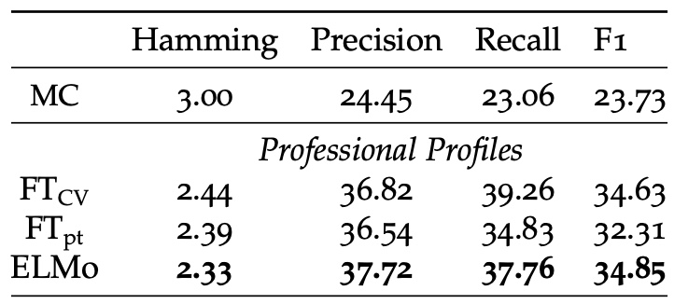
Results - Classification
Industry classification results on 150 classes.
Skills Prediction Results on 523 classes

Slide 34
Results - Classification
TODO
Examples of misclassified profiles
# | Profile |  | Predicted Industry | Actual Industry
 | Title | Description
(1)
(0)
(1)
(0)

Slide 35
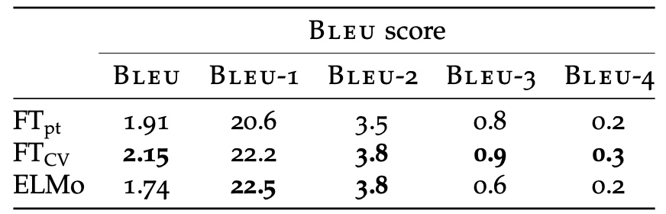
Results
Experimental results on job generation (title & description)

Slide 36
Results
Illustration of text generated by our decoder
Ground Truth
E-commerce Consultant. My mission consists in reaching the goals set up by the clients regarding their profitability and/or notoriety issues […]
FastText pre-trained
Marketing Manager. Management of the client relationship, Social networks management, Social networks management […]
FastText CV-oriented
Marketing Manager. Managing the communication strategy and the communication strategy for clients […]
ELMo
Sector Manager. Management of the client relationship, UNK, stock management, stock management[…]

Slide 37
Conclusion

Slide 38
USER DYNAMIC MODELING

Slide 39
User Dynamic Modeling
TODO schéma explicatif global, illustrant la tâche finale

Slide 40
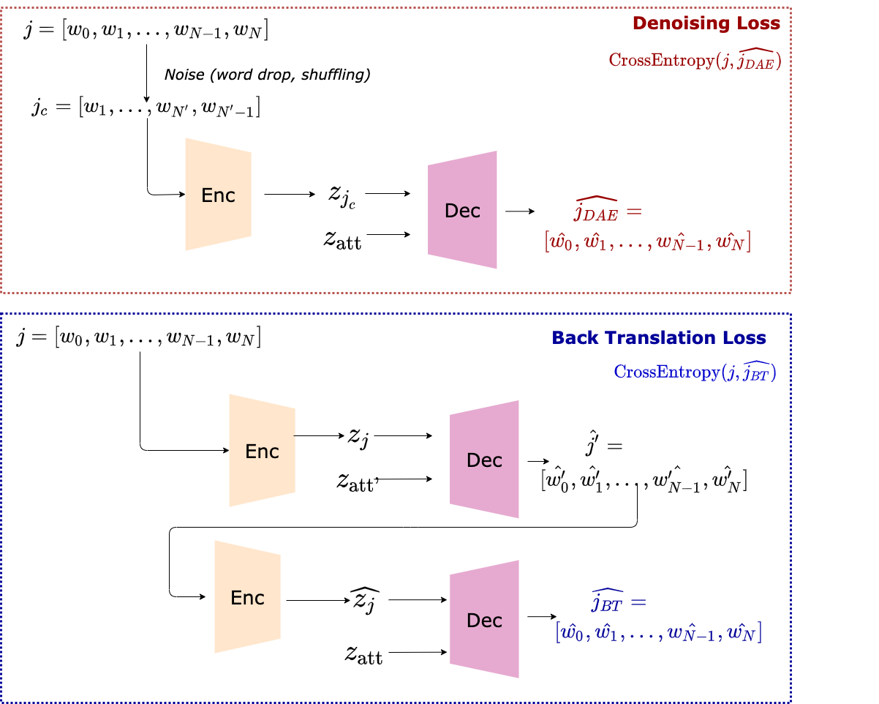
Job Expertise Rewriting

Slide 41
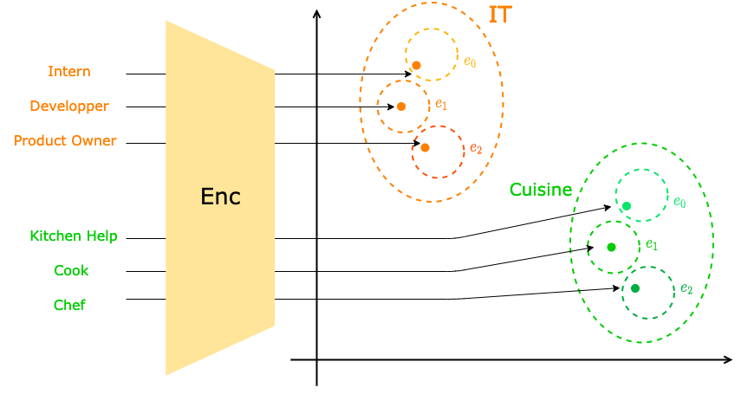
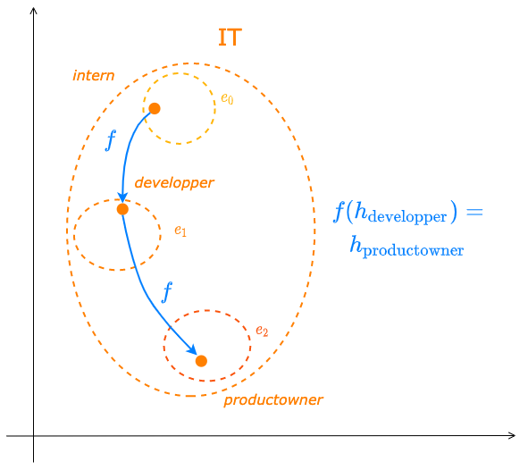
Industry Latent Space Structuring via VAE

Slide 42
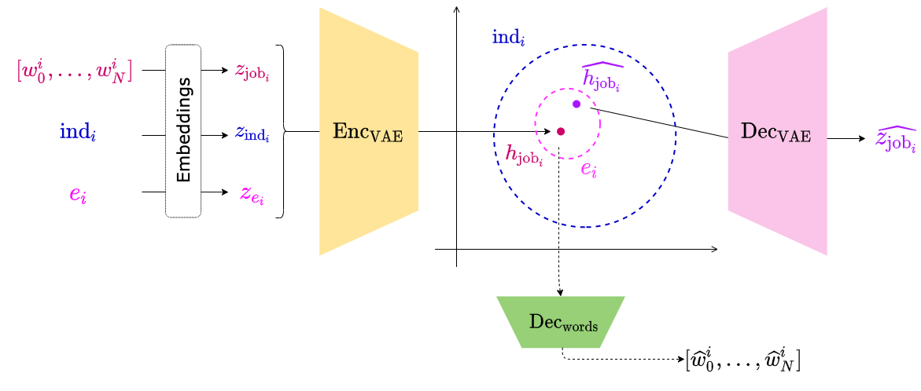
Industry Latent Space Structuring via VAE

Slide 43
Industry Latent Space Structuring via VAE

Slide 44
Conclusion

Slide 45
Contributions
A refined, explainable user representation
An NLP-based user representation framework
A new application domain: Human Resources

Slide 46
Perspectives
Update existing models with newer architectures
Diversify training objectives
User Dynamic Modeling
New application Domain

Slide 47
Perspectives
TODO : illustration des phrases générées avec un transformer

Slide 48
Thank You!
Publications:
RNN & modèle d’attention pour l’apprentissage de profils textuels personnalisés. C.-E. Dias, C. Gainon de Forsan de Gabriac, V. Guigue, P. Gallinari. CORIA 2018
Resume: A Robust Framework for Professional Profile Learning & Evaluation C. Gainon de Forsan de Gabriac, V. Guigue, P. Gallinari. ESANN 2020.

Slide 49
References ⠐ Appendix

Slide 50
References

Slide 51
Appendix for HRAN

Slide 52
Appendix for Resumé

Slide 53
Appendix for User Modeling

