Slide 1
Autoencoders and Variational autoencoders (VAE)

Slide 2
The CONCEPT

Slide 3
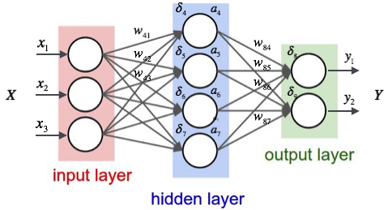
The concept
REMINDER
Neural networks can slowly approximate any function that maps inputs to outputs through an iterative optimization process also called training.
A neuron takes the value of a connected neuron and multiplies it with their connections weights. The sum of all connected neurons and the neurons bias value is then put into an activation function which simply mathematically transforms the value before it finally can be passed on to the next neuron.
But, now, our goal is not to find the output Y but to reconstruct the original input X

Slide 4
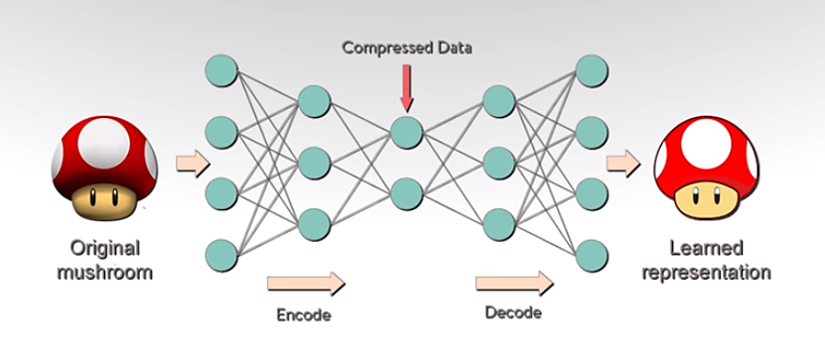
Reconstructing the original input X : if our input was an array consisting of a few numbers, our network should output that same input with those same exact numbers after applying a series of operations to it
If we set the output to be the same as the input, this neural network is an autoencoder because it encodes a denser representation of the input data.

Slide 5
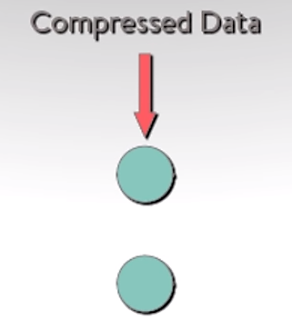
But, what is the point of doing this ?
Well… the hidden layer…
Once the network can reliably reconstruct its input, the hidden layer must contain enough information to represent the output.
The hidden layer is smaller than the input and output layers, what it represents is the same information in a lower density. It’s a much denser representation of the input data.

Slide 6
The Fundamental theory

Slide 7
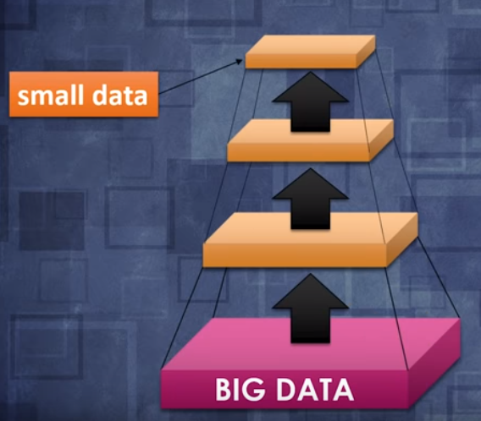
Definition of an autoencoder
Takes input data with a very high dimensionality
Runs in through the neural network
Tries to compress the data into a smaller representation
Unsupervised Machine Learning algorithm
Applies backpropagation, setting the target values to be equal to the inputs.
What does it do ?
If we need the original data, we can reconstruct it from the compressed data.
Loss function
By simply comparing pixel to pixel, differences between the input and the output, we can create a loss function and we can start training our network to compress images.

Slide 8
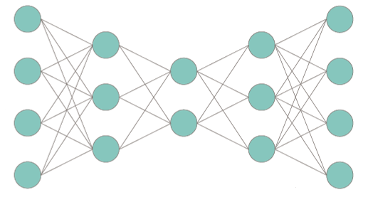
Architecture of an autoencoder
An autoencoder is composed of:
An encoder: bunch of layers (fully connected layers, convolutional layers) that are going to take the input and to compress it down to a smaller representation which has less dimensions that the input.
A bottleneck: layer between the encoder and decoder
A decoder: from the bottleneck, it is going to try and reconstruct the input by using again a fully connected or convolutional layers. This layer decodes the encoded image back to the original dimension.
ENCODER
DECODER
BOTTLENECK
The decoded image is a lossy reconstruction of the original image and it is reconstructed from the latent space representation.

Slide 9
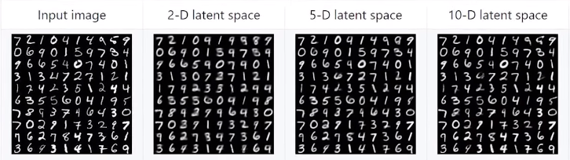
Properties of an autoencoder
Data-specific
Only able to compress data similar to what it has been trained on
Lossy
Decompressed outputs will be degraded compared to the original inputs
Learned automatically from examples
Easy to train specialized instances of the algorithm that will perform well on a specific type of input
When we reconstructed the input image, we lose some details and that’s why images look so fuzzy.
If we use more dimensions in the latent representation, we can get reconstructions that are much clearer and much sharper.
Initial image
Reconstructs images : pretty good but very fuzzy

Slide 10
HOW TO IMPLEMENT IT ?
model.fit(x,y)
Autoencoders are just neural networks where the target output is the input.
With Keras or Scikit learn libraries, just simply train the model by changing a single parameter.
model.fit(x,x)
TYPES of antoencoderS
Convolution Autoencoders
Deep Autoencoders
Variational autoencoders
Denoising autoencoder
…

Slide 11
EXAMPLE : DENOISING AUTOENCODER

Slide 12
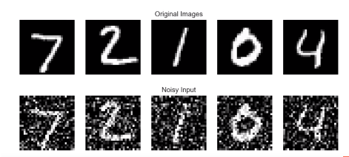
DENOISING AUTOENCODER
Imagine that we have clean images and then, we add a whole lot of noise to them :
We are going to run these noisy images through the encoder network and to try to reconstruct the original clean images (see jupyter notebook)

Slide 13
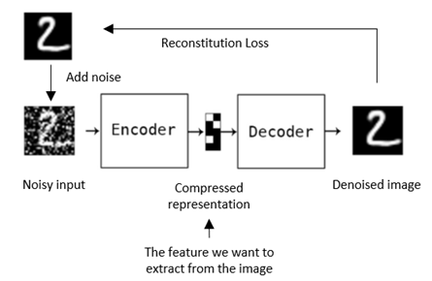
If we train the neuron network with a whole bunch of these noisy images, we are going to try to force the encoder to get rid of the noise. This is what we call a denoising autoencoder.

Slide 14
APPLICATION AREAS

Slide 15
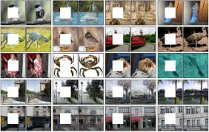
NEURAL IMPRINT
In this case, instead of adding noise to the input, we simply crop a rectangular area out of the image and we replace it with white or back pixels.
We feed that input image through the network. The network tries to reconstruct the original full image.

Slide 16
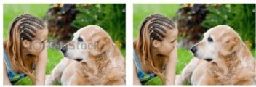
Watermark Removal
Autoencoders are also used for removing watermarks from images or to remove any object while filming a video or a movie.

Slide 17
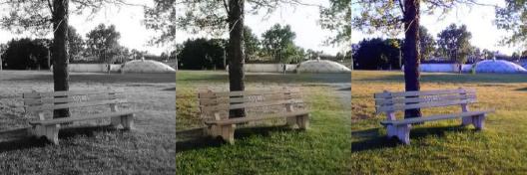
Image coloring
Autoencoders are used for converting any black and white picture into a coloured image. Depending on what is in the picture, it is possible to tell what the colour should be.

Slide 18
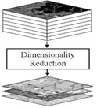
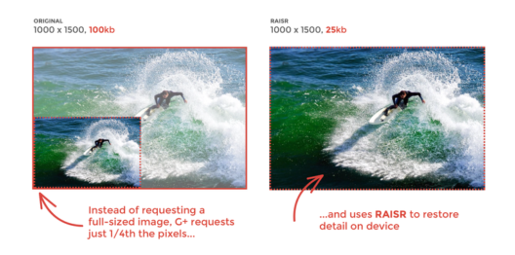
DIMENSIONALITY REDUCTION & DATA COMPRESSION
The reconstructed image is the same as our entry but with reduced dimensions. This helps to provide a similar image with a reduced pixel value.
Google is actually thinking of using this type of network to reduce the bandwidth you use on your phone. Thus, if you download an image, the full resolution image is first reduced and then transmitted over your wireless Internet connection. Then, in your phone, there would be a decoder that would reconstruct the full resolution image from the compressed representation.

Slide 19
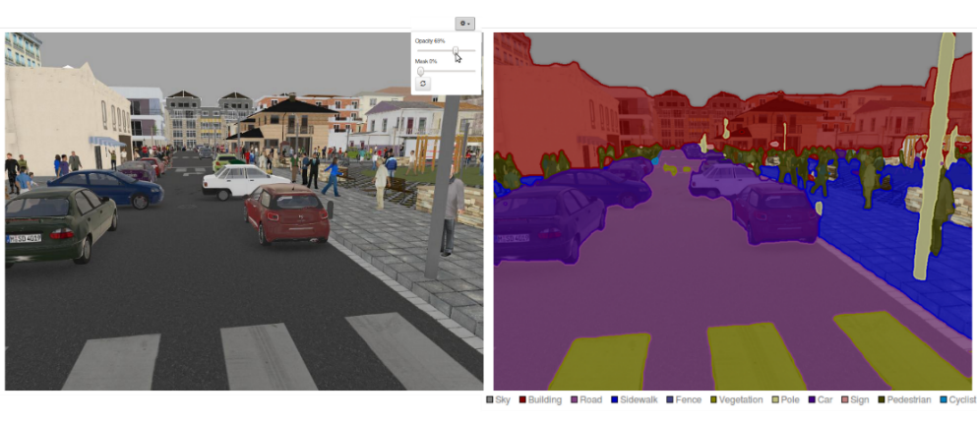
Image segmentation
We take an input image and execute it through a convolutional encoder. Instead of rebuilding the original image, we will try to target a segmented version of our original image.
It is exactly this type of network used in autonomous cars to segment the different parts of the public road into specific objects that a car must detect.

Slide 20
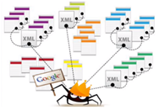

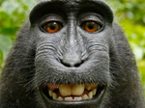
IMAGE SEARCH
When we search on Google using an image as a search query (instead of text), it is very likely that Google uses autoencoders.
Every time one of Google's bots explores the web and finds an image, it compresses it with an automatic encoder. Whenever we look for new images, it compresses them and then classifies them according to their similarity.

Slide 21
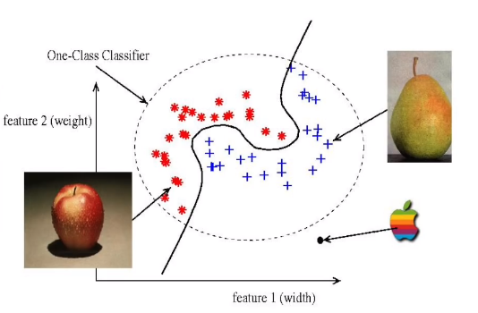
ONE-CLASS CLASSIFICATION
When we only have a dataset with a single class which is called the target class and we feed it to an autoencoder, it will learn to detect objects of that class. When it receives an object that doesn’t fit that class category, it will detect it as an anomaly

Slide 22
VARIATIONAL AUTOENCODERs (VAE)

Slide 23
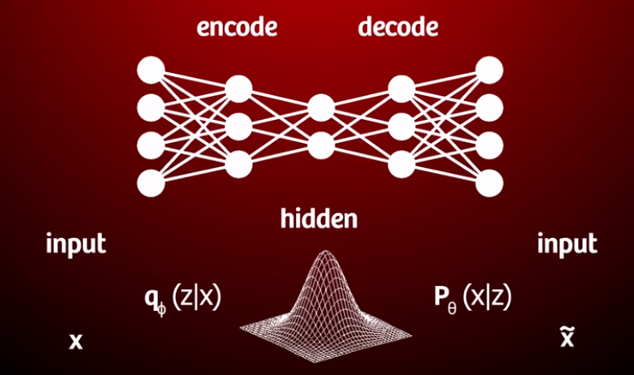
WHAT IS THE DIFFERENCE between an autoencoder and a vae ?
VAE : a type of autoencoders
The idea behind VAE is that instead of mapping an input to a fixed vector, we want to map the input onto a distribution.
The only thing that is different in a variational autoencoder is that the normal bottleneck vector is replaced by two separate vectors :
one representing the mean of the distribution
the other one representing the standard deviation of the distribution

Slide 24
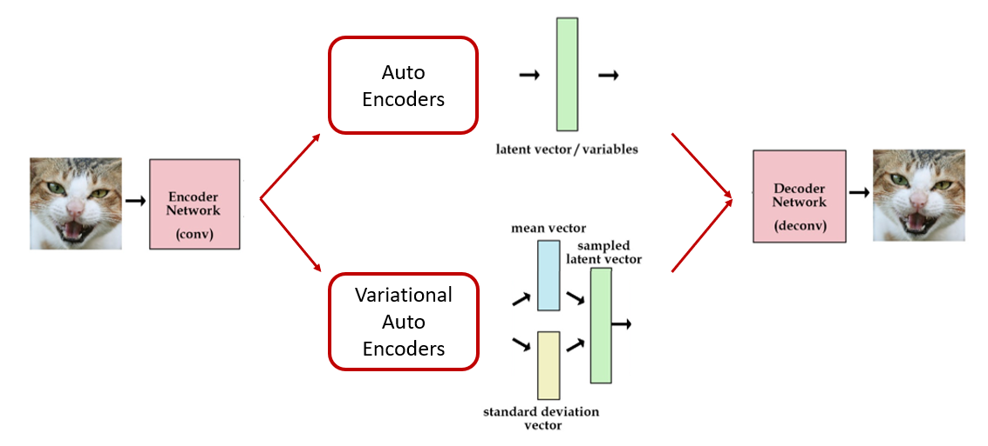

Slide 25
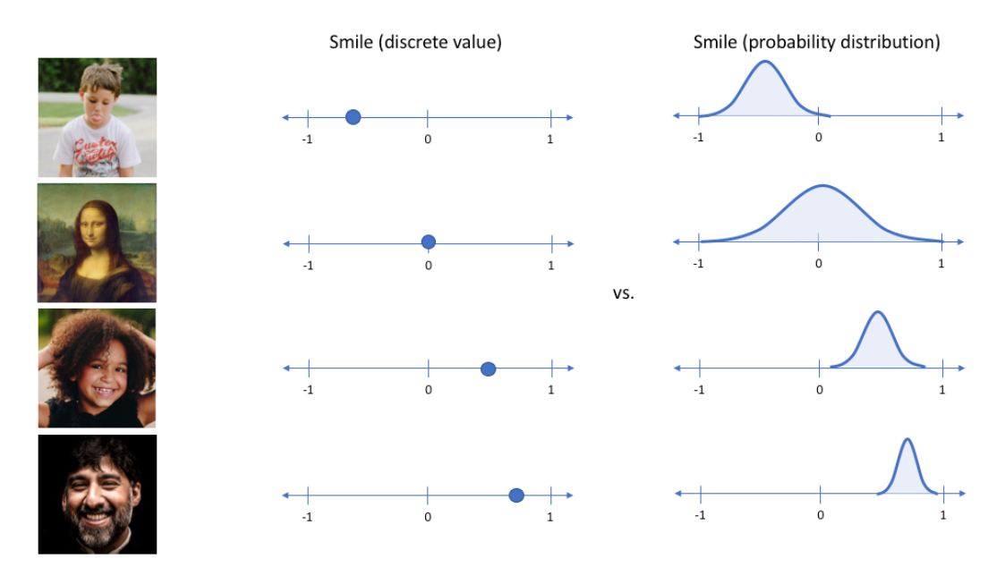
Instead of letting the network learn some function, we are learning the parameters of a probability distribution that models our data. Using a variational autoencoder, we can describe latent attributes in probabilistic terms.
Then, we can sample points from this distribution and generate similar but different outputs meaning that a VAE can be considered as a generative model.

Slide 26
DISENTANGLED VARIATIONAL AUTOENCODERS
There is a new class of VAE which has a lot of promising results that’s called disentangled variational autoencoders.
The basic idea behind this disentanglement is that you want to make sure that the different neurons in your latent distribution are uncorrelated, that they all try to learn something different about the input data.

Slide 27
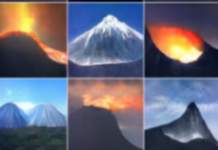
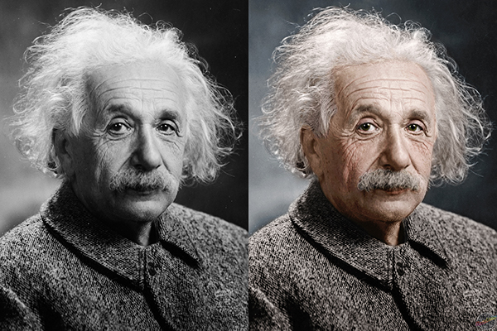
Application AREAS
Image generation
Image colorization

Slide 28
CONCLUSION
3 points to encode in your biological neural network:
Neural networks can slowly approximate any function that maps inputs to outputs through an iterative optimization process also called training.
If we set the output to be the same as the input, we can call this neural network an autoencoder because it encodes a denser representation of the input data.
There are many types of autoencoders we could make, a more recent generative model is the Variational Auto Encoder which learns a latent variable of its input data.

