Slide 1
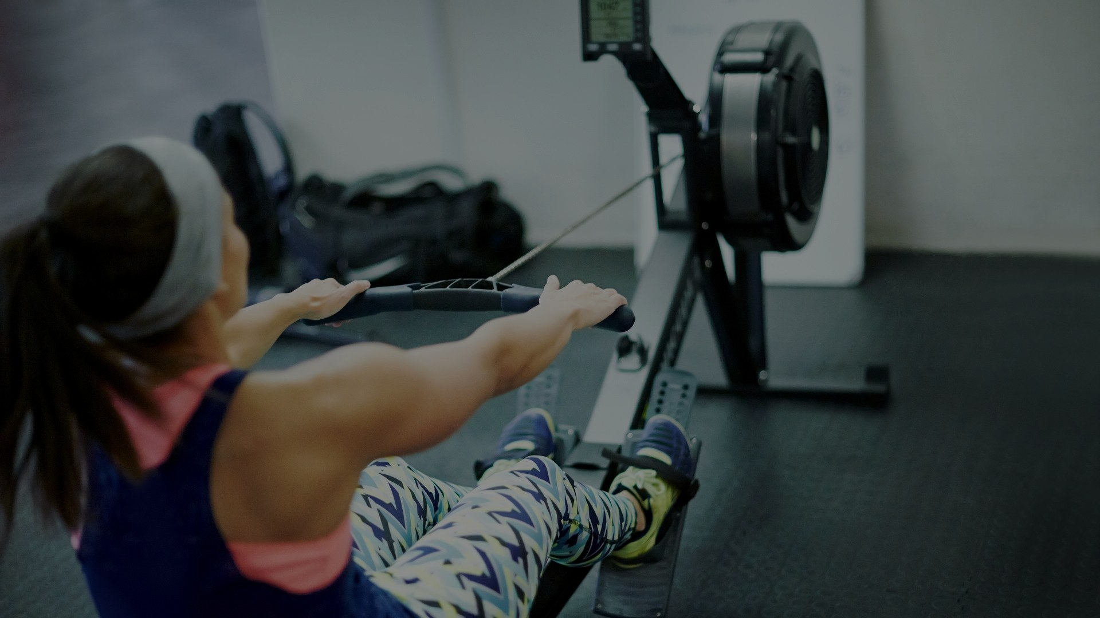
MACHINE LEARNING · POSE ESTIMATION
Rowing Motion Analysis
Stroke-by-stroke quality evaluation
Clara Brilke 25 June 2026
Notes:
- Introduce yourself and the topic: judging rowing technique on an ergometer.
- Hook: *Can we rate every single stroke automatically — from nothing but a video?*
- The idea combines MediaPipe pose estimation with a custom model.

Slide 2




THE GOAL
Aim
Per-stroke
Feedback at the granularity of one rowing stroke
Train a model that evaluates stroke quality on a rowing ergometer — automatically, after every single stroke.
Video-only
No wearables or on-body sensors required
Scope so far
Binary task — good stroke vs. failed stroke. A working pipeline, normalization, a leak-free split and first baselines are already in place.
Real-time-capable
Designed to score strokes as they happen
Assessing Rowing Technique on an Ergometer
2
Notes:
- Goal: a model that evaluates stroke quality automatically, after every stroke.
- It's a **binary** task: good stroke vs. failed stroke.
- Three target properties: per-stroke, video-only (no wearables), real-time-capable.
- A working pipeline, normalization, a leak-free split and first baselines are already done.

Slide 3
OUTLINE
What this talk covers
1
Motivation
5
Segmentation & split
Why automate stroke assessment
Per-stroke handling, leak-free split
2
Related work
6
Biggest Fail: The imbalance problem
Sensor- and pose-based approaches
355 good vs 21 bad strokes
3
Approach & pipeline
7
Baseline & autoencoder
MediaPipe → CNN → classification
Random Forest and LSTM-AE
4
Data preparation
8
Next steps
Landmarks, downsampling, normalization
Towards richer feedback
Assessing Rowing Technique on an Ergometer
3
Notes:
- Quick roadmap so the audience knows where we're going.
- Motivation → related work → approach & pipeline → data → the imbalance problem → baselines → the autoencoder → next steps.

Slide 4
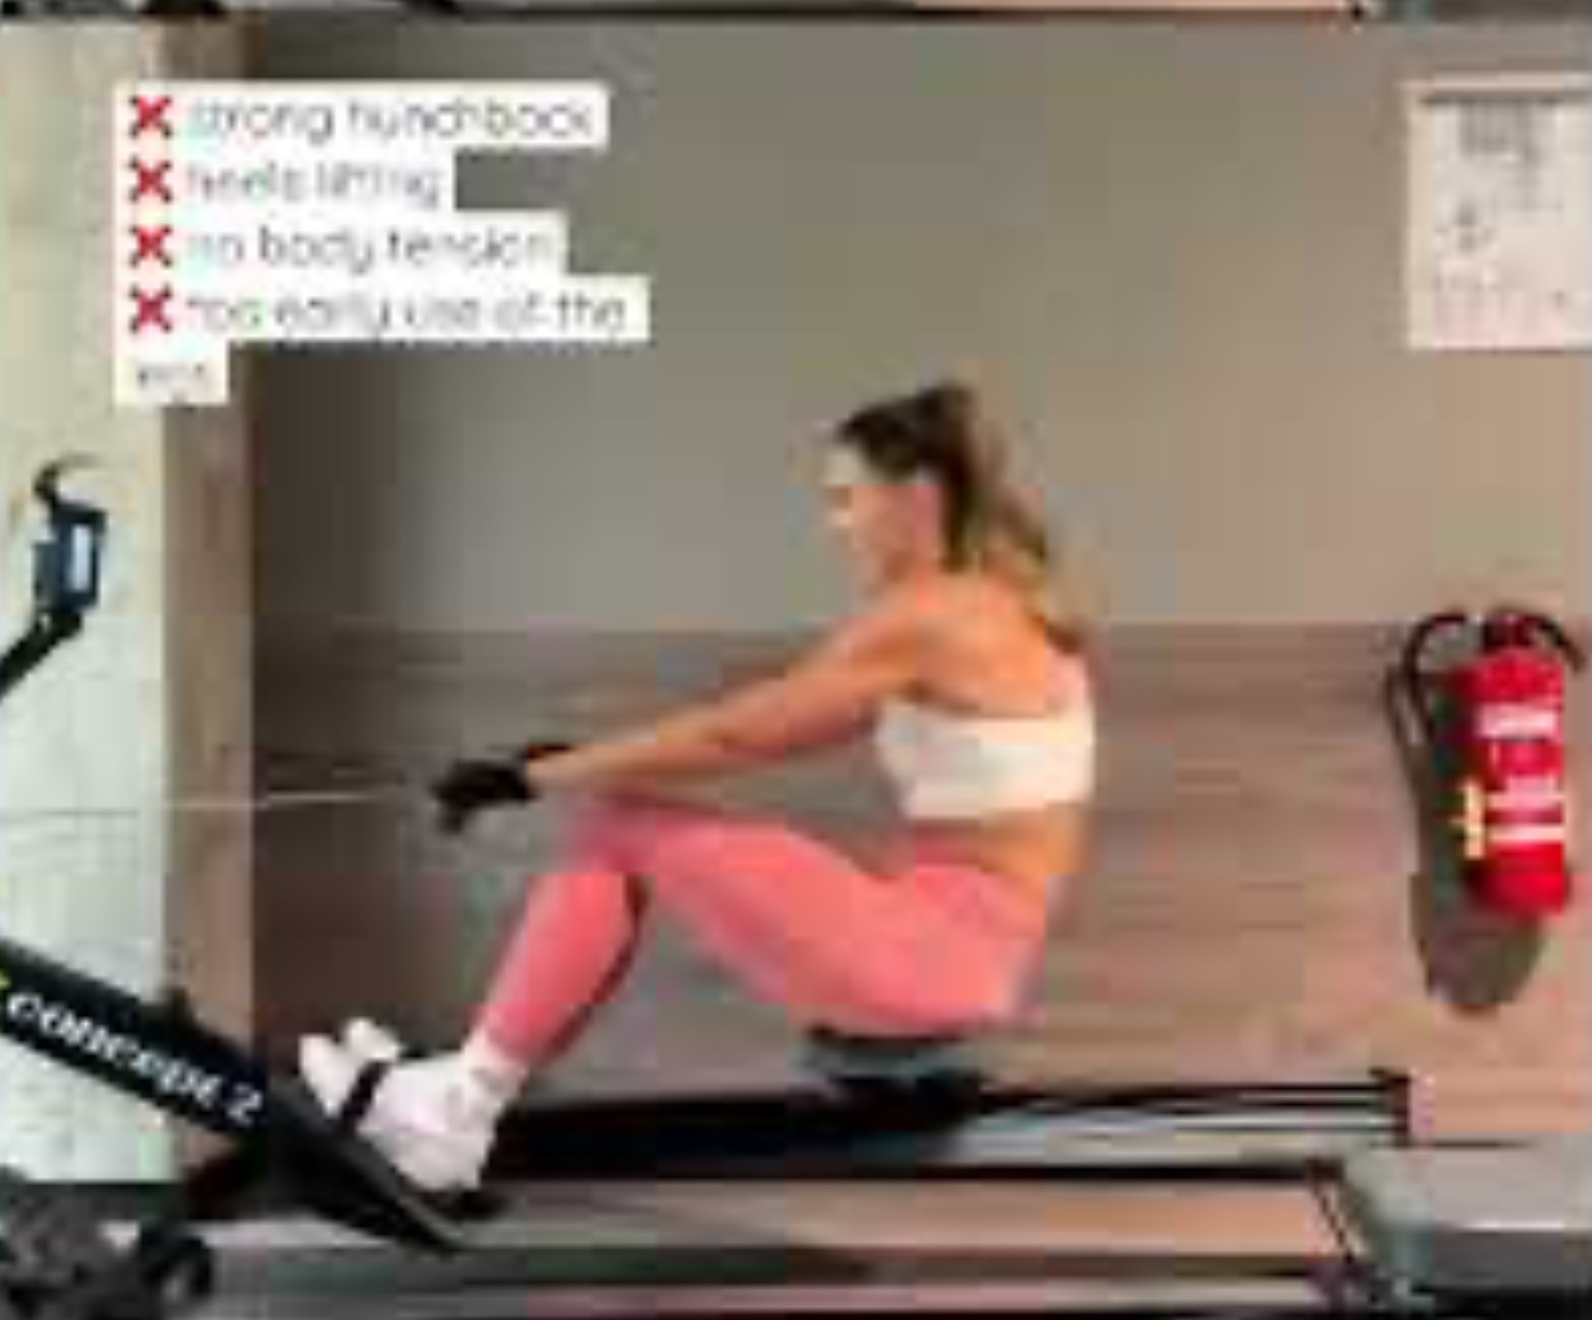
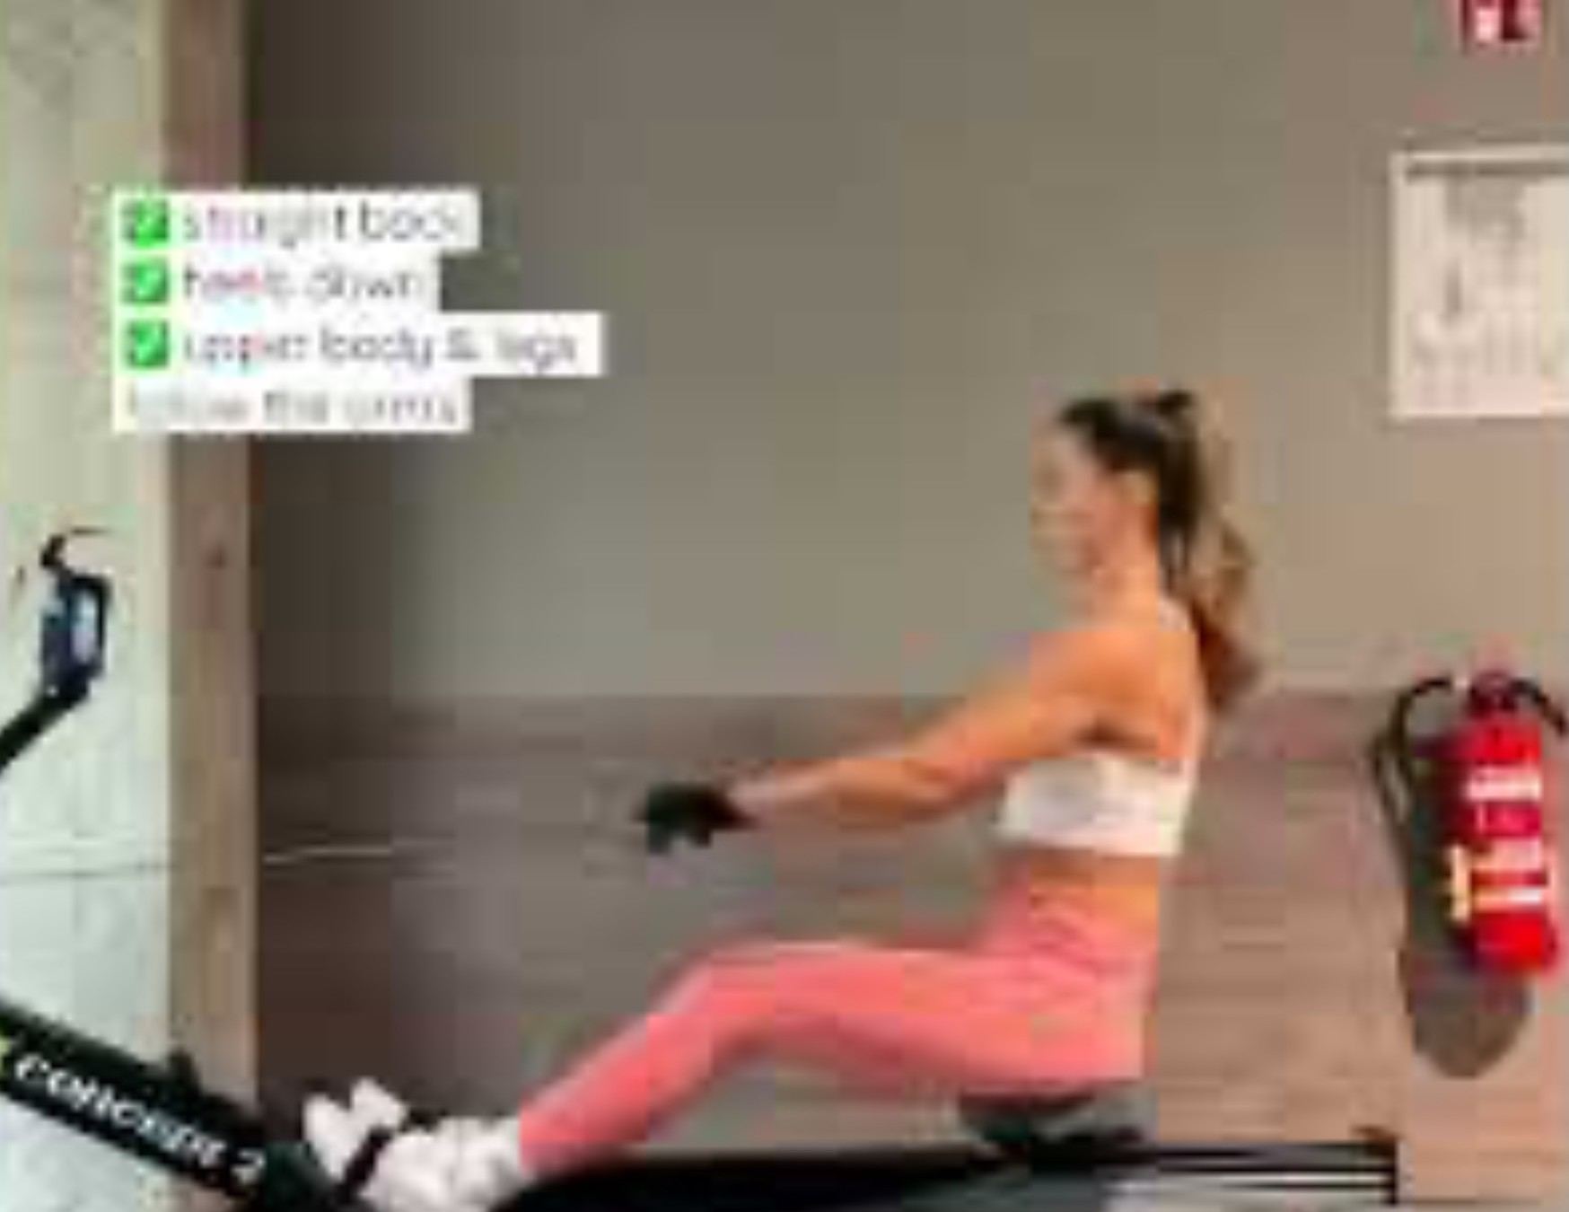



WHY IT MATTERS
Motivation
Manual technique assessment relies on experienced coaches. It is time-consuming, subjective and does not scale.
The goal
Automatically classify rowing strokes directly from ergometer video — giving every athlete instant feedback.
Faulty technique
Good technique
Hunched back · heels lifting · early arm pull
Straight back · heels down · legs then arms
Assessing Rowing Technique on an Ergometer
4
Notes:
- Today, technique feedback depends on experienced coaches.
- That's manual, subjective, time-consuming and doesn't scale.
- The idea: automatic feedback straight from ergometer video, so every athlete can get it.

Slide 5




RELATED WORK · 1 / 2
Wearable inertial sensors
Bosch et al. (2015) — Analysis of indoor rowing motion using wearable inertial sensors
Objective
Distinguish experienced from novice rowers.
Limitation
Method
Relies on on-body sensors — the athlete has to wear hardware on every session.
k-Nearest-Neighbours
Findings
My approach avoids this — a camera is all that is needed.
Clear differences in stroke-timing consistency — but no difference in absolute posture angles.
Assessing Rowing Technique on an Ergometer
5
Notes:
- Used wearable inertial sensors to analyse indoor rowing motion.
- Strength: accurate motion capture.
- Limitation: the athlete has to wear on-body sensors every session.
- My approach avoids that — a camera is all that's needed.

Slide 6
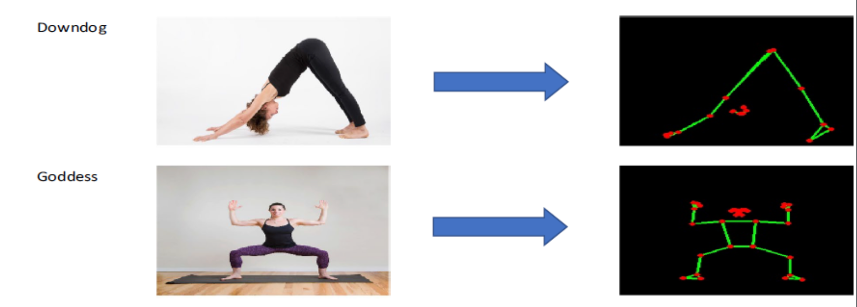


RELATED WORK · 2 / 2
Pose-based deep learning
Garg et al. (2022) — Yoga pose classification: a CNN and MediaPipe inspired deep-learning approach
Objective
Classify yoga postures; compare models with vs. without skeletonization.
Method
MediaPipe skeletonization, then CNN and transfer-learning models.
Image → skeleton → classification (Garg et al.)
Outcome
Takeaway Skeletonization + a custom CNN is the most promising route — this directly motivates my design.
Skeletonization clearly boosts performance — and a custom CNN benefits most, beating the transfer-learning models.
Assessing Rowing Technique on an Ergometer
6
Notes:
- Pose-based deep learning: yoga-pose classification with a CNN + MediaPipe.
- Shows that pose landmarks plus a CNN work well for classifying human movement.
- That's the inspiration for my pipeline.

Slide 7




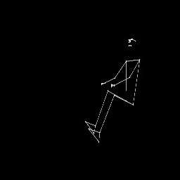
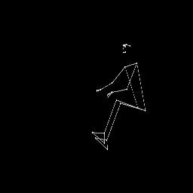
METHOD
My approach
1
2
3
Pose extraction
Custom CNN
Binary classification
MediaPipe landmarks from ergometer video
Trained on the landmark sequences
Good stroke vs. bad stroke
Good Stroke
Bad Stroke
Notes:
- Three steps: pose extraction (MediaPipe) → custom CNN on the landmark sequences → binary classification.
- The two clips show an example good stroke vs. a bad stroke as skeleton overlays.
- Everything comes from the video — no extra hardware.

Slide 8

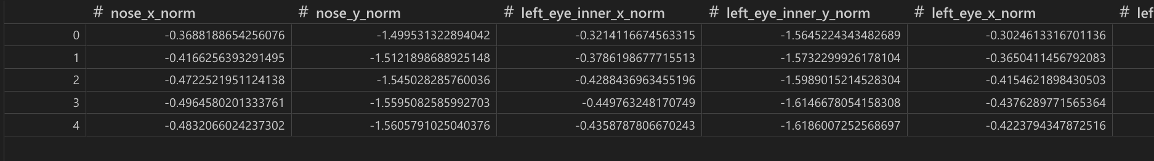

DATA · 1
Data preparation
1
Landmark extraction
Landmark data · CSV
MediaPipe coordinates stored as CSV — 69 features per frame.
2
Downsampling
30 fps → 10 fps: removes redundancy while keeping the motion.
67
30→10
CSV
features / frame
fps reduction
per-frame export
3
Normalization
MediaPipe returns a pose for every frame — 0 frames without a detected pose across the dataset.
Makes videos from different angles and body proportions comparable.
Assessing Rowing Technique on an Ergometer
8
Notes:
- Extract MediaPipe landmarks per frame, stored as CSV — 69 features per frame.
- Downsample 30 → 10 fps: removes redundancy while keeping the motion.
- Normalize so videos from different angles and bodies become comparable.

Slide 9
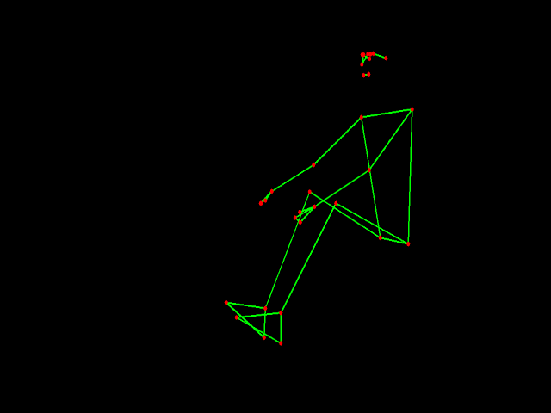
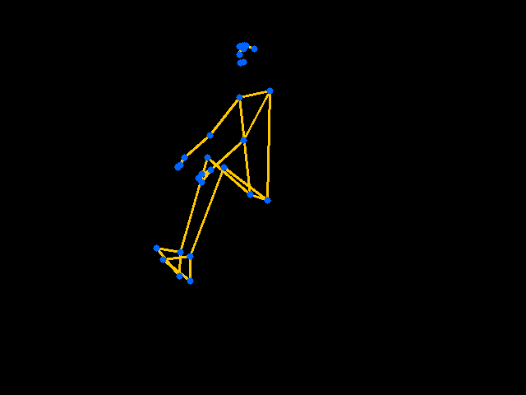
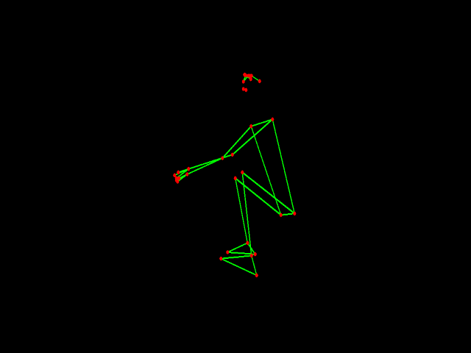
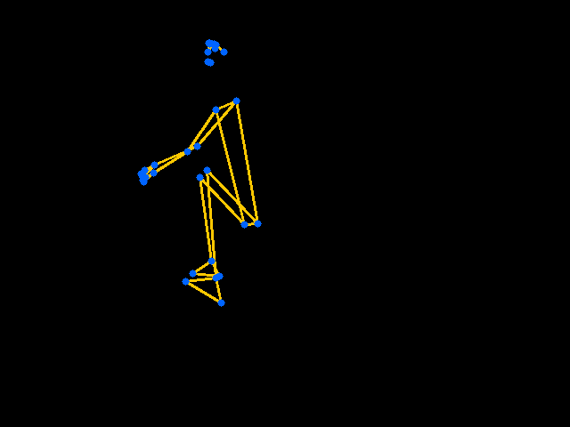

DATA · 2
Normalization
Why. Recordings differ in camera angle and in the rower's body proportions, so raw coordinates are not comparable across videos.
Raw
Normalized
How. Centre each pose on a hip reference and scale by torso length — making strokes directly comparable.
Same stroke, same representation — regardless of who is rowing or where the camera stands.
Assessing Rowing Technique on an Ergometer
9
Notes:
- Why: recordings differ in camera angle and in the rower's body proportions.
- So raw coordinates aren't comparable across videos.
- After normalization the same stroke looks the same, regardless of camera or athlete.

Slide 10
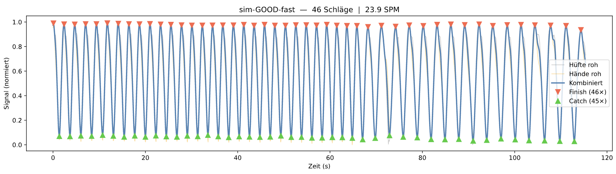
PIPELINE
Segmenting strokes
Goal. Count strokes and locate the motion phases — catch and finish.
Detected strokes over time
How. Peak detection on the smoothed motion signal splits the sequence into individual strokes of ~24–28 frames each.
Each peak marks one stroke; phase boundaries give catch and finish.
Assessing Rowing Technique on an Ergometer
10
Notes:
- Goal: count strokes and locate the motion phases — catch and finish.

Slide 11
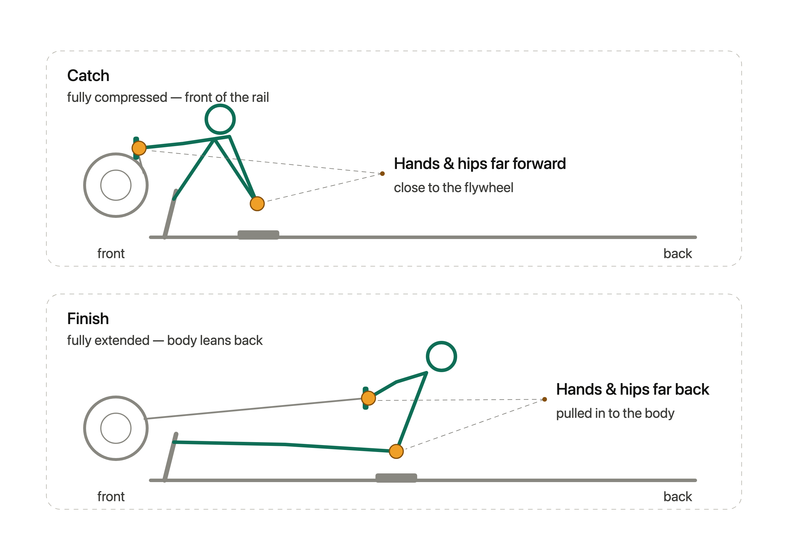
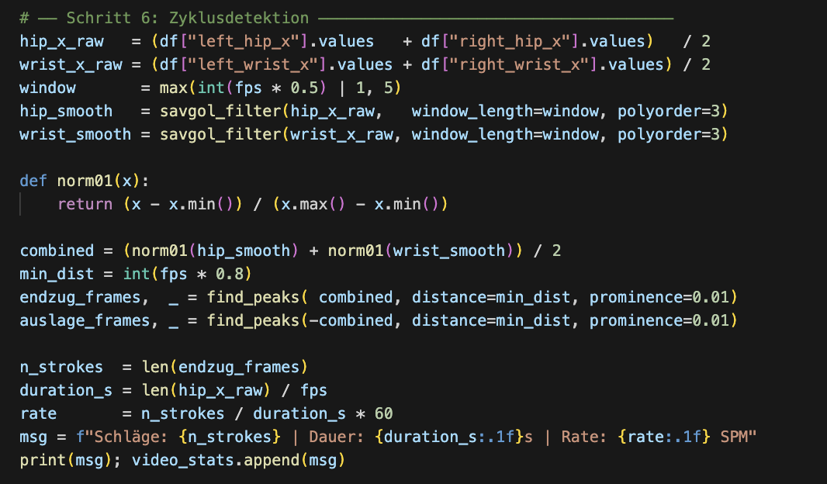
PIPELINE
Segmenting strokes
Segmentation · peak detection
Assessing Rowing Technique on an Ergometer
10
Notes:
Each rowing stroke moves between two extremes.
At the catch, the rower is fully compressed — hands and hips are as far forward as they get.
At the finish, the rower is fully extended — hands and hips are as far back as they get. Every stroke is simply one swing from catch to finish and back.
That gives us a clean signal to work with: we track the horizontal position of the hands and hips over time, and it rises and falls like a wave — one full cycle per stroke. By detecting the peaks (finish) and troughs (catch) of that curve, we can mark where each stroke begins and ends. Counting these cycles tells us how many strokes there are, and the peaks and troughs directly locate the catch and finish phases within every stroke.

Slide 12
METHODOLOGY
Stroke-aware train / test split
Random split confuses data
How frames group into strokes
A stroke is ~24–28 consecutive, highly correlated frames. A plain shuffle-and-split puts neighbouring frames in both train and test.
stroke 1
stroke 2
stroke 3
stroke 4
stroke 5
each block = one stroke (≈24–28 frames, shown reduced)
Split by stroke, not by frame
TRAIN
TEST
Give every frame a stroke_id, then split on that id. It is reconstructed from the known frame and stroke counts per video.
whole strokes only
held-out strokes
Assessing Rowing Technique on an Ergometer
11
Notes:
- A random split leaks data: frames of one stroke end up in both train and test → inflated scores.
- Instead, split by **stroke**, not by frame.
- Whole strokes go entirely to train or test

Slide 13

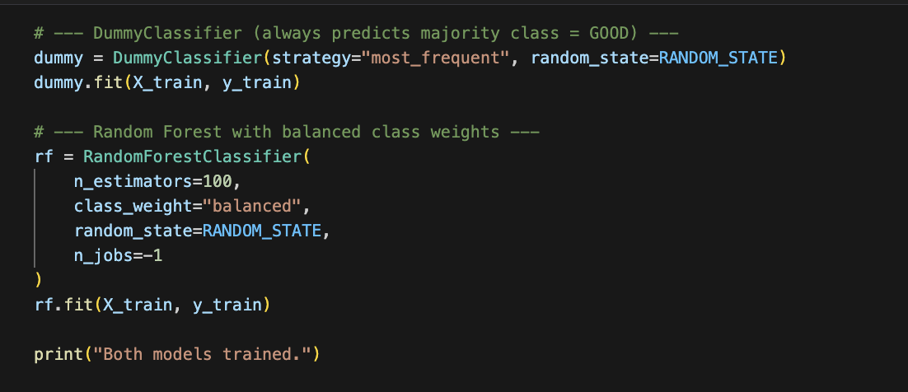
BASELINE · IMPLEMENTATION
Two baselines to beat
Dummy classifier
Implementation
Majority baseline — always predicts the dominant GOOD class.
Random Forest
Class-weighted (balanced) so the rare BAD strokes actually count during training.
Assessing Rowing Technique on an Ergometer
13
Notes:
- Dummy classifier: always predicts the majority (GOOD) — sets the floor.
- Random Forest: class-weighted (balanced) so the rare BAD strokes actually count in training.
- Both give us something concrete to beat.

Slide 14
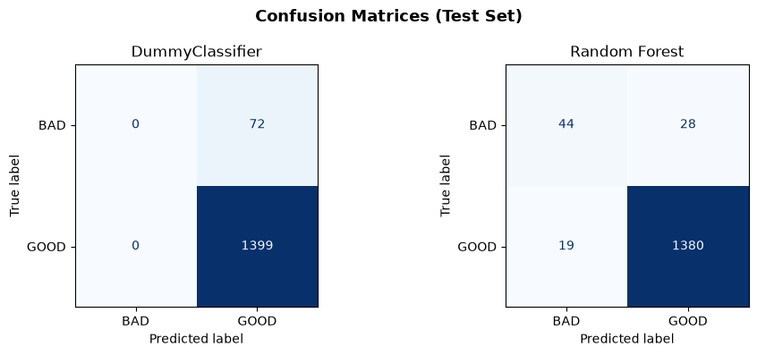
BASELINE · RESULTS
Accuracy is misleading
Dummy (majority)
95.1%
0.50
0.49
Accuracy
ROC-AUC
Macro F1
Predicts GOOD for everything — BAD recall 0.00
Random Forest
96.8%
0.97
0.82
Both models score ~96% accuracy, but only the Random Forest moves ROC-AUC to 0.97 and Macro F1 to 0.82.
Accuracy
ROC-AUC
Macro F1
Actually separates the classes
Assessing Rowing Technique on an Ergometer
14
Notes:
- Dummy classifier: by always predicting GOOD it makes **zero false positives but misses every bad stroke** — BAD recall 0.00. Its whole error sits in the rare, important class.
- That's why its 95% accuracy is misleading: with ~17:1 imbalance, getting the rare class completely wrong barely moves accuracy.
This is why Macro F1 0.49 is important here; weights both classes equally, so bad-class errors count
- Random Forest: catches most bad strokes (far fewer false negatives), at the cost of a few false positives on good strokes — a useful trade-off.
- The better metrics capture this: ROC-AUC rises to 0.97 (ranks bad above good across all thresholds) and Macro F1 to 0.82

Slide 15

THE CHALLENGE
Biggest Fail: Imbalanced Dataset
355
21
≈17 : 1
good strokes
bad strokes
class ratio
The Problem
Strokes per class
95% accuracy is reachable by a model that always predicts GOOD — while learning nothing about technique.
Assessing Rowing Technique on an Ergometer
12
Notes:
- The dataset is heavily imbalanced: 355 good vs. 21 bad strokes — about 17 : 1.
- The problem: 95% accuracy is reachable by always predicting GOOD — while learning nothing about technique.
- So accuracy on its own is the wrong yardstick.

Slide 16

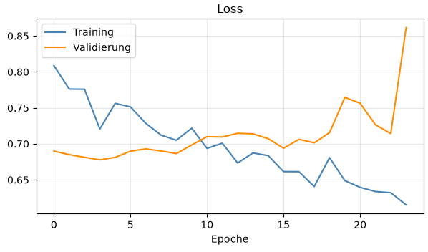



LIMITATIONS
Main Concern: Data Quality
Only five videos
Evidence: Training a 3D-CNN
The original dataset is very small.
Bad strokes from only one source
Every low-quality stroke came from a single video.
The 3D-CNN's training documentation confirms these concerns — strong train/validation divergence points to memorization.
Memorization risk
The model learns that one video instead of technique.
Assessing Rowing Technique on an Ergometer
15
Notes:
- The main risk is data quality: only five videos, and every bad stroke came from a single source.
- So the model may memorize that one video instead of learning technique.
- The 3D-CNN training documentation backs this up — strong train/validation divergence points to memorization.

Slide 17
LIMITATIONS
Main Concern: Data Quality
Only five videos
The original dataset is very small.
My solution
Steadily extend the dataset — record more sessions, leaving out bad strokes to stabilise the GOOD class.
Bad strokes from one source
Every low-quality stroke came from a single video.
Result so far
Memorization risk
7 clean videos · 405 strokes · 0 frames without a pose
The model may learn that one video instead of technique.
Assessing Rowing Technique on an Ergometer
16
Notes:
- Solution: steadily extend the dataset — record more sessions, first leaving out bad strokes to stabilise the GOOD class.
- Result so far: 7 clean videos · 405 strokes · 0 frames without a pose.

Slide 18
CURRENT DATASET
8 self-recorded videos
Video | Duration (s) | Orig. fps | Red. fps | Orig. frames | Red. frames | No-pose | Strokes | SPM
cla-BAD | 50.6 | 30 | 10 | 1518 | 506 | 0 | 21 | 24.9
cla-GOOD-fast | 209.3 | 30 | 10 | 6280 | 2094 | 0 | 88 | 25.2
cla-GOOD-slow | 189.9 | 30 | 10 | 5698 | 1900 | 0 | 69 | 21.8
mar-GOOD-fast | 140.6 | 30 | 10 | 4217 | 1406 | 0 | 62 | 26.5
mar-GOOD-slow | 135.9 | 30 | 10 | 4076 | 1359 | 0 | 51 | 22.5
sim-GOOD-fast | 115.4 | 30 | 10 | 3461 | 1154 | 0 | 46 | 23.9
sim-GOOD-slow | 247.3 | 30 | 10 | 7419 | 2473 | 0 | 77 | 18.7
sim-GOOD-slow2 | 35.1 | 30 | 10 | 1054 | 352 | 0 | 12 | 20.5
Total | 1124.1 | 30 | 10 | 33 723 | 11 244 | 0 | 426 | 22.7
8
≈18.7 min
426
11 244
0
videos
total
strokes
reduced frames
no-pose frames
Assessing Rowing Technique on an Ergometer
17
Notes:
- The dataset now has 8 self-recorded videos — including the first bad-technique clip (21 bad strokes).
- Totals: ≈18.7 min, 426 strokes, 11,244 reduced frames, 0 frames without a pose.
- A first step towards a balanced set.

Slide 19
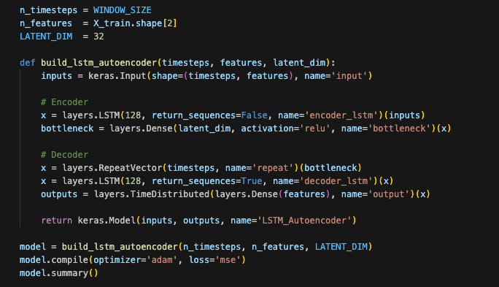

NEW APPROACH
LSTM Autoencoder
Anomaly detection. Trained only on good strokes, the model reconstructs correct technique well — faulty strokes reconstruct poorly and stand out by a high error.
Autoencoding
LSTM Autoencoder · Implementation
Train on good strokes only — learn to reconstruct correct technique.
Sliding windows
Process sequences, not single frames (window 24, stride 12).
Threshold
Set from the training MSE; strokes whose error exceeds it are flagged BAD.
Assessing Rowing Technique on an Ergometer
18
Notes:
- New approach: anomaly detection.
Train the autoencoder on **good strokes only** — it reconstructs correct technique well;
faulty strokes are expected to be reconstructed poorly; consequently they should be flagged as BAD.
- Works on sequences with sliding windows (window 24, stride 12), not single frames.
- Threshold from the training MSE (~95th percentile): if a stroke's reconstruction error exceeds it, flag it BAD.

Slide 20
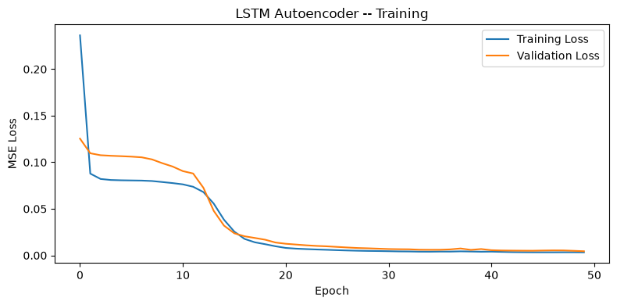
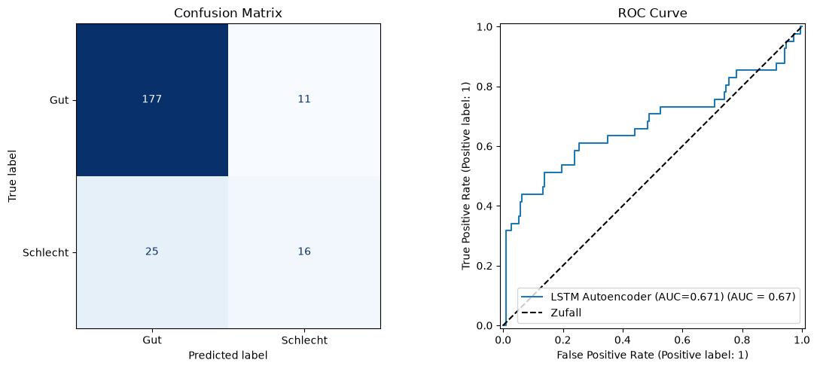
NEW APPROACH · RESULTS
First autoencoder results
Training & validation loss
0.84
0.67
0.69
Accuracy
ROC-AUC
Macro F1
GOOD strokes
0.91
0.88
0.94
Confusion matrix & ROC curve
F1
Precision
Recall
BAD strokes
0.47
0.59
0.39
F1
Precision
Recall
Good strokes are caught well; bad strokes stay hard (recall 0.39) — more varied bad examples are needed.
Assessing Rowing Technique on an Ergometer
19
Notes:
- Good strokes are detected well (F1 0.91); bad strokes stay hard (recall 0.39, F1 0.47).
- Promising, but the model needs more — and more varied — bad examples.

Slide 21

OUTLOOK
Where this goes next
Done so far
Next steps
End-to-end pipeline: MediaPipe → features → model
Normalization across angles & body proportions
Stroke segmentation and leak-free, stroke-aware split
Supervised baseline — Random Forest at Macro F1 0.82
LSTM autoencoder built and evaluated (ROC-AUC 0.67)
Dataset extended to 8 videos incl. first bad-technique clip
Record more & more varied BAD strokes (rowers, error types)
Lift bad-stroke recall beyond 0.39 — tune threshold & window
Benchmark the autoencoder against the RF baseline
One Day:
Per-phase feedback on catch and finish
Thank you · questions welcome

