Slide 1
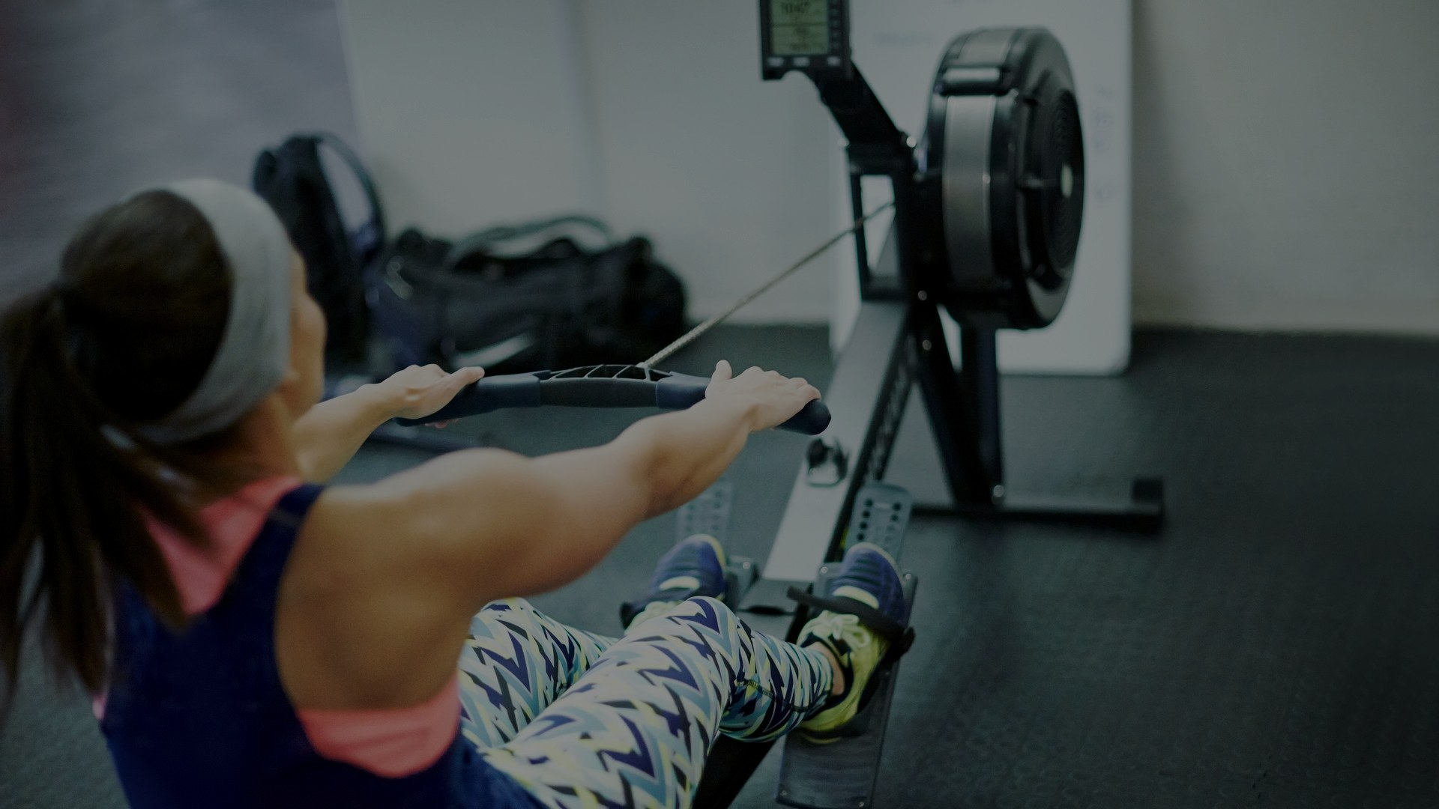
APPLIED MACHINE LEARNING | OPENCAMPUS.SH
Rowing Technique Analysis
Stroke-by-stroke quality evaluation
Clara Brilke 25 June 2026

Slide 2




THE GOAL
Aim
Per-stroke
Feedback at the granularity of one rowing stroke
Train a model that evaluates stroke quality on a rowing ergometer — automatically, after every single stroke.
Video-only
No wearables or on-body sensors required
Scope so far
Binary task — good stroke vs. failed stroke. A working pipeline, normalization, a leak-free split and first baselines are already in place.
Real-time-capable
Designed to score strokes as they happen
Assessing Rowing Technique on an Ergometer
2

Slide 3
OUTLINE
What this talk covers
1
Motivation
5
Segmentation & split
Why automate stroke assessment
Per-stroke handling, leak-free split
2
Related work
6
Biggest Fail: The imbalance problem
Sensor- and pose-based approaches
355 good vs 21 bad strokes
3
Approach & pipeline
7
Baseline & autoencoder
MediaPipe → CNN → classification
Random Forest and LSTM-AE
4
Data preparation
8
Next steps
Landmarks, downsampling, normalization
Towards richer feedback
Assessing Rowing Technique on an Ergometer
3

Slide 4
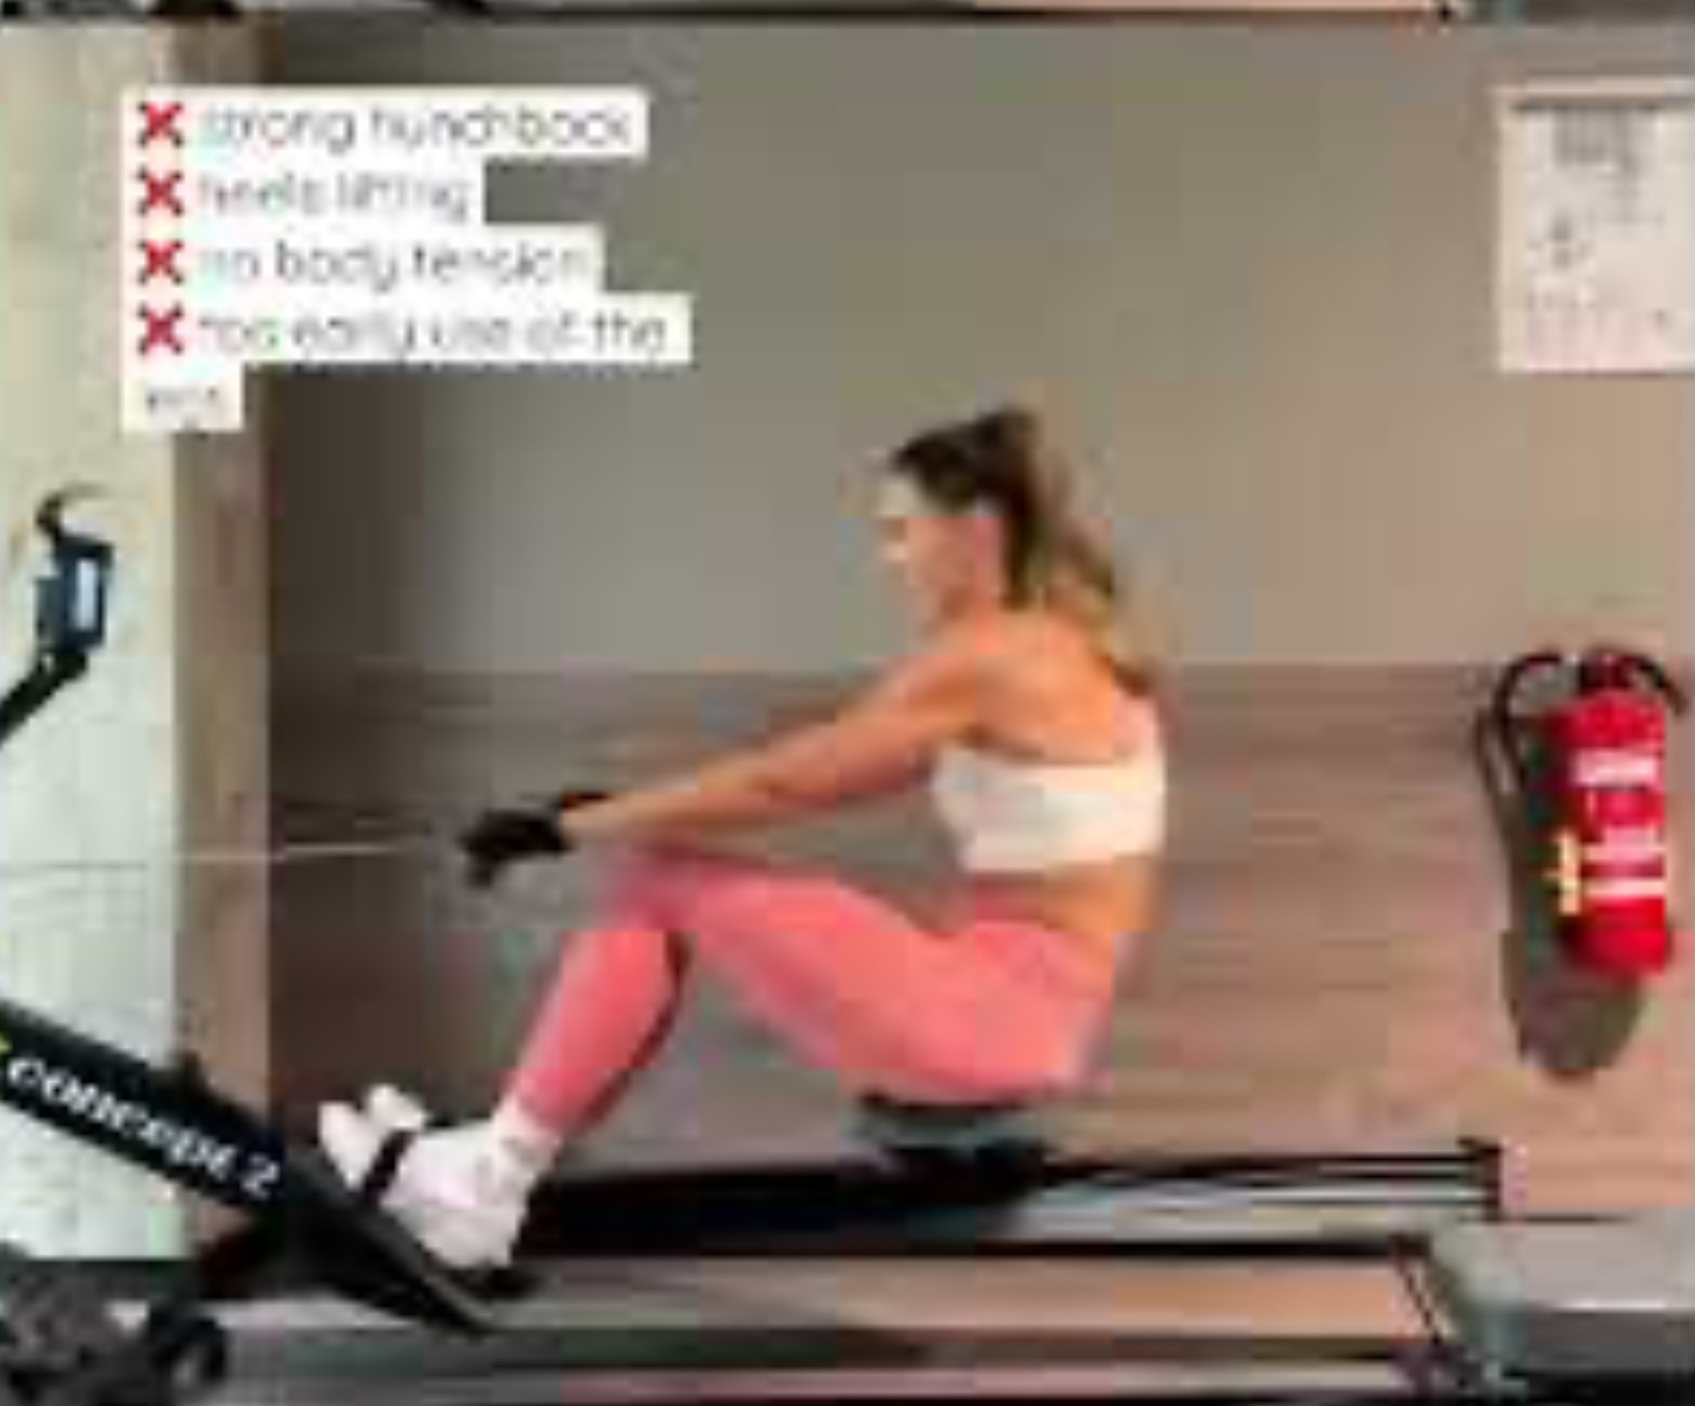
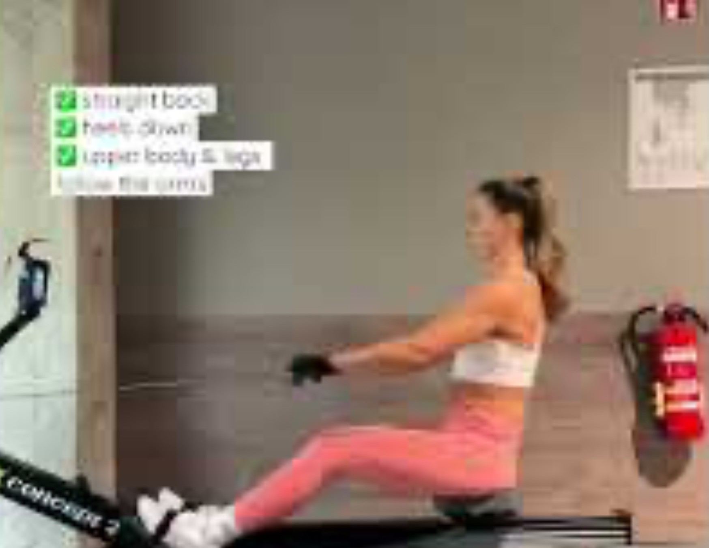



WHY IT MATTERS
Motivation
Manual technique assessment relies on experienced coaches. It is time-consuming, subjective and does not scale.
The goal
Automatically classify rowing strokes directly from ergometer video — giving every athlete instant feedback.
Faulty technique
Good technique
Hunched back · heels lifting · early arm pull
Straight back · heels down · legs then arms
Assessing Rowing Technique on an Ergometer
4

Slide 5




RELATED WORK · 1 / 2
Wearable inertial sensors
Bosch et al. (2015) — Analysis of indoor rowing motion using wearable inertial sensors
Objective
Distinguish experienced from novice rowers.
Limitation
Method
Relies on on-body sensors — the athlete has to wear hardware on every session.
k-Nearest-Neighbours
Findings
My approach avoids this — a camera is all that is needed.
Clear differences in stroke-timing consistency — but no difference in absolute posture angles.
Assessing Rowing Technique on an Ergometer
5

Slide 6
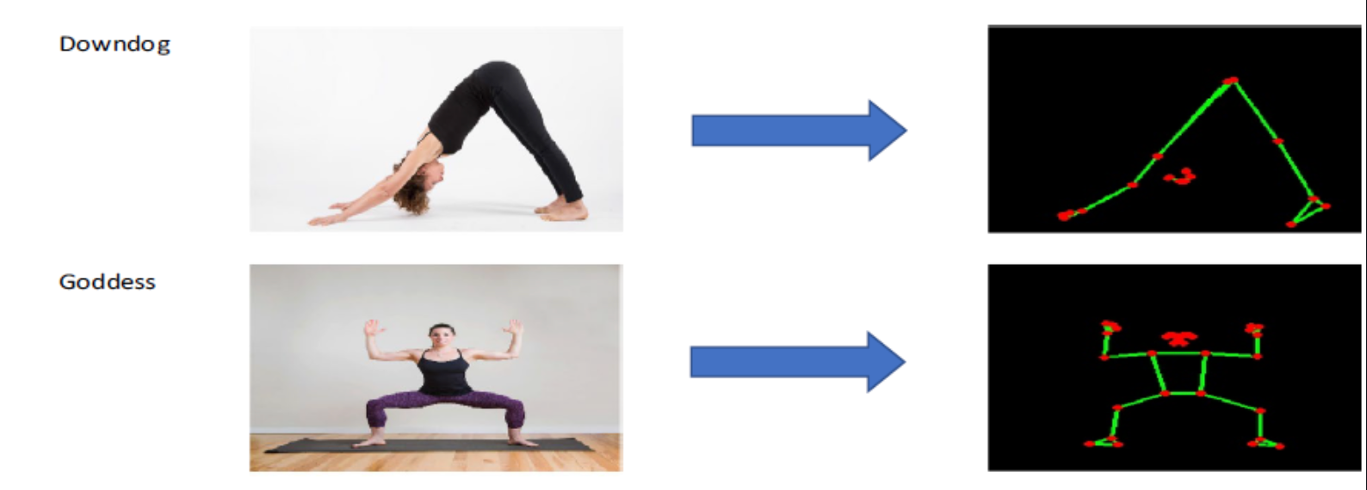


RELATED WORK · 2 / 2
Pose-based deep learning
Garg et al. (2022) — Yoga pose classification: a CNN and MediaPipe inspired deep-learning approach
Objective
Classify yoga postures; compare models with vs. without skeletonization.
Method
MediaPipe skeletonization, then CNN and transfer-learning models.
Image → skeleton → classification (Garg et al.)
Outcome
Takeaway Skeletonization + a custom CNN is the most promising route — this directly motivates my design.
Skeletonization clearly boosts performance — and a custom CNN benefits most, beating the transfer-learning models.
Assessing Rowing Technique on an Ergometer
6

Slide 7




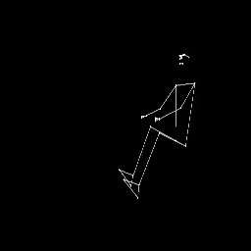
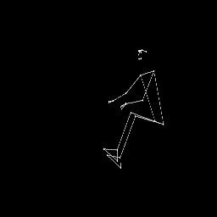
METHOD
My approach
1
2
3
Pose extraction
Custom CNN
Binary classification
MediaPipe landmarks from ergometer video
Trained on the landmark sequences
Good stroke vs. bad stroke
Good Stroke
Bad Stroke

Slide 8

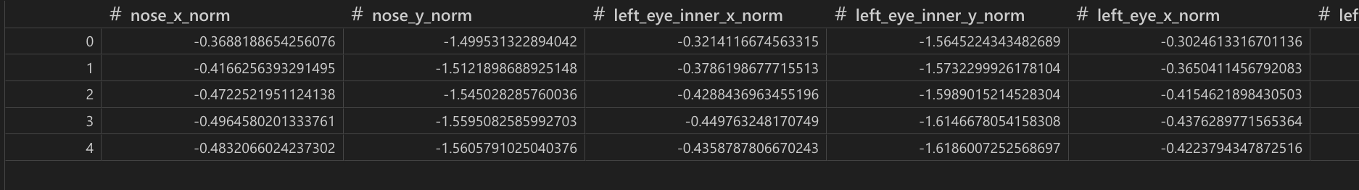

DATA · 1
Data preparation
1
Landmark extraction
Landmark data · CSV
MediaPipe coordinates stored as CSV — 69 features per frame.
2
Downsampling
30 fps → 10 fps: removes redundancy while keeping the motion.
67
30→10
CSV
features / frame
fps reduction
per-frame export
3
Normalization
MediaPipe returns a pose for every frame — 0 frames without a detected pose across the dataset.
Makes videos from different angles and body proportions comparable.
Assessing Rowing Technique on an Ergometer
8

Slide 9
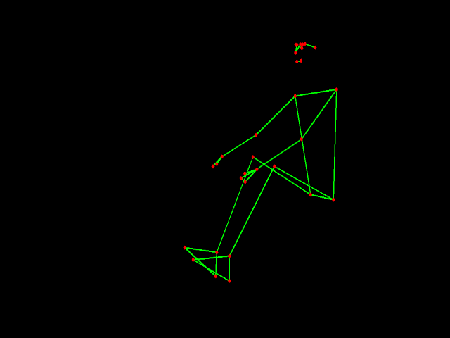
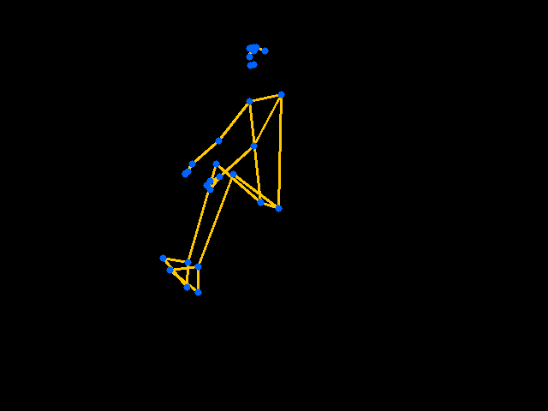
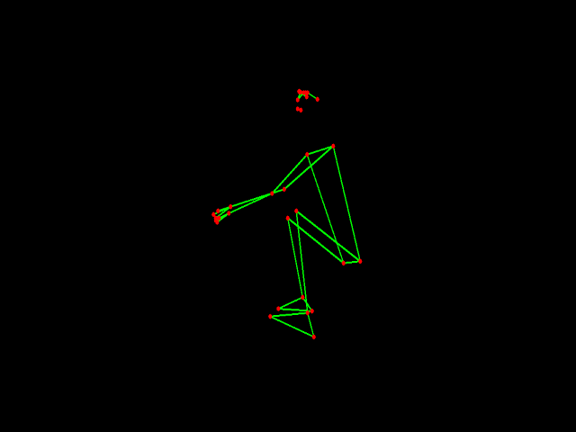
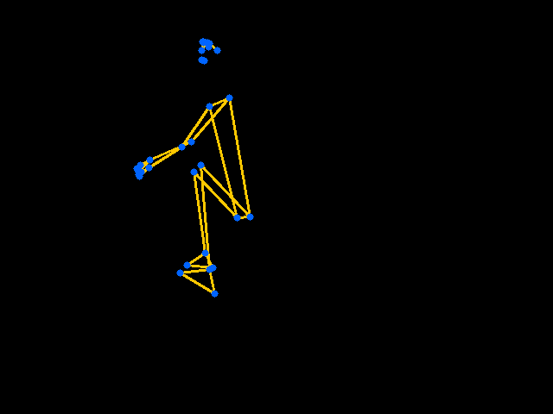

DATA · 2
Normalization
Why. Recordings differ in camera angle and in the rower's body proportions, so raw coordinates are not comparable across videos.
Raw
Normalized
How. Centre each pose on a hip reference and scale by torso length — making strokes directly comparable.
Same stroke, same representation — regardless of who is rowing or where the camera stands.
Assessing Rowing Technique on an Ergometer
9

Slide 10
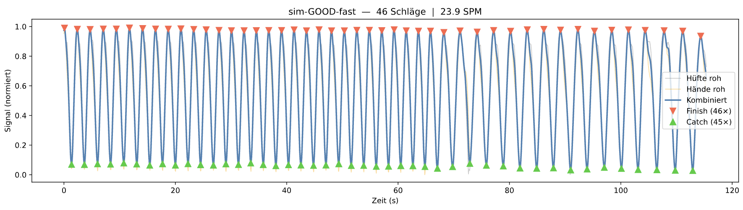
PIPELINE
Segmenting strokes
Goal. Count strokes and locate the motion phases — catch and finish.
Detected strokes over time
How. Peak detection on the smoothed motion signal splits the sequence into individual strokes of ~24–28 frames each.
Each peak marks one stroke; phase boundaries give catch and finish.
Assessing Rowing Technique on an Ergometer
10

Slide 11
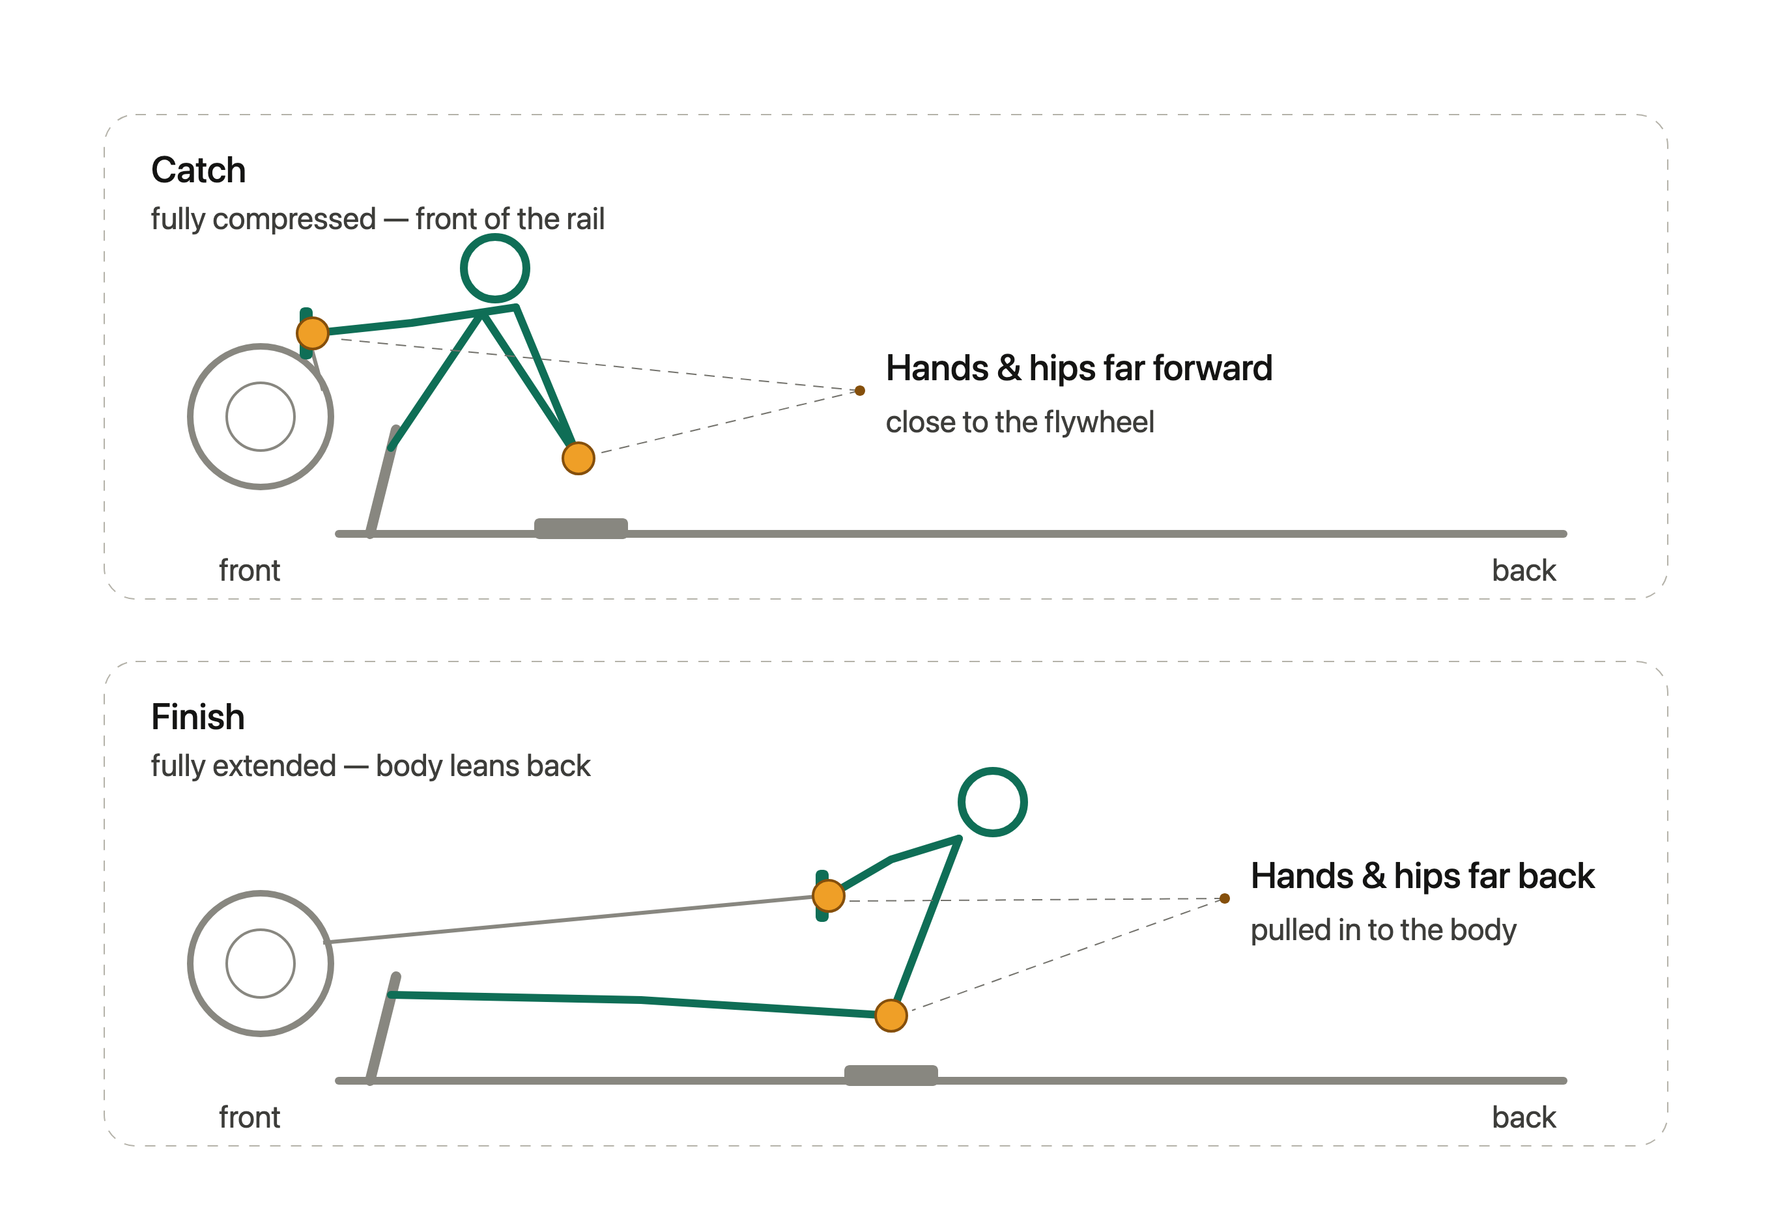
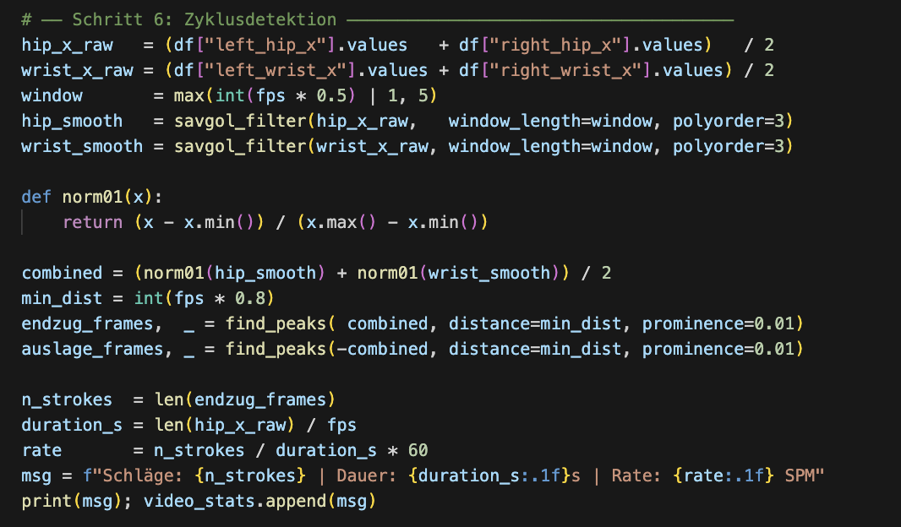
PIPELINE
Segmenting strokes
Segmentation · peak detection
Assessing Rowing Technique on an Ergometer
10

Slide 12
METHODOLOGY
Stroke-aware train / test split
Random split confuses data
How frames group into strokes
A stroke is ~24–28 consecutive, highly correlated frames. A plain shuffle-and-split puts neighbouring frames in both train and test.
stroke 1
stroke 2
stroke 3
stroke 4
stroke 5
each block = one stroke (≈24–28 frames, shown reduced)
Split by stroke, not by frame
TRAIN
TEST
Give every frame a stroke_id, then split on that id. It is reconstructed from the known frame and stroke counts per video.
whole strokes only
held-out strokes
Assessing Rowing Technique on an Ergometer
11

Slide 13

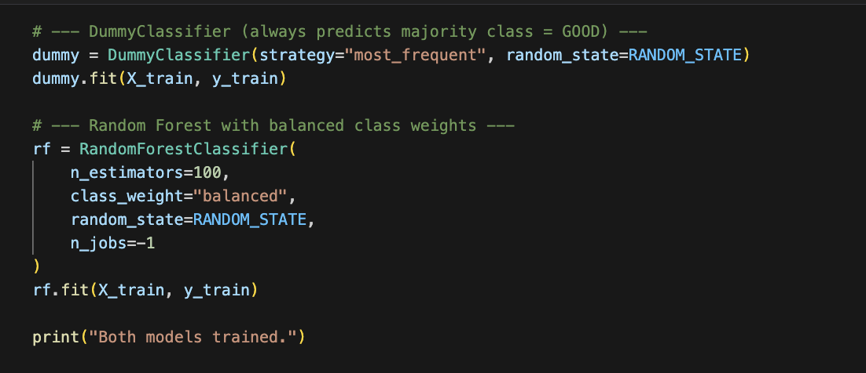
BASELINE · IMPLEMENTATION
Two baselines to beat
Dummy classifier
Implementation
Majority baseline — always predicts the dominant GOOD class.
Random Forest
Class-weighted (balanced) so the rare BAD strokes actually count during training.
Assessing Rowing Technique on an Ergometer
13

Slide 14
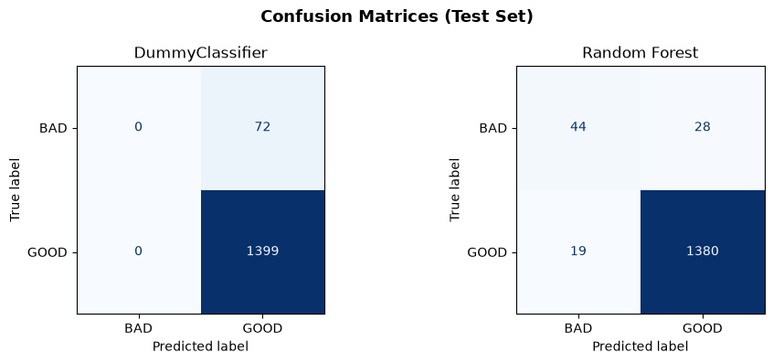
BASELINE · RESULTS
Accuracy is misleading
Dummy (majority)
95.1%
0.50
0.49
Accuracy
ROC-AUC
Macro F1
Predicts GOOD for everything — BAD recall 0.00
Random Forest
96.8%
0.97
0.82
Both models score ~96% accuracy, but only the Random Forest moves ROC-AUC to 0.97 and Macro F1 to 0.82.
Accuracy
ROC-AUC
Macro F1
Actually separates the classes
Assessing Rowing Technique on an Ergometer
14

Slide 15

THE CHALLENGE
Biggest Fail: Imbalanced Dataset
355
21
≈17 : 1
good strokes
bad strokes
class ratio
The Problem
Strokes per class
95% accuracy is reachable by a model that always predicts GOOD — while learning nothing about technique.
Assessing Rowing Technique on an Ergometer
12

Slide 16

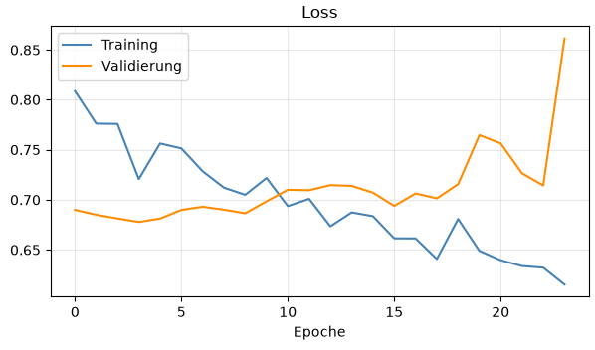



LIMITATIONS
Main Concern: Data Quality
Only five videos
Evidence: Training a 3D-CNN
The original dataset is very small.
Bad strokes from only one source
Every low-quality stroke came from a single video.
The 3D-CNN's training documentation confirms these concerns — strong train/validation divergence points to memorization.
Memorization risk
The model learns that one video instead of technique.
Assessing Rowing Technique on an Ergometer
15

Slide 17
LIMITATIONS
Main Concern: Data Quality
Only five videos
The original dataset is very small.
My solution
Steadily extend the dataset — record more sessions, leaving out bad strokes to stabilise the GOOD class.
Bad strokes from one source
Every low-quality stroke came from a single video.
Result so far
Memorization risk
7 clean videos · 405 strokes · 0 frames without a pose
The model may learn that one video instead of technique.
Assessing Rowing Technique on an Ergometer
16

Slide 18
CURRENT DATASET
8 self-recorded videos
Video | Duration (s) | Orig. fps | Red. fps | Orig. frames | Red. frames | No-pose | Strokes | SPM
cla-BAD | 50.6 | 30 | 10 | 1518 | 506 | 0 | 21 | 24.9
cla-GOOD-fast | 209.3 | 30 | 10 | 6280 | 2094 | 0 | 88 | 25.2
cla-GOOD-slow | 189.9 | 30 | 10 | 5698 | 1900 | 0 | 69 | 21.8
mar-GOOD-fast | 140.6 | 30 | 10 | 4217 | 1406 | 0 | 62 | 26.5
mar-GOOD-slow | 135.9 | 30 | 10 | 4076 | 1359 | 0 | 51 | 22.5
sim-GOOD-fast | 115.4 | 30 | 10 | 3461 | 1154 | 0 | 46 | 23.9
sim-GOOD-slow | 247.3 | 30 | 10 | 7419 | 2473 | 0 | 77 | 18.7
sim-GOOD-slow2 | 35.1 | 30 | 10 | 1054 | 352 | 0 | 12 | 20.5
Total | 1124.1 | 30 | 10 | 33 723 | 11 244 | 0 | 426 | 22.7
8
≈18.7 min
426
11 244
0
videos
total
strokes
reduced frames
no-pose frames
Assessing Rowing Technique on an Ergometer
17

Slide 19
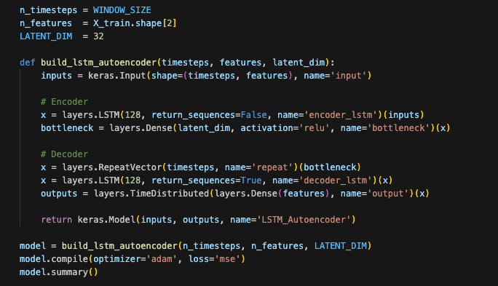

NEW APPROACH
LSTM Autoencoder
Anomaly detection. Trained only on good strokes, the model reconstructs correct technique well — faulty strokes reconstruct poorly and stand out by a high error.
Autoencoding
LSTM Autoencoder · Implementation
Train on good strokes only — learn to reconstruct correct technique.
Sliding windows
Process sequences, not single frames (window 24, stride 12).
Threshold
Set from the training MSE; strokes whose error exceeds it are flagged BAD.
Assessing Rowing Technique on an Ergometer
18

Slide 20
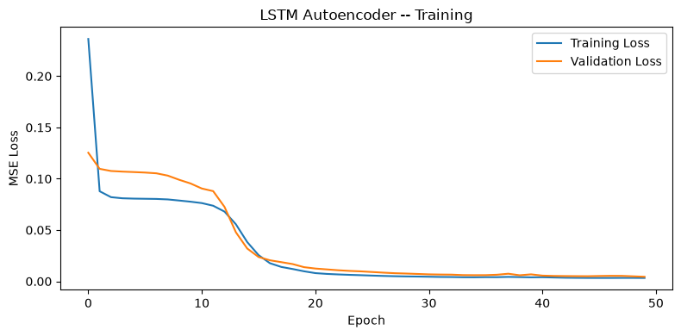
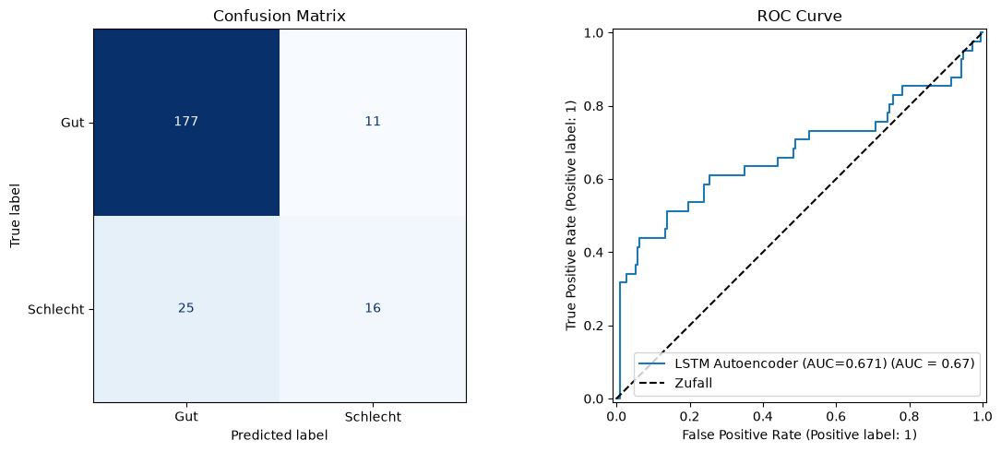
NEW APPROACH · RESULTS
First autoencoder results
Training & validation loss
0.84
0.67
0.69
Accuracy
ROC-AUC
Macro F1
GOOD strokes
0.91
0.88
0.94
Confusion matrix & ROC curve
F1
Precision
Recall
BAD strokes
0.47
0.59
0.39
F1
Precision
Recall
Good strokes are caught well; bad strokes stay hard (recall 0.39) — more varied bad examples are needed.
Assessing Rowing Technique on an Ergometer
19

Slide 21

OUTLOOK
Where this goes next
Done so far
Next steps
End-to-end pipeline: MediaPipe → features → model
Normalization across angles & body proportions
Stroke segmentation and leak-free, stroke-aware split
Supervised baseline — Random Forest at Macro F1 0.82
LSTM autoencoder built and evaluated (ROC-AUC 0.67)
Dataset extended to 8 videos incl. first bad-technique clip
Record more & more varied BAD strokes (rowers, error types)
Lift bad-stroke recall beyond 0.39 — tune threshold & window
Benchmark the autoencoder against the RF baseline
One Day:
Per-phase feedback on catch and finish
Thank you · questions welcome

