Slide 1
Classifying Financial Data
XX, YY

Slide 2
Motivation
Privacy-first tracking of our expenses
Did not like the surface of Open-source options like Actual
Keep track of your expenses
Identify potential for saving money
Prototype: categorize after main categories only (subcategories will be added later)
Main Categories:
Groceries (e.g. supermarket)
Lifestyle&fun (e.g. vacation, going out, cinema, …)
Mobility
Family
Education
Healthcare
Fixed costs

Slide 3
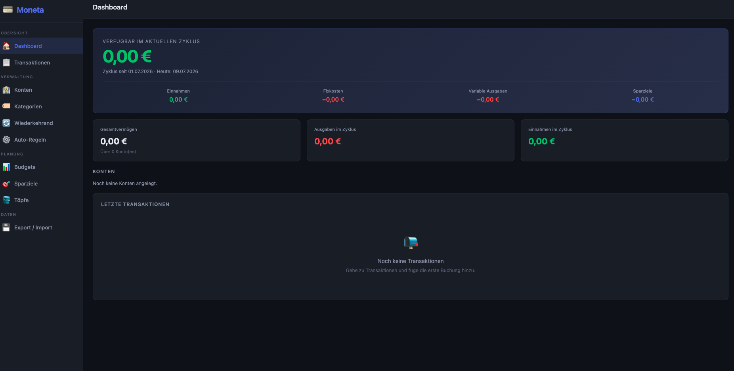

Slide 4
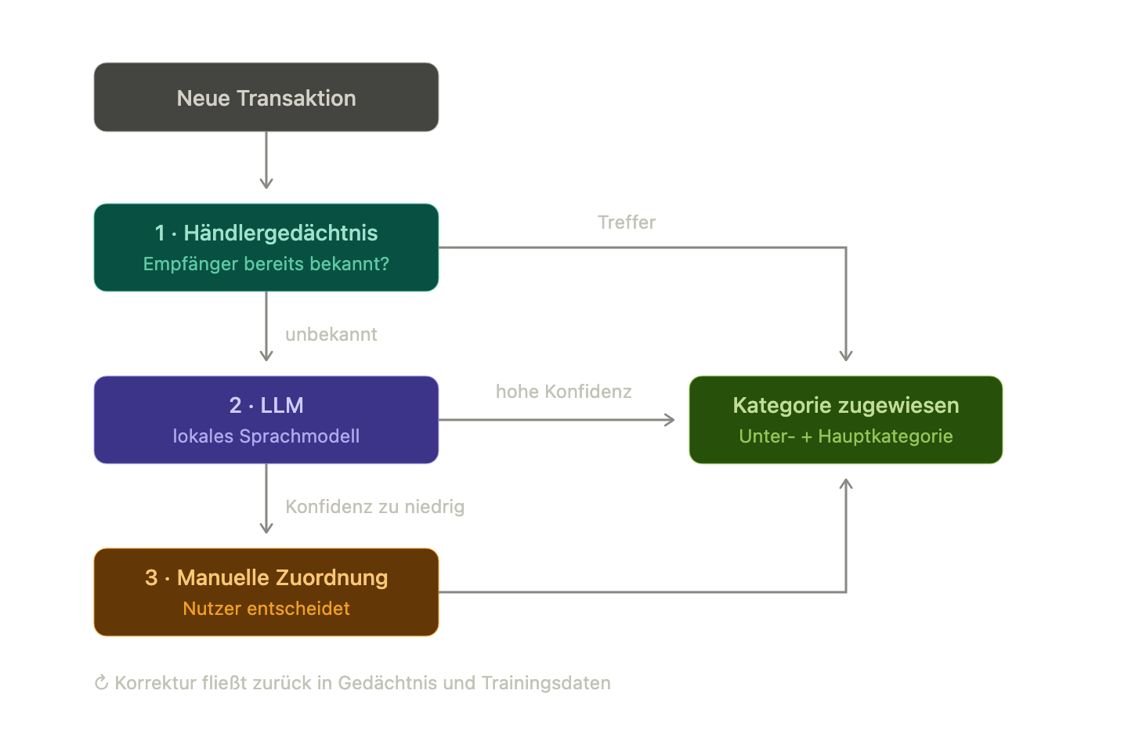
Approach

Slide 5
Biggest Challenge
Idea of privacy first: we cannot work with real data while using Co-Pilots
Synthesized data is not as authentic
…. Problems????

Slide 6
