Slide 1

Classifying financial data
Privacy-first expense tracking with a local language model
Romina Fernandez, Clara Brilke

Slide 2



Motivation
Privacy first
Bank statements are sensitive personal data. They should never leave the device.
Goal of the prototype
Automatically assign every bank transaction to a personal category system.
Start with main categories only — subcategories (~35) follow once the pipeline works.
Keep the model small enough to train and run on a normal desktop CPU.
Existing tools fall short
Open-source options like Actual Budget work, but the interface and categorization workflow did not convince us.
Understand spending
100 %
of processing happens locally
Reliable per-category tracking reveals where money actually goes — and where there is potential to save.
Classifying financial data
2

Slide 3







Seven main categories
Groceries
Lifestyle & fun
Mobility
Family
supermarket, drugstore
vacation, going out, cinema
fuel, tickets, car
kids, gifts, support
Education
Healthcare
Fixed costs
+ ~35 subcategories
courses, books, fees
pharmacy, doctor
rent, utilities, subscriptions
planned for a later stage — each maps to exactly one main category
Classifying financial data
3

Slide 4
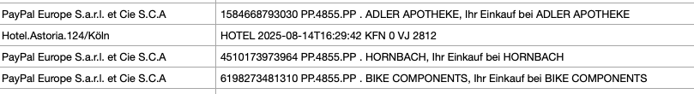
First approach: Embedding & Regression
Payee and purpose lines mix payment-provider prefixes, transaction IDs, and timestamps — the same merchant appears in many disguises:
1 · Clean
2 · Embed
3 · Classify
Strip city names, numbers, and boilerplate from payee and purpose fields.
Encode each cleaned description as a sentence-embedding vector.
Train a logistic-regression classifier on top of the embeddings.
Embeddings did not work at all — the vectors barely separated the categories, so we switched to a local language model instead.
Classifying financial data
4

Slide 5
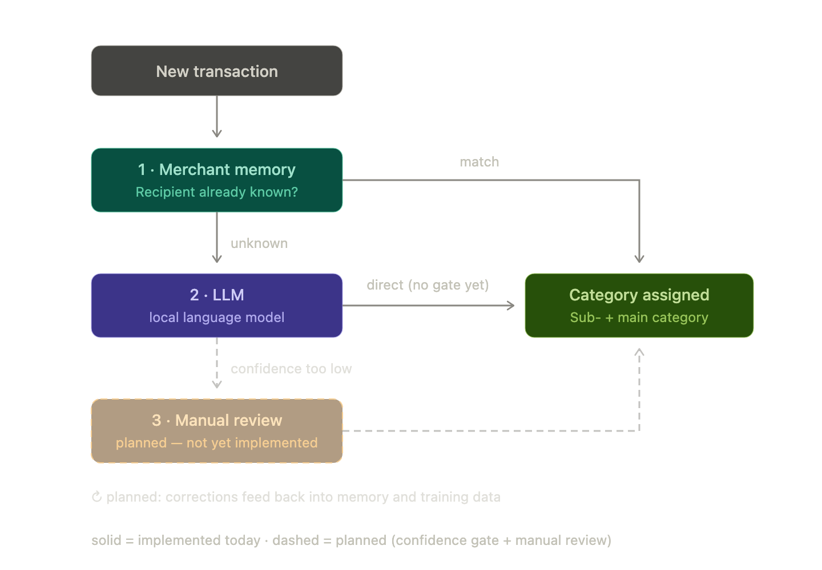
Solution: a three-stage cascade
Cheapest path first — the model only sees what the memory cannot answer
1
Merchant memory
Known recipients are matched instantly from past decisions (SQLite) — covers most recurring bookings, zero model calls.
2
Local language model
Unknown transactions are classified on-device; every prediction comes with a confidence score.
3
Human in the loop
Low-confidence cases go to the user. Each correction feeds memory and training data — the system keeps improving.
Classifying financial data
5

Slide 6
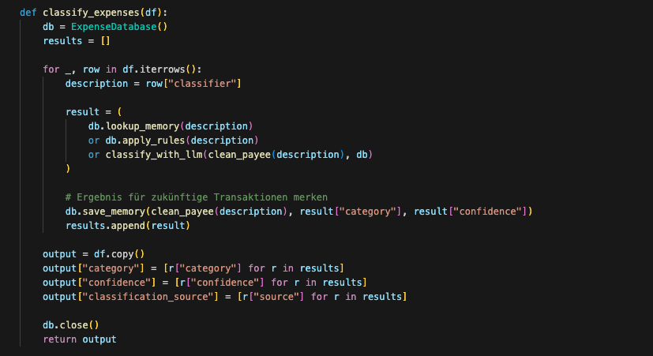
Implementation
One pass per transaction: memory → rules → model — everything on-device
Memory first
Known payees are answered straight from SQLite — no model call at all.
Rules as backstop
Simple keyword rules catch obvious cases the memory has not seen yet.
Model last
Only what remains goes to the local language model, together with a confidence score.
Every decision is saved back — the merchant memory grows with each run.
Classifying financial data
6

Slide 7

Biggest challenge: data we cannot show
Real data is off-limits for AI tooling
Synthetic data is not authentic
Working with co-pilots and cloud assistants means real bank statements can never touch the development loop. Prompts, context windows, and telemetry would all leak sensitive data.
Generated transactions miss the quirks of real bookings: inconsistent merchant spellings, truncated purpose lines, regional chains, one-off transfers. A model trained only on clean data may stumble on reality.
Working with synthetic data – what could go wrong?
Distribution shift — synthetic wording is cleaner and more regular than real statements
Overly optimistic evaluation — validating on synthetic data measures the generator, not reality
Classifying financial data
7

Slide 8
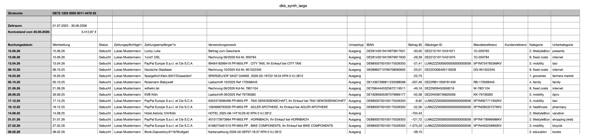



Compromise: synthesized data
~2600 DKB-format transactions
Realistic structure
Balanced by design
Safe to share
Real merchant names, DKB column layout, plausible amounts and dates
Each main category gets enough examples to train on
No personal data — usable with any tool, in slides, in repos
Classifying financial data
8

Slide 9
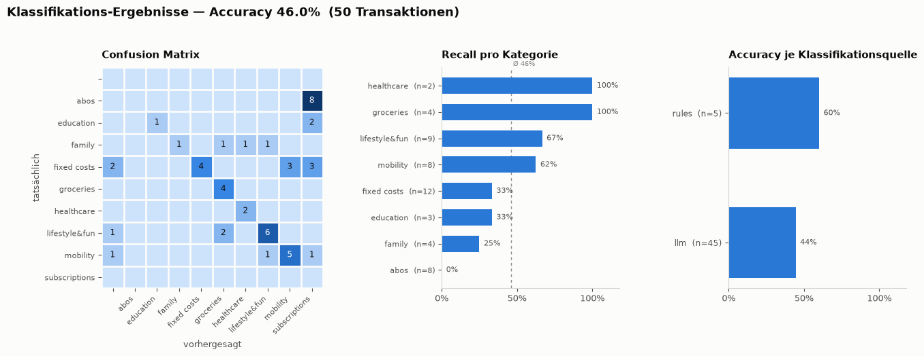
Evaluation
Baseline on 50 held-out synthetic transactions — before any fine-tuning
46 %
60 % vs. 44 %
overall accuracy — a working baseline, not yet a product
rules beat the raw model — merchant memory pays off
Classifying financial data
9

Slide 10



Where this is going
Four concrete next steps for the prototype
Improve accuracy & speed
Bring it into a frontend
Push past the 46 % baseline: fine-tune on the user’s own confirmed transactions, sharpen rules and prompts, and classify a full statement in seconds on a normal CPU.
Move from scripts to an app: import a CSV, review category and confidence per booking, and fix low-confidence cases with one click — corrections feed the merchant memory.
Personalized charts
Isolate sensitive data
Generate the views each user cares about: spending per category over time, fixed vs. variable costs, savings potential — rendered locally, like everything else.
Build a workflow that keeps real bank data away from VS Code and co-pilots — the prerequisite for ever fine-tuning on the user’s real transactions.
Classifying financial data
10

Slide 11
What we learned
Three takeaways from building privacy-first ML tooling as a team
01
02
03
Plan before you build
Branch discipline matters
Keep secrets out of the IDE
Without clear planning and task management we did not work efficiently.
Long-lived branches cost us hours of merge conflicts.
Real bank data must never reach AI-assisted editors — we need a workflow that isolates sensitive data from VS Code and co-pilots.
Classifying financial data
11

Slide 12
Thank you for your attention
Classifying financial data
12

