Slide 1

Marketing
Data Analysis
Data Analytics Capstone Project
Cesar Aracena | https://github.com/claracena/data-analytics

Slide 2
Task:
Detect differences between the usage of the service
by members and casual users
Cyclistic
Marketing Data Analysis

Slide 3
Data Source
All the data was provided by the client separated in monthly, CSV files. For this analysis, only the past 12 months were selected (March 2021 to February 2022).
Cyclistic
Marketing Data Analysis

Slide 4
Data Treatment
The files containing the data were first imported into a secure SQL server.
Once the 12 tables were created, the totality of the data was combined, and the following steps were taken:
Check for duplicates
Check for null/empty values
Check for data format inside each column
Cyclistic
Marketing Data Analysis

Slide 5
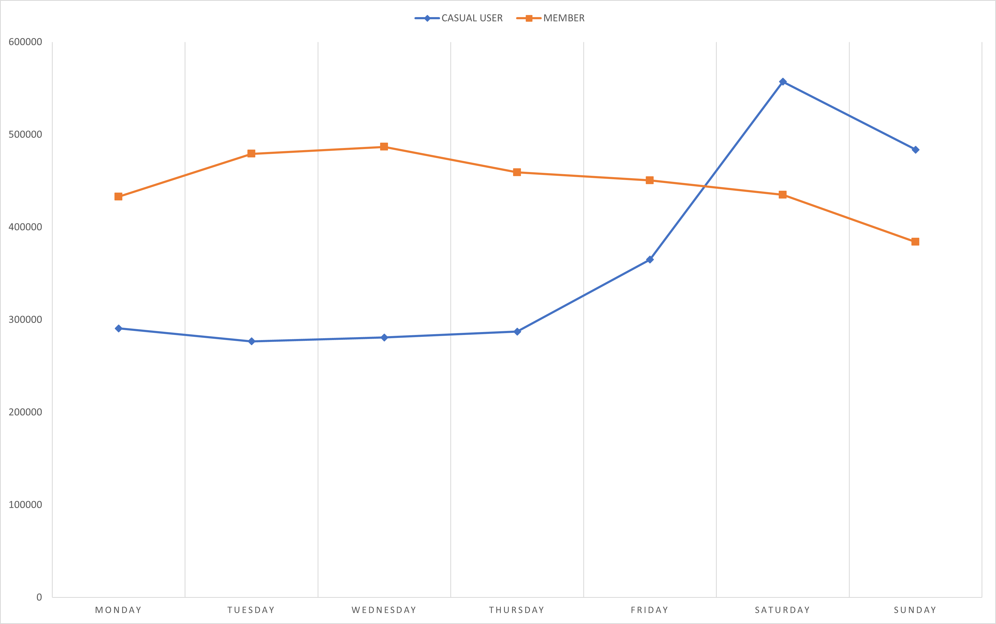
Daily Usage By User Type
Daily Average for 12 months
Members are notoriously more active during weekdays and casual users are more active during weekends.
Cyclistic
Marketing Data Analysis

Slide 6
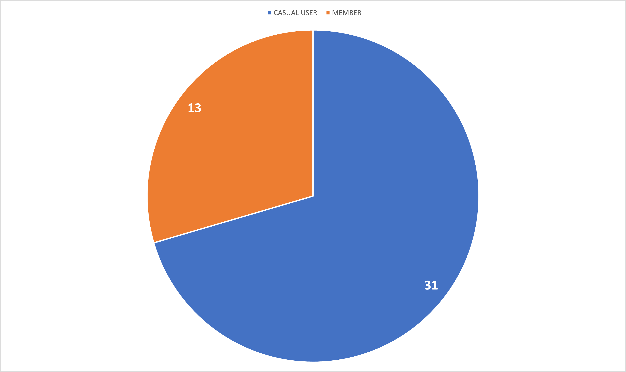
Average Ride Duration
By User Type
Average for 12 months, in minutes
Casual users use the bicycles more time each time they rent one.
Cyclistic
Marketing Data Analysis

Slide 7
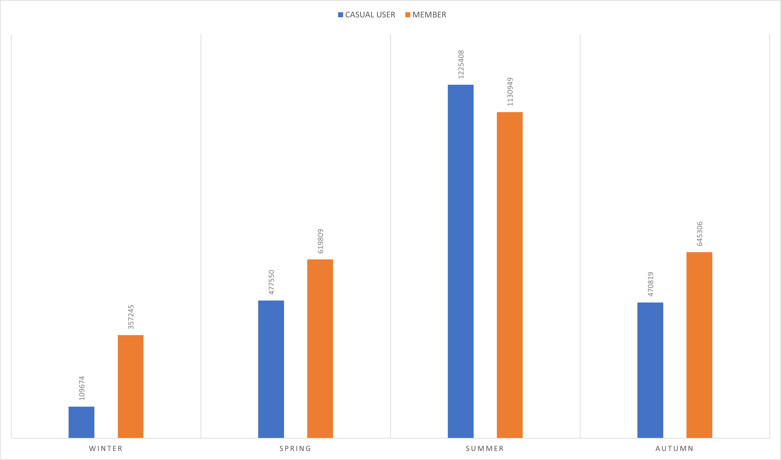
Seasonal Use
By User Type
Total rides per season
Casual users increase the use of the service when the conditions are best suited for outdoor activities.
Cyclistic
Marketing Data Analysis

Slide 8
Key Insights & Recommendations
The analysis of the data shows that while annual members use the service for commuting to and from work, casual users tend to only use the service when outside conditions are optimal.
Because the data does not include the quantity of times single casual riders use the service or how they use it, it is not possible to determine the average recurrency of users.
Cyclistic
Marketing Data Analysis

Slide 9
Key Insights & Recommendations (continued)
Without more data to analyze, the only recommendation we can propose is:
Create a marketing campaign to offer a better price for weekend/casual users
Unfortunately, any other recommendation would be based on hypothesis as the data is incomplete or not broad enough.
Cyclistic
Marketing Data Analysis

Slide 10
Next Steps
To be able to create a better recommendation, we suggest the following:
Continue gathering data, including some sort of id that identifies each casual user for the next 12 months
Create a campaign to survey both casual users and members to have a better understanding on their habits and interests on the service.
Cyclistic
Marketing Data Analysis

