Slide 1
The following is a capstone project for the Google Data Analyst Professional Certificate on Coursera.
It is a fictional company that creates mobile games and wants to inaugurate a new department to make games for a platform different from mobile and ask a data analyst to find out which platform and game genre is best suited for the ongoing times.

Slide 2
NC GAMING
ANALYTICS REPORT
MARCH 22, 2022
EVALUATION BEFORE DEVELOPMENT OF NEW GAMING DIVISION
CAPSTONE/PORTFOLIO PROJECT
CESAR L. ARACENA | HTTPS://GITHUB.COM/CLARACENA/DATA-ANALYTICS

Slide 3
OBJECTIVE
GATHER DATA ON RELEASE OF GAMES ON DIFFERENT PLATFORMS FROM LAST DECADE AND ANALYZE IT TO DISCOVER THE FOLLOWING:
MOST USED PLATFORM BETWEEN PC, XBOX AND PLAYSTATION
BEST CATEGORIES BETWEEN SPORTS, ACTION AND DRIVING SIMULATION GAMES, BASED ON BOTH METASCORE AND USERS SCORE
FIND HOW MULTIPLAYER GAMES COMPARE TO SINGLE PLAYER GAMES
NC Gaming
Analytics Report

Slide 4
OBJECTIVE (CONTINUED)
THE GOAL IS TO DETERMINE WHAT A NEW DIVISION OF NC GAMING SHOULD BE FOCUSED ON.
NC Gaming
Analytics Report

Slide 5
DATA SOURCE
DATA WAS ACQUIRED AS A DATASET FROM WWW.KAGGLE.COM. IT IS CALLED METACRITIC VIDEO-GAMES DATA PROVIDED BY THE USER BRUNOVR AND HAS DATA FROM 1995 TO 2020. IT IS LICENSED AS CCO: PUBLIC DOMAIN.
MORE INFORMATION AT HTTPS://WWW.KAGGLE.COM/DATASETS/BRUNOVR/METACRITIC-VIDEOGAMES-DATA.
NC Gaming
Analytics Report

Slide 6
DATA TREATMENT
WHILE CLEANING AND TRANSFORMING THE DATA, THE FOLLOWING STEPS WERE TAKEN:
CHECK FOR DATASET VALIDITY BY HAND (20 RANDOM ENTRIES)
DELETE ENTRIES WITH NO RELEASE DATE AND NO USER SCORE
DELETE ENTRIES WITH MALFORMED DATA
NORMALIZE META SCORE WITH THE USERS SCORING SYSTEM (1 TO 10)
ALL DATA WAS CLEANED, TRANSFORMED AND ANALYZED USING MS EXCEL.
NC Gaming
Analytics Report

Slide 7
ANALYSIS: SCORE PER CATEGORY
WHILE METASCORE INDICATES THAT THE BEST CATEGORIES ARE ACTION (GROWING SLOWLY), SIMULATION (GROWING FAST) AND RACING (DECREASING), USERS SCORE SHOW THAT ACTION ADVENTURE IS TIED WITH ACTION AS THE BEST TWO CATEGORIES, BOTH HAVING A VERY STABLE SCORES FOR THE PAST YEARS.
IN AVERAGE, ACTION IS THE BEST CATEGORY FOLLOWED VERY CLOSE BY ACTION ADVENTURE.
NC Gaming
Analytics Report

Slide 8
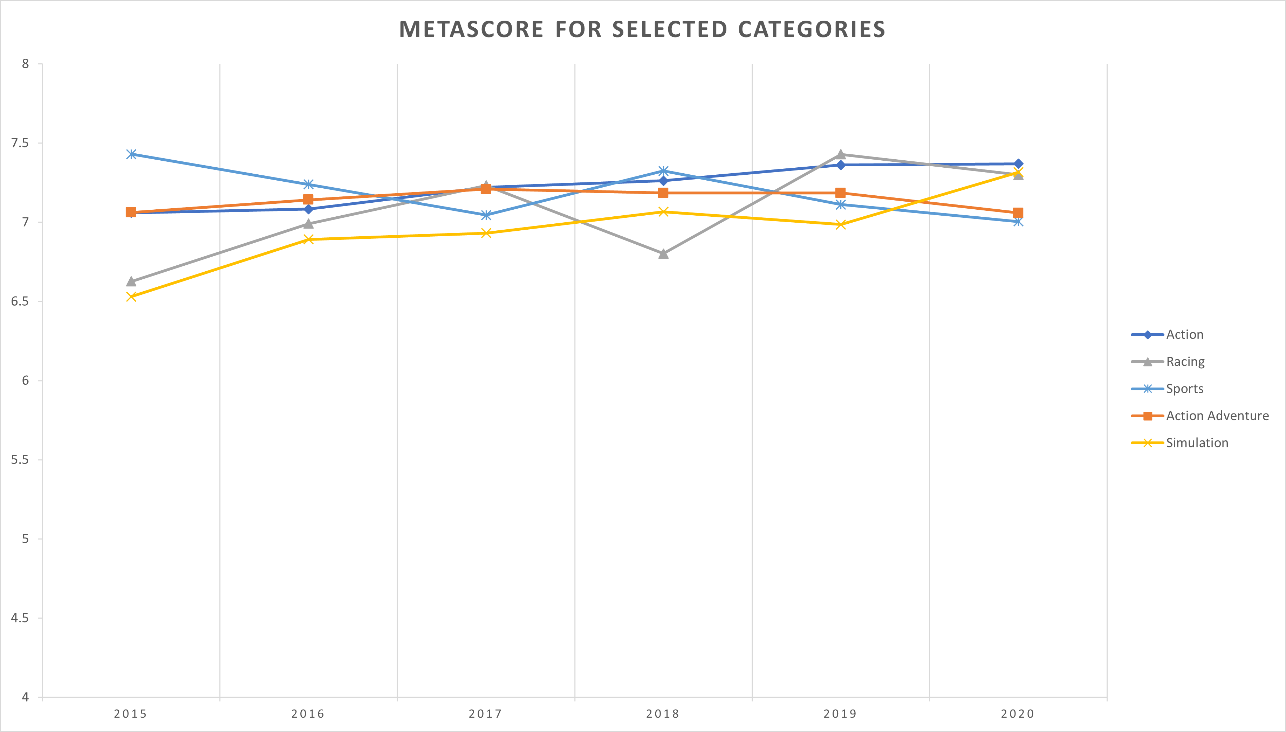
ANALYSIS: SCORE PER CATEGORY
(METASCORE | ALL PLATFORMS | LAST 5 YEARS)
THE BEST CATEGORIES PER METASCORE FROM 2015 TO 2020 ARE ACTION, SIMULATION AND RACING
NOTE: SCALE ZOOMED IN FOR BETTER VIEW
NC Gaming
Analytics Report

Slide 9
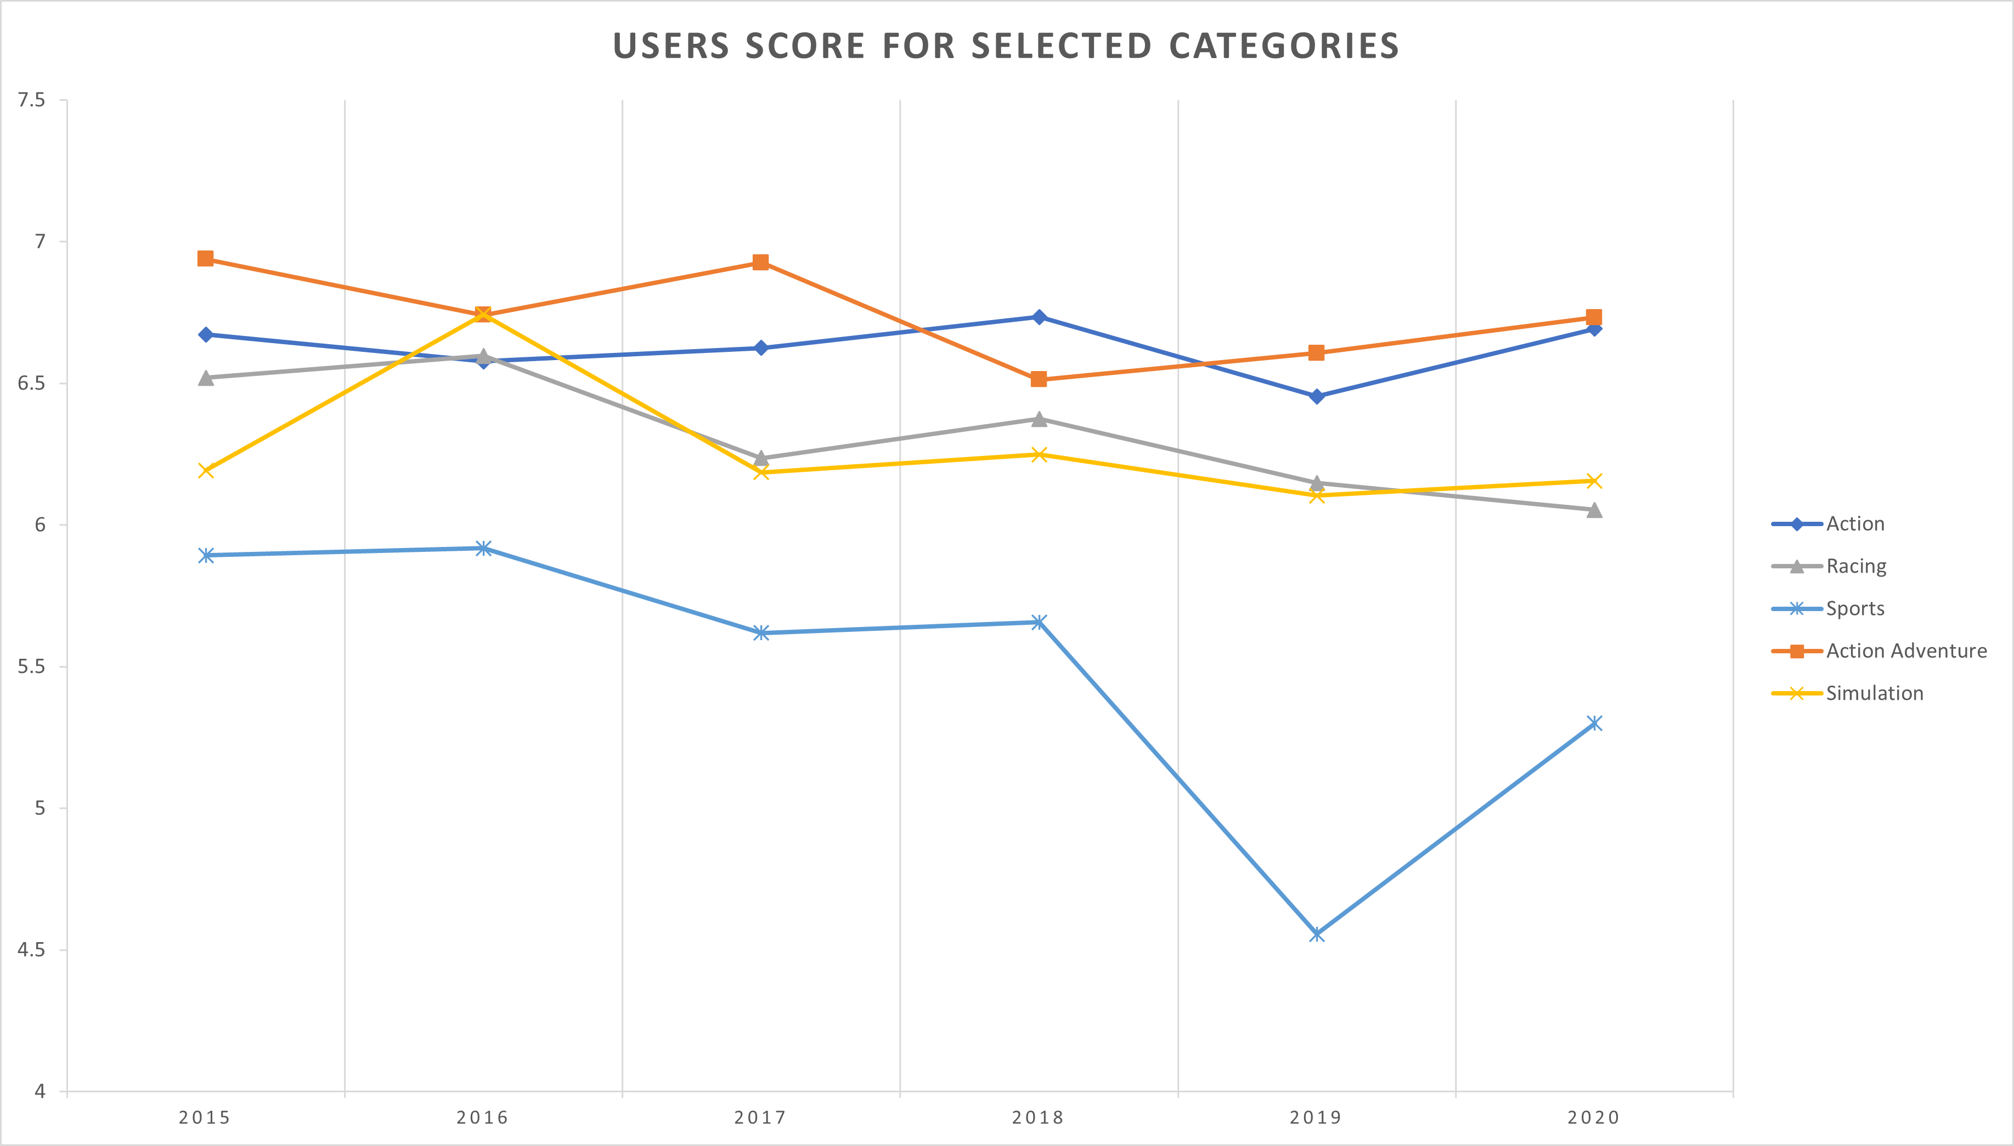
ANALYSIS: SCORE PER CATEGORY
(USERS SCORE | ALL PLATFORMS | LAST 5 YEARS)
THE BEST CATEGORIES PER USERS SCORE FROM 2015 TO 2020 ARE ACTION AND ACTION ADVENTURE
NOTE: SCALE ZOOMED IN FOR BETTER VIEW
NC Gaming
Analytics Report

Slide 10
ANALYSIS: GAMES RELEASED BY PLATFORM
DURING THE 2015 – 2017 PERIOD, THERE WAS A BOOM IN CONSOLE USERS BUT BY THE END OF THE DECADE, MANY DEVELOPERS OF COMPUTER GAMES BEGAN PORTING MORE GAMES TO PC AND DEVELOPING CROSS-PLATFORM GAMES.
IN THE LAST YEARS, FOCUS TURNED INTO MAKING MORE REALISTIC GAMES WITH LONGER STORIES, RESULTING IN LESS GAMES RELEASED PER YEAR.
NC Gaming
Analytics Report

Slide 11
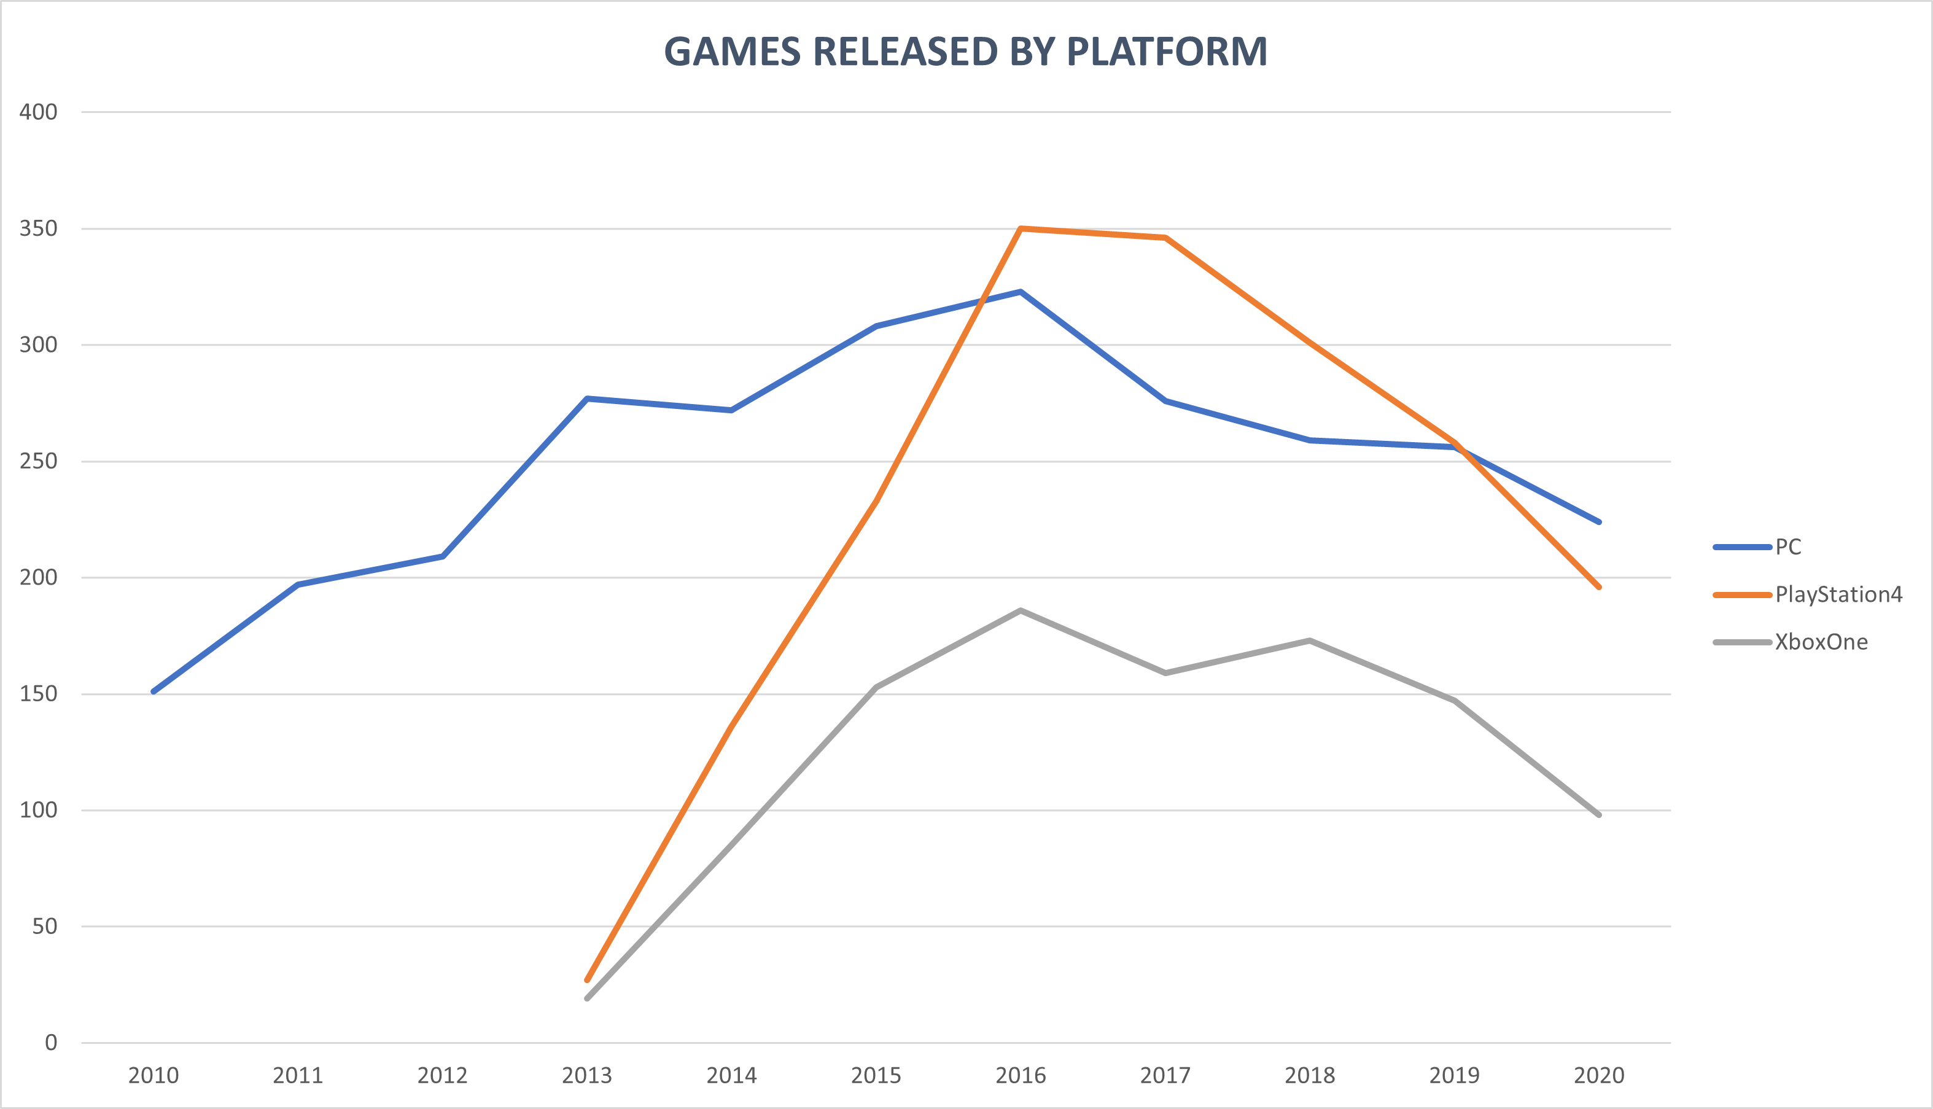
ANALYSIS: GAMES RELEASED BY PLATFORM
NC Gaming
Analytics Report

Slide 12
ANALYSIS: MULTIPLAYER vs. SINGLE PLAYER GAMES
CONTRARY TO INTUITION, DEVELOPERS ARE RELEASING MORE SINGLE PLAYER GAMES THAN MULTIPLAYER GAMES.
NOTE: SINGLE PLAYER GAMES INCLUDE BOTH ONLINE SINGLE PLAYER AND OFFLINE SINGLE PLAYER GAMES.
NC Gaming
Analytics Report

Slide 13
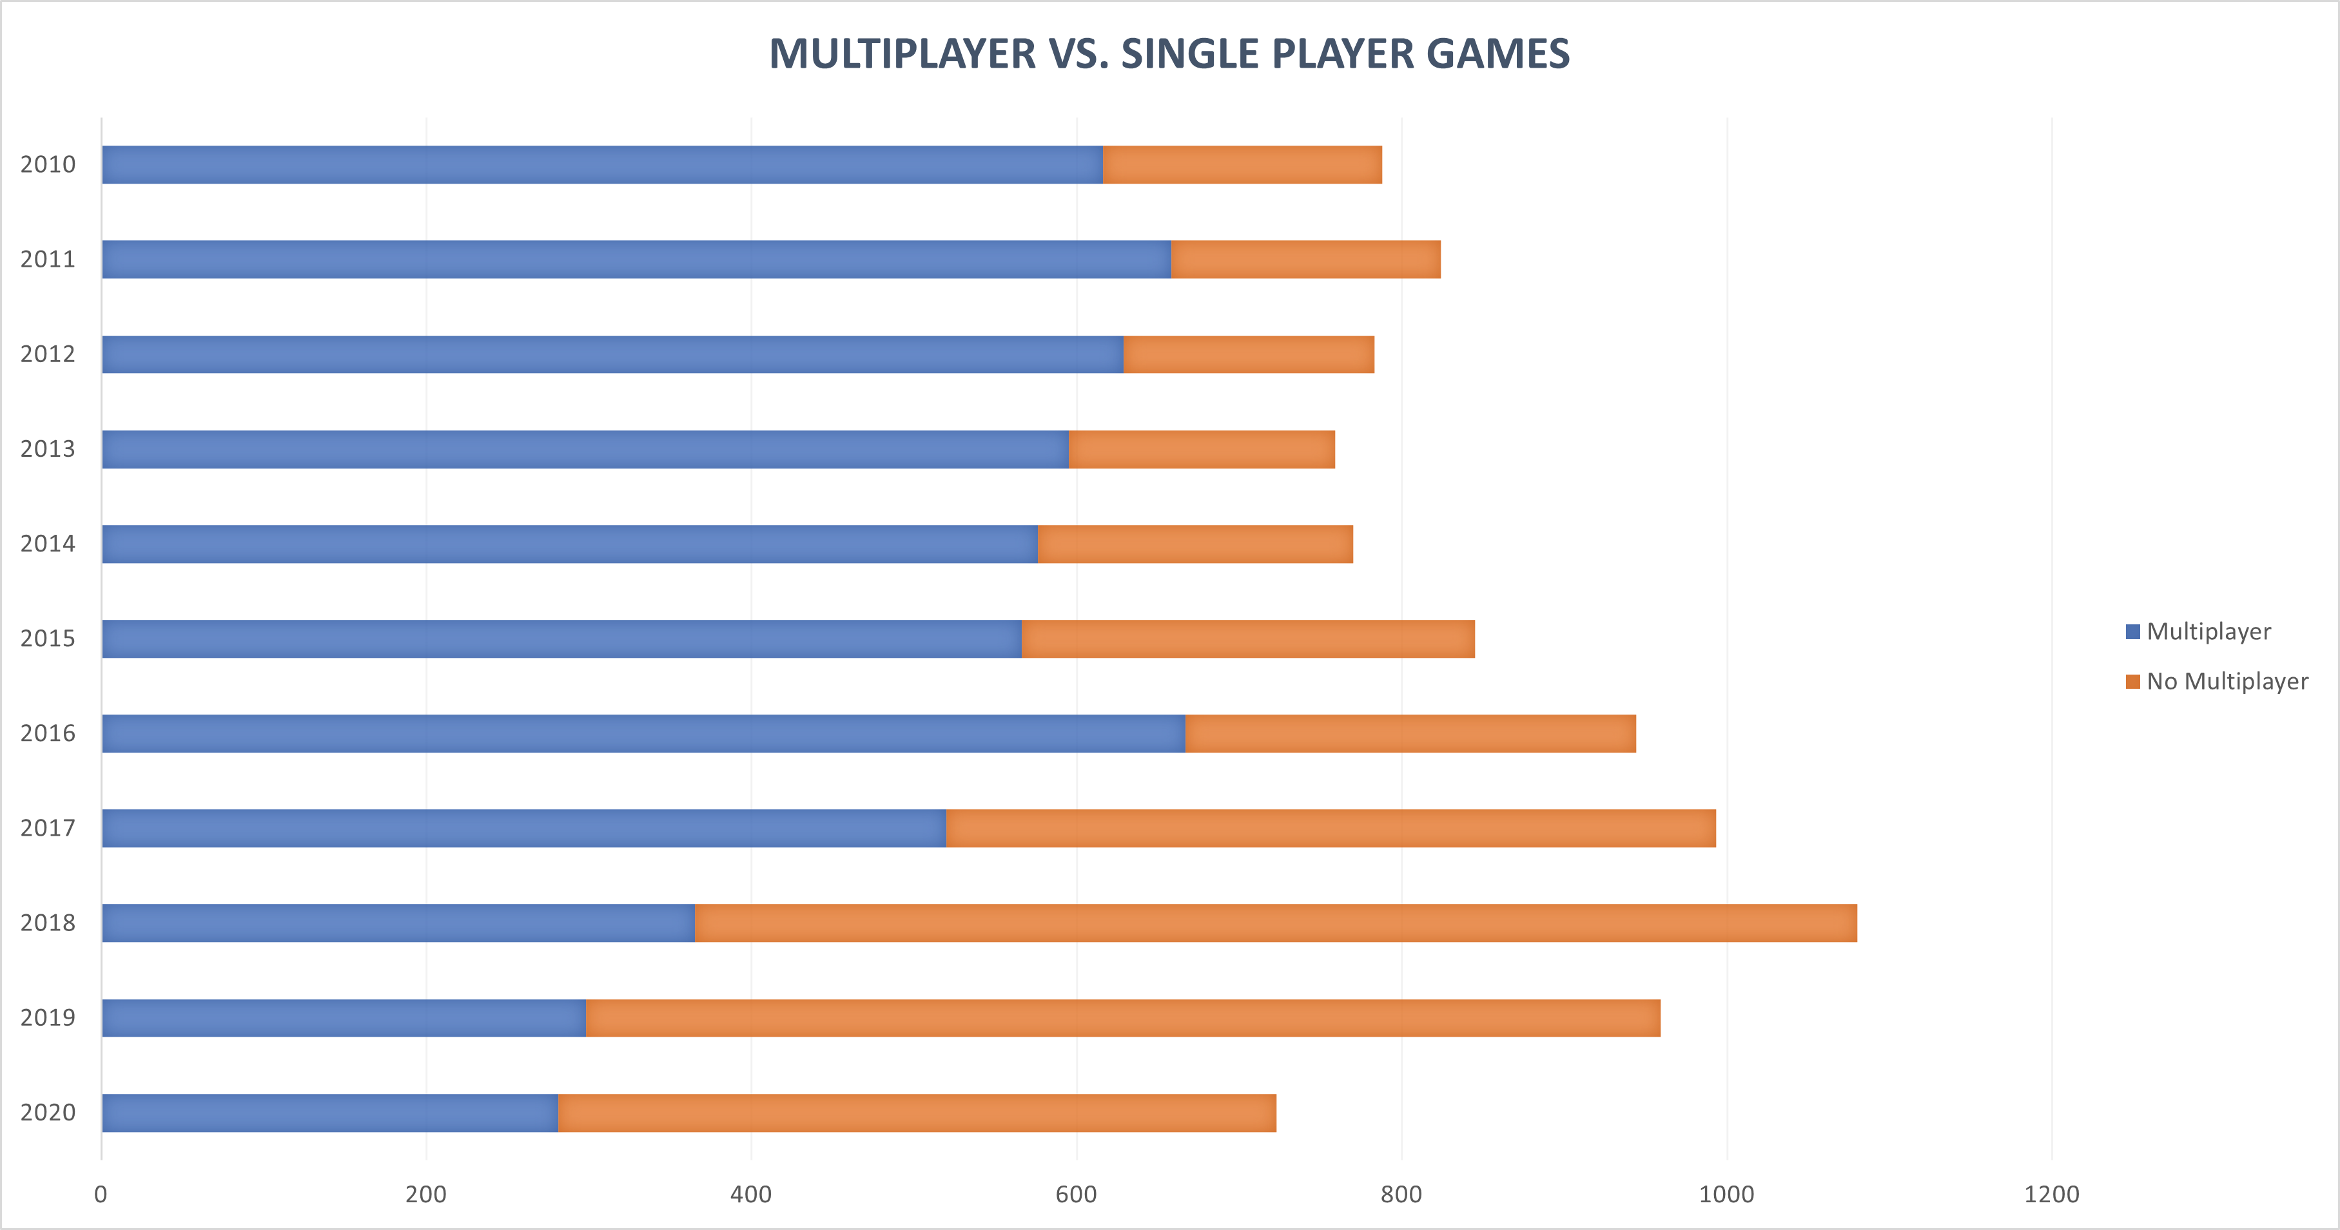
ANALYSIS: MULTIPLAYER vs. SINGLE PLAYER GAMES
NC Gaming
Analytics Report

Slide 14
KEY INSIGHTS AND CONCLUSION
BASED ON THE DATA ANALYZED, THE NEW GAME DEVELOPMENT DIVISION AT NC GAMING SHOULD AIM TO CREATE ACTION OR ACTION/ADVENTURE GAMES FOR PC, FOCUSED ON SINGLE PLAYER STYLE GAMES WITH, IF POSSIBLE, ONLINE ACCOUNTS.
MULTIPLAYER SUPPORT AND CROSS-PLATFORM MULTIPLAYER WOULD BE SIGNIFICANTLY BETTER.
NC Gaming
Analytics Report

Slide 15
NEXT STEPS
TO HAVE MORE AND BETTER RESULTS, IT WOULD BE MY RECOMMENDATION TO ALSO DO THE FOLLOWING ANALYSIS:
BEST PUBLISHERS FOR FUTURE GAME RELEASES (FROM DATABASES)
A DEEP ANALYSIS ON PLAYERS CHARACTERISTICS TODAY (FROM SURVEY)
NC Gaming
Analytics Report

