Slide 1
Java
JSON and APIs

Slide 2
Code Examples
https://github.com/claraj/Java2545Examples

Slide 3
How do different computer systems talk to each other?
Scenario to consider:
An e-commerce retailer. Which systems may work together to display products (with reviews, similar product suggestions) on pages, take orders, process orders, ship orders... ?
Typical IT infrastructure has many separate systems that communicate as needed

Slide 4
Many technologies to connect different computer systems over a network
Various technologies including CORBA, Message Passing, PubSub... (we won't cover these)
One technology that's become very popular is using HTTP
Same technology used in your web browser, to request web pages
HTTP can also be used by programs to make requests to API servers
An API server is much like a web server, but it's designed to respond to programs, not humans, and send data, not web pages

Slide 5
HTTP
HTTP is the protocol used for browsers to request web pages, and for servers to send pages, images, other resources in response
Can also use HTTP to send requests from your program to another computer, somewhere else on the network (or internet)
The other computer can respond with data of some kind - a file, text, error message, or JSON

Slide 6
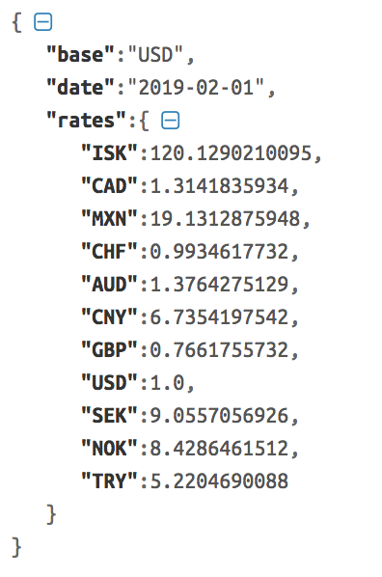
JSON
JavaScript Object Notation, used by the JavaScript language, but widely understood by many other programming languages
The structure looks a lot like a Python dictionary
And, we can turn a JSON response into a Python dictionary in our program, and use the data

Slide 7
HTTP Requests with requests
Java has built-in libraries for making HTTP requests but it's a little clunky to use
So we'll use the Unirest library instead to help
http://kong.github.io/unirest-java/

Slide 8
First HTTP request
We need a random cat fact
So we need a random cat fact service
Let's use the https://catfact.ninja API

Slide 9
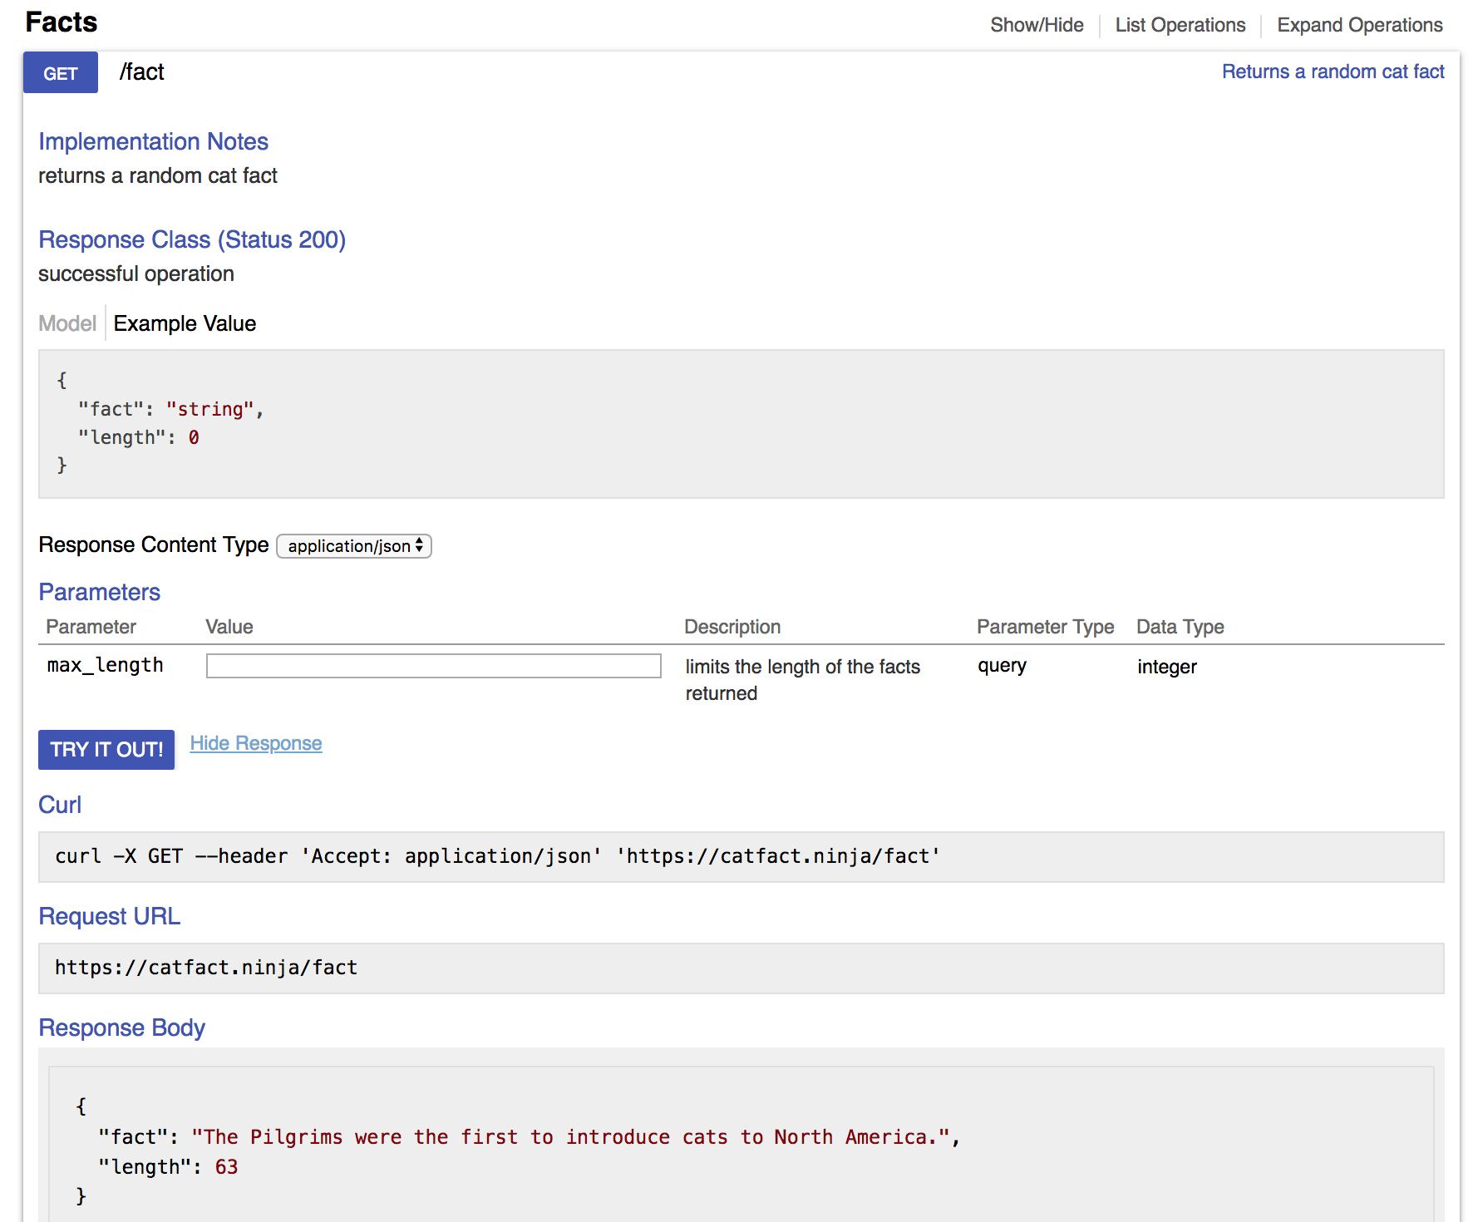
Using an API
Step 1: read the documentation to figure out what request to make
There's an example URL
Paste it into your browser address bar to see what happens

Slide 10
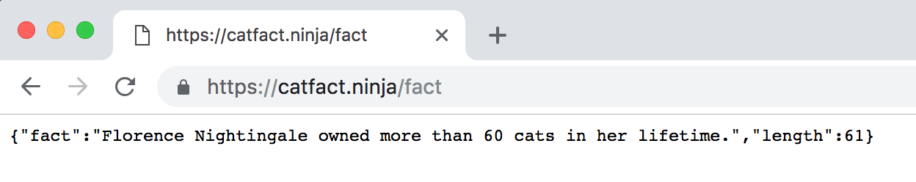
Step 2: Test out the API
Test in browser or with curl
Looks like a random cat fact
What format is the data in?
JSON response - it's plain text but formatted to be readable by computers. The structure has key: value pairs

Slide 11
Step 3: How is the response structured?
Note the JSON has keys "fact" and "length".
We are interested in the fact

Slide 12
Step 4: Use in program
Add Unirest to project
Make HTTP request to API
Parse response into useable form*
Use response in program
* A String, a JSON object, or a custom object

Slide 13
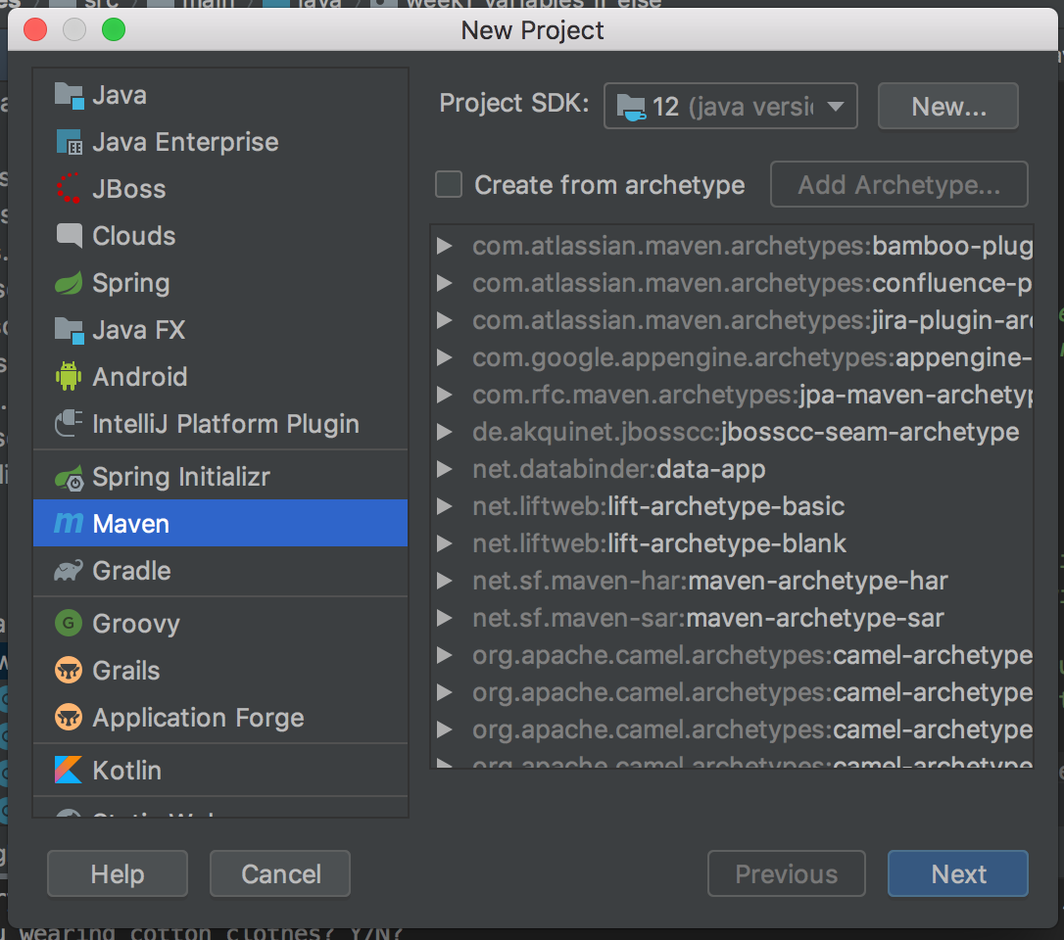
Create New Project
Select Maven as the type, Project SDK should be Java 12, click Next
Select Maven here

Slide 14
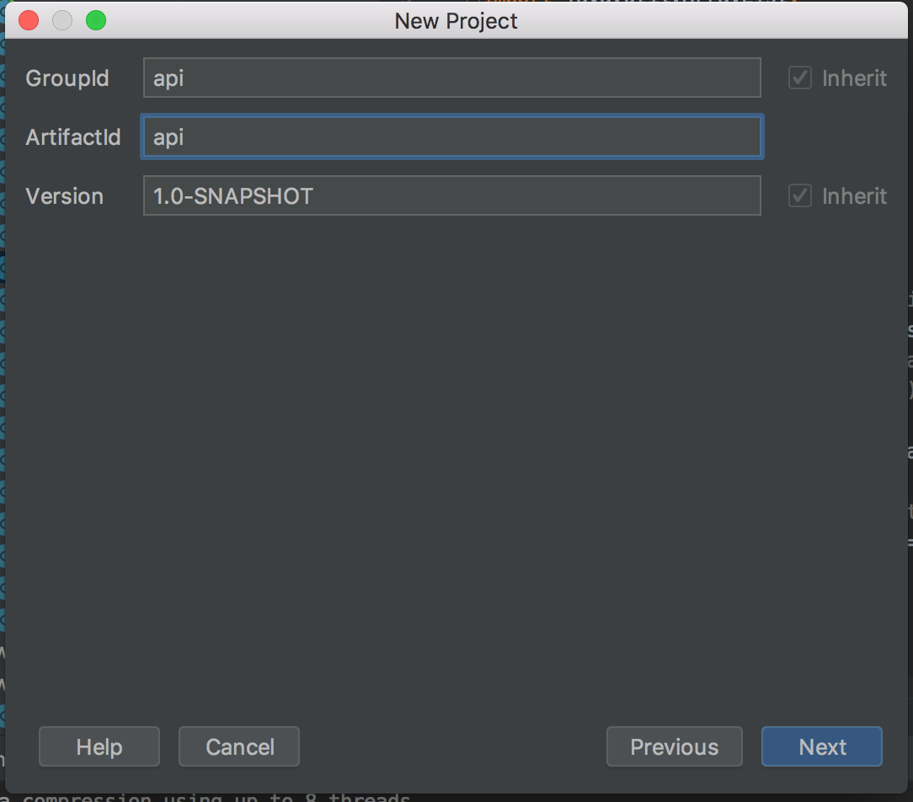
New Maven Project
GroupID = api and ArtifactID = api
Specific name is not important for this project
Values should be all one word, no spaces
Click next

Slide 15
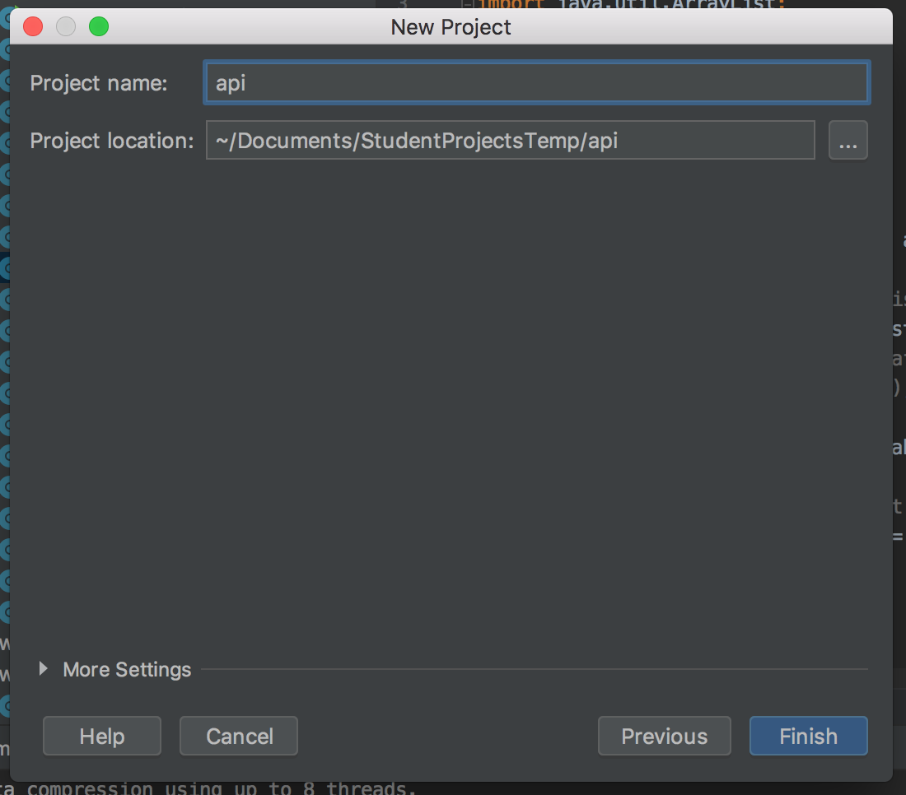
Project name
Anything you like - I called mine api
Set the project location to the location of your choice
Click Finish

Slide 16
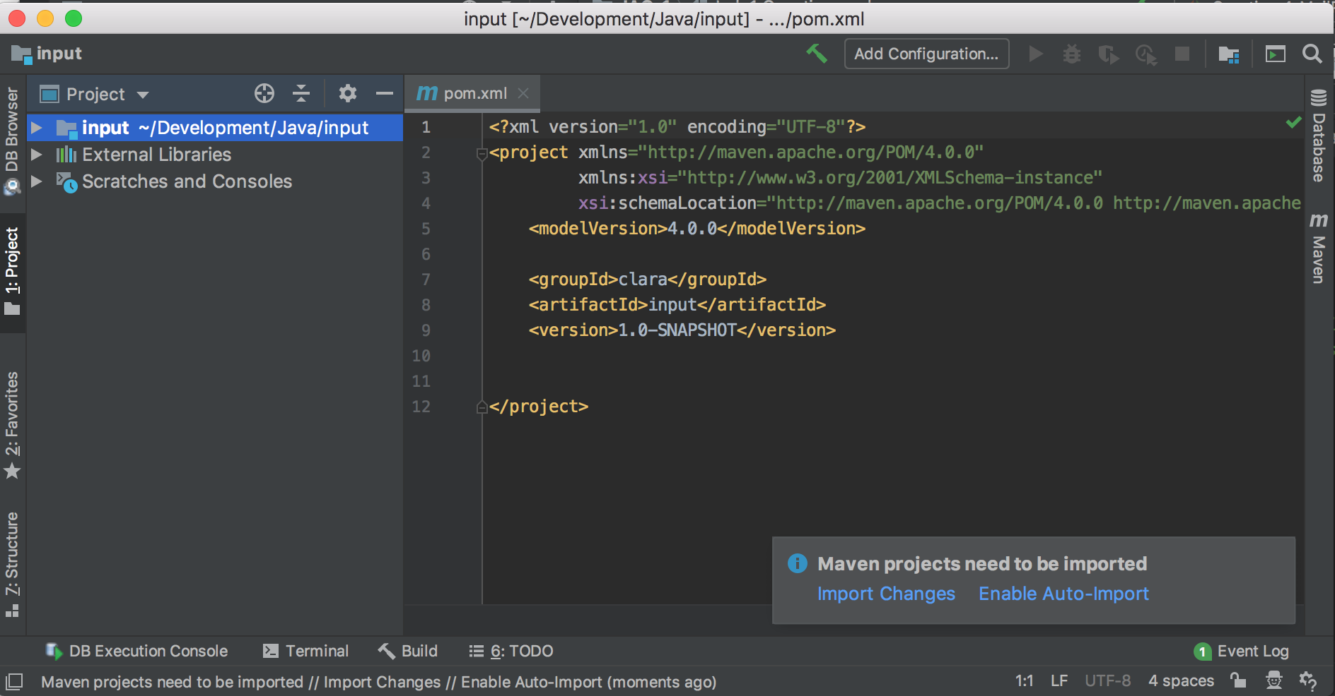
Project opens, pom.xml file
Maven is a build manager for Java projects. It can control how a project is compiled, and fetch other code that the project needs
Maven projects needs a file called pom.xml that describes the project, it's dependencies (other code it needs), and various other information

Slide 17
Examine the pom.xml
You will add Unirest, GSON, and input-utils dependencies to pom.xml here
Also need to specify which version of Java we are using
You will add dependency here
Before the </project> line

Slide 18
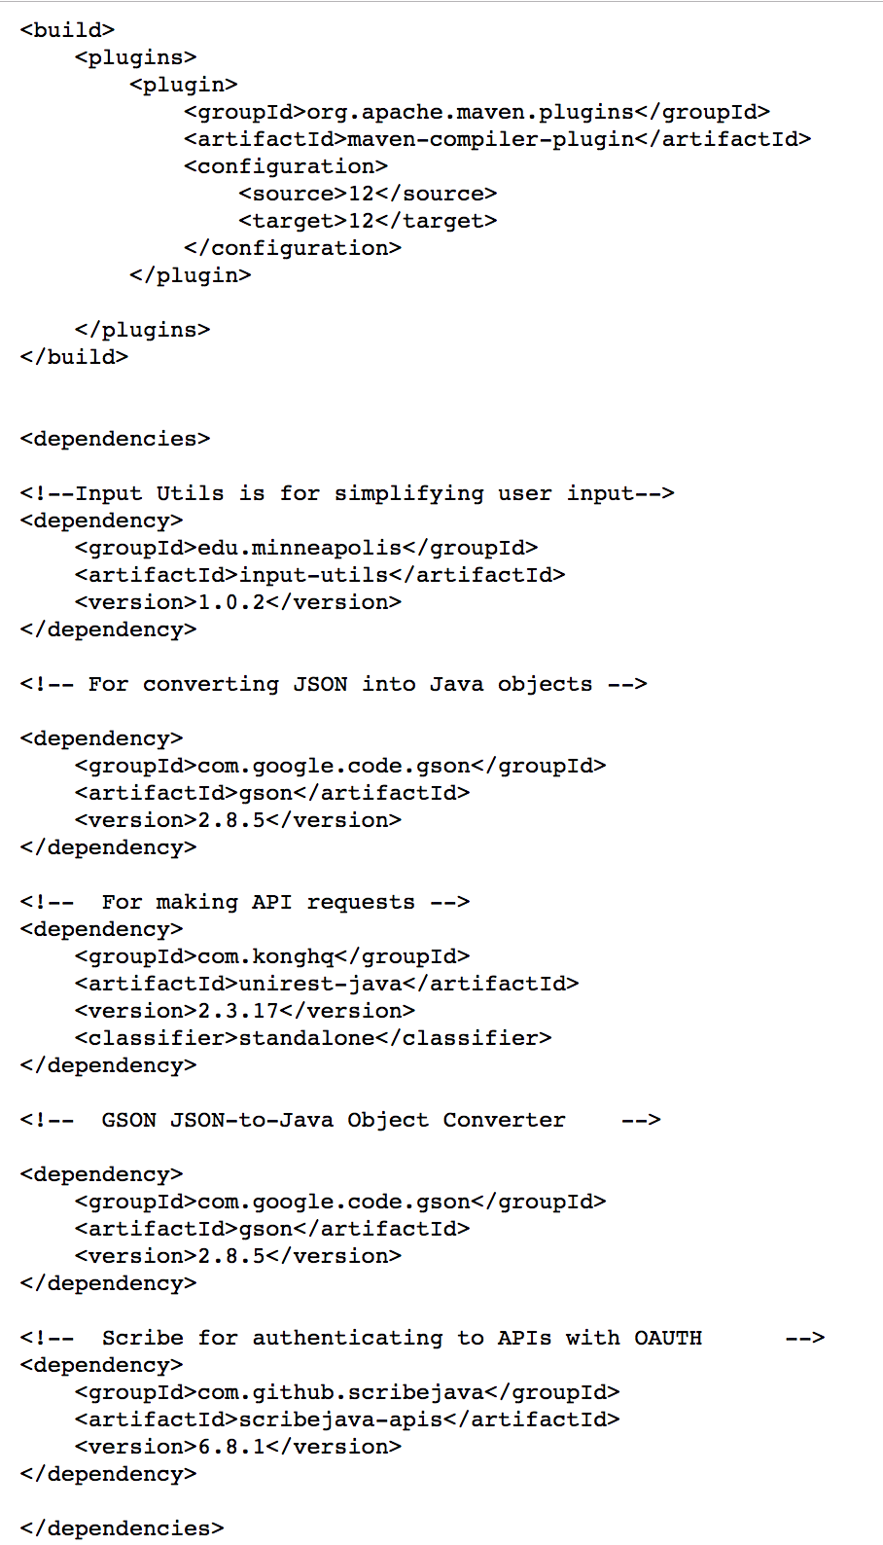
Go to this link
https://git.io/JeGW1
This tells Maven what version of Java to use, and where to find and download the dependencies
Copy all of the text on this page

Slide 19
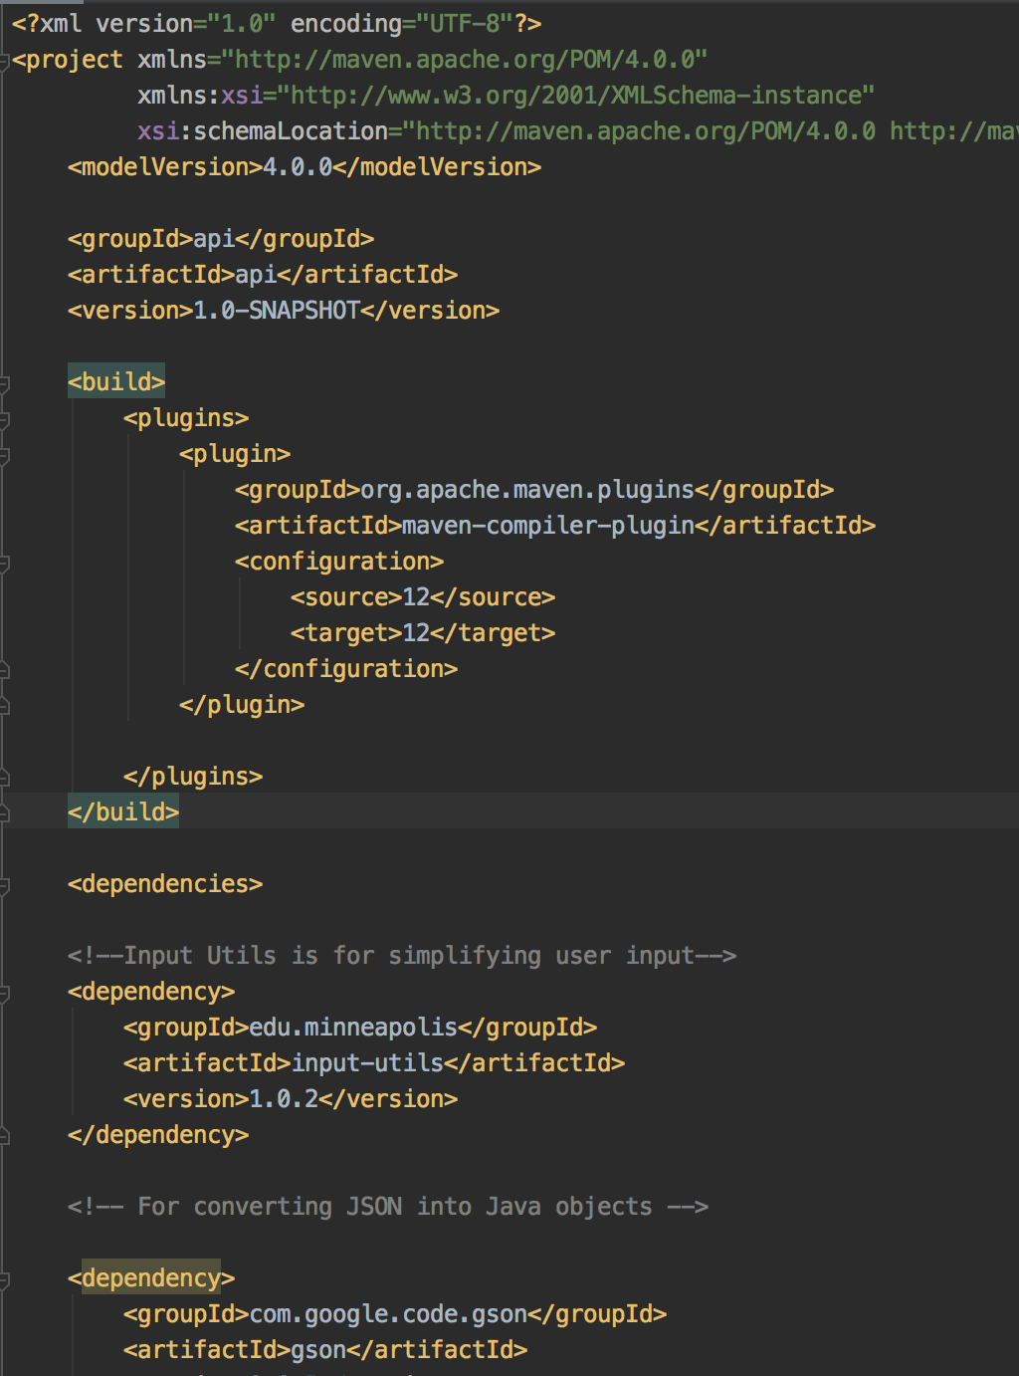
Paste the text from the previous page into your pom.xml The start of your pom.xml file should look like this
This is the part you pasted from the web page

Slide 20
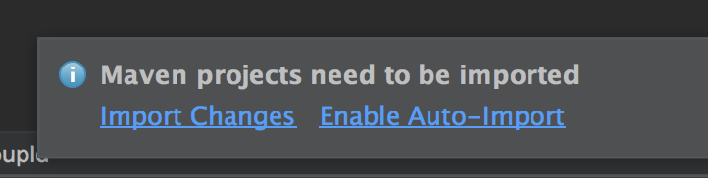
Import changes
Click on Import Changes link
Your project can now use the the Unirest, GSON, Scribe and input-utils libraries

Slide 21
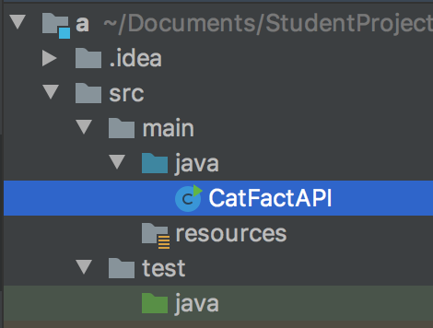
Create Java File
Expand src/main/java
Right-click on java directory
Select New > Java Class
Call the new class CatFactAPI.java

Slide 22
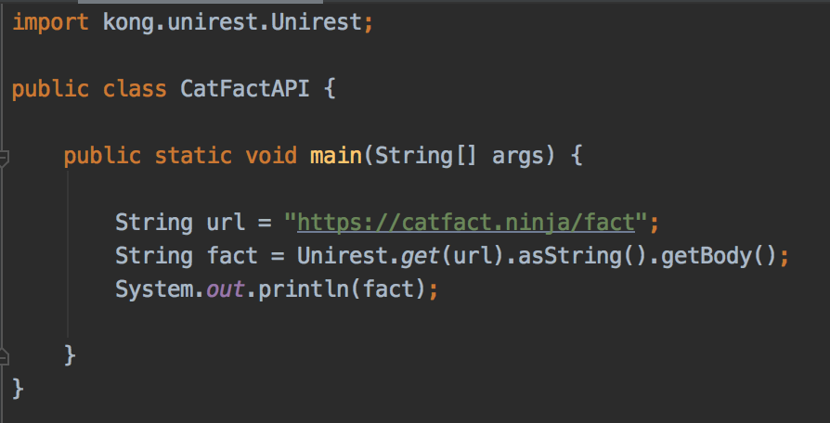
Write this code in CatFactAPI.java

Slide 23
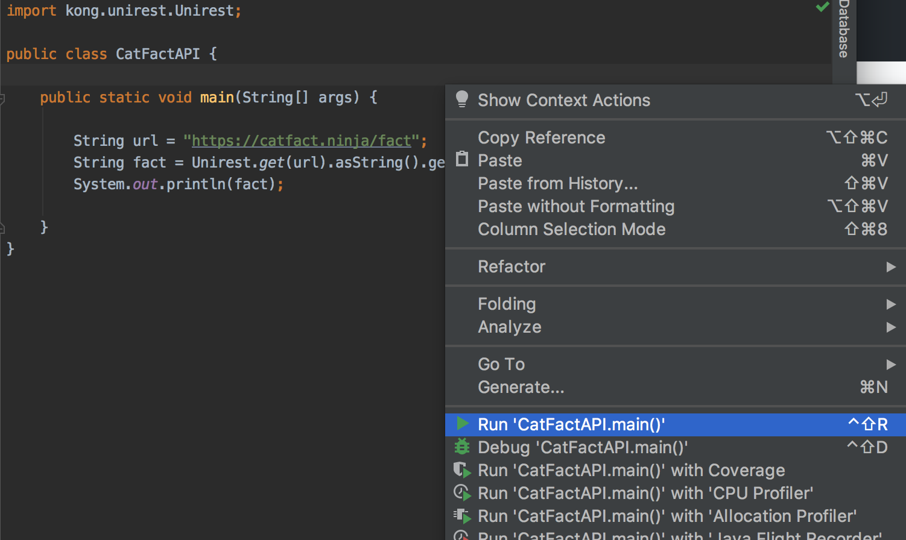
Right-click on your file and select Run

Slide 24
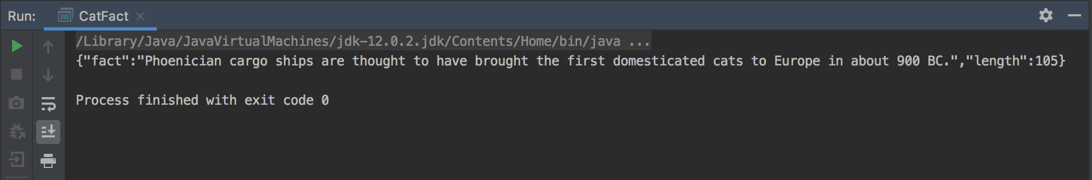
Example output

Slide 25
Problem
The output is a String
How do we get the fact by itself?
Solution: convert it into a Java object

Slide 26
Problem
Java makes you be very specific about which variables are in an object
Need to define a class that has the same variables as the JSON response
Use the GSON library to convert the JSON response to a Java object

Slide 27
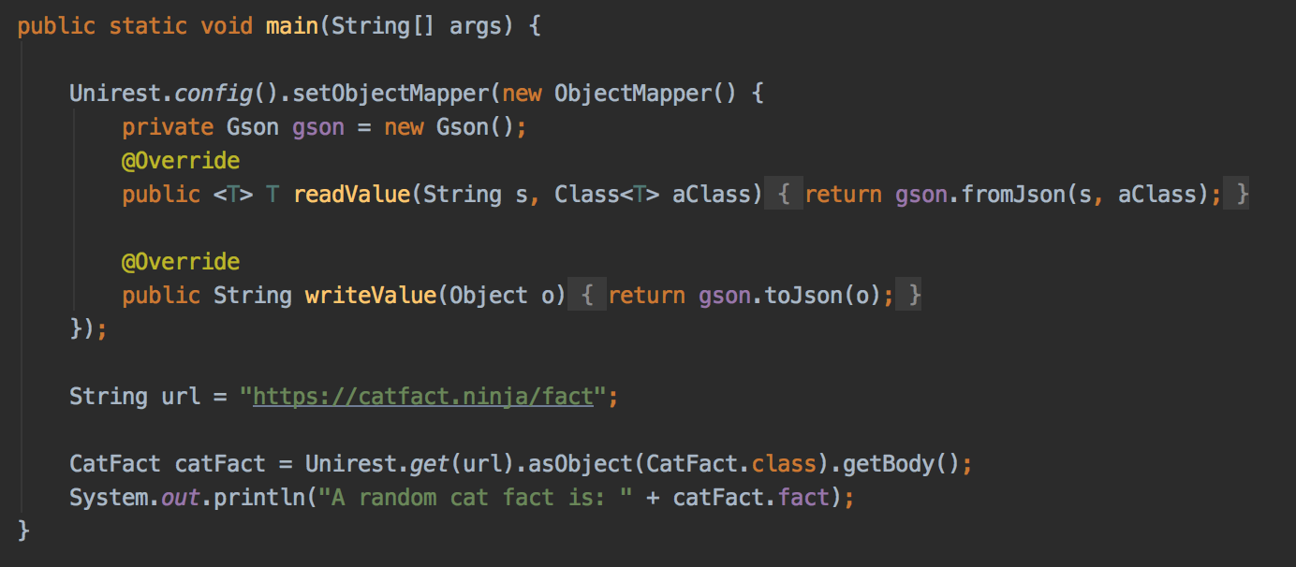
Set up GSON object mapper
Add this code - need to do one time per program

Slide 28
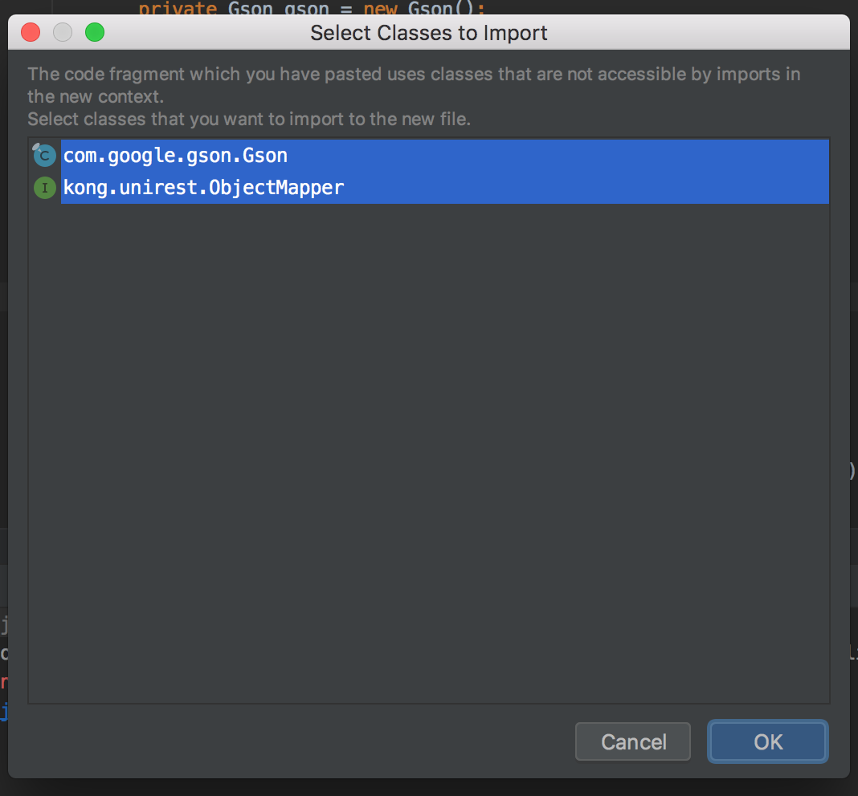
Set up GSON object mapper
OK here

Slide 29
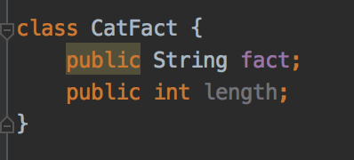
Define a CatFact class
Add this to CatFactAPI.java
The variable names match the keys in the JSON

Slide 30
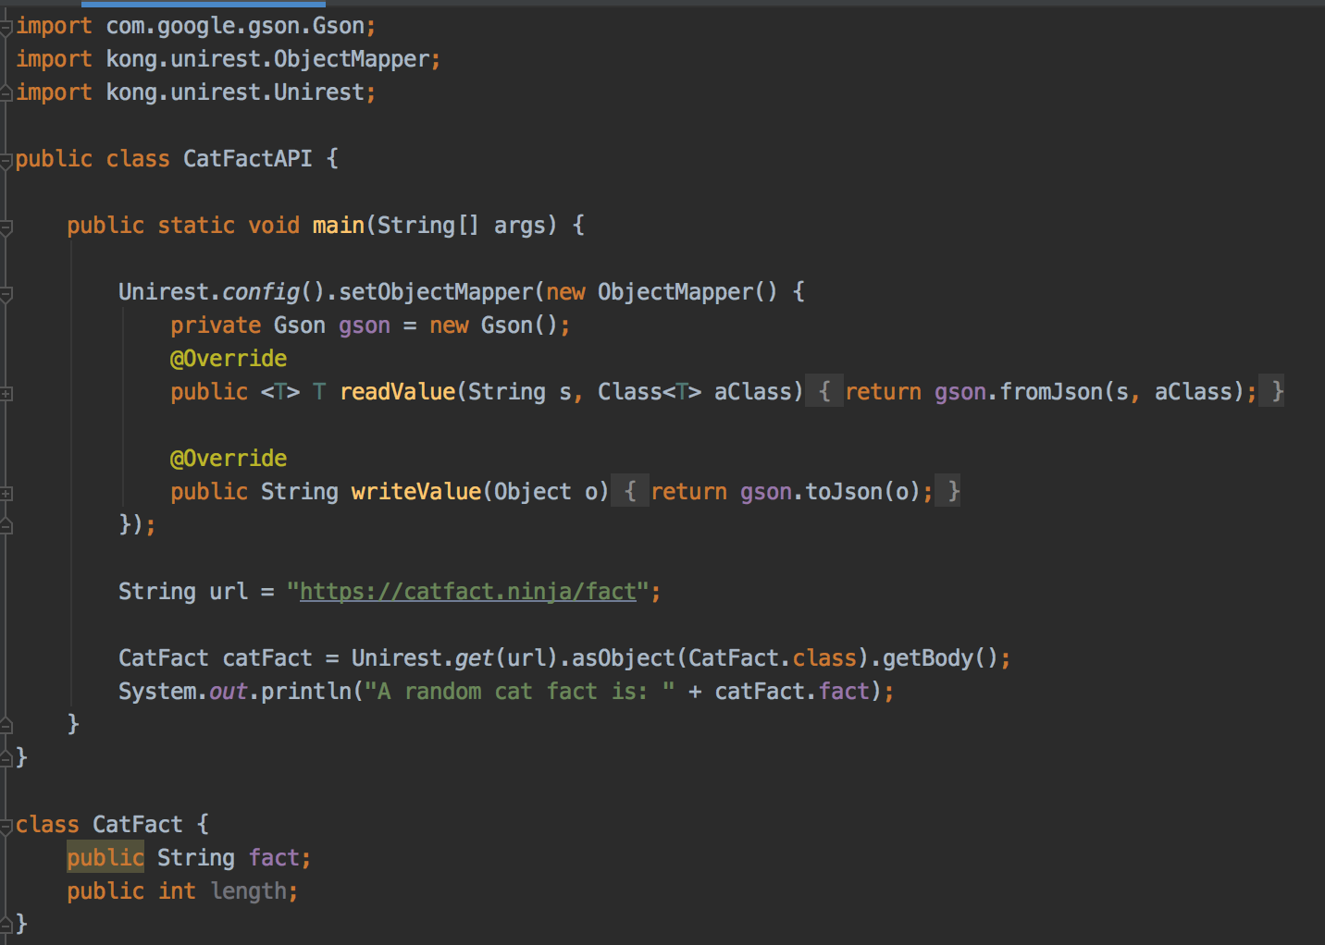
Entire program
CatFactAPI.java

Slide 31
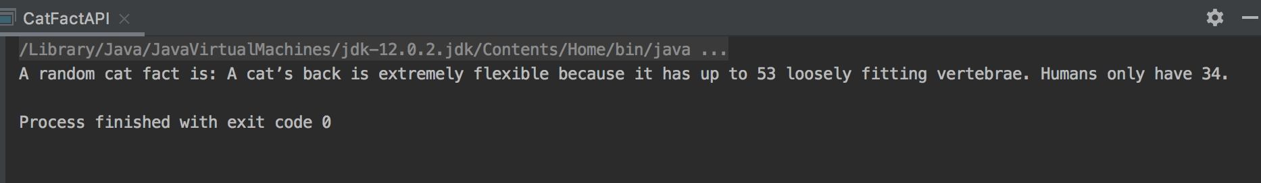
Run and test
Random fact as a String
Data can be used in your code

Slide 32
Another API - Exchange rates
https://exchangeratesapi.io/
List of currency codes: https://www.iban.com/currency-codes

Slide 33
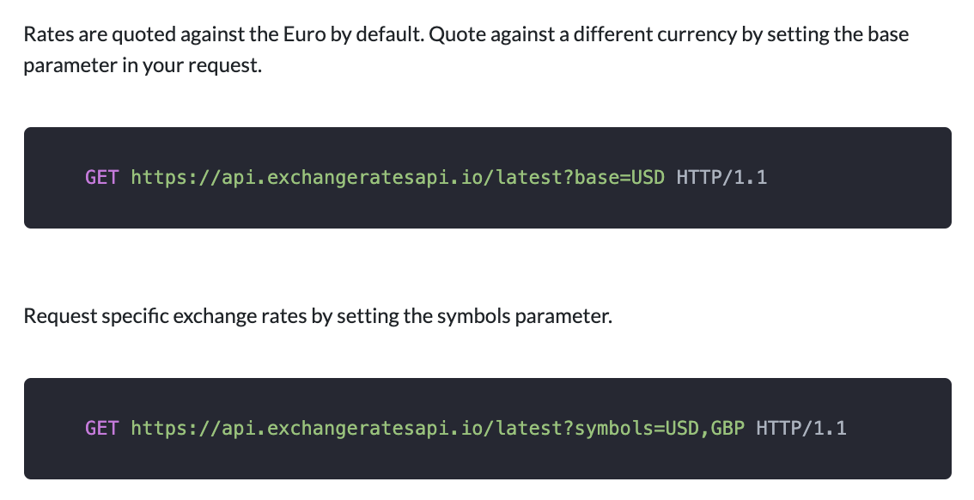
A basic exchange rate program
Example: we want the dollars-euros exchange rate for conversions
From reading the documentation, we can specify a base currency, and symbols (the currencies to convert to) with this URL
https://api.exchangeratesapi.io/latest?base=USD&symbols=EUR

Slide 34
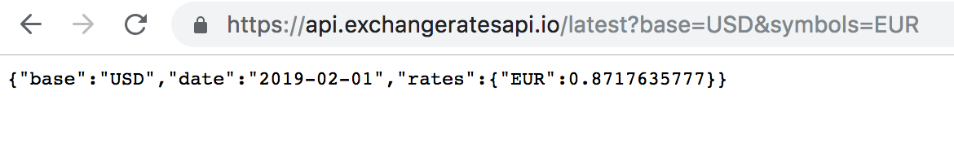
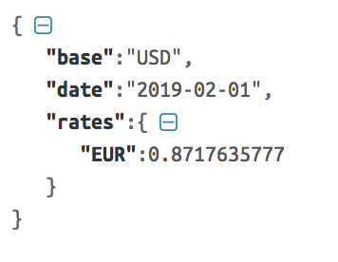
JSON formatter
Helpful to see the structure of the response
https://jsonformatter.curiousconcept.com/
Easier to read format

Slide 35
Response
The response has a rates key
The value for this key is another dictionary
This dictionary has a EUR key, and it's value is the exchange rate from dollars to Euros

Slide 36
Create new Java file: ExchangeRates.java

Slide 37
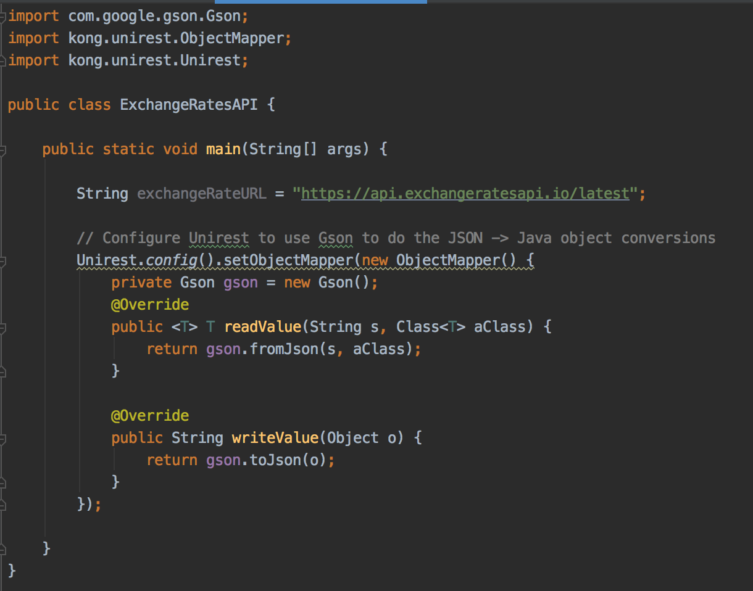
Create a main method, make variable for URL, and set up GSON mapper

Slide 38
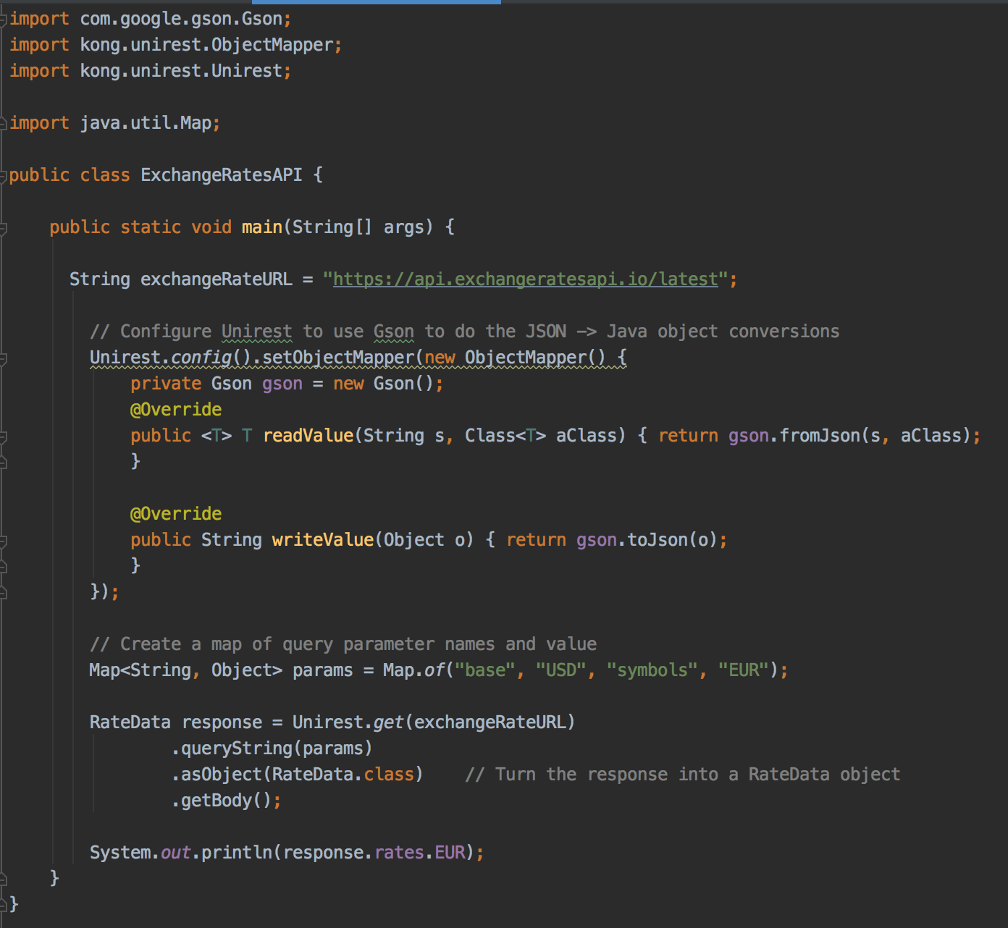
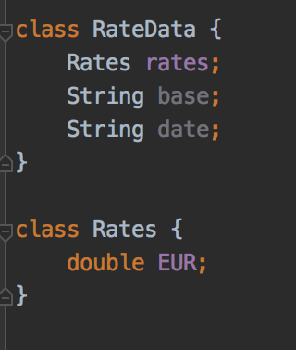
Code for API call
Run and test

Slide 39
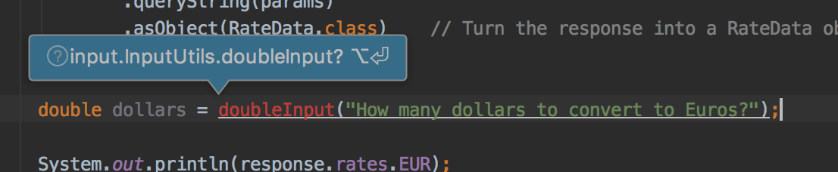
User input
Press Alt+Enter on this line

Slide 40
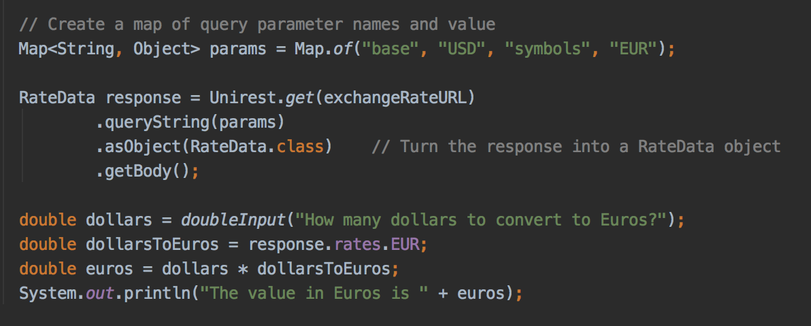
Modify code
User input, calculate dollar equivalent

Slide 41
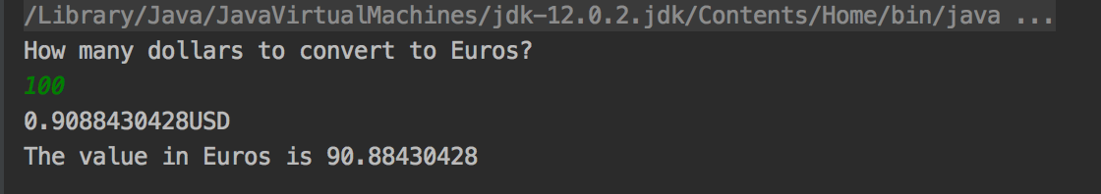
Run and test

Slide 42
More Examples in the repository
Kanye Quotes API
Yelp Cheap Restaurants API
BoredAPI

Slide 43
API Keys
These APIs are unusual because you don't have to authenticate to use the service
Most APIs are restricted to authorized users
Why?
Either with OAuth - equivalent of a username and password
Or require a key to access - less security but still useful for managing and monitoring users

Slide 44
Let's build an app with the Yelp API
Search for cheap restaurants in Minneapolis
https://www.yelp.com/developers
Create an account, create an application, make a note of your key

Slide 45
Key Management
It's not a good idea to write your key in code
It's like a password
One solution: save the key in an environment variable

Slide 46
Environment Variables
A variable that your computer stores
Programs can read environment variables
Common solution to private data needed by programs, that should not be part of the codebase
Also used to store database access credentials, other secrets
And for high-level development settings
Run the program in development or production mode?
What port should the web server run on?

Slide 47
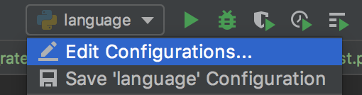
Environment variables
Run your code that expects to have an environment variable
Click on the name of the file you are running, menu bar, top right
Select Edit Configurations...

Slide 48
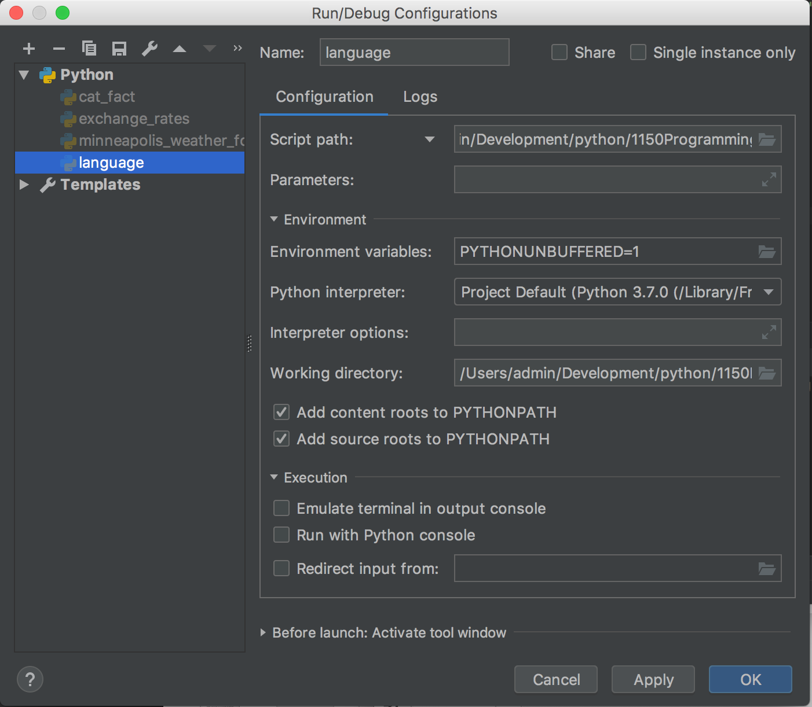
Environment variables
Click on the little folder on the right of the Environment Variables configuration to open the Environment Variables dialog

Slide 49
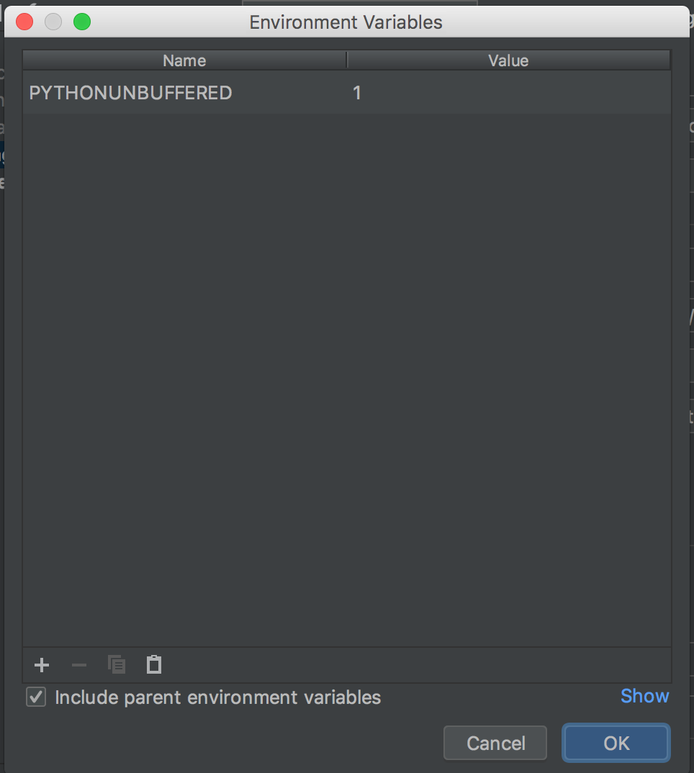
Environment Variables dialog
Click on the + button at the lower left of the window

Slide 50
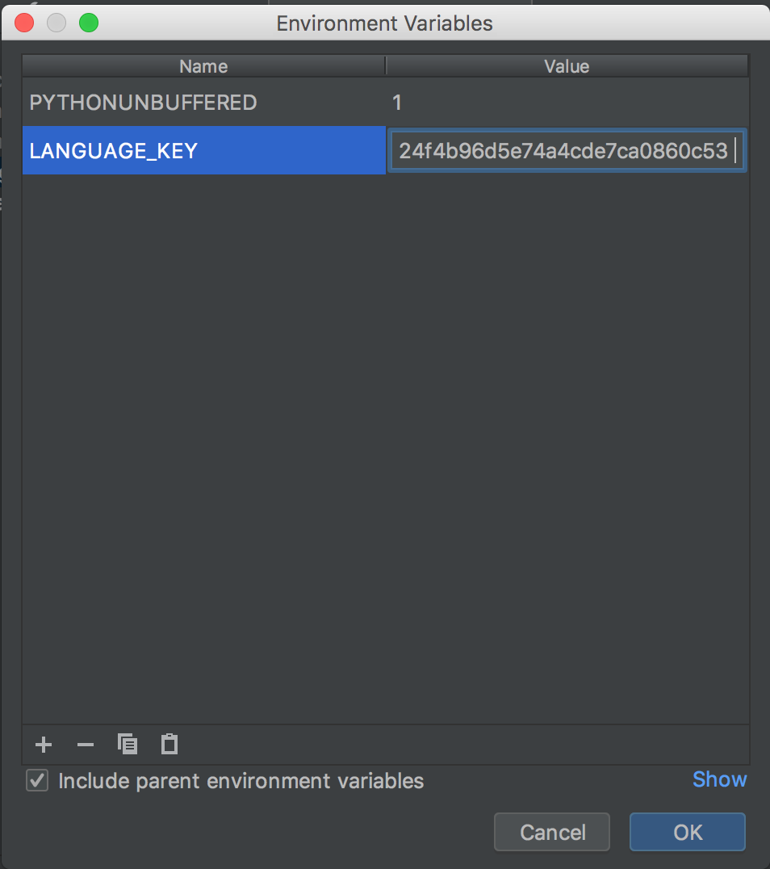
Create new environment variable
Enter YELP_API_KEY for the name
Past in your API key for the value
Make sure there are no extra spaces around the key
Click OK

Slide 51
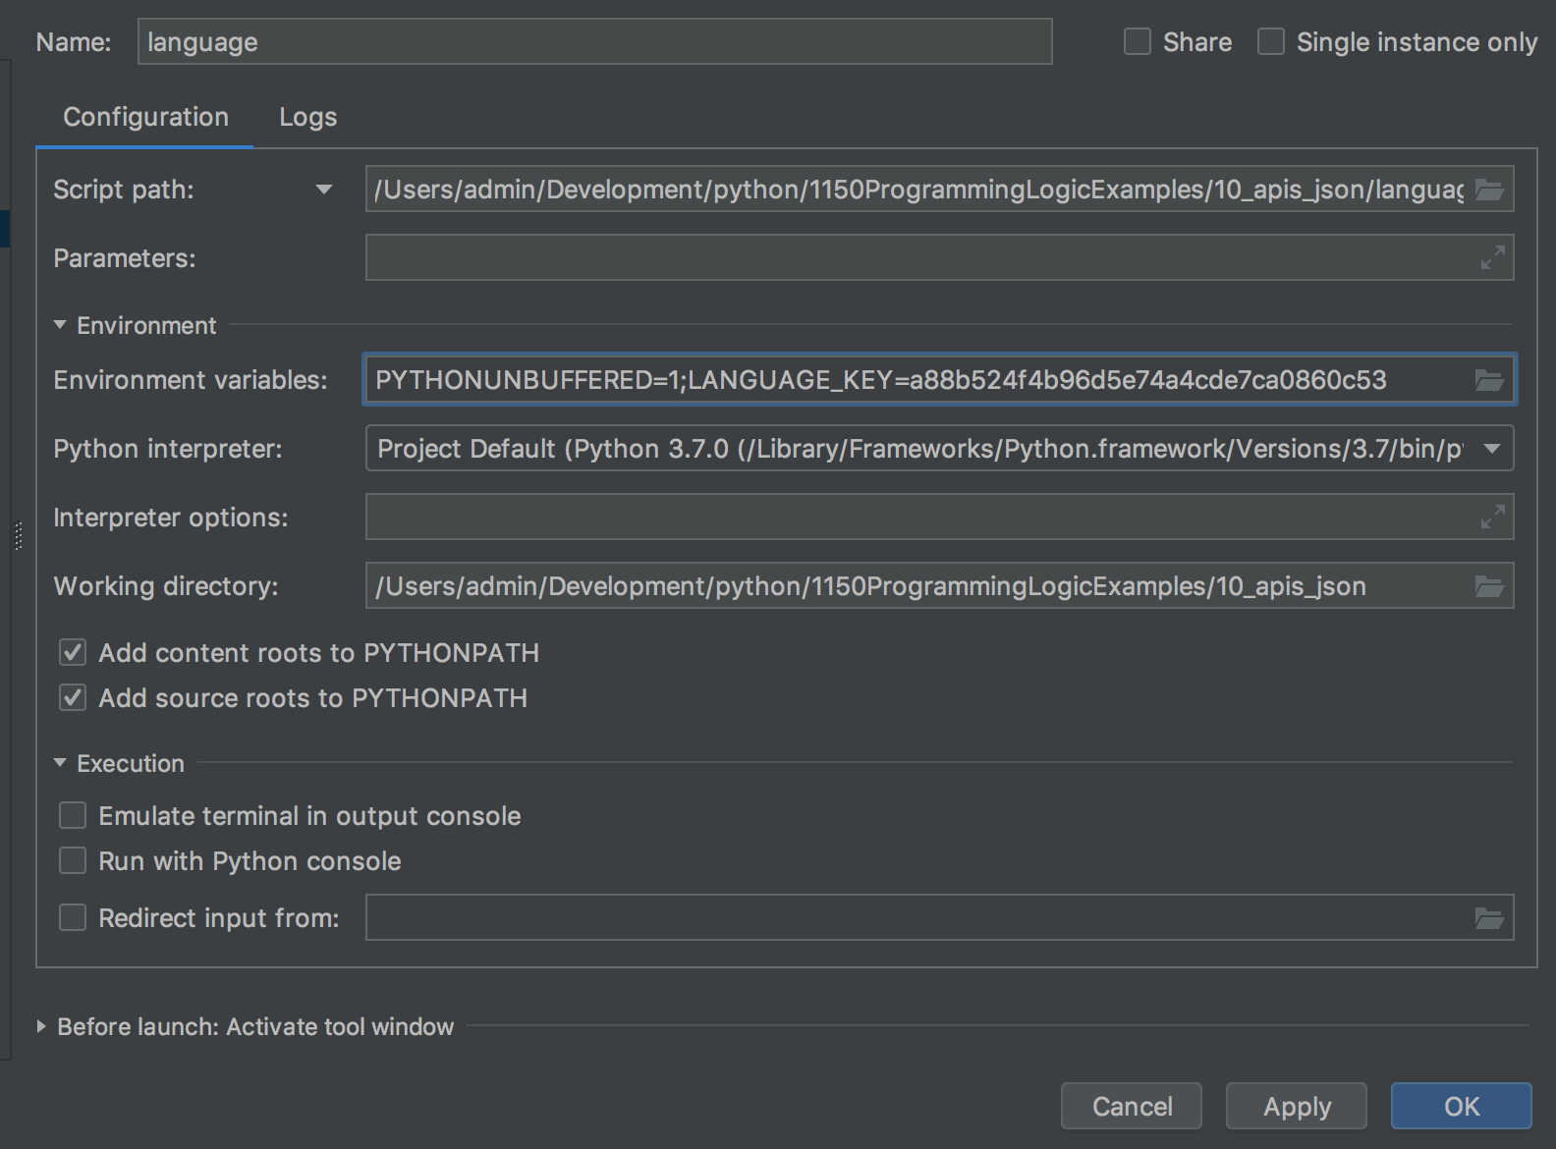
Verify key is set
Should see key in the Environment Variables
Click Apply and OK

Slide 52
Reading environment variable
import os
Instead of coding the key, read from the environment variables
Program should work as before, but your key is more secure

Slide 53
Code in the repository

Slide 54
100's of other APIs
A list https://github.com/toddmotto/public-apis

