Slide 1
Overview of Common ERP Components Part 1
Clara Rhee

Slide 2
ERP Component Categories
Exogenous sensory components
Endogenous components
Motor components
Naming Conventions
N400
P2
P300
P2 vs N400
Notes:
Exo: 자극이 있을 때 무조건적으로 trigger 되는 component
Endo: neural process를 나타냄, 과제에 따라 달라짐
Motor: motor response의 준비와 반응을 나타냄
자신이 관심이 있는 component가 아니더라도 모두 알고있어야함
N400: negative component peak at 400ms
P2: second major positive peak (ordinal position of the peak within the waveform)
P300: 350ms~600ms, but peaked at 300ms when first discovered
Visual P2 and auditory P2 mean different things but N400 means the same thing in both auditory and visual

Slide 3
Contingent Negative Variation (CNV)
Stimulus-preceding negativity (SPN)
Notes:
Negativity between warning signal and target signal
After presentation of the warning stimuli, the negativity returns to baselevel
And preceding the target signal, there is negative phase that may reflect the response to the warning stimuli
And second negative phase is preparation for the target stimuli
Related component: SPN
These may confound the results

Slide 4
Visual Sensory Responses

Slide 5
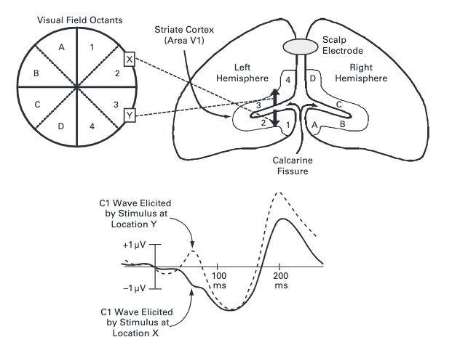
C1
Notes:
It is neither P or N because the positivity or negativity changes.
The reason for that is the location of the generated area.
C1 is generated at area V1, which is in calcarine fissure.
The area that codes the lower visual field is on the upper bank of the fissure and the area that codes the upper visual field is in the lower bank
As a result, the voltage recorded from an electrode above the calcarine fissure is positive for stimuli in the lower visual field and negative for the upper visual field
C1 makes a great example for localizing ERP component because it shows how hypotheses that C1 comes from area V1 were validated
Since the polarity for upper vesus lower field stimuli were inverted, with the known anatomy of visual cortex, there were no other areas that was folded except V1

Slide 6
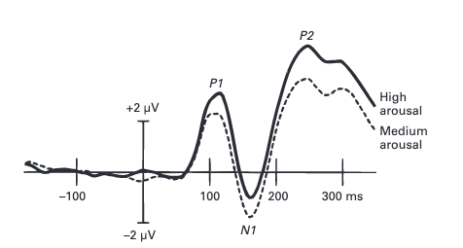
P1
C1 is followed by P1
60-90ms poststimulus with peak between 100 and 130 ms
Onset is hard to assess
Modulated by selective attention & state of arousal
Notes:
C1 is followed by P1
P1 appears 60-90ms after the stimulus is presented and peak between 100 and 130ms
Because it overlaps with C1, it is difficult to assess the onset time.
P1 is modulated by selective attention and state of arousal.
The picture here shows how the participant’s state of arousal affects P1
Medium arousal → respond as quickly as possible
High arousal → same instruction + gave feedback of their RT
Therefore, when designing ERP experiment, you should control for arousal

Slide 7
N1
P1 is followed by N1
Subcomponents
Earliest → peaks 100-150ms at anterior electrode sites
Two posterior → peak 150-200ms from parietal cortex and lateral occipital cortex
All subcomponents are influenced by spatial attention
Highly refractory
Notes:
P1 is followed by N1.
N1 consists of 3 subcomponents. → read
All subcomponents are found to be influenced by spatial attention.
In addition, the lateral occipital N1 subcomponent appears to be larger when subjects are performing discrimination tasks than when they are performing detection tasks
The visual N1 compoenent is highly refractory. If a stimulus at a particular location is preceded by another stimulus at the same location at a short delay, the response to the second stimulus is greatly reduced

Slide 8

N170 & Vertex Positive Potential
VPP: Difference from 150 to 200ms at vertex site in response to faces and non-face stimuli
N170: Faces elicit a more negative potential than non-face at lateral occipital electrode sites
Notes:
VPP is the difference ~~~. The vertex site is the Cz electrote at the very top of the head
Faces elicit a more negative potential than non-face stimuli at lateral occipital electrode sites, especially over the right hemisphere.
This is N170 wave. It is likely that N170 and VPP are just the opposite sides of the same dipole.
The Key question is whether the N170 effect truly reflects face-specific processing or whether it reflects low-level properties that just happen to be more prominent in faces, Although several research have found that this effect is truly related to face perception

Slide 9
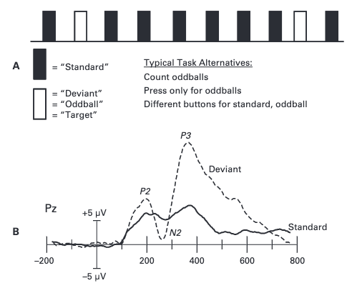
P2
P2 follows N1 wave
Larger for stimuli containing target features
Enhanced when the targets are relatively infrequent
Notes:
In the picture, B shows data from Cz electrode site in visual oddball paradigm

Slide 10
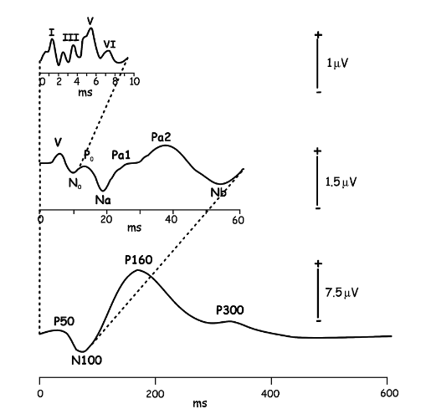
Auditory Sensory Responses
Subcomponents
Frontocentral component
Vertex-maximum potential
Laterally distributed component
Notes:
When a stimulus has a sudden onset (like a click), a distinctive set of peaks are seen over the first 10 ms.
This reflects the flow of information from the cochlea thru the brainstem and into the thalamus
This is called the auditory brainstem response (ABRs) and are labeled with roman numerals.
This process is highly automatic and are used to assess the integrity of auditory pathways, especially in infants in clinical settings
Midlatency responses (MLRs) follow ABRs.
MLRs start from medial geniculate nucleus and to primary auditory cortex.
And then comes the long-latency responses that begin with P50, the P1, to N100 (N1), and to P160(P2)
Long-latency auditory responses are strongly influenced by high-level factors, such as attention and arousal.
Midlatency and long-latency auditory responses become smaller when the interval between successive stimuli decreases with long refractory periods. Therefore, when evaluating an ERP study, it is important to assess if the difference between conditions might be confounded by differences in interstimulus interval.
Like visual N1, auditory N1 has several subcomponents.
First, frontocentral component peaks around 75ms and appears to be generated in auditory cortex on the surface of temporal lobes
Second, the vertex-maximum potential of unknown origin that peaks around 100ms
And laterally distributed component that peaks around 150ms and appears to be generated in the superior temporal gyrus
N1 is very sensitive to attention.
As you can see in the picture, visual ERP waveforms tend to be narrower in the beginning and broadens with time.
This is because ABR peaks last for only 1-2ms each, whereas MLR peaks last 10-20ms each. And some cognitive peaks like P3 last for several hundred ms.

