Slide 1
Overview of Common ERP Components Part 2
Clara Rhee

Slide 2
The P3 Family

Slide 3
Varieties of P3 Components
P3a: Frontally maximal
P3b: Parietally maximal
Frontal P3-like response
P3a = Frontal P3?
]
Unpredictable, infrequent changes in the stimuli
→
Unexpected, unusual, or surprising task-irrelevant stimulus within an attended stimulus train
Notes:
In the time range of P3, there are several distinguishable ERP components
P3a is frontally maximal and P3b is parietally maximal.
Both are elicited by unpredictable infrequent changes in the stimuli (like the oddball paradigm)
When researchers say P3 or P300, it usually means P3b
Some research has found that unexpected~~~ elicit a frontal P3-like response. However it is not clear if this is related to P3a.
Verleger, Jaskowski, Wauschkuhn found that P3b is observed for targets that are infrequent but are in some sense expected or awaited, whereas frontal P3 wave is elicited by stimuli that are truly unexpected or surprising
But it is not clear that this frontal P3 is as automatic as the P3a

Slide 4
Theories of Functional Significance
What neural or cognitive processes are reflected by P3?
Context updating (Donchin, 1981)
Working memory updating(Luck, 1998; Vogel, Luck, Shapiro, 1998; Vogel & Luck, 2002)
Strategic rather than tactical (Donchin, 1981)
Notes:
So what neural or cognitive processes are reflected by P3? We don’t know!
Most cited theory is by Donchin (1981). He proposed that P3 wave is related to process he called “context updating”
This is often interpreted as updating of working memory but it is not.
The word context here is a broad representations of the overall state of the environment, not specific representations of individual items or tasks.
However, Luck ran several experiments assuming P3 reflects working memory updating and it has led to very sensible results.
Tactical response: Sth that is done to deal with the current situation (when a pilot suddenly banks to the left to avoid a flock of birds)
Strategic response: Sth that is done to prepare for the future (when a pilot chooses a different route to avoid turbulence that is predicted to occur in an hour) Donchin claimed that P3 reflects strategic process because it frequently occurs too late to have an impact on the behavioral response.
Also, the amplitude of P3 is predictive of later memory for that stimulus

Slide 5

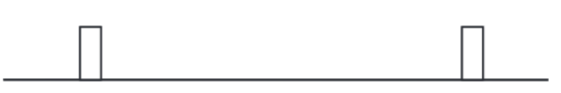
Effects of Probability
Sensitive to target probability
P3 amplitude↑ as target probability ↓
Along with overall probability, local probability matters as well
Probability of the task-defined stimulus category
A-E-A-A-A-A-A-A
A-B-E-F-G-T-Y-C
Sequential probability Temporal probability
Notes:
Although we don’t know what P3 wave means, we know what factors influence its amplitude and latency
First, amplitude is affected by target probability. P3 amplitude gets larger as target probability gets smaller.
However, it is not just the overall probability that matters. Local probability also matters. P3 wave elicited by a target becomes larger when it has been preceded by more and more nontargets.
The crucial detail is that the probability of a given physical stimulus is not the relevant factor. It’s the probability of the task-defined stimulus category that matters.
In the given examples, what the non-target is does not matter. It’s the task defined category (E or not E) that matters
For decades people thought sequential probability affects P3 amplitude. However, recent studies showed that P3 amplitude is largely dependent on temporal probability.
Sequential probability is number of stimuli in a particular category divided by the total number of stimuli.
Temporal probability is number of stimuli in a particular category divided by the time period over which the stimuli are presented

Slide 6
P3, Resource Allocation, and Task Difficulty
More effort → Larger P3 amplitude → measure of resource allocation
Uncertainty → Smaller P3 amplitude
P3 amplitude = U x (P + R)
Notes:
P3 amplitude is larger when more effort is devoted to a task. Therefore P3 amplitude can be used as a measure of resource allocation.
However, amplitude is smaller when the subject is uncertain of whether a given stimulus is a target or nontarget.
Thus, if a task is more difficult, this might increase P3 amplitude by more effort put into the task but it might decrease amplitude by making subjects less certain of the category of a given stimulus.
Consequently, there is no simple rule for determining whether P3 amplitude will get larger or smaller for more difficult tasks.
Johnson proposed that Probability, Uncertainty, and Resource allocation combine to influence P3 amplitude

Slide 7
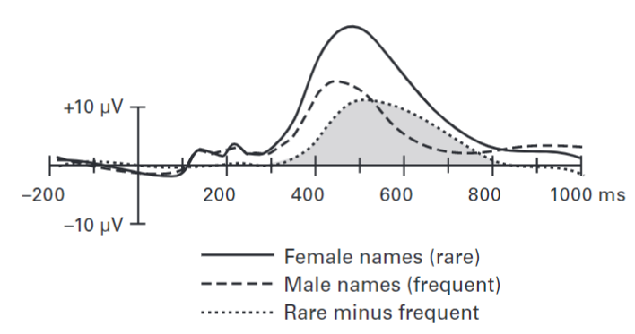
P3 Latency and Stimulus Categorization
Kutas et al. (1977)
Notes:
In the experiment by Kutas et al., the subjects were instructed to categorize the presented name as male or female. Male names were more frequent and female names were rare. Each name occurred only once.
The graph shows that the difference between the two categories deviated from 0 at approximately 300 ms.
This provides evidence that brain had begun to determine the category of the names by 300ms The difference in onset time reflects the processing and determining if the stimulus is rare or frequent.
The most widely accepted theory about the latency was that it reflects stimulus evaluation time.
The P3 on rare trials reflects surprise and before a stimulus can surprise, it must be identified first. Therefore, the late onset of rare trials reflect the evaluation time.
The Donchin lab however focused on the peak rather than the onset time and focused on P3 rare rather than the difference wave.
They argue that the onset of difference in rare and frequent waves is late because the difference cannot occur until after the brain has begun to determine whether the stimulus falls into the rare category or the frequent category.

Slide 8
P3 Latency and Stimulus Categorization
Response selection
Categorization must occur before P3
Notes:
The subject saw two targets on each trail separted by a variable SOA.
They made speeded responses to both targets. At short SOAs, the brain will be busy processing the first target when the second target appears. This delays the rt to the second target
Pashler theorized that this delay reflects a postponement of response selection, which is the process of determining which response should be made once the stimulus has been identified
This process comes after identification and categorization of the target.
If this theory is correct, then these earlier processes shouldn’t be delayed by short SOAs. So they took 2 versions of the task where one had second target being rare and the other frequent.
The P3 latency indicated that the RT slowing was mainly due to slowing of processes that follow stimulus categorization, not stimulus categorization itself.
This shows that P3 component itself does not arise from the process of categorizing the stimulus. The categorization must occur before P3.
In ERP experiments, like this example, the component can be used to assess the timing of processes that must have occurred prior to the time at which the waveforms diverge.
In this case, we don’t need to know what cognitive process the component reflects.

Slide 9
P3 and Postcategorization Processes
P3 latency is sensitive only to the time required to perceive and categorize the stimulus
P3 latency (measured by onset) reflects the time required to categorize a stimulus and insensitive to response-related processes
Notes:
Although onset of rare-minus-frequent difference must follow stimulus categorization, this does not tell us whether P3 latency depends on postcategorization processes.
Several studies have found that P3 latency is sensitive only to the time required to perceive and categorize the stimulus and is not sensitive to the amount of time required to select and execute a response once a stimulus has been categorized.
When subjects press RIGHT hand button for stimulus on the RIGHT and LEFT hand button for stimulus on the LEFT, P3 latency is no faster or slower than when they are asked to do the opposite.
However, when the stimulus is perceptually degraded, the P3 latency is delayed for these stimli

Slide 10
P3 and Schizophrenia
Auditory oddball paradigm where participants silently count the rare stimuli
Cannot draw a precise and broadly meaning conclusion
Does P3 reflect auditory-specific processes?
Notes:
For people with schizophrenia, P3 is often used as a biomarker.
Most studies use auditory oddball paradigm and have them silently count the rare stimuli.
The peak amplitude of the P3 elicited by the rare stimuli is reduced for people with schizophrenia.
This result have a large effect size and exhibits excellent stability and reliability, hence they are often used as a biomarker.
However, because we do not know what P3 reflects, we cannot draw~~~~~

