Slide 1
Dating Textual Documents
Beau, Clara, Sunny

Slide 2
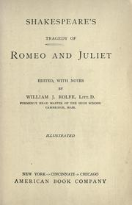
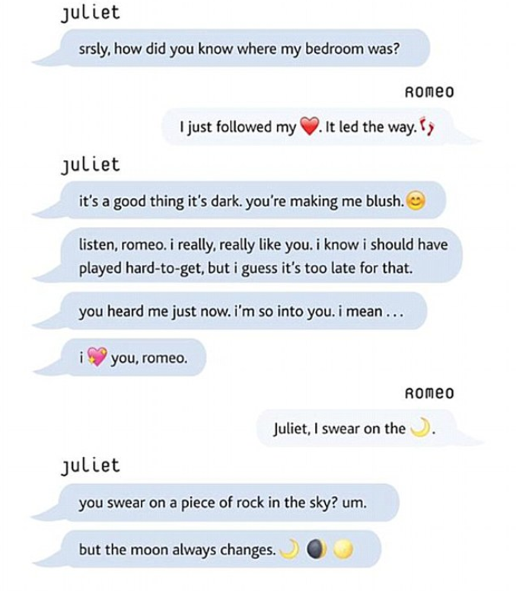
The prediction we hope to make
Given a short text in English, predict the year (or the decade in which) it was written.
Classification problem
Originally published: 1597

Slide 3
The plan for solving the problem
Our data set: 1000+ fiction books (retrieved from the corpora gutenberg.org)
For each text in our data set, we look for the following features:
Distribution of word frequency
Specific words are used
Specific phrases
Sentence length
Use of punctuation

Slide 4
Data sources
Free online book rescues
gutenberg.org (over 50,000 books)
Publication dates
Goodreads
Word frequencies
Google n-grams

Slide 5
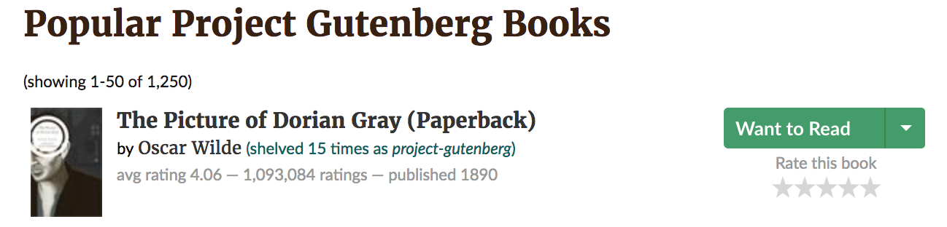
Data cleaning: currently done?
Scraping with publication dates from gutenberg.org
Simple tokenization of text
from nltk.tokenize import TweetTokenizer

Slide 6
Data cleaning: Next goal
Correctly parse the Gutenberg catalog to match with the scraped Good read book titles
Good Read book titles: 1,250 books
Gutenberg Catalog: over 50,000 books
Merged titles: 530 books
Identify which Gutenberg books in current merge is in English

Slide 7
Data cleaning: Next goal
Correctly parse the Gutenberg catalog to match with the scraped Good read book titles
Good Read book titles: 1,250 books
Gutenberg Catalog: over 50,000 books
Merged titles: 530 books
Identify which Gutenberg books in current merge is in English
Identity what need to parse: sentence structure, phrases, noise, etc

Slide 8
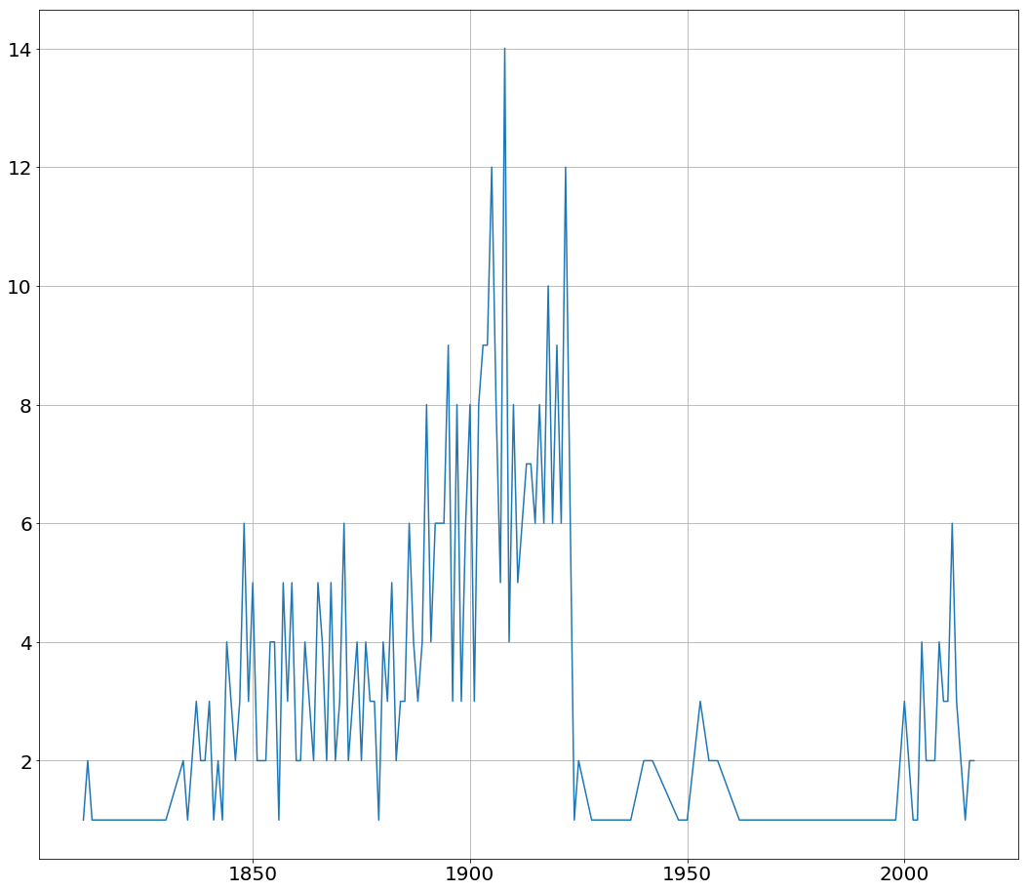
Distribution of books in terms of time period of publishing year

Slide 9
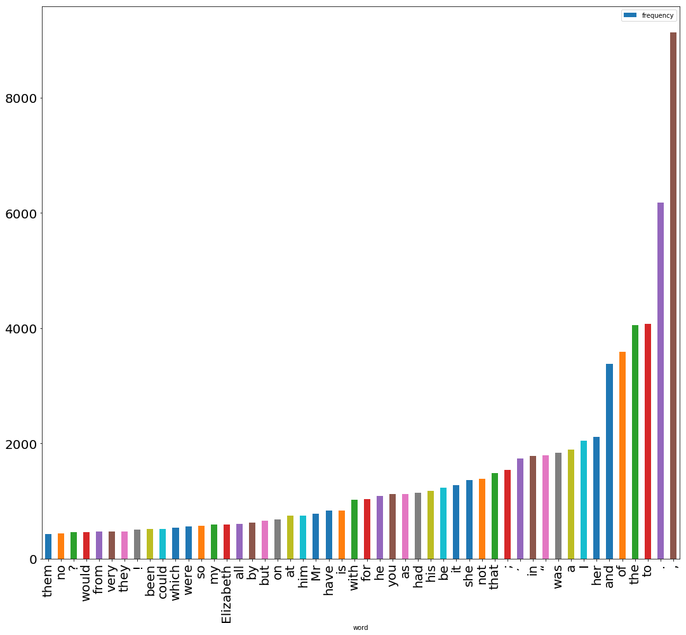
The frequency of the 50 most common words in ‘Pride and Prejudice’

