Slide 1
TETRIS
Now with 100% more worms…

Slide 2
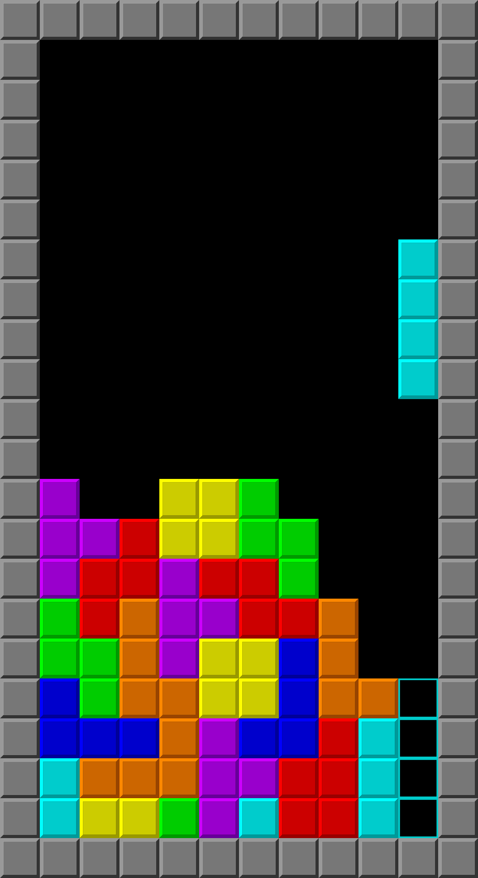

Have you ever been playing Tetris and thought to yourself…
Where are all the worms?!

Slide 3
Look no further!!

