Slide 1
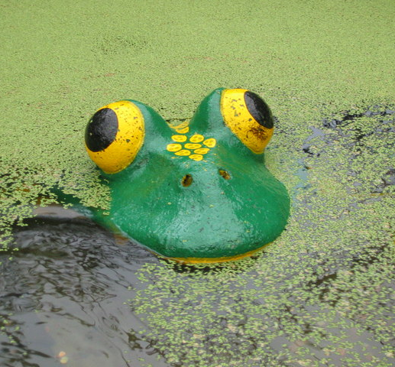
Mcpuddock development
Oleg
Jake
Luca
Clara

Slide 2
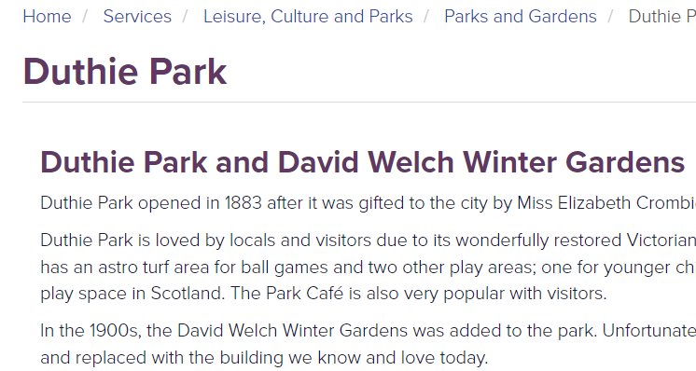
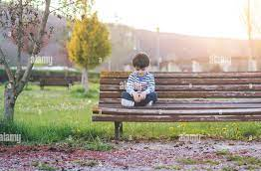
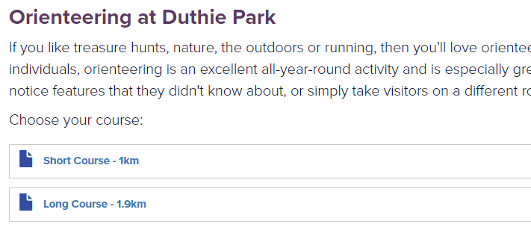
The Current Duthie Park website

Slide 3



Our Aims
Functionality
Interactivity
security

Slide 4
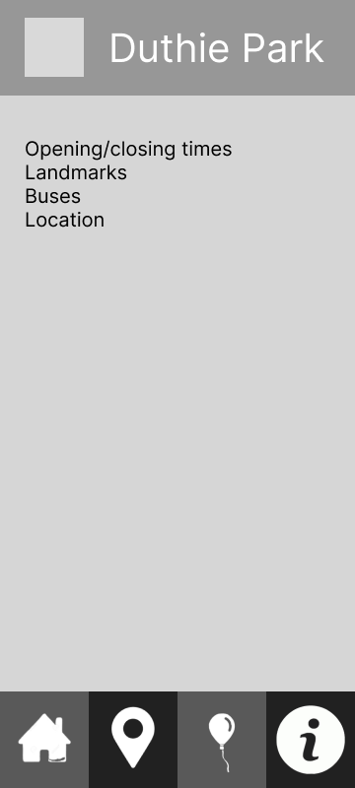
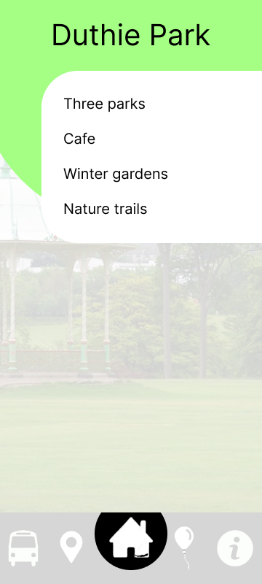
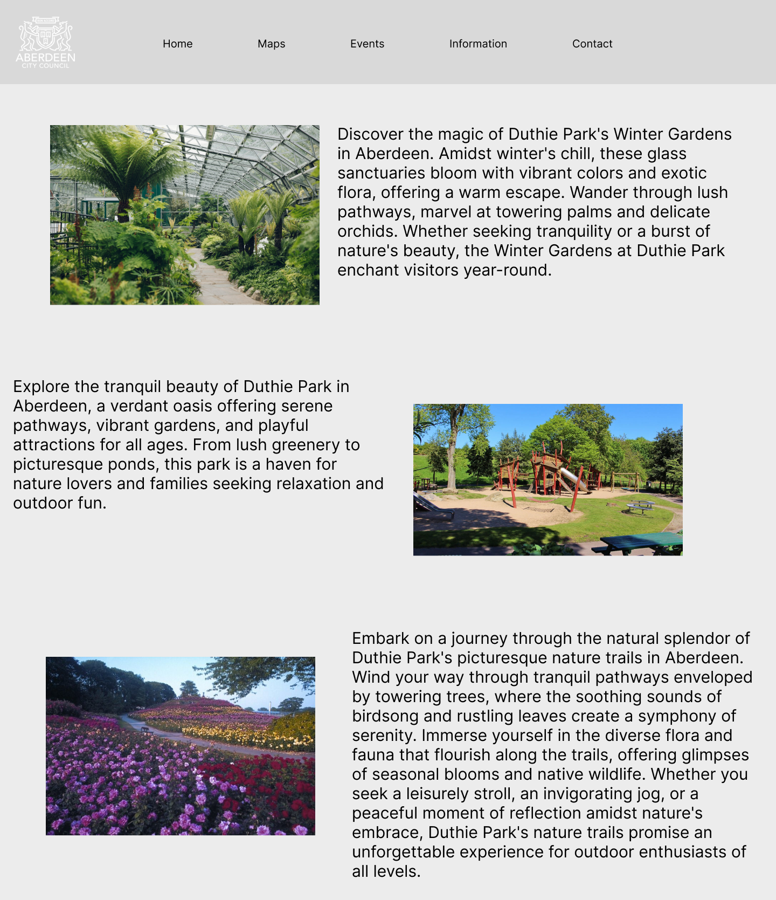
prototyping
Wireframing
Designing
Cross- compatibility

Slide 5
Interactive Maps
map markers
Augmented Reality
Implemented Open Street Map API
Click on the markers to view information about each location
Use the camera function to view the world in AR
See if you can find the hidden objects

Slide 6

Website redesign
Html / css
ejs
APIs
Add content including text, maps, and images to the website
Website styled to match the visuals of the Aberdeen council
Used to structure and re-use code blocks for fast prototyping
Use of external libraries to add additional data including temperature, calendars and interactive maps

Slide 7
Weather & Travel
forecasts
Bus Routes
View the weather forecast up to a week ahead to plan when you go
Plan your route beforehand by viewing the available buses

Slide 8
Demonstration

Slide 9
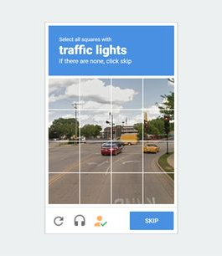
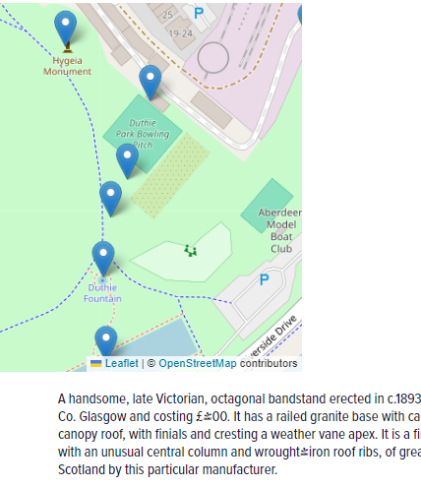
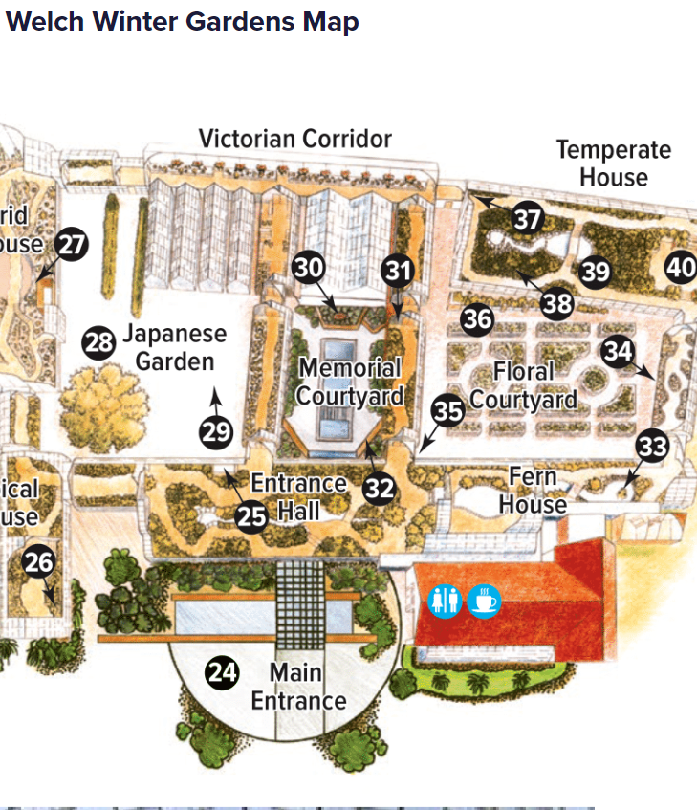
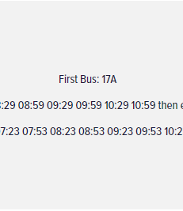
SUMMARY
This new redesign implements html, css, and ejs to create a modern layout that utilises interactive maps, captchas, AR, and calendars to seamlessly plan a day out to Duthie park

Slide 10
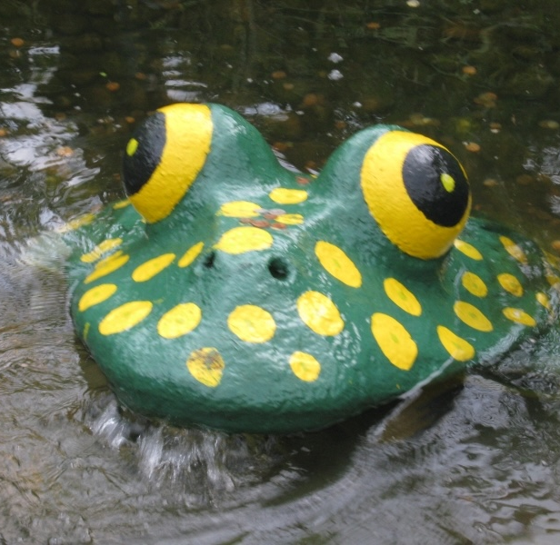
A website with an intuitive and fun design to help navigate Aberdeen’s Duthie Park
McPuddock Development
https://github.com/clararingrose/rguhack2024

