Slide 1
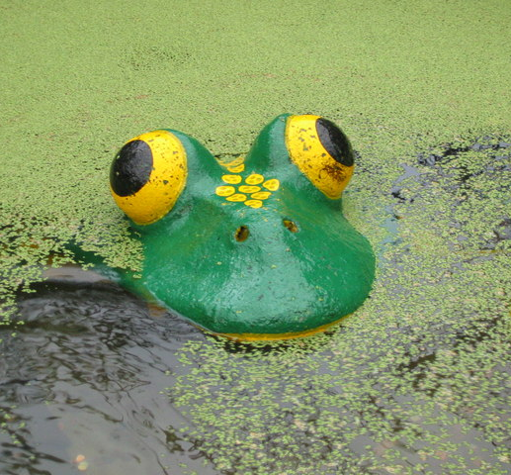
Mcpuddock development
Oleg
Jake
Luca
Clara

Slide 2
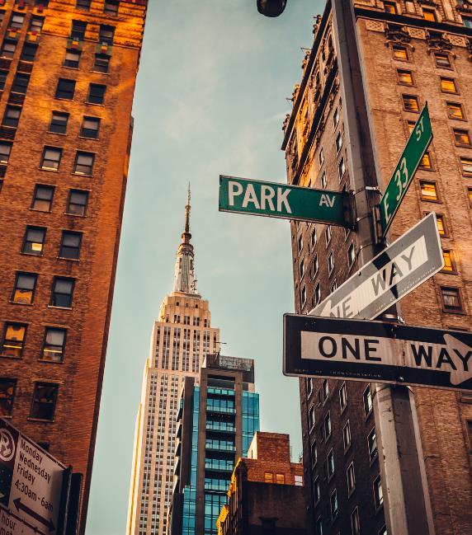
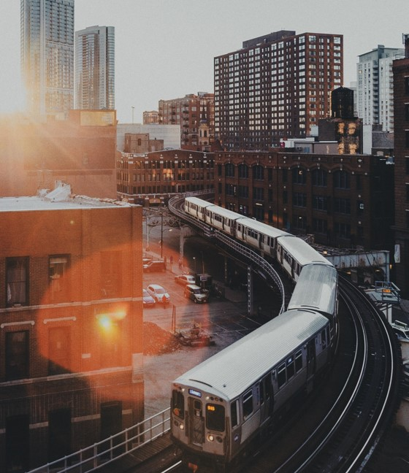
AGENDA
Duthie park website
The idea
Final product

Slide 3
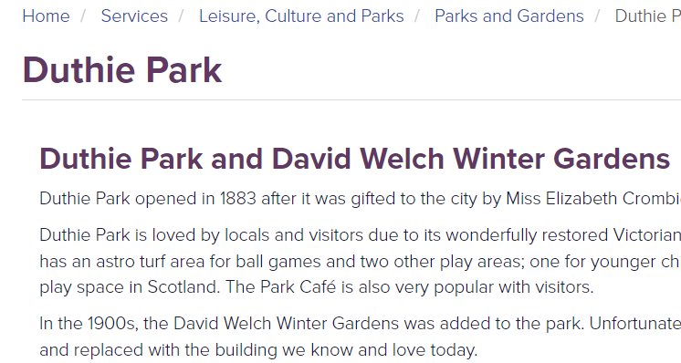
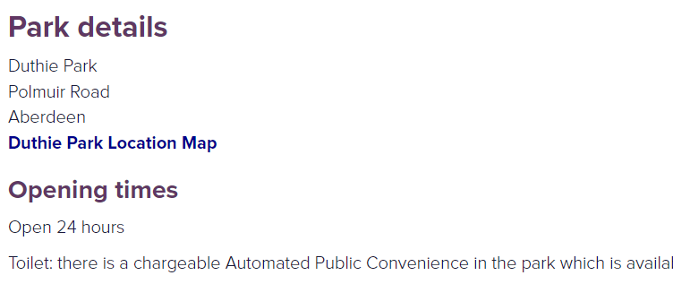
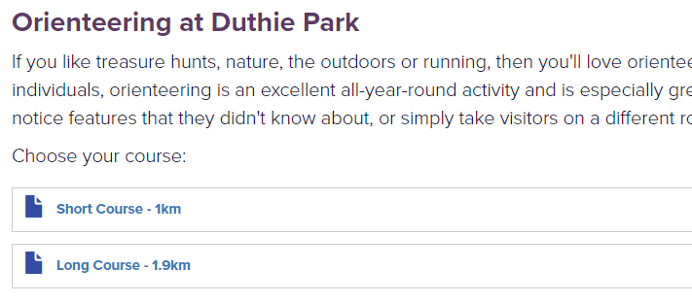
The Current Duthie Park website

Slide 4
Our Aims
Improve layout
Add interactable maps
Make information easily accessible

Slide 5
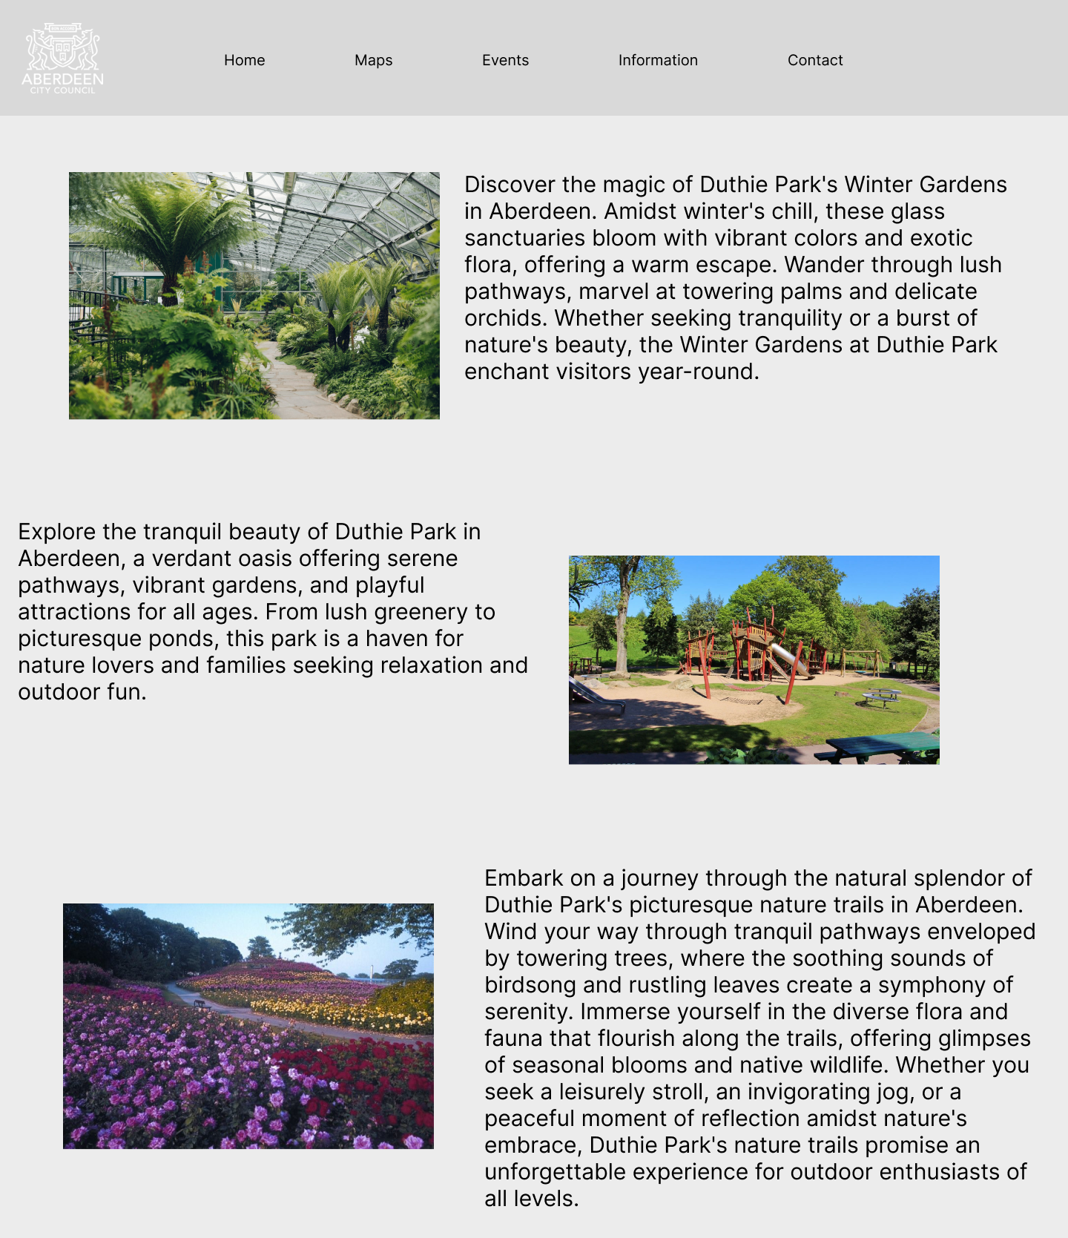
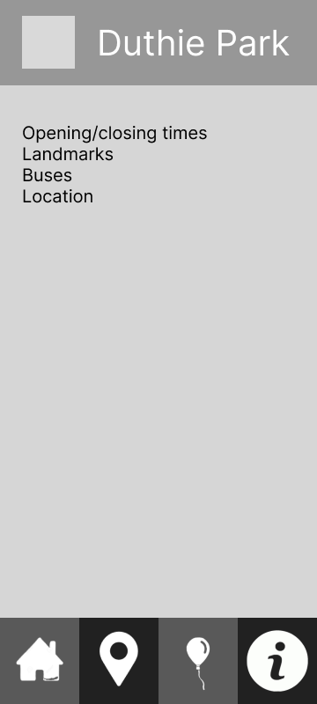
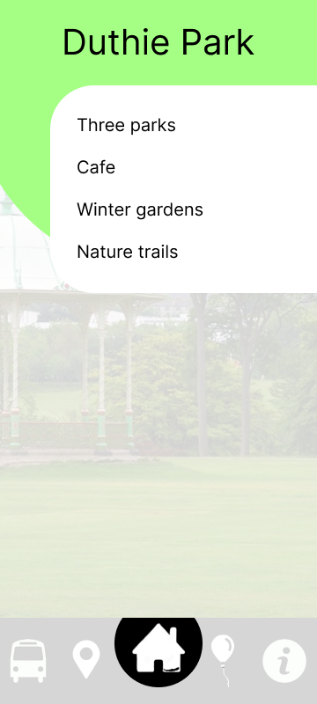
prototyping

Slide 6
Interactable Maps
Selecting map markers
Integrating with website
Add text, images, art, and videos.
Add transitions, animations, and motion.
Save to OneDrive, to get to your presentations from your computer, tablet, or phone.
Open the Design Ideas pane for instant slide makeovers.
When we have design ideas, we’ll show them to you right there.

Slide 7
Website Design
html
ejs
css
Add text, images, art, and videos.
Add transitions, animations, and motion.
Save to OneDrive, to get to your presentations from your computer, tablet, or phone.
Open the Design Ideas pane for instant slide makeovers.
When we have design ideas, we’ll show them to you right there.
This PowerPoint theme uses its own unique set of colors, fonts, and effects to create the overall look and feel of these slides.
PowerPoint has tons of themes to give your presentation just the right personality.

Slide 8
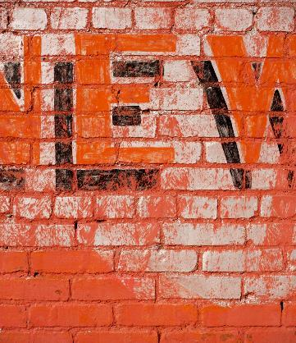
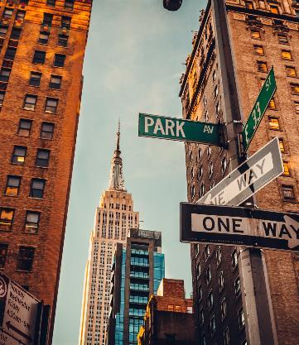
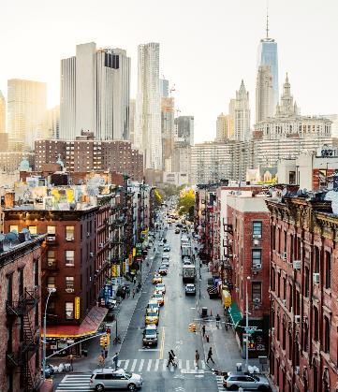
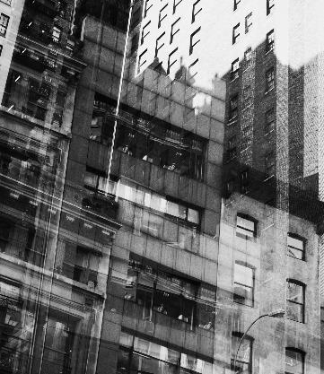
SUMMARY
With PowerPoint, you can create presentations and share your work with others, wherever they are. Type the text you want here to get started. You can also add images, art, and videos on this template. Save to OneDrive and access your presentations from your computer, tablet, or phone.

Slide 9
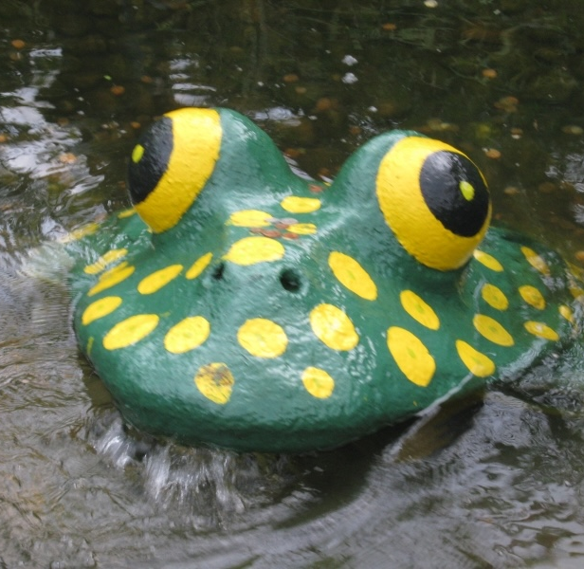
An intuitive and innovative design to help navigate Aberdeen’s Duthie Park
McPuddock Development
https://github.com/clararingrose/rguhack2024

