Slide 1
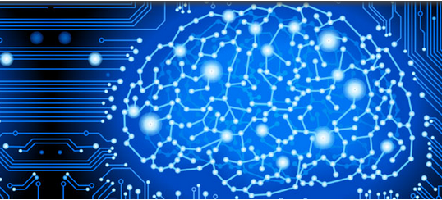

NeuroMiner®
machine learning for precision medicine
V1.4
fingolfin
{devel}
© Nikolaos Koutsouleris, Clara Vetter, Ariane Wiegand, Lisa Hahn, Sergio Mena
The development of NeuroMiner has been supported by the EC under the 7th Framework Programme / Grant Agreement No. 602152

