Slide 1
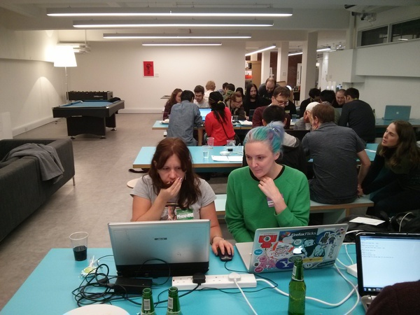
Hello!
Me (right), in deep concentration, at the London Code Dojo meetup!

Slide 2
You (the audience):
Awesome. Obv.
Drupal module dev
API user not GUI user
PHP dev

Slide 3
Summary
Exposing Data
Handlers, Plugins, Hooks
(MAYBE) Working directly with the view object and view result
Useful drush commands and views contrib modules

Slide 4
Exposing your data
hook_views_api()
hook_views_data()

Slide 5
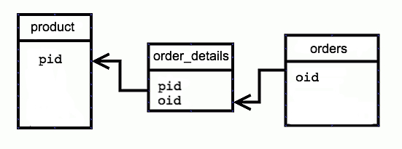

Slide 6
// 1. Base table: Product
$data['product']['table']['group'] = t('Shop');
$data['product']['table']['base'] = array(
'field' => 'pid',
'title' => t('Product'),
);
// 2. Order Details Table
$data['order_details']['table']['group'] = t('Shop');
$data['order_details']['table']['join']['product'] = array(
'left_field' => 'pid', // primary key on product
'field' => 'pid', // foreign key on order_details
);
// 3. Orders Table – note we need to use the ‘Left table’ here
$data['orders']['table']['group'] = t('Shop');
$data['orders']['table']['join']['product'] = array(
'left_table' => 'order_details',
'left_field' => 'oid',
'field' => 'oid',
);

Slide 7
Handlers
Argument - contextual filters
Filter e.g. ‘is equal to’
Field - formatting data
Relationship -Joins
Sort – er, sorting!

Slide 8
More Hooks
hook_views_data_alter()
hook_views_query_alter()

Slide 9
Plugins
Display
Style
Row Style
Argument Default
Argument Validator
Access
Query
Cache
Pager plugins
Exposed form plugins
Localization plugins
Display extenders
MORE INFO: https://api.drupal.org/api/views/
views.api.php/group/views_plugins/7

Slide 10
View objects
$view = views_get_view(‘view_name’);
views_get_view_result(‘view_name’);

Slide 11
drush
drush views-dev (vd) sets up views to be more
Developer friendly
Have a look in here!
http://drupalcontrib.org/api/drupal/contributions!views!drush!views.drush.inc/function/views_drush_command/7

Slide 12
Contrib modules
Debugging – devel_contrib – gives you a devel tab and krumo output of the view object – NICE
Alternative data sources
https://drupal.org/project/services_views
https://drupal.org/project/efq_views
Views XML Backend
https://drupal.org/project/views_xml_backend
UI to expose data (as opposed to hook_views_data)
https://drupal.org/project/views_expose_tables
Views caching
https://drupal.org/project/views_cache_bully
https://drupal.org/project/editableviews

Slide 13
Thankyou!
@nano_monkey
References:
Advanced Help Views docs – bit old now tho, it’s for version 2 of views and doesn’t cover handlers and plugins.
Views code itself - The views.api.php is a good place to learn about the hooks
https://archive.org/details/DevelopingForViews3Api
http://www.grasmash.com/article/demystifying-views-api-developers-guide-integrating-views
http://www.lullabot.com/blog/article/building-views-query-plugins Yay @heyrocker!
http://drupalize.me/series/coding-views-drupal-7
https://github.com/J7mbo/twitter-api-php - PHP Wrapper for Twitter API calls
http://drupal.stackexchange.com/questions/48039/difference-between-views-handler-and-views-plugin/53955#53955

Slide 14
One more thing!
http://www.justgiving.com
/joe-2014
London Triathlon for CALM – the Campaign Against Living Miserably!

