Slide 1
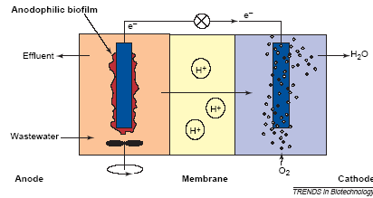
Basic MFC schematic
How can we relate current, energy, and biomass growth in this system?

Slide 2
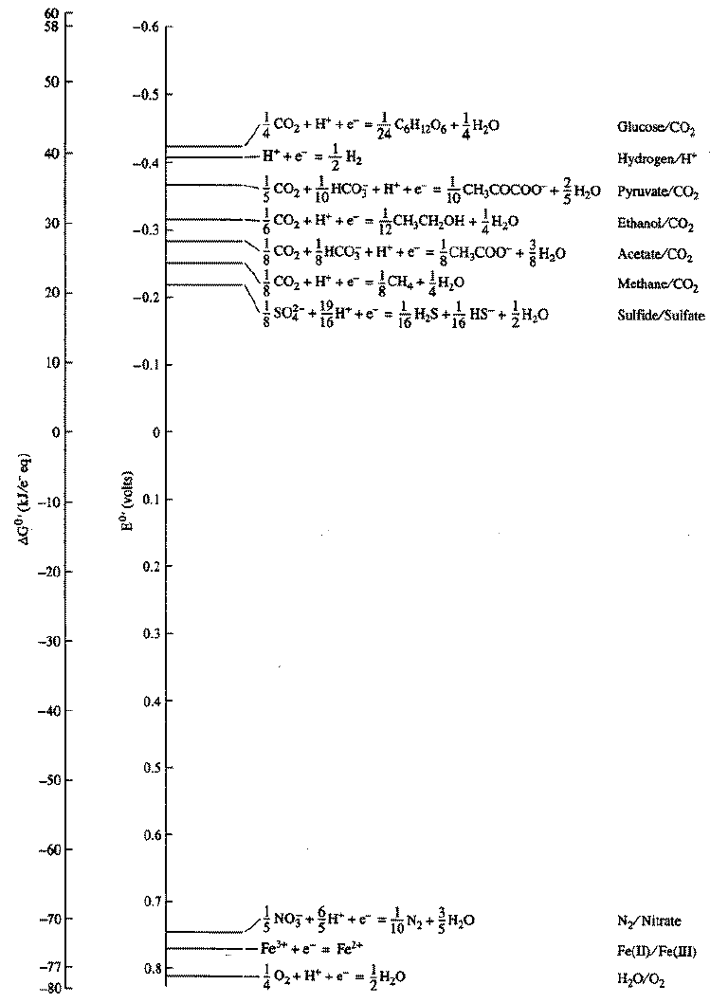
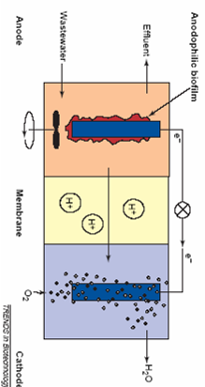
E donor
Anode voltage?
E acceptor in cathode

Slide 3
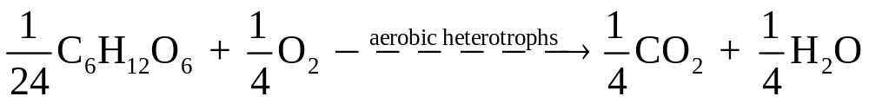
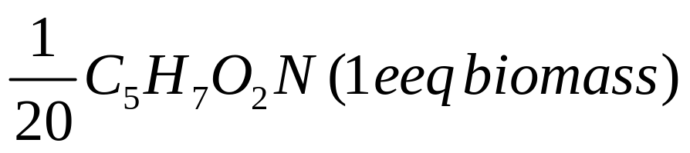
Balancing flow of eeqs to energy and to synthesis
ΔGr per eeq ED/EA coupled
ΔGp per eeq ED
1/10 CH₃COCOO– pyruvate
ΔGc (cells from pyruvate)
= + 7.5 kcal/eeq

Slide 4
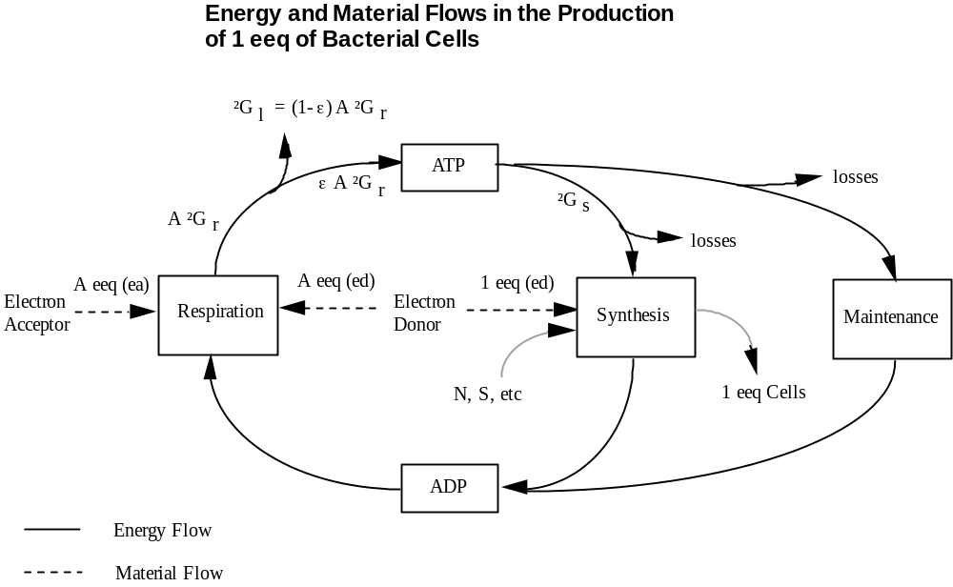
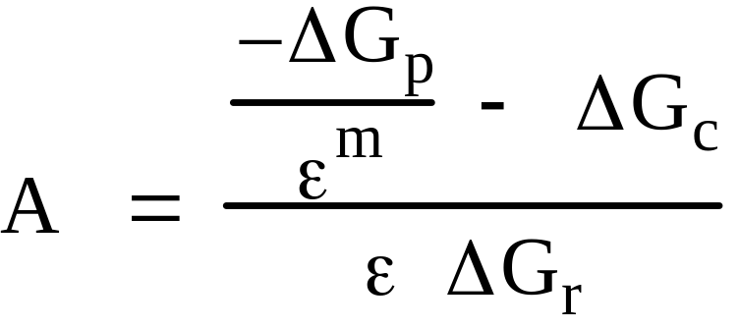
From Gossett’s CEE657 notes
m = +1 (∆Gp > 0)
m = –1 (∆Gp < 0)
in which ε = 0.6 and ∆Gc = 7.5 kcal are usually assumed.

