Slide 1
Biodegradation of Antibiotics

Slide 2
Related Learning Objectives
-Explain why it is more difficult to enrich for organisms that PRODUCE compounds of interest than those that biodegrade them (note exceptions - e.g. antibiotic production).
-Bioremediation ((discovery of biodegradation pathways)
-Recognize the challenges to biocatalysis for production of bioenergy and biochemicals of interest
IDing of orgs/genes capable of specific biosynthetic capabilities
maximizing yields and minimizing side reactions
product recovery and purification

Slide 3
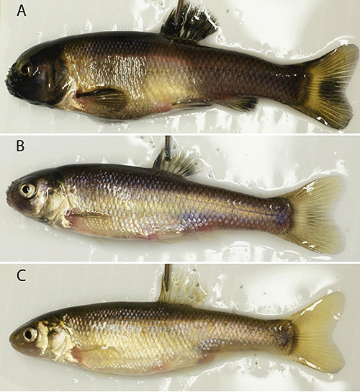
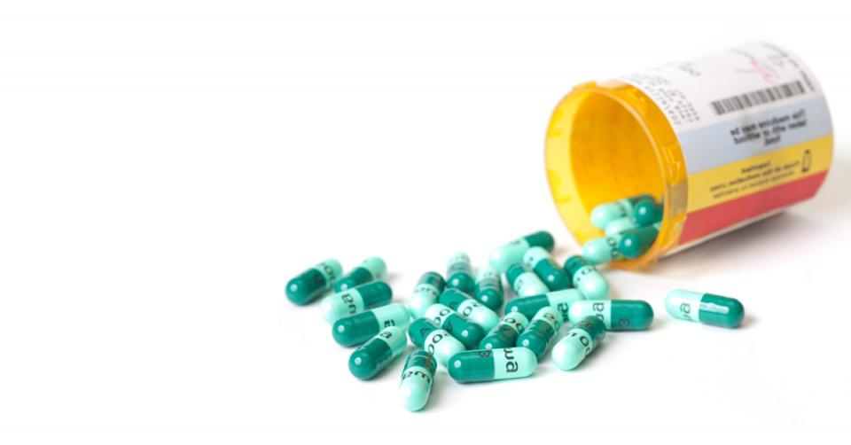
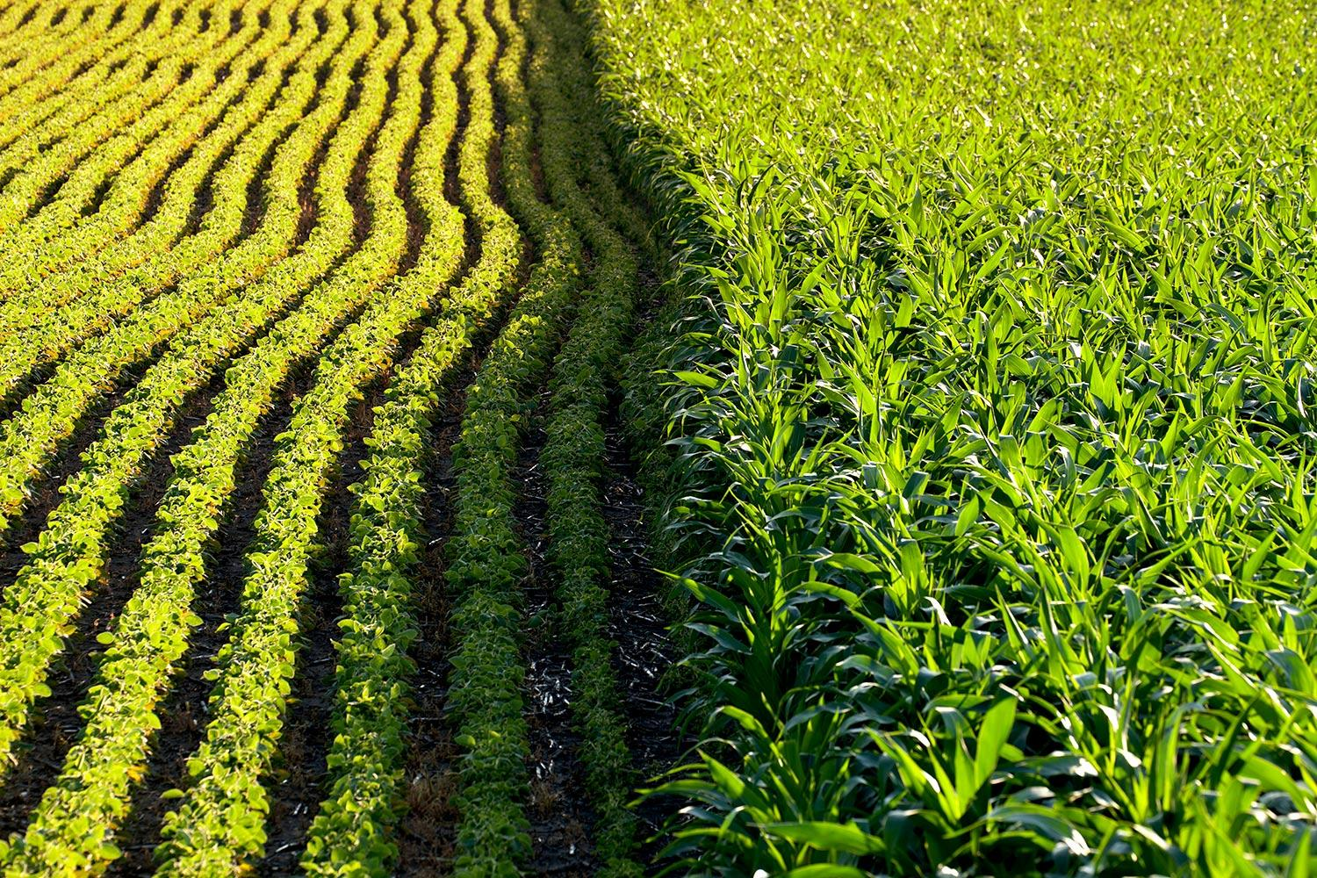
Problem
Antibiotic resistance
The mechanism is still unknown
Endocrine disruption of fish
feminization
Crop uptake + bioaccumulation
Leads to high concentrations that might be consumed
Changes in crop growth
Legume disruption in some soils

Slide 4
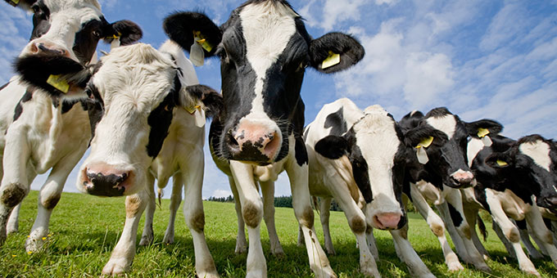
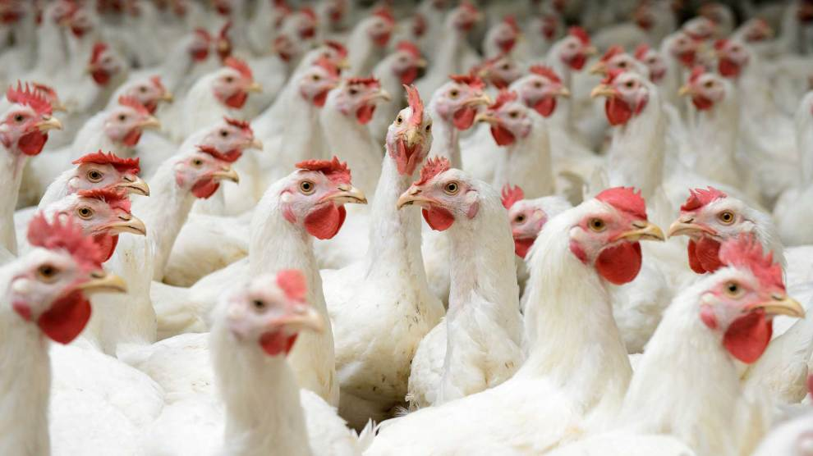
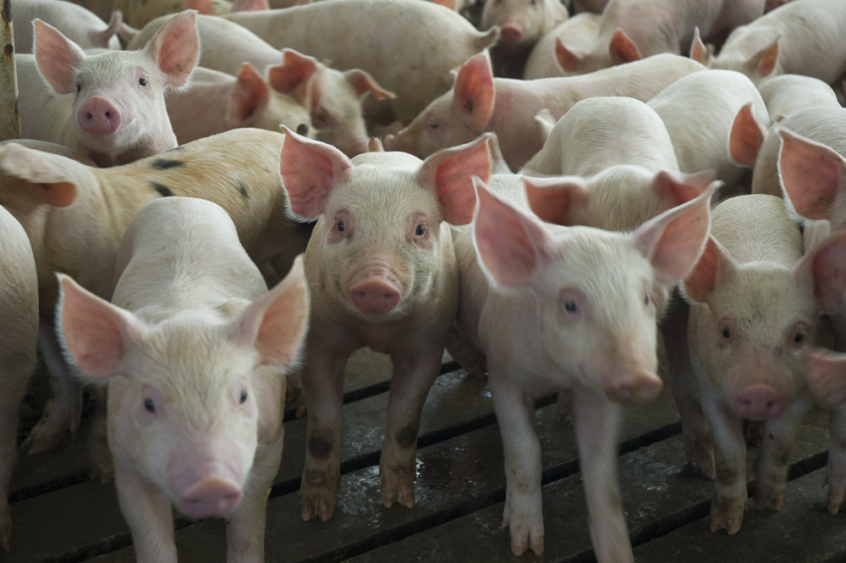
Where do they come from?
Release in waste
Human
Livestock
Industrial Waste
Ends up in many natural systems
Surface water
Soils
Sediments
Ground water

Slide 5
Current Solutions
Most are physical and chemical:
Membrane contractor processes
Activated carbon and adsorption
Ultraviolet technology
This helps in natural settings
Ozone technology

Slide 6
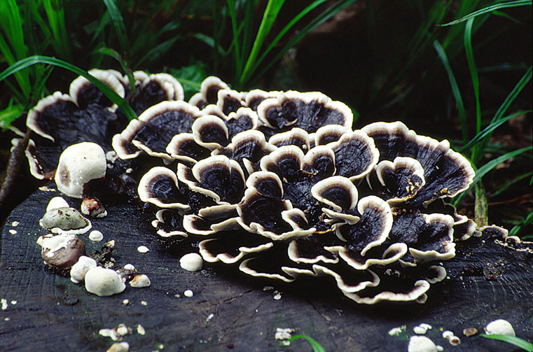

Biodegradation Solutions
Enzymes from fungus:
Usually degrades lignin on wood
Can be harvested to remove antibiotics
Manganese Peroxidase
Catalyzes:
The Mn³⁺ then chelates with the lignin

Slide 7
Biodegradation Solutions
In a wastewater system this could include adding a reactor step
Might be challenging!
Temperature dependence
Out in the environment the solution is less controlled
NPS

Slide 8
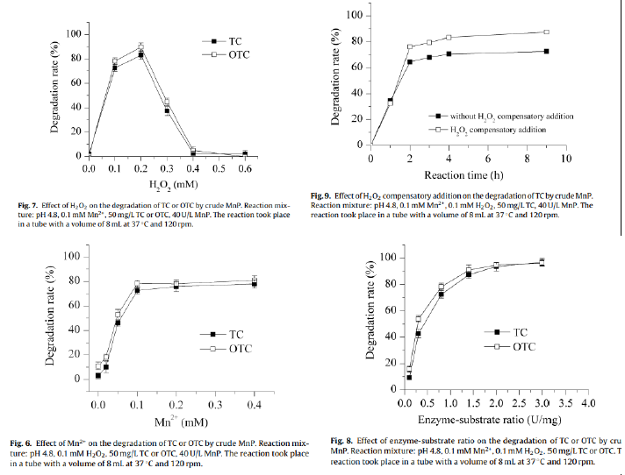
Biodegradation Solutions

Slide 9

Biodegradation Solutions
As antibiotics are still an “emerging contaminant” and a “micropollutant” there is a lot left to learn!

Slide 10
References
Wen, X., Jia, Y., & Li, J. (2010). Enzymatic degradation of tetracycline and oxytetracycline by crude manganese peroxidase prepared from Phanerochaete chrysosporium. Journal of Hazardous Materials, 177(1), 924–928. https://doi.org/10.1016/j.jhazmat.2010.01.005
Daghrir R., Drogui P.(2013)Tetracycline antibiotics in the environment: a review | SpringerLink. (n.d.). Retrieved May 17, 2018, from https://link.springer.com/article/10.1007/s10311-013-0404-8
Hu, X., Zhou, Q., & Luo, Y. (2010). Occurrence and source analysis of typical veterinary antibiotics in manure, soil, vegetables and groundwater from organic vegetable bases, northern China. Environmental Pollution, 158(9), 2992–2998. https://doi.org/10.1016/j.envpol.2010.05.023
Larsson, D. G. J. (2014). Antibiotics in the environment. Upsala Journal of Medical Sciences, 119(2), 108–112. https://doi.org/10.3109/03009734.2014.896438

