Slide 1
Classifying Macroeconomic Indicators
An exercise in using supervised machine-learning to predict recessions globally

Slide 2
What is a recession?
"a significant decline in economic activity spread across the economy, lasting more than a few months, normally visible in real GDP, real income, employment, industrial production, and wholesale-retail sales.” –NBER
“"a decline in annual per‑capita real World GDP, backed up by a decline or worsening for one or more of the seven other global macroeconomic indicators: Industrial production, trade, capital flows, oil consumption, unemployment rate, per‑capita investment, and per‑capita consumption”. –IMF
The general rule of thumb is two consecutive quarters of negative economic growth

Slide 3
What causes a recession?
A big increase in oil prices
Asset bubbles
An inverted yield curve
Notes:
oil prices has preceded nearly every U.S. recession since World War II.
An inverted yield curve has come before all recessions since 1960. This occurs when the interest on a short-term debt (say, three-month Treasuries) is higher than the interest on a long-term debt (say, 10-year Treasuries).

Slide 4
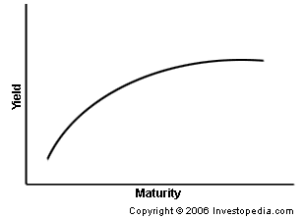
What is a Yield curve?
A yield curve is a line that plots the interest rates, at a set point in time, of bonds having equal credit quality but differing maturity dates.
Notes:
Asset bubbles and crude prices are easy to understand….but

Slide 5
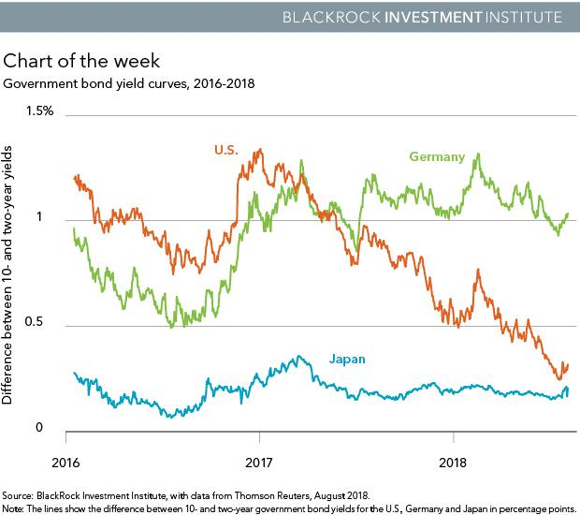

Slide 6
That means we can predict recessions right?
“Predicting recessions well in advance is notoriously difficult” –Guggenheim Partners
“Accurately predicting recessions, like accurately predicting anything, is hard to do.” St. Louis Fed
“Recessions have an annoying tendency to strike when people least expect.”—Noah Smith, Bloomberg News

Slide 7
What happens when economist try to predict recessions?
In 2008, the economic recession of 2008/09 was not being predicted
Over a three quarters ahead horizon, the mean prediction made for GDP growth has never been negative.
The correlation between forecast and data is very low, and over the most recent 25 years is not significantly different from zero.
“while forecasters are generally aware that recession years will be different from other years, they miss the magnitude of the recession by a wide margin until the year is almost over.” --iMF

Slide 8
The Data
Jordà-Schularick-Taylor Macrohistory Database
Covering 17 advanced economies 1870-2016
25 macro-economic variables
DataBankWorld Development Indicators
Custom Index of 20+ macroeconomic features
Retained 2500 rows x 29 features for initial exploratory data analysis (< 3% nulls)

Slide 9
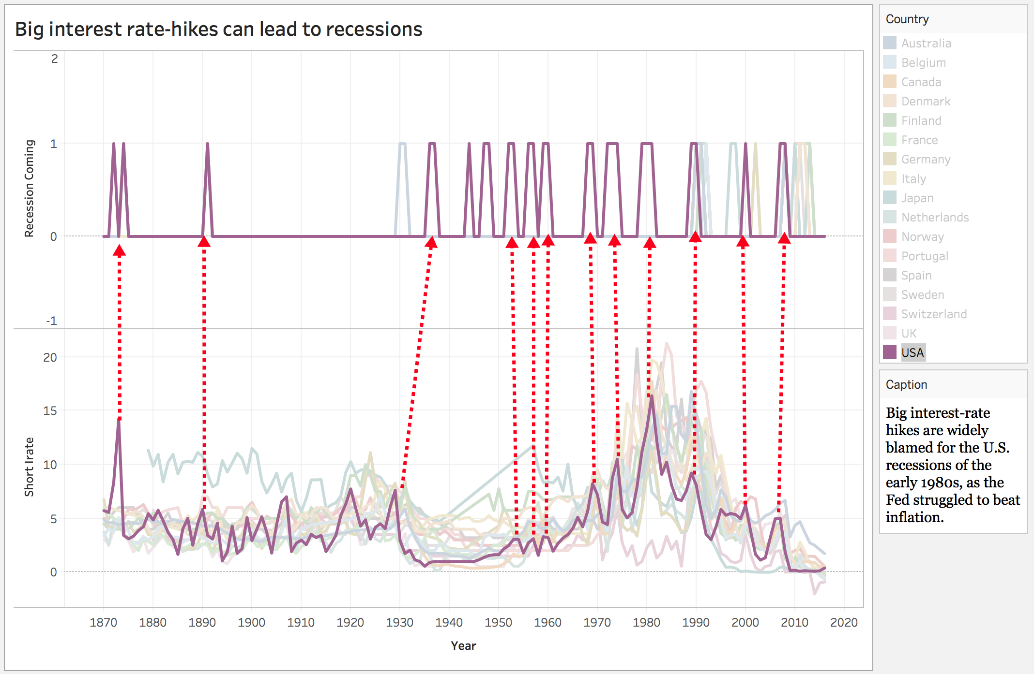

Slide 10
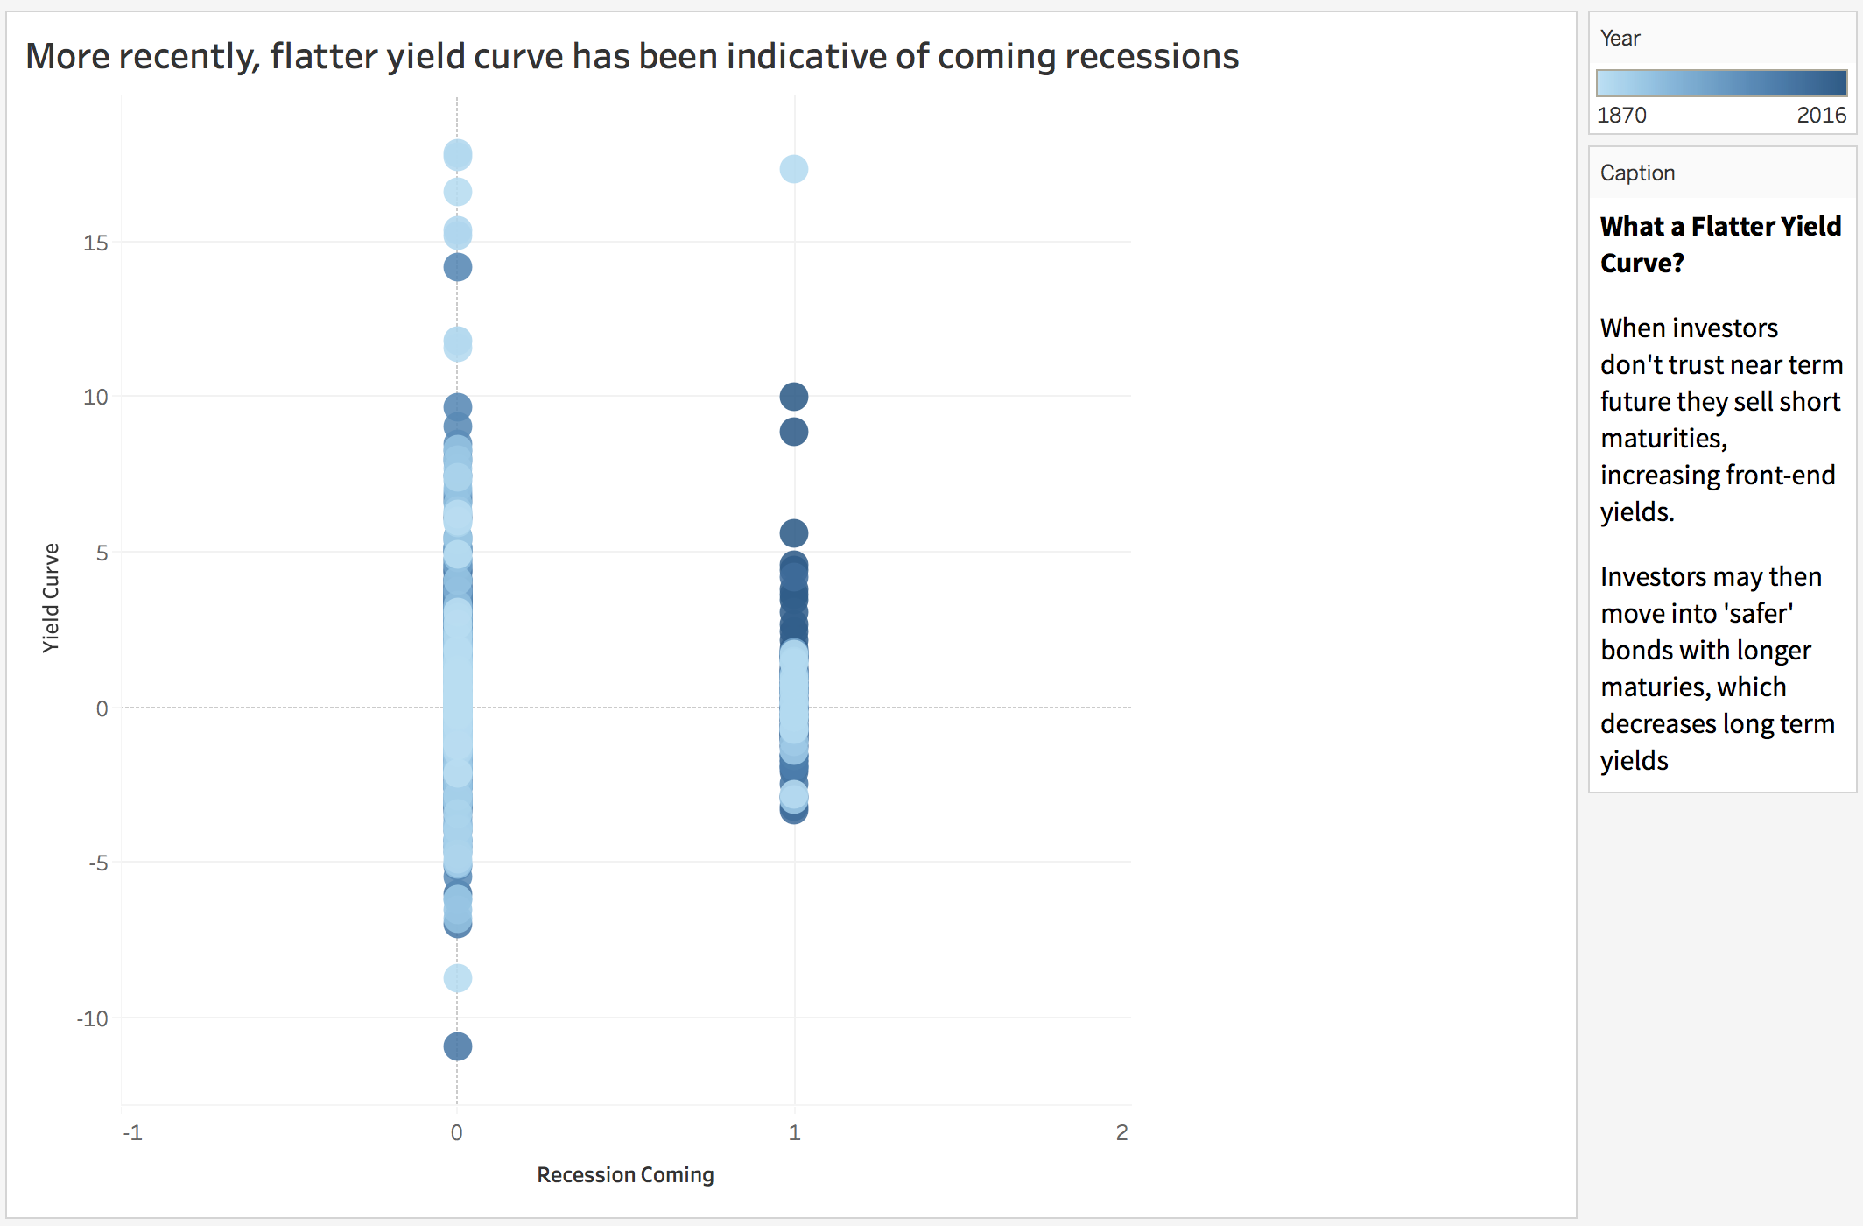

Slide 11
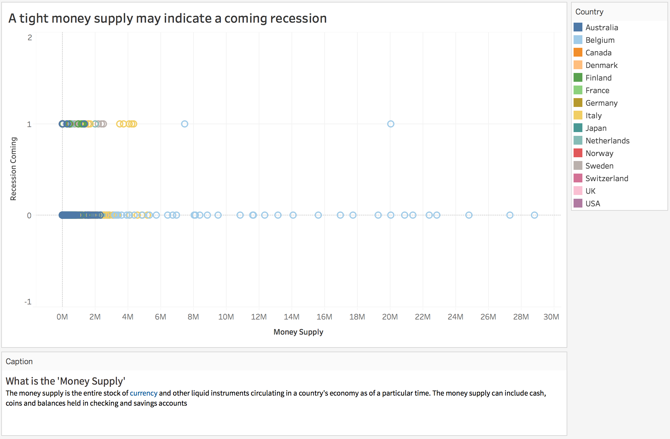

Slide 12
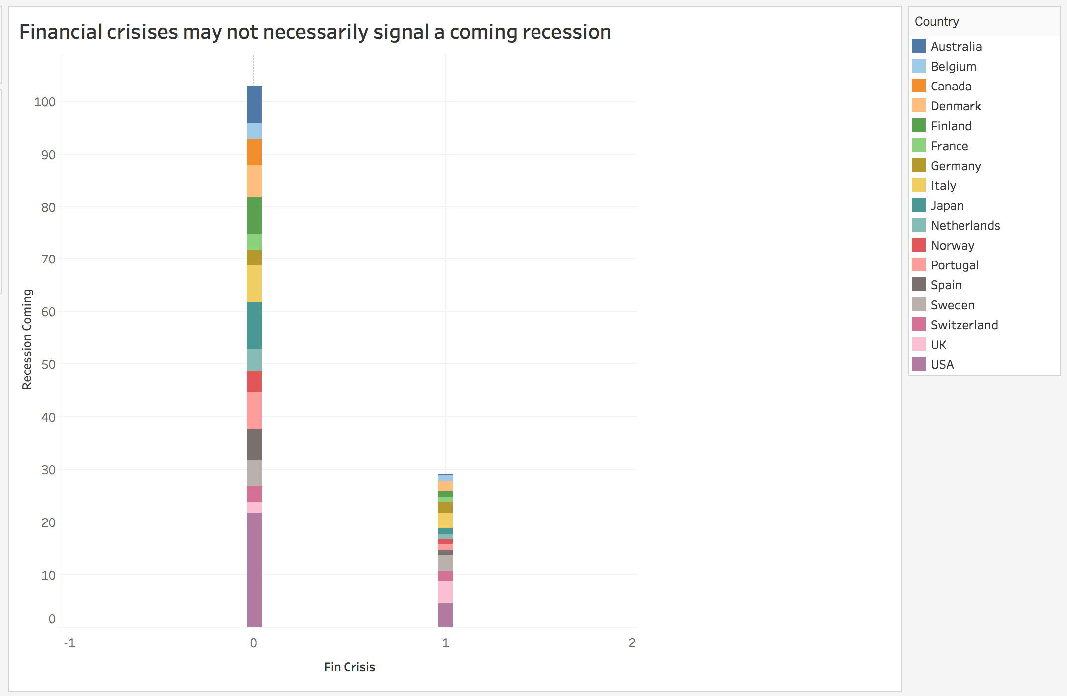

Slide 13
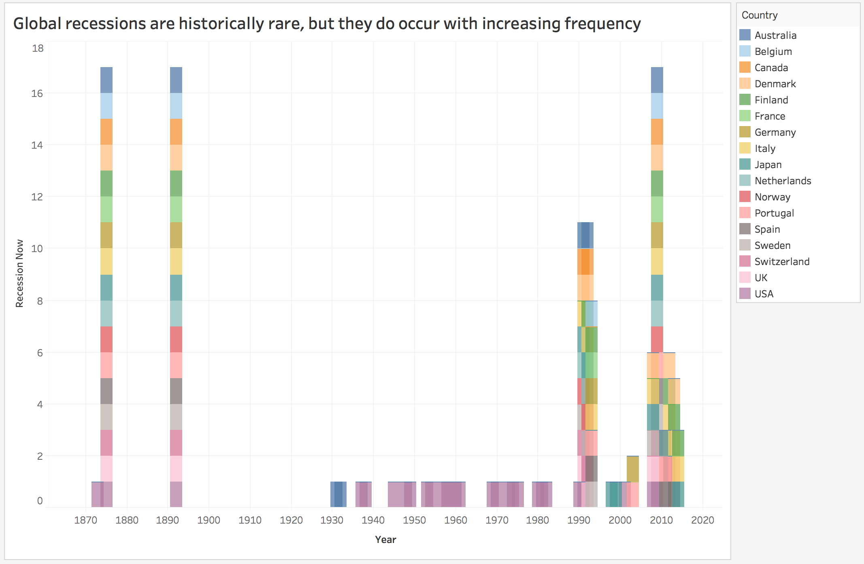

Slide 14
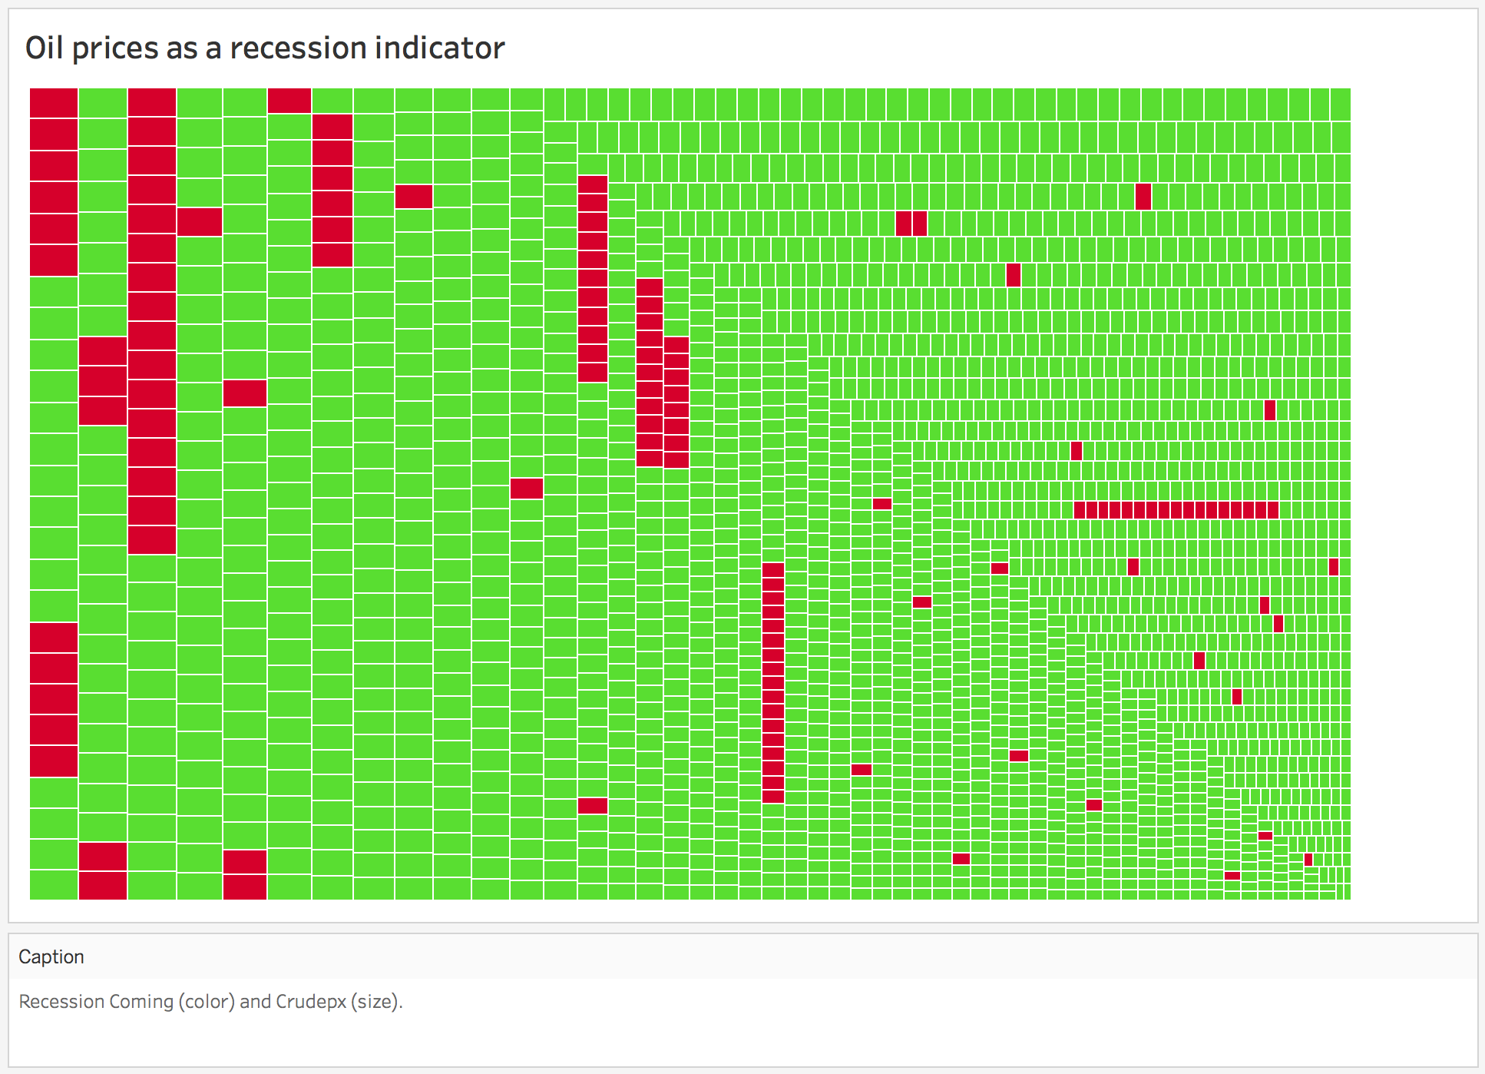

Slide 15
Predictability….
Out of 132 recessions….
Year | Country | Yield-Curve | Crude-Prices
1990 | UK | -3.21083333 | 42.97
1974 | USA | -2.94333 | 55.62
1872 | USA | -2.818333333 | 71.64
1981 | USA | -2.4792 | 93.57
1990 | Switzerland | -2.07 | 42.97
1990 | Canada | -1.95666666 | 42.97
1980 | USA | -1.89 | 105.81
1979 | USA | -1.7475 | 103.07
1990 | Norway | -1.06442727 | 42.97
1990 | Australia | -0.97083333 | 42.97
2008 | Norway | -0.91833 | 106.94
2007 | UK | -0.897916667 | 82.65
2008 | Australia | -0.853722727 | 106.94
2008 | Denmark | -0.599166666 | 106.94
2008 | Netherlands | -0.406733 | 106.94
2007 | USA | -0.39083 | 82.65
1990 | Sweden | -0.32666667 | 42.97
1990 | Denmark | -0.26383333 | 42.97
2008 | Portugal | -0.111733333 | 106.94
2007 | Denmark | -0.041666667 | 82.65
1990 | Japan | -0.0354 | 42.97
2008 | Sweden | -0.016666667 | 106.94
Notes:
The U.S. economy hasn’t been in recession since June 2009 -- almost nine years ago.
If the economy sustains its expansion for just 14 more months, this will be the longest the country has gone without an economic downturn in recorded history

Slide 16
Statistical Considerations
Imbalanced Classes (Only 132 recessions = 5.3%)
Fbeta
Oversampling
Class weighting
Feature engineering: Money Supply, Yield-curve
Eliminated correlated features (15 of 29)
Scaling & Regularization

Slide 17
Train-Test split
1870 – 2016
(100%)
1870 – 1972
(70%)
train
1972 - 2016
(30%)
1972 - 2002
(20%)
test
2002- 2016
(10%)
hold-out

Slide 18
Model-Selection
Logistic
Base-case: balanced classes (F7 = 0.148)
Best-case: (With regularization, scaling, oversampling; F7 = 0.198)
Random forest (F7 = 0.226)
False-positive: tree methods over-fit on years & don’t extrapolate well
Rejected
XGB (F7 = 0)
Under sampling
KNN
Linear-svm, svm
Decision-tree classifier
Notes:
Logistic – class conditional densities not normal; Random forest feature importance; False-positive: tree methods over-fit on years & don’t extrapolate well
Rejected Under sampling (only 2500 rows), KNN (features between rows irrelevant), Linear-svm, svm (features not on same scale), Decision-tree classifier (over-fit, low predictability)

Slide 19
Final Validation
Logistic (oversampled)
Random Forest
Retrain on 1860-2002 data (90%)
Logistic (balanced)
Test on 2002-2016 data (10%)
Random Forest F7-score: 0.120
Logistic (‘Best’) F7-score: 0.588
Logistic (balanced) F7-score: 0.672
Notes:
Logistic Best = oversample
Logistic #2 = regularized, balance

Slide 20
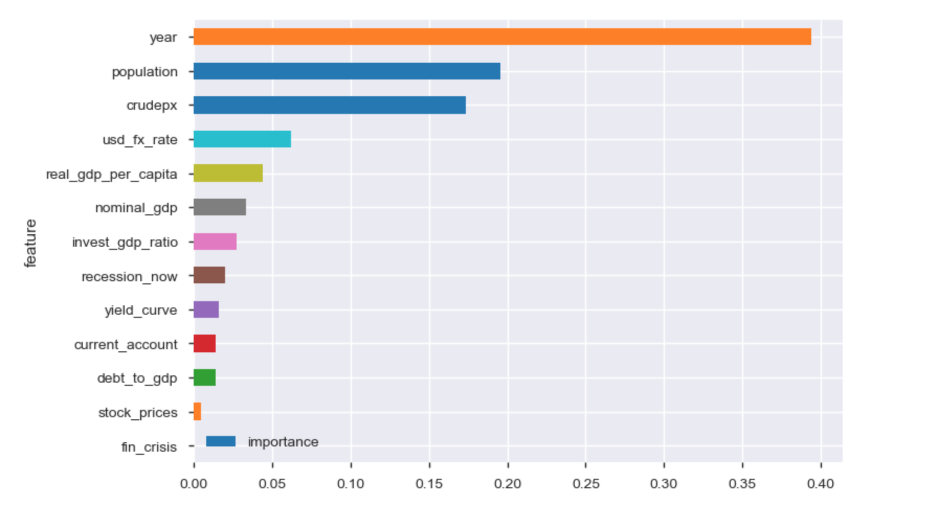
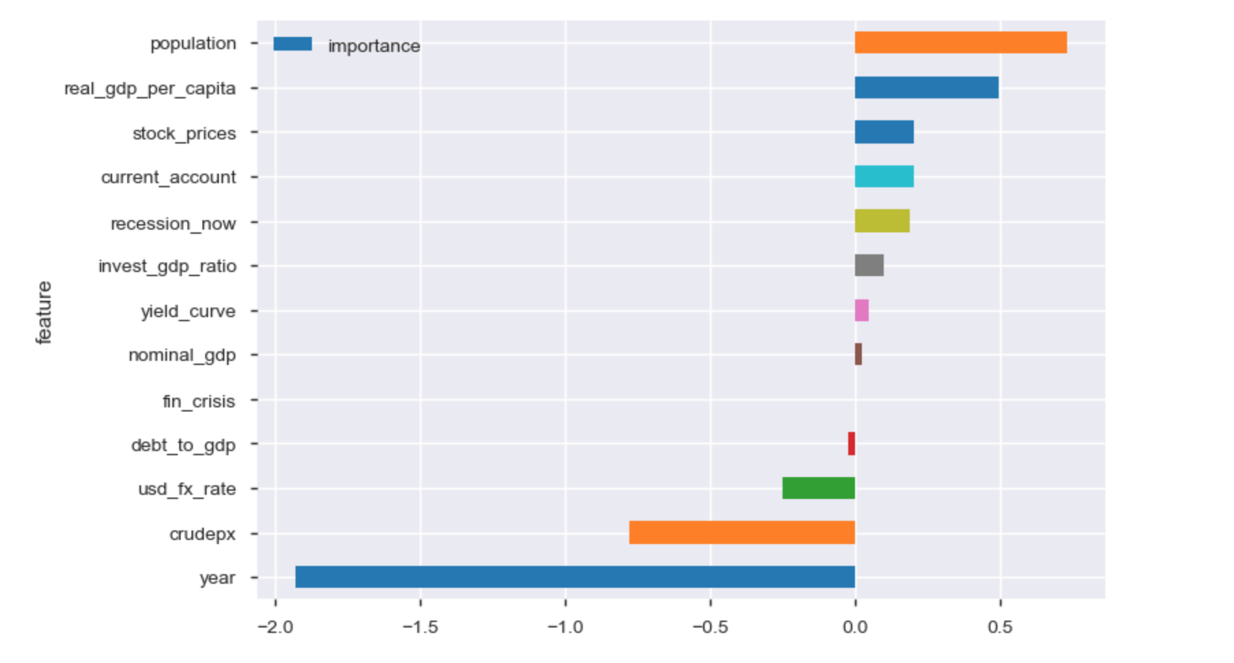
Comparing Models
Random Forest Classifier
Logistic Classifier
Notes:
Both models weight years too heavily; this is an issue inherent to time-series analysis.
The RF classifier makes the mistake of placing more important on USD_FX_rate over GDP metrics
Logistic model ‘correctly’ weights GDP/capita over USD FX rate.
Logistic implies probability becomes less as time progresses (based on recent trends)
Logistic also is weighted inversely with crude px and this has been proven wrong.

Slide 21
2019 prediction…
Logistic: 99% confident you should hedge in 2019
Random Forest: 53% confident you should hedge in 2019
Consensus: 17% chance of recession in 2019
Notes:
Logistic is factoring 40% stock rally, ~3% GDP growth,

Slide 22
Next steps…
Data acquisition
Quarterly interest rate differentials
Change in crude prices q/q
Schiller CAPE index (Cyclical Adjusted Price-earnings Ratio)
Uniform unemployment metric
Country-specific feature scaling
Modeling
Country specific-models
Modern-training on expanded data set
Integration or comparison with consensus economic recession probabilities

Slide 23
Sources
https://www.stlouisfed.org/open-vault/2018/february/fed-predict-recessions
https://www.investopedia.com/
https://www.bloomberg.com/view/articles/2018-02-06/don-t-forget-what-causes-a-recession
https://www.guggenheiminvestments.com/perspectives/macroeconomic-research/forecasting-the-next-recession
https://voxeu.org/article/did-rising-oil-prices-trigger-current-recession
Blanchard, Olivier J. and Gali, Jordi (2007), “The Macroeconomic Effects of Oil Price Shocks: Why are the 2000s so Different from the 1970s?” 18 August. MIT Department of Economics Working Paper No. 07-21.
“Predicting Economic Recessions Using Machine Learning Algorithms” by Rickard Nyman and Paul Ormerod, December 2016, https://arxiv.org/pdf/1701.01428.pdf
http://databank.worldbank.org/
http://www.macrohistory.net/data/
“How Well Do Economists Forecast Recessions?” by Zidong An, João Tovar Jalles, and Prakash Loungani, IMF

