Slide 1
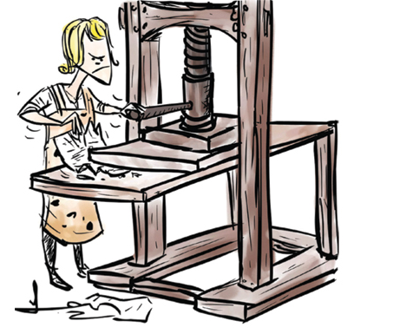
Gutenberg Library Analysis

Slide 2
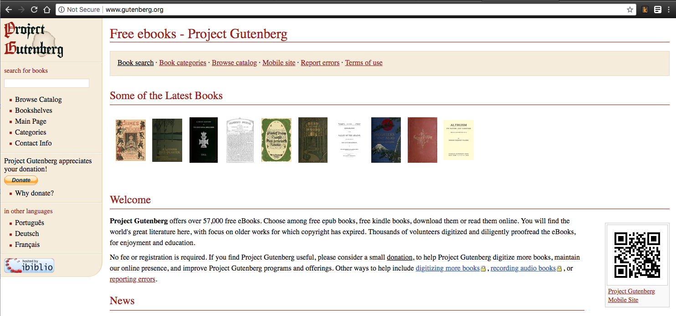
Notes:
57k e-books

Slide 3
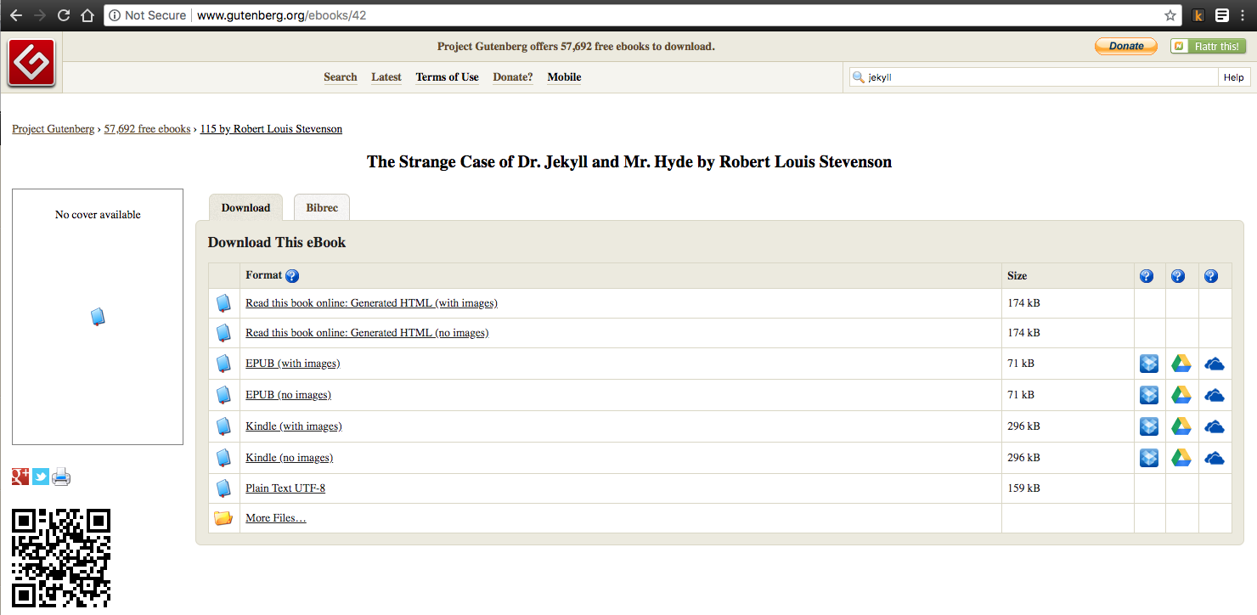
Notes:
No character, plot, rating… just bare bones.

Slide 4
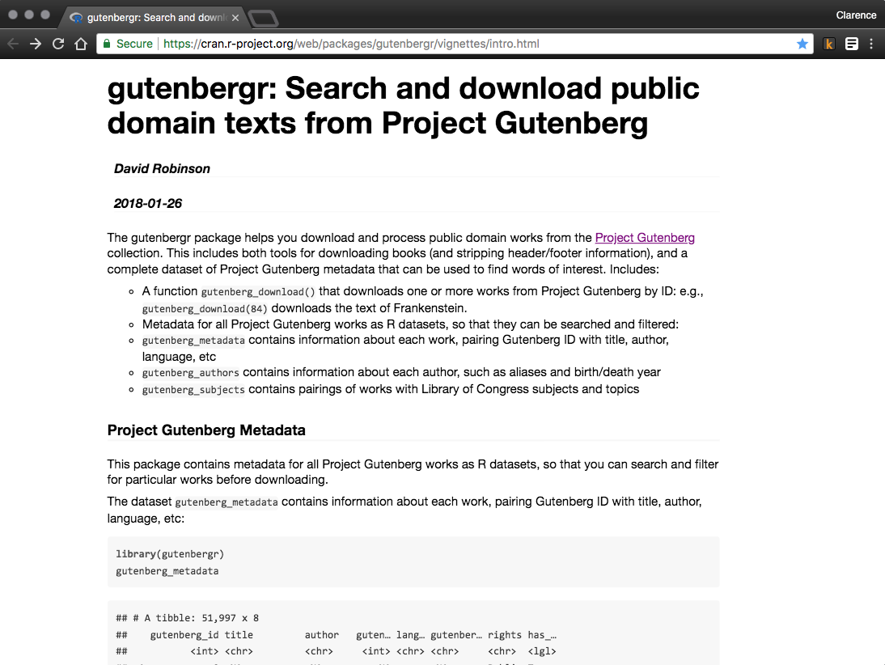

Slide 5
Goals
Topics → Subgenres
Sentiment → Plot
Recommendations

Slide 6
Topics → Subgenres
Clean
Fantasy, Adventure, Fiction, Children, Myth, Folklore
~6% of Gutenberg Library
Lemmatize
TFIDF
12,000 term limit
NMF
Clusters
15 topics
T-SNE
The cars are different → the car be differ
LDA
K-means

Slide 7
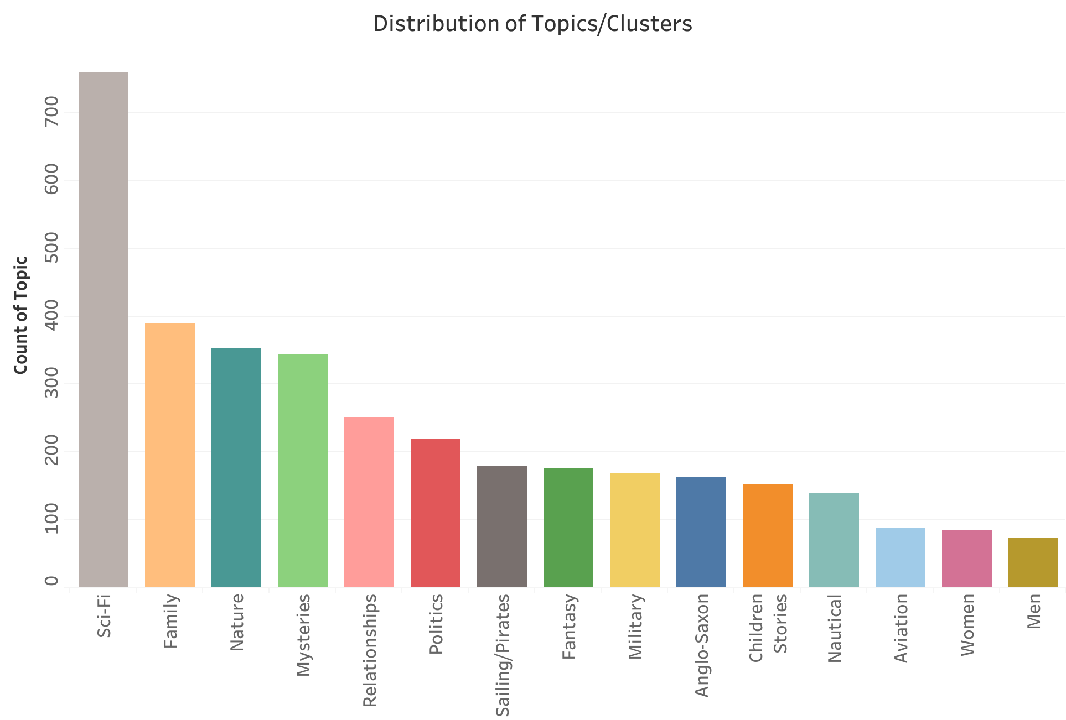

Slide 8
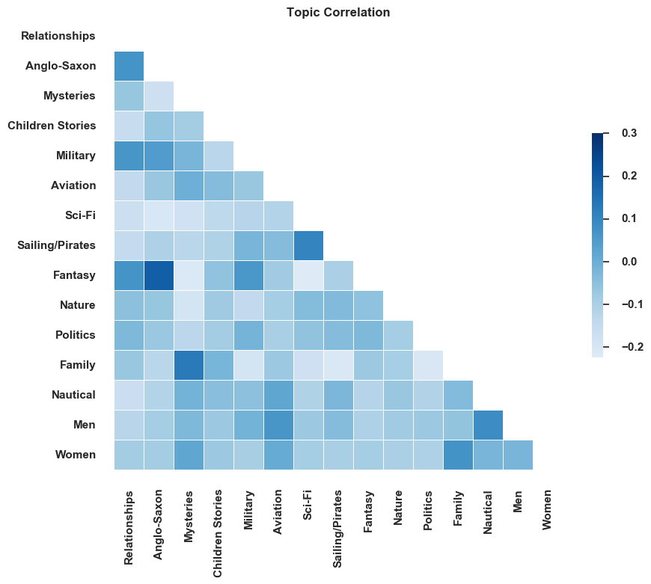

Slide 9
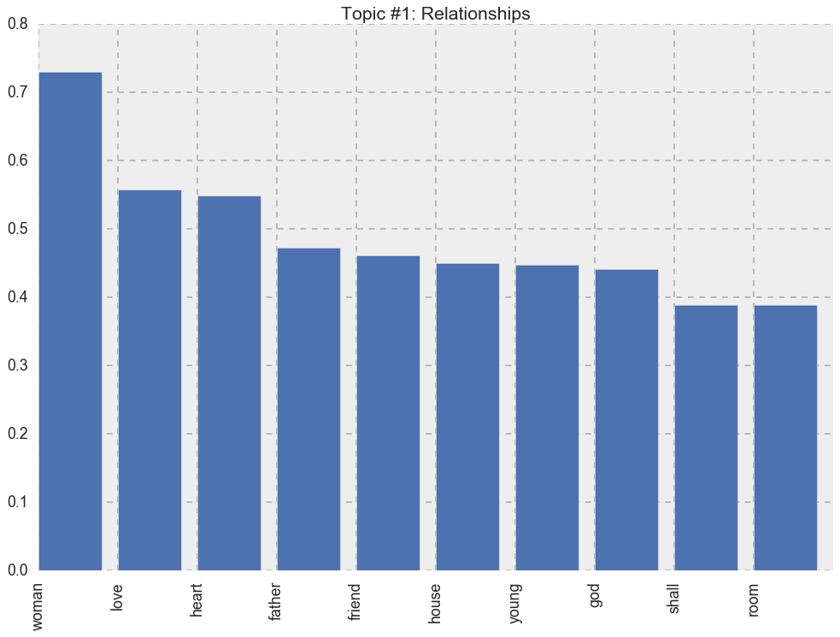

Slide 10
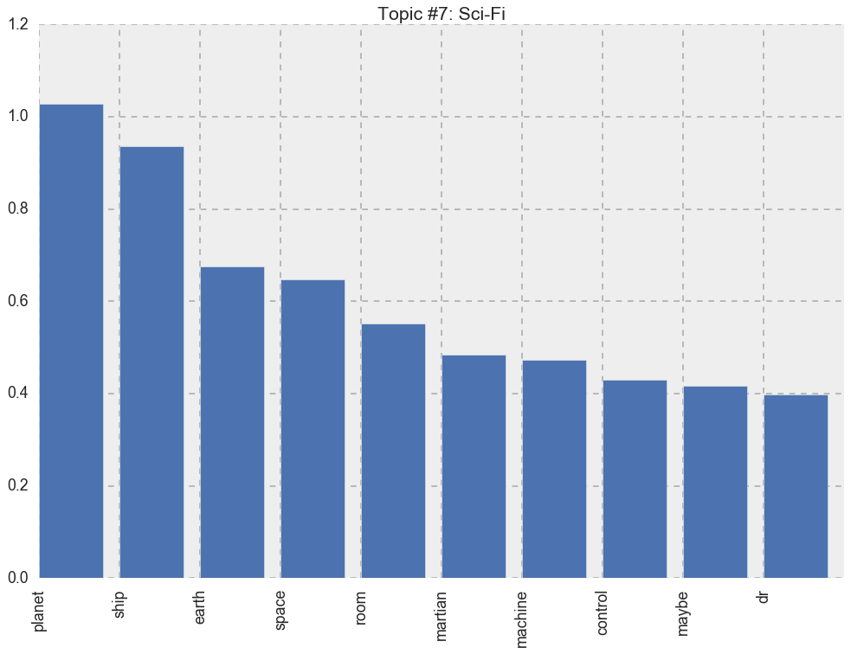

Slide 11
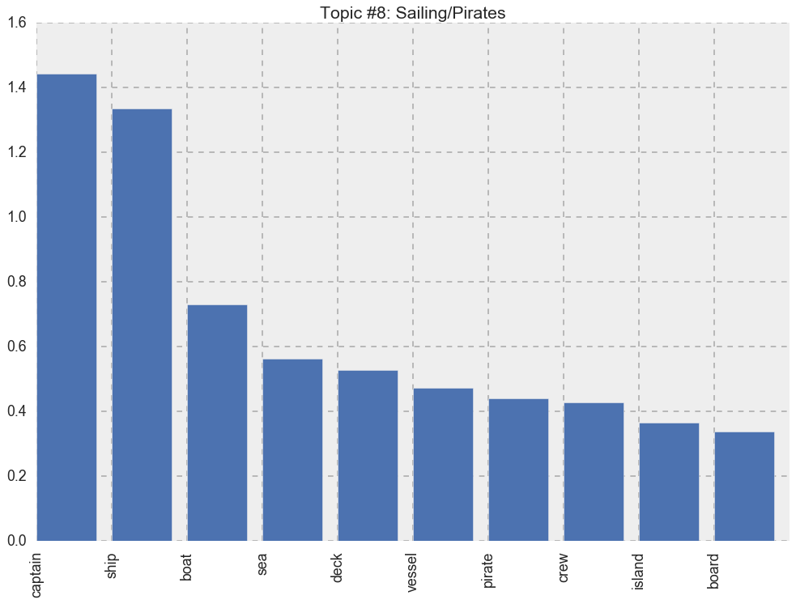

Slide 12
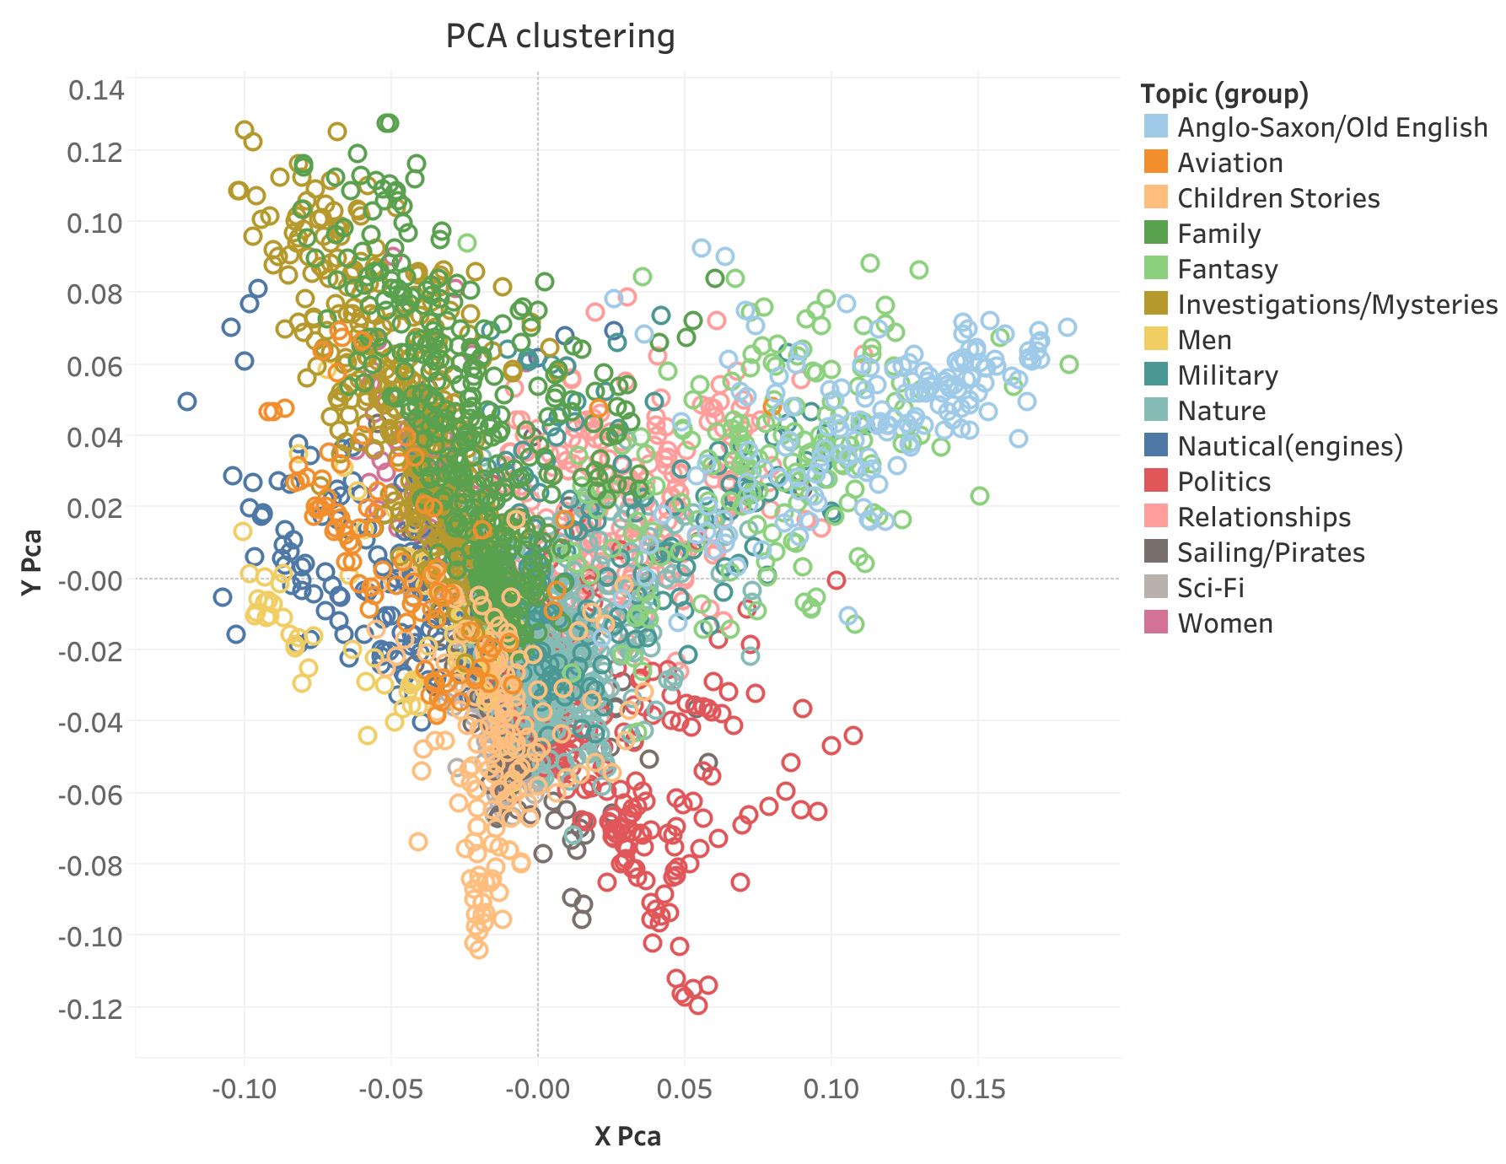

Slide 13
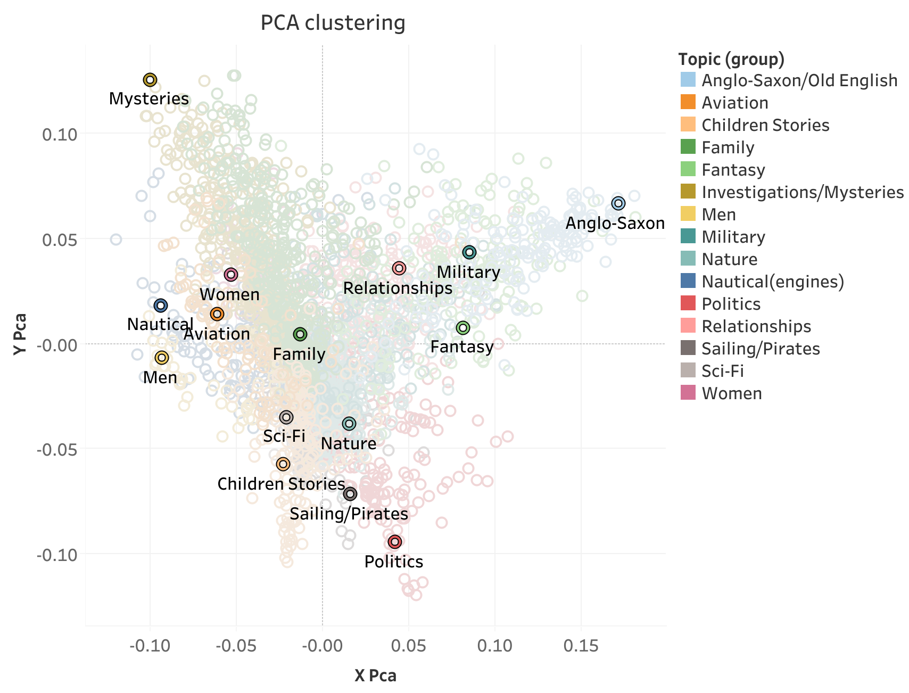

Slide 14
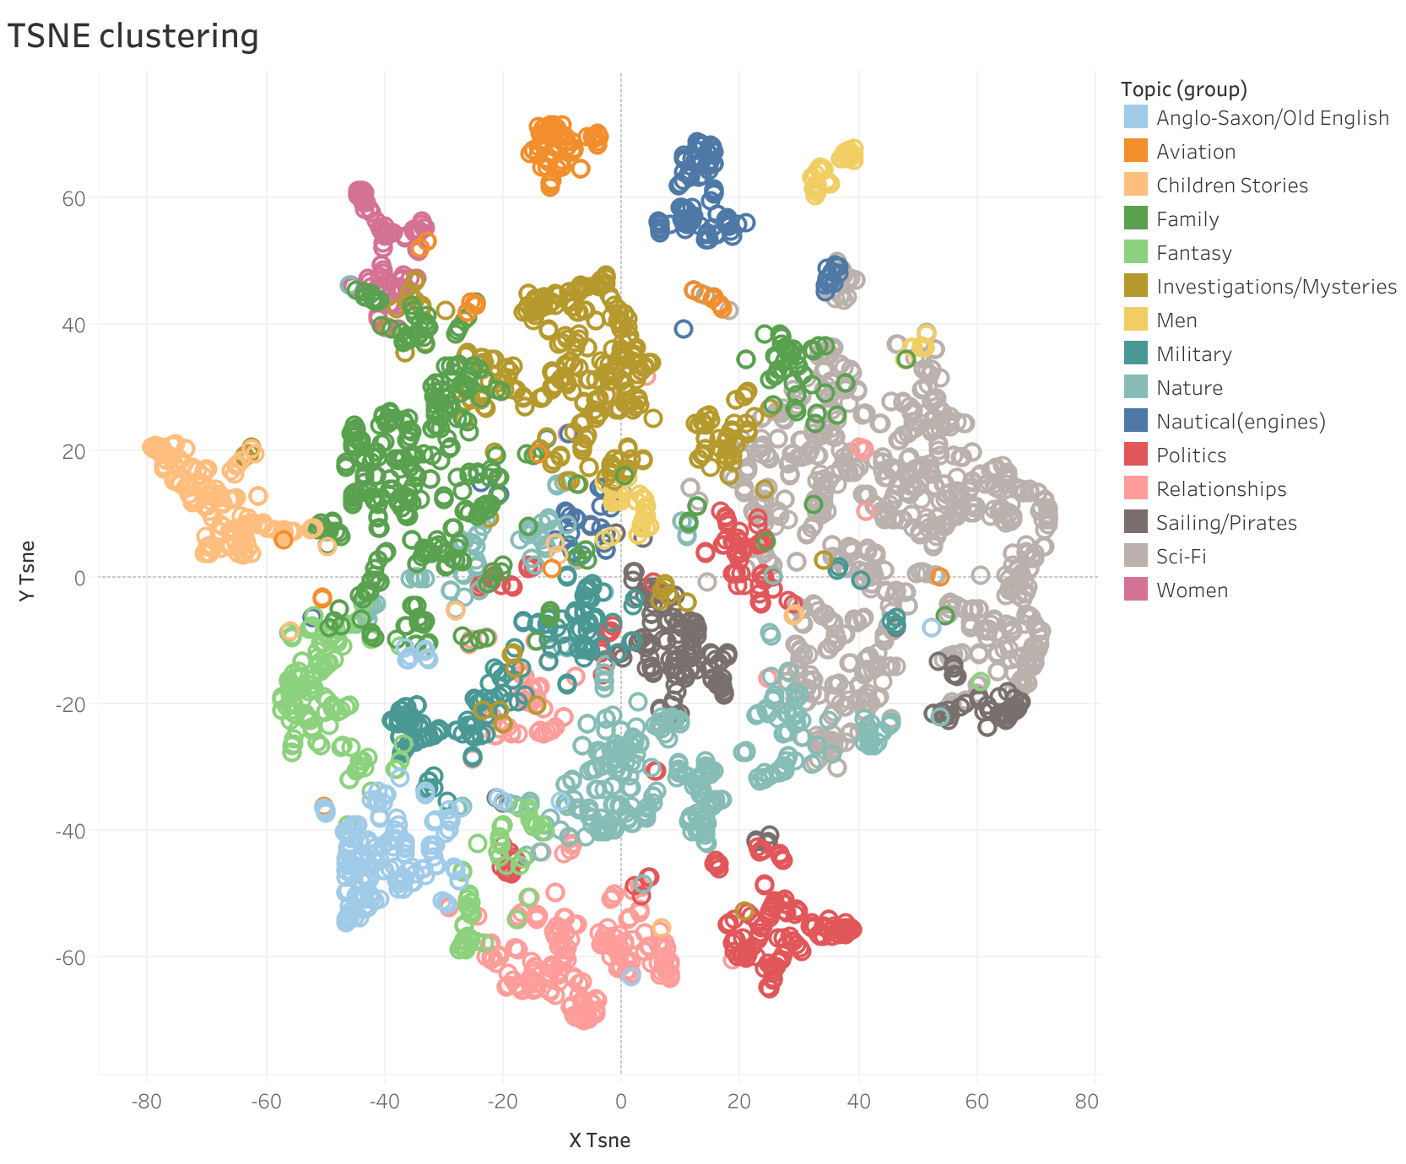

Slide 15
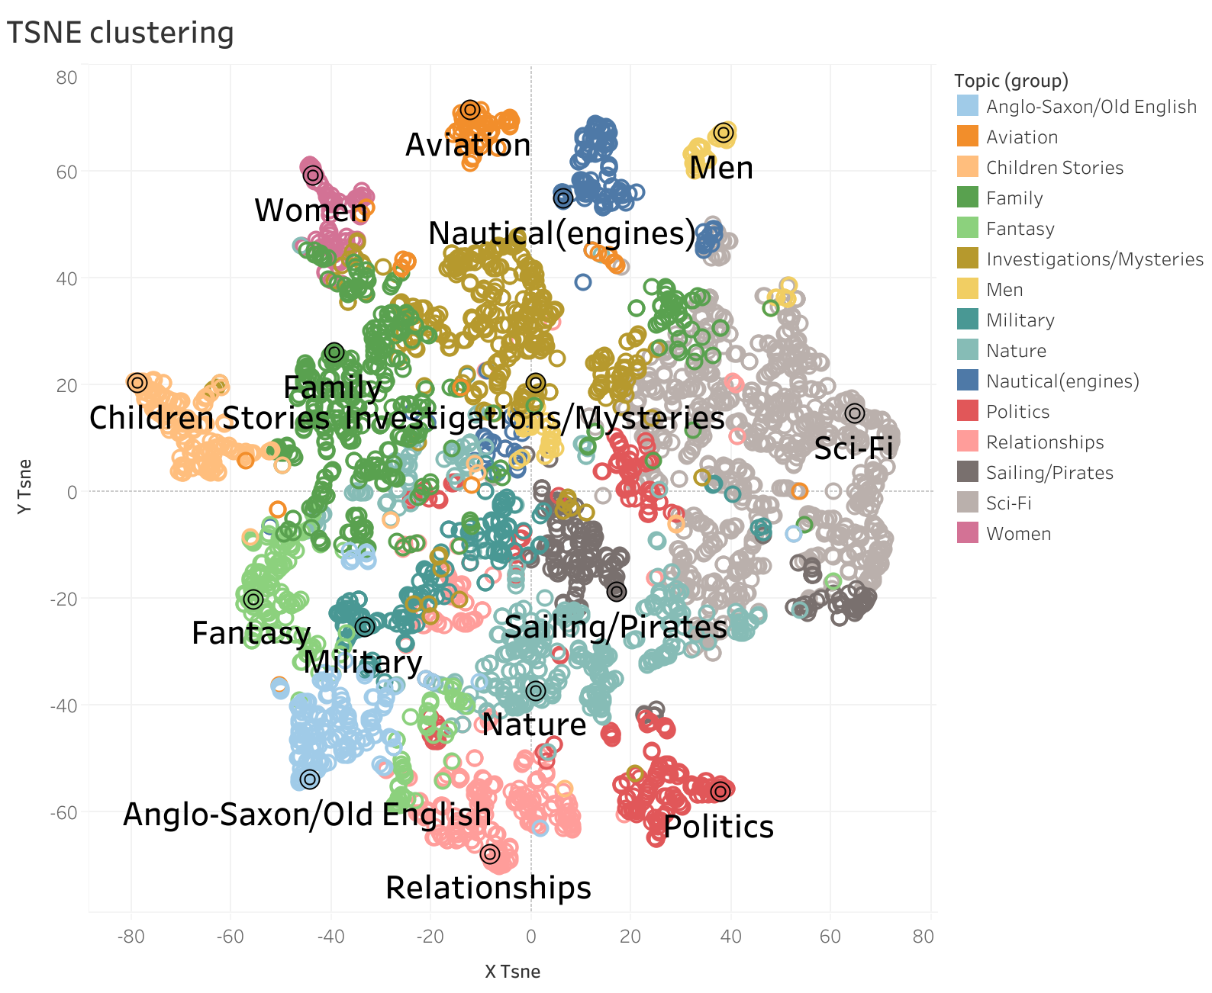

Slide 16
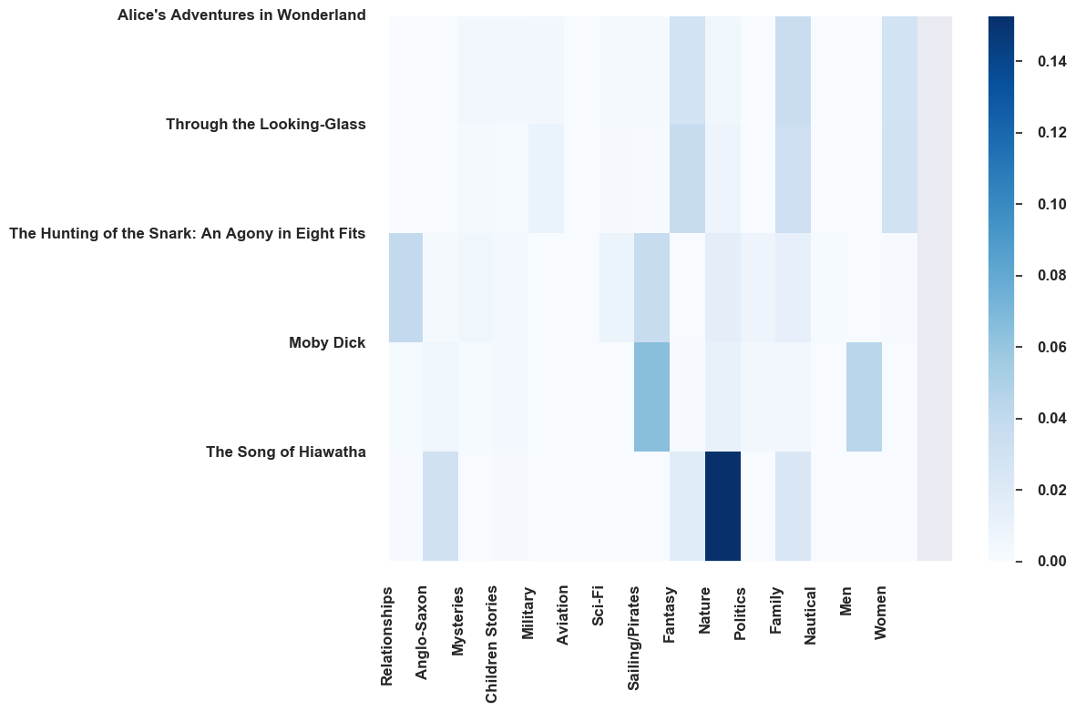
How much do these books fit the topics?

Slide 17
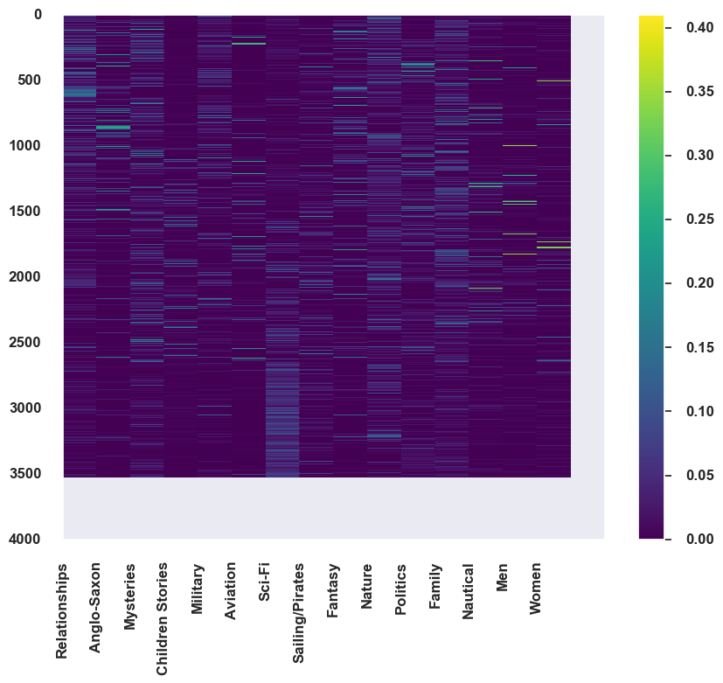
How much do these books fit the topics?

Slide 18
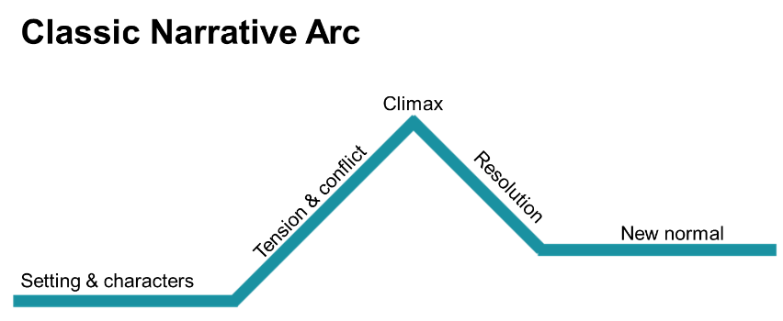
Sentiment → Plot

Slide 19
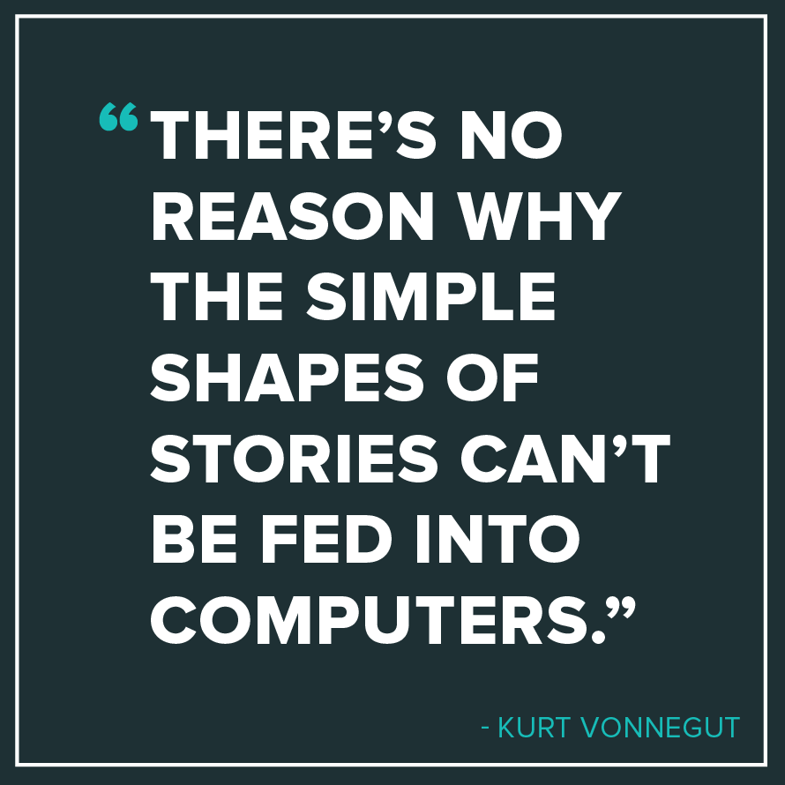

Slide 20
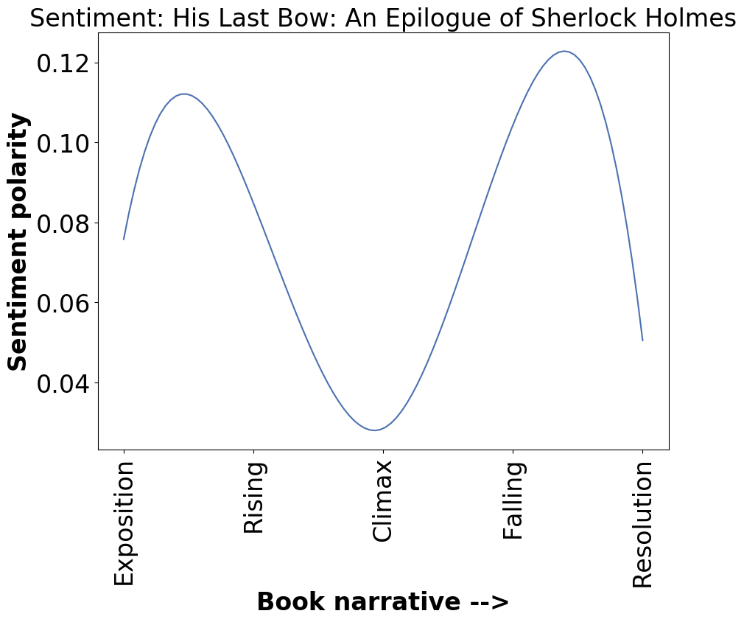
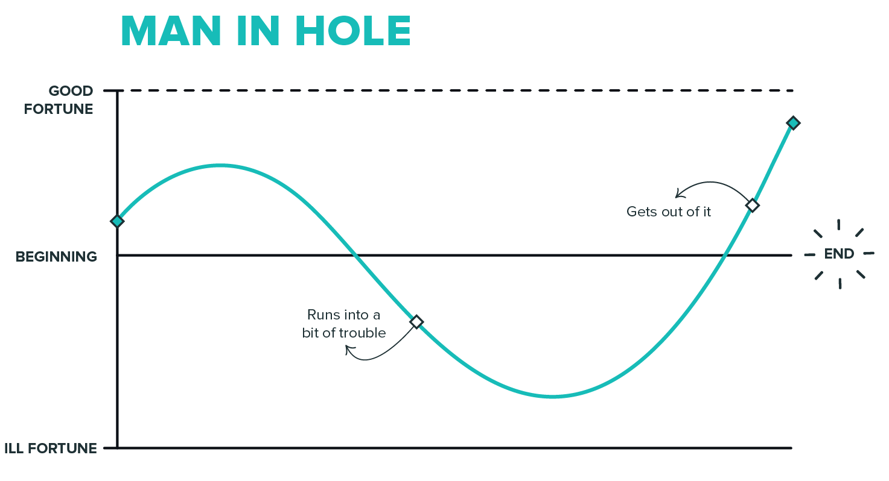
Plot shapes

Slide 21
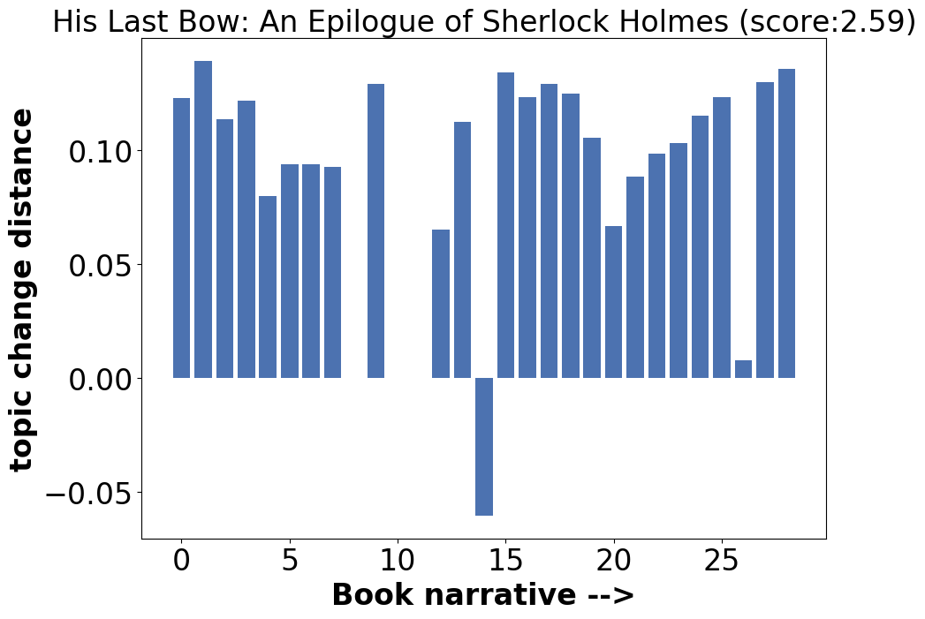
Topic Shift → Complexity

