Slide 1

FINANCIAL LOAN OVERVIEW
Contains the Models Used for the classification Analysis

Slide 2
Three Models Used- .Decision Tree .Logistic Regression .Support Vector Machine
Firstly, the Loan Data was prepared like changing the data type, deriving a custom column etc. I used python to analyze the data , identified the relationship between the columns.
Best classification models were developed, leveraging artificial intelligence algorithms. Evaluation metrics such as accuracy, precision, recall.

Slide 3
Using Decision tree
200 rows of dataset was used for easy visualization. However, I initially use the whole dataset, the accuracy score is same with few one.
From the decision tree model, we can see that there many factors that affect customers being a default and non_default.
we predicted this model using Decision Tree, having accuracy score of 70%.

Slide 4
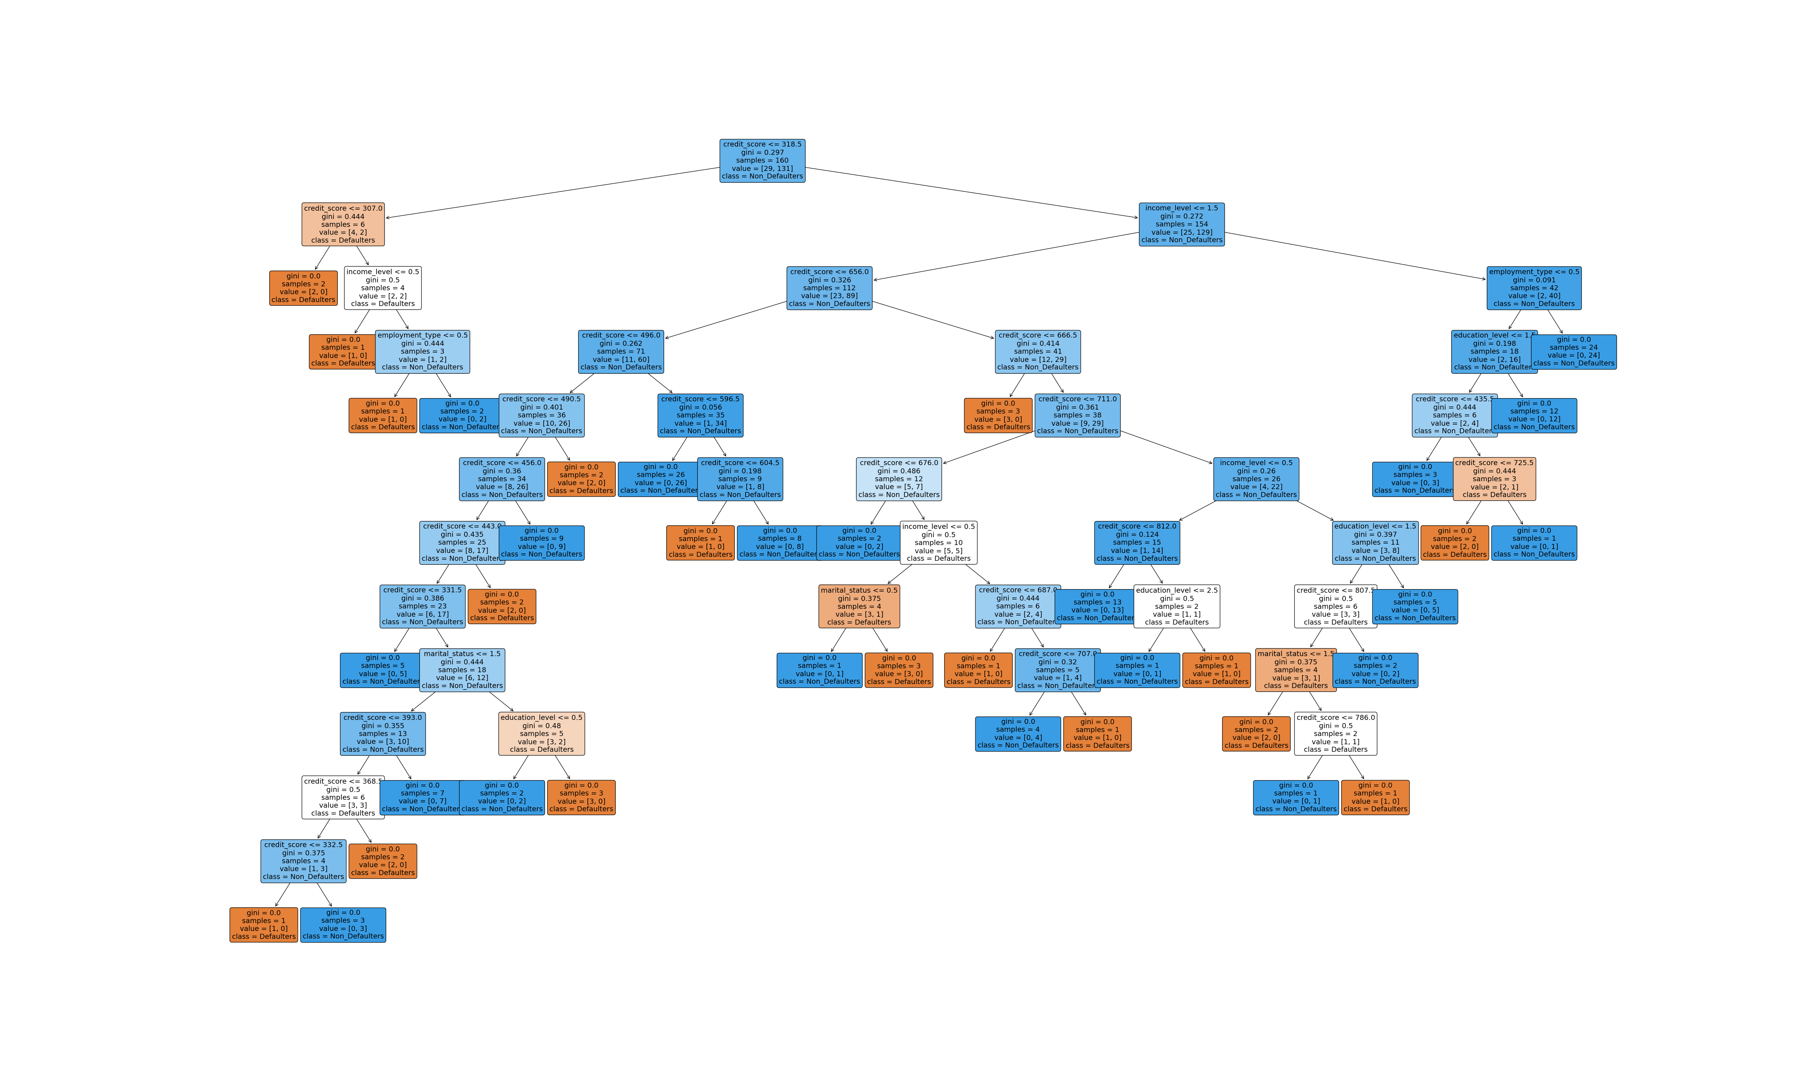

VISUALIZATION

Slide 5
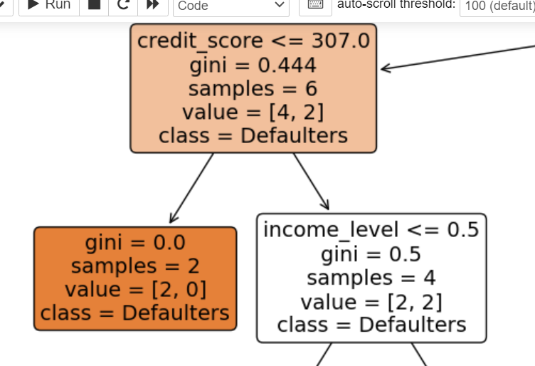
There is high chance that customers with
low credit score are likely to be default, vice versa.
This model clearly shows that not only the credit score affect the customers inability to pay his loan.
Low income, Divorced, Self employed, and High School has 40% impact on customers being default.
However, non-Default are those who can pay their loan debt, this model classified them as those that has high credit score, single, maried, full time employment statue, bachelors, masters and PHD.

Slide 6

when credit score was 368.5, we can see that, the gini is at (0.5) ie there is 50% of default and non-default customers.
when credit score is at 307.0 , gini was at 0.4, there is 40% of them with 307 credit score are default and 50% of them has low income earners, some them also self employed.
From the predictive model used so far, decision tree is more preferable and gave clear classification of the loan default.

Slide 7
LOGISTIC REGRESSION MODEL
Predicting loan involves thorough exploratory data analysis to understand dataset features.
The accurancy score of this model is 80% ,precision and recall is 0.0 due to default statue contain more false value.
Loan Default is highly dependent on the credit score, people with lower income are more likely to default on loans.

Slide 8
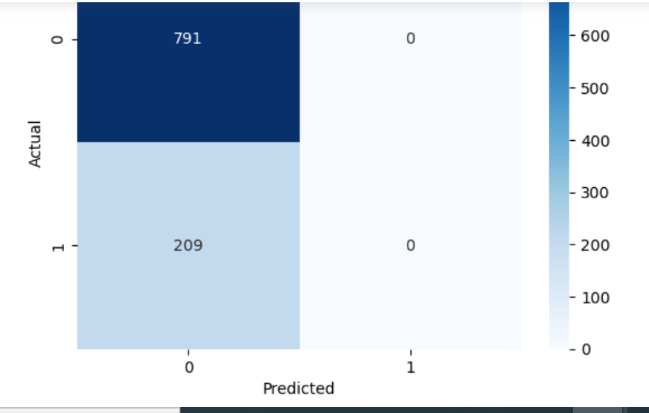
LOGISTIC REGRESSION MODEL
According to the confusion metric used in this model, TP shows 791 records of the Loan data were predicted correctly by the model. The FN shows that 209 records of a loan data were wrongly predicted.
In conclusion , I can say that logistic regression is not suitable model for classify this dataset

Slide 9

Support Vector Machine.
The whole dataset was prepared, I created machine learning model and use it for prediction. This support vector machine algorithm tested many kernel.
According to the results of the analyses, the best results were obtained with polynomial kernel, accuracy is (79%) and sigmoid kernel is also good (69%).

Slide 10
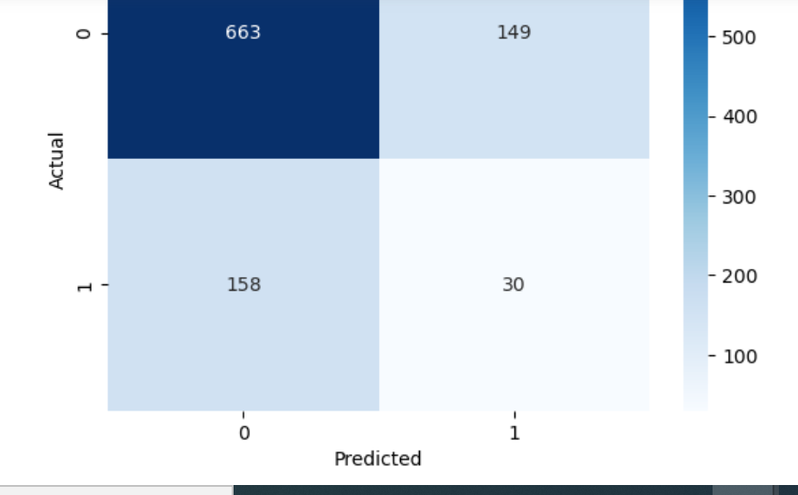
Using sigmod Kernel Accuracy: 0.693 Precision: 0.168, Recall: 0.16
The confusion metrics of support vector model gave accurate classification of the model, although accuracy score is not very high. This model can help in decision-making factor in the banks, it must not be used solely, without the intervention of humans.

