Slide 1


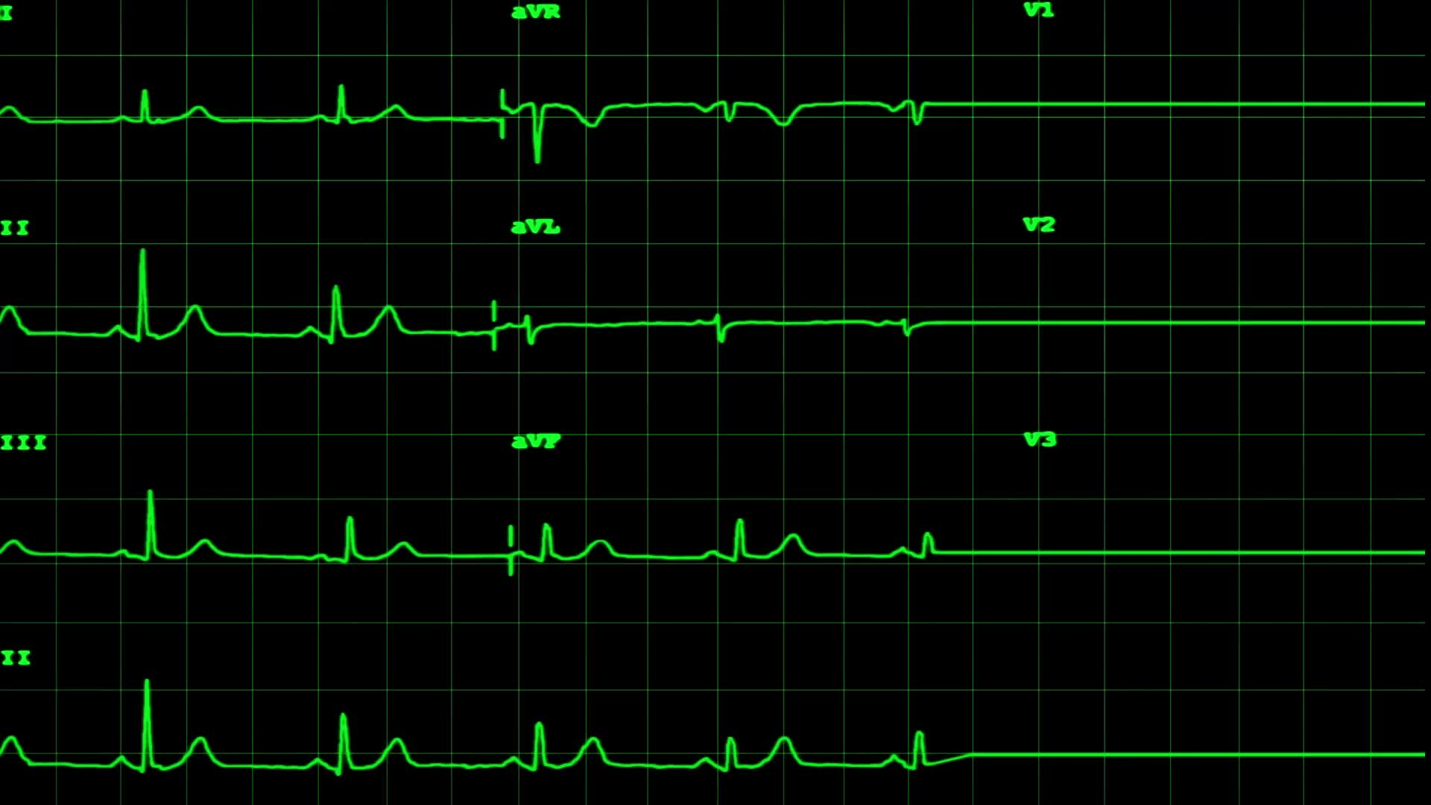

Cardio Health Prediction
Project Summary

Slide 2
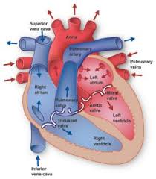
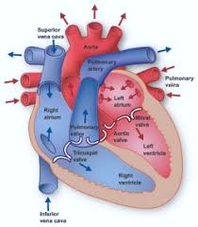
Requirement:
A project was given as part of final assessment for data science course, The requirement is to identify the presence or absence of heart disease based on various medical and lifestyle

Slide 3


The Process:
Firstly, cleaning and exploration was done in python. The data was splitted into numerical, date and categorical features. The correlation tools indicated that few of the features has relationship. other tools was used to identify outliers.
Prediction using machine learning algorithm ( I created different models for better result). visualization tools was used to display the outcome.

Slide 4
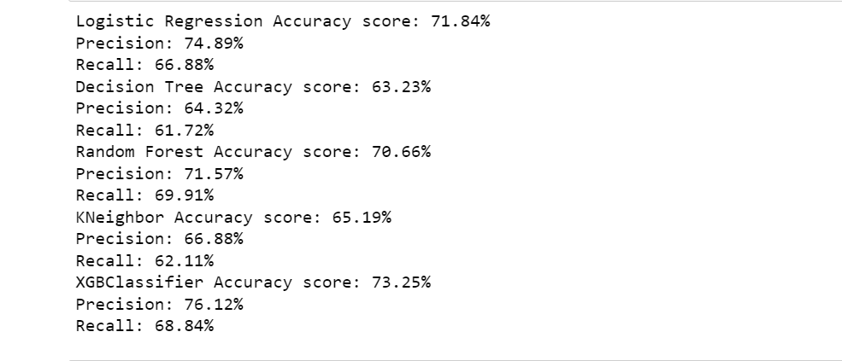
Observations:
Preparation was done as per the algorithm principles and five models were created.
The models that had best accuracy were:
( XGBClassifier ,Logistic Regression and Random Forest), including their precision and recall.
Decision Tree and KNeighbor models did not really gave good accuracy.

Slide 5

XGBoost Tree Visual:
It correct errors that occured sequentially. Each tree learns from its predecessors then updates the residual errors.

Slide 6
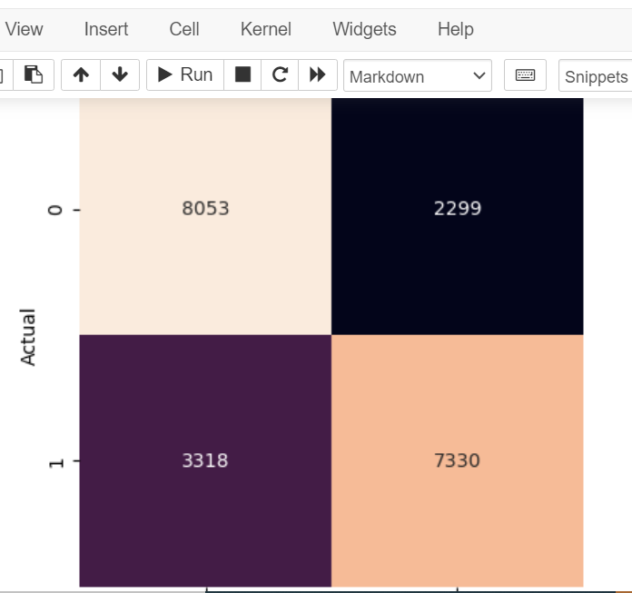
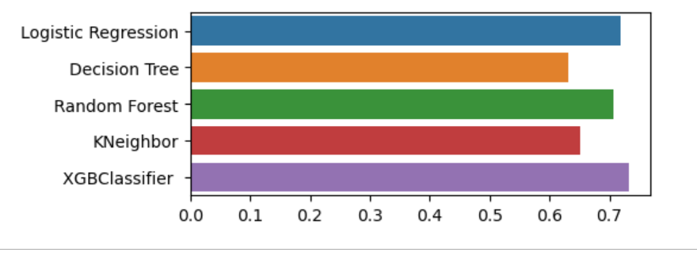
Confusion MatrixVisual:
From the visualization- There are (8053) diseased and (7330) not diseased people.
Although, this is large volume of data, the true classification is higher than the false alarm and missed cases.

Slide 7
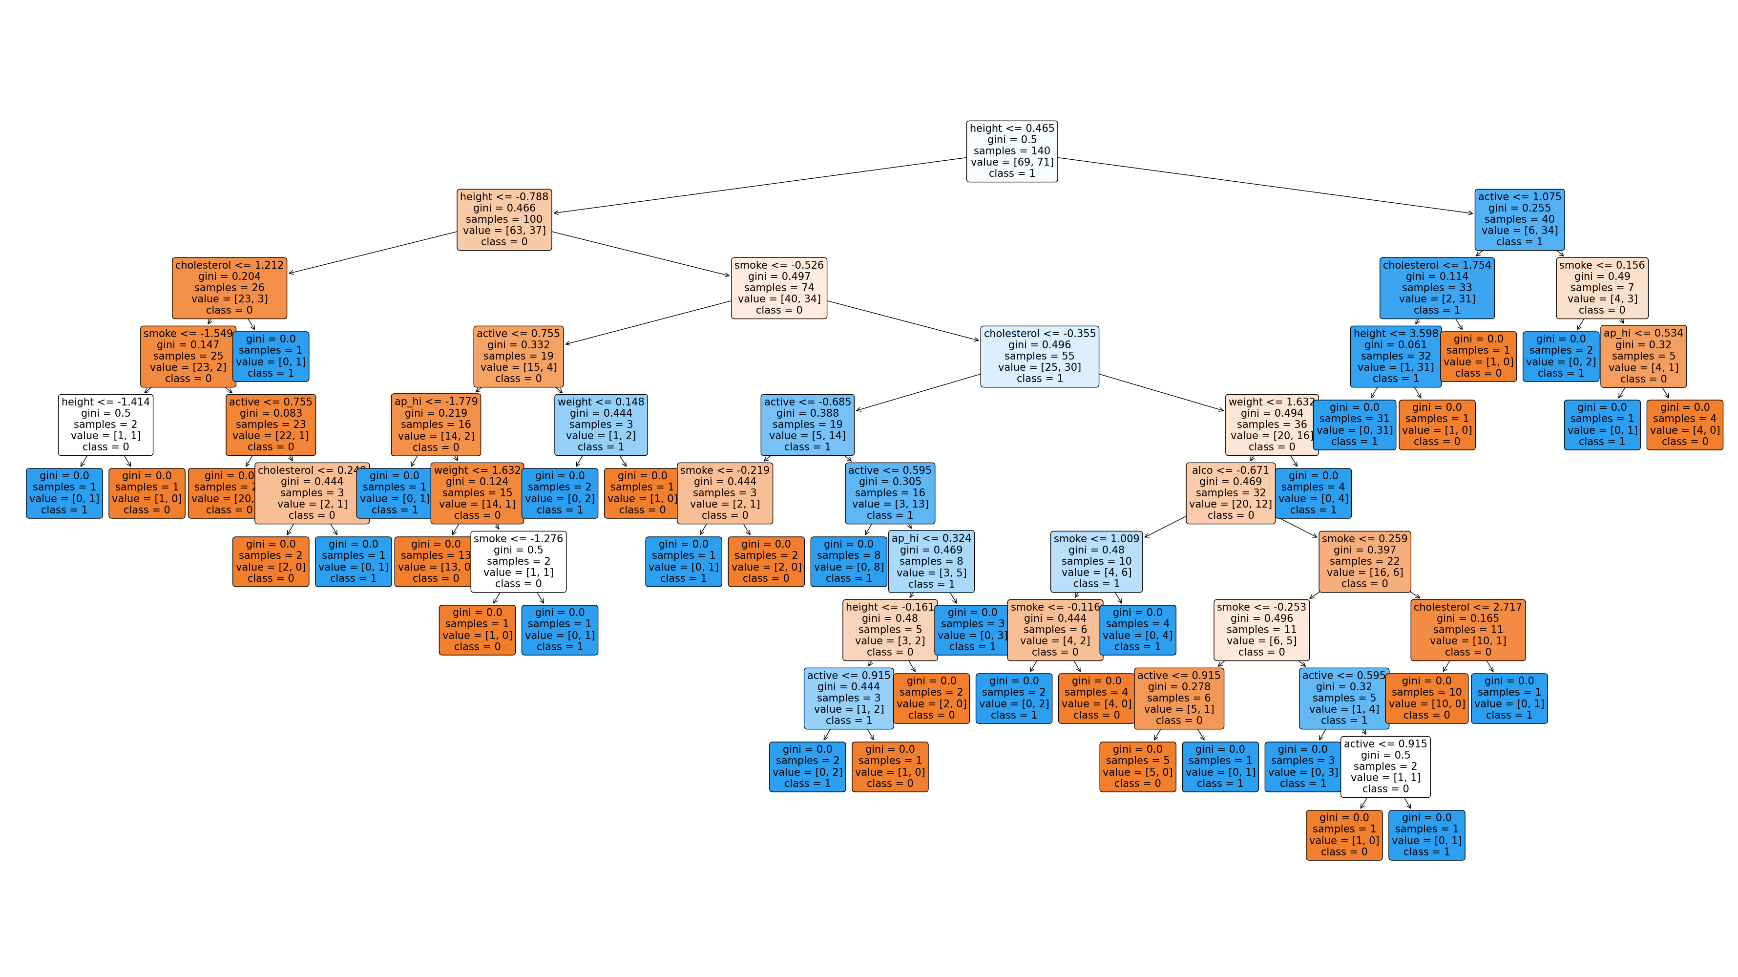
Decision Tree Visual:

Slide 8
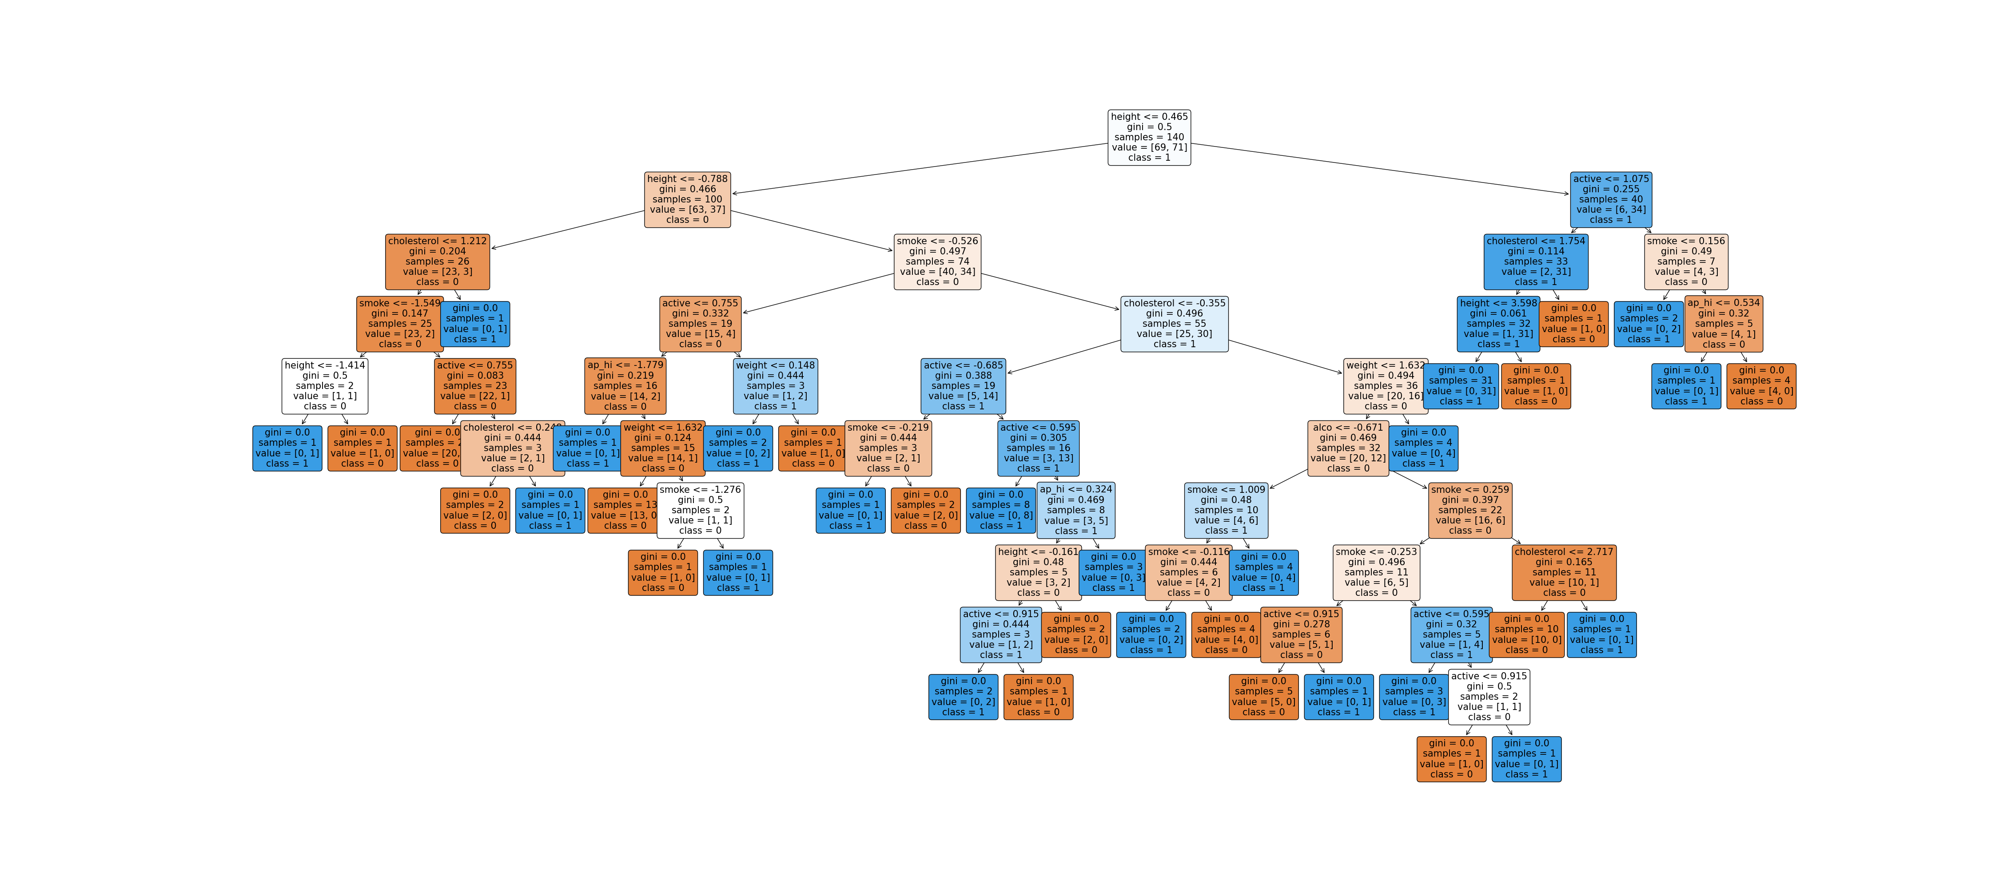
Decision tree visualization was done using sample of (200) rows of dataset. The gini of all sample data size range from (0.0 to 0.5) showing that there no much impurity in the model.

Slide 9

Above all, the models were able to detect presence and absence of disease , especially XGBClassifier and Random Forest that gave better accuracy and precision,

