Slide 1
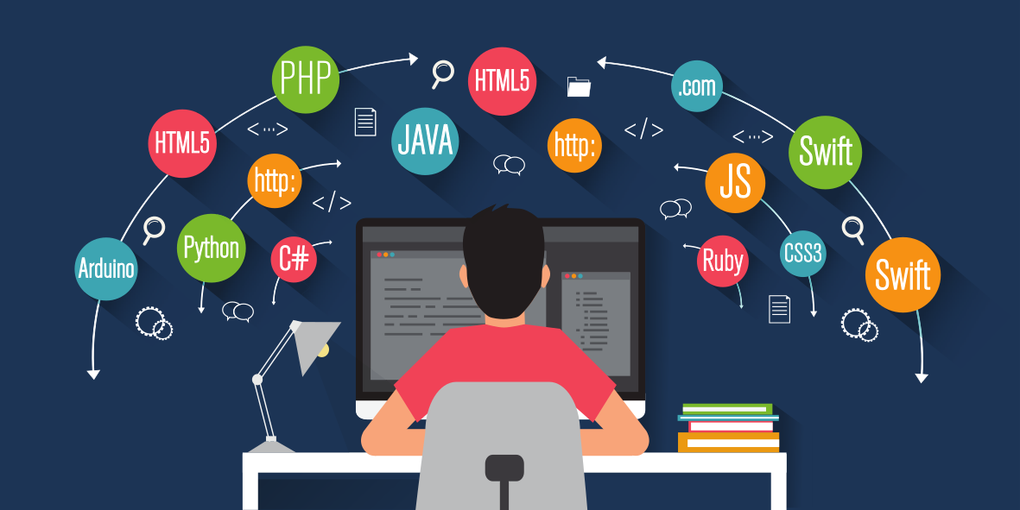
What is Programming and Python?
Programming: writing codes that allow you to create your own set of instructions for your device to carry out.
Python: a language we can use for programming

Slide 2
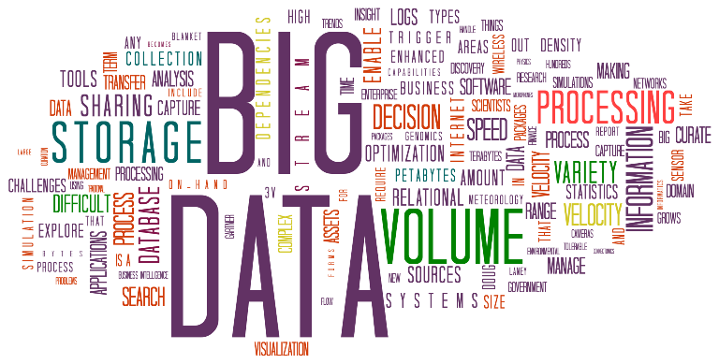
I’m a biology major, why do I need it?
It allows us to work with large data sizes faster, more efficiently and more precisely

Slide 3
Variables
Variables are used to store information or values such as a number or words. To create a variable in Python, write the name of the variables and assign it to a value.
variable_name = value

Slide 4
Naming variables
Must begin with a letter (a - z, A - B) or underscore (_)
Other characters can be letters, numbers or _
Do not use Python keywords
Case Sensitive
Meaningful names

Slide 5
Lists
Lists are a collection of data which can be of different data types.
Lists are mutable, meaning you can add, delete or change the elements in the list.

Slide 6
Slicing lists
Values can be sliced from lists by specifying its position
When extracting a range of items, use [Start:End:Step]

Slide 7
Dictionary
Dictionary is similar to a list, but the order of items doesn’t matter, and they aren’t selected by an offset such as 0 or 1. Instead, you specify a unique key to associate with each value.
dictionary = { key : item }

Slide 8
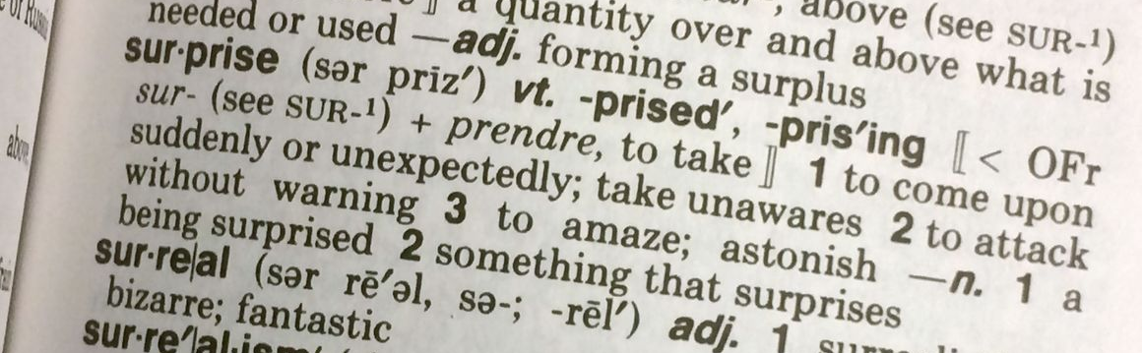
Dictionary
Key
Value

Slide 9
For loops
Python makes frequent use of iterators, for good reason. They make it possible for you to traverse data structures without knowing how large they are or how they are implemented.
It is possible to loop through:
Strings
Integers
Lists
Etc

Slide 10
For loops
for each item in this list:
do this

Slide 11
For loops
prime_numbers = [2, 3, 5, 7, 11]
for each number in the list of prime_numbers:
multiply by two
print each number
2 x 2 = 4
3 x 2 = 6
5 x 2 = 10
7 x 2 = 14
11 x 2 = 22
Outcome: 4 6 10 14 22

Slide 12
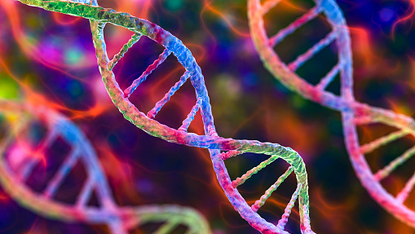
Complementary Strand of DNA

Slide 13
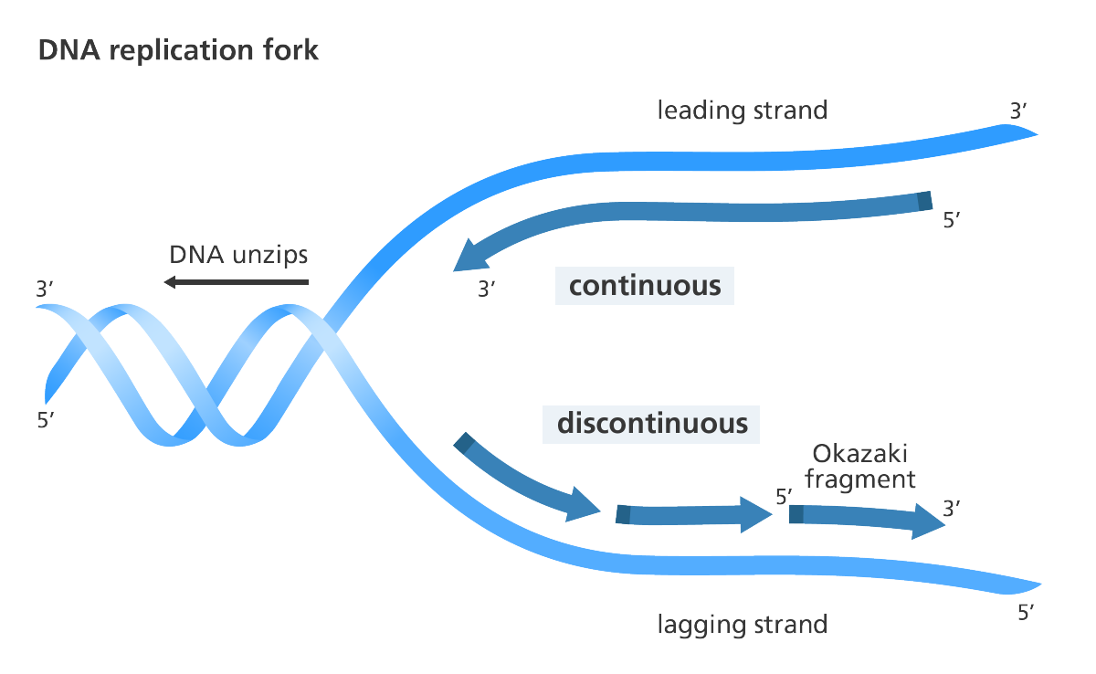

Slide 14
Given a strand of DNA, how do we find its complementary strand?
^{3’} A C G T A C G T G A C G ^{5’}
G C A T G C A C T G C

Slide 15
1. Identify complement bases
A → T
C → G
G → C
T → A

Slide 16
2. Replace the bases, one at a time using the complement bases
^{3’} A C G T A C G T G A C G ^{5’}
^{5’} T G T C A C G T A C G T ^{3’}

Slide 17
2. Replace the bases, one at a time using the complement bases
^{5’} A C G T A C G T G A C G ^{3’}
^{5’} T G T C A C G T A C G T ^{3’}

Slide 18
2. Replace the bases, one at a time using the complement bases
^{5’} A C G T A C G T G A C G ^{3’}
^{5’} T G C C A C G T A C G T ^{3’}

Slide 19
2. Replace the bases, one at a time using the complement bases
^{3’} A C G T A C G T G A C G ^{5’}
^{5’} T G C A T G C A C T G C ^{3’}

Slide 20
Solution

Slide 21
Making a dictionary
complement = {
'A': 'T’,
'C': 'G’,
'G': 'C’,
'T': 'A’
}

Slide 22
dna = ‘ACGTACGTGACG’ complement = {'A': 'T', 'C': 'G', 'G': 'C', 'T': 'A’}
rev_complement = ''
for base in dna[::-1]:
rev_complement = rev_complement + complement[base]
print(reverse)

Slide 23
Given a strand of DNA, how do we find its complementary strand?
complement = {
'A': 'T’,
'C': 'G’,
'G': 'C’,
'T': 'A’
}
^{5’} A C G T A C G T G A C G ^{3’}
^{3’} T G C A T G C A C T G C ^{5’}

Slide 24
Given a strand of DNA, how do we find its complementary strand?
complement = {
'A': 'T’,
'C': 'G’,
'G': 'C’,
'T': 'A’
}
^{5’} A C G T A C G T G A C G ^{3’}
^{3’} T G C A T G C A C T G C ^{5’}

Slide 25
Given a strand of DNA, how do we find its complementary strand?
complement = {
'A': 'T’,
'C': 'G’,
'G': 'C’,
'T': 'A’
}
^{5’} A C G T A C G T G A C G ^{3’}
^{3’} T G C A T G C A C T G C ^{5’}

Slide 26
Remember to flip the strand!
^{5’} C G T C A C G T A C G T ^{3’}

Slide 27
dna = 'GCGCGCGCGCGAAATTTT’
base_dict = {'A': 'T', 'C': 'G', 'G': 'C', 'T': 'A'}
complement = ''
for nucleotide in dna:
complement += base_dict[nucleotide]
reverse_complement = complement[::-1]
print(reverse_complement)

