Slide 1
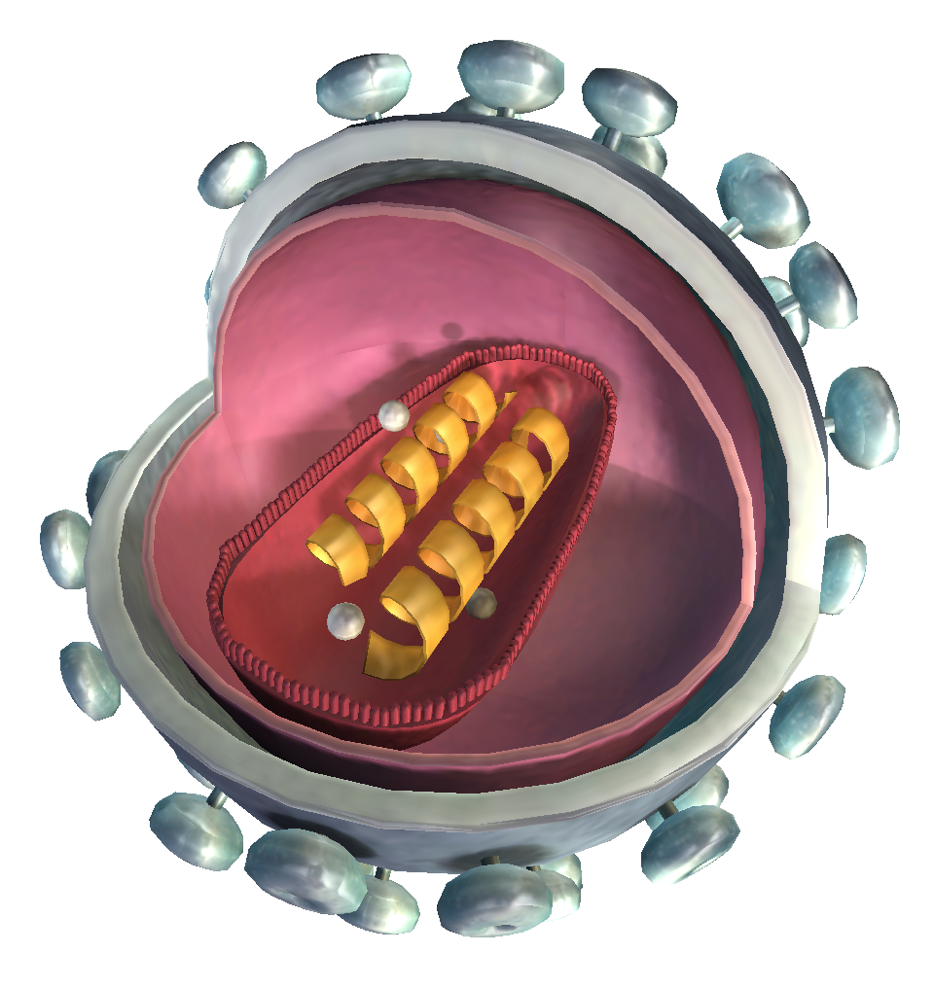

Adenovirus
Orthopoxvirus
Herpes Simplex
Influenza
Virus-TEM-to-Proteonomic Code: A Multimodal AI Pipeline for Viral Morphology and Antibody Sequence Generation David Claridge Team #: [Not Received] Course Section: 730ZA
Click to open in Lifeliqe

Slide 2
The Problem of Time
According to the CDC Museum Covid-19 Timeline (available online), the novel virus was recognized as atypical pneumonia symptoms in patients within Wuhan as early as December 12, 2019 and the genetic code was sent to the WHO as soon as January 5th, 2020. The virus is officially categorized as a strain of Coronaviridae on January 10th. The first reported death is reported by China on January 11th. The first documented case of Covid-19 leaving China was on January 13th, reported by Thailand’s Ministry of Public Health. By the end of the month, Covid-19 managed to spread worldwide, despite efforts by countries around the world to curtail the spread. By February 10th, 2020, the worldwide death toll was reported to be 1,013. March 11th, the deaths reached 4,291. Moderna begins human trials for a vaccine March 17th. April 30th, 2020, the Trump Administration established Operation Warp Speed to fund six “promising” vaccine candidates for study. The first person to receive a vaccine outside of trial was Sandra Lindsey on December 14th. Over the next 10 days ~1 million vaccines are administered to elderly patients and healthcare workers. While 2.8 million US citizens were vaccinated by December 31st, this was 1/10th of the goal set out by policy and the reported death toll of Covid-19 in the states was reported to be 400,000 by January 18th, 2021, double the highest estimate that Dr. Fauci and Dr. Brix gave in March 31st, 2020. The death toll worldwide was estimated 15 million from January 2020-December 2021. The death toll reached 1 million in the USA by May 12th, 2022, with Brown University estimating 50% of these US deaths were vaccine preventable (reported May 16th, 2022). (CDC 2023)
Why is this relevant?
In 2020, AI was still in relative infancy, so conventional biological tests were the norm for the medical field. However, with CNN models and generative AI becoming more prevalent and available publicly, innovation in de novo study may be key for medical advancement. While the detection of Covid-19 was relatively fast, the response came far later than the initial detection. While all medicine requires vigorous testing for side effects, vaccines (while reliable) are slower than natural antibodies.
Keywords
Adenovirus, Influenza, Orthopox/Cowpox, CNN, Generative AI, Amino Acids, Proteomic Code

Slide 3
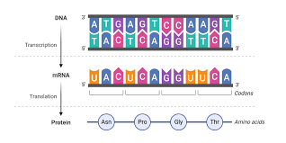

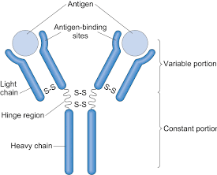
Lexicon
Dry Biochemistry
Antibodies
Amino Acids
Proteins released by B-cells within the immune system that bind and attack foreign bodies (i.e. viruses)
Building blocks of proteins such as antibodies. There are 20 base and distinct amino acids that every living being can code from DNA.
Proteonomic code
TEM imaging
Like the nucleotides in DNA (GCAT), Amino Acids also have an alphanumeric code (ACDEFGHIKLMNPQRSTVWY) which is often simpler to use than the traditional DNA code.
Transmission Electron Microscopy is a high-resolution imaging technique used for imaging microscopic organisms and viruses.
AI fun
CNN.
Convolutional Neural Network, a layered network utilized primarily for visual data such as images. (Krizhevsky et al 2012)
Computer Vison
Field of Artificial Intelligence focused on enabling computers to interpret, analyze, and extract meaningful data. (Goodfellow 2016)
Fig 1. DNA to RNA to Protein pathway
Fig 2. Diagram of Antibody
Fig 3. Graph of standard CNN

Slide 4
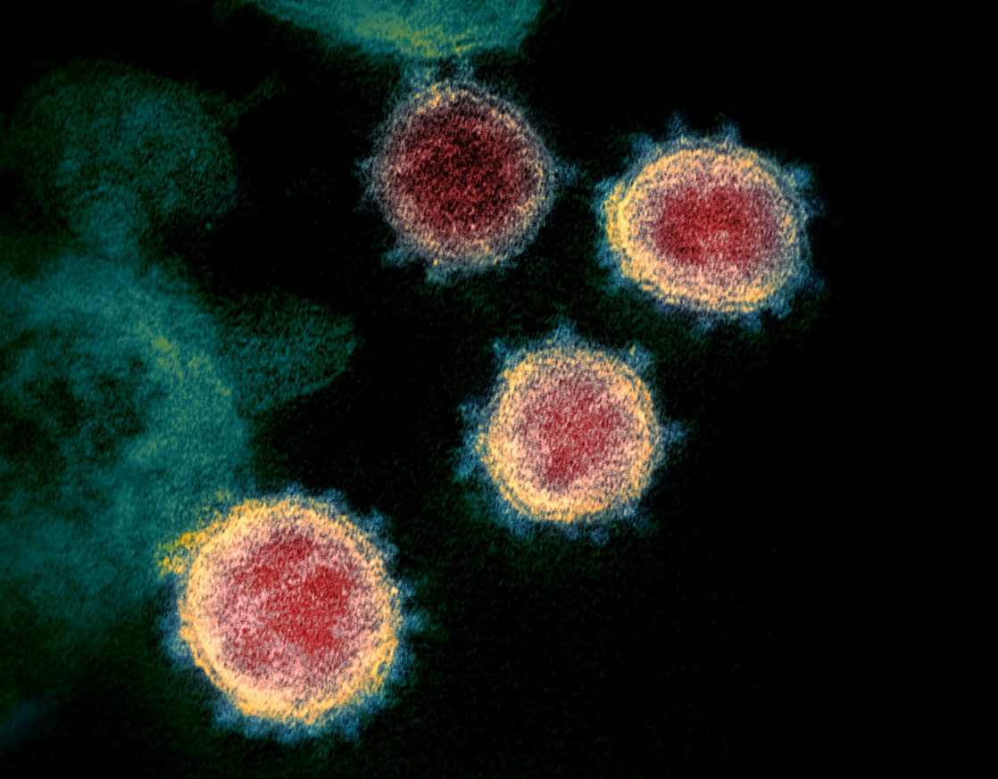
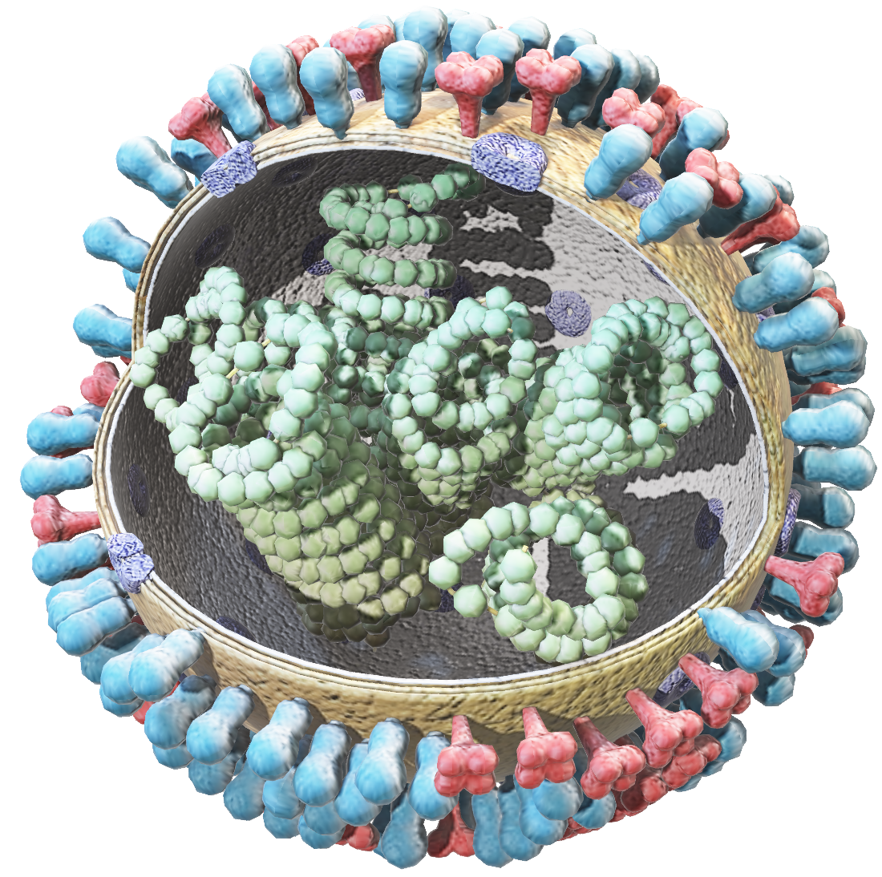
The Pipeline
Image → CNN → Class → Markov Model → VH/VL → Similarity score
Slide 4
4
Click on the model to interact
Transmission Electron Microscopy is typically in black and white, but usually, color is added for research reporting

Slide 5
1. TEM Training
Damian Matuszewski and Ida-Maria Sintorn created a data set of 22 classifications of viruses with 1245 images. (Matuszewski, Sintorn 2021).
*Disclosure* The training data is robust but the dataset itself was not utilized for the same purpose as this project, and the data is publicly available, so plagiarism is not a concern for this project.
For sake of time, 3 classes were chosen for their similarity to Herpes Simplex: Adenovirus, Orthopox/Cowpox, and Influenza
The images were put through a CNN and ran through 25 epochs.
CNN
self.conv1 = nn.Conv2d(3, 16, 3, padding=1)
self.conv2 = nn.Conv2d(16, 32, 3, padding=1)
self.fc1 = nn.Linear(32 * 7 * 7, 64)
self.fc2 = nn.Linear(64, 3)
x = self.pool(F.relu(self.conv1(x)))
x = self.pool(F.relu(self.conv2(x)))
x = torch.flatten(x, 1)
x = F.relu(self.fc1(x))
x = self.fc2(x)
Antibody: context = seq[i:i+k]
next_char = seq[i+k]
model[context][next_char] += 1
next_char = random.choices(chars, weights=weights)[0]
output += next_char
2. Antibody Training
Antibodies for differing diseases have been isolated, structurally identified, and logged away in databases for decades. Thus, viruses that have been in the eye of the medical community long enough will ultimately have their corresponding antibody documented somewhere. Unfortunately, there is no one dataset for the three selected viruses so multiple were used, and the Adenovirus data required the creation of a webscraper
Adenovirus antibody dataset was scraped from RCSB Protein Data Bank
Influenza antibody dataset was sourced from Immune Epitope Database
Cowpox antibody dataset was sourced from Pox-AbDab
Once collected, all three datasets were concat into a single spreadsheet and then fed into a Markov-chain-style probabilistic sequence model so that given antibodies could be linked to the CNN model. Once coded with a generator it can then generate heavy and light chains when analyzing new TEM images.

Slide 6
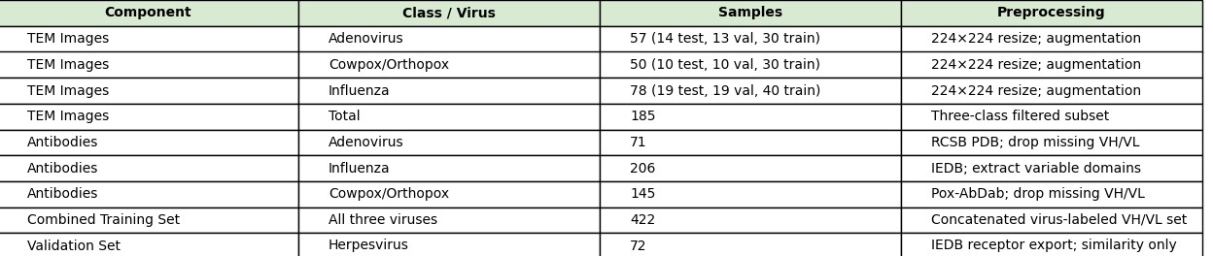
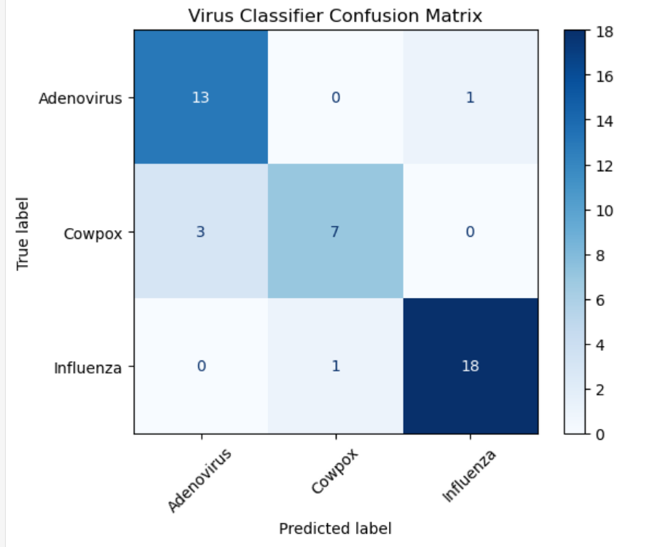
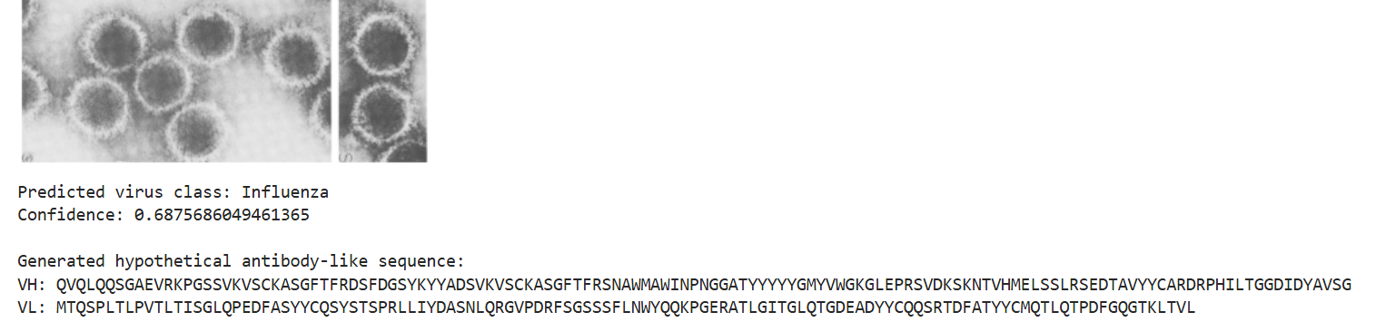
Generation
If we’re training on Adenovirus, Influenza, and Cowpox, then why are we evaluating Herpes which was NOT in the dataset?
The challenge for this proof of concept is to show that the model can have significant accuracy when faced with an unknown virus. Herpes is its own classification of virus, but is structurally similar to Influenza and shares other characteristics with Cowpox and Adenovirus
We have the data, now what?
Give the model the TEM of Herpes Simplex:
img = Image.open(input_image_path).convert("RGB")
predicted_class, confidence = predict_virus(
input_image_path,
model,
test_transform,
train_data.classes
)
Plus generation of proteonomic code
generated_vh = generate_sequence(
generators[predicted_class]["VH"]
)
generated_vl = generate_sequence(
generators[predicted_class]["VL"]
)
Figure 4. Table of dataset construction, placed here due to lack of space on previous slide.
Figure 5. Confusion matrix of CNN model, included here to show the competency of this model in guessing a virus’s classification.
Figure 6. Output of proteonomic code alongside the competence test. Since it was not trained on herpes, influenza was the next best guess for it.

Slide 7
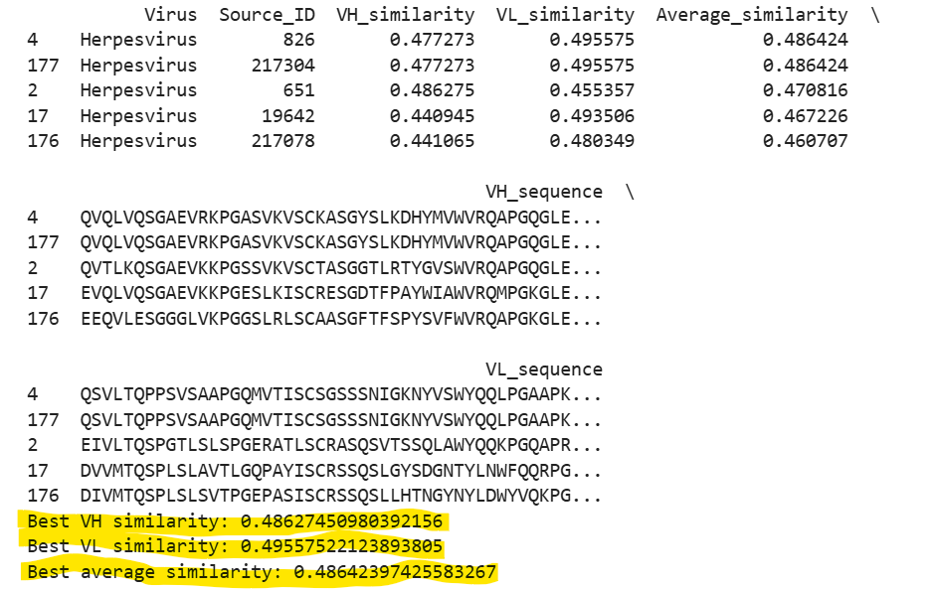
Validation
What is to be done with the chains?
Luckily, Immune Epitope Database also has antibody data for herpes, so a comparison to actual antibodies can be done with the generated code. A random sequence would generate 5-15% similarity, so Score>15% is the goal.
SequenceMatcher(None, generated_seq, reference_seq).ratio()
(IEDB Herpes Receptor Dataset)
Fig 7.. Probabilistic antibody sequence generation process using VH/VL amino acid transition patterns.
Disclaimer: No structural or binding validation is performed. There is no biological binding metric in the validation.

Slide 8
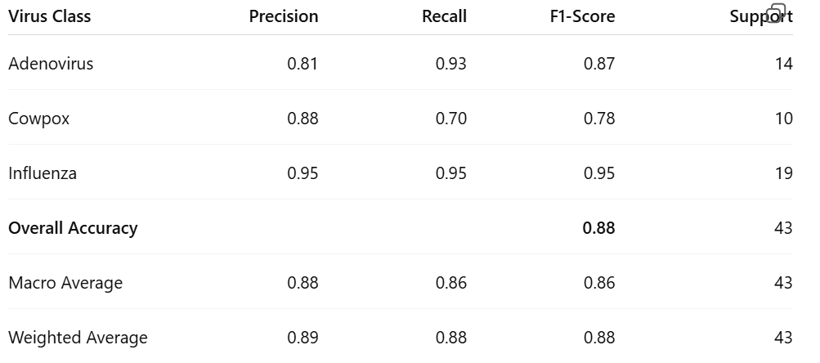
Conclusion and Takeaways
Best Validation Accuracy: 90.7%
Test Accuracy: 88.37% vs. Random classifier chance of 33% Or Majority Class Baseline of 78 (influenza)/ 185 (total)= 42.2% (classification is therefore not random).
Adeno virus Antibody entries: 71
Influenza Antibody entries: 206
Pox entries Antibody: 145
Final TEM dataset: 422 entries
Herpes antibody entries: 72
Confidence score of classification of Herpes: 68.7% (Compare again to RC and MC baselines)
Best VH similarity: 48.6%
Best VL similarity: 49.6
Best average similarity: 48.6%
Fig 8. Herpes simplex evaluation against an unseen viral class.

Slide 9
References
Goodfellow, I., Bengio, Y., & Courville, A. (2016). Deep learning. MIT Press. https://www.deeplearningbook.org/
Krizhevsky, A., Sutskever, I., & Hinton, G. E. (2012). ImageNet classification with deep convolutional neural networks. Advances in Neural Information Processing Systems, 25. https://papers.nips.cc/paper/2012/hash/c399862d3b9d6b76c8436e924a68c45b-Abstract.html
Matuszewski, B. J., Sintorn, I.-M., & Strand, R. (2021). TEM virus images: Benchmark dataset and deep learning classification. Computer Methods and Programs in Biomedicine, 209, 106318. https://www.sciencedirect.com/science/article/pii/S0169260721003928
Immune Epitope Database (IEDB). (n.d.). Immune Epitope Database and Analysis Resource. National Institute of Allergy and Infectious Diseases. Retrieved May 6, 2026, from https://www.iedb.org/
Protein Data Bank. (n.d.). RCSB Protein Data Bank. Worldwide Protein Data Bank. Retrieved May 6, 2026, from https://www.rcsb.org/
Raybould, M. I. J., Marks, C., & Deane, C. M. (n.d.). Pox-AbDab: A database of antibodies against orthopoxviruses. University of Oxford. Retrieved May 6, 2026, from https://opig.stats.ox.ac.uk/webapps/poxabdab/
Centers for Disease Control and Prevention Museum. (2023). CDC Museum COVID-19 timeline. https://www.cdc.gov/museum/timeline/covid19.html

Slide 10
HW12 Reflection Question 1
What aspect of AI did you find most technically challenging in completing this term project?
The hardest part was determining how many epochs would be necessary for accuracy. I settled on 25 as that consistently got ~90% accuracy.

Slide 11
HW12 Reflection Question 2
What aspect of AI do you think you learned the most about over the course of the project?
That is hard to quantify as I came in with an empty cup. I think just the depth of how many classifications of AI exist was my biggest takeaway.

Slide 12
HW12 Reflection Question 3
What is your top priority for future work, if you were to continue this project as a research project or in independent study?
This project was a proof of concept and I would prefer to develop actionable software. I would want to train the AI on larger datasets first and foremost, but after it would need to be trained on the chemical/physical properties of the 20 amino acids as at first glance I am not confident that the light chain is structurally sound. Ideally, this AI could create an actionable antibody sequence that could then be fabricated in a wet lab.

Slide 13
Interview Question Q4
Your project is currently framed under the 'Agentic AI' track. However, looking at your final architecture (Image → CNN → Class → Markov Model → Sequence), this operates strictly as a feed-forward, multimodal prediction pipeline. What specific component of this system demonstrates autonomous decision-making, environment interaction, or policy optimization that justifies the 'Agent' label?
The project would likely be more accurately described as a multimodal perception and generative prediction pipeline. The justification is due to the perception portion, not the agent. CV would be the better label in this case.

Slide 14
Interview Question Q5
The core achievement of your pipeline is that it generates statistically plausible amino acid sequences conditioned on a virus class. But as we know, an amino acid sequence does not equal a functional antibody unless it correctly folds and binds. If you were to take this project into next semester, how would you specifically integrate a structural validation step—perhaps using something like AlphaFold—to prove these generated sequences actually bind to the viral morphology your CNN detected?
Using Alpha fold would be the quickest option, and very well may be the next step, but ideally, the agent would be a standalone model. The next step would be to incorporate training on amino acids and textual data to train the AI to understand intermolecular interactions and begin teaching it on how proteins fold.

