Slide 1

Ready Hacker One Web Service
Created By: Yi, Andy, Joe, & Claire
Github: https://github.com/josephkniest/ready-hacker-one-web-service

Slide 2

The Task:
Build an ordering system for Bonnie’s Famous Vegan Diner in under 24 hours
Meet all of the business requirements
Simultaneous food service & world domination
Github: https://github.com/josephkniest/ready-hacker-one-web-service

Slide 3
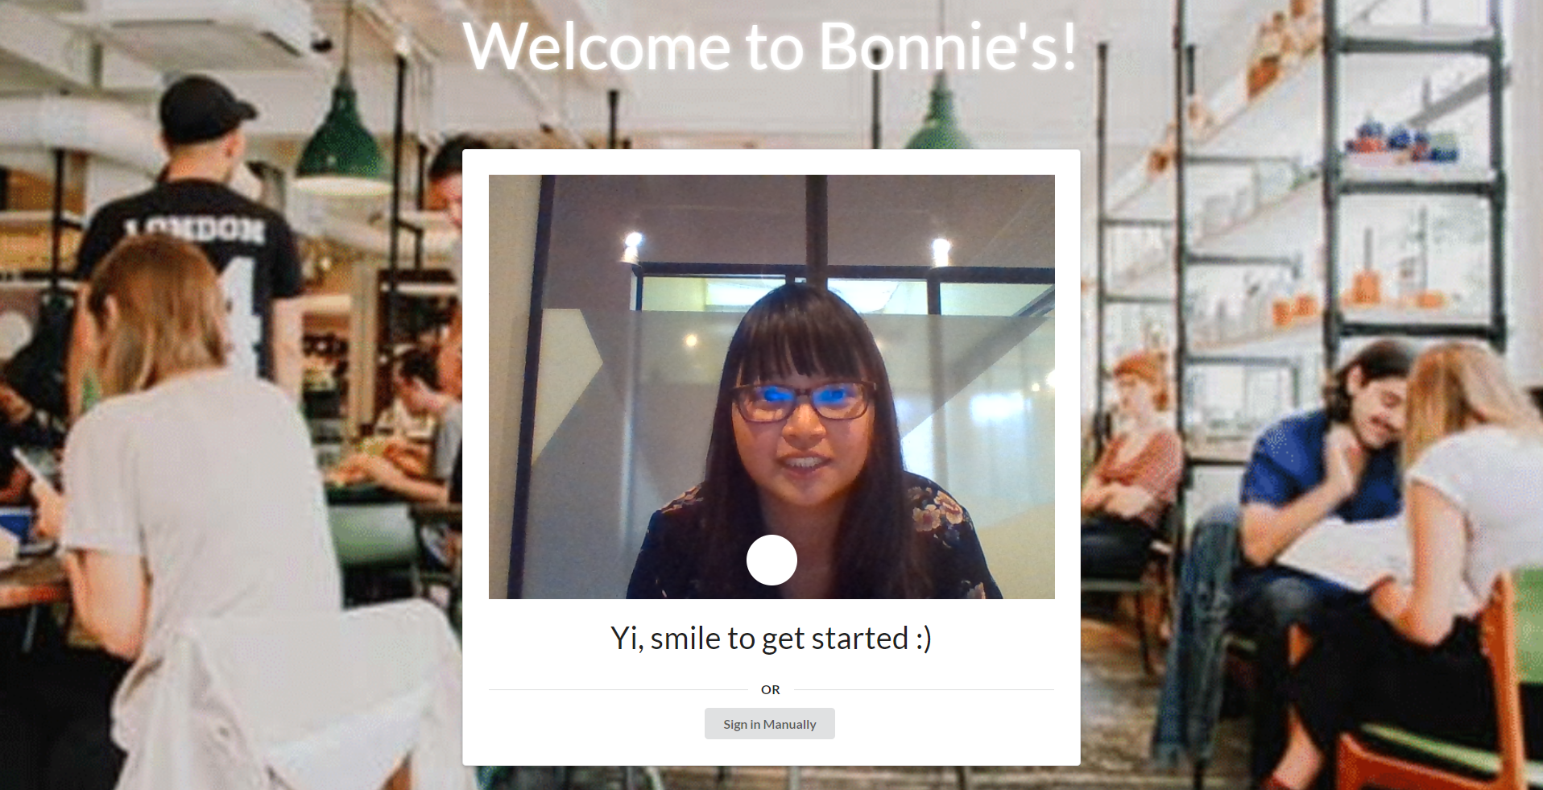
Built With:
Demonstration:
HTML
CSS
JavaScript (React for UI)
MySQL
NodeJS
Express
RDS/AWS
Semantic UI
Github: https://github.com/josephkniest/ready-hacker-one-web-service

Slide 4
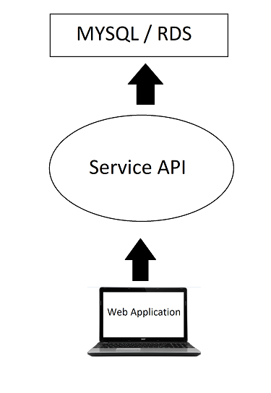
Architecture
Github: https://github.com/josephkniest/ready-hacker-one-web-service

Slide 5

Future Improvements
Facial Recognition
Voice Login
Machine Learning
Email/SMS Service
Delivery Tracker
Github: https://github.com/josephkniest/ready-hacker-one-web-service

Slide 6
Thank you for listening!
Any Questions?

