Slide 1
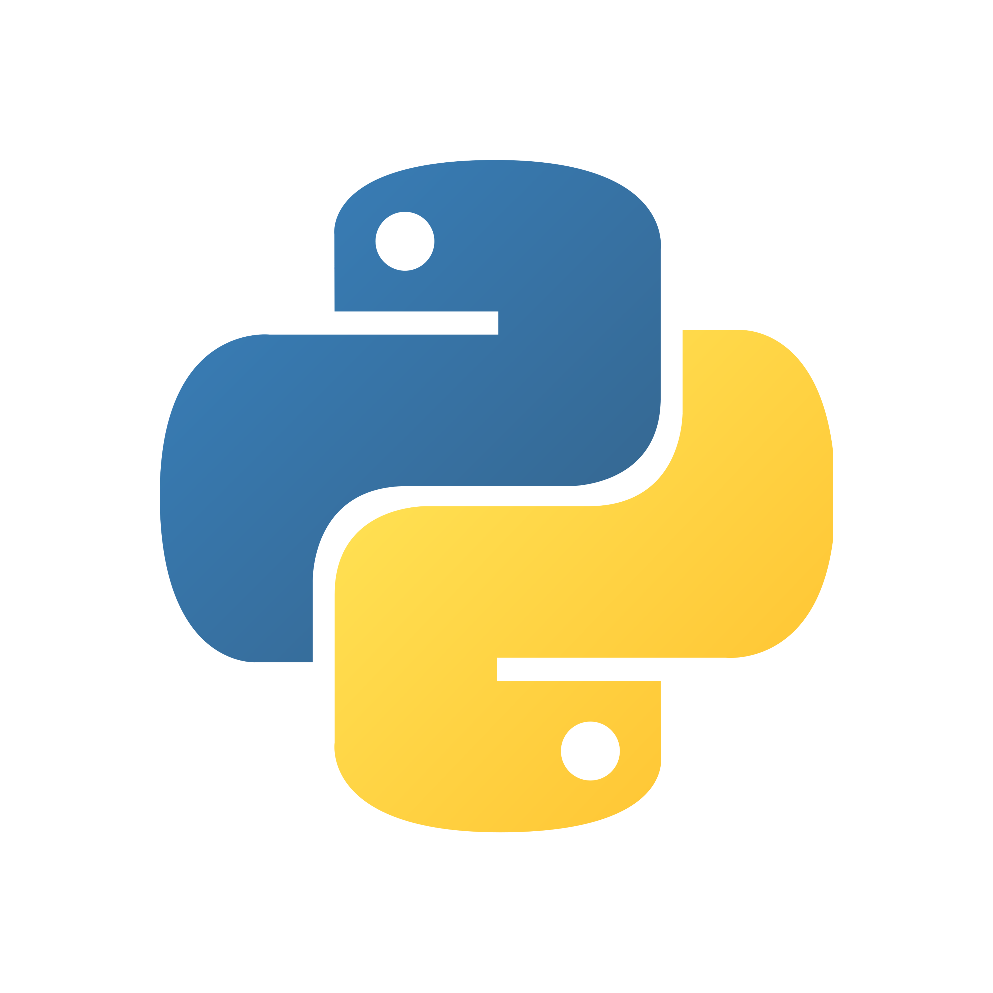
Functions
Chapter 9:

Slide 2
What are Functions?
Notes:
First a quick overview about what functions are:
- Functions are named pieces of code that only run when they're called
- A function usually accomplishes one specific task
- Functions provide a way to organise larger programmes into manageable pieces of functionality, thereby increasing readability
- Also, they save you from having to retype code that you want to use repeatedly, thereby achieving code reusability
- Functions can take any number and type of input, meaning you can pass all kinds of data into a function
- Functions can return any number and type of data as their result
Broadly speaking there are two types of functions:
- built-in functions that can be found in the Python standard library, ready for use
- user defined functions that we can create ourselves to suit our specific requirements for the programme that we’re writing

Slide 3
Function Syntax

Slide 4
def function_name(parameters):
....# statement
....return [expression] # optional
Function Syntax
Notes:
The general syntax for defining a function is to:
- type the keyword “def”
- followed by the name of the function
- parentheses enclosing any comma-separated input parameters
- finally, a colon
A functions name must begin with a letter or an underscore, and the whole name can only contain letters, numbers, or underscores. Use lowercase.
The next line needs to be indented (4 spaces).
The return statement is used to return a value and exit from the function - optional.

Slide 5
def say_hello():
pass # this function intentionally left blank
Function Syntax
Notes:
Here’s an example of a function with no parameters:
- It’s important to note that the parentheses and colon are always necessary, even with zero parameters, otherwise a SyntaxError will be raised.
The pass keyword:
- It’s a placeholder for code that will be written later
- Python requires this statement to indicate that this function does nothing - it’s sort of the equivalent of a “This page intentionally left blank” statement
- If you leave the function empty, Python will raise an IndentationError
- You would use it if you don’t have the code for your function available yet, but you need this syntactically

Slide 6
Function Syntax
def say_hello():
print('hello')
say_hello()
# hello
Notes:
Once a function is defined and you want to execute it, you can call the function by typing its name and parentheses.

Slide 7
def say_hello(someone):
print('hello', someone)
say_hello('brandi')
# hello brandi
Function Syntax
Notes:
Now, let's pass some data into the function as well.
The method say_hello is defined with one parameter called someone.
This time it will output the string 'hello’ and the value of ‘someone’.
When we call the function with the string ‘brandi’ as it's argument, it will output ‘hello brandi’.
So, in Python parameters also refer to these variables (point to them)
And arguments refer to the values passed in at function call (point)
When you call the function with an argument, the argument value is assigned to its corresponding parameter.
In the book they use the wording “copied to its corresponding parameter” which I thought sounded a bit confusing - it wasn’t clear to me whether argument and parameter would point to the same value or not. But it seems that they do! So, I’m just going to use the word assign …

Slide 8
def say_hello(someone):
print('hello ', someone)
say_hello('brandi', 'pete')
# TypeError: say_hello() takes 1 positional argument but 2 were given
Function Syntax
Notes:
The number of arguments passed in must match the number of parameters in the definition, otherwise Python will raise a TypeError.

Slide 9
return
Notes:
Now to the question: what do we get back after a function call?
Generally, functions in Python always return something, either explicitly or implicitly.
You can use the return statement to explicitly return a specific value or expression and exit the function.
That value can be any data type or object.
Statements coming after the return statement will not be executed.
A return statement is not necessary though.

Slide 10
# Function with no return value
def say_hello(someone):
print('hello ' + someone)
say_hello('clare') # => None
# hello clare
return
Notes:
If return is not explicitly called, like in the previous example, a function will implicitly return None.

Slide 11
# Function with return value
def add(a, b):
return a + b
add(12, 17) # => 29
return
Notes:
If return is explicitly called, it’ll return the expression to the caller, in this case the sum of a and b.

Slide 12
# Function with multiple return values
def divide(a, b):
quotient = a // b
remainder = a % b
return quotient, remainder
divide(15, 4) # => (3, 3)
quotient, remainder = divide(15, 4)
print(quotient) # 3
print(remainder) # 3
return
Notes:
A function can also return multiple values by returning a tuple.
For example, this function returns a tuple of the quotient and remainder of a division.
You can also assign the values in the tuple to separate variable.

Slide 13
# Function with multiple return statements
def divide(a, b):
if b == 0:
return
else:
quotient = a // b
remainder = a % b
return quotient, remainder
divide(15, 0) # => None
return
Notes:
You can also have multiple return statements, for example to return different things dependent on different conditions.
So if we wanted to ensure that our programme doesn’t raise a ZeroDivisionError, we can check for it and simply return the function without any calculation taking place in case the divisor is zero. This also demonstrates that a return statement without a specific expression will return None, like when no return statement is used at all.

Slide 14
type(None) # => <class 'NoneType’>
thing = None
if thing:
print("it's something")
else:
print("it's nothing")
# it’s nothing
thing = None
if thing is None:
print("it’s nothing")
else:
print("it’s something else")
# it’s nothing
None
Notes:
What is None?
None is Python’s equivalent of a null value, meaning that it doesn’t have a particular value at all.
It’s a data type of it’s own, the NoneType, and only None can be None.
It’s not the same as 0, the boolean False, or an empty string, but it’s a falsy value:
When evaluated as a boolean, it will evaluate to false.
However, this only tells you that ‘thing’ is a falsy value.
To distinguish ‘None’ from other falsy values, use the ‘is’ operator.
It’s a subtle distinction, but it necessary to distinguish missing values – indicated by None – from empty values (zero-valued integers or floats, empty strings, lists, dictionaries etc.).

Slide 15
Positional Arguments
Notes:
Python is quite flexible in terms of how it handles function arguments and parameters and supports several types.
The most familiar type are positional arguments: their values are assigned to their corresponding parameters in order.

Slide 16
def menu(entree, dessert, wine):
print(f"entree: {entree}")
print(f"dessert: {dessert}")
print(f"wine: {wine}")
menu('fish', 'cake', 'chardonnay')
# entree: fish
# dessert: cake
# wine: chardonnay
Positional Arguments
Notes:
For example, this function prints out a menu list from it’s positional arguments.
fish -> entree
cake -> dessert
chardonnay -> wine
This is very common, but the downside is that you need to remember the meaning of each position.

Slide 17
def menu(entree, dessert, wine):
print(f"entree: {entree}")
print(f"dessert: {dessert}")
print(f"wine: {wine}")
menu('chardonnay', 'fish', 'cake')
# entree: chardonnay
# dessert: fish
# wine: cake
Positional Arguments
Notes:
If we mixed up the order and called the menu function with the last argument as the first instead, the meal would be very different.

Slide 18
Keyword Arguments
Notes:
Keyword arguments can help to avoid "positional confusion".
Keyword arguments are specified by the names of their corresponding parameters, even if they are in a different order from their definition in the function.

Slide 19
def menu(entree, dessert, wine):
print(f"entree: {entree}")
print(f"dessert: {dessert}")
print(f"wine: {wine}")
menu(wine='merlot', entree='beef', dessert='ice cream')
# entree: beef
# dessert: ice cream
# wine: merlot
Keyword Arguments
Notes:
This is achieved by writing the parameter name and an equals sign, and then typing the argument value you want that parameter to take. Even if it’s out of order, it will still be printed correctly.

Slide 20
def menu(entree, dessert, wine):
print(f"entree: {entree}")
print(f"dessert: {dessert}")
print(f"wine: {wine}")
menu('beef', wine='merlot', dessert= 'ice cream’)
# positional first works as expected
menu(wine='merlot', dessert= 'ice cream', 'beef')
# SyntaxError: positional argument follows keyword argument
Combining Positional & Keyword Arguments
Notes:
You can call a function with both positional and keyword arguments.
Positional arguments need to be listed first, otherwise Python will raise a SyntaxError.

Slide 21
Keyword-Only Arguments
Notes:
We’ve now seen the benefit of keyword arguments to avoid positional confusion. So far it’s been up to the caller of the function to decide whether to use positional or keyword arguments. If you want to ensure that people are explicitly using keyword arguments to avoid any mis-ordering, Python lets you specify keyword-only arguments.

Slide 22
def menu(*, entree, dessert, wine):
print(f"entree: {entree}")
print(f"dessert: {dessert}")
print(f"wine: {wine}")
menu(wine='sauvignon', entree='curry', dessert='pudding')
# entree: curry
# dessert: pudding
# wine: sauvignon
Keyword-Only Arguments
Notes:
To achieve this you can type a single asterisk in the function definition: it means that the following parameters (here entrée, dessert, wine) must be provided as named keyword arguments.
So, this example shows how it would be done correctly, passing in all the arguments as a name=value pair. It still doesn’t matter in which order you pass them in.

Slide 23
def menu(*, entree, dessert, wine):
print(f"entree: {entree}")
print(f"dessert: {dessert}")
print(f"wine: {wine}")
menu('curry', 'pudding', 'sauvignon')
# TypeError: menu() takes 0 positional arguments but 3 were given
Keyword-Only Arguments
Notes:
Whereas in this example we try to pass in the arguments in a positional manner, and now we will get a TypeError.
The asterisk here is at the very beginning of the parameter list, but if you want to allow for certain positional arguments, you could have some parameters to the left of that asterisk as well.

Slide 24
Default Parameter Values
Notes:
Python allows you to specify default parameter values, which can provide some added flexibility.
Normally you need to pass in exactly as many arguments as parameters were defined. This way you make an argument optional rather than required.
Now, if the caller doesn’t provide a corresponding argument, the function will use the defined default value.

Slide 25
def menu(entree, dessert, wine='house red'):
print(f"entree: {entree}")
print(f"dessert: {dessert}")
print(f"wine: {wine}")
menu('pizza', 'cookie')
# entree: pizza
# dessert: cookie
# wine: house red
Default Parameter Values
Notes:
Continuing with the previous example of the menu function:
You can specify a default value by adding an equals sign after the parameter in question, followed by the default value you want it to take.
Here, we have specified a default value for the wine parameter.
If we call the function now without the wine argument, the code still runs – we’re defaulting to the house wine.
You can still specify a wine argument if you want a different value to the default, and the code will work fine.

Slide 26

def add_to_list(element, list=[]):
list.append(element)
print(list)
add_to_list(12)
add_to_list(15)
# Expected:
# [12]
# [15]
# Actual:
# [12]
# [12, 15]
Default Parameter Values
Notes:
Here’s an interesting gotcha moment to remember:
-- Explain the function --
Looking at this example, with what we know from Ruby, we would expect that each time the function is called a new default parameter ’list’ is created when a second argument isn’t provided.
That would produce this expected output.
In Python, default parameters are calculated when the function is defined, not when it is run (as it is done in Ruby). That means, ‘list’ is created once when the function is defined and the same list is used in each successive function call
This results in this – to me – surprising output.
It means if you have mutable object as a default value, once you mutate it, you will have that mutated object for all future function calls as well.

Slide 27
def add_to_list(element, list=None):
if list is None:
list = []
list.append(element)
print(list)
add_to_list(12)
add_to_list(15)
# [12]
# [15]
Default Parameter Values
Notes:
It‘s advised to never use mutable objects as default parameter values.
Instead, you should create a new object every time the function is called, using the default value to signal that no argument was passed in. None is often a good choice.

Slide 28
Explode & Gather Positional Arguments with *
Notes:
If you don’t know how many arguments will be passed into your function, you can add an asterisk in front of your parameter to denote an arbitrary amount of arguments.
An asterisk, when used inside a function with a parameter, groups a variable number of positional arguments into a single tuple of parameter values.

Slide 29
# args is a tuple
def display(*args):
print(args)
display()
# ()
Gather Positional Arguments
Notes:
For example:
This function has a parameter args, and because of the astersisk, that parameter will gather any number of arguments passed into the function, whether that’s 0 or 100, and it will resolve into a tuple ‘args’.
When you ‘display’ with no arguments, you will get an empty tuple.

Slide 30
# args is a tuple
def display(*args):
print(args)
display(2, 4, 8, 9, 15)
# (2, 4, 8, 9, 15)
Gather Positional Arguments
Notes:
When you call it with some arguments, you can see that all arguments are collected in the tuple.
It’s not necessary to call this ‘args’. But it’s common to do that, even though technically it’s a parameter and could be called *params – using *args seems to be the Pythonic way.

Slide 31
# args is a tuple
def display(required1, required2, *args):
print('need this one:', required1)
print('need this one too:', required2)
print('all the rest:', args)
display(2, 4, 8, 9, 15)
# need this one: 2
# need this one too: 4
# all the rest: (8, 9, 15)
Gather Positional Arguments
Notes:
You can also define a function in a way that it has some required positional arguments, and then a variable remaining number:
The required positional arguments need to go first, both in the definition and the call.
Here the first two arguments are assigned to the required parameters, and *args goes at the end and grabs whatever is left.

Slide 32
def display(number1, number2, number3):
print(number1, number2, number3)
numbers = (2, 4, 8)
display(*numbers) # like display(2, 4, 8)
# 2 4 8
Explode Positional Arguments
Notes:
In addition to gathering a number of arguments in a tuple, the asterisk can also explode a tuple into some positional arguments.
Let’s say we define this function so that it receives 3 arguments, and we have this tuple of size 3. Instead of accessing each element by hand and passing it into the function, we can use the asterisk and the variable name, and that will unpack this tuple into 3 positional arguments.

Slide 33
# args is a tuple
def display(*args):
print(args)
numbers = (2, 4, 8)
display(*numbers)
# (2, 4, 8)
more_numbers = (2, 4, 8, 9, 15)
display(*more_numbers)
# (2, 4, 8, 9, 15)
Explode Positional Arguments
Notes:
You can also combine these two uses of the asterisk:
- Here, the function remains flexible in terms of how many arguments it can receive and gathers all arguments into the tuple args that is then printed to the screen
- In the function calls, the asterisk will unpack these tuples of different lengths into a number of positional arguments

Slide 34
Explode & Gather Keyword Arguments with **
Notes:
To achieve this functionality with keyword arguments, use a double asterisk.
When used with a parameter, the double asterisk will gather a variable number of keyword arguments and resolve them into a dictionary, where the parameter names are the keys, and the argument values are the corresponding dictionary values.

Slide 35
# kwargs is a dictionary
def display(**kwargs):
print(kwargs)
display(a=1, b=2, c=3)
# {'a': 1, 'b': 2, 'c': 3}
Gather Keyword Arguments
Notes:
This example is similar to the previous, in that it will simply print the dictionary kwargs.
When calling the function with some keyword arguments, you can see that they are gathered in a dictionary:
- The name becomes the dictionary key
- The value the corresponding dictionary value
Again, the Pythonic way is to refer to this dictionary parameter as ‘kwargs’ – keyword arguments – even thought it’s technically a parameter.

Slide 36
def display(*, a, b, c):
print(a, b, c)
dictionary = {'a': 1, 'b': 2, 'c': 3}
display(**dictionary) # like display(a=1, b=2, c=3)
# 1 2 3
Explode Keyword Arguments
Notes:
You can also explode a dictionary’s key-value pairs into name=value arguments using the double asterisk.

Slide 37
# kwargs is a dictionary
def display(**kwargs):
print(kwargs)
dictionary = {'a': 1, 'b': 2, 'c': 3}
display(**dictionary)
# {'a': 1, 'b': 2, 'c': 3}
Explode Keyword Arguments
Notes:
And as with the positional arguments, you can combine the two use cases of the double asterisk and be super flexible.
The general argument order to remember:
- positional: first required, then optional
- then keyword: first required, then optional

Slide 38
Mutable & Immutable Arguments
Notes:
Lastly, I want to touch quickly on mutable vs immutable arguments.
Remember: when two variables are assigned to the same mutable object, you can can change that object using either variable. The same doesn’t hold true for immutable objects like Strings or Integers.

Slide 39
outside_list = ['i', 'love', 'python']
def mangle(list):
list[2] = 'ruby!!!'
print(outside_list)
# ['i', 'love', 'python’]
mangle(outside_list)
print(outside_list)
# ['i', 'love', 'ruby!!!']
Mutable & Immutable Arguments
Notes:
You need to watch for the same behaviour when passing arguments into a function:
- If the argument is mutable – like this list here – it’s value can be changed from inside the function via it’s corresponding parameter
It’s good practice to not do this and rather return a new value.

Slide 40
Quiz

Slide 41
1
Which of the following is a valid function name?
my_function
1my_function
my-function
_my_function1
What is the output of the following display_person() function call?
def display_person(*args):
for i in args:
print(i)
display_person(name="Emma", age="25")
3
What does None represent in Python?
an empty value
a missing or undefined value
C. a False value
D. a zero value
Given this code, what will be the output of the print function call?
def update_dict(key, value, my_dict={}):
my_dict[key] = value
return my_dict
result1 = update_dict('a', 5)
result2 = update_dict('b', 10)
result3 = update_dict('c', 15, {})
print(result3)
2
4

Slide 42
1
Which of the following is a valid function name?
my_function
1my_function
my-function
_my_function1
What is the output of the following display_person() function call?
def display_person(*args):
for i in args:
print(i)
display_person(name="Emma", age="25")
# TypeError: display_person() got an unexpected keyword argument 'name'
3
What does None represent in Python?
an empty value
B. a missing or undefined value
C. a False value
D. a zero value
Given this code, what will be the output of the print function call?
def update_dict(key, value, my_dict={}):
my_dict[key] = value
return my_dict
result1 = update_dict('a', 5)
result2 = update_dict('b', 10)
result3 = update_dict('c', 15, {})
print(result3)
# {‘c’: 15}
2
4

