Slide 1
Treaps (Cartesian Trees)
Clarissa Audrey
51844165

Slide 2

Properties of treaps
Tree + Heap = Treap!
Introduced first by Raimund Seidel and Cecilia Aragon in 1987.
In-order
For each node in the tree, x_{k} <= y_{k} for node y on the right subtree of x. And conversely, y_{k} <= x_{k} for node y on the left subtree of x.
Heap-order
For each node in the tree, x_{p} <= y_{p} if y is the parent of x (read this as x has lower priority than y). This can be min-heap or max heap.

Slide 3
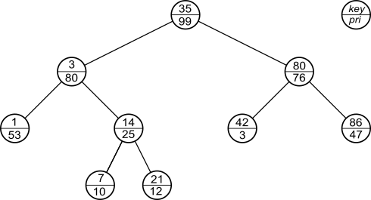
Example of a treap

Slide 4
Advantages of treaps
Easy to implement!
Treaps will offer a unique representation of the elements in the set. This is useful for authentication and security purposes.
We will mainly spend only O(log N) time complexity for operations in treaps, where N is the number of nodes.

Slide 5
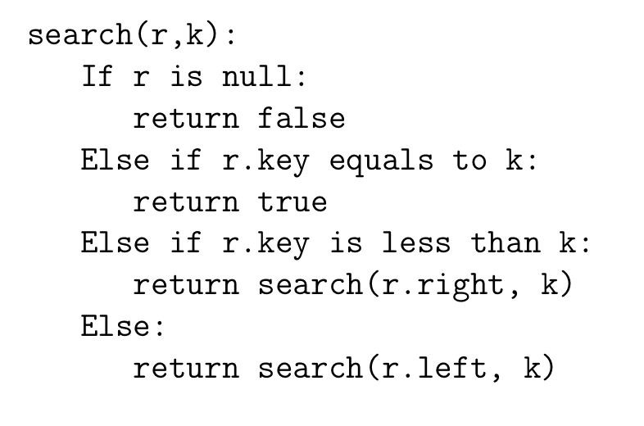
Searching a node
Time complexity: O(log N)

Slide 6
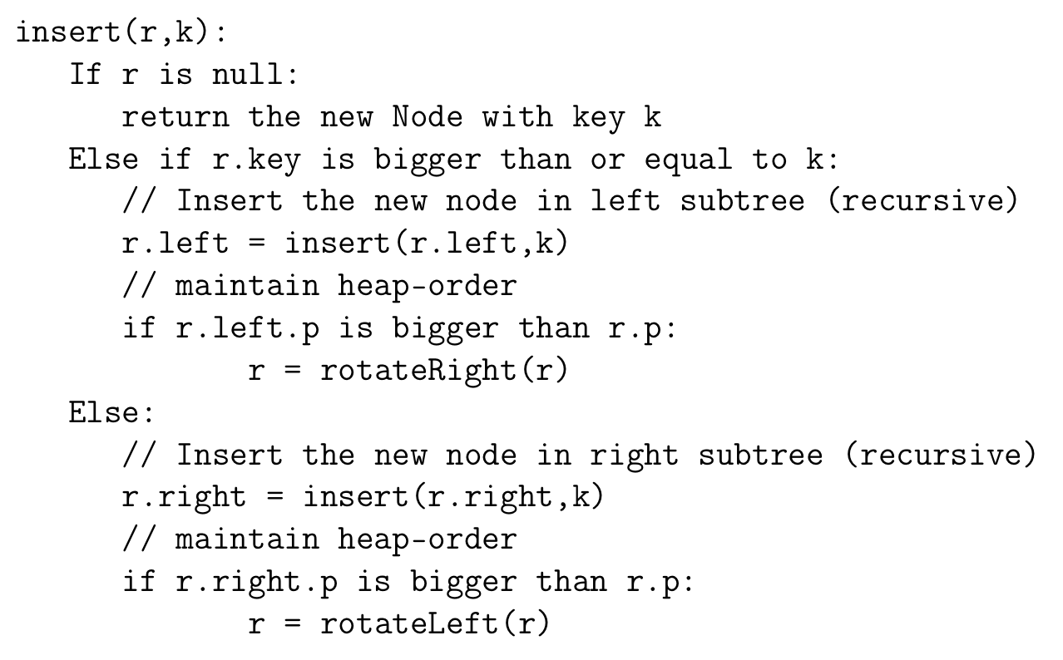
Inserting a node
Note: After inserting, heap order needs to be maintained by rotating the tree
Time complexity: O(log N)

Slide 7
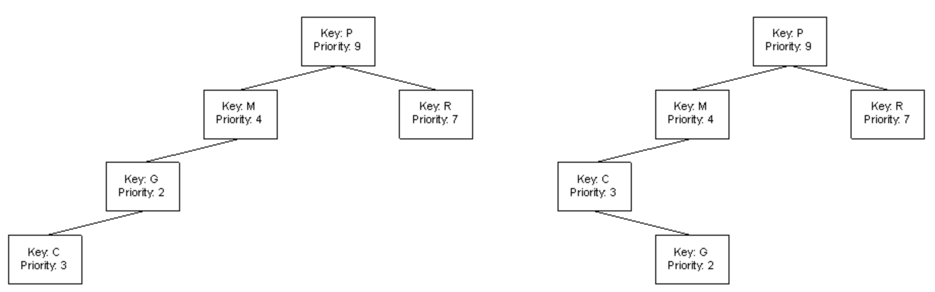
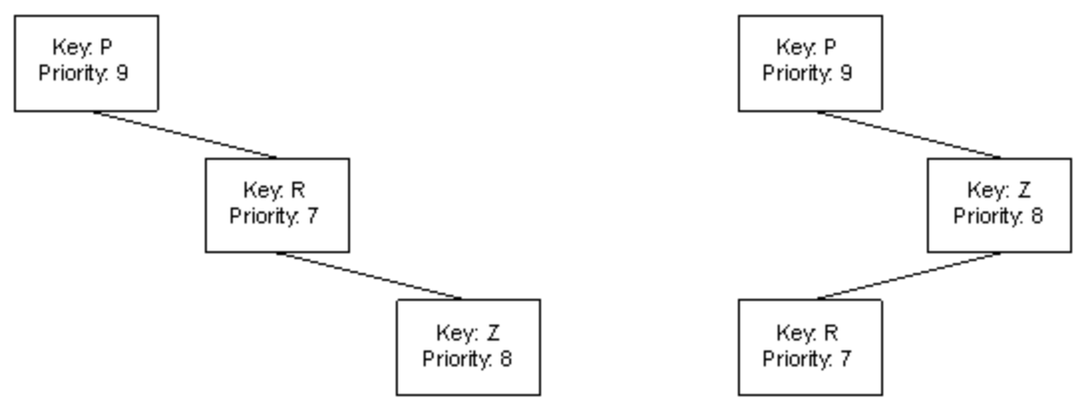
Rotating tree
Right rotation:
Left rotation:
Time complexity: O(1)

Slide 8
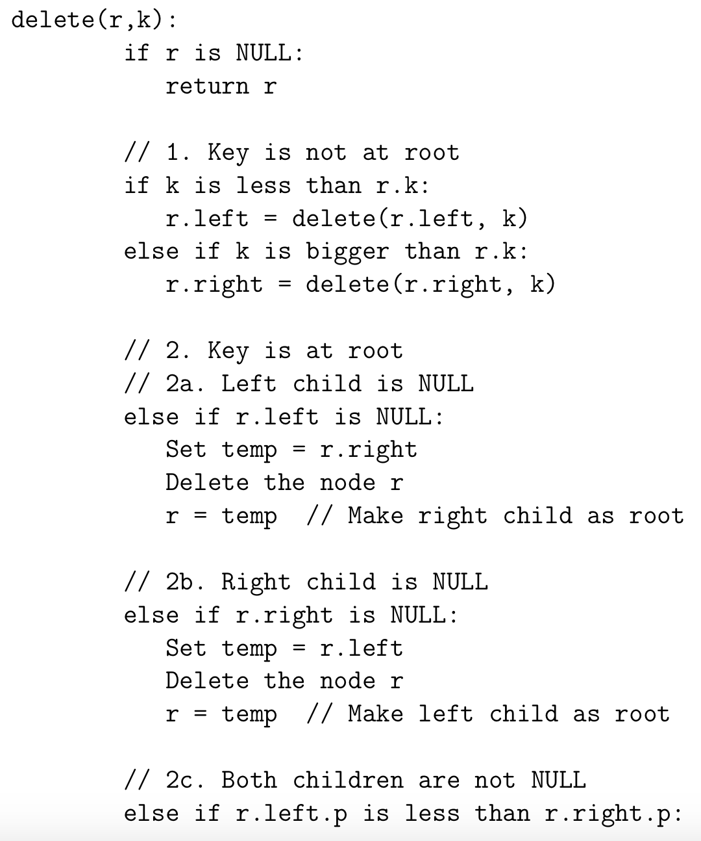
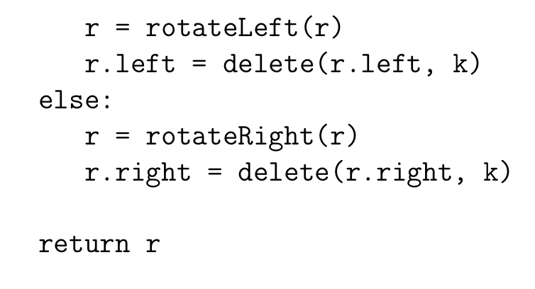
Deleting a node
Time complexity: O(log N)

Slide 9
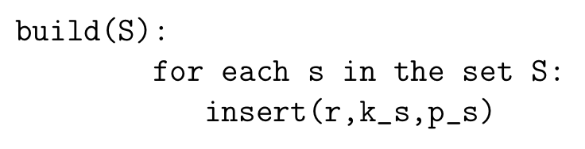
Build a treap
Time complexity: O(N * log N)

Slide 10
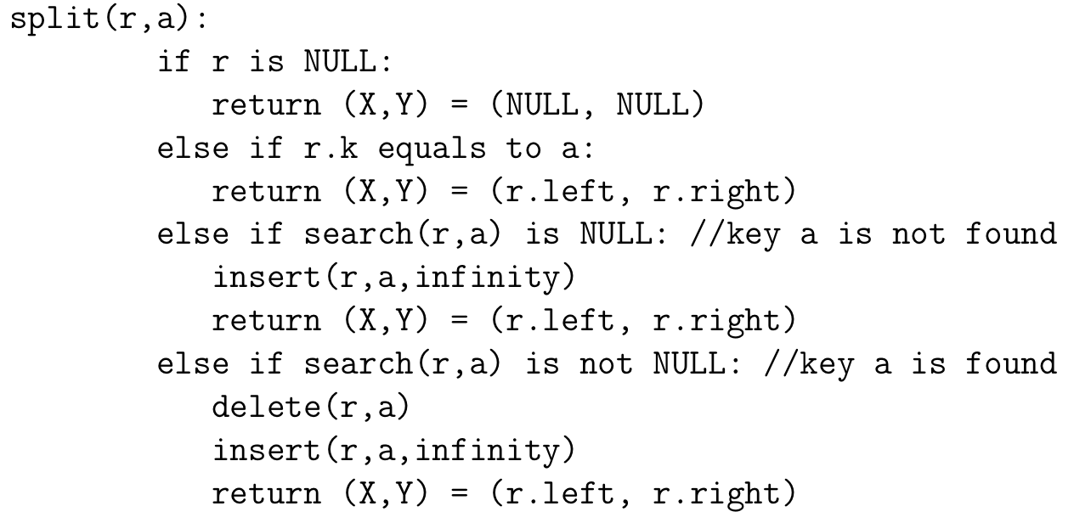
Splitting a treap into two subtreaps
Key idea: Add the specified key with infinity priority so it will be the root
Time complexity: O(log N)

Slide 11
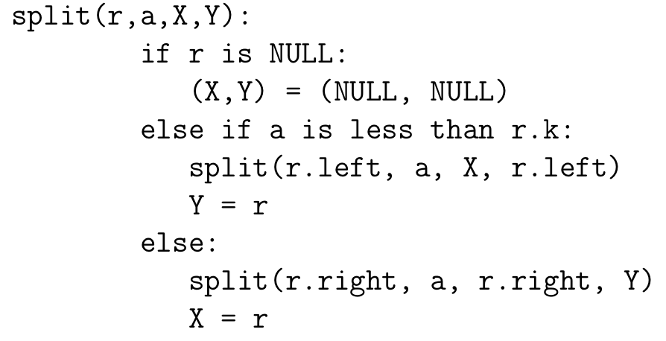
Splitting (recursive)
Time complexity: O(log N)

Slide 12
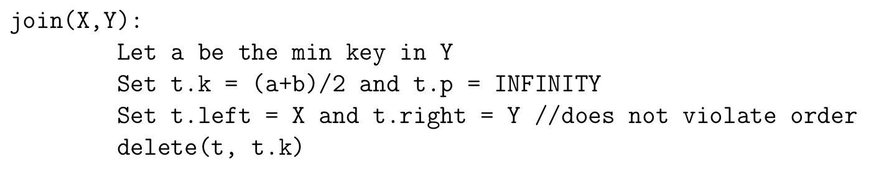
Merging two treaps
Assumption: The max key in X is smaller than the min key in Y
Key idea: Create a new node with key = (max_{key}(X) + min_{key}(Y))/2, append the two treaps, and delete this node
Time complexity: O(log N)

Slide 13
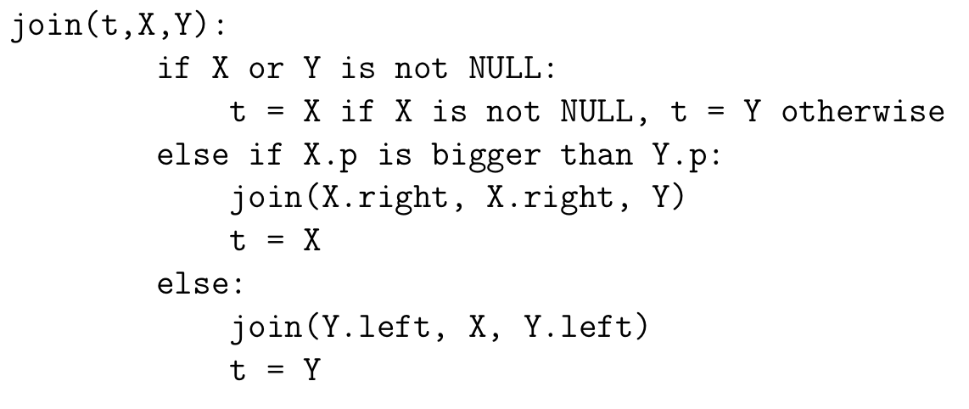
Merging (recursive)
Time complexity: O(log N)

Slide 14
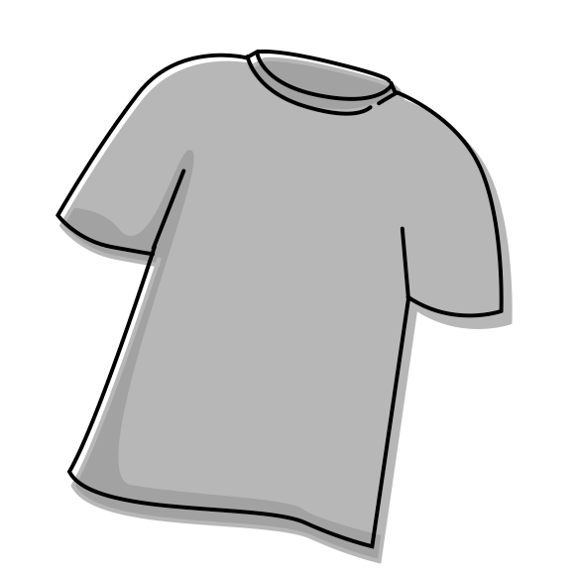
Example problem
Context: There are N type of t-shirts for sale. Each type has quality q and cost c, and is unlimited in quantity. There are M customers and each one brings some amounts of money y.
Problem: For each customer, find out how many t-shirt he/she can buy given the money that he/she has. The condition is the customer wants to buy the maximum possible number of the highest quality t-shirts, then to buy the maximum possible number of the highest quality t-shirts from residuary t-shirts and so on. If quality of a type is the same, then customers will prefer the cheaper one.
Assume: All customers act independently from each other, and the purchase of one does not affect the purchase of another.
Source: https://codeforces.com/contest/702/problem/F

Slide 15
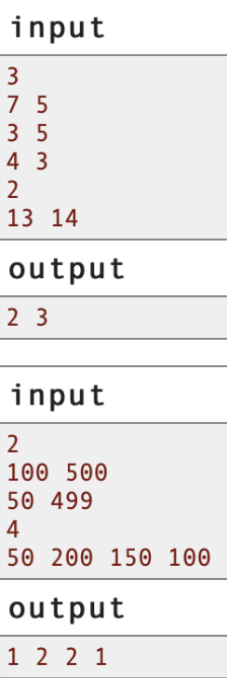
Example inputs and outputs
# of t-shirts type
Cost and quality of type i
# of customers
Money of customer k
Amount of t-shirts that customer k buy

Slide 16
Solution
Insight:
Use lazy propagation: compute the value of any objective function f for a node from the answers of its children.
f₁ = Cost so far and f₂ = how many affordable t-shirts there are in each subtree
Function push(x) propagates the objective functions from x to its children. Add this function at the beginning of all the functions which modify the tree.
The implementations of insert, merge, and split are the same as before.
Key of each node = money each customer has, random priority
Sort the array based on decreasing quality order. If quality is the same, sort in increasing cost order.
Point_update(x): Given a value x, e.g cost of a t-shirt type, split the array into l and r. If r is not NULL, add f₁ by x and add f₂ by 1. Merge back the treap.

Slide 17
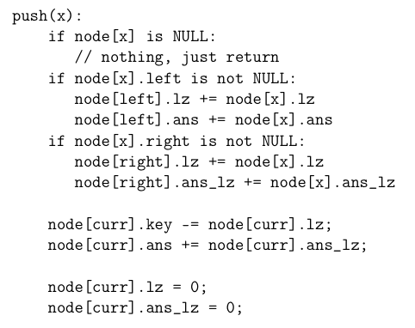
Pseudocode for push(x)
Time complexity: O(1)

Slide 18
Runtime analysis
M = # of types of T-shirts N = # of customers
Sorting the cost/quality array = O(M log M)
Building the treap out of each customer’s money = O(N log N)
Push = O(1)
Insert, merge, split = O(log(N))
Point update for each cost of t-shirts type = O(M log N)
Total runtime = O(M log M + N log N + M log N + c)

Slide 19





Quarantine recommendations
Binge watching Rick & Morty or O Mecanismo
At-home workout
Read some Ayn Rand or Dostoevsky
Learn a new skill
Do the things that you said you would do two years ago but never did

