Slide 1

Introduction to Whinfell
January 2023

Slide 2
Table of Contents
Topic
Situation Update & Executive Summary
Platform Overview
Baja Project Investment Structuring
Comparable Credits
Page
2
4
[ ]
[ ]

Slide 3
Situation Update & Executive Summary

Slide 4
Situation Update
C O N F I D E N T I A L D R A F T
Situation Update & Executive Summary
[Discussions had to ACT to-date]

Slide 5
C O N F I D E N T I A L D R A F T
10-Yr IRR at Cave Costs and Credit Sale Prices
Assumptions
$20mm investment
Cave costs from $1,500 to $2,500
Credit prices from $100/tonne to $300/tonne
90% of credits are sold to investor in exchange for investment of any size (does not contemplate economies of scale)
Production scales at 33% of target in the first year, 66% of target in the second year, and 100% of target thereafter
Assumes investment in year 1 and credit generation from year 2

Slide 6
[ ]
Project Structuring Discussion Materials
Assumptions
$20mm investment
Cave costs from $1,500 to $2,500
Credit prices from $100/tonne to $300/tonne
90% of credits are sold to investor in exchange for investment of any size (does not contemplate economies of scale)
Production scales at 33% of target in the first year, 66% of target in the second year, and 100% of target thereafter
Assumes investment in year 1 and credit generation from year 2

Slide 7
Team Introduction & Executive Summary
Key Differentiators
Whinfell’s professionals have executed a wide variety of global projects and have deep sector expertise.
Independence with institutional focus
“Client first approach”
No conflicts arising from lending, investing, or underwriting activities
Full time and senior-level engagement team with buy-side mindset
Delivery team average age of ~50
Ability to complement culture and pace of early-stage entrepreneurial projects to established corporates
Methodical and disciplined approach
Execution methodology developed through rigorous world class institutional training and experience: Allstate, AXA, Evercore, Jefferies, IBM, Lazard, MetLife, and JP Morgan
Master degrees from leading universities: Erasmus, Kellogg (Northwestern), Vanderbilt, NYU, and University of Texas
Multi-product and cross-functional capabilities
Financial: Straight/convertible debt, municipals, straight/structured equity, tax equity, joint-ventures, and sustainability-linked
Asset /Risk Management & Hedging: Bespoke hedge design, portfolio management, and sophisticated derivatives trading expertise
Sustainability: Sustainability framework design and implementation of Sustainability Accounting Standards
Data Science: Statistical method-based design of enterprise data gathering, structuring, interpretation, and reporting
Operations: Industrial facility operational template design, supply chain optimization, and organizational design
Active global network
Strong and current working relationships with European, Asian, and Latin American investment groups through overseas postings in the China, Germany, Hong Kong, , UK, Singapore, and Taiwan

Slide 8
Team Introduction & Executive Summary
Environmental Offset Capabilities
Whinfell works across the environmental offset value chain to provide bespoke solutions for its clients. We are vertically integrated with primary focus on asset management and corporate/project finance.
Environmental Offset Landscape
Project Sponsors
Corporate Issuers
Market Makers
Asset Managers
Corporate Buyers
Corporate & Project Financial Advisory
Project and corporate financial advisory
Carbon sequestration and storage methodology compliance
Voluntary carbon credit structuring and issuance
Outsourced corporate development, risk management, and liquidity management
Offset - Linked Debt & Equity
Mandatory convertible debt/equity
Debt/equity + voluntary carbon credit options/SDG offset options
Project-specific structures: pre-construction, growth, steady-state, hybrid
Long-only
Tailored strategies: vintage spread, volatility-constrained, geographic spread, sector spread, vintage spread
Portfolio decarbonization
Global research
Index Funds & SMAs

Slide 9



Team Introduction & Executive Summary
Indicative Investment Opportunities
Whinfell is advising a number of US-based carbon credit generators at various stages of development.
Project
Description
Metrics
Development-stage corn biofuels platform based in Iowa, USA
Industry-leading carbon impact score
Capacity of 20mm gallons SAF, 68mm gallons ethanol, and other co-products
Will sequester ~450K tonnes CO₂ per year
Seeks to raise ~$15mm via future credit monetization
Puro registration in-process
EBITDA margins of >30%
Biogenic sea cave producer based in California, USA
Pilot project underway in Baja, Mexico in partnership with local fishing co-ops
Additional projects scheduled for California coast, Senegal, Papua New Guinea, and other regions
Will sequester 4 tonnes CO₂/cave and ~
Raising ~$20mm project financing
ICR and J Blue Credit registration in 2023
10-IRR of ~17% at $20mm investment
Development-stage blue methanol project based in Louisiana, USA
Capacity of 1.8mm tonnes blue methanol
Off-take agreements for 80% of capacity
Will sequester ~1mm tonnes CO₂ per year
Seeks to raise ~$60mm via future credit monetization
Puro registration in-process
EBITDA margins of >20%

Slide 10
Platform Overview

Slide 11
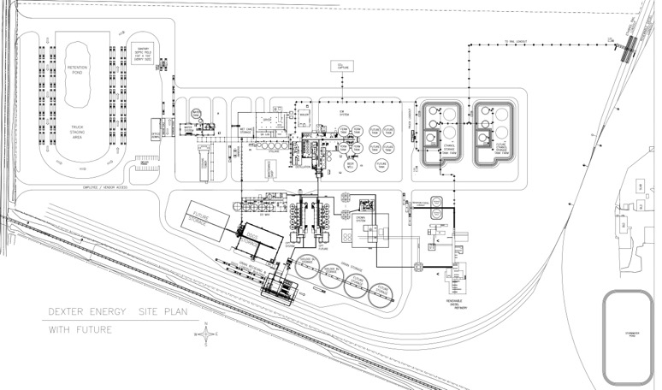
Dexter Energy
Summary Profile: Dexter, IA Facility ($ in millions, unless otherwise indicated)
Business Description
Carbon Credits Opportunity
68mm-gallon facility to produce an attractive portfolio of bioenergy products and coproducts
Includes low CI ethanol, SAF, human grade high protein corn starch, and dried distiller’s grains
Preliminary debt and equity term sheets received for $420mm financing including up to $300mm USDA debt guarantee
Also seeking additional $15mm of near-term liquidity
18 to 24-month construction and ramp-up period
Off-take/corn procurement agreements with CHS and hedging arrangements with Cargill
Facility will sequester 400,000 to 500,000 CO₂ per year
Will utilize Navigator pipeline for permanent sequestration
Seeks to monetize 15-20% of projected CO₂ credits using Puro’s methodology
Currently marketing 200,000 tonnes to direct buyers
Likely Puro and CIX auctions during Q2-2023
Estimated credit value of $100 to $300 / tonne
Operational Footprint
Will be constructed on 186 acres in Dexter, IA
On-site access to rail and I-80
Space to double ethanol and SAF capacity
Summary Financials
Management & Shareholders
100% owned by Dexter CEO & Management
Pat Hinner, CEO (founding family member)
Jeff Kistner, CFO (formerly Cobank; currently turnaround CFO)
Wayne Mitchell (formerly Fagen)
Source: Dexter Management (Nov-22)

Slide 12
Dexter Energy
Summary Profile: Midwest Platform ($ in millions, unless otherwise indicated)
Financial Partners
AGRA
Industries
AGRA
Global Bioproducts
Commercial & Other Partners
Advanced Biofuels
Bio Energy Campus I: Dexter, Iowa
Bio Energy Campus II: Griggsville, Illinois
Sites III & Beyond: Midwest US & International
C0₂ Credits Generated Through Sequestration
High Margin Co-Products
Cumulative # Sites
1
2
7 to 10
Cumulative EBITDA
~$180
~$360
Up to $1,800
Cumulative Capex
~$470
~$940
Up to ~$4,700

Slide 13
Fish Reef Project

Slide 14
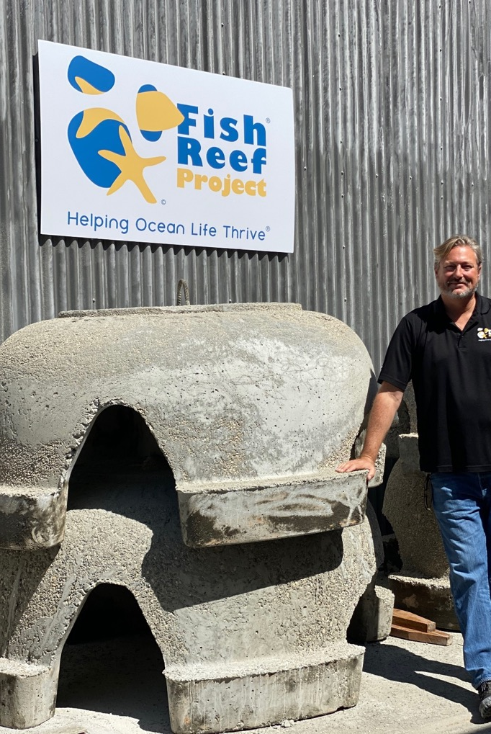
Fish Reef Project
Summary Profile ($ in thousands, unless otherwise indicated)
Business Description
Blue Carbon Credit Opportunity
Non-profit that has developed and begun to deploy biogenic sea cave technology to regenerate underwater biomass
Sea caves create optimal habitat for marine life
Each sea cave supports 500 kg of marine life and removes up to 4 tonnes CO₂/year as blue carbon
Enhances nearshore fisheries production through regeneration of kelp forests and coral reefs; kelp grows at 12-18”/day
Goal is to create 10 plants to serve as regional hubs worldwide
Each plant will deploy up to 30,000 sea caves per year
Proprietary mold designed to facilitate mass production
Permanent Observer status at UN Seabed Authority
20,000-sea cave project could sequester up to 53,000 tonnes of blue carbon per year (~$20mm capex) at cost of $1,500/cave
ICR registration to be completed by late 2023
Operational Footprint
Current: Baja, Mexico
55-acre Seabed Lease at Isla San Martin
Fits 27,000 Sea Caves
Strong local support from fishing co-op
Selected Planned:
Rincon Island, Ventura County, California
Decommissioned oil assets, Goleta, California
Various African countries (e.g., Senegal)
Papua New Guinea
Indicative Summary Financials
Management & Shareholders
100% owned by Chris Goldblatt and Management
Chris Goldblatt, CEO (formerly OCS Sustainable Seafood)
Dr. Ryan Jenkinson, Science & Monitoring (National Geographic)
Whinfell Partners, Interim CFO & CIO
Steven Chew, Director of Operations (formerly Curtin Maritime)
Fred Doucedame, Marine Infrastructure (formerly Steve P Rados)
Source: Fish Reef Management (Jan-23)

Slide 15
Baja Project Investment Perspectives

Slide 16
IGP Methanol
Summary Profile ($ in millions, unless otherwise indicated)
Business Description
[ ]
Source: IGP Management (Nov-22)

Slide 17
Contact Information
Clark Thornburgh
clark@whinfellcap.com
+1 (917) 703-5198
Chicago Mercantile Exchange Center
30 S. Wacker Dr
Chicago, IL
60606

