Slide 1
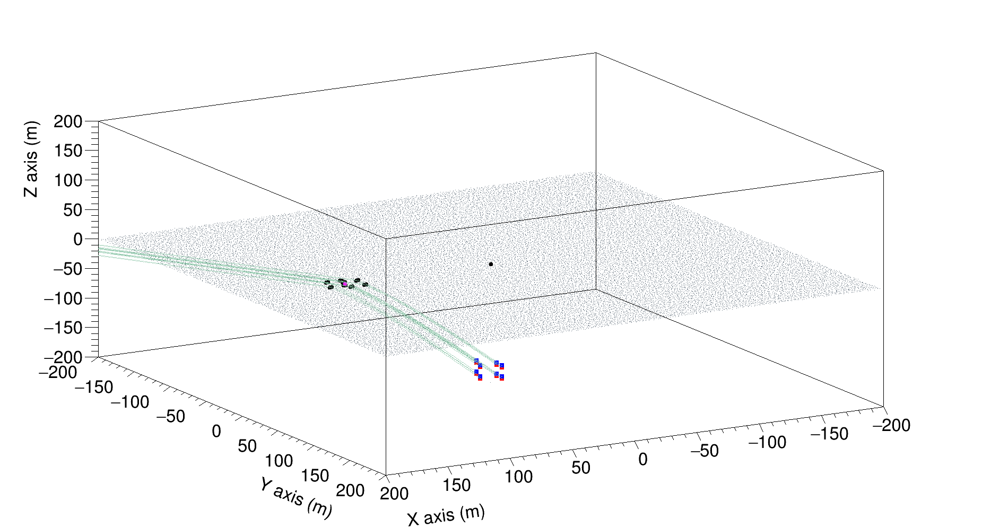
Overall Picture: Simulating EAS for ARA using CoREAS
Pink dot is the shower core.
Black dots are where it enters the ice.
Red and blue are the ARA antennas.
Origin is at SE corner of ARA02 DAQ box.
Shower θ=60 deg and φ=360 deg.
z (Elevation)
Ice Surface
x (Mag. North)
y (West)
ARA02
Antennas

Slide 2
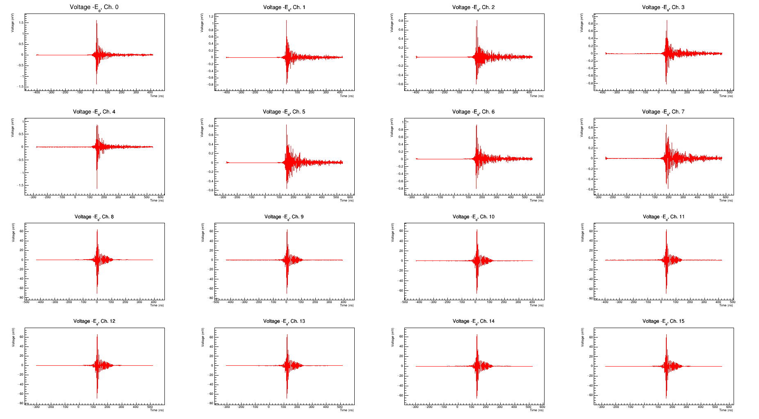
CR Voltage
Waveforms
Shower simulated with theta=60 deg, phi=360 deg and 10^18 eV.
The hadronic models use are QGSJETII.04 for high energy showers and UrQMD 1.3 for low energy showers.
Thinning was ON, with a thinning fraction of 10^-6.
Hpol waveforms have stronger signal which is expected as most of the geomagnetic emission happens in Hpol at SP.
Note:
- X axis is in mV
- Y axis is in ns
S1
S2
S3
S4
TV
BV
TH
BH

